Slide 1
Experiment Design Comparison (set-10)
Sadia Afrin Purba

Slide 2
 | Label Encoding (Basically Generative Usage of RBM) |  |  |  |  | RBM as classifier
Variables | Mahdi's RBM | Mahdi's RBM | ML tools RBM | Mahdi's QRBM | Mahdi's QRBM | ML Tools RBM + KNN | Mahdi's QRBM + KNN
n_features | 33 | 33 | 33 | 33 | 33 | 32 | 33
n_hidden_layer | 128 | 128 | 128 | 32 | 32 | 2 | 32
n_visible_layer | 33 | 33 | 33 | 33 | 33 | 32 | 33
learning_rate | 0.01 | 0.01 | 0.01 | 0.01 | 0.01 | 0.01 | 0.01
epoch | 10 | 10 | 10 | 50 | 50 | 100 | 50
batch_size | 256 | 256 | 256 | NONE (in each epoch, one by one training data is used, there was not any batch-wise operation) | NONE (in each epoch, one by one training data is used, there was not any batch-wise operation) | 32 | NONE (in each epoch, one by one training data is used, there was not any batch-wise operation)
RBM Learning algorithm | Contrastive divergence | Contrastive divergence | Persistent contrastive divergence | Contrastive divergence | Contrastive divergence | Persistent contrastive divergence | Contrastive divergence
Sampling Technique | Gibbs sampling | Gibbs sampling | Gibbs sampling | Simulated annealing sampling | Simulated annealing sampling | Gibbs sampling | Simulated annealing sampling
Evaluation Function | Mean Squared Error | MCMC sampling 10 times and majority voting | Mean Squared Error | Mean Squared Error | Corrupt the test data, generate sample from QRBM model and calculate error rate | Error rate | Error rate
# of training data | 100,000 | 100,000 | 100,000 | 50 | 50 | 100,000 | 50
# of experiments | 100 | 100 | 100 | 8 | 30 | 100 | 2
Average train_err | 36.87 | 13.1 | 25.42 | 27.27 | 27.49 | 8.18 | 15.28
Average dev_err | 37.34 | 49.59 | 25.47 | 27.39 | 27.23 | 44.4 | 47.64
Average eval_err | 37.26 | 49.95 | 25.43 | 27.35 | 27.05 | 33.47 | 45.88

Slide 3
QRBM with MSE error

Slide 4
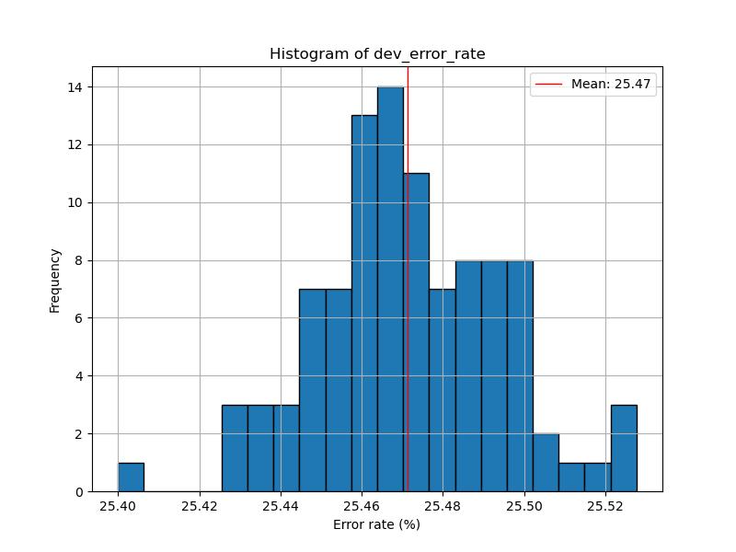
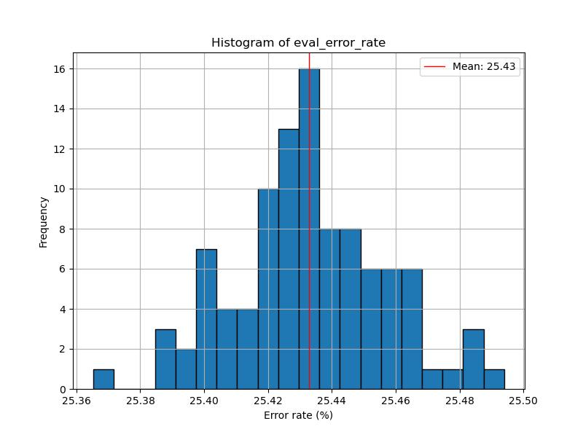
ML tools RBM with label encoding

Slide 5
Mahdi’s RBM

Slide 6
Mahdi’s RBM

Slide 7
Ml_tools RBM without label encoding
In Mahdi’s paper, reported error rate on DEV set was 41.66
In Mahdi’s paper, reported error rate on EVAL set was 34.69

Slide 8
Ml_tools RBM without label encoding
In Mahdi’s paper, reported error rate on Train set was 13.10

Slide 9
QRBM with label encoding
Error rate distribution for 30 different random seeds

Slide 10
QRBM with label encoding
Error rate distribution for 30 different random seeds

Slide 11
References
Scripts |  | Experiment Results
Mahdi's RBM | /data/isip/exp/quantum_ml/exp_0008/legacy_exp_0001/test_zero.py | /data/isip/exp/quantum_ml/exp_0008/output_legacy_rbm/set_10/error_rates_with_different_random_seeds.csv
ml_tools RBM + KNN | /data/isip/exp/quantum_ml/exp_0008/run_ml_tools_rbm.sh | /data/isip/exp/quantum_ml/exp_0008/output_ml_tools_rbm/set_10/error_rates_with_different_random_seeds.csv
Mahdi's QRBM | /data/isip/exp/quantum_ml/exp_0010/legacy_exp_0003/qrbm/run.sh | /data/isip/exp/quantum_ml/exp_0010/legacy_exp_0003/qrbm/qrbm_error_rates_with_different_random_seeds.csv
ml_tools RBM with label encoding | /data/isip/exp/quantum_ml/exp_0010/ml_tools_rbm/label_encoding/run.sh | /data/isip/exp/quantum_ml/exp_0010/ml_tools_rbm/label_encoding/set_10/rseed_vs_err.csv
QRBM + KNN (with label encoding) | /data/isip/exp/quantum_ml/exp_0010/legacy_exp_0003/qrbm/run_rbm_knn_classifier.sh | /data/isip/exp/quantum_ml/exp_0010/legacy_exp_0003/qrbm/qrbm_knn_error_rates_with_different_random_seeds_data_point_50.csv

