Slide 1
Error rate distribution
Mahdi’s RBM vs ML tool RBM vs QRBM
Sadia Afrin Purba

Slide 2
Experiment Design Comparison (set-10)
Parameters | Mahdi's RBM | ml_tools RBM | Mahdi's QRBM
n_features | 33 | 32 | 33
n_hidden_layer | 128 | 2 | 32
n_visible_layer | 33 | 32 | 33
learning_rate | 0.01 | 0.01 | 0.0001
epoch | 10 | 100 | 50
batch_size | 256 | 32 | NONE (in each epoch, one by one training data is used, there was not any batch-wise operation)
train_err | 13.1 | 8.18 | 27.49
dev_err | 49.59 | 44.4 | 27.23
eval_err | 49.95 | 33.47 | 27.05

Slide 3
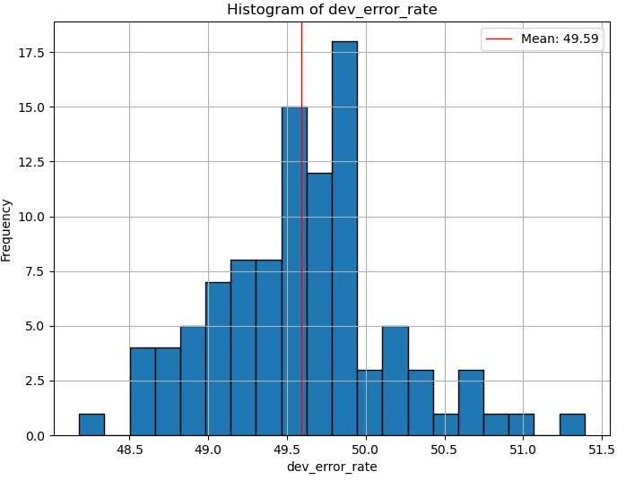
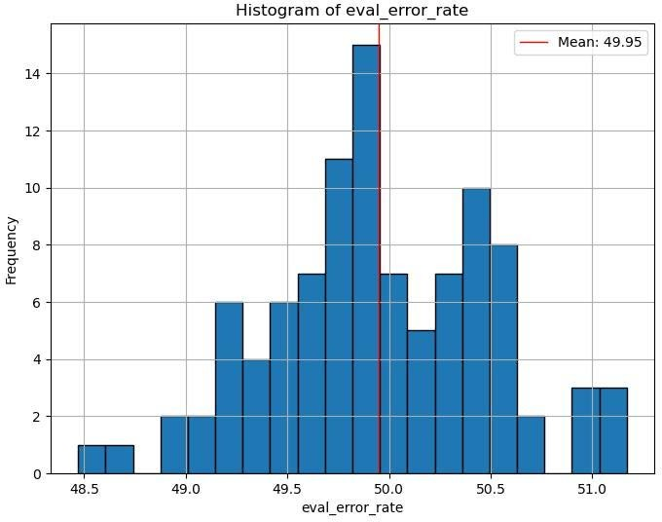
Mahdi’s RBM

Slide 4
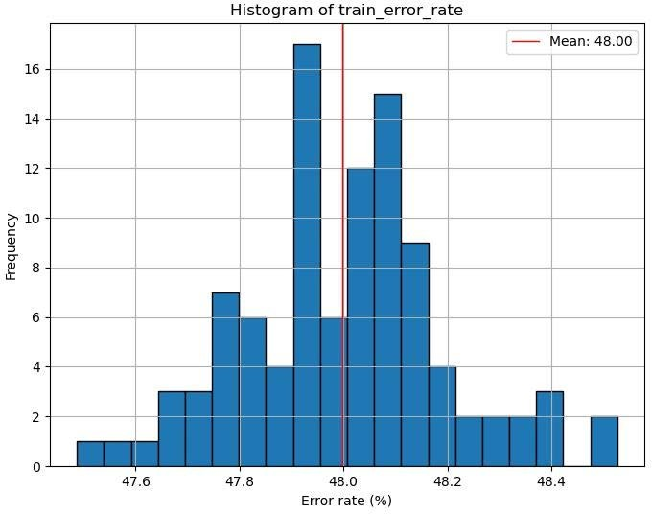
Mahdi’s RBM

Slide 5
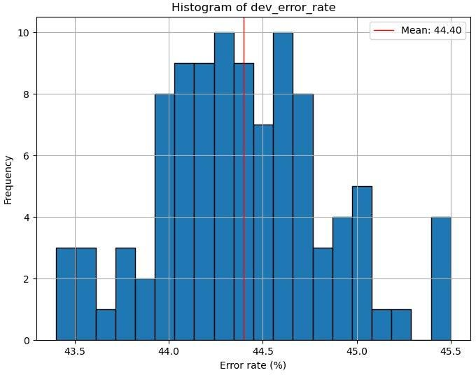
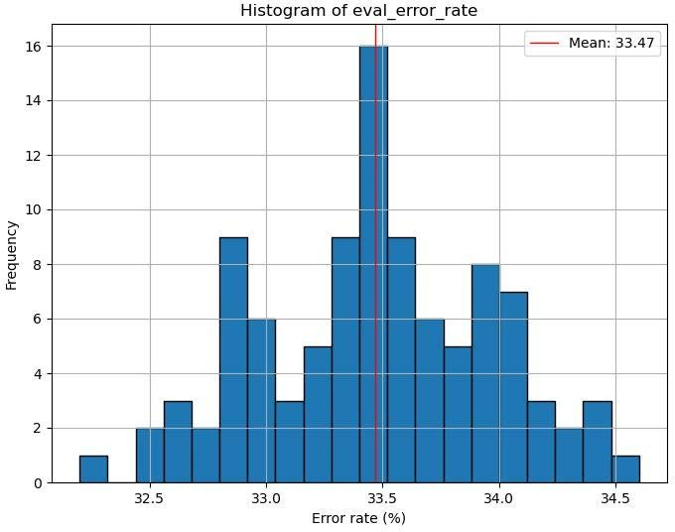
Ml_tools RBM
In Mahdi’s paper, reported error rate on DEV set was 41.66
In Mahdi’s paper, reported error rate on EVAL set was 34.69

Slide 6
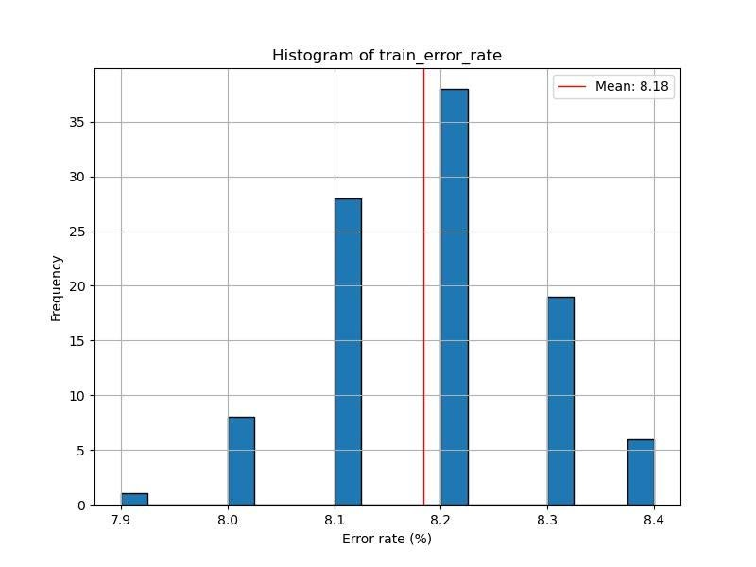
Ml_tools RBM
In Mahdi’s paper, reported error rate on Train set was 13.10

Slide 7
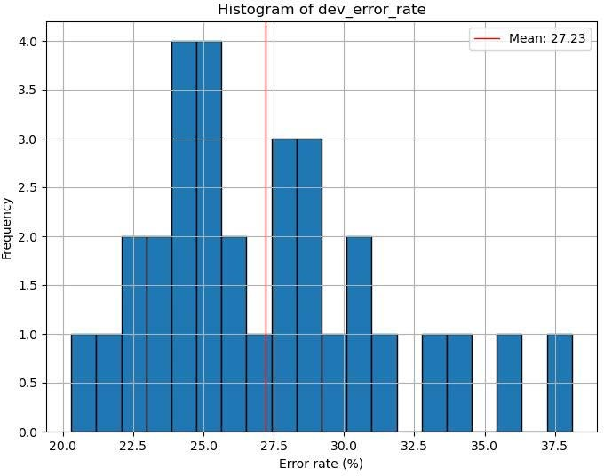
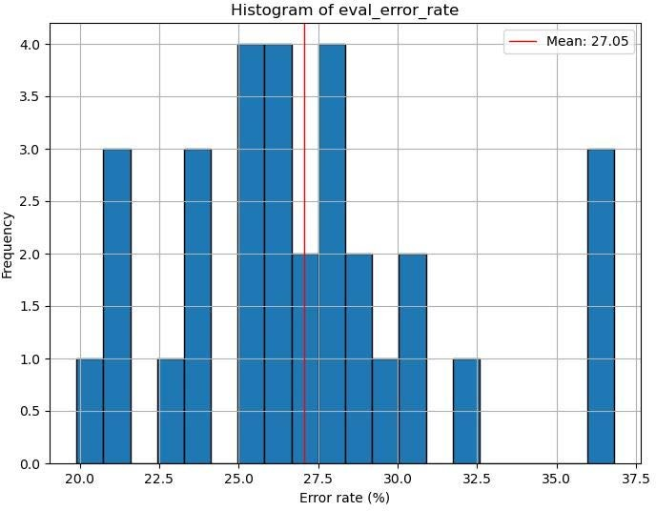
QRBM
Error rate distribution for 30 different random seeds

Slide 8
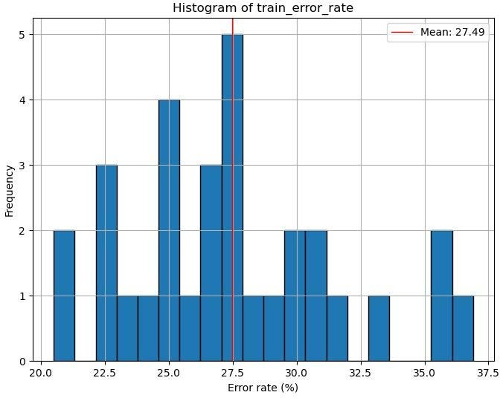
QRBM
Error rate distribution for 30 different random seeds

Slide 9
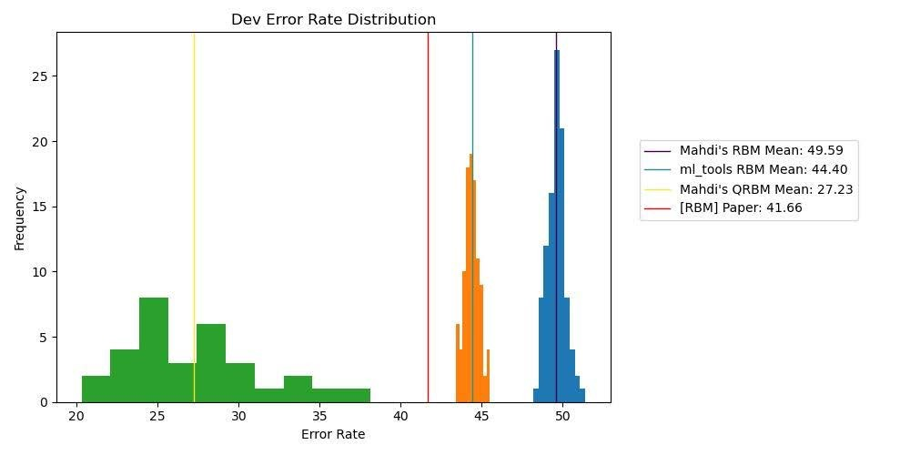
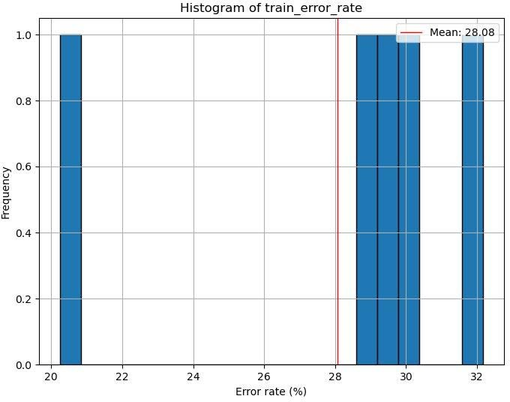
Everything together – Dev

Slide 10
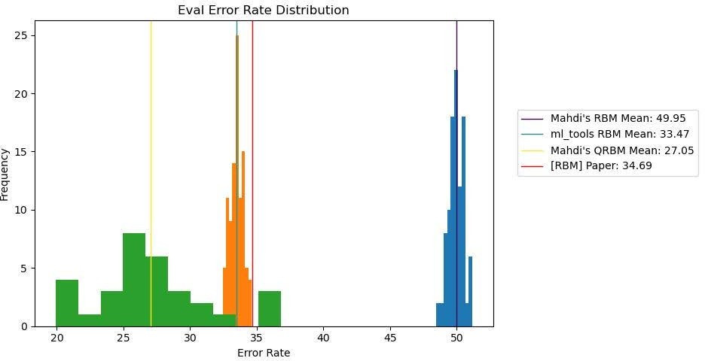
Everything together – Eval

Slide 11
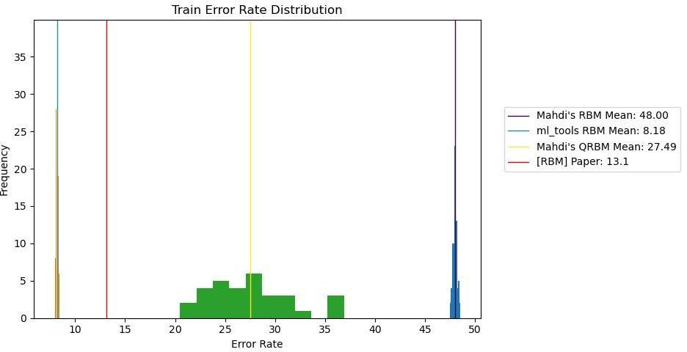
Everything together – Train

Slide 12
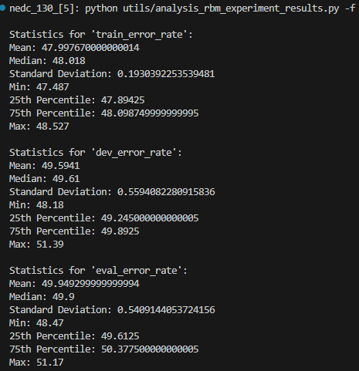
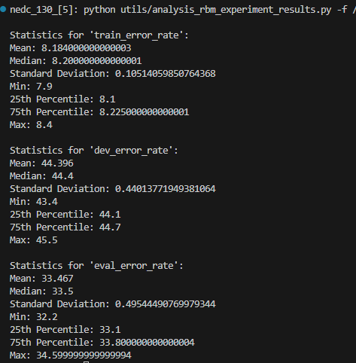
More statistics
Mahdi’s RBM
Ml_tools’ RBM

Slide 13
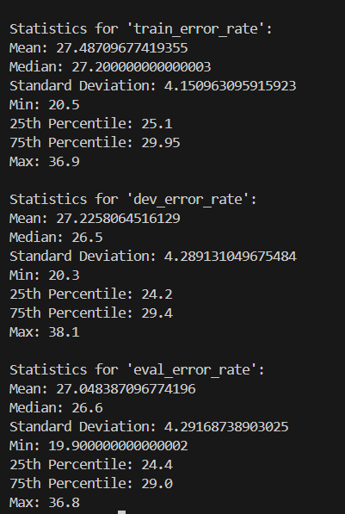
More statistics
QRBM

Slide 14
References
Scripts |  | Experiment Results
Mahdi's RBM | /data/isip/exp/quantum_ml/exp_0008/legacy_exp_000 1/test_zero.py | /data/isip/exp/quantum_ml/exp_0008/output_legacy_rbm/set_10/error_rates_ with_different_random_seeds.csv
ml_tools RBM | /data/isip/exp/quantum_ml/exp_0008/run_ml_tools_rb m.sh | /data/isip/exp/quantum_ml/exp_0008/output_ml_tools_rbm/set_10/error_rates _with_different_random_seeds.csv
Mahdi's QRBM | /data/isip/exp/quantum_ml/exp_0010/legacy_exp_000 3/qrbm/run.sh | /data/isip/exp/quantum_ml/exp_0010/legacy_exp_0003/qrbm/qrbm_error_rate s_with_different_random_seeds.csv

