Slide 1
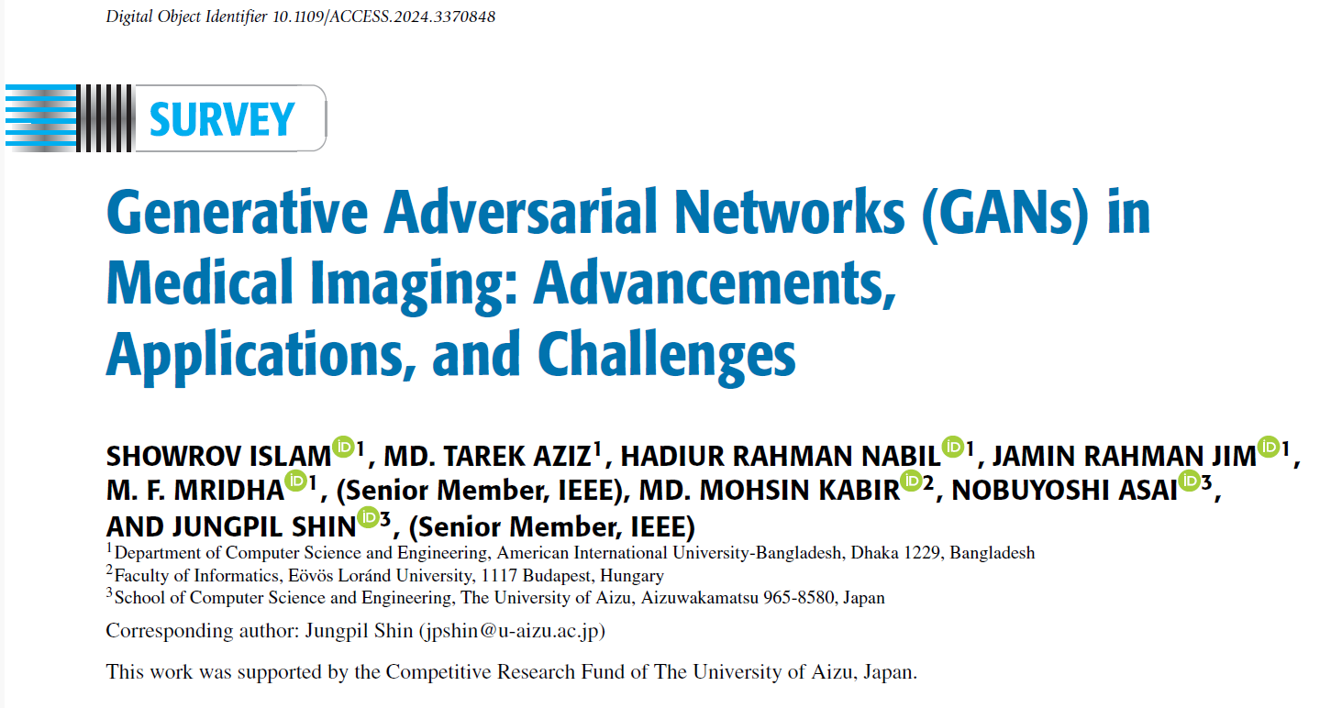
Summarized by
Claudia D.

Slide 2
Not the only generative method (next time: GAT)
YAY!
Book chapter with 172 ref(s)
Summarized by
Claudia D.

Slide 3
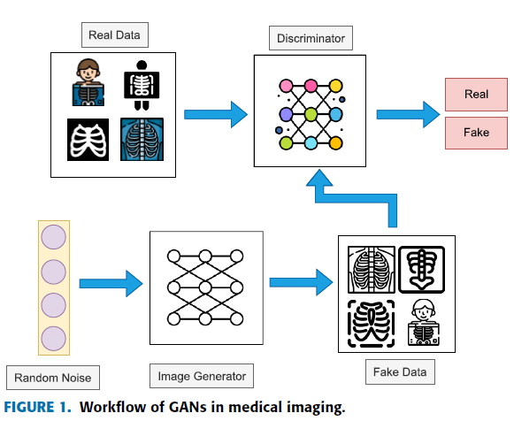
What’s so cool about GANs?
Generative Adversarial Networks (GANs) stand out as a powerful class of neural networks that use parallel training of two networks for image generation and discrimination.
ability to produce realistic images (image enhancement) and handle domain shifts [1].
GANs in medical imaging involve two neural networks where one is the generator (G) and another is the discriminator (D).
The generator produces synthetic medical images from random noise, aiming to replicate real data Objective: maximize (for real data) log⁡𝐷(𝑥) and minimize (for generated data) log⁡(1−𝐷(𝐺(𝑧|c))) = increase confidence (real data).
The discriminator evaluates and differentiates between genuine and generated images. Objective: Minimize log⁡(1−𝐷(𝐺(𝑧)))) = minimize the likelihood of classifying fake data as real, meaning it wants 𝐷(𝐺(𝑧)) to be as close to 0 as possible for generated samples.
GAN framework sets up a minimax optimization problem:
logarithmic functions are steeper at smaller probabilities and flatter near 1

Slide 4
Challenges
Optimization might suffer convergence problems (due to the min-max nature of the GANs, they might reach equilibrium difficultly).
Privacy concerns and trust-ability of generated data.
Limited integration with models from other domains and multimodal medical image augmentation
Needs advanced metrics for evaluation (NOT pixel-wise metrics).
Prone to lacking geometric correlations (important for microscopic imaging).
Lack of interpretability and high training cost.
Class leakage
Skewed distribution of medical data = rare cases are likely not gonna be generated.
> Adding noise to discriminator (penalizing discriminator weights)
> Incorporating physics-based simulations
>Attention mechanism, Transformers
> learned perceptual image path similarity
> The Bidirectional Generative Adversarial Network (Bi-GAN) -promising solution for synthesizing diverse microscopic images across multiple domains.
> Lighter GAN architectures
> Suitable metrics and constraints

Slide 5
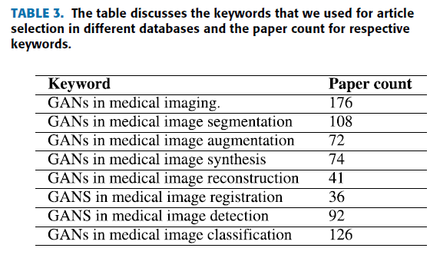
Popular GAN (medical)
CycleGAN is used for domain adaptation by translating images in different modalities [3]
pix2pix focuses on translation between images by supporting tasks such as resolution enhancement or denoising of medical images [4].
UNIT GAN enables cross-modal image fusion in medical imaging by learning a shared latent space between different modalities.
ProGAN (progressive training) makes it easier to produce high-resolution medical images (~2017).
SAGAN focused on relevant image regions and long-term relationships (~2019).
RANDGAN emphasize segmentation for anomaly detection (outperforming traditional GANs).
DGGAN generates anonymous brain vascular images for medical imaging from MRA patches [11].
ED-GAN combines VAEs (variational autoencoders) and GANs [12].
PLGAN (Pseudo-labeling) only uses a small number of real images with few labels to generate fake images or mask images to enlarge the sample size of the labeled training set.

Slide 6
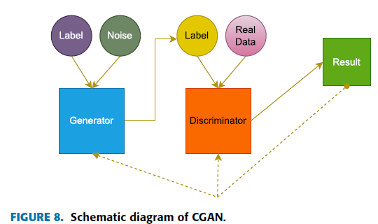
Dive into Segmentation
Conditional Generative Adversial Networks (CGAN) introduce supplementary information into the generative model, thereby enabling the controlled synthesis of generated data.
The supplementary information is typically encoded as a one-hot vector within both the discriminator and the generator. Subsequently, it is combined with an encoded noise vector (z) within the generator and with the actual data (x) within the discriminator.
The discriminator itself cannot produce the class label for the input data. It is common for cGANs to necessitate pairs of input and output images during training, a requirement that might not always be met in domain adaptation scenarios.
Generator: Instead of generating an entire image from random noise, the generator 𝐺 is responsible for producing a segmentation map (a pixel-wise classification map) from an input image.
Some other varieties: CycleGAN, SSimDCL, DualMMP-GAN.
Evaluation metrics used: SSIM, PSNR, accuracy, AUC, Dice coefficient, MAE, ROC curve, IoU, entropy, and normalization.

Slide 7
Results
Histology Paper (2018): Application to quantification of Ki67 breast cancer images - Senaras et al.
Optimized generation of high-resolution phantom images using cGAN
Result: Six readers (three pathologists and three image analysts) tried to differentiate 15 real from 15 synthetic images and the probability that the average reader would be able to correctly classify an image as synthetic or real more than 50% of the time was only 44.7%.

Slide 8
