Slide 1
3D Segmentation
ImageJ Guide

Slide 2
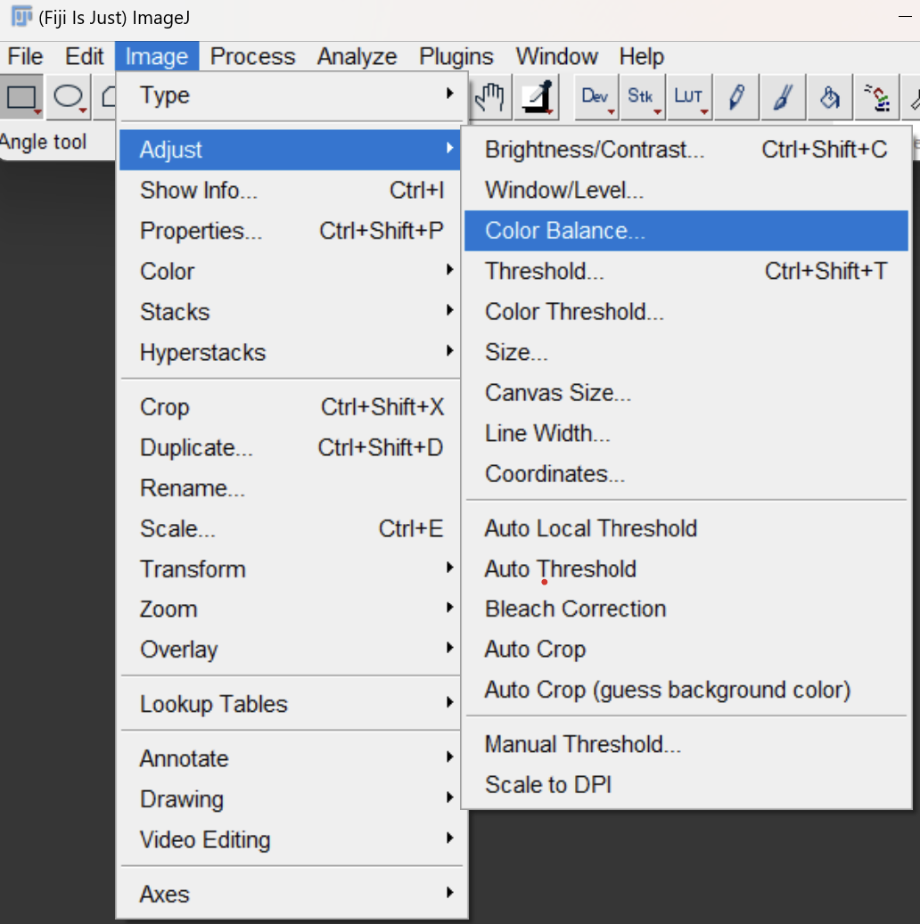
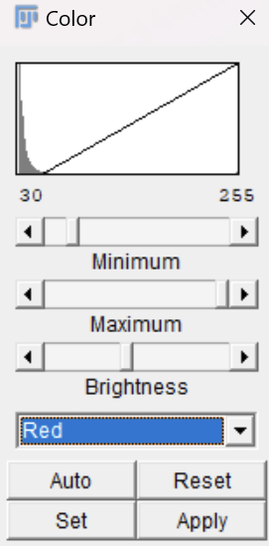
Color Balance

Slide 3
Overview
Balancing is a useful first step in clearing noise or making a region of interest clearer.
Dragging the slider on the top most bar (minimum) will exclude the lower values of the color and adjust the scaling of the new range of values.
Dragging the slider for the maximum will not exclude higher values, it will only adjust the scaling.
(the brightness adjusts itself)

Slide 4
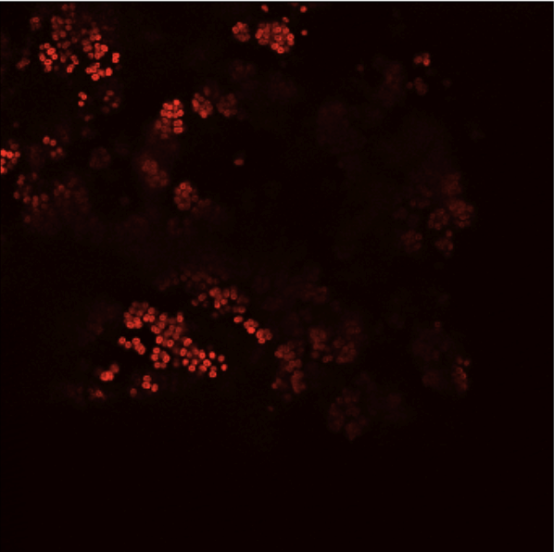
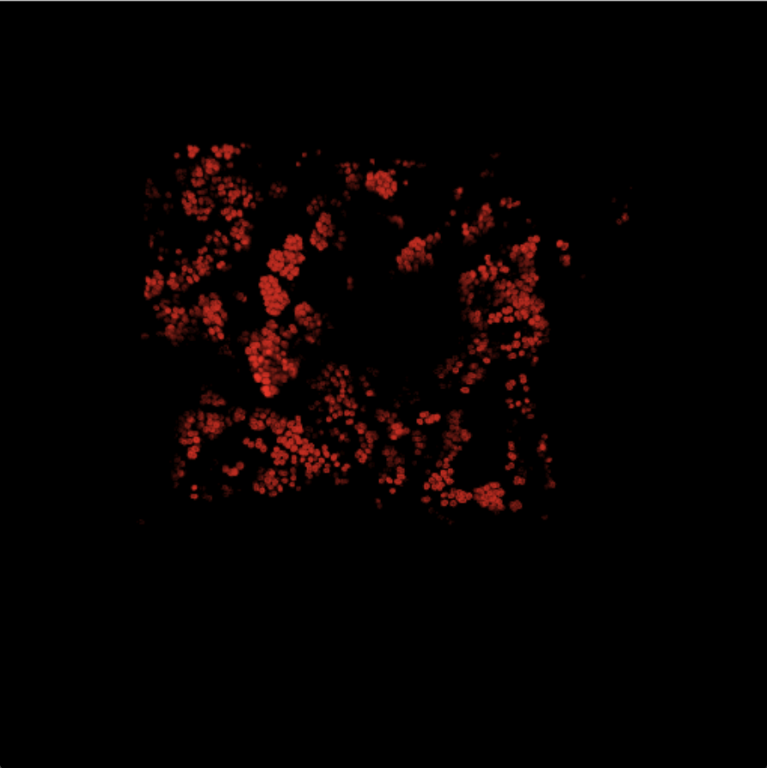
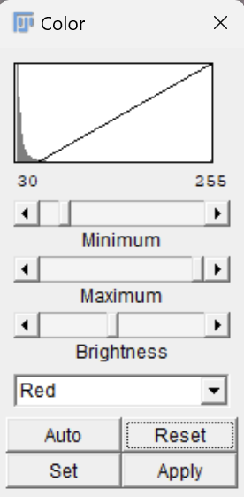
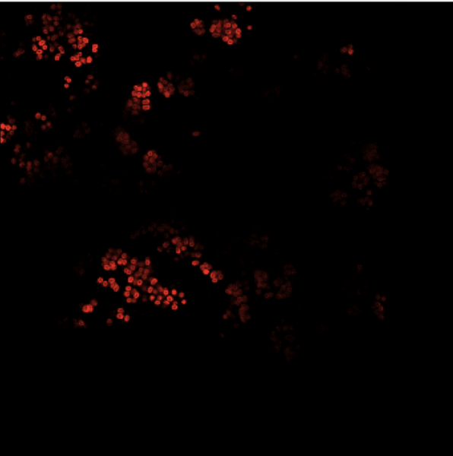
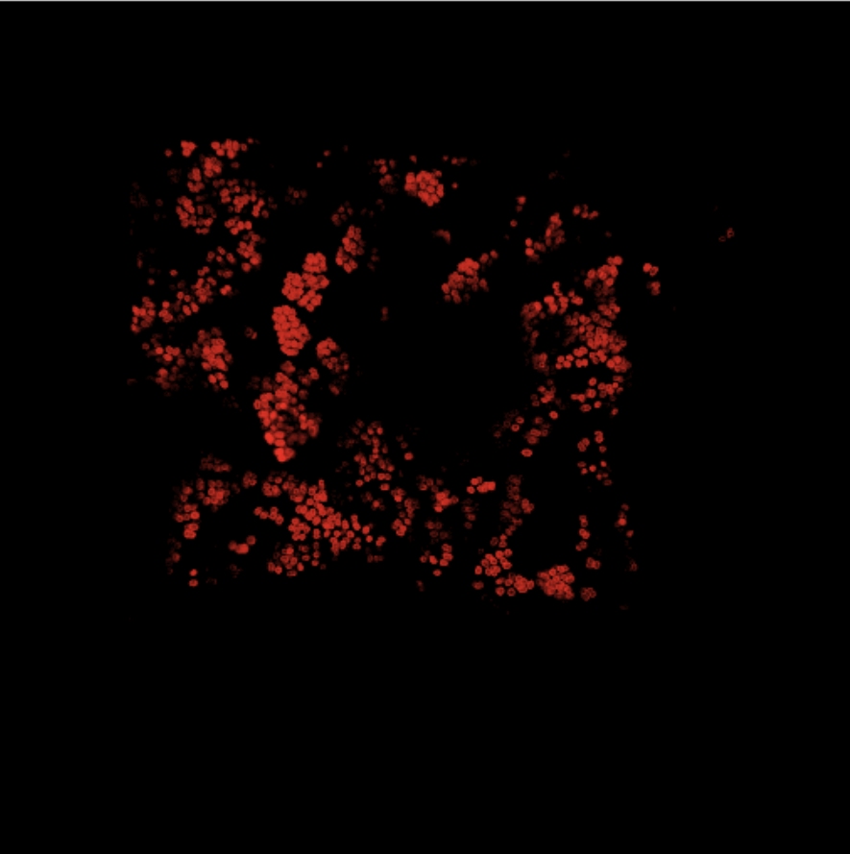
For Segmenting the Red Channel, setting the minimum value to 30 gives modest results.
2D 3D
Before
After

Slide 5
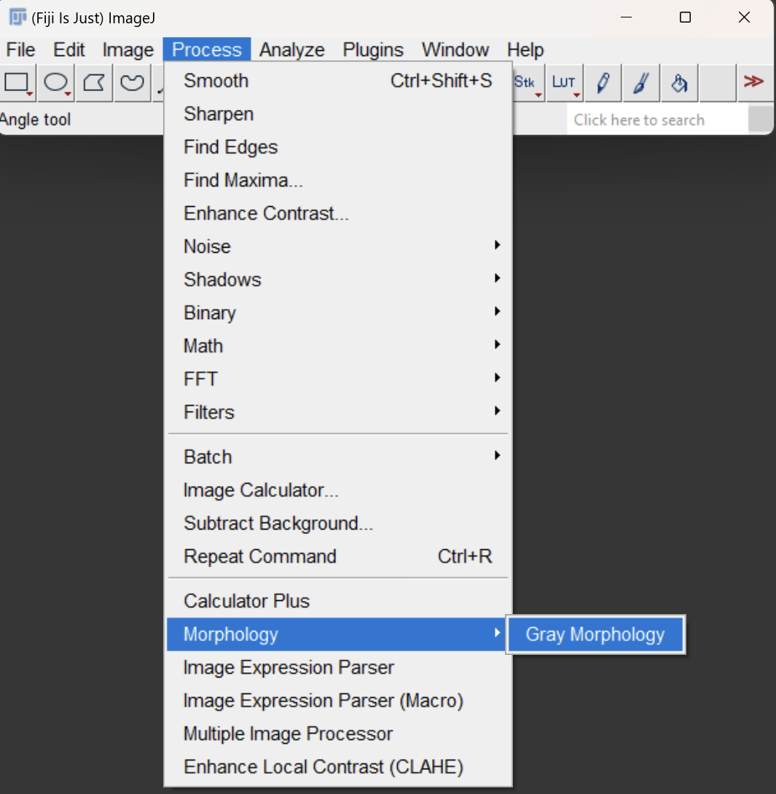
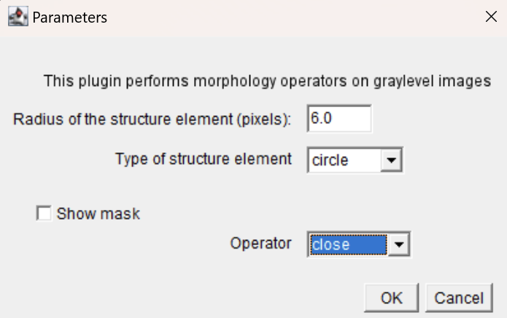
Morphology

Slide 6
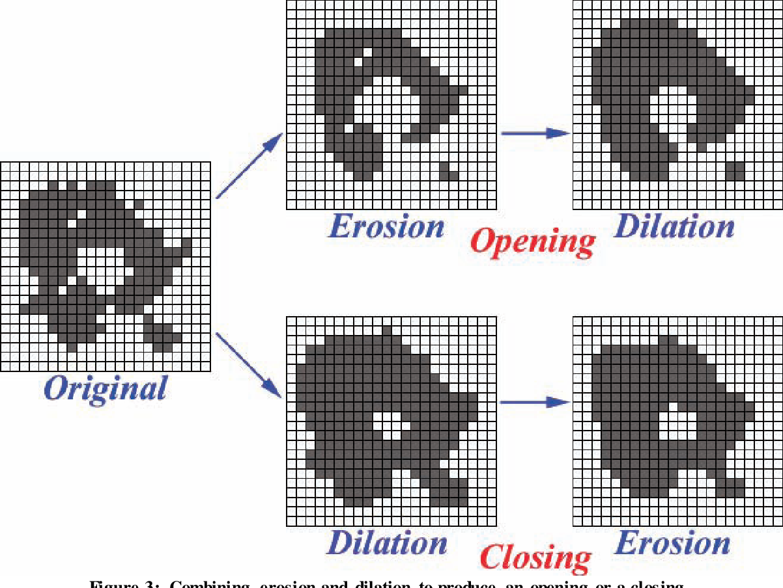
Overview
Morphological operations allow us to inflate (dilate) or deflate (erode) groups of pixels.
When the erode or dilate operations are used in conjunction, depending on the order, we can fill in gaps or remove noise.

Slide 7
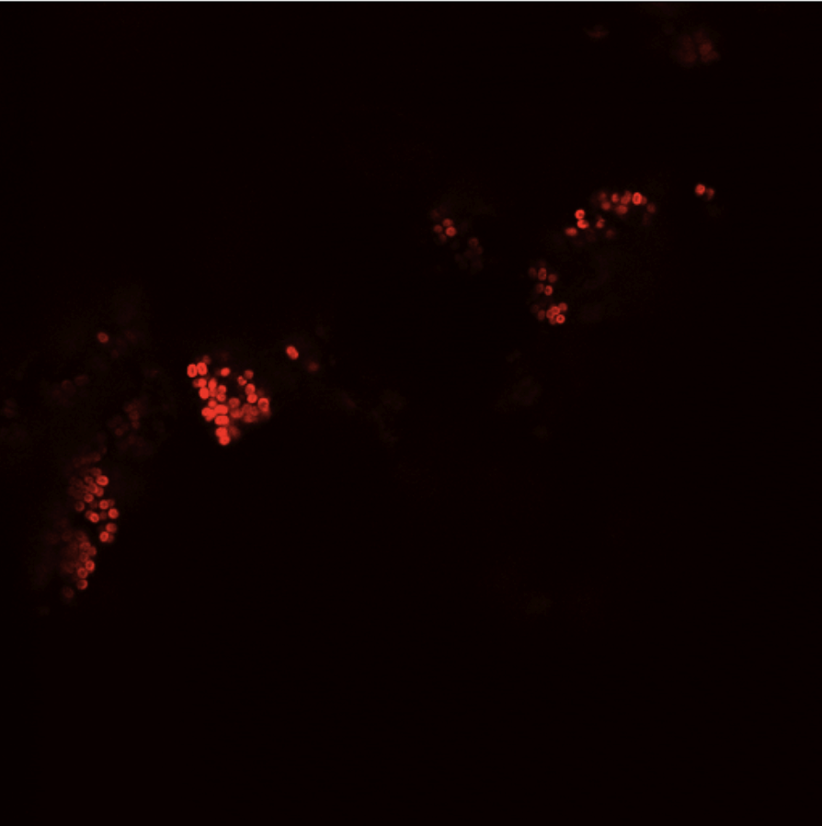
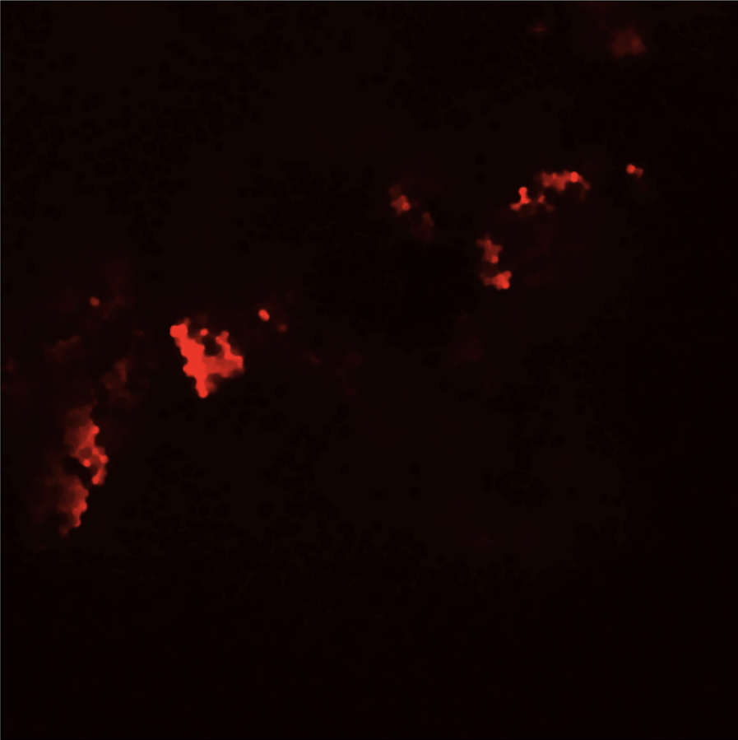
Morph Close 6

Slide 8
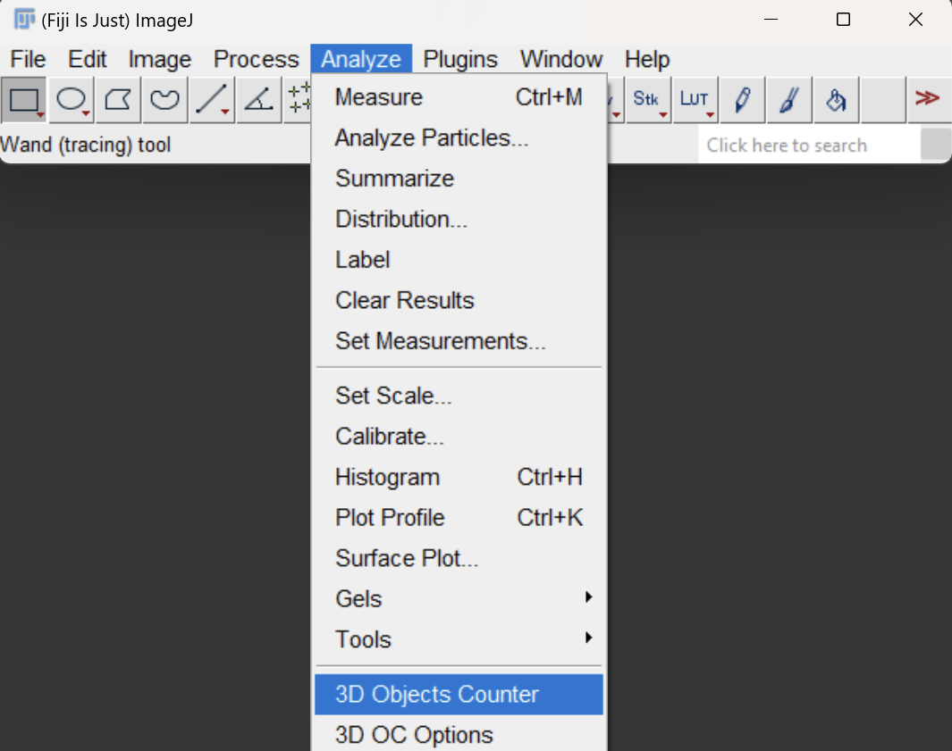
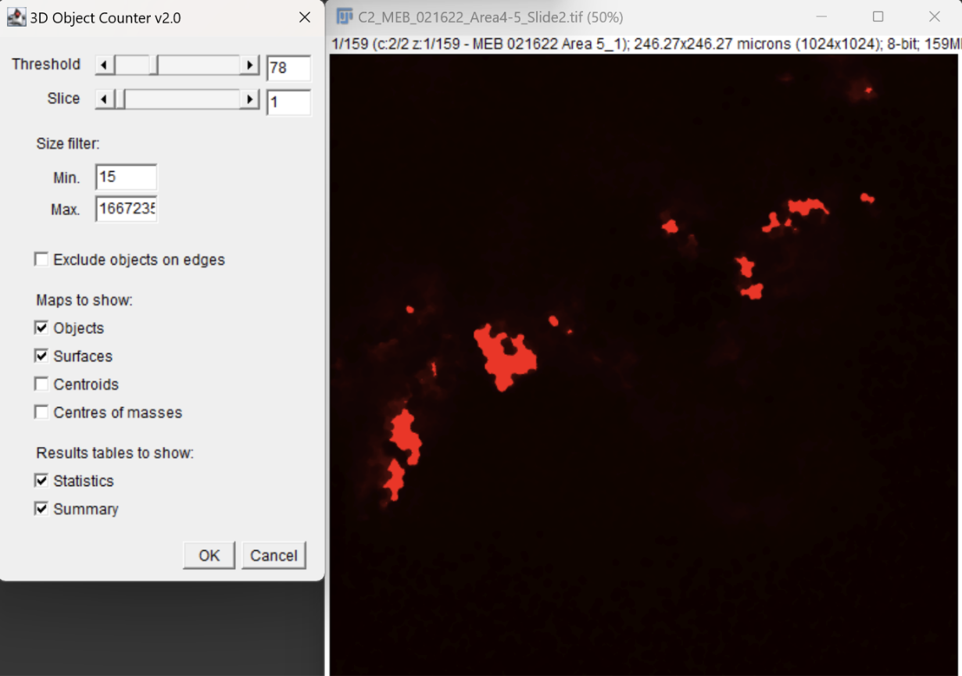
Segmentation
*See Params File

Slide 9
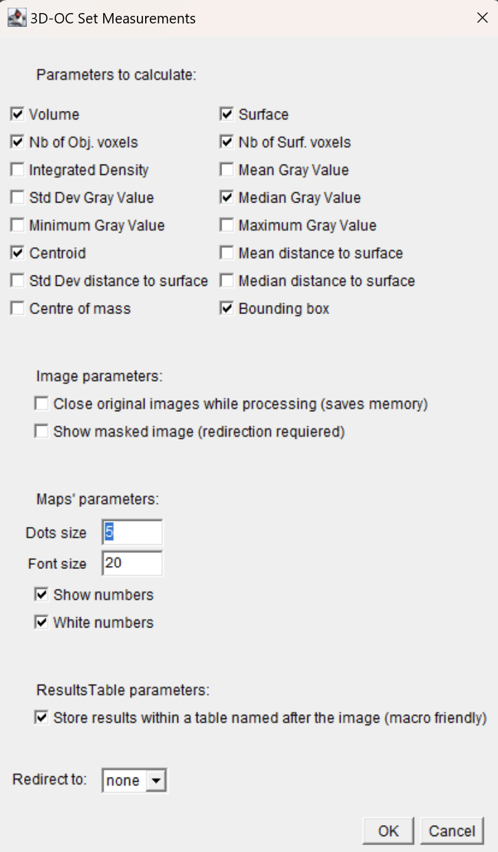
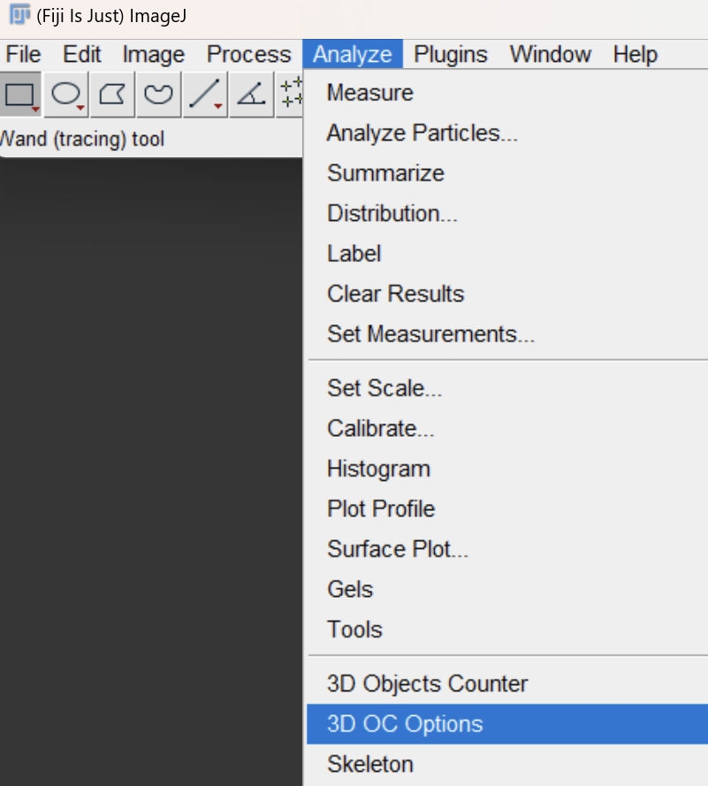
Overview
Segmentation involves thresholding, meaning that all values must be either 0 or (8 bit) 255.
For the red channel,use the value of 85 (+/- 5)
The size filter lets us disregard objects under n volume. (pixels)
Additional settings can be changed to reduce outputs to relevant information.

Slide 10
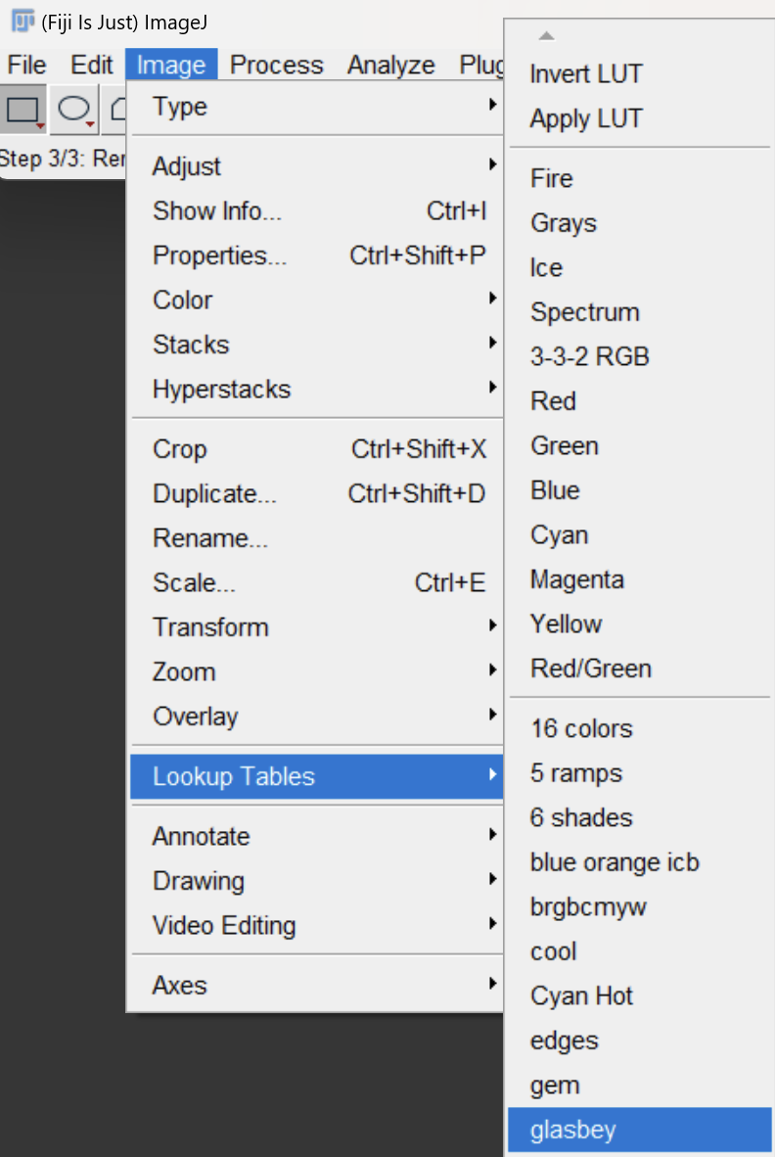
After Segmentation
The 3d object counter should open 2 images after segmentation, the object map and the surface map.
The colors make it near impossible to see many of the objects.
Head over to the image section and select the lookup table entitled:
“glasbey on dark”

Slide 11
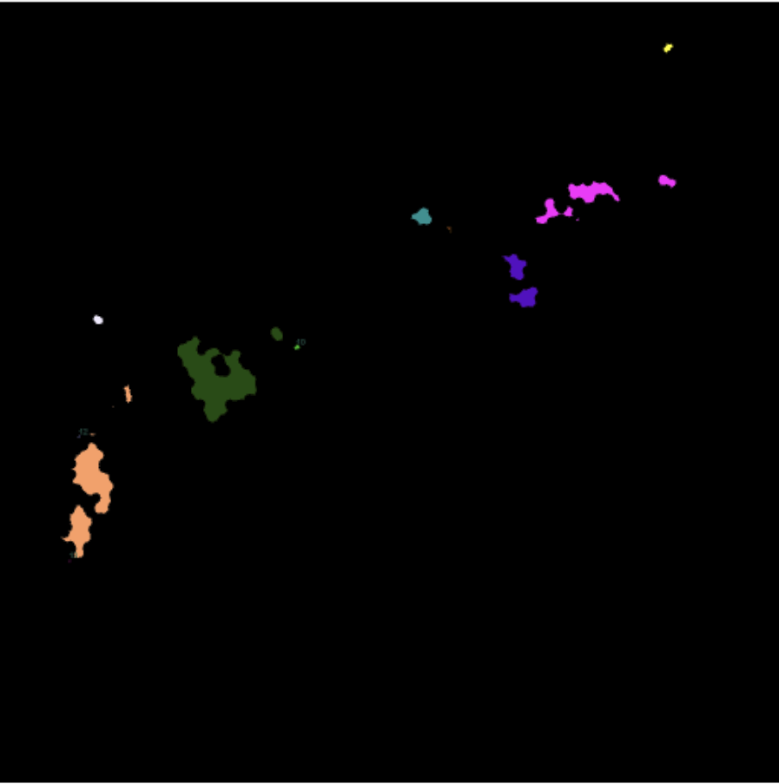
Before and After

Slide 12
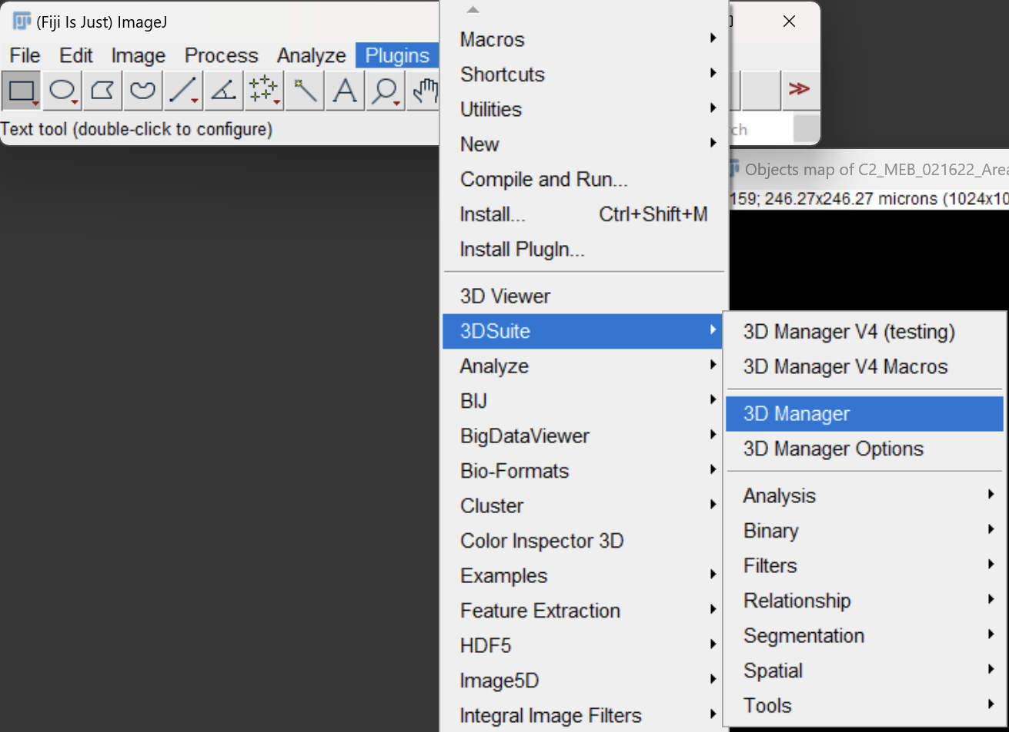
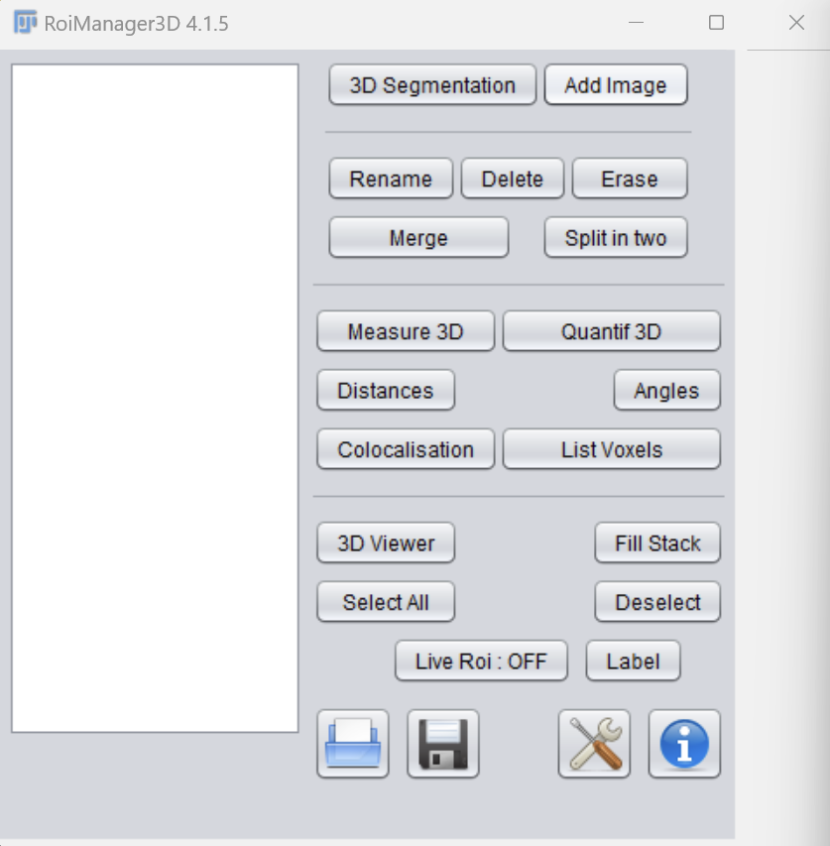
3D ROI Manager

Slide 13
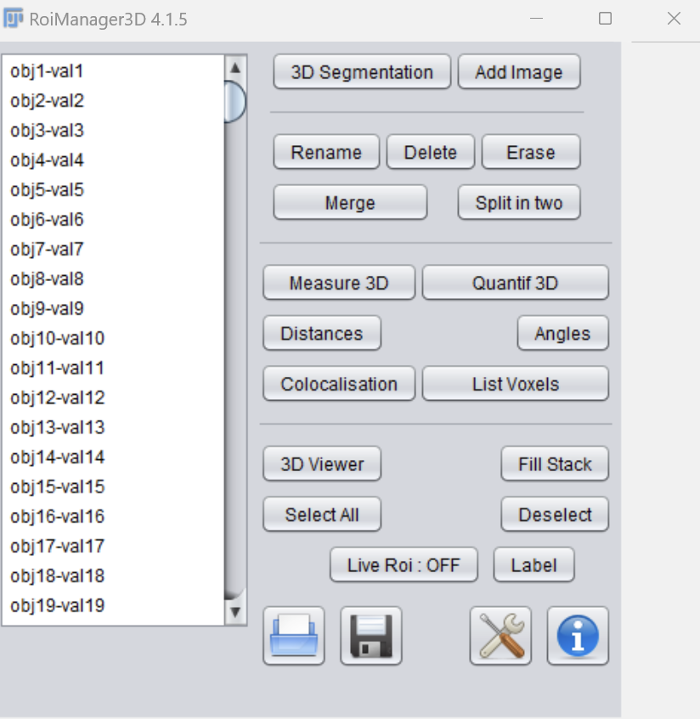
Overview
The ROI manager allows us to interact with our newly segmented tiff file.
With you image selected, click add image to load the annotated objects in to the list.
From here you can outline and track objects with the live roi for further analysis.

Slide 14
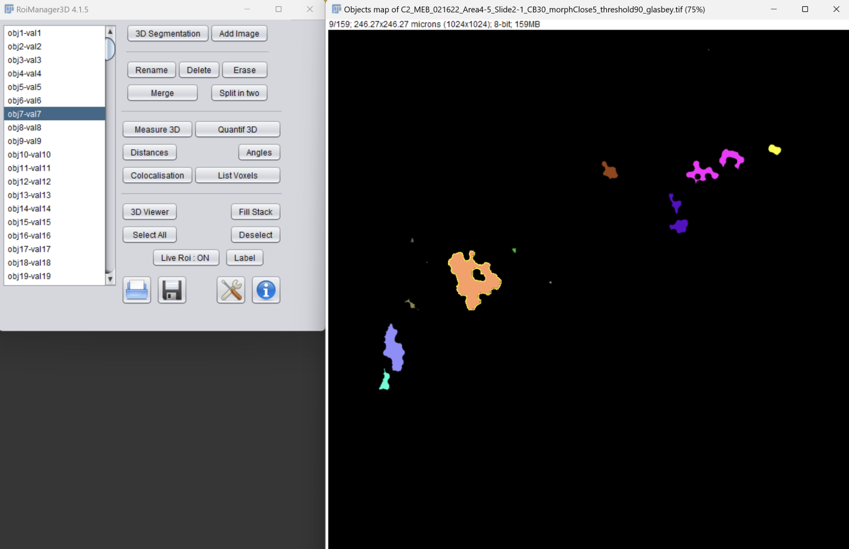
Result
You should be able to see yellow outlines on selected objects and view voxel lists.
As you scroll through the slices you will notice that the outline persists.

Slide 15
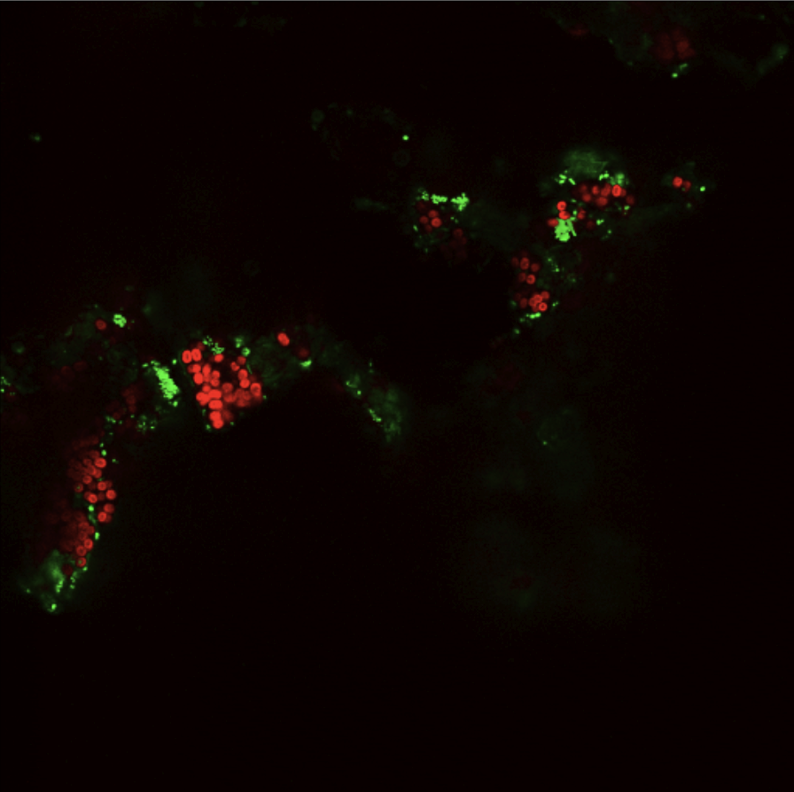
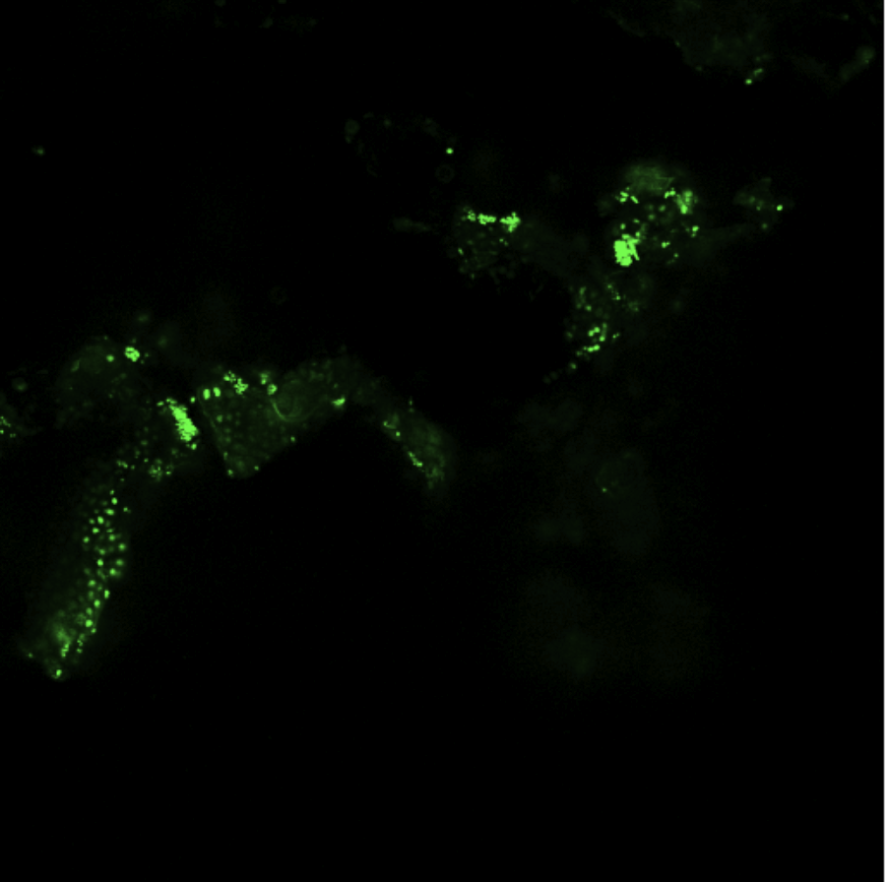
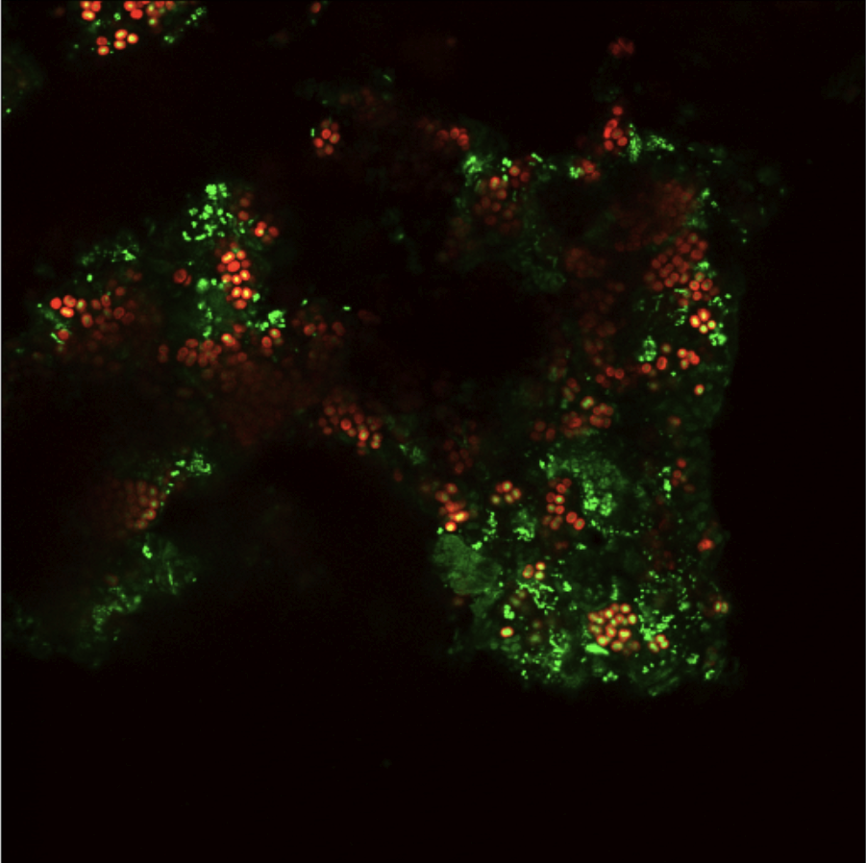
Green Channel

Slide 16
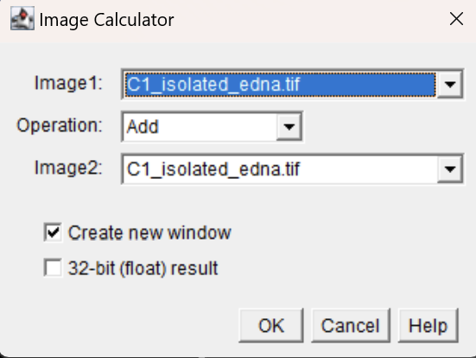
Image Calculator
This is going to be used extensively in order to remove the nuclei, isolate the eDNA etc.
These basic operations in conjunction with a decent amount of color balancing, will yield fair results.

Slide 17
Removing the Nuclei

Slide 18
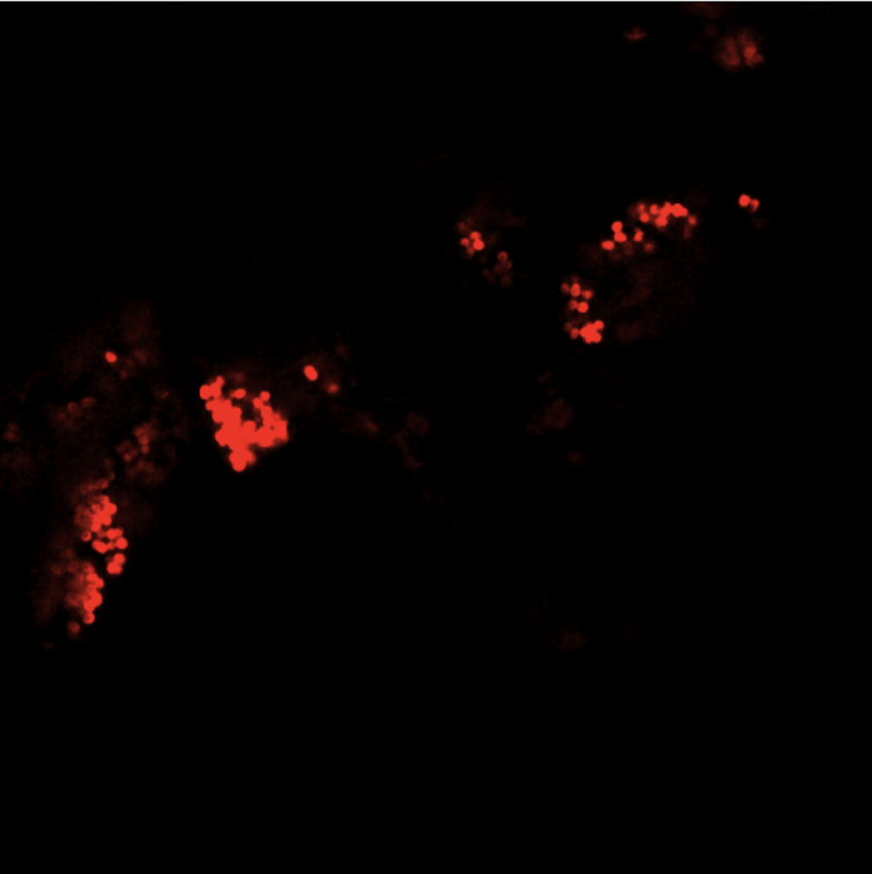
Processing the Red
Simply subtracting the red from the green channel will not sufficiently remove the nuclei.
Process the red channel like so:
1) Morph Close: Radius = 2
2) Color Balance: Min = 10, Max = 120
*See previous slides for help*

Slide 19
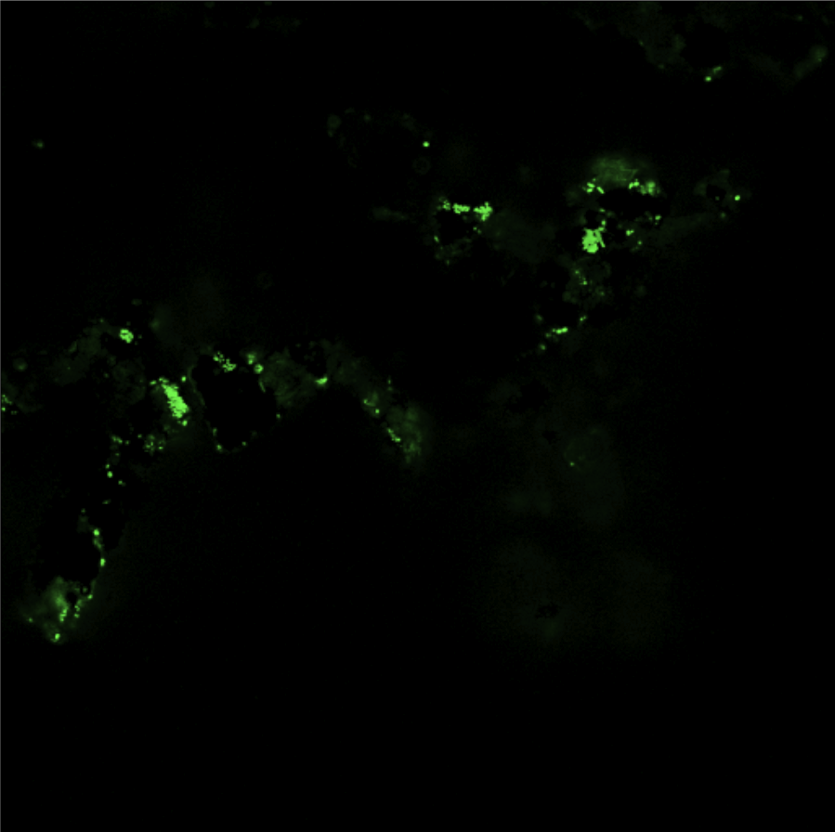
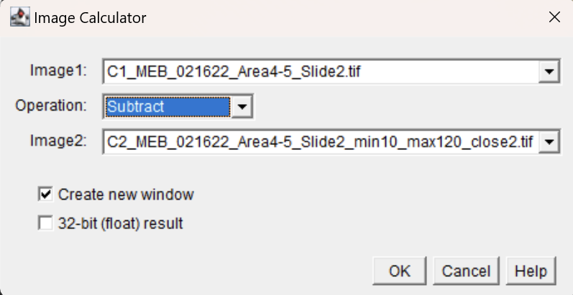
Subtract
Image 1: Base green channel
Image 2: Processed red channel

Slide 20
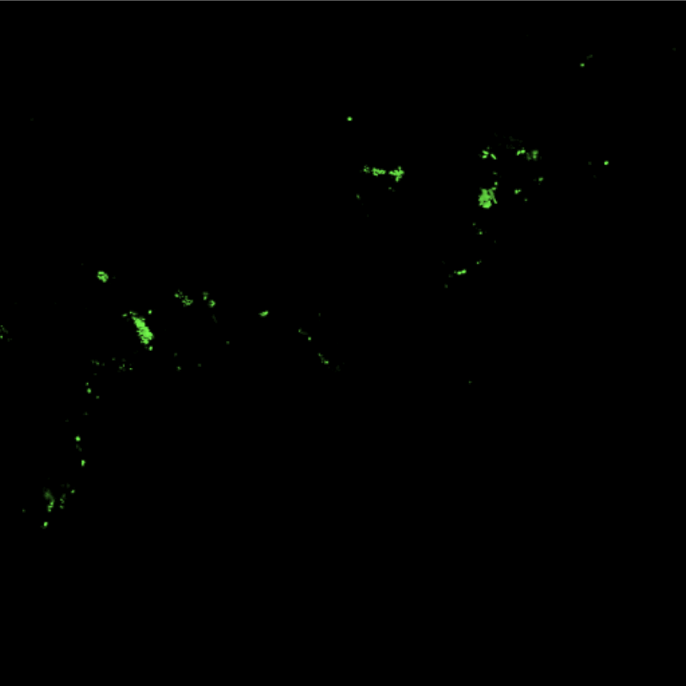
Isolating the Puncta
This step is quite simple.
1) Color Balance: Min = 100, max = 170
*See previous slides for help*

Slide 21
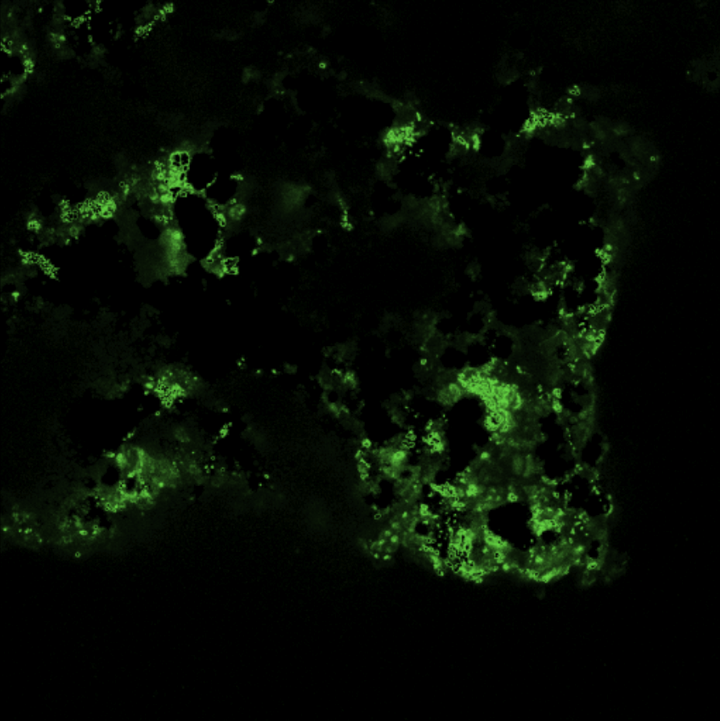
Isolating the eDNA
With the Puncta already isolated, this step is fairly simple as well.
1) Image Calc:
Image 1 = Removed Nuclei
Image 2 = Isolated Puncta
Operation = Subtract
2) Color Balance: max = [80:100]
*See previous slides for help*

