Slide 1
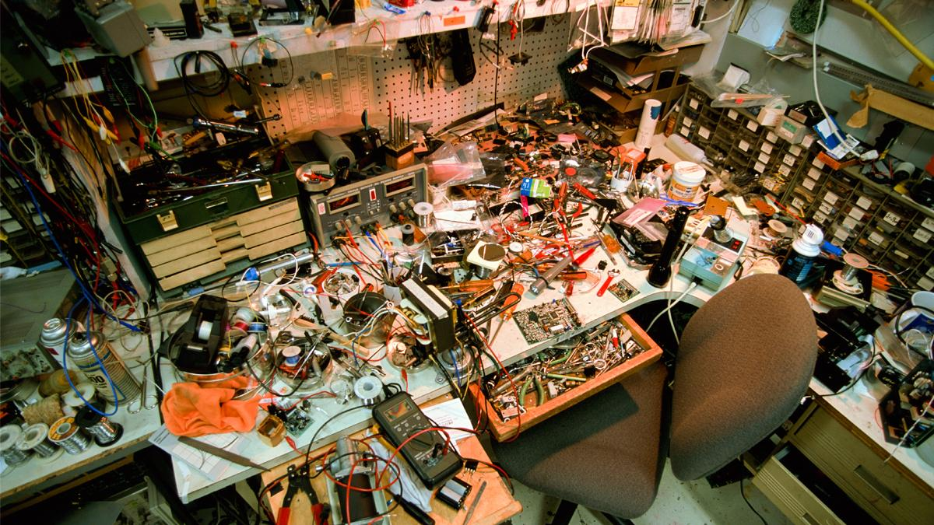
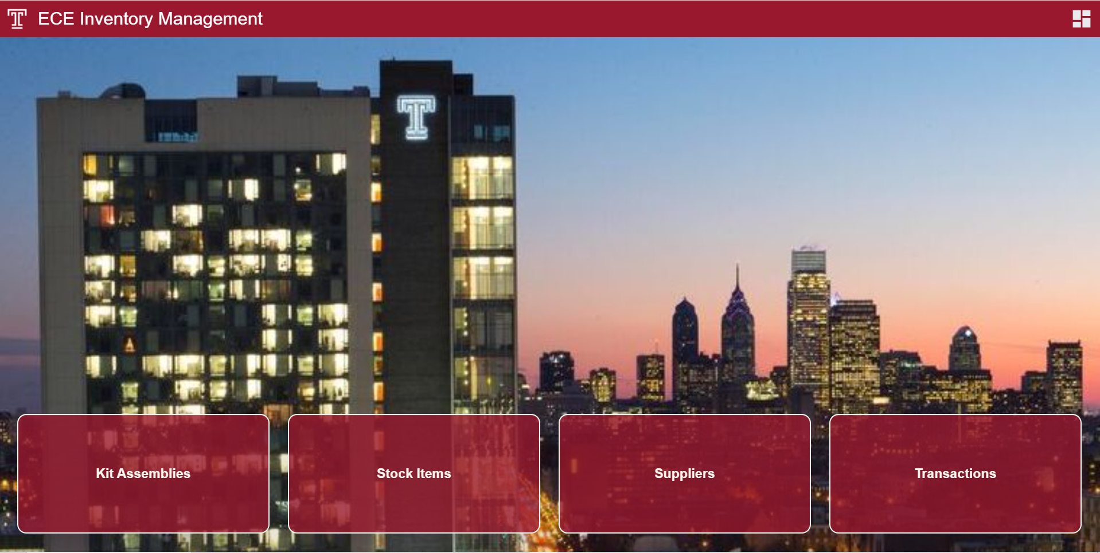
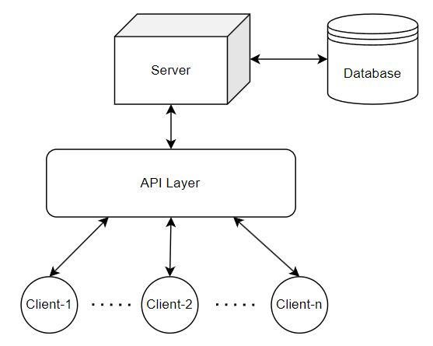
Digitalizing ECE Inventory Management
James Kinter

Slide 2
Problem Statement
1
Manual
Inefficient
2
Inaccurate
Unreliable
Understocking
3
Risky
Overstocking
Data Loss
Data Exposed

Slide 3
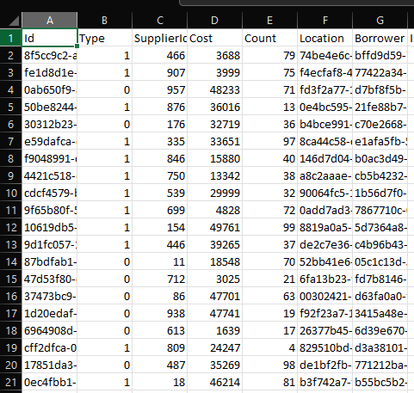
Proposed Solution
Manual
Digital

Slide 4
Function Requirements and Design Constraints:
Requirements:
Constraints:
✔
Ability to perform transactions.
✔
Meet ADA compliance criteria.
P/F
NN
P/F
N
Initial site load time under limit.
✔
Adhere to TU color palette.
≤ 8s
NN
P/F
NN
Critical path load times under limit.
≤ 2s
NN
*N = Negotiable; NN = Non-Negotiable

Slide 5
Project Architecture
Technologies Used:
Database
Server
MySQL (Open Source)
C# / ASP.NET / Dapper
Blazor (C# WASM Framework)
Postman (API Testing)
JSON (JS Object Notation)
API Layer
Client₁
Client₂
Client₃

Slide 6
Data Models – Kits, Stock, and Suppliers
Kit Assemblies
Assembly of kit components, which are consumables assigned to kits.
Stock Items
Comprised of assets and consumables.
Suppliers
Vendors who supply stock items to Temple University.

Slide 7
Testing:
Unit Testing
Benchmarking

Slide 8
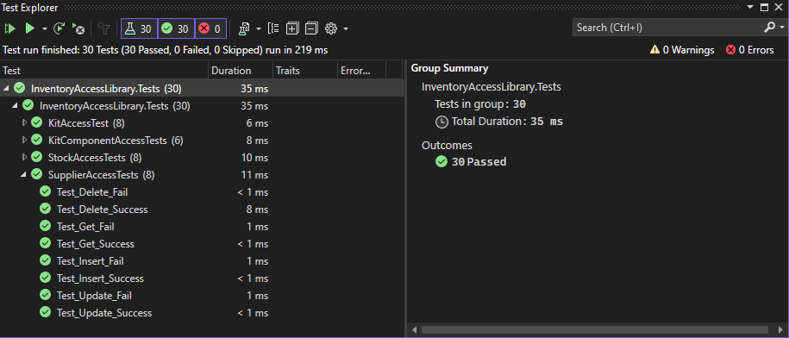
Unit Testing - Results:

Slide 9
Benchmarking - StockItems Results:

Slide 10
Function Requirements and Design Constraints:
Requirements:
Constraints:
✔
Ability to perform transactions.
✔
Meet ADA compliance criteria.
P/F
NN
P/F
N
Initial site load time under limit.
✔
Adhere to TU color palette.
≤ 8s
NN
P/F
NN
Critical path load times under limit.
≤ 2s
NN
*N = Negotiable; NN = Non-Negotiable

Slide 11
Questions?

Slide 12
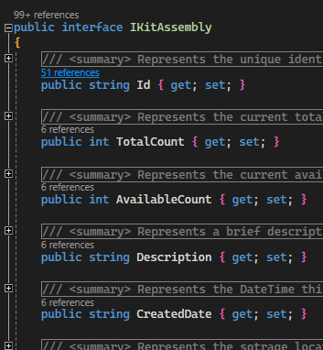
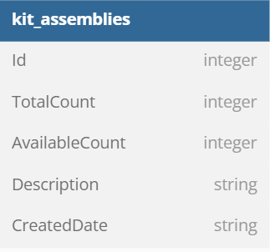
Object Relational Mapper (ORM)
ORM (Dapper)

Slide 13
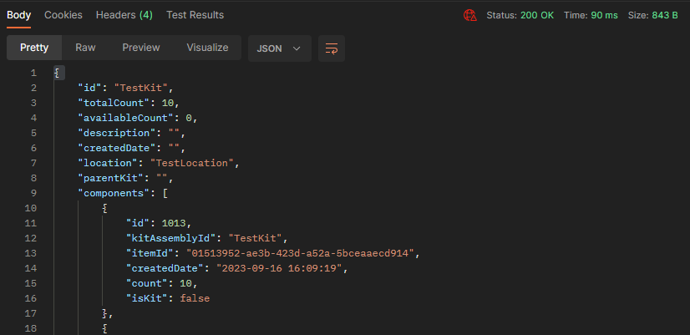
API Response
URL Routing:
https://localhost:80/api/Kits/{id}
HTTP Response Code
Metrics
JSON Formatting

Slide 14
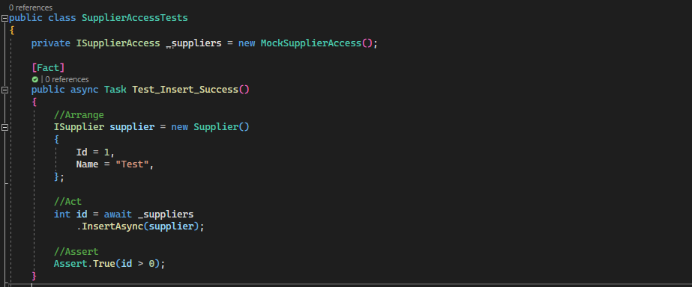
Unit Testing - Setup:
Test Class
Mock Access
Arrange
AAA Model
Act
Assert

Slide 15
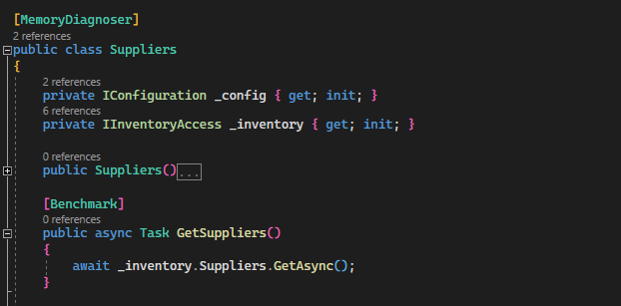
Benchmarking - Setup:
Memory Attribute
Configuration
Method Declaration

