Slide 1
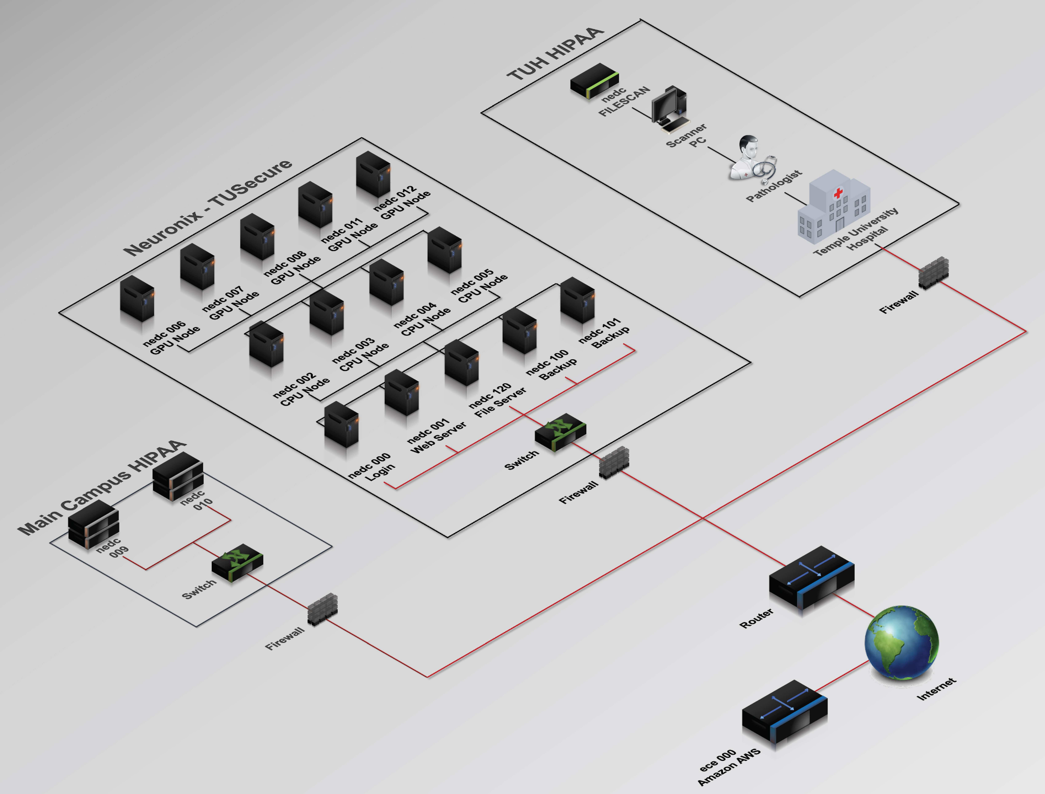
ARM Based Coprocessor
ARM Based Coprocessor
Colin Bakum, Ben High, Noah Antonio
Coordinator: Dr. Maryam Alibeik
Advisor: Dr. Joseph Picone
Notes:
*need a graphic and explanation

Slide 2
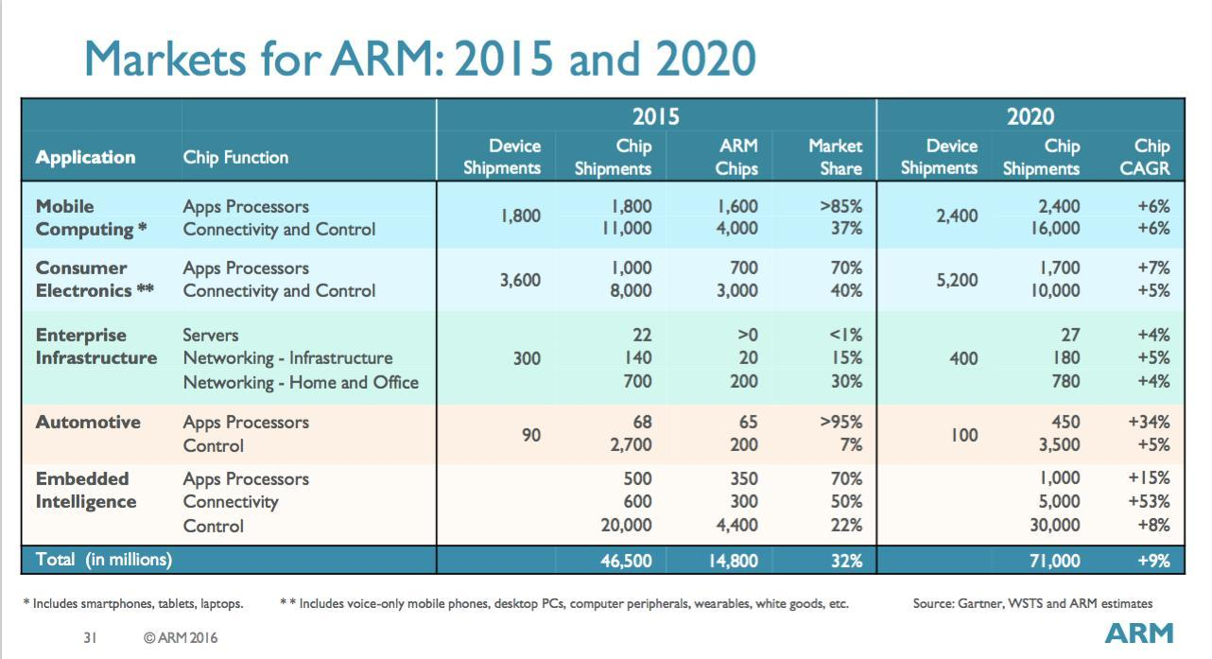
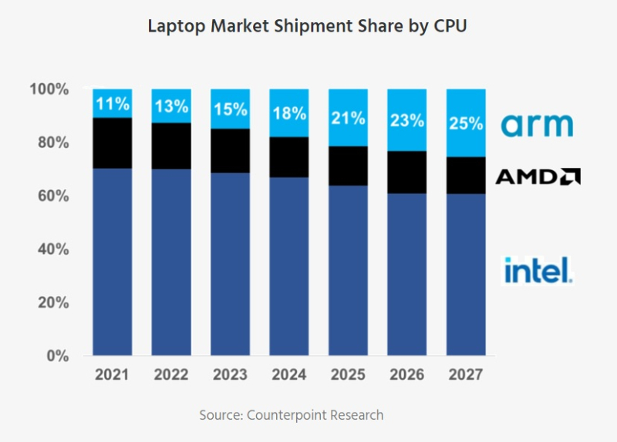
Problem Statement
ARM core processors are evolving making advancements in the computer processor market
Not faster than x86, but approaching parity and cheaper
Emerging technologies (AI/machine learning) need high performance processors
Mobile/edge AI implementation is growing; energy efficiency is key
Cloud computing is also expanding and ARM’s server market share is growing
Notes:
Arm chips are not faster, but they are making gains in performance towards parity with x86 counterparts But they are cheaper and have significantly lower power consumption.
Important as AI/ML Applications grow in size/embedded AI (battery powered)
-customizable architecture; 2.4GHz 4 core raspberry pi 5 silicon, to ampereOne with 192 cores. Anyone wanna guess which of those two are in the 400 petaflop fugaku super computer? Neither; it uses fujitsu processors. But all three use the same instruction set
-freal:there is a growing need for powerful yet efficient processors as computers become more integrated in our daily lives. From the cpu in your smartwatch, to the self-driving car using image detection, to the computationally intensive world of generative AI that is unfolding before us, there is an ever-growing need for purpose-built, cost efficient, and

Slide 3
Progress Chart
Learn the Neuronix Cluster Environment
Pi Prototyping (mini cluster)
Obtained Mac node
Introduced to the Neuronix Cluster
Hardware Planning/Market Survey
Custom Benchmarking
Linpack benchmarking
Python benchmarking
Machine Learning Demo
Eigen Benchmarking
NEON Intrinsics exploration
Notes:
Learn Cluster
Hardware Planning
Pi prototyping (mini cluster)
Obtained Mac node
Linpack+custom benching
Python benchmarking
Neon Intrinsics exploration
Eigen Benchmarking
ML Demo

Slide 4
Power/Hardware Differences
Key Differences
ARM (RISC):
Smaller and simpler instruction sets
Fewer transistors per instruction
Uses less power
Generates less heat
X86 (CISC):
More varied and complex instruction sets
More transistors per instruction
Uses more power
Generates more heat
Rough Estimates of RDP: Pc = TDP/Cores
TDP is rough metric (estimates while under load)
ARM node: 20W/8 = 2.5W/Core
AMD node: 200W/24 = 8.33W/Core
Transistor Count:(ARM: 20E9) (AMD: 26.3E9)
Process Node: (ARM: 5nm) (AMD: 6nm)
Die Size: (ARM: 141.7mm^2) (AMD: 288mm^2)

Slide 5
Design Criteria
Priority | Requirement | Metric | Target range | Justification
Non-negotiable | Accessible through Neuronix | Ssh into node, shares file system with cluster | Pass/fail | Node must exist virtually identical to others
Non-negotiable | Execute python, c/c++ | Must execute same programs as x86 nodes | Pass/Fail | Node must be able to offload computing
Negotiable | Optimize programs for ARM | Ratios of execution times, FLOPS, TOPS | >1.50 | Explore ARM specific techniques
Negotiable | Automated test bench environment | Thousands of tests running automatically | Pass/Fail | Ease of data collection
Negotiable | ML demo runtime, benchmarks comparable to baseline | Ratios of execution times, FLOPS, TOPS | >0.80 Ideally >0.90 | Used to understand, optimize strengths and weaknesses

Slide 6
Standards
IEEE 754: floating-point arithmetic
IEEE 29119: Software testing, comprehensive standards for benchmarking
ISO/IEC 9899: C programming language standards, software development
IEEE 2030: Internet of Things (IoT) applications, processor integration
American National Standards Institute (ANSI) bench tests
Notes:
754 maintains compatibility between different archs/nodes
The importance of 754 is to maintains sameness of calculations between computers. Ensures compatibility (results of one computers computation are replicatable on another)

Slide 7
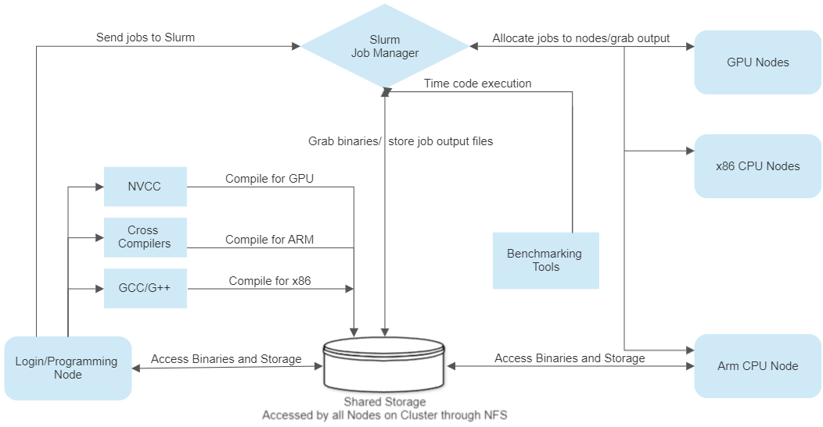
Proposed Hardware Solution
Notes:
Dev environment with arm Accessible from cluster Original idea of peripheral (Mac mini fit our needs better/easier)

Slide 8
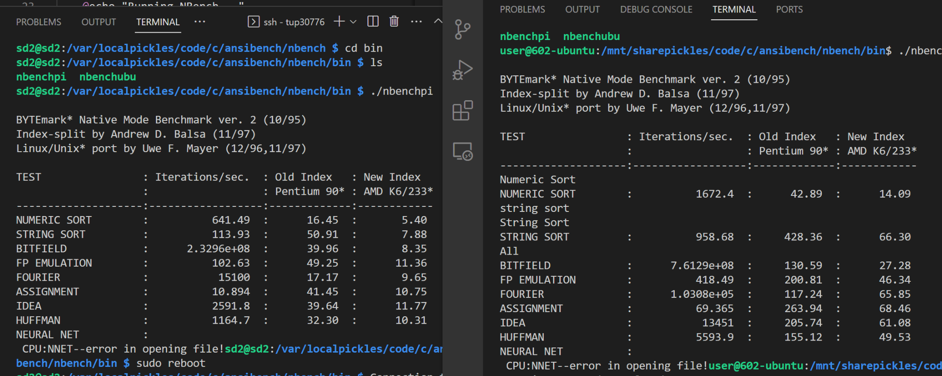
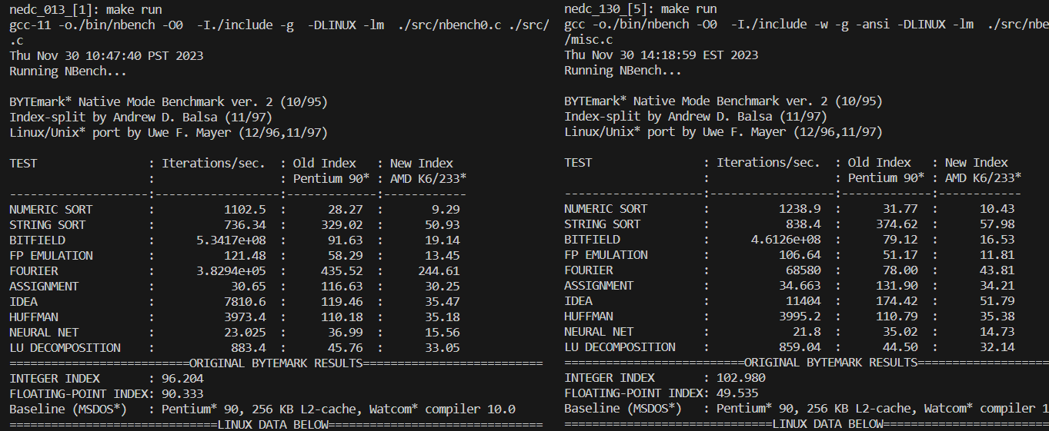
Prototype Success and Mac Mini Deployment
IEEE 2030
✅
Notes:
How we prototyped and tested that prototype, that we essentially did the same thing with the mac.
-important part is declaring the deployment a success and segueing into real benching
-LINPACK IS a standardized jawn. ANSI = american national standards institute
Note the indexes are x86 amd this was built in 97. The benchtest was designed more or less for x86 in mind, and intel/amd built shit that would specifically excel at these tests. Since ARM (currently) doesnt make wafers, their approach is totally different; basically, the platform exists and people have produced dank ass intel killers

Slide 9
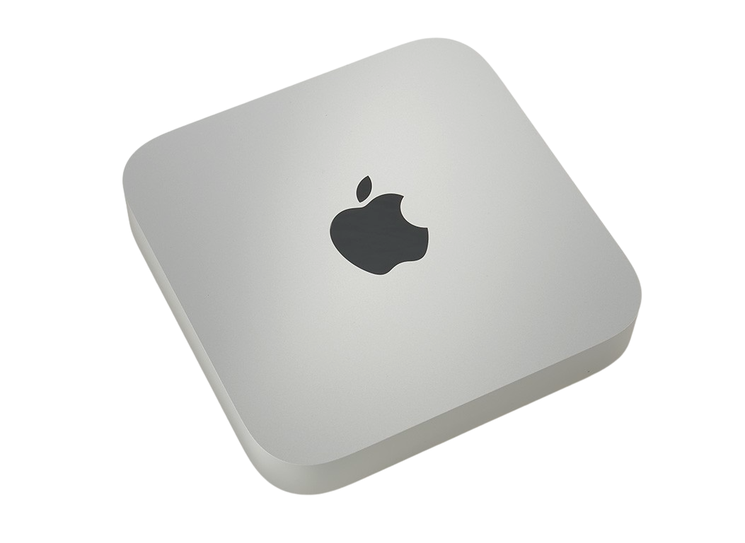
Costs
Apple Mac mini m2:
$599.99 + 47.92 (Tax)
SPECS
Cores | Threads | RAM | Clock Speed | L1 Cache | L2 Cache | L3 Cache
8 | 8 | 8GB | 2.4-3.5GHz | 2MB | 20MB | 8MB

Slide 10
Benchmarking Motivation
-optimization level
-thread count
-which compiler
-understand behavior;
If anomalous, why?
Basic
-Simple, lowest level as possible
-add/mul/sub/div
-float and int
Intermediate
- matrix manipulation
-Fourier transforms
-correlation
Advanced
-Full suites
-Look to prebuilt tests, complex libraries (eigen)
-Battery of tests
Goal
-ML analysis
-Is it a viable contender?
-How do we make it better?
✅
✅
*According to Apple’s documentation, the M2 does follow the IEEE 754 standard for floating point numbers
Notes:
https://developer.apple.com/documentation/swift/floatingpoint
The importance of 754 is to maintains sameness of calculations between computers. Ensures compatibility (results of one computers computation are replicatable on another)

Slide 11
Prior Benchmarking/Testing Strategies
Advantages:
Disadvantages:
Premade
Simple inputs to execute
Runs on large quantity of data
Executes several types of operations
Detailed outputs
Minimal Control
Limited input
Tests many things at once
Complex output
Linpack/Dhrystone/Wetstone and other ANSIBench tests
*All Benchmarking tests were created in compliance with IEEE 29119 Software testing, comprehensive standards for benchmarking

Slide 12
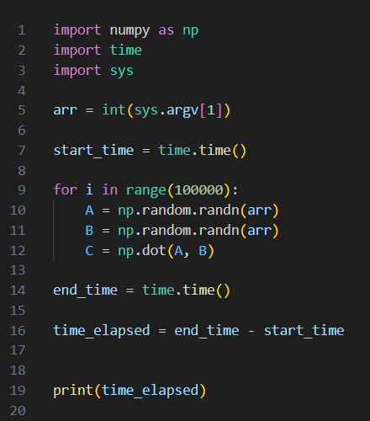
Final Design: Ideal Benchmarks
Customizable
Simple Test
Simple Output

Slide 13
Final Design: Data Collection
How to effectively gather data
Testing Script:
Max Param
Output File
Send Incrementing Parameters
Write To File
Test Results:
Data File
Easily Graphed
Return Timing Data
Simple Benchmark

Slide 14
Final Design: Automated Data Collection
Tester Scripts
Driver Script:
Detects OS
Sets Parameters
Program Tester Scripts
Test Results
Simple Benchmarks
Driver Log

Slide 15
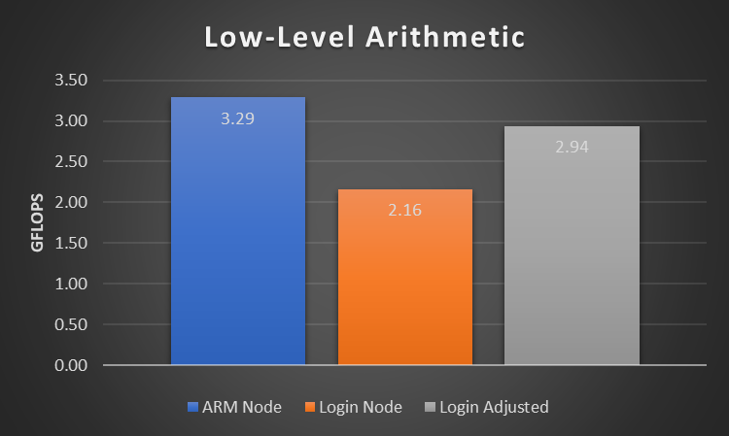
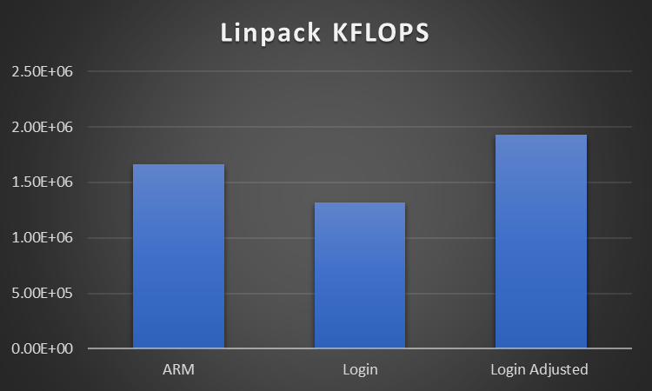
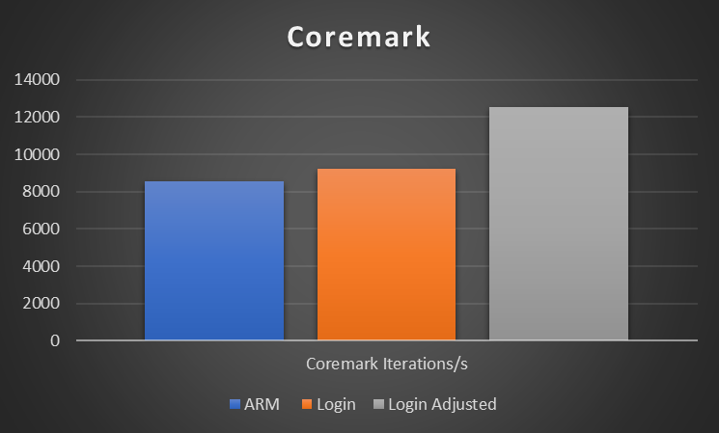
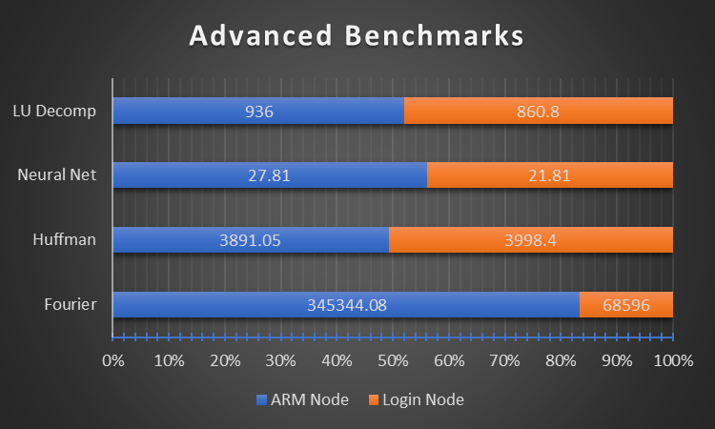
Low-Mid Level Bench Test Results
Notes:
Linpack is floating point LU decomp
Coremark does a series of operations designed to mimic a program - list processing, state machines, matrix maths… it doesnt call external libraries and it is designed to guard against pc optimizations
Last one calls into question

Slide 16
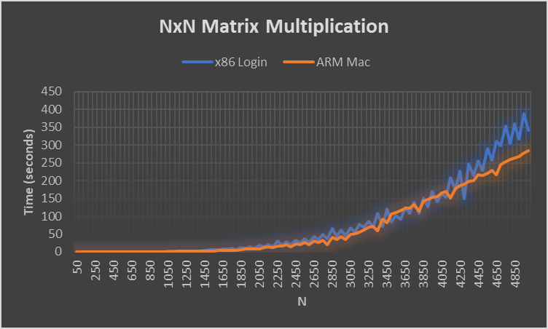
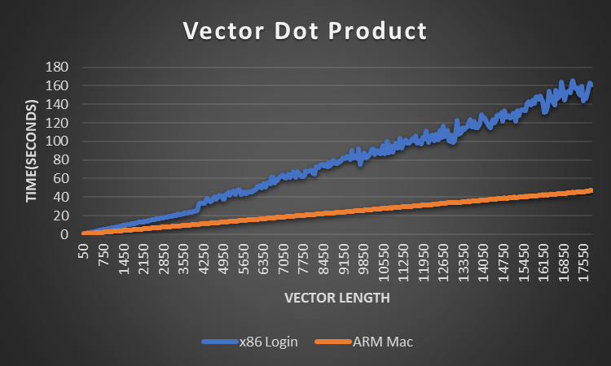
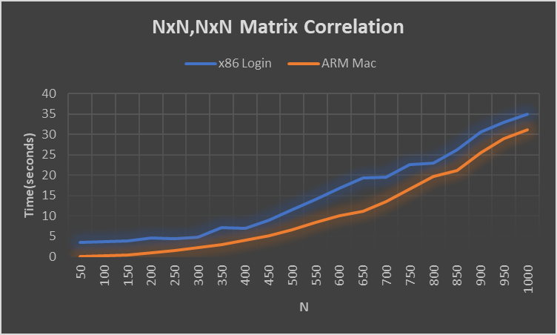
Interpreted Language Test Results

Slide 17
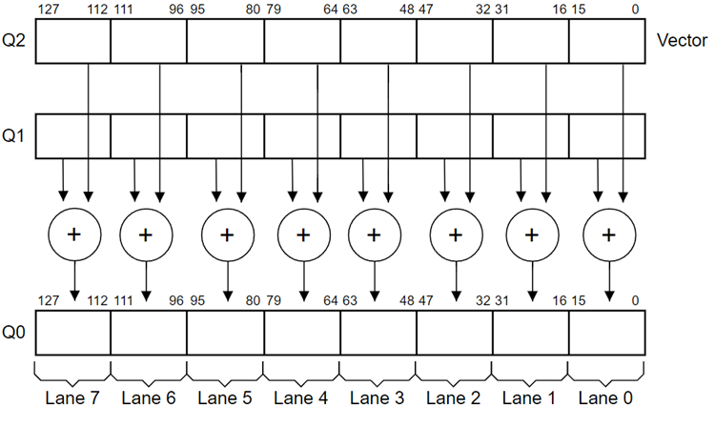
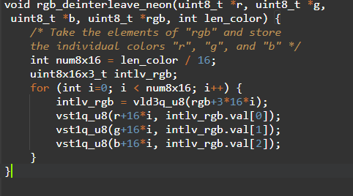
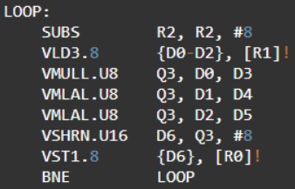
Hardware Level Optimizations
NEON Intrinsics
Perform elementary arithmetic on multiple values in both memory locations simultaneously
Use a single memory location to store multiple values
Not User Friendly

Slide 18
Eigen
Simplifies SIMD implementation/Neon compatible
High Performance C++ package for Linear Algebra
Template library for variable input sizes
Header library
Basis for TensorFlow
Enforces data alignment for SIMD (neon) enhancements
Notes:
When did arm neon start??

Slide 19
Eigen Test Bench
Test Mode | Clock Speed | Average Execution Time (μs) | Normalized
AMD-Node | 2.4 GHz | 30533 | 1.00
AMD-Node (AVX extension) | 2.4 GHz | 25840 | 0.85
ARM-Node gcc (emulated) | 3.5 GHz | 101102 | 4.50
ARM-Node gcc (native- no NEON) | 3.5 GHz | 69115 | 3.28
ARM-Node gcc (native- with NEON) | 3.5 GHz | 21452 | 1.02
ARM-Node clang (no NEON) | 3.5 GHz | 104125 | 4.95
ARM-Node clang (with NEON) | 3.5 GHz | 34656 | 1.66
3.21x increase
Notes:
Check real time clock speed on login Add clock speed?

Slide 20
Eigen Results Reflection
Configure Compiler Correctly
X86 SSE / AVX
Neon SIMD
Price $1825 vs $600
3.27x more KFLOPS/W

Slide 21
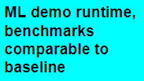
EEG Demo
High-Level Test Case
Train
Library Version Control
File I/O
Decode
Evaluate
Real Time Detection

Slide 22
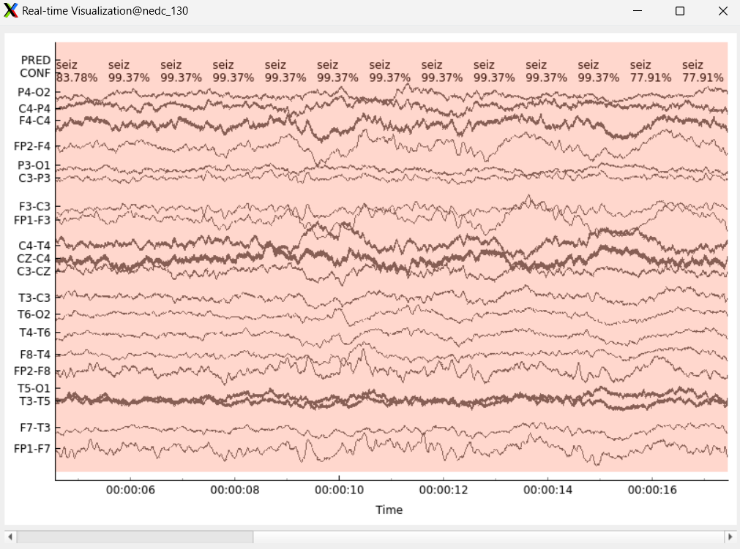
EEG Decoder Results
 | Repetitions | Average Timing
ARM-Node Decoder | 40 | 20.825s
x86-Node Decoder | 40 | 18.625s
Model can achieve real-time detection

Slide 23
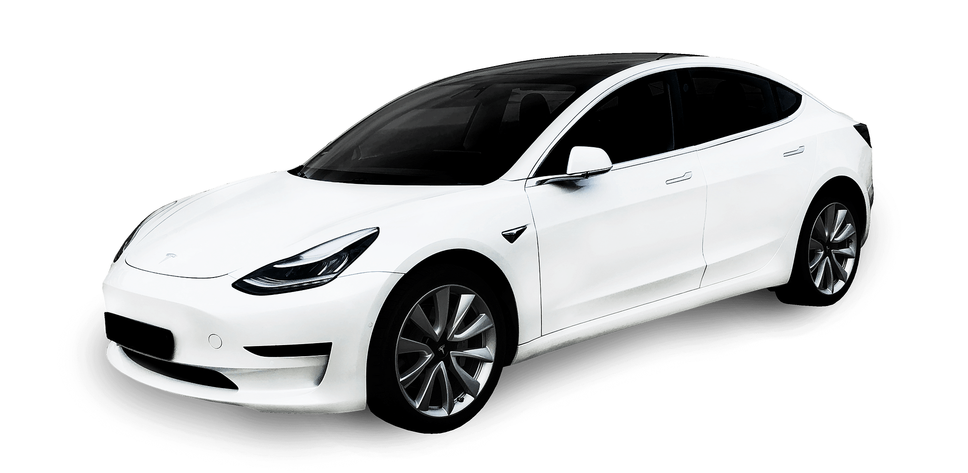
Future for ARM
ARM is adopting some complex instructions
Modern libraries are targeting ARM hardware specifically
ARM market is growing on high performance side
Better power efficiency protect embedded market share
New investment from Apple, Qualcomm, and Microsoft
Recent IPO

Slide 24
Targeting ARM for Performance
No performance boost in standard Python, but some high performance libraries target ARM hardware (ex: Numpy, Tensorflow)
Compiler options enable vectorization with NEON for performance boost
Neon intrinsics give developers direct access
Template libraries like eigen promote portability with hardware specific acceleration
Makes accessing NEON easier

Slide 25
Questions?

