Slide 1
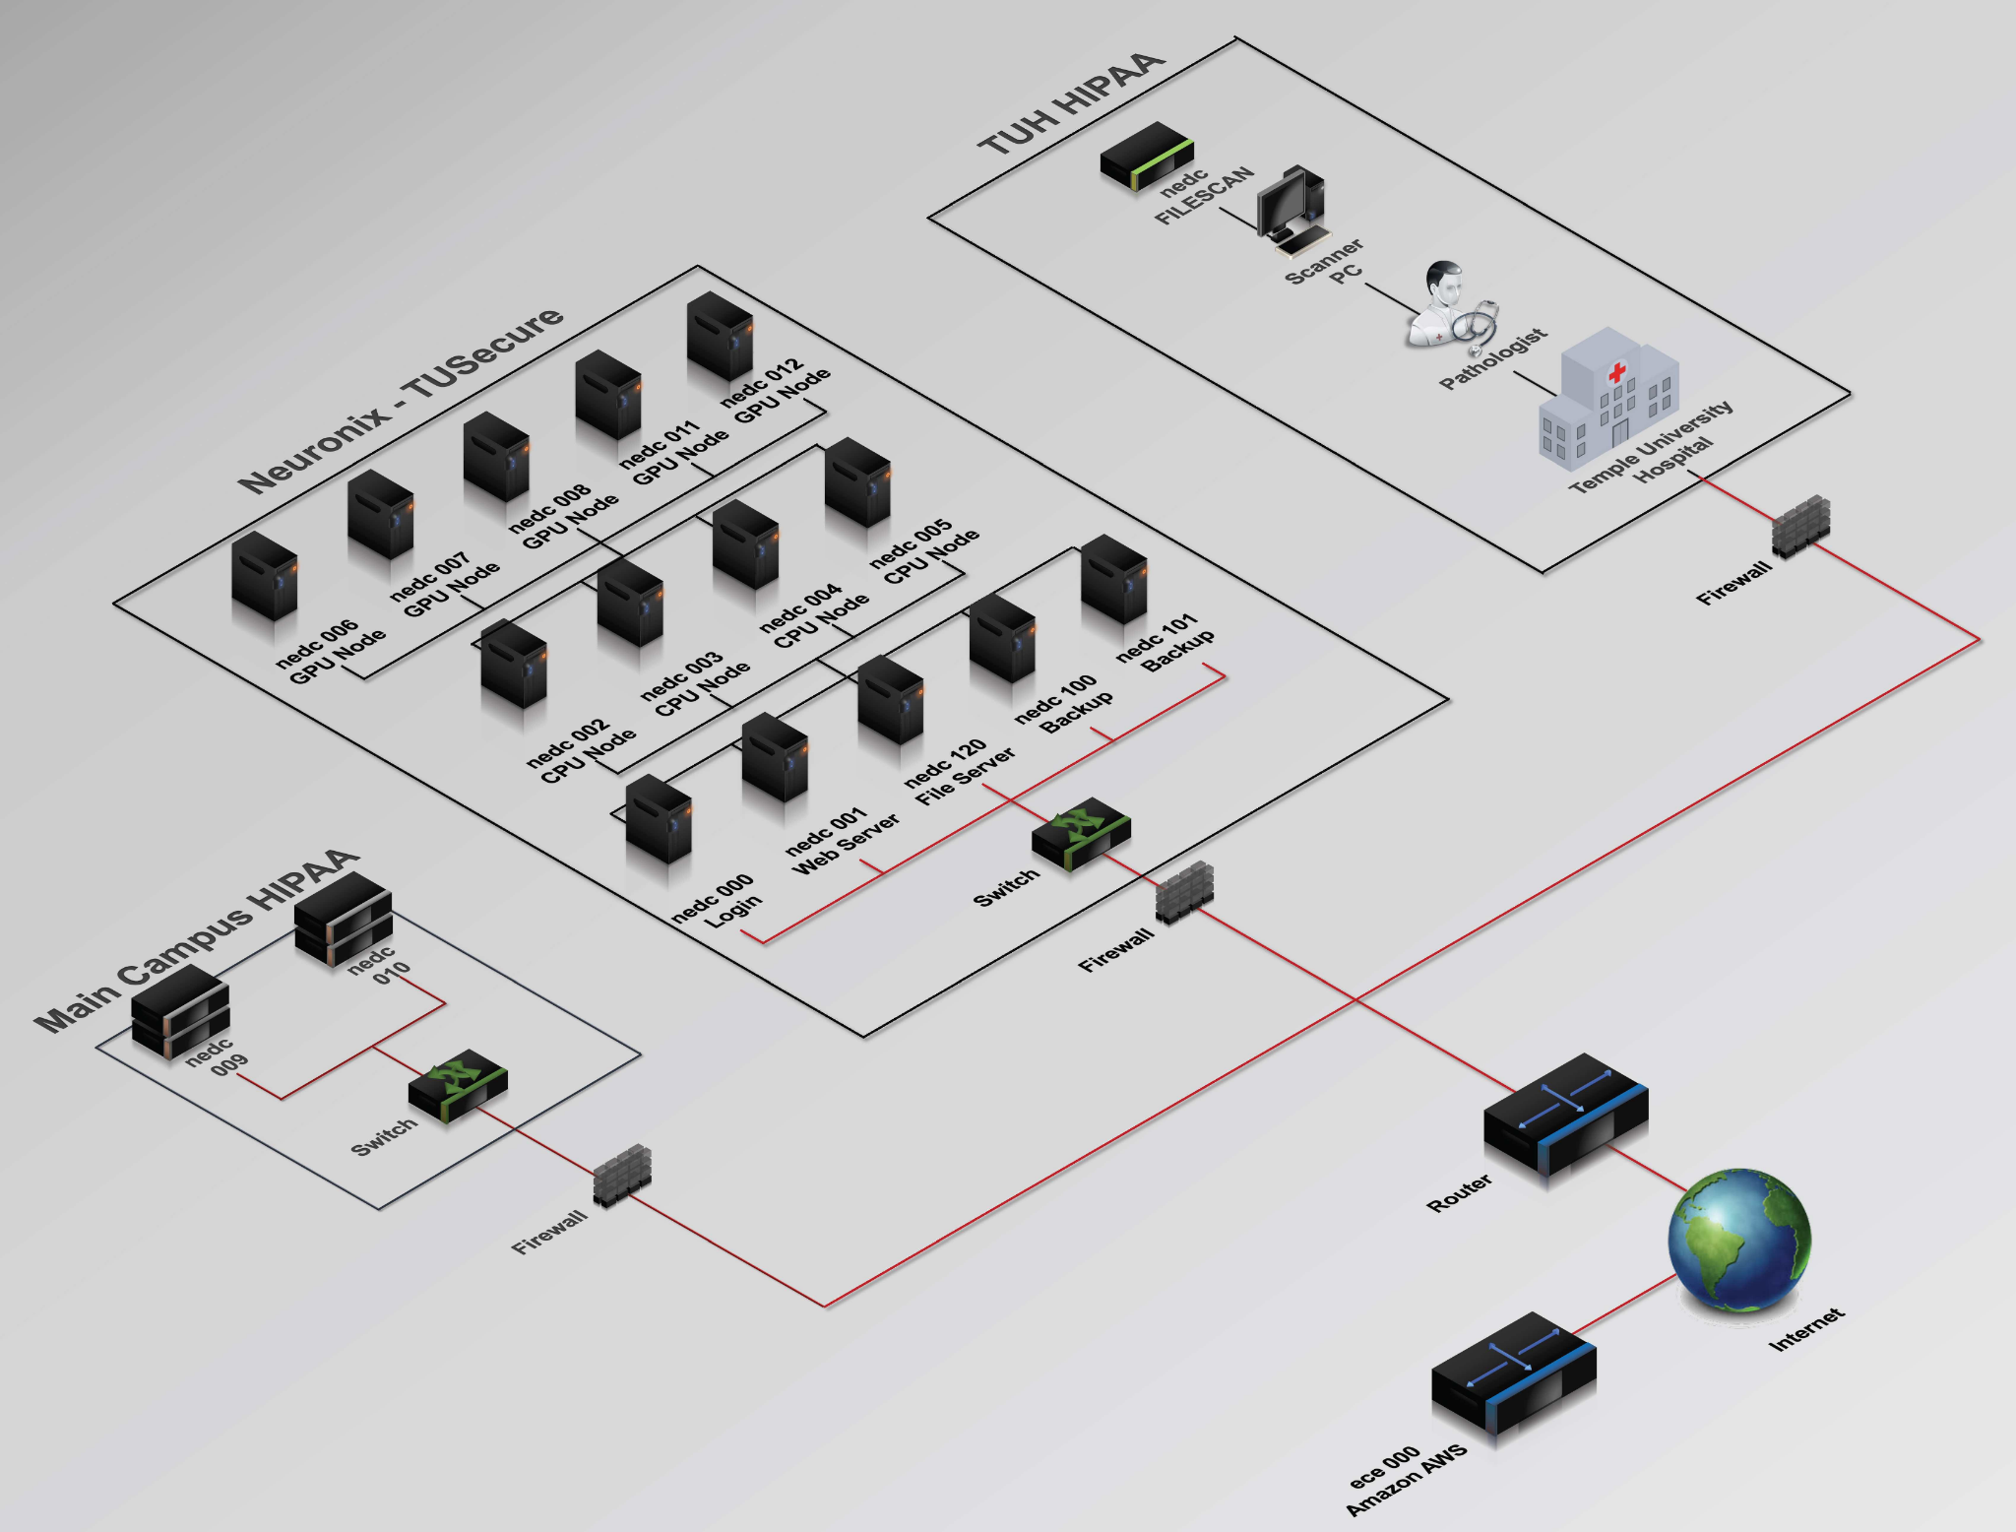
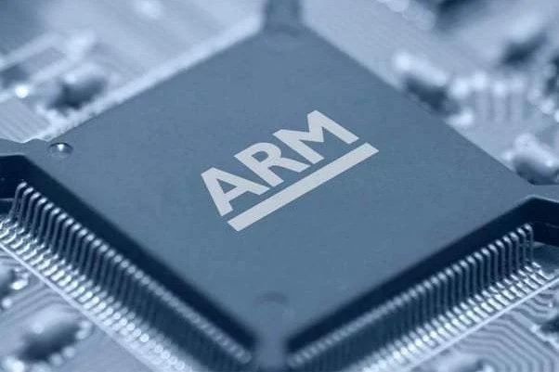
ARM Based Coprocessor
ARM Based Coprocessor
Colin Bakum, Ben High, Noah Antonio
Coordinator: Dr. Brian Thomson
Advisor: Dr. Joseph Picone
Team #2
Colin Bakum, Ben High, Noah Antonio
Coordinator: Dr. Brian Thomson
Advisor: Dr. Joseph Picone
Notes:
*need a graphic and explanation
Implement arm because its modular

Slide 2
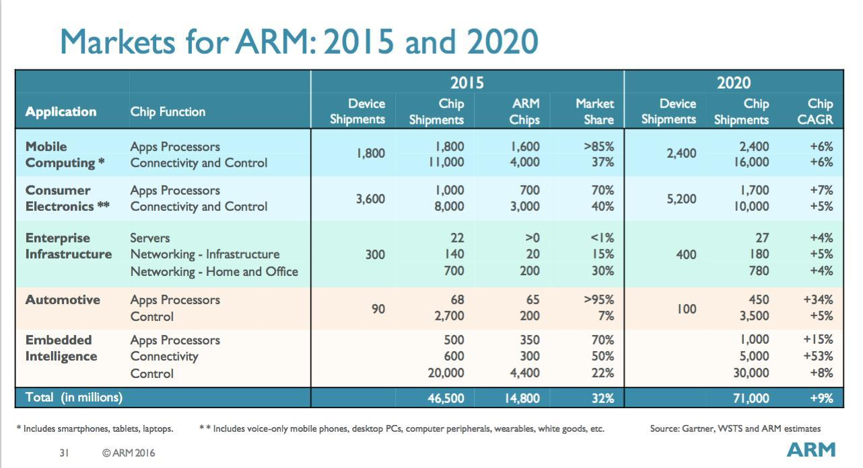
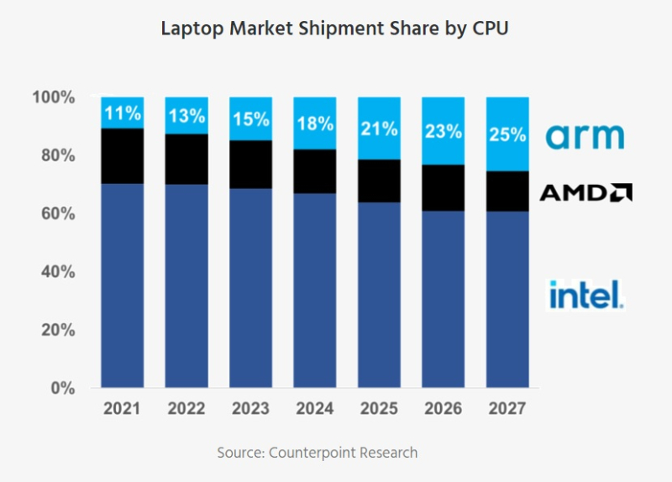
Problem Statement
ARM core processors are evolving making advancements in the computer processor market.
Emerging technologies (AI/machine learning) need high performance processors
Mobile use of AI is growing and needs energy efficient processing for battery life
ARM processor market is growing
Neuronix Cluster is a prototyping environment
Notes:
Need for low cost, low power, small size computers that can deliver on computationally demanding applications (AI/machine learning)
ARM scales from embedded, to desktops, servers, supercomputers, etc
How to benefit from these economies of scales (hardware specific optimizations, cloud/edge computing)
Cluster is rapid prototyping environment
Project is small piece of much larger journey (how does our piece fit into this?)

Slide 3
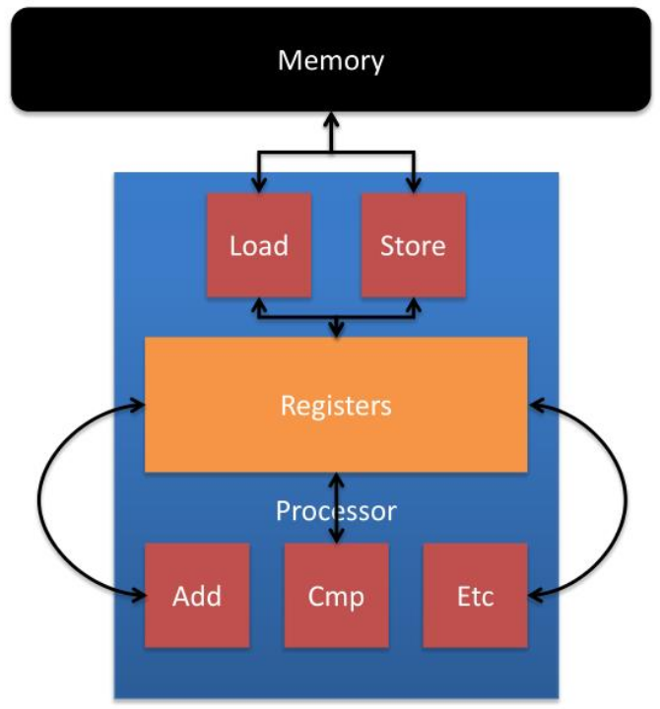
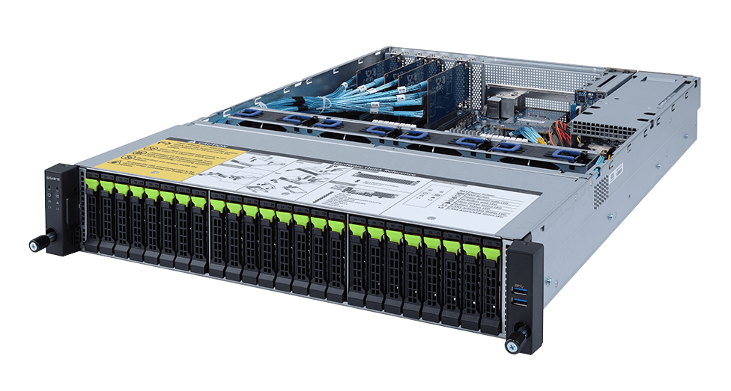
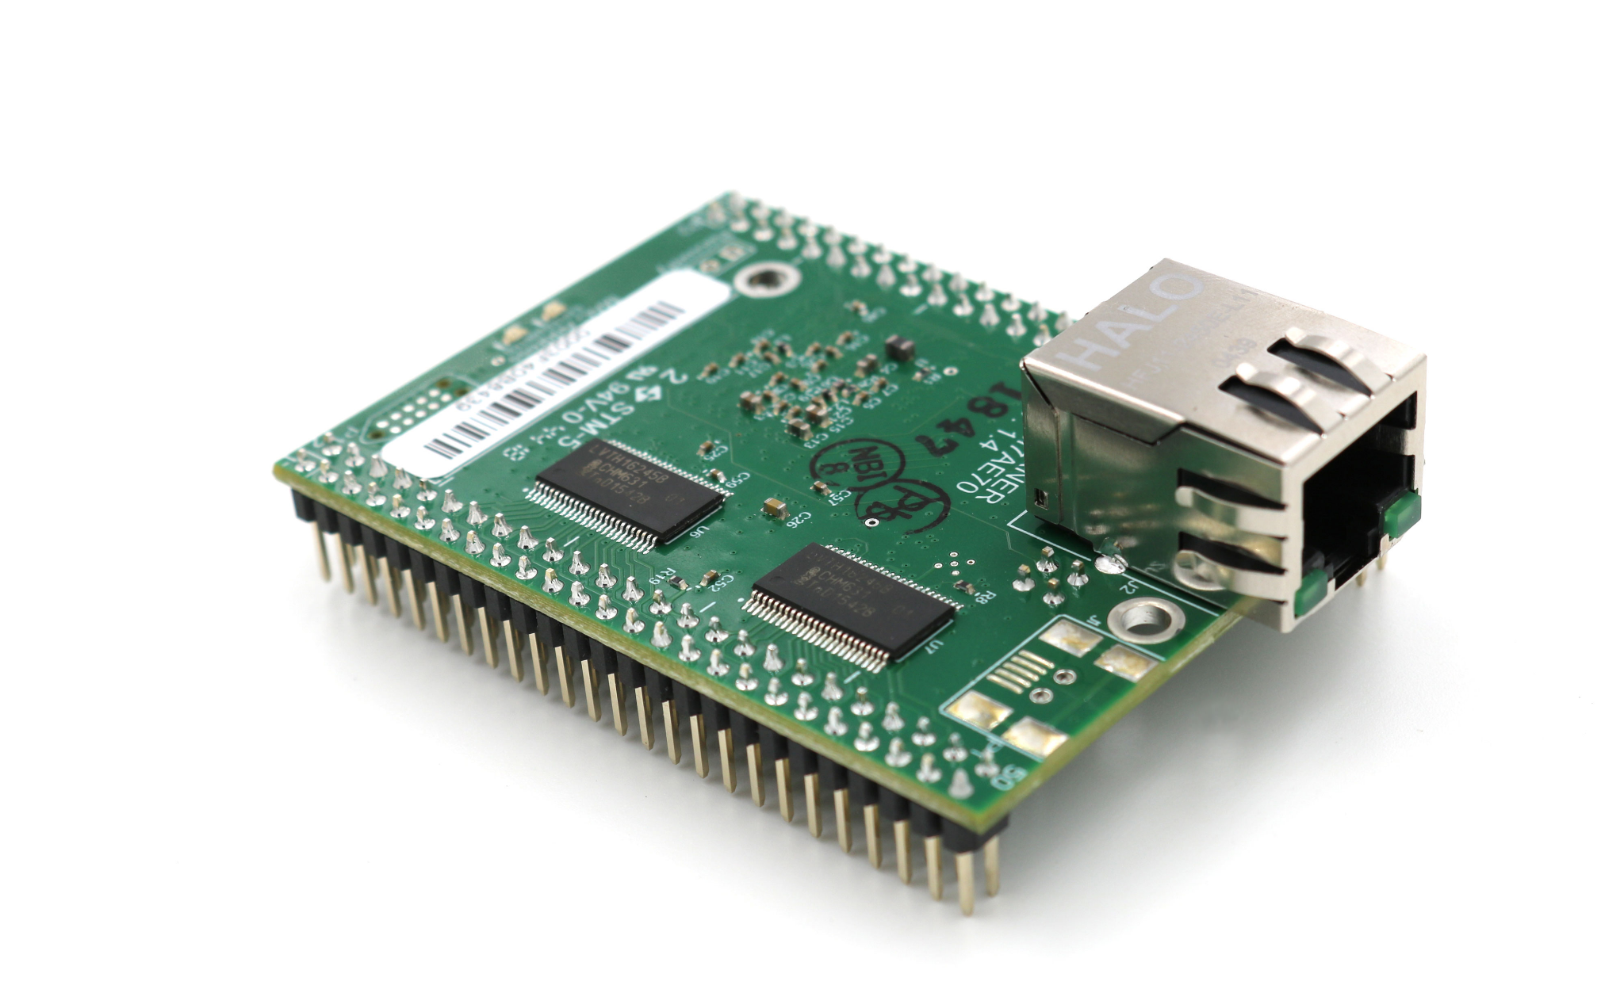
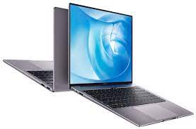
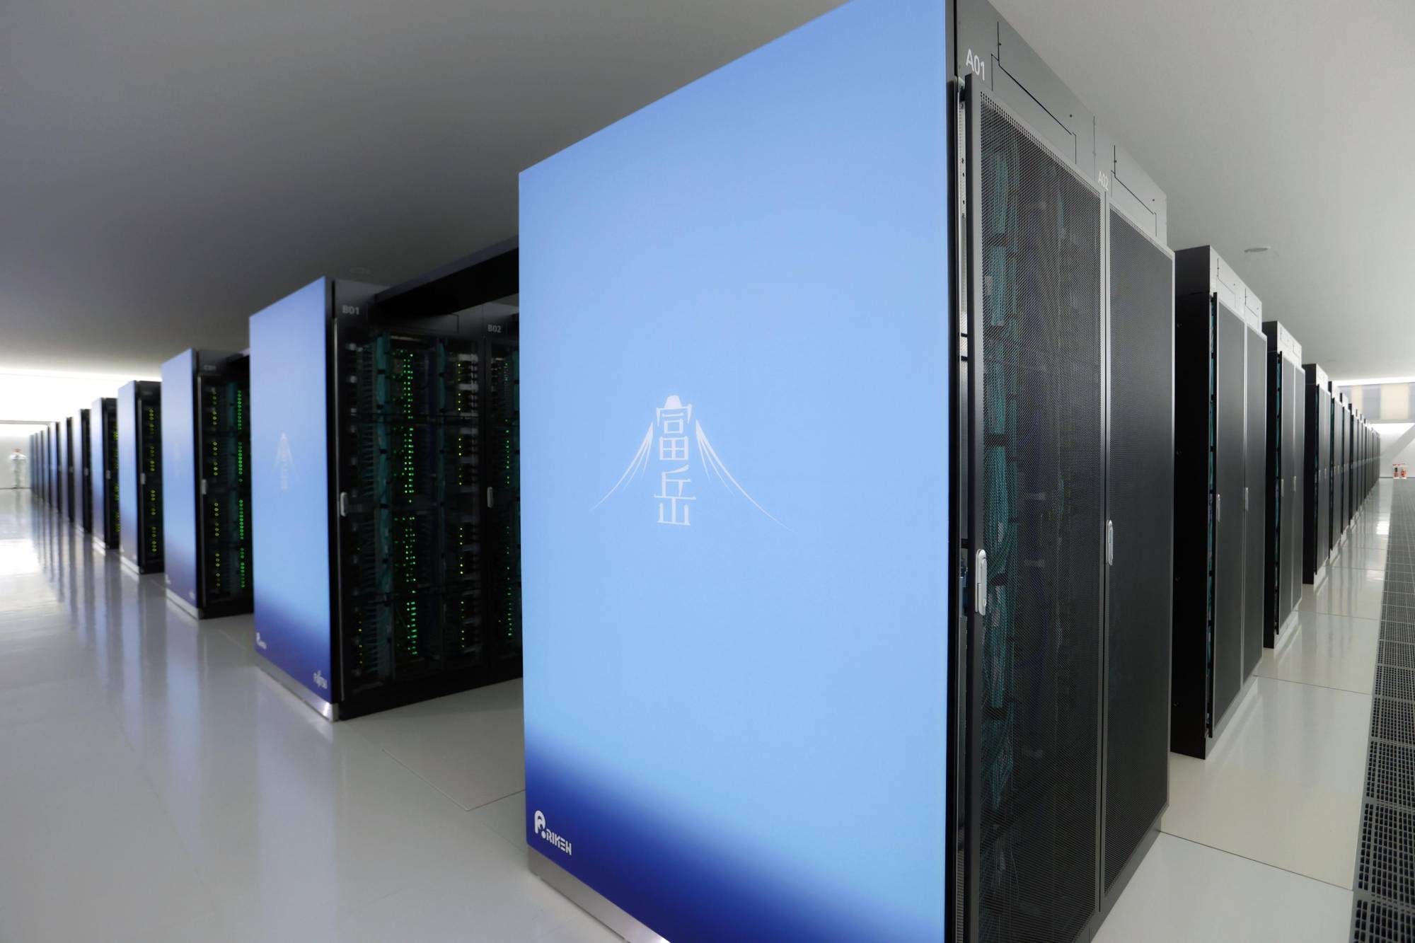
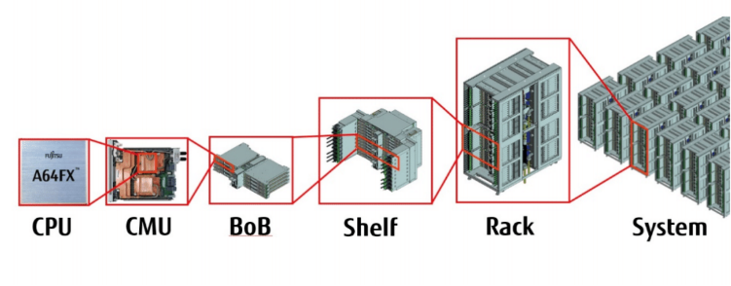
Essence of an ARM
ARM processors thrive off their scalability
RISC (ARM) vs CISC (x86)
Instruction set simplicity and size
Power efficiency (great for mobile devices)
Load/Store architecture
Laptops, Desktops, smartphones and various small devices
Server rack
Embedded systems
Fugaku Supercomputer (2nd fastest supercomputer in the world)
Notes:
Show visuals of ARM used from embedded products to desktops to servers and supercomputers
Discuss adoption of ARM in supercomputers

Slide 4
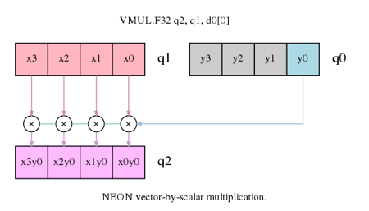
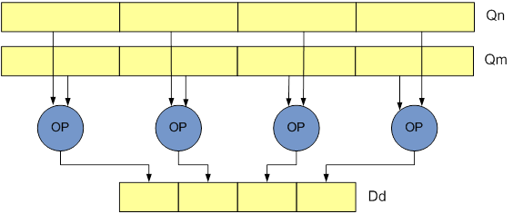
Project Overview
Optimize for ARM
Hardware Level Mathematics Optimizations
Low Level
High Level
Dot Products
Matrix Multiplication
Vector Operations
Eigenvalue Decomposition
Matrix Inversion
DSP Downsampling
Filtering
Machine Learning Applications
EEG Demo

Slide 5
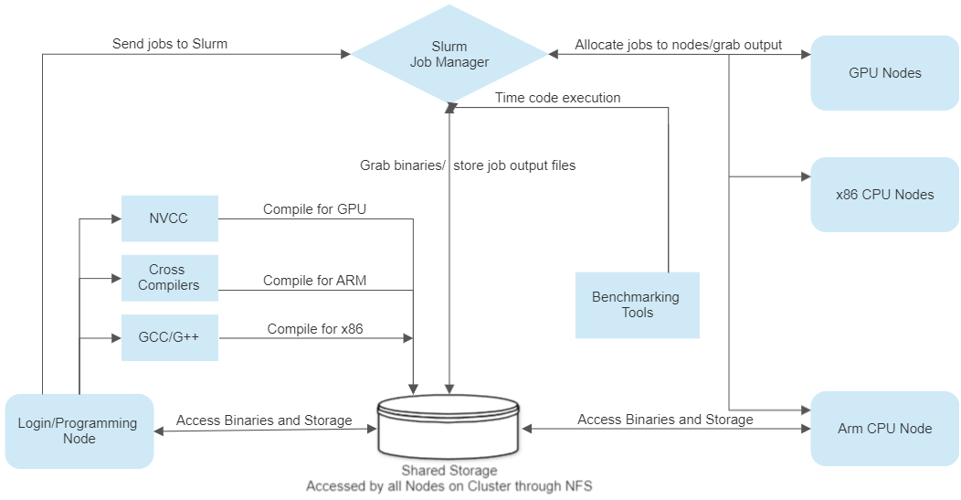
Proposed Solution

Slide 6
Milestones and Epics
We are here
Picking ARM processor
Integrate new node into Cluster’s API
Physical integration of ARM with cluster
Notes:
-m2 is the closest equivalent to modern desktop x86
-OS and Linux both based on unix
-integration via NFS over ethernet
-ssh tunneling reduces security concerns
*block diagram of system as opposed to process. Stylized diagram of cluster, how arm is incorporated
*mac mini is prototype, RU server is desirable goal depending on prototype outcome

Slide 7
Prototyping Requirements
Login node must be able to cross compile code
ARM node must be able to access cross compiled binaries
ARM node must have sufficient RAM, cores, and clock:
> 8Gb of RAM
>4 Cores
>2GHz clock
Libraries must be available for hardware specific optimizations (neon, simd, edsp, etc)
Must test hardware level optimizations against control test cases

Slide 8
Prototyping Stage 1 (Outside of Cluster)
Login Node/ Lab CPU (x86)
ARM Node/ Raspberry Pi

Slide 9
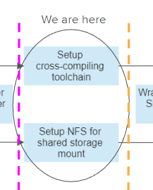
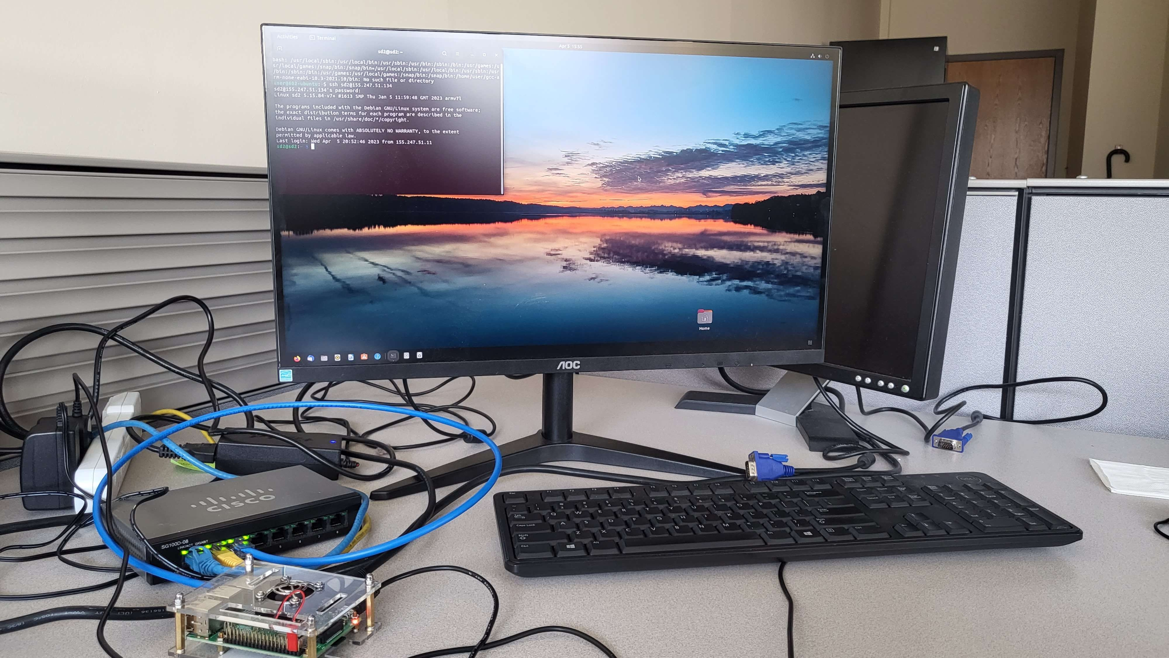
Pi-Based Prototyping
Physical integration of ARM with cluster
Integrate new node into Cluster’s API
Notes:
Change images here to more current programs and location of progress

Slide 10
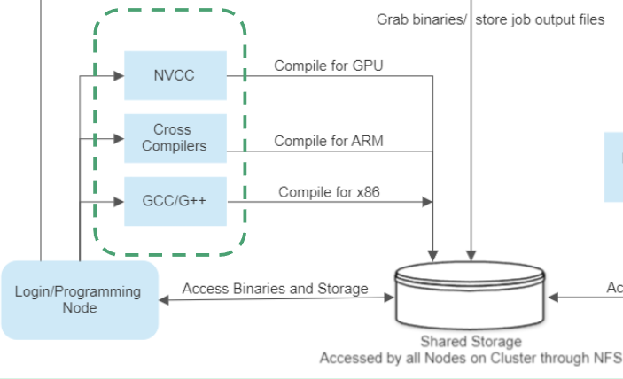
Mount/Cross-Compilation
Notes:
Update to more current Test programs

Slide 11
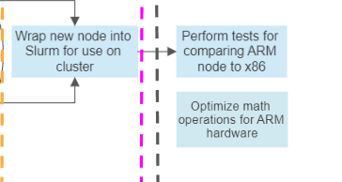
Benchmarking/Optimization
Neon Intrinsics:
128 bit Q-word Registers
F32 F32 F32 F32
Vector Addition Testing
Raspberry Pi
Lab PC
F32 F32 F32 F32
~8.9x longer
~2.1x longer
Notes:
*benchmark things with data available. Spec marks, matrix multiplication. -> machine learning, start simple/standard (random forests, vector machines), progress to realtime eeg/c detection. Time to recognize patterns, time to train
*use native python timing. Understand pros/cons of algos

Slide 12
Prototyping Stage 2 (On the Cluster)
Mac Mini (ARM M2)
Login Node/ Lab CPU (x86)
ARM Node/ Raspberry Pi

Slide 13
Mac-Based Node
Pros:
Clock Speed
4 Efficiency Cores @ 2.42 GHz
4 Performance Cores @ 3.5 GHz
16 Apple Neural Engine (ANE) Cores
Comparable Cache (and greater) to CPUs nodes on cluster
2MB L1 cache
2MB L2 cache
8MB L3 cache
8GB RAM
1Gb/s ethernet
Cons:
Less Cores than other CPU nodes on cluster
Different OS than other nodes on cluster (macOS vs Linux)
8GB of RAM is the bare-minimum for this project
May require different toolchain for cross-compilation
Notes:
-OS and Linux both based on unix
-integration via NFS over ethernet
Title including prototype
-ssh tunneling reduces security concerns

Slide 14
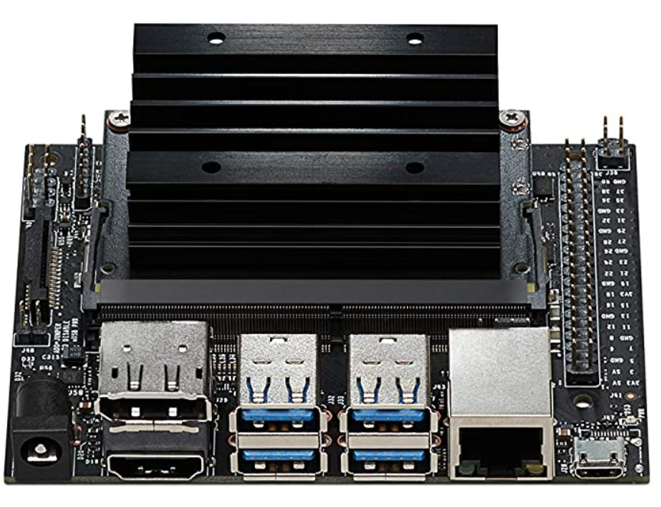
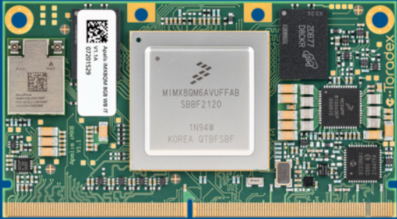
Alternative Candidates
Nvidia Jetson Nano:
Pros:
ARM Cortex-A57 CPU
Extensive ethernet & USB interface
Native Linux support
Cons:
Only 4GB RAM
No built-in Wi-fi
Optimized for edge computing/robotics (not our use case)
NXP Apalis IMX8 Quad:
Pros:
ARM Cortex-A72 CPU (x2)
ARM Cortex-A53 CPU (x4)
Native Linux support
Cons:
Low clock speeds (<2GHz for all cores)
Requires carrier boards

Slide 15
Future Work
Develop+run tests to analyze strengths/weaknesses of M2
Specifically target assembly instructions like load, add, multiply, store
Develop understanding to make use of M2 cores, neural engine
Optimize Python machine learning algorithms for M2/ARM
Modify Pytorch library modules and/or develop libraries from scratch
Potentially develop/modify m2/ARM specific Python compiler
Work with EEG demo at first, expand optimizations for wider use scenario
Demonstrate equivalent/near-equivalent performance with x86 processor at ML/AI applications

Slide 16
Questions?

