Slide 1
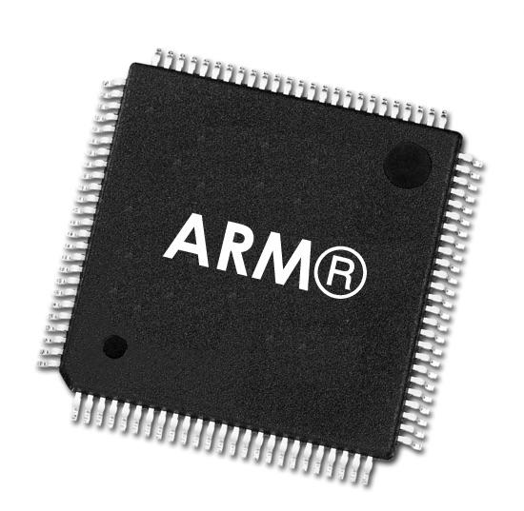
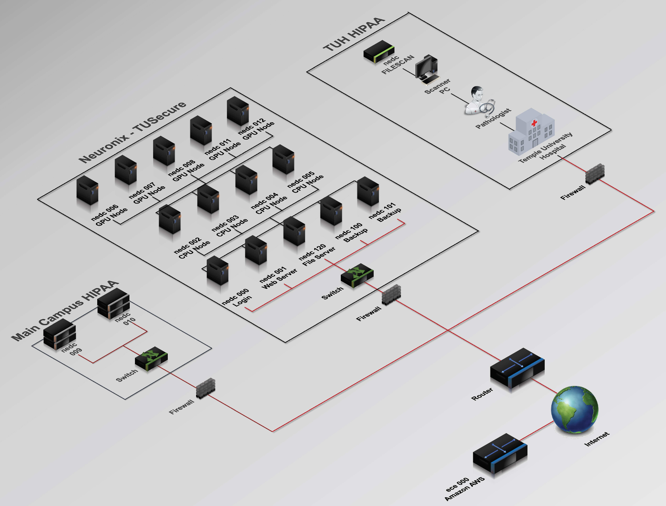
ARM Based Coprocessor
ARM Based Coprocessor
Colin Bakum, Ben High, Noah Antonio
Coordinator: Dr. Brian Thomson
Advisor: Dr. Joseph Picone

Slide 2
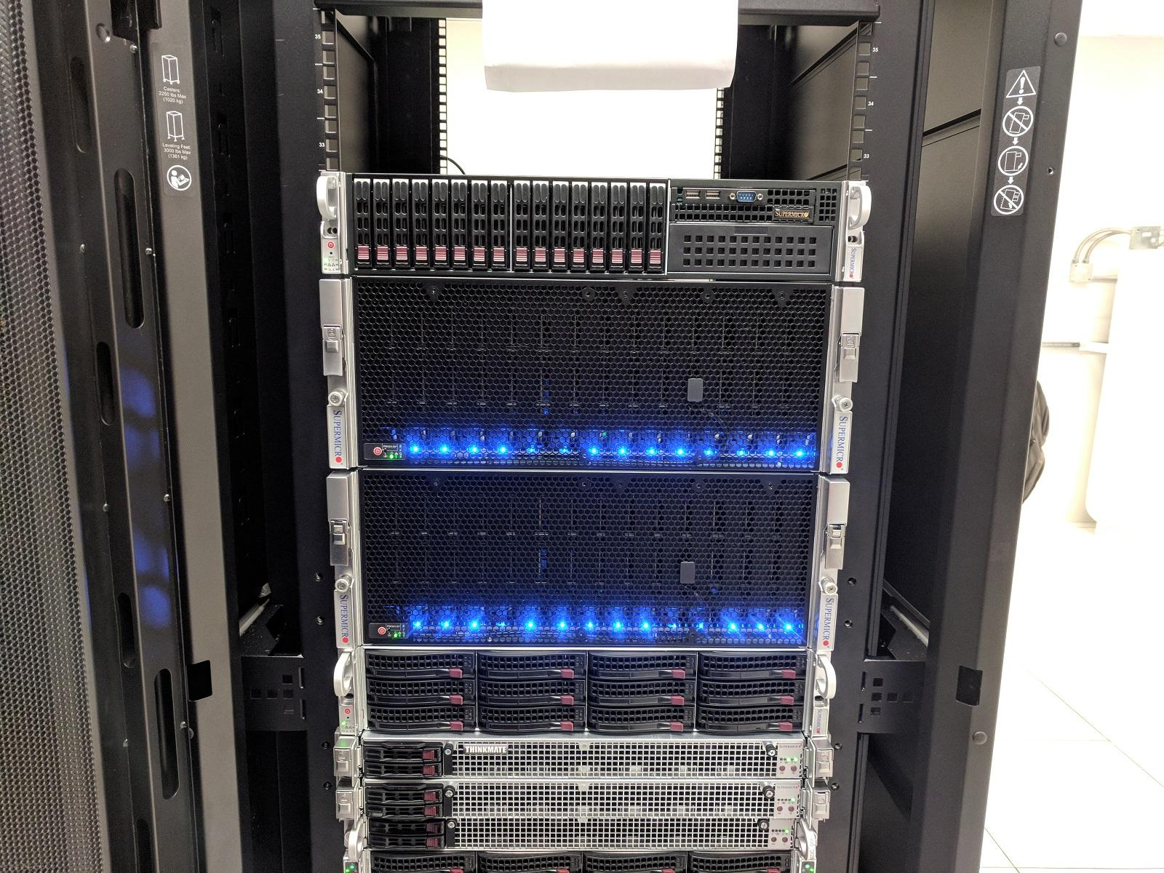
What is The Neuronix Cluster?
High Performance Computing (HPC) cluster on Temple campus
Nodes consist of CPUs, GPUs
Four 16-core AMD CPUs (x86 Arch)
Each machine has 256gb RAM
Five GPU nodes
GTX 980Ti, GTX 1070, Tesla P40, RTX 2080, A40
Nodes targeted by scheduler software ‘Slurm’
Notes:
-Most cluster computing you’re exposed to is cloud computing
which is meant for things like hosting websites, microservices
aws, google cloud, software development, ect
-High performance computers on the other hand are used for super computing.
-The massive computational power is used for things such as
creating simulations and artificial intelligience.
-So? ... Where does all this power come from?
-Well ... The Neuronix cluster has 4 CPU and 4 GPU nodes
-All Eight Nodes contain 256gb of RAM
-Each CPU node contains a 16-core AMD CPU
-The four GPU nodes on the other hand each have a different processor
containing 100s of cores which have a parallel architecture
allowing for high computaitonal performance.
-These nodes can work together without fail thanks to the scheduler slurm

Slide 3
How does the Neuronix cluster work?
Tasks are able to run on various nodes of the cluster scheduled by Slurm
Slurm allocates time and resources to run jobs across the nodes in parallel
Netdata used to monitor the CPUs in real time
NFS (Network File System)
ZFS is used for disk management
Notes:
-Now what is Slurm?
-Slurm is used to allocate time and resources to run jobs accross the various
nodes in parallel
-Using Slurm you can choose to target any node that is free, or specific
nodes, it is really up to the user
-Using slurm allows for jobs to be ran and queued with minimal waste of
computational resources
-Slurm also allows people to view their job's progress
-The Neuronix cluster also uses Netdata
-Netdata is used to monitor the different cluster nodes in real time
-Using Netdata you can check the GPU or CPU usage
-you can check the current amount of in and out-bound data at
any given time
-You can check the current RAM usage and various other system metrics
-The way the cluster shares its files is using NFS or a network file sytem
-network file systems work by allowing administrators to share a portion
of a file system on a networked server to make is accessible to remote users
-The Neuronix cluster uses ZFS for disk management and works by
backing up thedata within a storage pool
-Anytime a bad data block is detected, ZFS fetches the correct data from the
storage pool, then copies and repairs the bad data

Slide 4
Why add an ARM? What’s the Difference?
ARM processors are a family of central processing units (CPUs) based on a reduced instruction set computer (RISC) architecture
Power efficient, application specific designs
ARM leases IP, does not build hardware
ARM is common in microcontrollers, embedded systems, but growing popularity in performance processing
Mac using ARM with proprietary m1 and m2 chips
ARM based Fugaku supercomputer
Notes:
-Now you may be wondering, why use an ARM processor
what advantages does it provide?
-Well unlike x86's CISC architechure ARM uses RISC architecture.
RISC is more power effcient and supports application specific design
-This means ARM processpors can be designed to complete a specific
task very quickly and power efficent
-Another reason we are considering ARM is becausue it is becoming much more
popular.
-They are growing in popularity becuase ARM chips are quickly becoming
competitive with x86 processors.
So much so that
-Macs are starting to use ARM processors with their latest M1 and M2 chips.
-Also the Fugaku supercomputer, the current second fastest computer in the
world uses ARM architechture.
-Not to mention they are in almost every smartphone,
many laptops and other small devices

Slide 5
Problem Statement
Integrate an ARM processor into an x86 based cluster computer for performance testing and practical computation.
x86 and ARM processors are not cross compatible
Operating systems, programs are architecture dependent
So how do we implement the node?
What hardware means will we integrate the ARM node?
ARM processors have seen more recent use in performance computing and Neuronix could greatly benefit from their implementation.
Notes:
-What do we want to do with these ARMs ... well ...
-We want to integrate an ARM processor into the x86 cluster computer
for testing and computation
-We also want to do it in a way that does not sacrifice performance and
has minimal overhead
-However there is a problem
-The problem being x86 and ARM processors are not cross compatible.
-This is becuase operating systems and software are architecture dependent
-it is impossible for an OS or program to be cross compatible without
virtualization
-The problem with virualiztion being it is slow and defeats the
purpose of the high performance computing
-With all of this recent usage of ARM processors
the Neuronix cluster could defenetly benefit from thier implimentation

Slide 6
The Challenge
Integrating ARM CPU on system run by x86-64 CPUs
Avoiding bottlenecks in data transfer/file sharing
Cross compiling, communication between new and existing nodes
Wrapping new computer into API for Slurm/job management
Notes:
Basically everything up there ^ needs to get cut down to a few words per bullet and the trimmed verbiage goes here

Slide 7
Proposed Solution
Use ZFS & NFS to share file system with rest of cluster
Implement ARM coprocessor on the Neuronix Cluster
Build cross-compilation toolchain to make ARM compatible executables
Write scripts to make ARM processor accessible to Slurm
Compare code performance between ARM processor and other nodes of the cluster:
Compare C/CUDA code runtime executing between AMD/ARM/GPU nodes
Compare python script runtime between types of nodes
Normalize time for RAM/Clock differences
Notes:
-dont totally discount containerization? Maaaybe mention FPGA? Or subcluster?

Slide 8
Hardware Constraints
Desired RAM: Minimum 4GB, Preferably >8GB
Interface:
Explored PCIE to plug into motherboard as peripheral
Explored purchasing compute module with hotswap compatible daughter boards
Explored baremetal processor with ethernet connection for sending instructions
Currently exploring standalone computer with network connection to mount NFS
No built in GPU (only comparing the CPU)
Desired Cores: Minimum 4, Preferably more
High clock speed desirable (current AMD nodes clock at 2.4 GHz, others at 1.7 GHz)

Slide 9
Project Epics and Milestones
Pick Board
Integrate node into the clusters API
Physically integrate board into the cluster
Perform market survey
Raspberry Pi prototyping
Purchase Target ARM CPU
Cross-compilation toolchain
Generate API commands
Pick desired specs
Pick Hardware Connection
Connect with cluster
Setup address within cluster
Integrate into SLURM

Slide 10
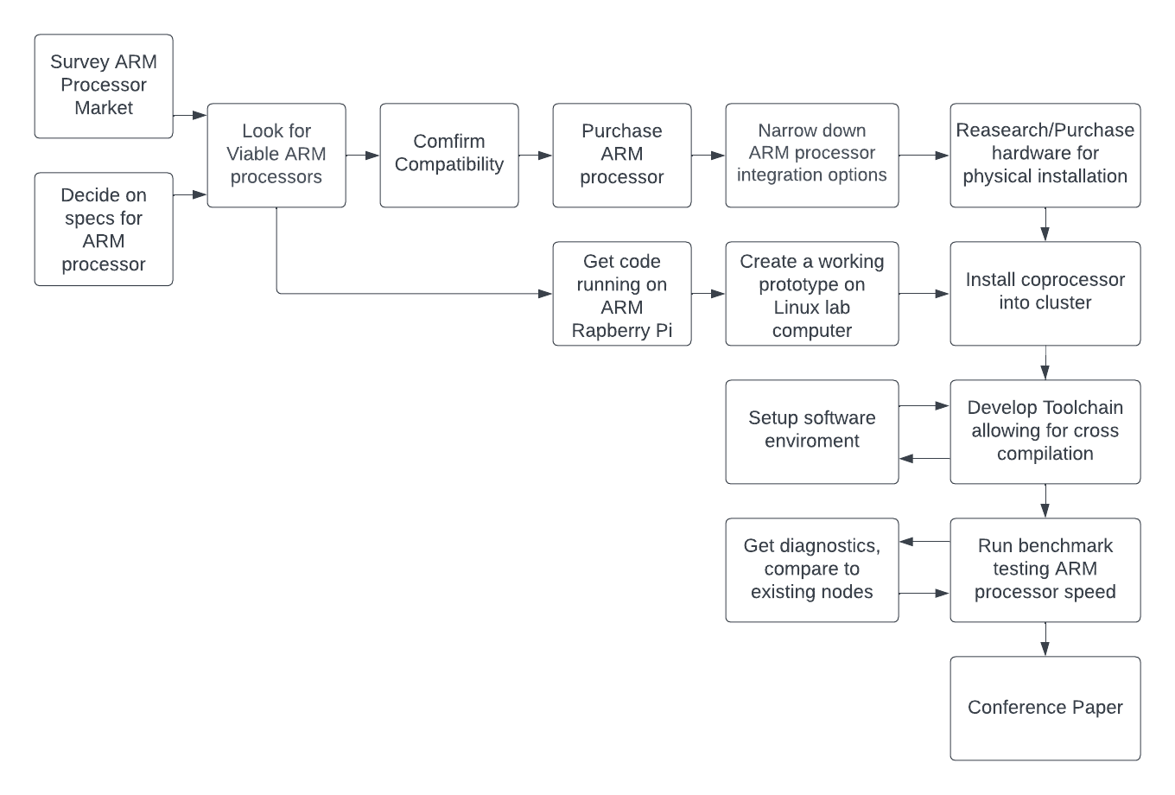
Project Flowchart
Notes:
Snapdragon, m2, super computers. X86 has dominated the major pc market but ARM is proving itself to be a powerful, efficient alternative

Slide 11
Accomplishments and Current Tasks
Operate SLURM, target nodes, run code on GPU’s, genuinely understand how Neuronix works ✅
Wrote C, Python programs and ran them on targeted CPU and GPU nodes
x86 Linux desktop NFS serving Raspberry Pi ✅
Desktop with Linux distro served Pi raspbian OS, file structure over ethernet. no SD card
Limited Bare-Metal Programming; ruled out as option ✅
Installed C program on Pi SD card to blink an LED without a true OS
Attempted this through NFS without SD card; ultimately proved unnecessary
Write Slurm scripts for x86->Pi
Incorporate Pi prototype to Neuronix

Slide 12
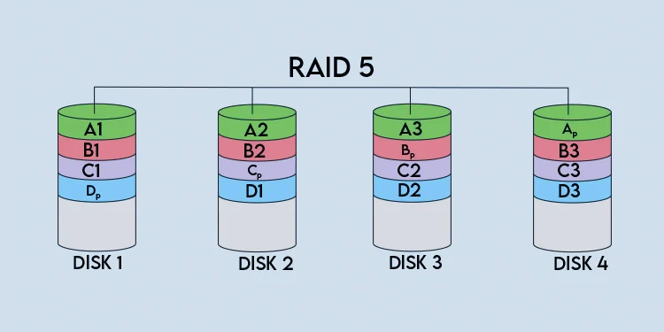
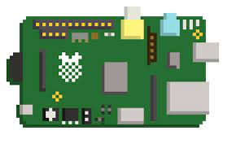
Shared File System
ZFS to create redundant file storage (Software implementation of RAID)
NFS to access files shared across all computers in cluster
Access binaries for execution from ARM processor through shared storage
Shared File System

Slide 13
Next Tasks and Final Design Goal
The Road Ahead
Write scripts to send jobs to pi with Slurm
Settle on choice for final hardware
Mounting Neuronix NFS onto pi/final ARM board
Finalize Hardware Selection
Compute modules connected through daughter boards
Single board computers (SBC’s)
NVIDIA DPU
Testing
Wide battery of bench testing with specific algorithms
Analyze results; do ARM’s handle memory tasks faster? Floating point arithmetic?
Power consumption/efficiency

Slide 14
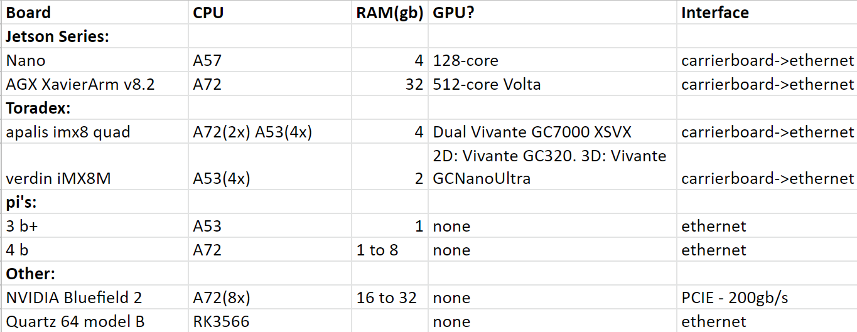
Hardware Choices

Slide 15
Questions?

Slide 16
_____Following Slides Used for Reference_____

Slide 17
Current Prototyping Strategy
Raspberry Pi:
Runs ARM Cortex A54’s
Connecting to test computer running Linux
Looking to mount shared file system to share binaries between computers
Learn file share protocols to communicate between nodes
BASH scripting
Notes:
Same note as slide 8

Slide 18
Accomplishments and Next Tasks
We have early stage proof-of-concept systems:
Linux desktop is NFS serving pi’s
Subcluster with selectable nodes, shared file structure
Some bare metal programming
Starting with shall we say limited understanding, we can operate SLURM, target nodes, run code on GPU’s, genuinely understand how Neuronix works
Now we get to build a mockup from the ground up what fun
The Road Ahead
Flesh out prototype
Settle on choice for final hardware (more on that soon)
Consider docker-style containerization
Develop bench tests
Notes:
Same note as slide 8

Slide 19
Final Design
Hardware
Compute modules connected through daughter boards
modular (hot swappable), can test different ARM variants
Single board computers (SBC’s)
Souped up pi’s; rock64, jetson series
NVIDIA DPU
Some of the best specs, but it costs an ARM and a leg. Purpose built to transfer huge amounts of datums. Not as customizable (probably)
Testing
Wide battery of bench testing with specific algorithms
Analyze results; do ARM’s handle memory tasks faster? Floating point arithmetic?
Power consumption/efficiency
Write a paper, break some ground, make a statement about multi-arch systems idk
Notes:
Same note as slide 8

Slide 20
Table of contents (for our needs)
Problem statement - what is the problem, why is it important
Background on arm, background on hpc/neuronix, talk about heterogeneous isa difficulty
Its important because ARM processors are proving themselves in the HPC world.
Its important because we aim to create a test environment where various ARM cpu’s can be benched against x86, GPU’s, app specific
Proposed solution (visuals, talk about prototype pi’s)
Nfs server, maybe a single processor node, maybe daughter board with hotswap
Make it expandable. Since arm needs its own version of the OS, why not subcluster?
Touch on fpga? You know i want to. containerization?
Milestones: pi prototype is basically working (lets really get ubuntu server nfs jawn)
Images images images
Engineering design evidence
Quantifiable prototype reqs:
Nfs delivers OS/filesystem to pi from x86
Move between nodes at will
Develop slurm/bash commands to automatically run programs on arm without switching nodes?
Why are these our reqs? Basically we want to emulate everything the neuronix is doing in the same software environment to prove the prototype and enable final integration
What tools/analysis/software? Ubuntu desktop, slurm, nfs, eventually run multi-core stress-test code to bench the processor. Does it do floating point slower, but data transfer faster? Can we measure power efficiencies? heat
Results
Rubric emphasizes visuals. Screen caps? Camera recording 2 screens?
That damn ethernet bare metal code will work and there will be a video of a damn led blinking so help me god. Then we’ll talk about why its a terrible idea. And not a waste of time at all.
Future work
Quantitative goals: have a structure with near 1:1 to the neuronix. Same NFS, same high level script/slurm commands.
Able to log in and out of arm/x86 nodes, send program to arm from x86, get it to return results
Reach: Acquire final board, test it in our prototyping environment. Prepare neuronix with necessary tools to host the arm. Host the arm

Slide 21
Links to cite
https://wiki.chipp.ch/twiki/bin/view/LCGTier2/ServiceLRMS
https://www.redhat.com/en/topics/linux/what-is-arm-processor
https://www.atatus.com/blog/arm-vs-intel-what-are-they-what-is-the-difference-between-them/#:~:text=Intel%20processors%20
Neuronix: A Low-Cost High Performance Cluster (piconepress.com)

