Slide 1
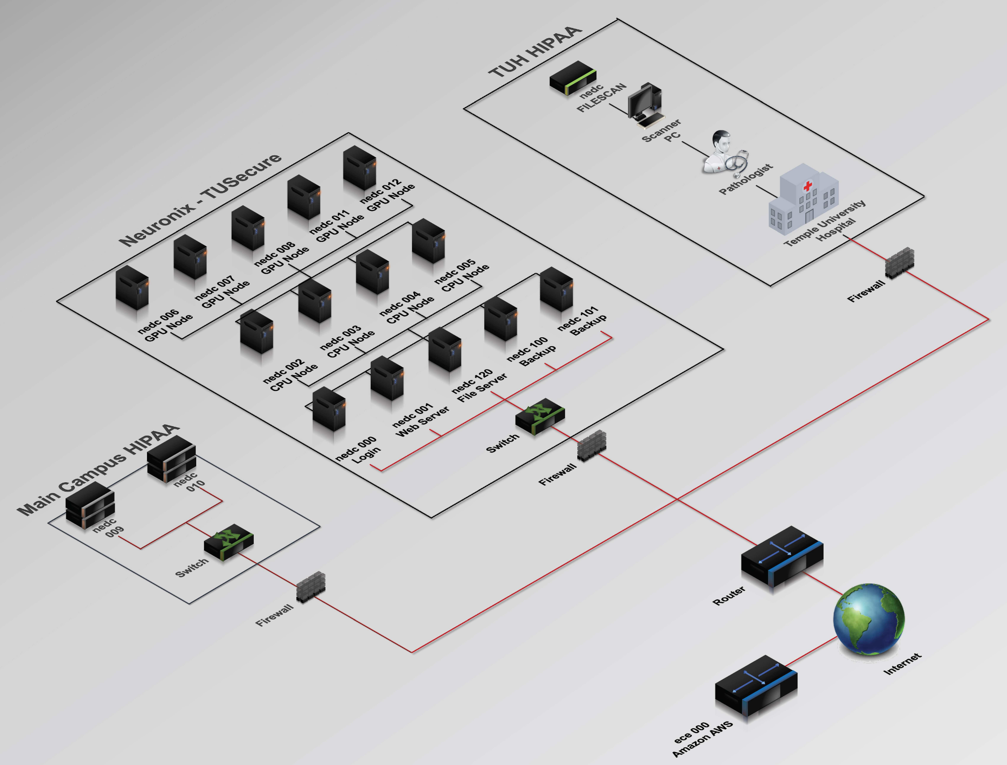
ARM Based Coprocessor
ARM Based Coprocessor
Colin Bakum, Ben High, Noah Antonio
Coordinator: Dr. Brian Thomson
Advisor: Dr. Joseph Picone
Team #2
Colin Bakum, Ben High, Noah Antonio
Coordinator: Dr. Brian Thomson
Advisor: Dr. Joseph Picone
Notes:
*need a graphic and explanation

Slide 2
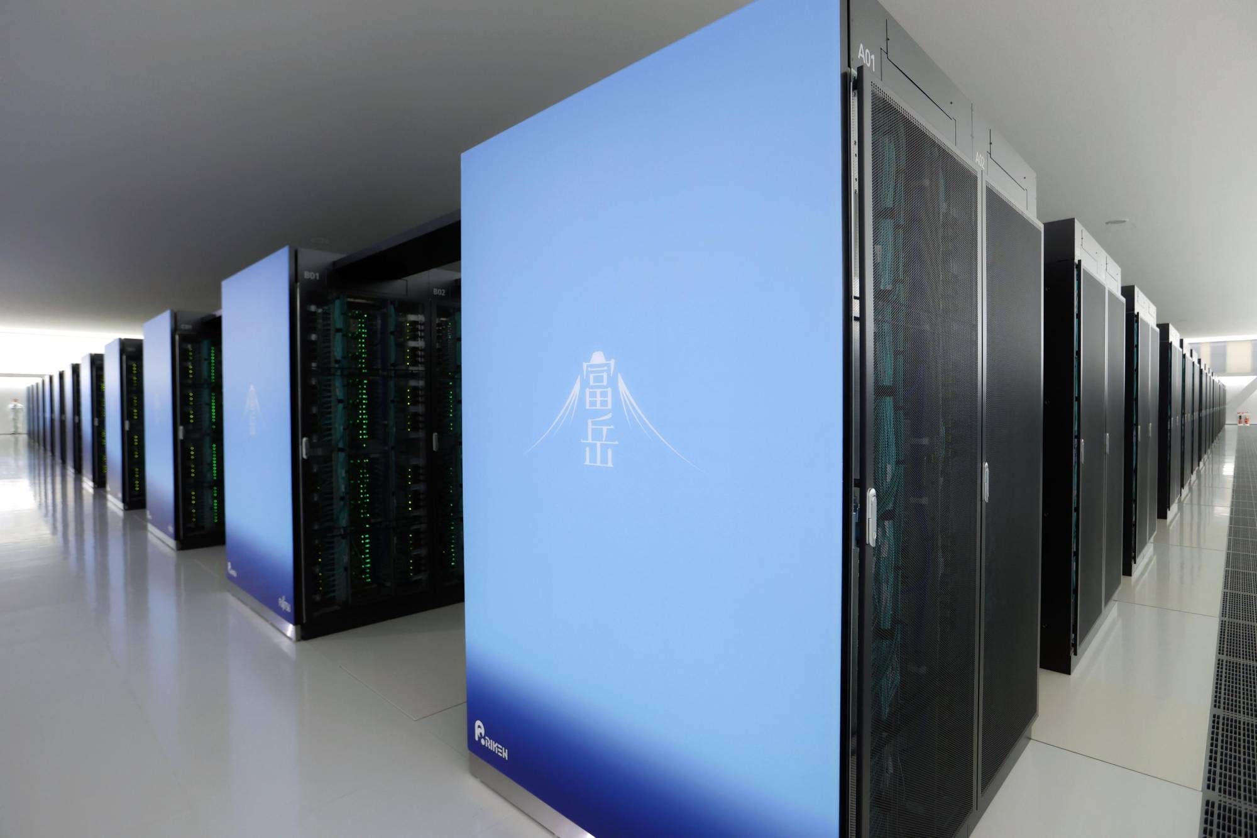
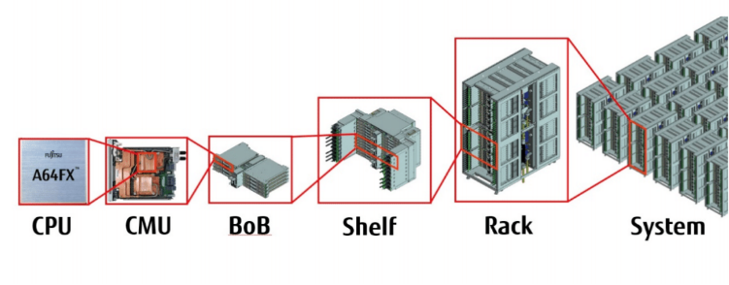
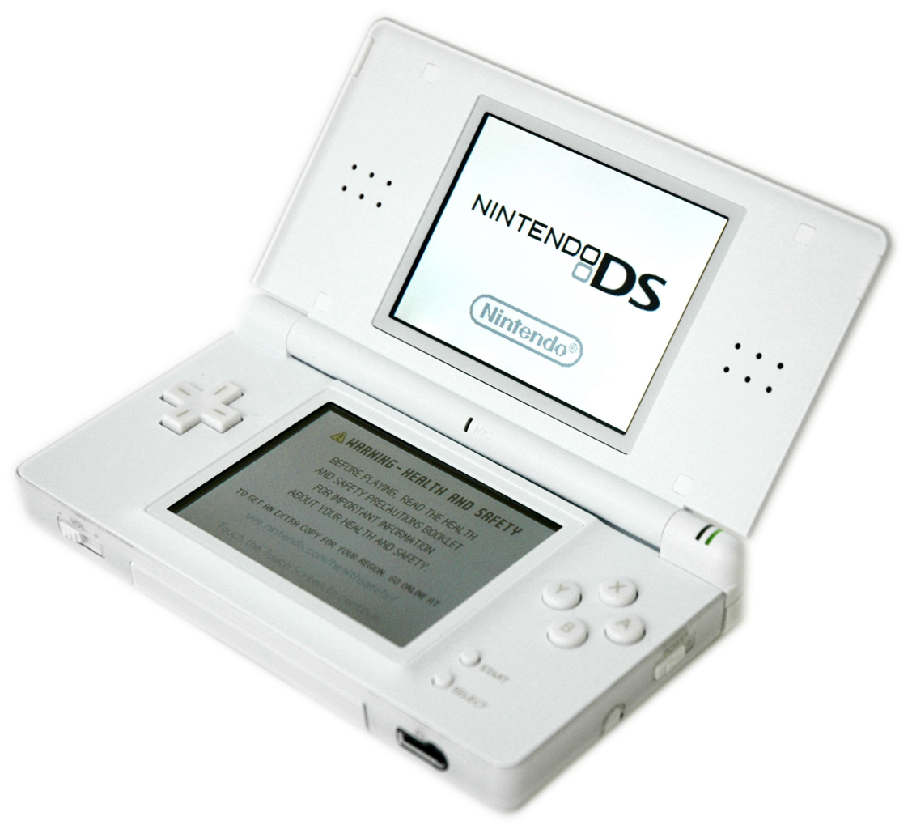
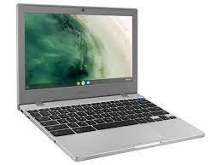
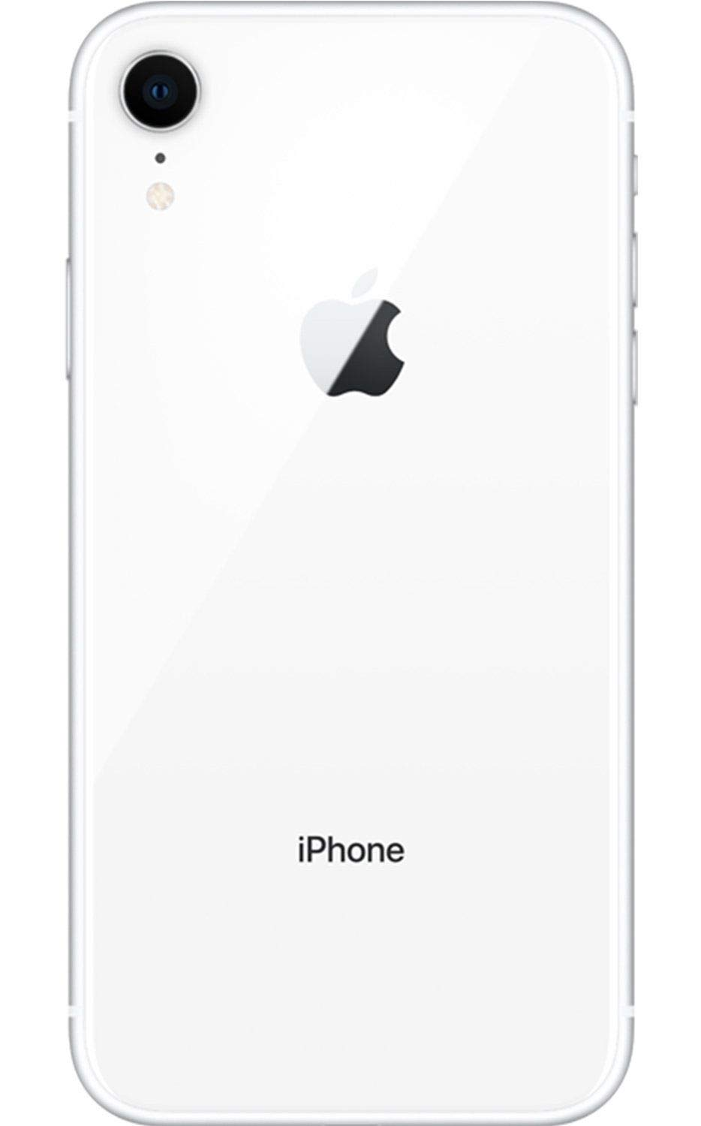
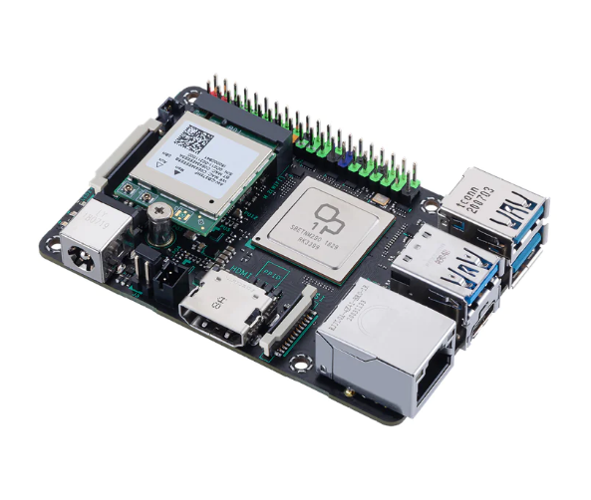
Problem Statement
ARM core processors are making advancements in high performance computing.
Increased adoption of ARMs is due to their reduced power consumption and increases in performance at the upper end of the market.
The suitability of ARM processors for applications in machine learning and artificial intelligence needs to be tested.
Emerging technologies require high speed, low cost computing
Why is it Important?
Notes:
Computing at the commercial and research levels takes a lot of time and power. Powerful ARM processors may be more time or power efficient at executing certain kinds of tasks in the fields of AI and machine learning. Testing is needed to evaluate these possibilities. In order to perform this testing we need an adequate testing environment, that is why we want to integrate an ARM processor into the Neuronix network.

Slide 3
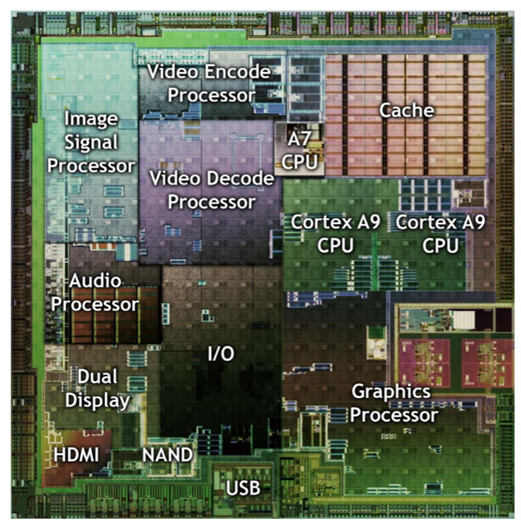
(Why is it Important cont.) ARM Power Consumption
Simplified instructions, standardized instruction size, minimal legacy instructions to support with hardware
RISC reduces die size and transistors for processing capabilities
Sleep capabilities, isolating clock from unused modules
Variable clock speeds available for IO ports
Notes:
*image should be arm, ideally heatmap
Flops, cost, power, volume. Energy density
https://en.wikipedia.org/wiki/Performance_per_watt

Slide 4
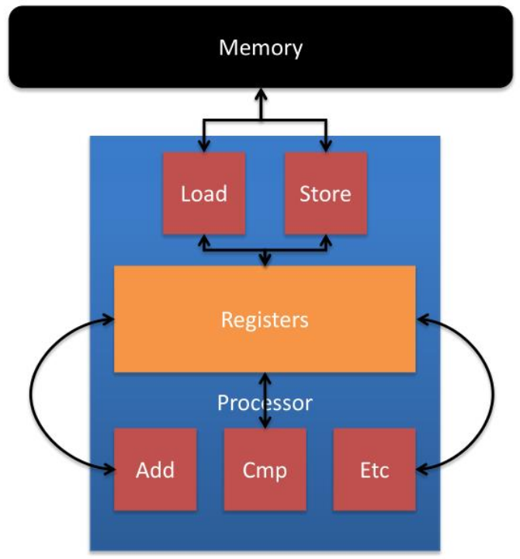
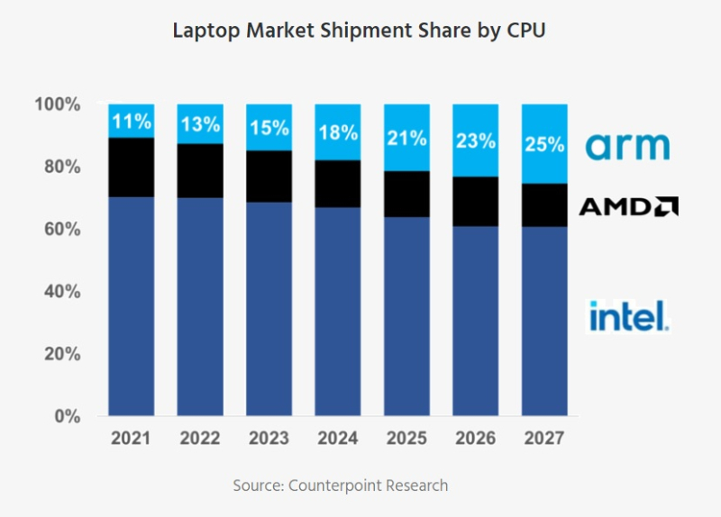
(Why is it Important cont.) ARM performance
Low latency, Quicker response time
Vanilla cortex series Ideal for embedded systems; Apple, Qualcomm and others expanding on architecture for more powerful computing
Load store architecture - RISC never works directly on memory
Notes:
*arm market share
load/store instructions take multiple cycles. ARM processors make use of higher number of registers to reduce need for L/S(not exactly)
*15:00 https://www.youtube.com/watch?v=AADZo73yrq4

Slide 5
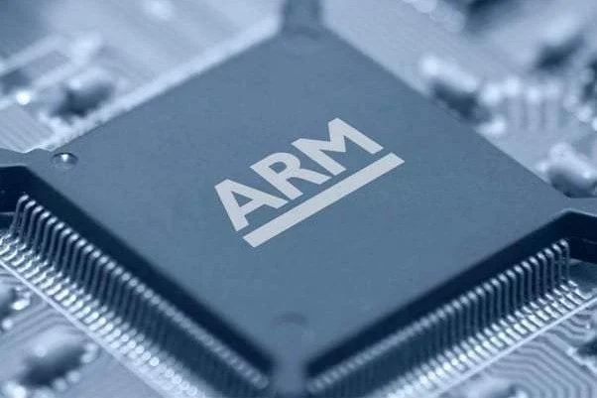
Proposed Solution

Slide 6
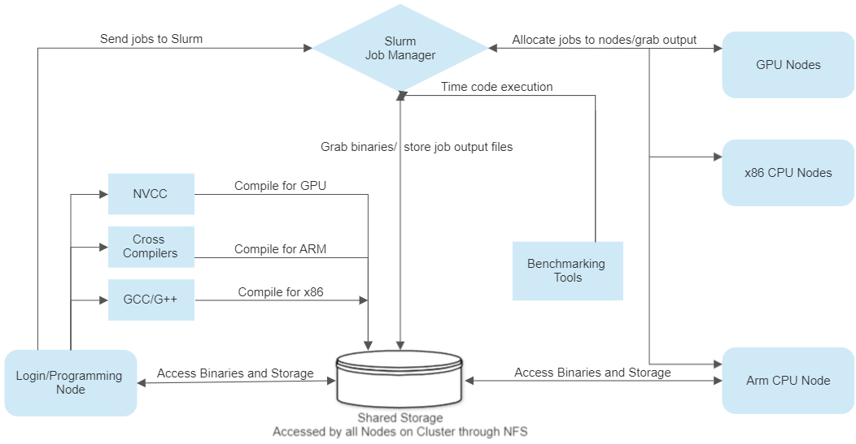
Proposed Solution

Slide 7
Milestones and Epics
We are here
Picking ARM processor
Integrate new node into Cluster’s API
Physical integration of ARM with cluster
Notes:
-m2 is the closest equivalent to modern desktop x86
-OS and Linux both based on unix
-integration via NFS over ethernet
-ssh tunneling reduces security concerns
*block diagram of system as opposed to process. Stylized diagram of cluster, how arm is incorporated
*mac mini is prototype, RU server is desirable goal depending on prototype outcome

Slide 8
Prototyping Requirements
Login node must be able to cross compile code
ARM node must be able to access cross compiled binaries
ARM node must have sufficient RAM and cores
Return outputs to login node
Compare runtimes of various tasks (floating point math, etc)
Quantified results in the form of bench test outputs
Tools: c/c++, python/anaconda, GNU-ARM cross compiler, runtime counters in program, NFS, SSH, Linux, Unix, ANSIBENCH, GPROF
Must be targetable by Slurm (must only pick for ARM compatible binaries)
Notes:
*talk with lucas about diskmounting, shared user profiles etc. Tasks can range greatly from basic benchmarks to advanced jobs

Slide 9
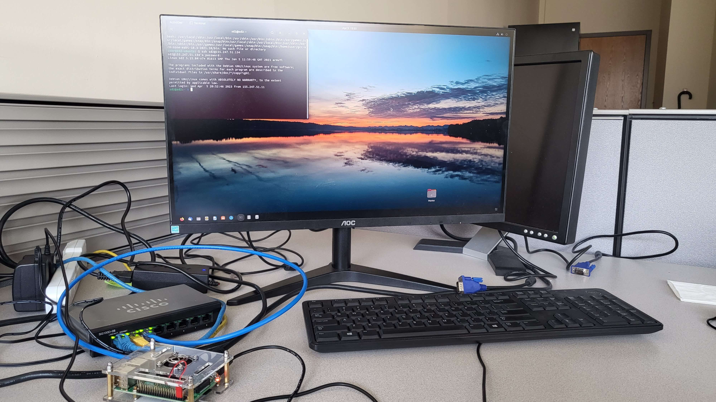
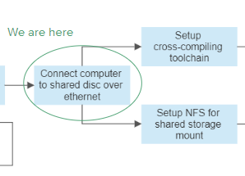
Pi-Based Prototyping
Physical integration of ARM with cluster
Notes:
To model the cluster, a Pi (running ARM Cortex A57) is connected to computer on Temple Campus by ethernet
Mounting a shared folder to access binaries
Cross-compilers installed for both C and C++
Remotely accessible by SSH chaining from the Neuronix cluster

Slide 10
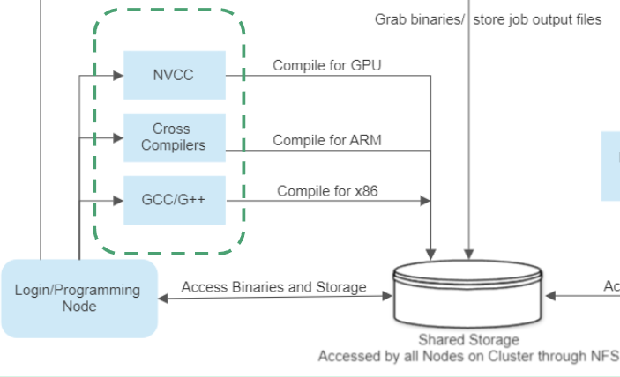
Prototyping Results

Slide 11
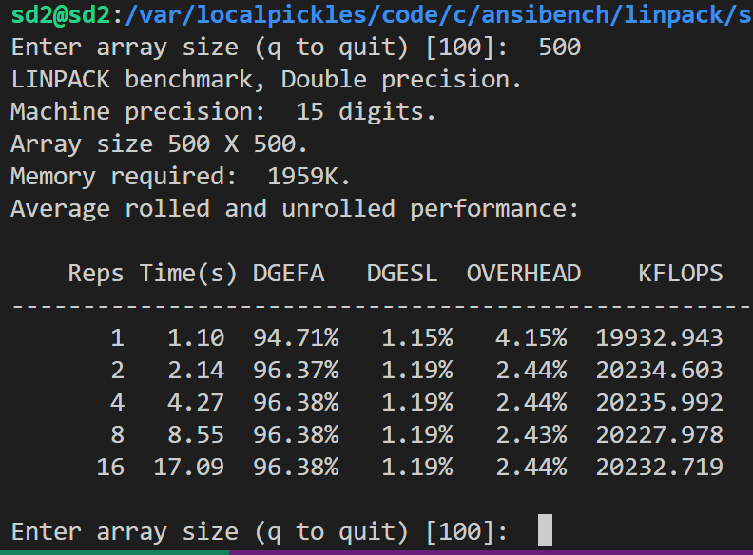
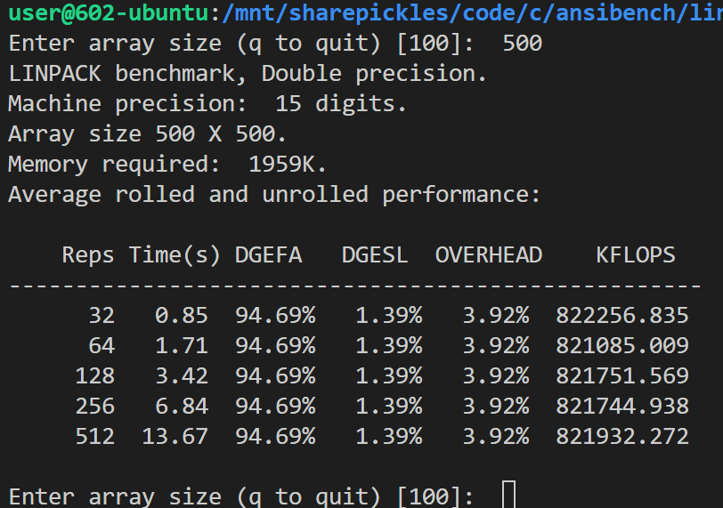
Early Benchmarking Results
Benchmark strategies/programs
Ansibench in C
Matrix Multiplication Testing
Raspberry Pi
Lab PC
Notes:
*benchmark things with data available. Spec marks, matrix multiplication. -> machine learning, start simple/standard (random forests, vector machines), progress to realtime eeg/c detection. Time to recognize patterns, time to train
*use native python timing. Understand pros/cons of algos

Slide 12
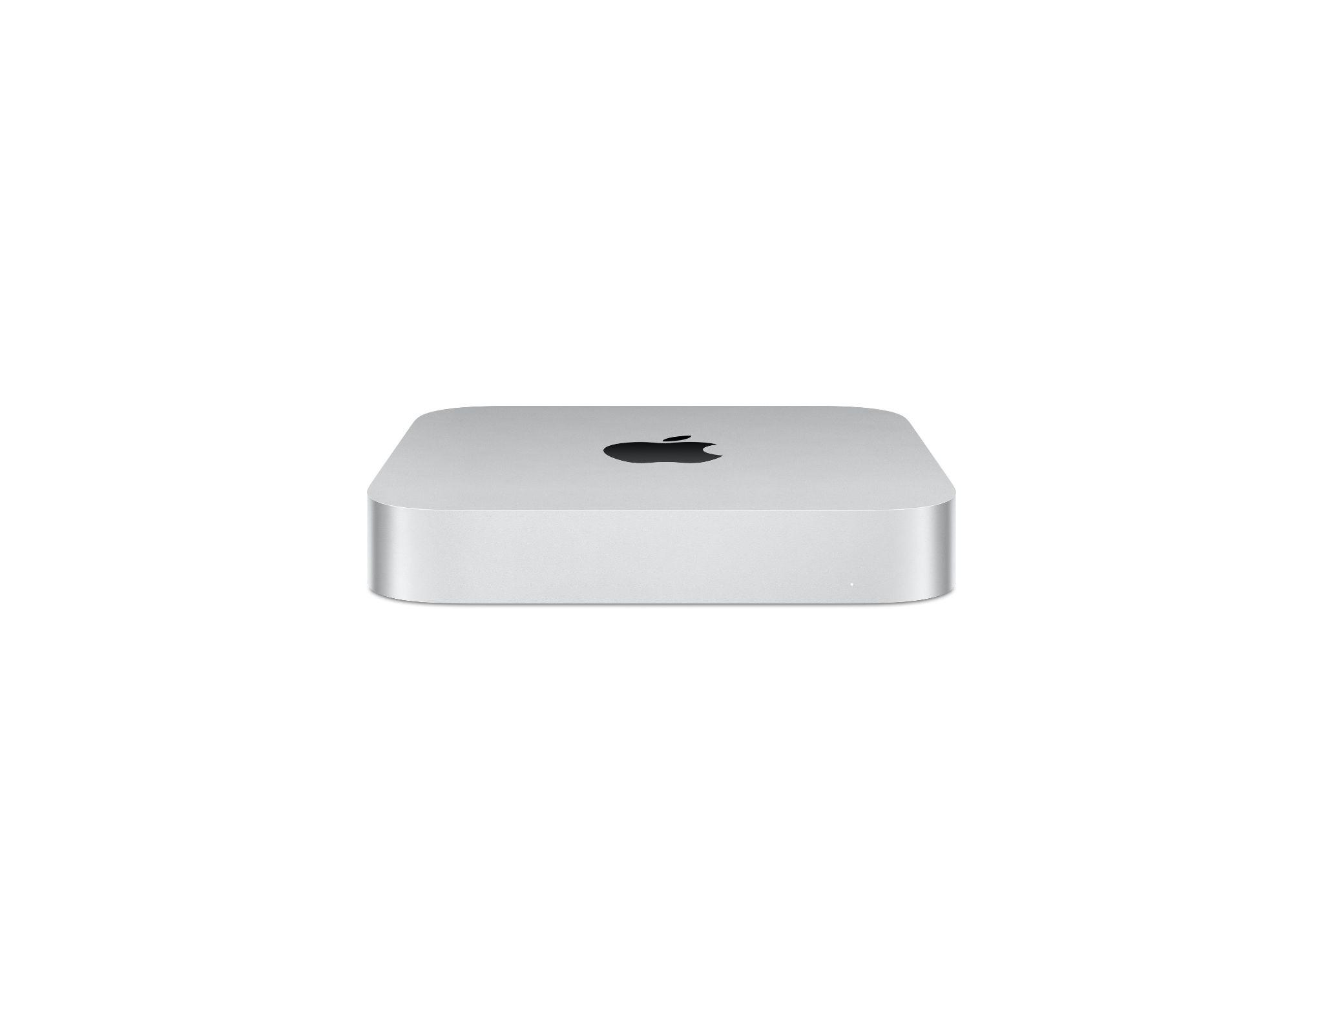
Mac-Based implementation
Unix based OS
ARM M2
8 core CPU, 10 core integrated GPU
2.42GHz
8GB RAM
1Gb/s ethernet
Mac is to be integrated into lab room prototype to build NFS, cross compiling, directory access toolchain. Then moved into neuronix
Notes:
-OS and Linux both based on unix
-integration via NFS over ethernet
Title including prototype
-ssh tunneling reduces security concerns

Slide 13
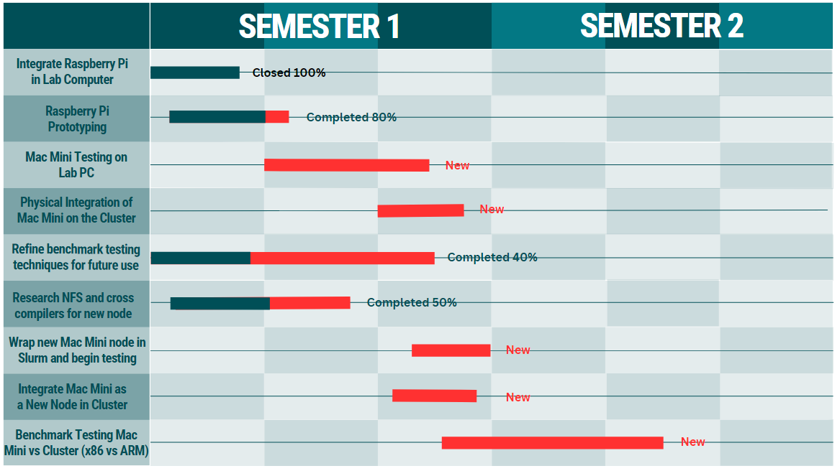
Project Timeline

Slide 14
Future Work
Implement Mac node on lab prototype
Gather proper cross-compilation toolchain to model Neuronix cluster
Binaries must be writable from login node/executable on ARM
Output must return to Lab computer
Attach Mac node to Neuronix Cluster
Wrap Mac into ISIP environment
Must be targetable by Slurm
Develop/write/present research paper on findings
Potentially add a high-powered rack mounted ARM node later.
Notes:
*evolution of arm architecture, platforms with cpus and gpus and the effects

Slide 15
Questions?

Slide 16
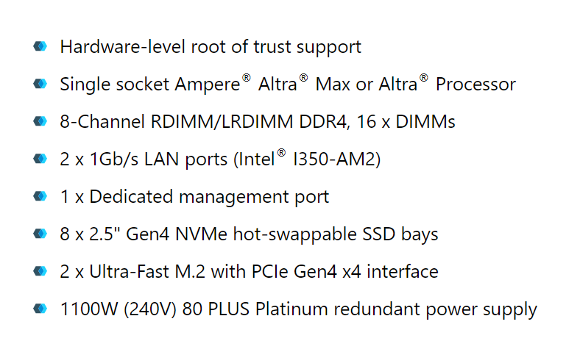
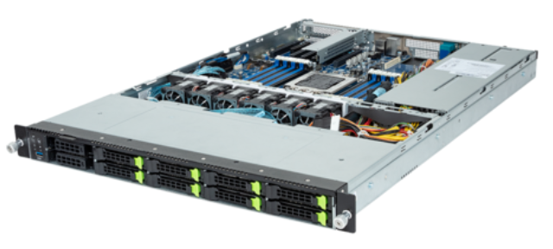
Slide Ideas
Why use an ARM processor
Are we interested in the ARM because they are cheap/low power or comparably fast
Power consumptions discussion
Scalability
Can be multiple slides if needed
How did we come to our hardware decision
Benchmark testing
Rack mounted arm server in the future? Talk to picone about it. Like this
Notes:
*talk about ru as future goal, dependent on results from mac mini

Slide 17
thoughts/notes/what we still need for this presentation
Clear benchmarking strategy
Exactly how/what directories are mounted (does each neuronix account need a copy on the mini?) (I think the accounts are on the local disk, nothing is actually on the mini)
Flesh out the gant chart (need Dr. Picone’s input)
Part of our issue with the last presentation was trying to be concise and clear with some of the lower level details. We need to get these complicated ideas across in a way that is detailed but understandable, avoid the weeds
Thus far the programs we compiled for arm are executing on the x86. We should look at the assembly and figure out why that is (QEM maybe?)
Amazon graviton is in aws
Fugaku uses scalable vector extension (SVE)
Notes:
*action items: Ben: matrix multi, tables
Noah: finalize gant chart
Colin: python results
Diagram of neuronix, intro slide
Get quality image of pi prototype

