Slide 1
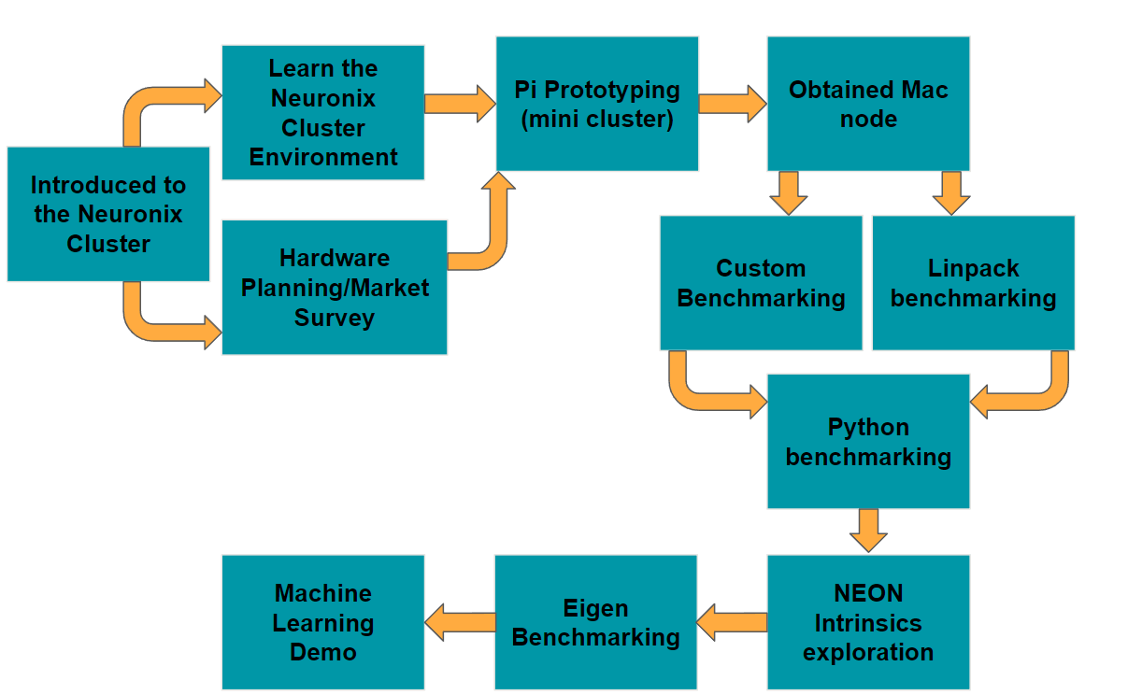
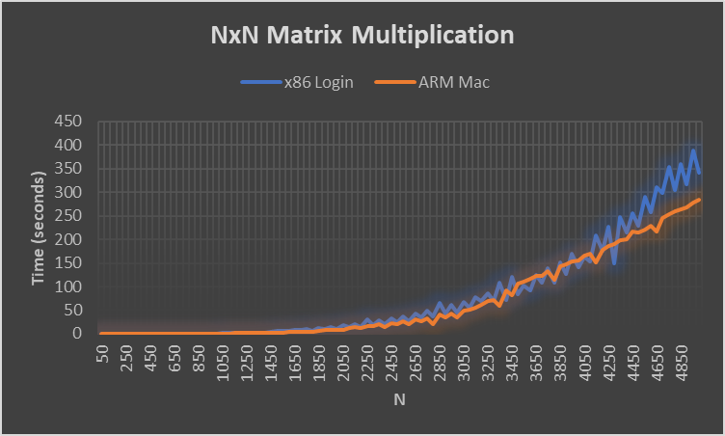
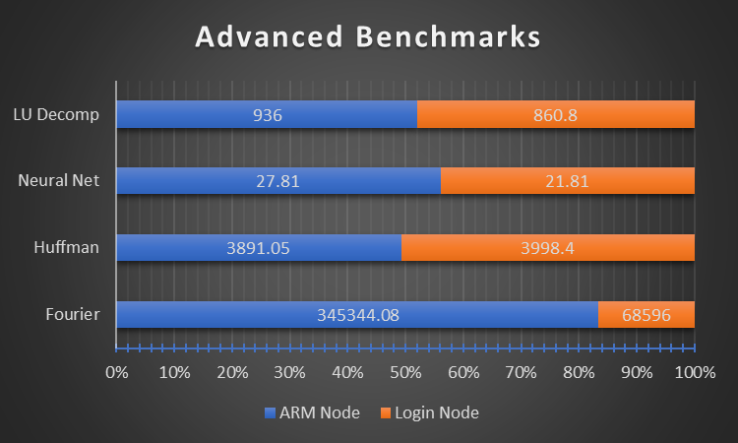
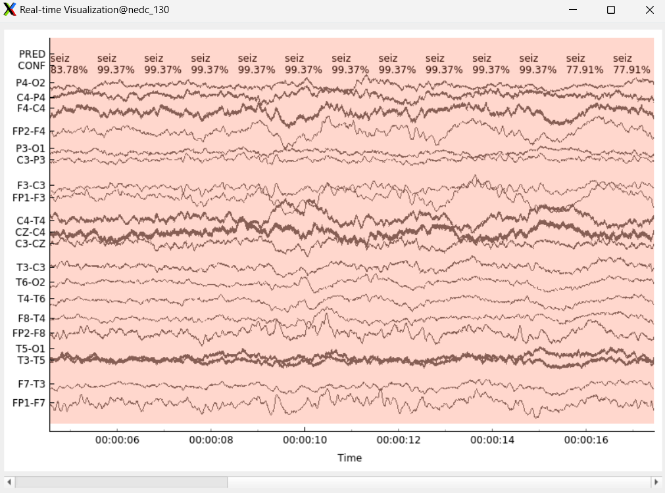
ARM-Based Coprocessor
B. High, C. Bakum, N. Antonio
Coordinator: Dr. Maryam Alibeik, Advisor: Dr. Joseph Picone
Temple University
Introduction/Problem Statement
The Reduced Instruction Set Computing (RISC) architecture of ARM core processors coupled with unique design features enable the devices to be more power efficient and cost effective than their x86-64 competition while maintaining comparable speed. As the demand for High Performance Computing (HPC) increases to handle AI training and cloud-based computing alongside the challenges of reducing greenhouse gas emissions, the efficacy of these processors and their implementation in existing x86-64-based systems must be validated. Our project succeeded in:
Deploying an ARM node in an x86-64 based HPC
Ensuring a seamless environment between architectures
Validating the processing capabilities of the ARM in the context of the multiarch system
Find ARM-specific hardware level optimizations for linear algebra operations
Design Approach
Design Criteria
Data Collection
Priority | Requirement | Target range
Non-negotiable | Accessible through Neuronix | Pass/fail
Non-negotiable | Execute python, c/c++ | Pass/Fail
Negotiable | Optimize programs for ARM | >1.50 performance gains
Negotiable | Automated test bench environment | Pass/Fail
Negotiable | ML demo runtime, benchmarks comparable to baseline | >0.80 Ideally >0.90
Testing Script:
Max Param
Output File
Write to File
Send Incrementing Parameters
Return Result
Test Results:
Plain Text
Easily Graph
Simple Benchmark
Benchmark Testing Results
Conclusions/Summary
ARM processors generally perform similarly to x86 processors with low level applications and simpler high-end applications
ARM processors slightly lag with exceedingly complex benchmarks
Some architectural advantages of ARM processors include power efficiency, simplicity, lower cost and hardware size
Code libraries, compilers, etc. specifically designed for ARM can enable far better performance commensurate with x86-64
ARM is proven to be a suitable platform for AI/ML capable embedded systems and high-power servers
Our system proves ARM can be integrated into existing x86-64 clusters and the overall viability of such multiarch environments
Benchmark Motivations
Comprehensive: Test basic operations up and down the scale of complexity
Simple: Test Single operations rather than system performance
Increased Complexity
Low | -- | -- | High
Dot Product | Eigenvalue Decomposition | DSP Downsampling | EEG ML System
Vector Multiplication | Matrix Inversion | Filtering
Matrix Multiplication
NxN matrix multiplication is a computationally intensive operation regularly used in graphics processing and AI training. By observing the associated figure, you will notice that the trend line for both processors remains comparable until the matrix size reaches a certain point. After which, the ARM node performs increasingly better.
The advanced benchmark tests contain four complex algorithms. The ARM node's performance in these tests vary from expected to exceptional. These tests are fundamental for machine learning (ML), meaning that ARM processors have potential in emerging technological fields such as AI development.
Eigen Tests
EEG Demo
Power Efficiency
Fewer Instructions: Requires less transistors to operate; thus lower power
-Less Legacy Support: Doesn’t have to support deprecated instructions
Test | Time (µs) | Normalized
AMD-Node (baseline) | 30533 | 1.00
Arm-Node (emulated) | 25840 | 4.50
Arm-Node (no NEON) | 39115 | 3.28
ARM-Node (NEON) | 21452 | 1.02
Arm-Node (clang w/ NEON) | 34656 | 1.66
The EEG seizure detection program is a complex machine learning algorithm that the team used as a benchmark. The input EEG data we will be using for this demo comes in the form of large .edf lists sampled from the Temple hospital. The ARM node had an average execution time 3.5% slower than the x86 node when clock speed is normalized. This falls well within the desired execution time parameters for this benchmark (within 20%).
Future Work
New iterations of ARM processors can benefit from custom IP
Compilers can be optimized to take better advantage of ARM's higher register counts and NEON
Python libraries can be built which take better advantage of NEON and register count
Microsoft has announced Windows on ARM, custom ARM CPUs
ARM is making silicon, including 'Neoverse' cloud processors
X86-64 node:
200W TDP
8.33 W/Core
ARM node:
20W TDP
2.5 W/Core
Template Library allows for easy access to NEON intrinsics while maintaining code portability.
Eigen Test Power Comparison:
$$P_{e}= \frac{KFLOP}{W∗Hz}$$
Arm node showed 3.4x greater $P_{e}$ in Eigen Test
NEON Gains:
$$Gains=\frac{NoNeon_{results_{normal}}}{Neon_{results_{normal}}}=\frac{3.28}{1.02}=3.21×$$
EEG Demo Results | Repetitions | Average Time (sec)
ARM-Node Decoder | 40 | 20.825
X86-Node Decoder | 40 | 18.625

