Slide 1
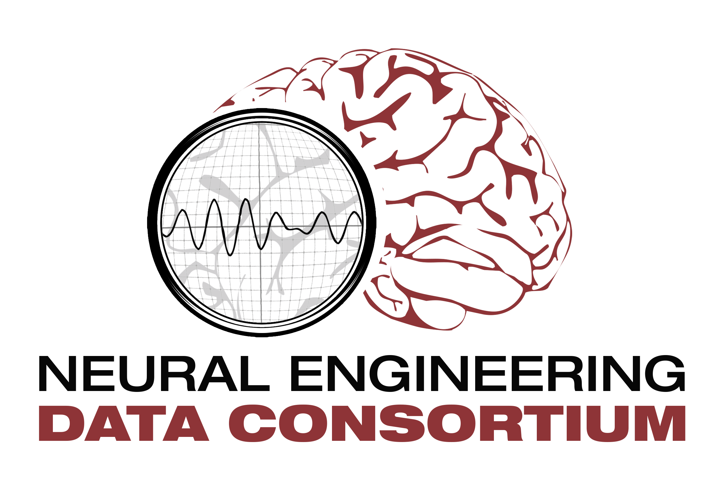
Neural Engineering Data Consortium
A. Hodgson
M. Jean-Pierre

Slide 2
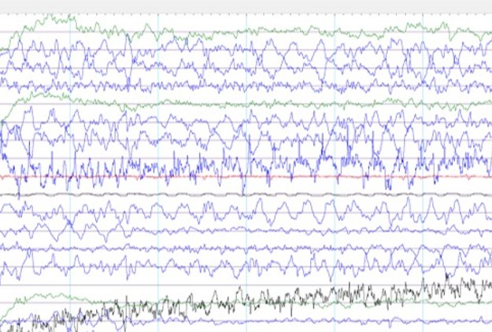
EEG research
Example of what EEG recordings look like:
Electroencephalograms or EEGs record the electrical activity along the scalp and measure spontaneous electrical activity of the brain.
EEG research is how we view/monitor the brain’s electrical activity.
It can be used to diagnose certain illnesses that evolve around the brain. Making EEGs essential for medical development.
Manual interpretation of EEGs is incredibly time consuming, as recordings can span hours or even days.
So in order to solve this problem, there have been several developments of automated interpretation of EEGs.

Slide 3
EEG research
In recent years there has been an increase in development of automated systems using machine learning.
However this has its own set of problems. Machine learning algorithms aren't always accurate and can misdiagnose someone, creating a false alarm.
For example if you were looking for dementia in patients, and you tested each of them using machine learning, the algorithm might show that 5 patients had dementia when in reality only 3 did.
This causes those two patients who didn’t have dementia to be prescribed medication they don’t need and could be harmful without that condition. It also makes properly diagnosing that much harder, which was the entire reason they went to the hospital in the first place.
Another problem is overwhelming healthcare staff. False alarms can quickly pile up and take up everyones time.
So even a relatively low rate of 1 false alarm per patient per day, makes that misdiagnosed person go down a rabbit hole to fix a condition they don’t even have, and wastes healthcare workers' time.

Slide 4
EEG research
In order to solve this issue, more development in machine learning is needed. The most important development being big data resources.
Big data is needed, as the more information you can feed machine learning algorithms, the more accurate they can be.
Now a significantly big data resource, known as the Temple University Hospital EEG Corpus (TUEG) is publicly available to use for machine learning.
While it doesn't solve every problem, having a publicly available resource as big as the TUEG lets several different algorithms develop at once, all using different angles.
This way problems like false alarms can be solved faster and more easily than if only Temple could work on it.

Slide 5
Seizure classification
Right now we're focusing specifically on seizures and their own issues in machine learning.
Seizures happen only a small fraction of the time in this type of data, and so we don't have as much information for algorithms to learn from.
This is the same problem noted earlier. Machine learning needs big data recourses in order to improve accuracy.
So the same solution was used, another corpus known as the Temple University Hospital EEG Seizure Detection Corpus (TUSZ) was made.
Another issue is that seizures are particularly hard to diagnose. As they build gradually and often lack discrete start and stop times.
In order to fix this issue, event-based and term-based annotations are included in the corpus.
This allows for two different views of seizure evolution and duration to be included, making it easier to spot.

Slide 6
Seizure classification
Benchmark test history of different machine learning algorithms
Since TUSZ consists entirely of clinical data, it has many real-world artifacts ( such as eye blinking, head movements, etc.).
While this information is helpful, it's extremely challenging for machine learning systems to map the data to underlying EEG signals.
However there are many different types of algorithms, with different strengths and weaknesses. Some of which have revolutionized fields like image and video recognition, medical image analysis, and natural language processing.

Slide 7
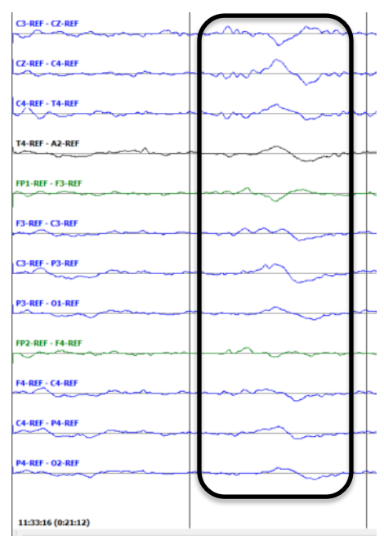
Seizure classification
The problem now is that many systems have lots of latency.
This is due to having to look over the same EEG signals multiple times in order to fully process the data.
One solution found to address this is to combine some aspects of different algorithms.
One of these algorithms classifies the EEG signals into three separate patterns.
These are things like the EEG recording spiking. It also classifies three background categories (the real-world artifacts).
This makes processing much easier as the programs can know what to look for.
An example of one of the patterns

Slide 8
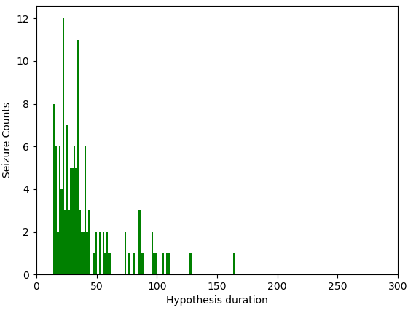
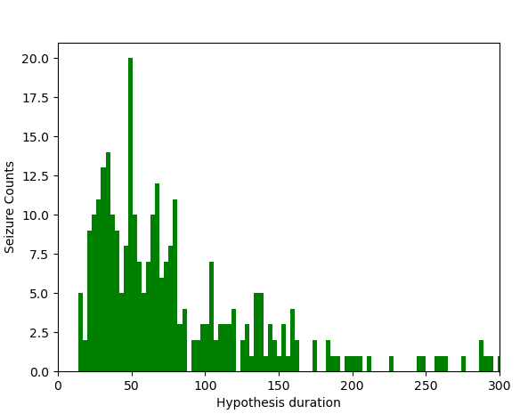
Seizure classification
The Sia system detects seizures which are mostly in the range of 15-40 seconds in duration.
The Sia system is very careful with over detection and performs well with mid-duration seizure events.
System: Sia
System: nedc
The nedc system detects seizures for durations as low as 4 seconds.
The nedc system provides more balanced performance across metrics whereas the Sia system performs better where time-alignment and partial overlaps are important.

Slide 9
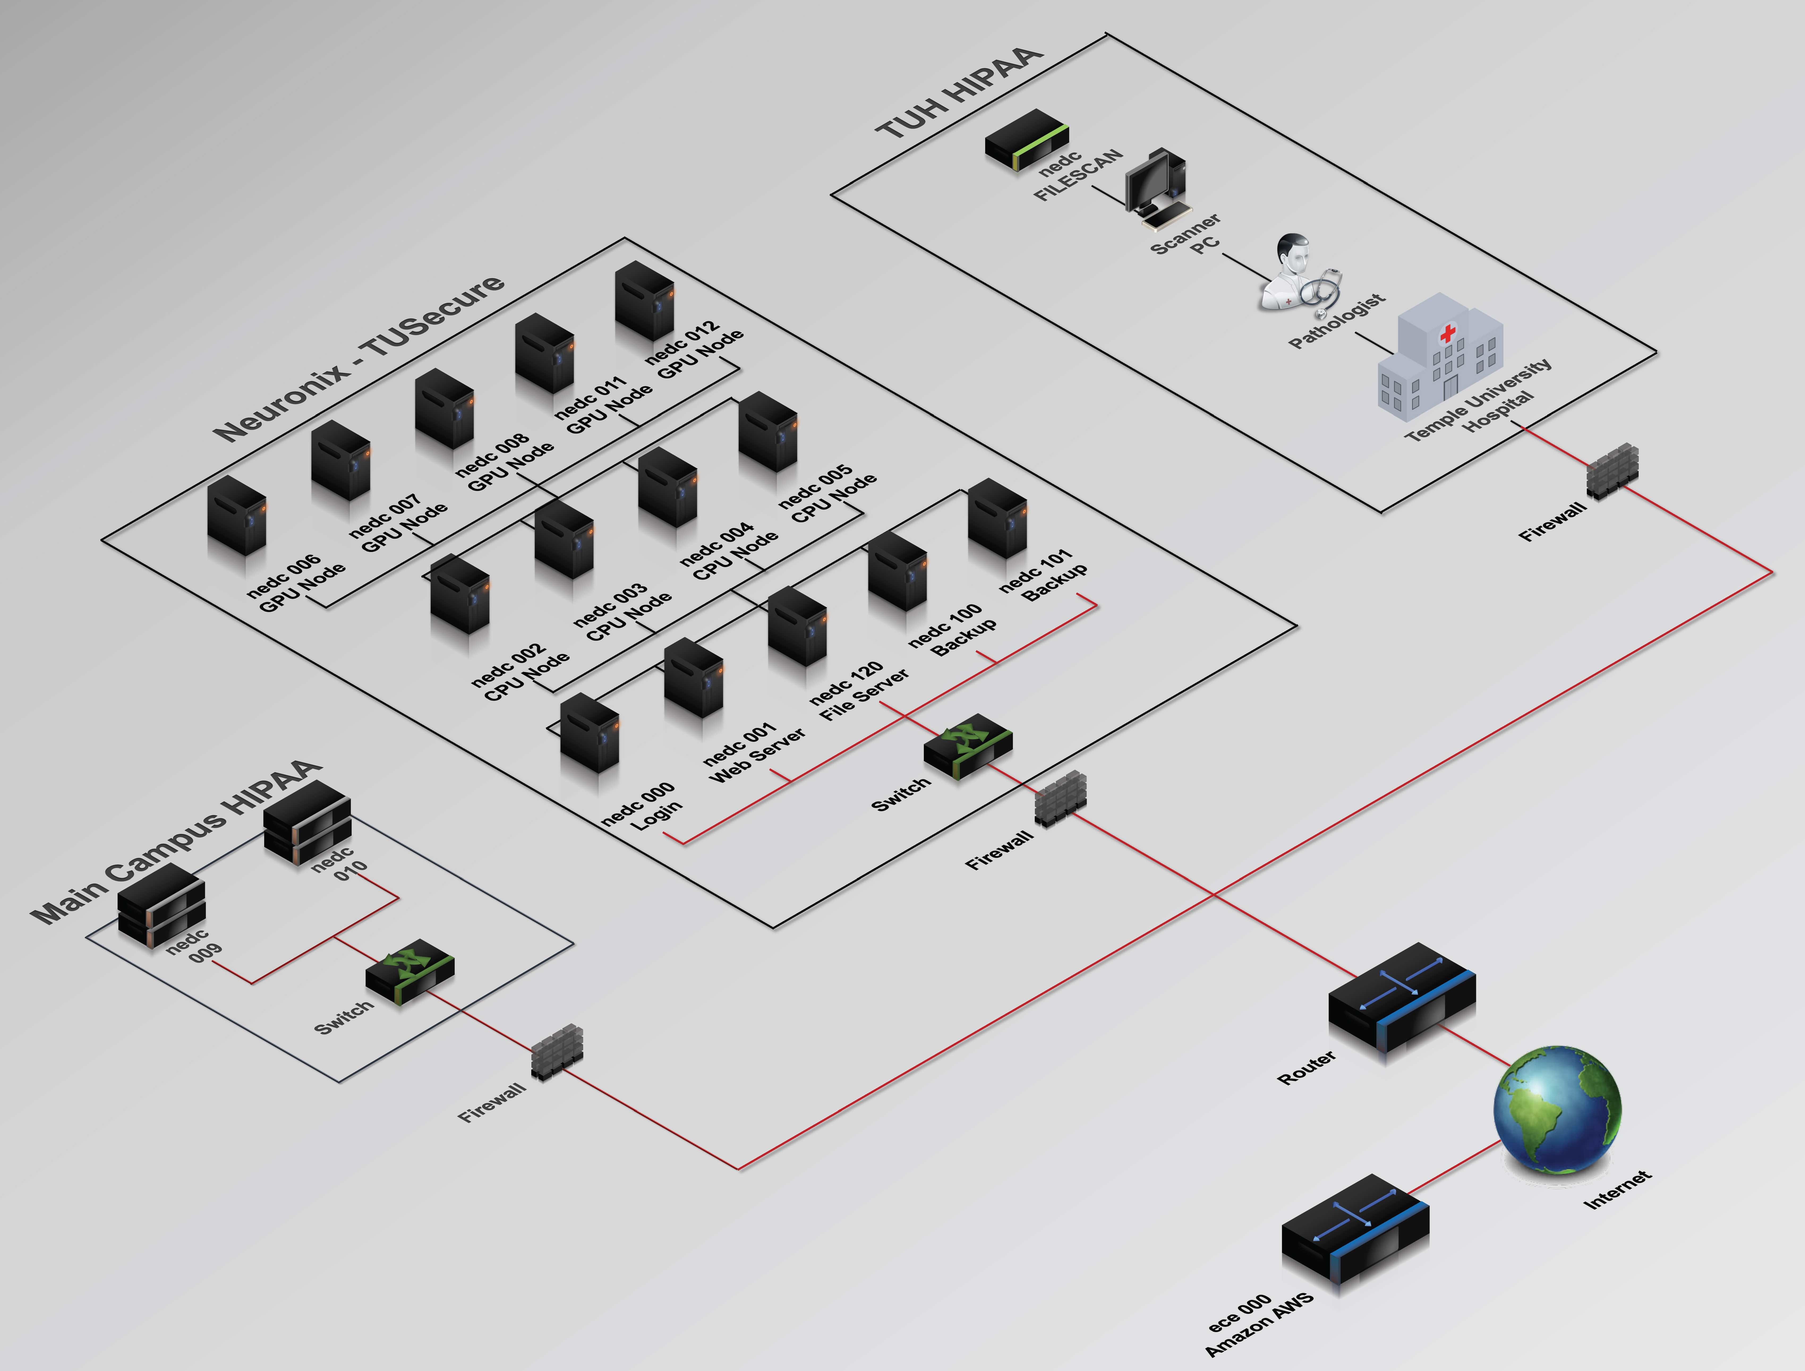
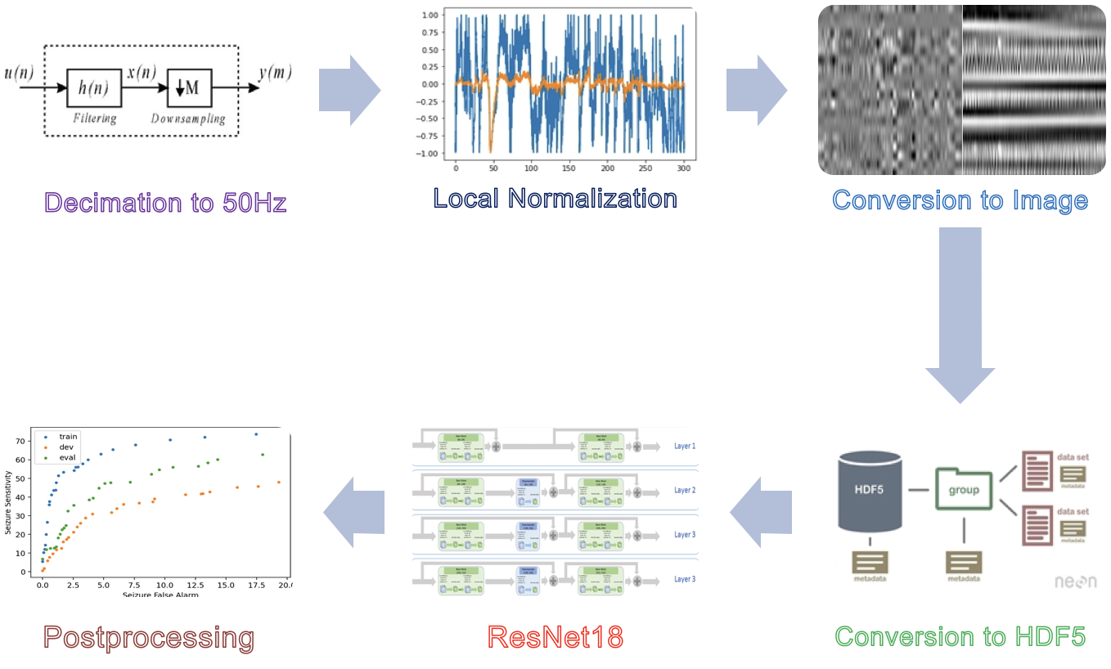
Current state
Image of the cluster
Right now temple runs on a computing cluster that connects the main campus, Neuronix and Temple University Hospital.
The system Temple has in place selects specific parts of EEG signals to analyze, it then converts it multiple times into files machine learning algorithms can understand.
The algorithm is then trained with the converted EEG signals and is checked with a reference list.
Finally all that data is converted into a graph that we can understand.
Diagram of the Temple system

Slide 10
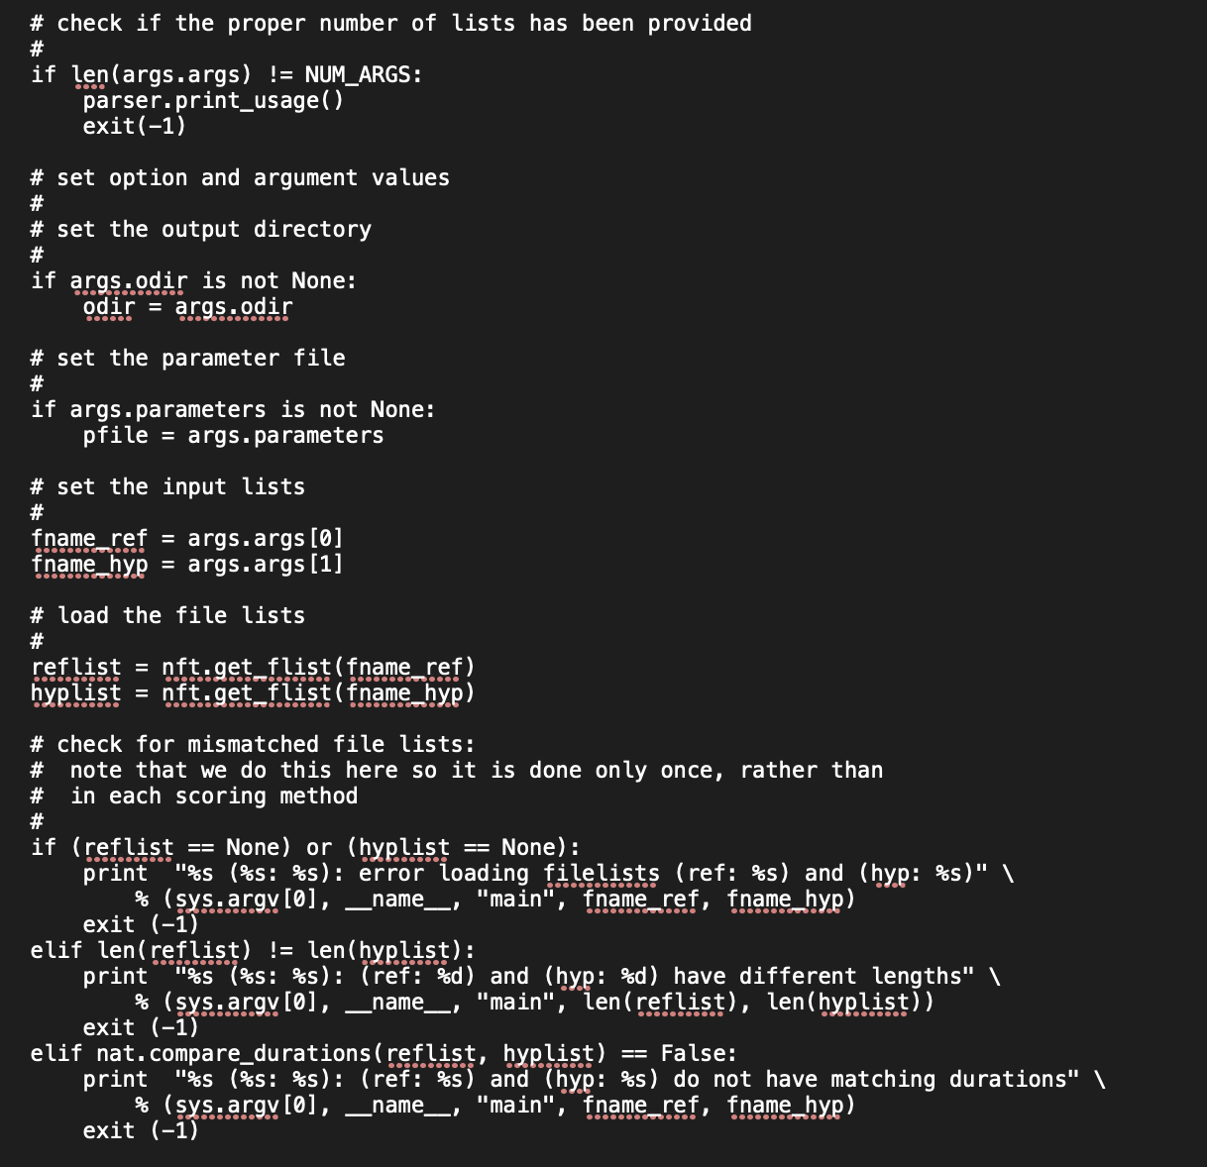
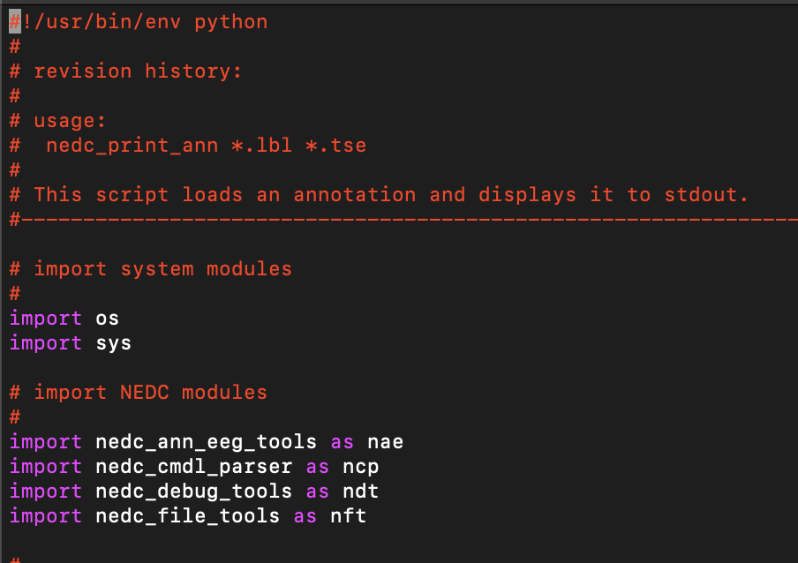
Python Coding
Now we are working on learning how these systems work as well as the programing language that lets it run, python.
Python is on of the best programming language for EEG research as it allows for easily imported code, intuitive commands, and isn't difficult to learn.

Slide 11
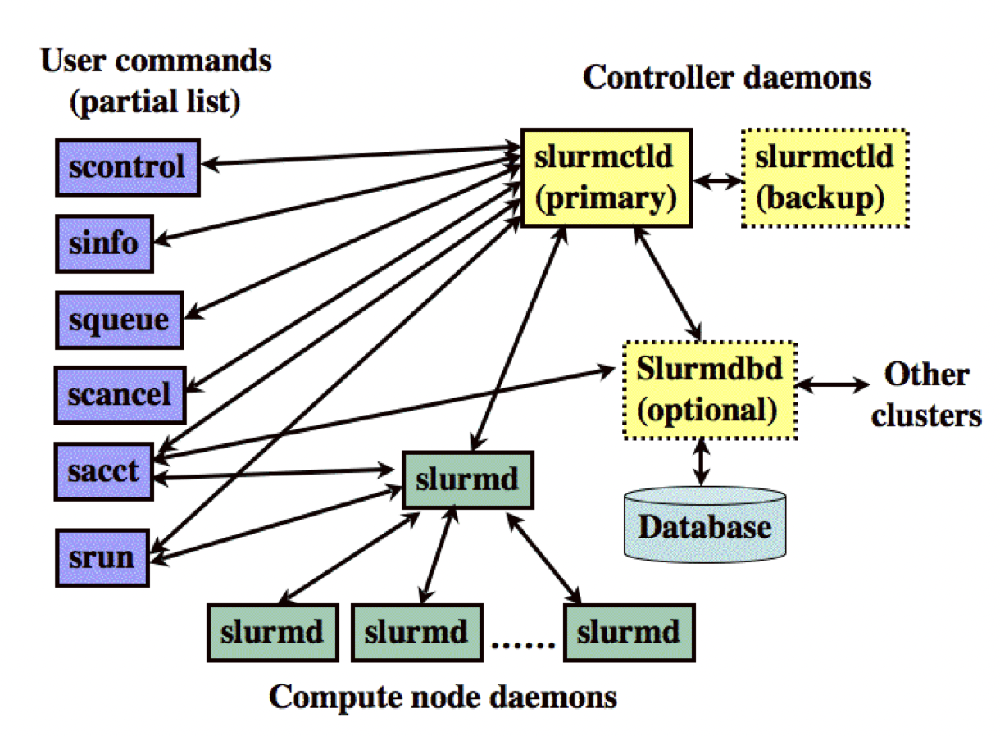
Python coding and personal experience
Python is a language of coding typically used for high-end programming. We started learning about basic programming like print, a form of IO. It allows us to “print” a statement when the code runs. There are 2 main types of Python (Python 2 and Python 3).
Slurm is an open source, fault-tolerant, and highly scalable cluster management and job scheduling system for large and small Linux clusters.
It wasn’t very hard to learn and implement coding. At first, it was a little frustrating because the small mistakes will give you errors but as time went on, the mistakes ceased and the outputs were on par with what as expected.

Slide 12
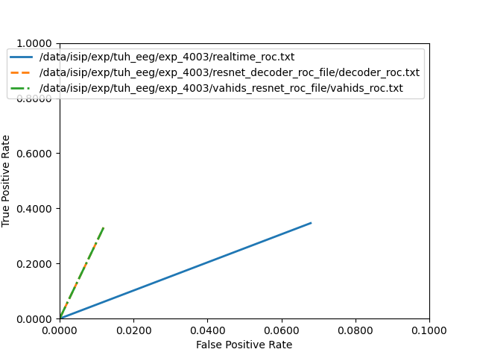
Python coding and personal experience
An example of EEG graphs
We were able to use the machine learning algorithm here at Temple.
This is mostly done by imputing different data sets into several different commands and converting the results
We unfortunately didn't get to spend a lot of time with it but we did get to decode a few files and run them through the system.

Slide 13
Reflecting on our experience
Overall I would say this internship has been a great experience and has made me want to do more in this field
It was tough at times, especially with decoding files for the system to run. However it felt very rewarding by the end
-Zander
The internship for me was a really good opportunity for me to grow my knowledge on the language of python.
Making errors and having to go back and make sure I didn’t add like an extra space or miss click on a key was frustrating but overall, it was worth it in the end.
-Micah

