Slide 1

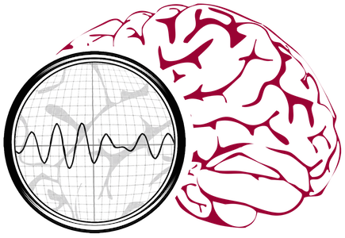
Machine Learning in Signal and Image Processing
Iyad Obeid, PhD
March 13, 2021
Temple University
Neural Engineering Data Consortium
iobeid@temple.edu

Slide 2
Machine Learning
Techniques for making statistical inferences from large, unwieldy data sets
Real world applicability
  Research vs Real world
More robust than simple regressions or heuristic methods
Data is everything

Slide 3
Data Silos
Hundreds of millions spent by NIH & NSF alone on “neural engineering” and “brain computer interfaces”
Significant additional investment from DARPA, military, state, international agencies
Over 1000’s of peer review journal papers
Conferences, book chapters, etc
Excellent academic output

Slide 4
Translation to Marketplace
Relatively little commercial technology development
Relatively little translation from well-controlled lab environments into general use
Signal processing isn’t sufficiently robust
  Insufficient training data
Lack of common benchmarks
  Need for community standards
Is there a better way of investing resources?

Slide 5
Neural Engineering Data Consortium
Focuses community on common problems
Drives algorithm development
Improves amount and quality of data
Validates performance claims
Promotes “technology that works”

Slide 6
Collaboration with TUH Neurology
Goal: Release 10’s of thousands of clinical EEG recordings from Temple University Hospital (2002 - present)
Includes physician EEG reports and patient medical histories
Released as free public resource

Slide 7
TUH-EEG Database
Task 1: Software Infrastructure and Development
  convert data from proprietary formats to an open standard (EDF)
Task 2: Data Capture
  copy files from 1500+ CDs and DVDs
Task 3: Release Generation
  De-identify data
  Resolve physician reports and EEGs
  Clean up data

Slide 8
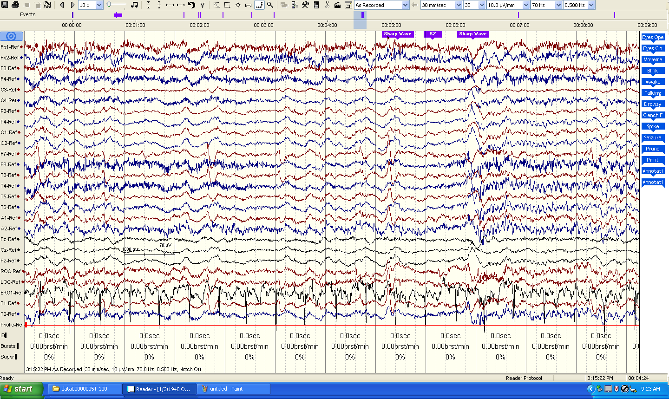
Task 1: Software and Infrastructure Development
Major Tasks:
Inventory the data (EEGs and physician reports)
Develop a process to convert data to an open format
Develop a process to deidentify the data
Gain necessary system accesses to the source forms of the reports
Status and Issues:
Efforts to automate .e to .edf conversion failed due to incompatibilities between Nicolet’s NicVue program and ‘hotkeys’ technology.
Accessing physician reports required access to 5 different hospital databases and cutting through lots of red tape (e.g., it took months to get access to the primary reporting system).
No automated methods for pulling reports from the back-end database.
EDF files were not “to spec” according to open source “EDFlib” so additional EDF conversion software had to be written.
Patient information appears in EDF annotations.

Slide 9
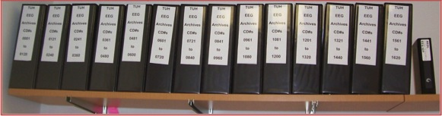
Task 2: Data Capture
Major Tasks:
Copy data from media to disk
Convert EEG files to EDF
Capture Physician Reports
Label Generation
Status and Issues:
22,000+ EEG sessions have been captured from 1570+ CDs/DVDs.
Approximately 15% of the media were defective and needed multiple reads or some form of repair.
Raw data occupies about 2 TBytes of space including video files.
Conversions to EDF averaged 1 file per minute with most of the time spent writing data to disk. The process generates three files: an EEG file in EDF format, an impedance report, and a test report that contains preliminary findings.
Multiple EDF files per session due to the way physicians annotate EEGs.

Slide 10
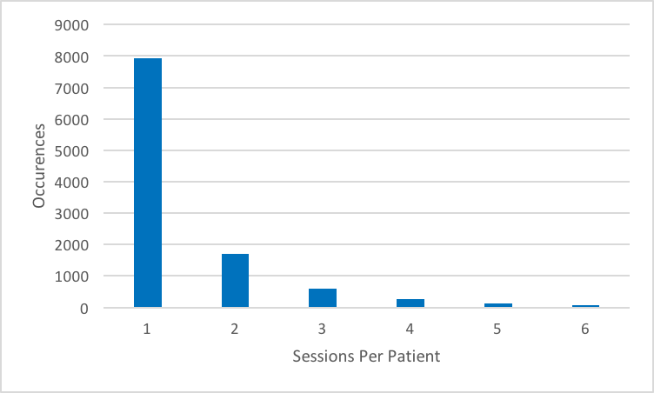
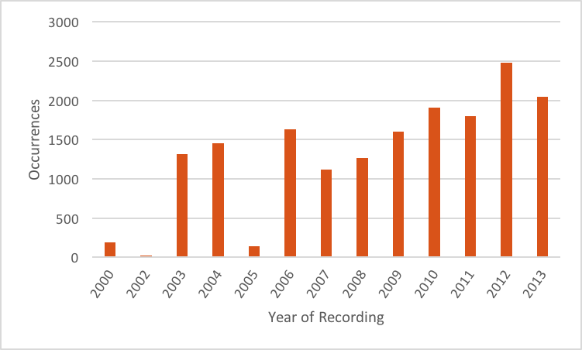
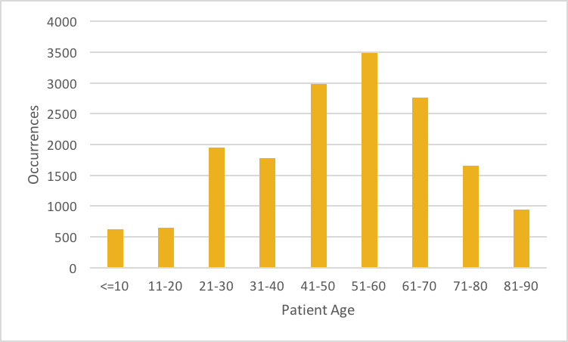
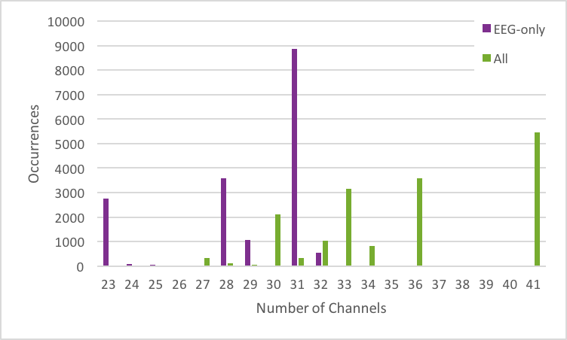
Task 2: TUH-EEG at a Glance
Obeid & Picone (2016) Frontiers in Neuroscience

Slide 11
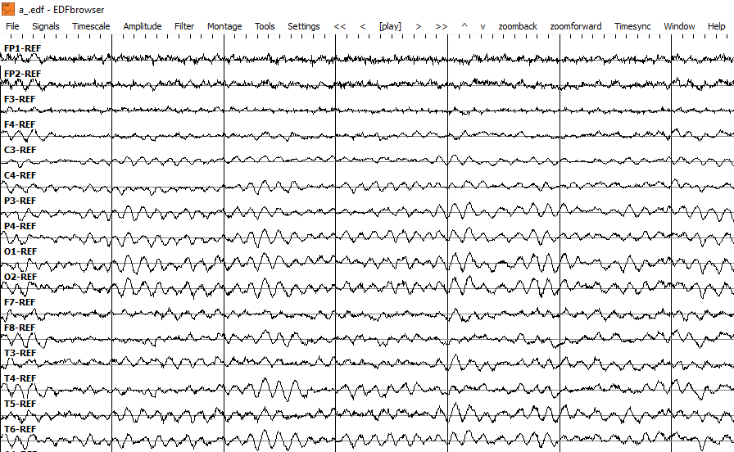
edf
001
00000001
s01_2011_11_01
a_.edf
002
00000002
s02_2011_11_11
00000003_s01.txt
003
00000003
CLINICAL HISTORY: 70 year old right handed woman with new onset nocturnal convulsive movements with foaming at the mouth, hypertension, and anxiety.
MEDICATIONS: Norvasc, Simvastatin, Nexium, Folate Acid.
INTRODUCTION: Digital video EEG was performed in lab using standard 10-20 system of electrode placement with 1 channel EKG. Hyperventilation and photic stimulation were completed.
DESCRIPTION OF THE RECORD: In wakefulness, the background EEG includes generous beta and an 11-Hz alpha rhythm. Hyperventilation produces an increase in amplitude of the background.

Slide 12
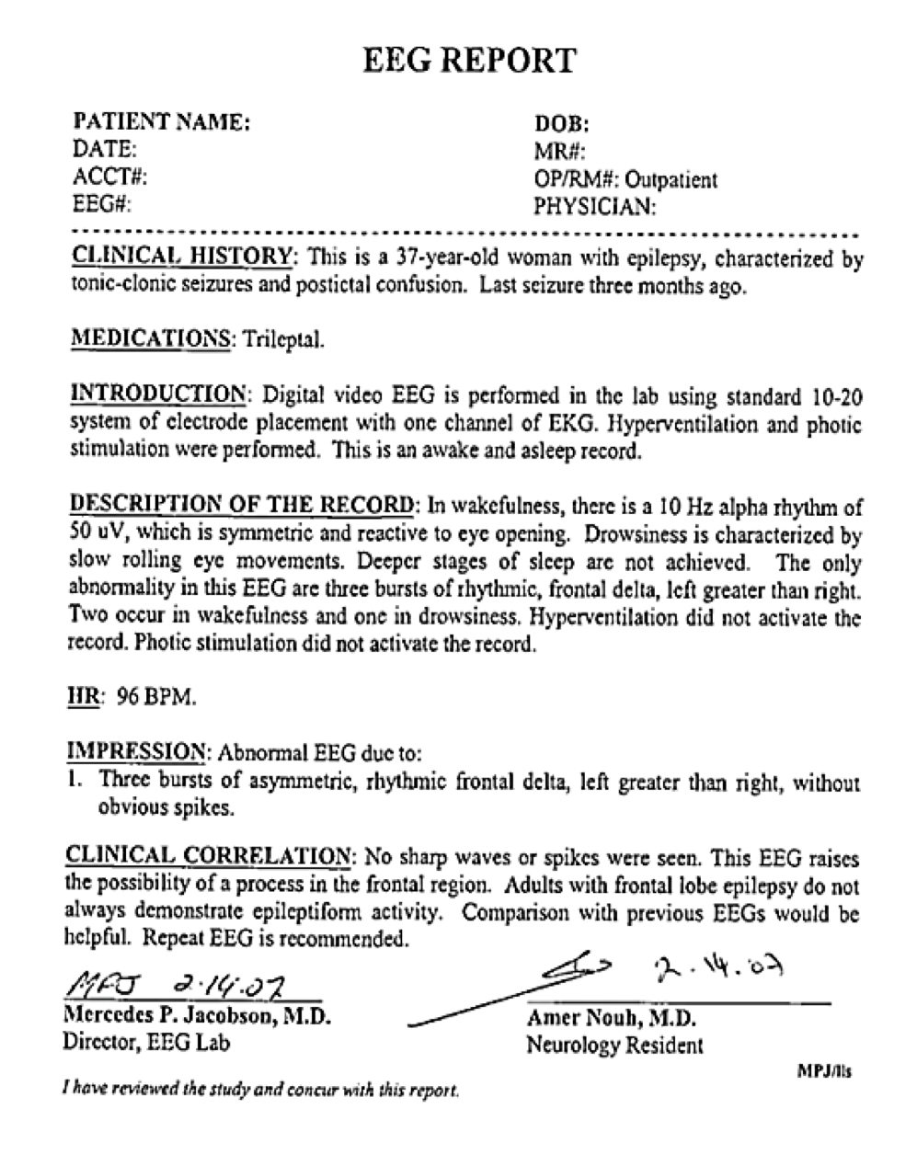
Task 2: Physician Reports
Two Types of Reports:
Preliminary Report: contains a summary diagnosis (usually in a spreadsheet format).
EEG Report: the final “signed off” report that triggers billing.
Inconsistent Report Formats: The format of reporting has changed several times over the past 12 years.
Report Databases:
MedQuist (MS Word .rtf)
Alpha (OCR’ed .pdf)
EPIC (text)
Physician’s Email (MS Word .doc)
Hardcopies (OCR’ed pdf)

Slide 13
Task 3: Release Generation
Major Tasks:
Deidentify and randomly sequence files so patient information can’t be traced.
Quality control to verify the integrity of the data.
Release data incrementally to the community for feedback.
Annotation – mark seizure start and stop times
  Primarily done by undergraduate students who are trained by MDs
  Student performance is excellent

Slide 14
Accomplishments and Results
~35,000+ EEG signals online and growing (about 3,000 per year).
Pilot release in 2014.
Data subsets have been released
  Seizure
  Abnormals
  Artifacts
Completely free and unencumbered
Tools
  Annotation tool
  Realtime seizure detection demo
  Matlab & Python
  EDF Browser
Kaggle-style seizure detection challenge
IBM
Results to be published in EBioMedicine (a Lancet publ.)

Slide 15
Observations
General:
Undergraduates! And Grad students!
This project would not have been possible without leveraging multiple funding sources.
Community interest is high, but willingness to fund is low.
  ~5,000 registered data users

Slide 16
Automatic Interpretation of EEGs
Use TUH-EEG big data resource to train machine learning systems for EEG interpretation
Assist neurologists (esp. w/ long rec’s)
Potentially missed diagnoses
Smaller regional hospitals lacking adequate neurology staff

Slide 17
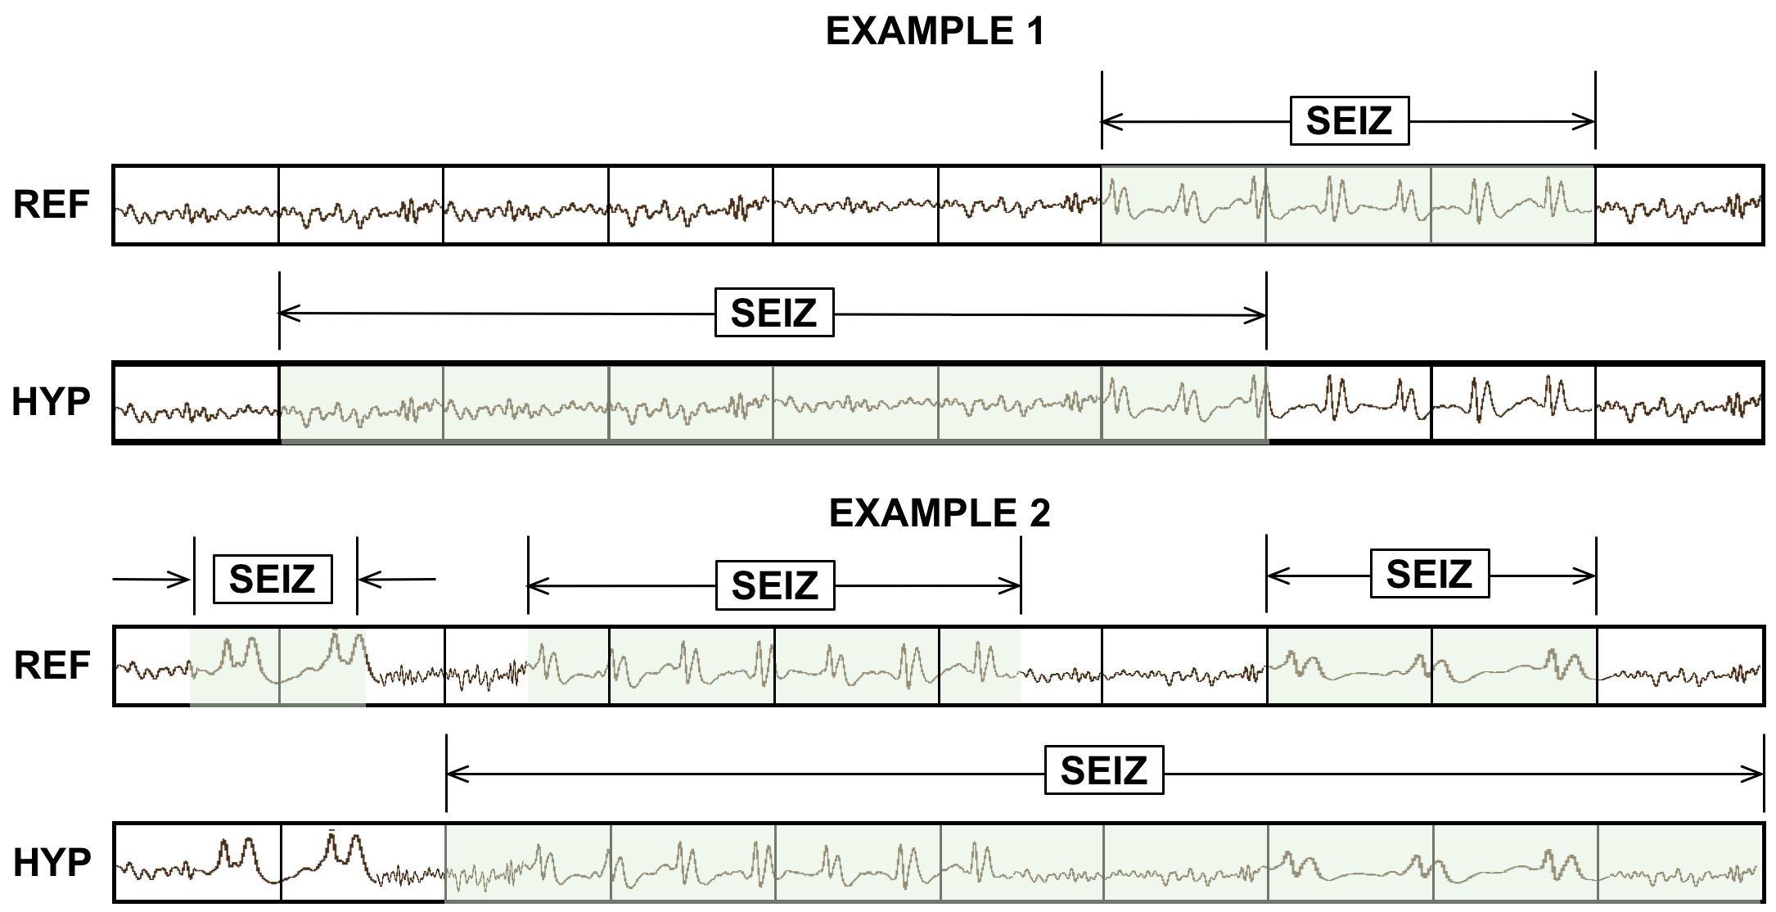
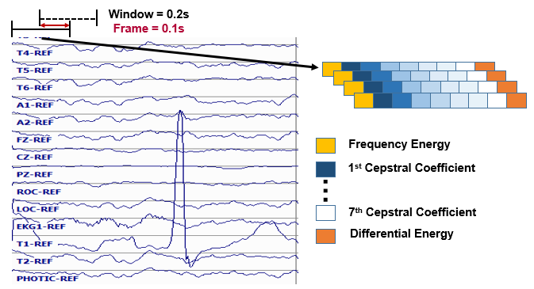
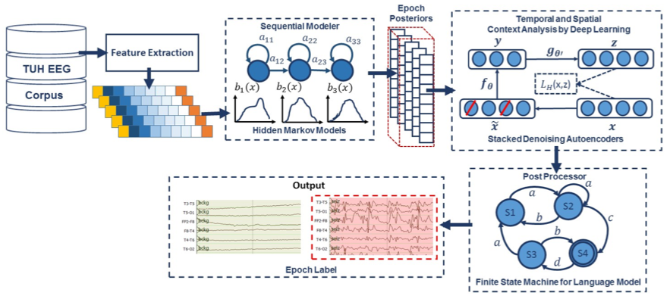
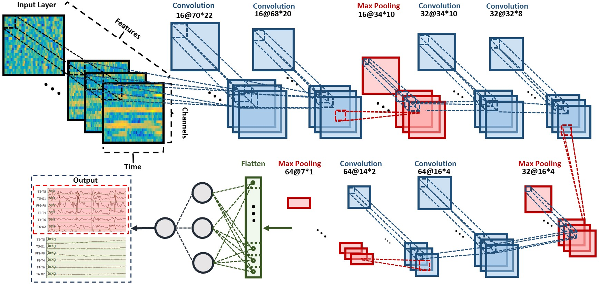
Finally!
Machine Learning

Slide 18
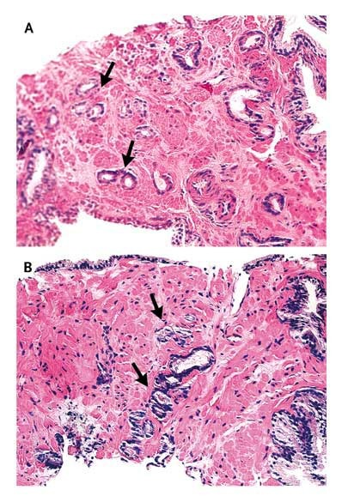
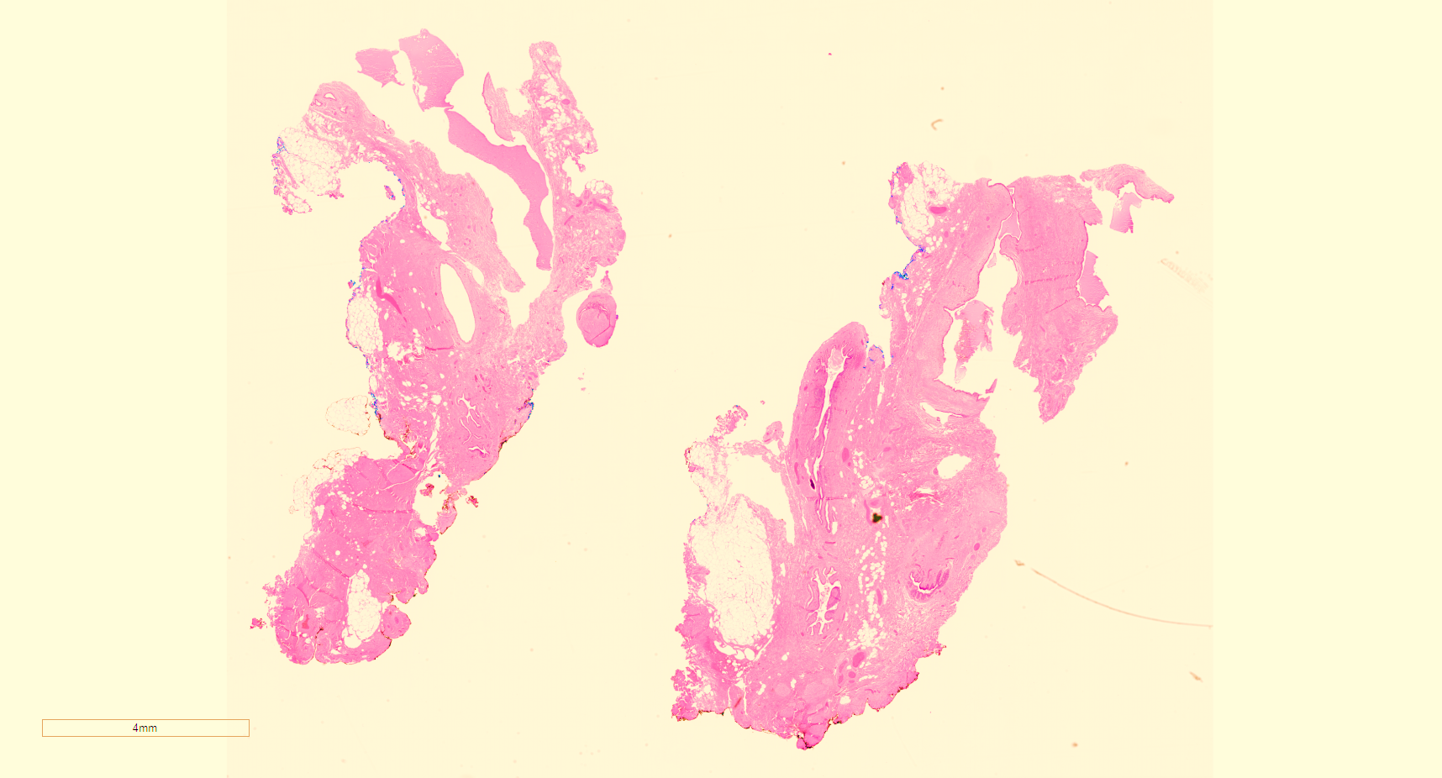
Digital Pathology
Temple Hospital Pathology
Aperio Slide Scanner
Same playbook – lots of messy data, hand curated & annotated
Machine Learning to improve outcomes

Slide 19
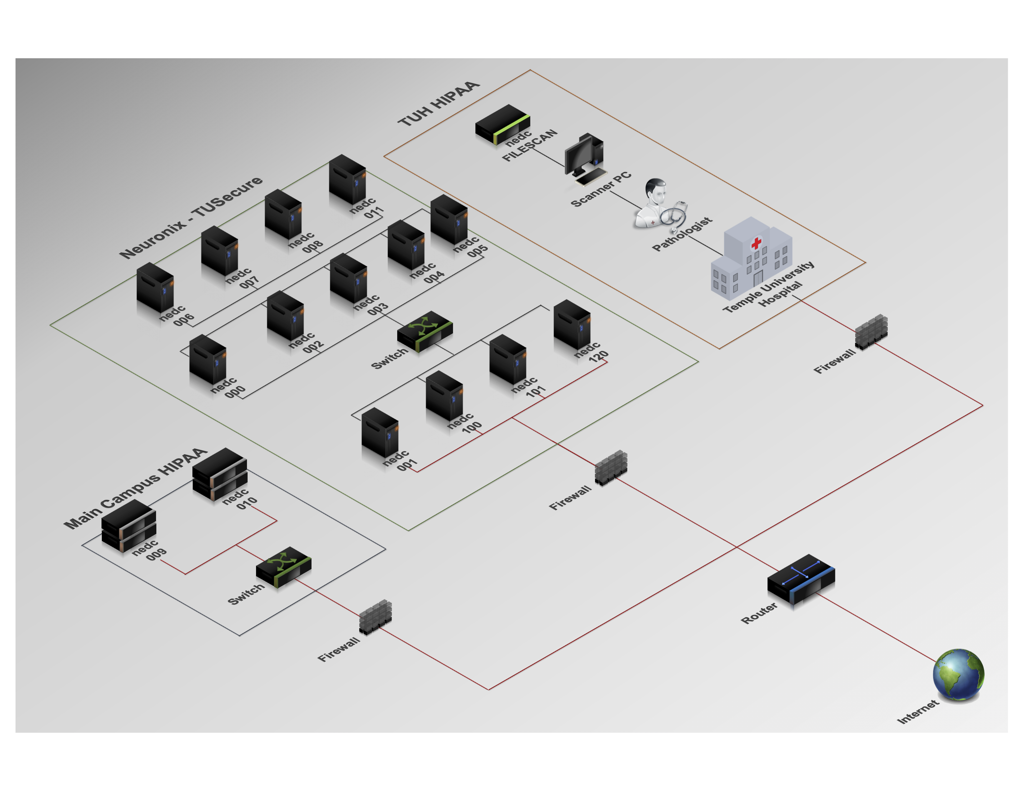
Infrastructure

Slide 20





Funding

