Slide 1
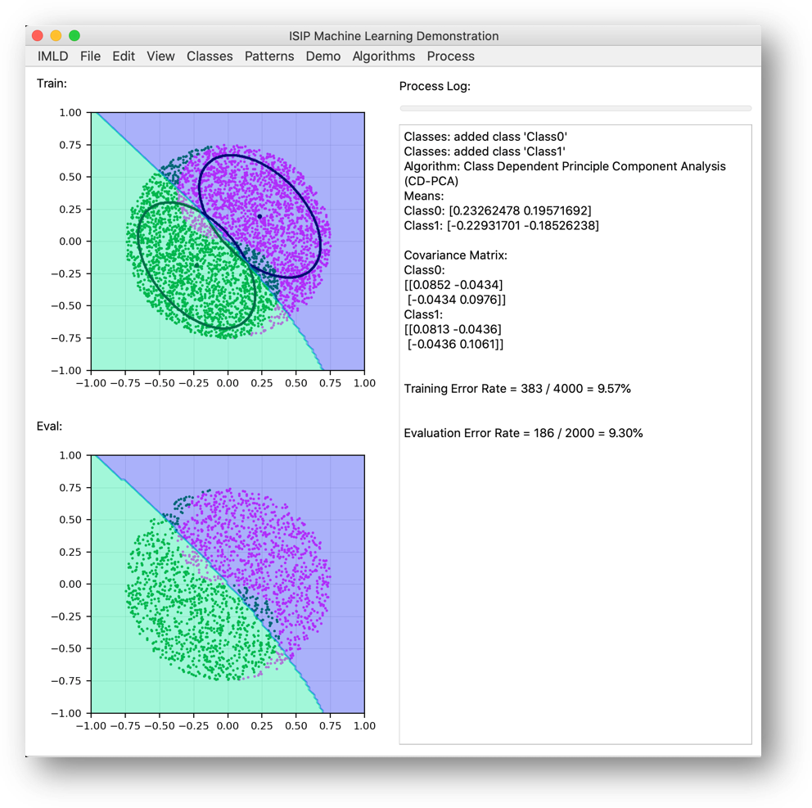
IMLD:
A Python-Based
Interactive Machine
Learning Demonstration
TEAM 45
Thao Cap, Aaron Kreitzer, Matthew Miranda, Dakota Vadimsky
Advisor: Joseph Picone & Coordinator: Brian Thomson
Notes:
Hello, today, we as team 45 will present our project called ISIP machine learning demo or IMLD for short. As on the title, our applicatopm is developed by Python and used for Machine Learning Demonstration. our project is completely a software engineering project involved a lot of coding in order to process data, and use our code as a human learner that can classify, and predict different classes of data. Our team includes … and our advisor is prof JP, and coordinator is prof BT

Slide 2
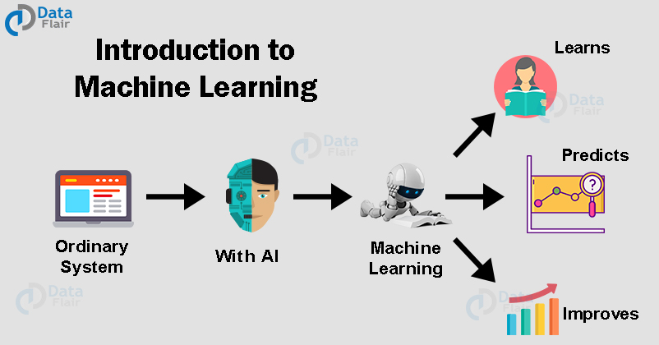
Overview: Problem Statement
Purpose of our IMLD
As machine learning increases in popularity and
usefulness, it will become crucial to teach it in a
way that is visually and practically intuitive.
IMLD is used to help students or learners visualize
and analyze their data and the classification of
each algorithms.
Students have been shown to learn higher complexity concepts more effectively when visualization is involved with learning.
The visual tool can help students to develop a comprehensive understanding of the basic concepts of ML, and the fundamentals of supervised and unsupervised learning through plots, and mean, cov, and error calculations.
Notes:
Machine Learning bring us a greater level of convenience as we see that we have been using it everyday, which makes it important for scientists and engineers to learn in order to catch up with the future. However, the concept behin d machine learning are hard to understand. As machine learning increases in popularity and usefulness, it will become crucial to teach it in a way that is visually and practically intuitive.
Seeing the struggle and wanting to improve it, we have decided to develop IMLD. They can use IMLD to test different approaches with different algorithms to optimize their model, to generate different dataset with different distributions, and to analyze the data’s behavior.

Slide 3
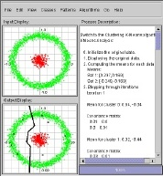
Overview: Problem Statement
IMLD in Java
This application began as an applet within the Java framework, dating back to the late 1990’s.
While the Java version was and still is operational, it became too difficult to keep it up-to-date, and other languages like Python and C++ surpassed Java in terms of machine learning functionality and processing speed.
The purpose of this project is to update IMLD to a programming language that can support more
robust libraries and have the potential of future expansion.
Notes:
IMLD began as an applet within the Java framework, dating back to the late 1990’s when Java was considered to be the future of computing. While the Java version was and still is operational, it became too difficult to keep it up-to-date, and other languages like Python and C++ surpassed Java in terms of machine learning functionality and processing speed.

Slide 4
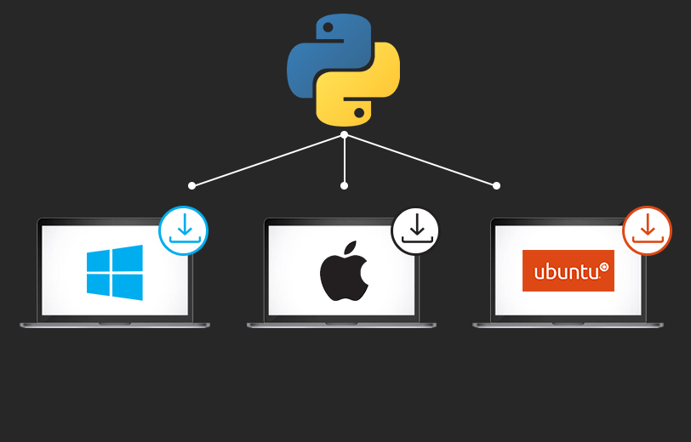
Overview: Problem Statement
Proposed solution
Python can be run on several platforms such as Linux, MacOs, and Windows,
It holds an extensive selection of libraries and frameworks used for machine learning, including Numpy/ Scipy for high data computing performance and Tensorflow/Sklearn for machine learning models.
We choose to rebuild IMLD and improve upon it within Python, rather than other modern programming languages.
Notes:
We have came up with different potential solutions such as updating/refactoring the original java version, rebuilding the applet with C+, and last but not least, rebuilding the applet with Python. We decided to choose Python as our proposed solution for various reason. It can be run on several platforms such as Linux, MacOs, and Windows,
In addition, Python has an ample amount of machine learning libraries that allow for powerful implementations. Even though Python is a simple language to learn, it holds an extensive selection of libraries and frameworks used for machine learning, including Numpy/ Scipy for high data computing performance and Tensorflow/Sklearn for machine learning models. For these reasons we choose to rebuild IMLD and improve upon it within Python, rather than other modern programming languages
on several platforms such as Linux, MacOs, and Windows, such as Linux, MacOs, and Windows,

Slide 5
Overview: Problem Statement
Benefits of IMLD
IMLD allows users to import or generate their own niche datasets
Once downloaded, IMLD can be used anywhere without Internet access.
Notes:
There are many other free open-source tools that are similar to our application; however, one feature that makes our application more unique and useful is that it allows users to import or generate their own niche datasets.
Compared to alternative online tools, the feature of importing and exporting datasets is not available.
Online tools also necessarily require internet access to use, while IMLD, once downloaded, can be used anywhere at any time.

Slide 6
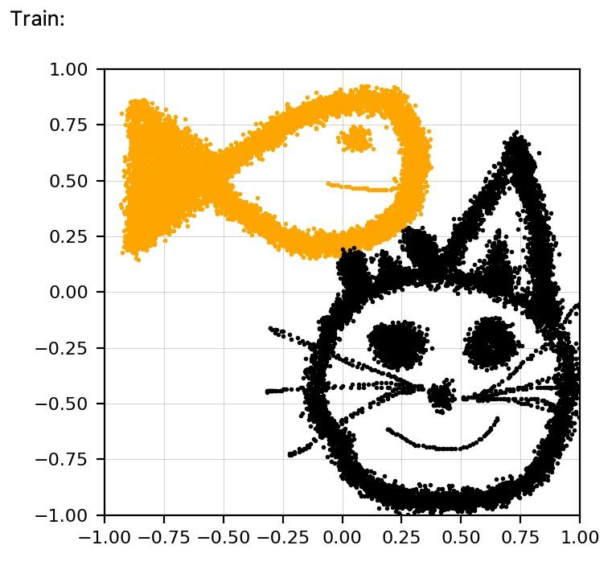
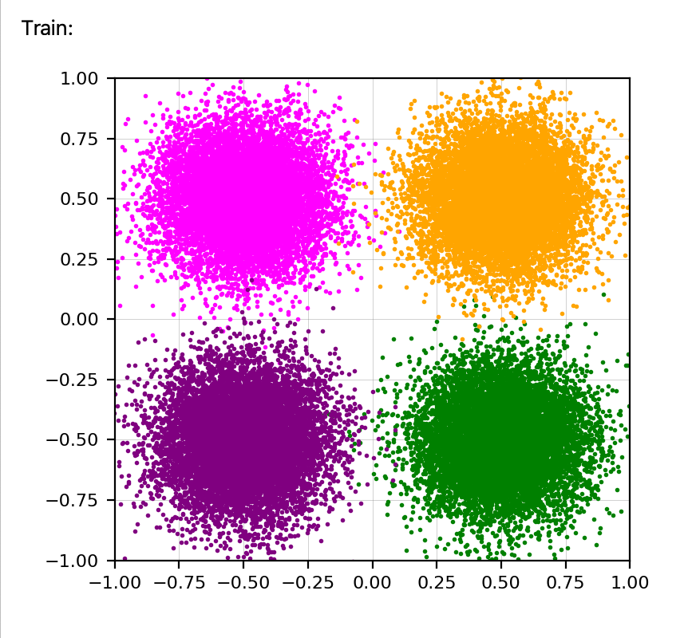
Overview: Functional Requirements
Load/ Save/ Draw Data
IMLD is designed to handle two dimensional data.
Users should be able to draw their own data or import/export created data.
Data needs to be in this format x, y.
IMLD must be able to handle potentially very large datasets consisting of greater than 1 million points.
Height
Length
Provide Demo
Multiple demo datasets are provided in IMLD. These demos must each be fully functional and user-customizable
Demo datasets. (8 different demo)
Notes:
The application has several functional requirements that are needed to be passed.
Students will be able to draw their own data points, and/or load previously created datasets directly into the applet for analysis and classification. The data that IMLD is designed to handle is two dimensional. For example of this photo, we have a dummy dataset, we have x represents the length of animal, and y represents the height of animal. Color orange represents data that are fish, and color black represents data that are cats. With IMLD, you could use to train the model, and let it predict what data is fish and what data is cat.
These datasets will be diverse in their scope and size, and so IMLD must be able to handle potentially very large datasets consisting of greater than 1 million points.

Slide 7
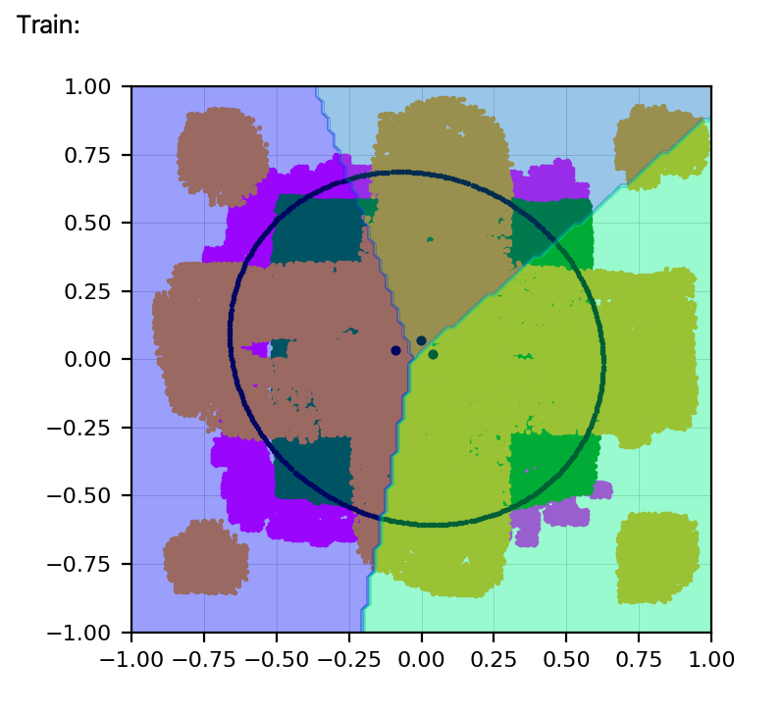
Overview: Functional Requirements
Apply Algorithms
Multiple algorithms are provided in IMLD. These demos must be tested to ensure full functionality. The algorithms must be properly implemented, and successfully handling the data fed to them.
Algorithms include: Principal Component Analysis, Linear Discriminant Analysis, K-Nearest Neighbors, K-means, SVM, Multilayer Perceptron, and Random Forests.
An implementation of the algorithm is consider successful when it reaches a consensus between IMLD and other sources. Once we can consistently get the results of IMLD’s algorithms to be within a 0.1% margin of error with multiple other sources, we will consider them to be successful.
Notes:
IMLD supports up to 7 different algorithms which include 2 variations of Principal Component Analysis and Linear Discriminant Analysis, CI and CD. Also included are KNN, Kmeans, SVM, Multilayer Perceptron, and Random Forests algorithm. Since students will be learning potentially all of the algorithms available in the applet, every algorithm will need to be tested to ensure full functionality. In this respect, full functionality refers to the algorithms being properly implemented and successfully handling the data fed into them. It does not refer to the accuracy of their classifications, which is a separate functional requirement. In order to test if our algorithms were properly implemented we will be cross referencing with other previously published ISIP material and the results from the current machine learning course taught by Dr.Picone. .

Slide 8
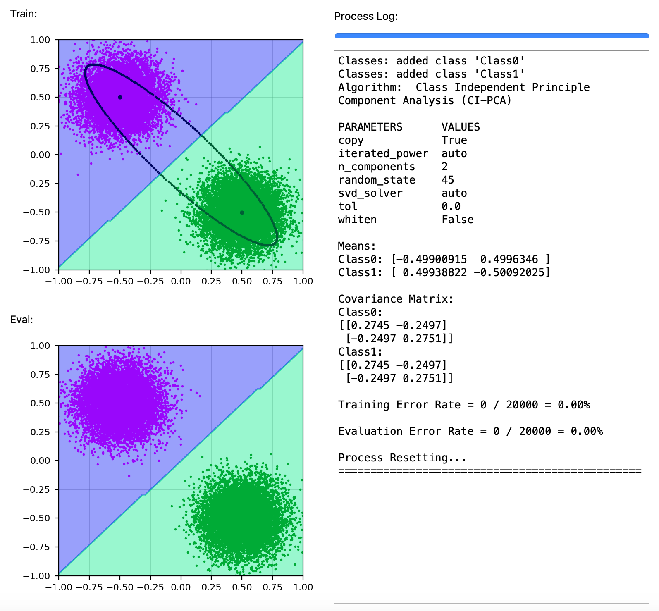
Overview: Functional Requirements
GUI
IMLD’s GUI should be user-directed
Provide clear and unambiguous directions to the user
Provide warning messages
Calculate Data
A minimum accuracy for all algorithms must be reached in order to establish and reinforce the legitimacy of the algorithms and the applet overall.
Notes:
IMLD is designed to be entirely user-directed from data input to analysis completion. Every step must therefore be neatly presented to the user through a GUI. This GUI needs to provide clear and unambiguous directions to the user without being overly invasive. This will be done by messages being printed out in the process log. It also needs to catch any errors the user makes and warn the user of said errors before allowing them to continue. While the layout and “usability” of the GUI is discussed further in the design constraints, the functional requirement of the GUI includes these warnings, preventing the user from taking action that would result in inaccurate classifications, loss of data, or program termination (crashing).
As IMLD is an educational machine-learning applet, its different algorithms will classify data sets at varying degrees of accuracy. This is to be expected, however a minimum accuracy for all algorithms must be reached in order to establish and reinforce the legitimacy of the algorithms and the applet overall.

Slide 9
Priority | Requirement | Metric | Target Value | Justification
Non-Negotiable | Load/Save/Draw large amounts of data | Test Cases | > 1 000 000 Data Points | Advisor/ Clients
Non-Negotiable | Provide Demo | Test Cases | > 1 000 000 Data Points | Advisor/ Clients
Non-Negotiable | Apply Algorithms | Test Cases | 0.1% margin of error | Advisor/ Clients
Negotiable | GUI | Test Cases | Pass/Fail | Advisor/ Clients
Non-Negotiable | Calculate Data | Test Cases | Pass/Fail | Advisor/ Clients
Functional Requirements
Notes:
Update FR chart

Slide 10
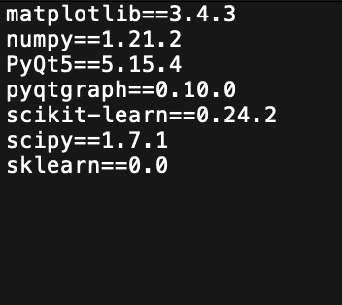
Overview: Design Constraints
User Interface
UI Usability
IMLD team will provide testers with a usability survey, covering metrics such as UI ease of access, learning curve, and overall usability.
Each metric will be scored on a a 1-5 scale. The target score in each category of 3.5 or higher.
Python Dependencies
IMLD needs to be up to date with all of its dependent libraries.
A requirements text file is included with every release version which automatically downloads/updates the necessary libraries for the user.
Notes:
With every release we will be including this survey to continue to improve the applets user interface.
Pyqt is the framework we chose to due to the flexibility with the GUI events and results in a smoother codebase

Slide 11
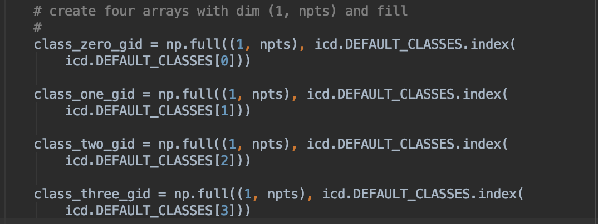
Overview: Design Constraints
Programming Language
IMLD code needs to pass the ISIP standard and be clean as possible. Hardcode is a hard NO
Notes:
No hard code, 80 characters, and header comments.
Please explain in the screenshot too.

Slide 12
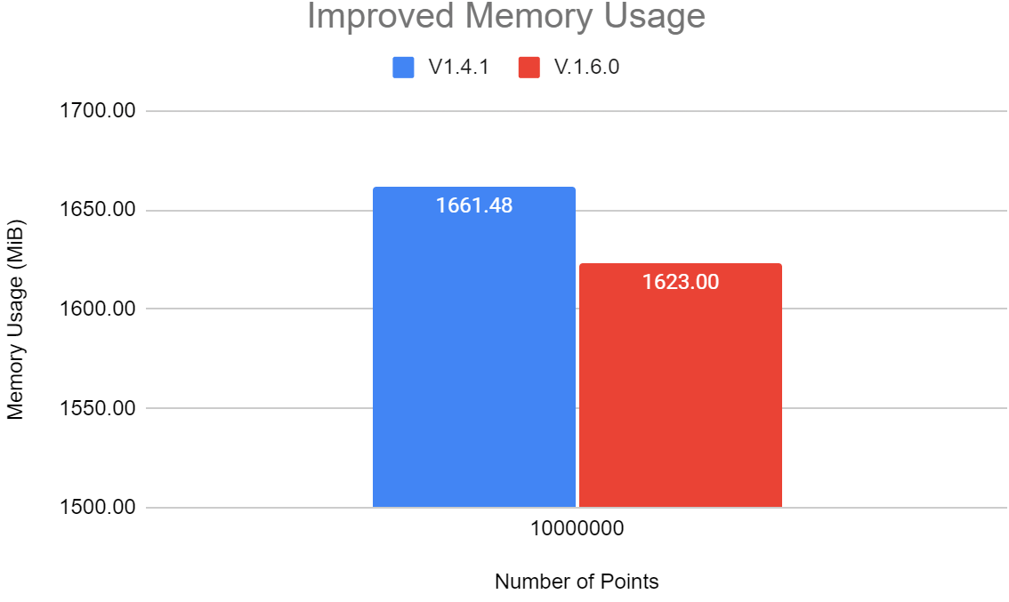
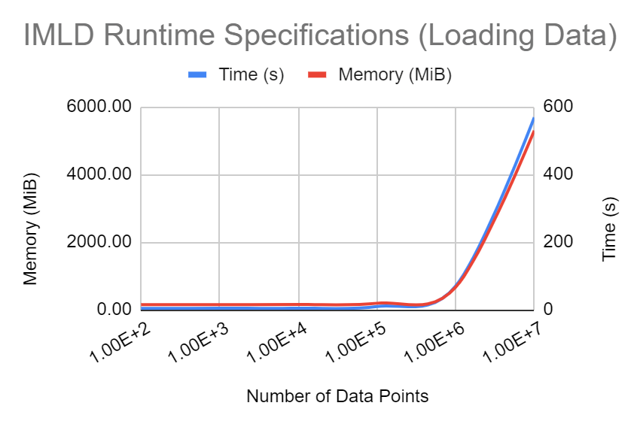
Overview: Design Constraints
Portability
Memory Requirement
We have ensured that all release packages of IMLD, including sample datasets, be under 15MB in size.
Processor Requirement
Through code re-formatting, we have reduced the memory usage of IMLD by a small, but non-negligible, margin
Notes:
Dakota - As we discussed previously, we intend for IMLD to be easily available for all students regardless of the sophistication of the systems they are using. This design constraint focuses on the storage and processor requirements of IMLD. We require that any release package of IMLD be small enough in size that it can be easily downloaded onto any computer without the user having to make space for it. This includes the program itself as well as sample datasets that we ship out with it, and we intend for these files to not exceed 15MB.
Last semester while testing the processor requirements of IMLD we found that the most demanding activities, such as loading in and classifying dataset of 10M points, were requiring roughly 5.5GB of processor memory. While this requirement would only last for a small fraction of the process’ run-time, after which the program would settle back down into a much more manageable memory usage, we wanted to try to find ways to reduce this, or at the very least to not make it worse. As you can see in the chart on the upper right hand side here, through reformatting our code we have managed to reduce the overall memory usage of IMLD’s most demanding activities by roughly 2%. We aim to continue this progress, especially after we successfully implement the rest of our algorithms and can turn our attention fully towards streamlining already functioning areas.

Slide 13
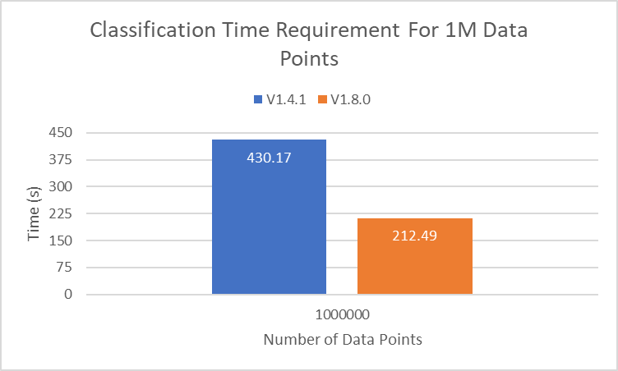
Overview: Design Constraints
Portability
Time Requirement
While not technically a design constraint, we did want to find ways to limit the amount of time large operations took.
Notes:
Dakota - While process duration has never been a constraint of this project, we still tried to find ways to limit the amount of time large operations would take in IMLD. Through code refactoring and our iterative design process, we were able to drastically reduce the duration of some of the more complex operations. In the chart on the right you can see the time taken to create a 1 Million point Yin-Yang and classify it using a Random Forest Algorithm in both version 1.4.1 and version 1.8.0. As you can see, we have more than halved the necessary time taken to perform this action. We see similar results for many other operations across a wide range of dataset sizes.

Slide 14
Priority | Requirement | Metric | Target Value | Justification
Negotiable | User Interface | UI Usability, Ease of access, Learning curve | Average >= 3.5 (1-5 scale) | Advisor/ Clients
Non-Negotiable | Python Dependencies | Version Number | Up-to-date | Advisor/ Clients
Non-Negotiable | Programming Language/Practices | Python ISIP Standards | Pass/Fail | Advisor
Negotiable | Portability | Memory Requirement | < 15 MB | Advisor/ Clients
Negotiable | Portability | Processor Requirement | < 6 GB | Advisor/ Clients
Design Constraints
Notes:
Dakota - We need to update this chart as well as the FR chart earlier.

Slide 15
ACCOMPLISHMENT
Evidence of engineering design
Optimization process
V1.7.0 release:
Drastically increased speed
Removed randomness from algorithms
Implemented RNF, MLP algorithms
V1.8.0 release:
Introduced data normalization option
Introduced progress bar
Added information to process log
Notes:
Dakota - Along with the changes we had already scheduled for implementation, we also integrated a lot of student feedback into our recent updates. Having a class of students using IMLD on large, complex datasets multiple times per homework assignment revealed some issues, namely the slowness of the program, the lack of visual indicator as to the progress of the classification process, not printing the parameters of the chosen algorithm to the process log, and a slight deviation in results between students due to inherent randomness in the way the algorithms are handled. We addressed these concerns in our latest two release versions, as well as fully implementing our final two algorithms and adding an option for users to normalize their data before classification.

Slide 16
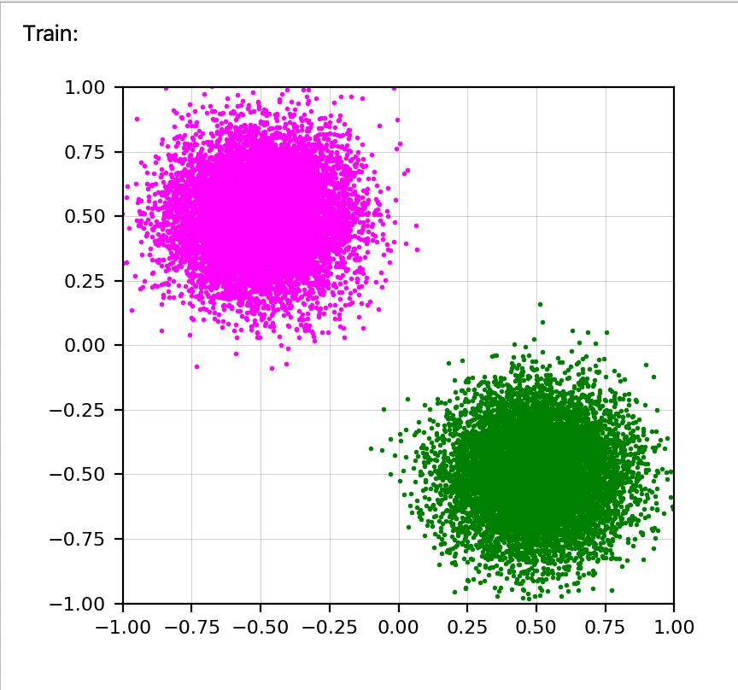
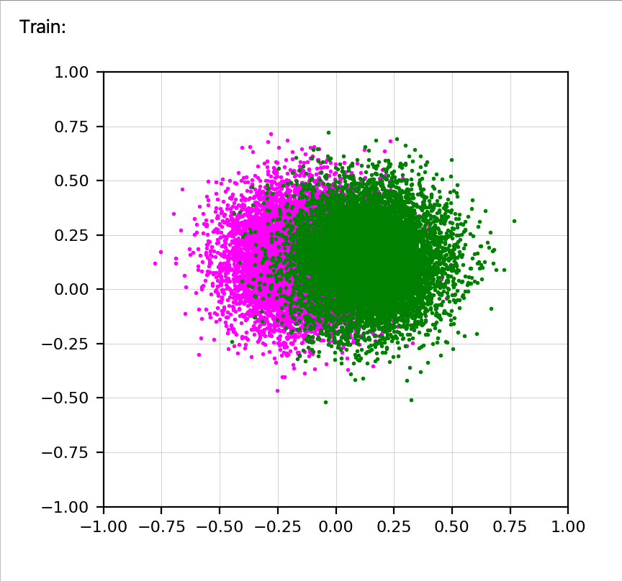
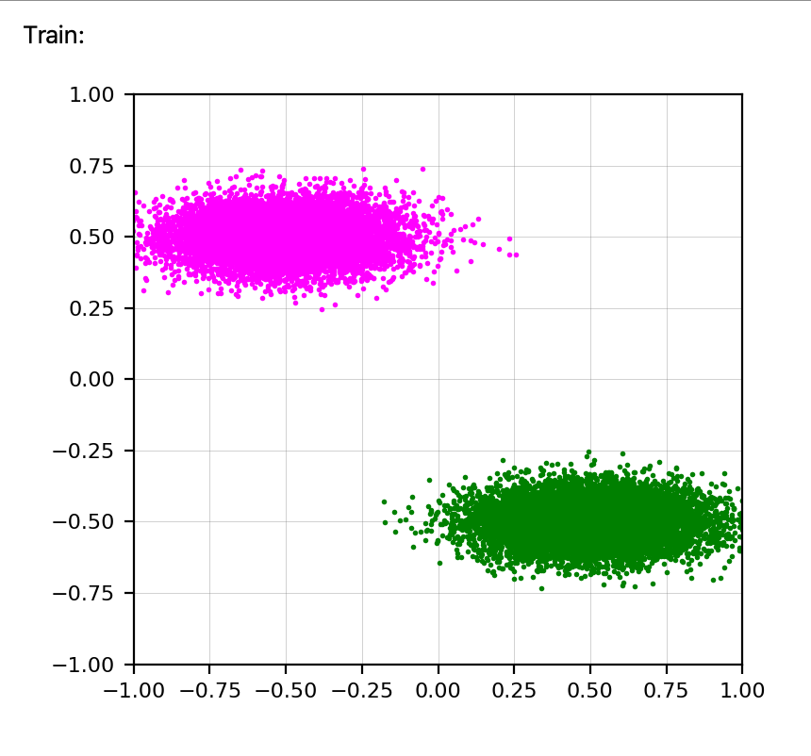
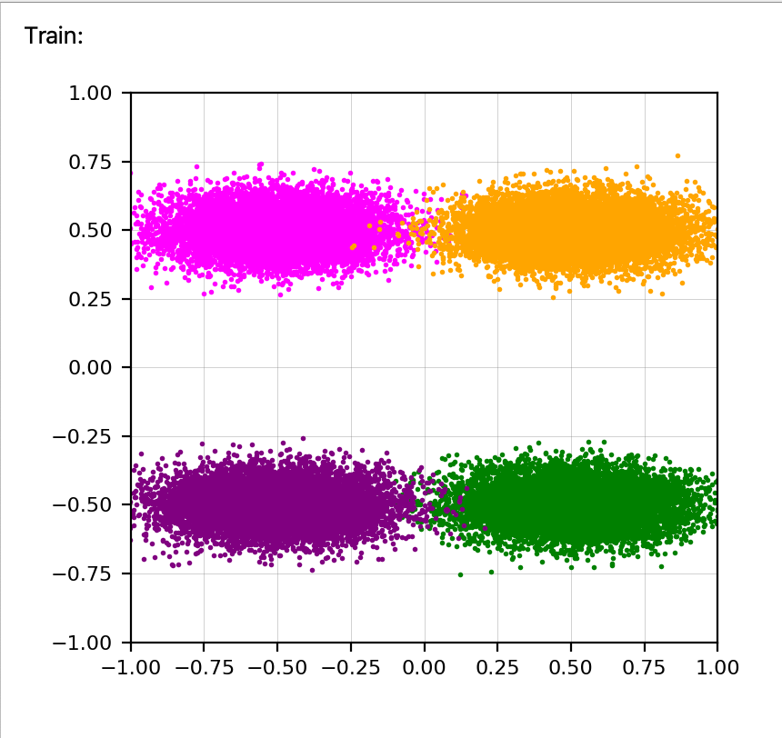
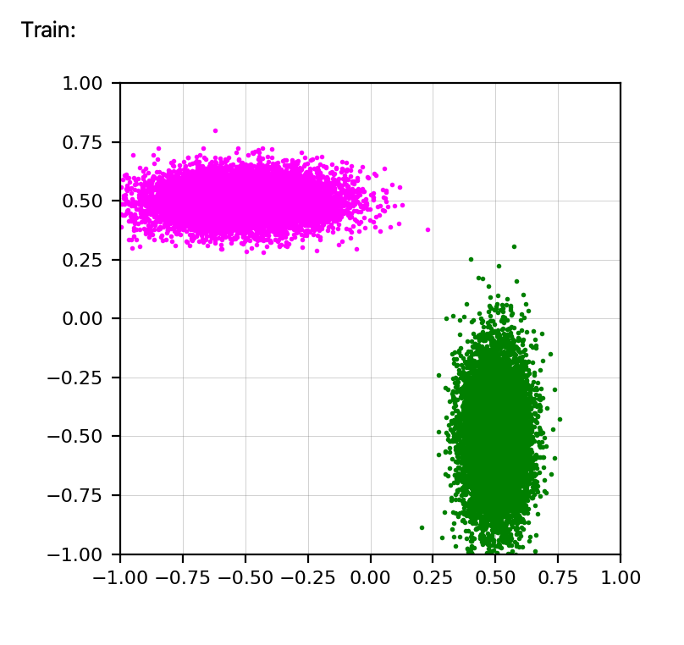
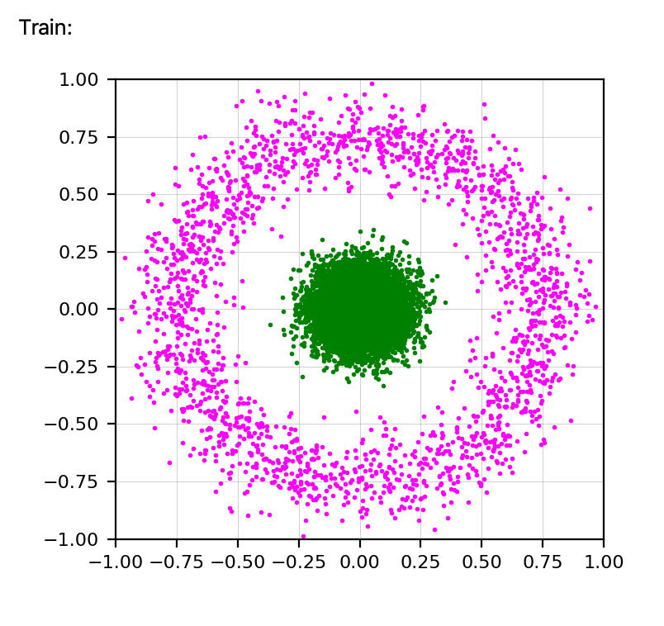
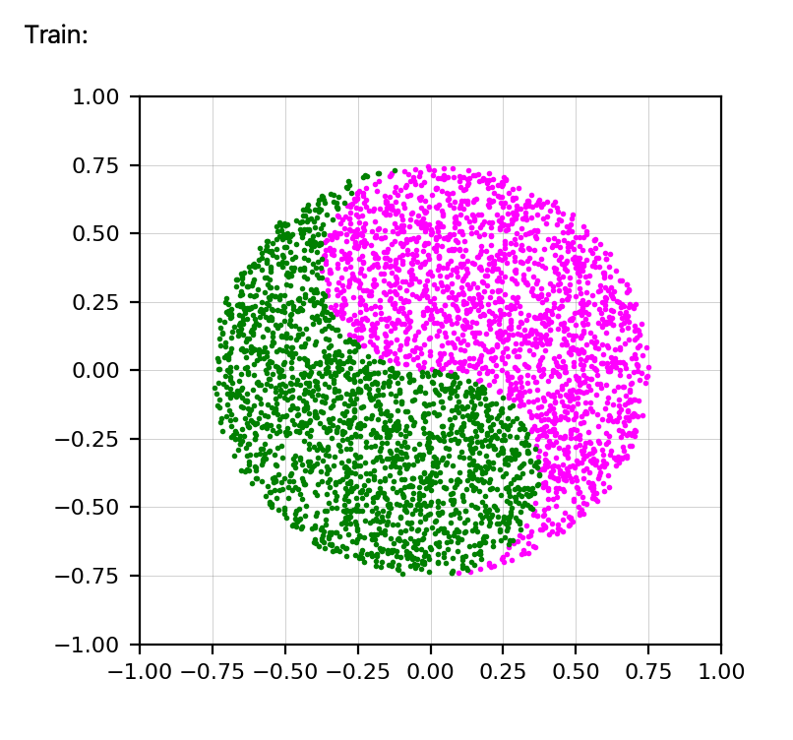
ACCOMPLISHMENT
Evidence of engineering design
8 Demonstration Datasets
2 Gaussian
4 Gaussian
Overlapped Gaussian
2 Ellipse
4 Ellipse
Rotated Ellipse
Toroidal
Yin-Yang
Notes:
Dakota - Here we can see our 8 demonstration datasets. These sets represent some typical shapes that datasets can take in ML, as we see many times that groups of similar data points form Gaussian distributions in either circular or elliptical shapes. It is useful for students to be able to easily create these datasets so that they can see how the different algorithms work on them. Students can easily change the parameters on these datasets to alter their sizes and positions in the data windows. Notable exceptions here are the Toroidal and Yin-Yang demos, which are not realistic datasets, but serve to show students the efficacy of certain algorithms over others. For instance, an algorithms which separates classes with a straight or parabolic line will not be sufficient to classify these datasets, while more complex algorithms can.

Slide 17
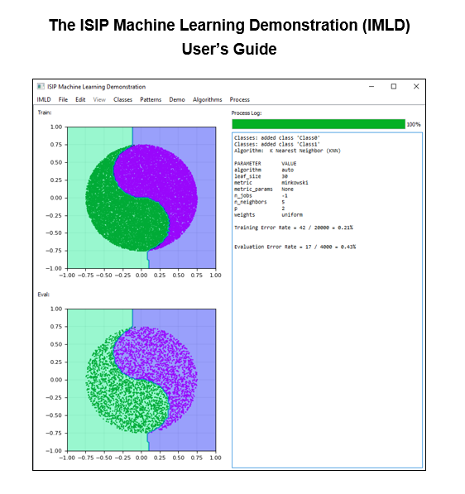
ACCOMPLISHMENT
Evidence of engineering design
User Guide
The team has created and updated a user guide to teach future users not only how to properly use all parts of IMLD, but also the theory behind how the algorithms function.
The user guide will also have examples, pulled from our test use cases, of what users can accomplish with the program.
Notes:
Dakota - As part of our documentation process, we have compiled a User’s Guide that we include with every release version. This guide details the use of every part of IMLD in depth, from installation to process completion, in order to better facilitate user understanding. We also briefly explain the theory behind each of our algorithms so that users know not only how to use them, but why to choose one over the other for each problem. The guide ends with some example use cases, pulled from our test cases, to guide the user step-by-step in how IMLD is supposed to be used.

Slide 18
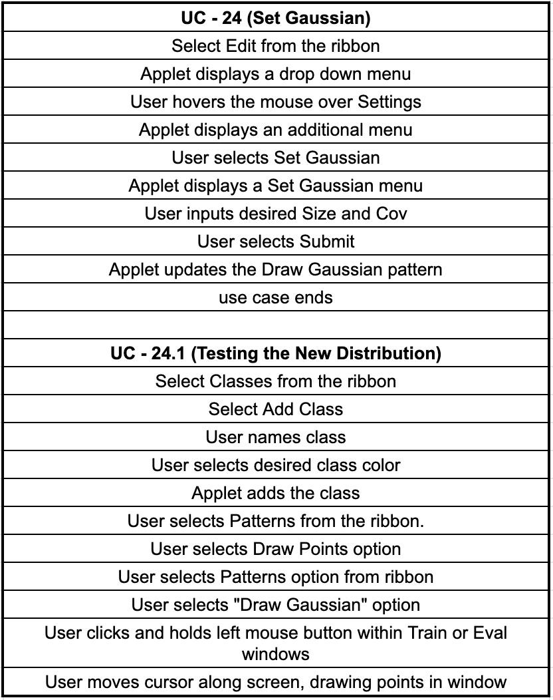
ACCOMPLISHMENT
Test Methods
Testing Goals
Document Crashes
Ensure changes are working as expected
Uncover Bugs
Surveying Users
See who we are testing
Get external feedback
Notes:
Aaron - A variety of testing methods were used during the life of this project. Initially the team put together Use Cases, shown in the upper right, to instruct testers how to perform a specific actions within the IMLD with the goal of these tests to being documenting crashes of the application. As releases got pushed out and the application became more stable testing goals increased in complexity. The goals shifted from documenting crashes to having testers try and create crashes and unintended actions or bugs within the application. Within this past semester the IMLD team was lucky enough to work with Dr.Picone’s Introduction to Machine Learning and Pattern Recognition course in attempt to aid the students learning machine learning potentially for the first time. As part of this testing process, we have asked the students to fill out a pre-semester survey in which they can let us know how comfortable they are with Python and with the various subjects covered in the course syllabus.We are also planning on sending out the final survey in the coming days to compare grades from this semester’s class - collected anonymously - with previous semesters in order to establish quantitative results regarding our introduction of IMLD to the course. The range of student’s comfort using Python allows IMLD to be tested by all different types of end users.

Slide 19
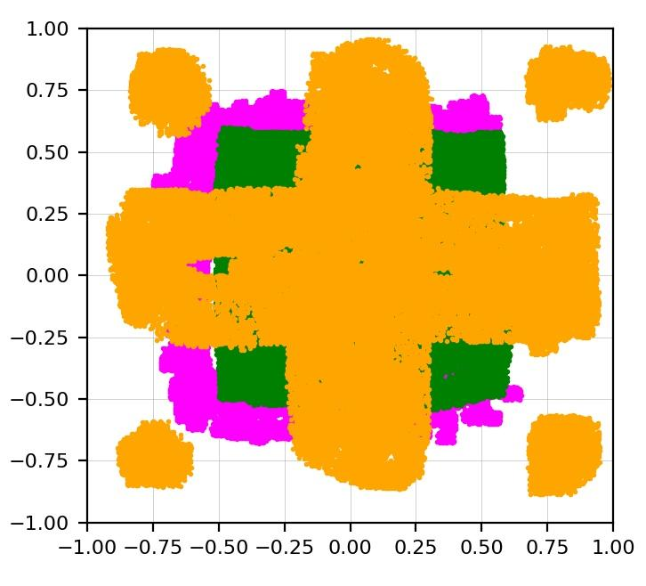
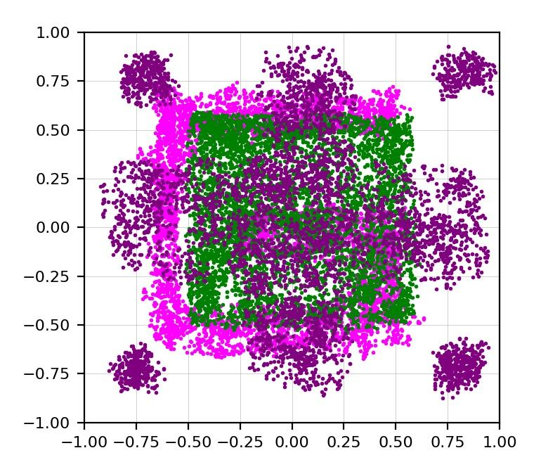
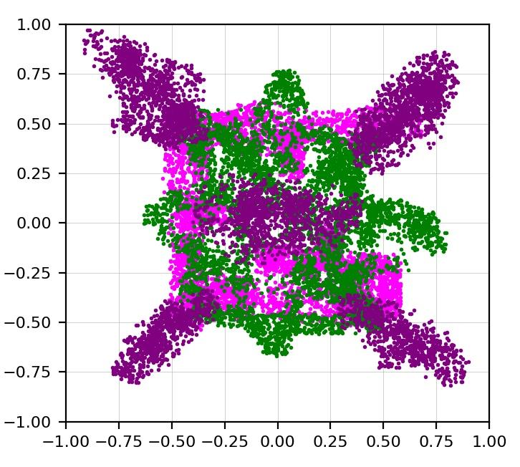
Testing Results
Train
Dev
Eval
Notes:
Aaron - Here we have some analytical results from a recent round of Algorithm testing, this testing was designed to take a look at how the K-Nearest-Neighbor and Random Forest algorithms are performing on different machines. This testing is very important to the performance of the IMLD application as even minor inconsistencies will result in different results when using millions of data points. The IMLD team expected some play between these results as the KNN and RF algorithms have some randomness, the results should still meet the Fundamental Requirements of 0.1% discrepancy between results. Upon recent releases of the application the testing goals are to create a constant Results value to ensure the classification of data would be consistent with the same parameters. Recent efforts have found previously hidden parameters have been set differently between tester’s machines, the team believes these parameters are causing the differences in results and are actively working to solve this issue.

Slide 20
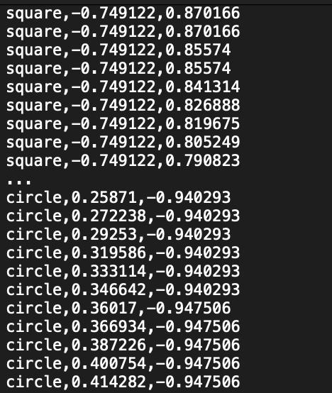
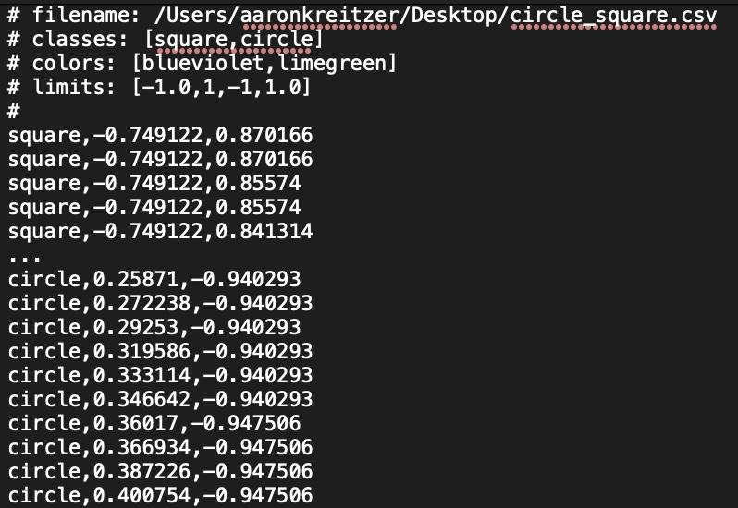
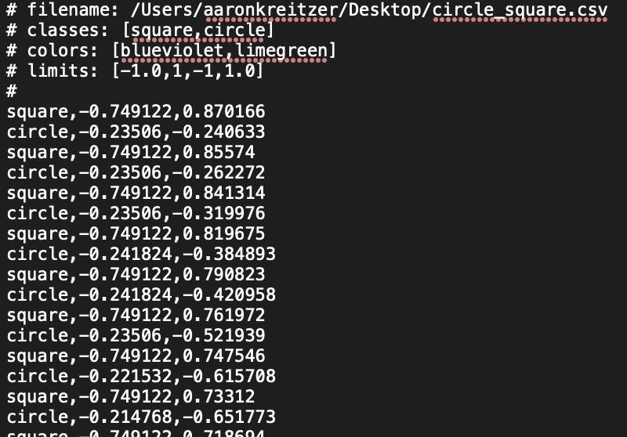
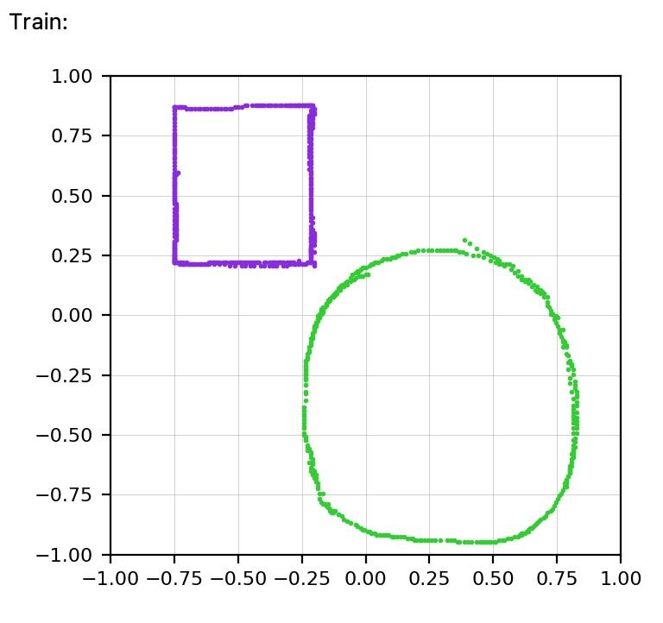
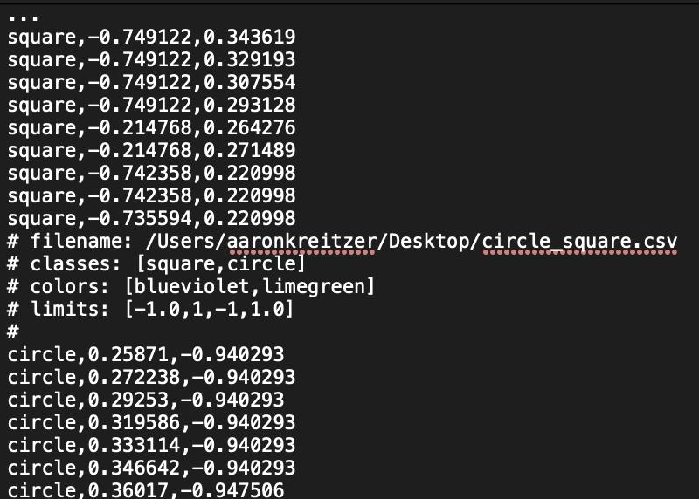
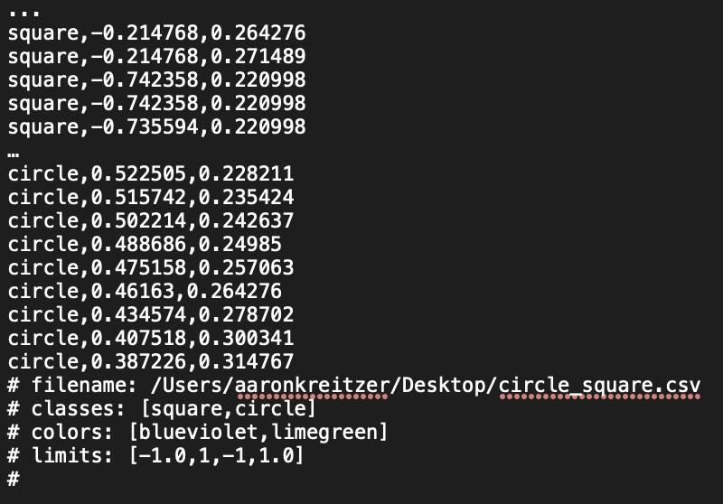
ACCOMPLISHMENT
Evidence of engineering design
Preferred CSV format
Notes:
Aaron - While the students were using the application, they initially had a great deal of difficulty uploading custom CSV files. Initially to solve this issue we turned over a sample of the preferred CSV file format with some clearer instructions on how to correctly format the CSV file for import, like shown in the upper left. Although with this was only a band-aid solution as students were still having issues with uploading CSV files, at this point we decided to look internally at the process of uploading CSV files. We saw that a big part of testing is also listening to the users to understand why the disconnect was taking place, and finding ways for users to have a better user experience. In order to improve this process we saw that we need to handle the most general CSV file format, and have IMLD fill in the missing fields that are required to display the data. With this improved process users are now able to upload CSV files, without the header, with their data out of order, with the header in the middle of the file, or at the end. The only fields required for IMLD CSV file imports are a class name, and at least two dimensional data for each data point. Users can upload larger dimensional sets of data, although the data will be limited to the first two dimensions.

Slide 21
Presentation of Schedule
Notes:
Aaron - This version of of gnatt chart shows the full overview of the project, we initially planned for 6 releases of IMLD indicated with the green bars. We were able to achieve this goal as we ended up putting out 8 versions of the application which averaged out to a release a month over Senior Design 1 and Senior Design 2. We were able to accomplish the goal we set for ourselves within Senior Design 2 of finishing all of the algorithms that were not implemented and were able to accomplish a few items on our wish list like a Progress bar to display while an algorithm is being run. We were able to come in on time and on budget. The budget was the easy part as we only used open source software, thus making the budget nothing. The IMLD application can be found on isip.piconepress.com/courses/temple/ece_8527/resources/imld/v1.8.0 at the link provided within chat, we encourage you to play around with the application. This project will continue with the ISIP group taking the lead upon the conclusion of Senior Design 2.
____________
This version of the gantt chart was first published in September, however updates were made to it over Winter break. These updates included planning the releases of IMLD, structuring these releases to include work that needs to be completed, include the due dates for all of the assignments within Senior Design 2 and dates for the Final Presentation, Poster and Final Design Document. This semester there is still an ample amount of work the IMLD team plans to implement in order to be a successful project and complete all of our goals. The first thing that needs to be completed is the remainder of the algorithms, currently the algorithms that have yet to be implemented into a packaged release includes K Nearest Neighbor, K-Means, Linde-Buzo-Gray, Multilayer Perceptron and Random Forest. Alongside implementing the algorithms the IMLD team will continue to squish any newly found bugs. Once the remainder of the algorithms are implemented the team will turn to some long awaited task that have been put on the back burner. One such task is the implementation of a progress bar to display while the algorithm is running, we have a list of similar tasks and hope to get to all of them before the semester is over.

Slide 22
Thank you for attending
Notes:
Thank you for attending and we will now take any questions you may have for us.

