Slide 1
IMLD:
A Python-Based Interactive Machine Learning Demonstration
TEAM 45
Thao Cap, Aaron Kreitzer, Matthew Miranda, Dakota Vadimsky
Advisor: Joseph Picone & Coordinator: Brian Thomson
Notes:
Hello, today, we as team 45 will present our project called ISIP machine learning demo or IMLD for short. As on the title, our applet is developed by Python and used for Machine Learning Demonstration. The picture right here shows that our project is completely a software engineering project involved a lot of coding in order to process data, and use our code as a human learner that can classify, and predict different classes of data. Our team includes … and our advisor is prof JP, and coordinator is prof BT

Slide 2
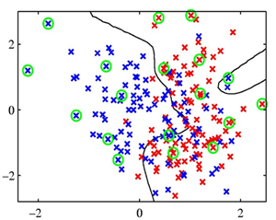
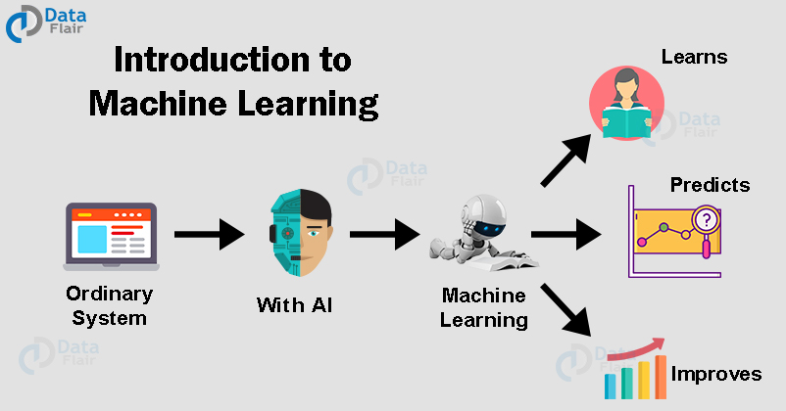
Overview: Problem Statement
Purpose of our IMLD
According to IBM, “Machine learning is a branch of artificial intelligence (AI) and computer science which focuses on the use of data and algorithms to imitate the way that humans learn, gradually improving its accuracy”
As machine learning increases in popularity and usefulness, it will become crucial to teach it in a way that is visually and practically intuitive.
IMLD is used for the education to help students or learners visualize and analyze their data and algorithms
Notes:
As modern computing problems have continued to increase in complexity, increased attention has been given to the field of machine learning. According to IBM, “Machine learning is a branch of artificial intelligence (AI) and computer science which focuses on the use of data and algorithms to imitate the way that humans learn, gradually improving its accuracy”.
Machine Learning is used to bring us a greater level of convenience, which makes it important for scientists and engineers to learn in order to catch up with the future. While this design method is undoubtedly the most efficient at processing and classifying large data sets, the algorithms behind machine learning are hard to understand. As machine learning increases in popularity and usefulness, it will become crucial to teach it in a way that is visually and practically intuitive.
Seeing the struggle and wanting to improve it, we have decided to develop IMLD. IMLD makes machine learning visualiable to students. They can use IMLD to test different approaches with different algorithms to optimize their model, to generate different dataset with different distributions, and to analyze the data’s behavior.

Slide 3
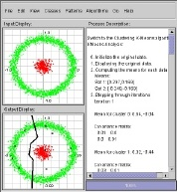
Overview: Problem Statement
IMLD in Java
This application began as an applet within the Java framework, dating back to the late 1990’s.
While the Java version was and still is operational, it became too difficult to keep it up-to-date, and other languages like Python and C++ surpassed Java in terms of machine learning functionality and processing speed.
Notes:
IMLD began as an applet within the Java framework, dating back to the late 1990’s when Java was considered to be the future of computing. While the Java version was and still is operational, it became too difficult to keep it up-to-date, and other languages like Python and C++ surpassed Java in terms of machine learning functionality and processing speed.

Slide 4
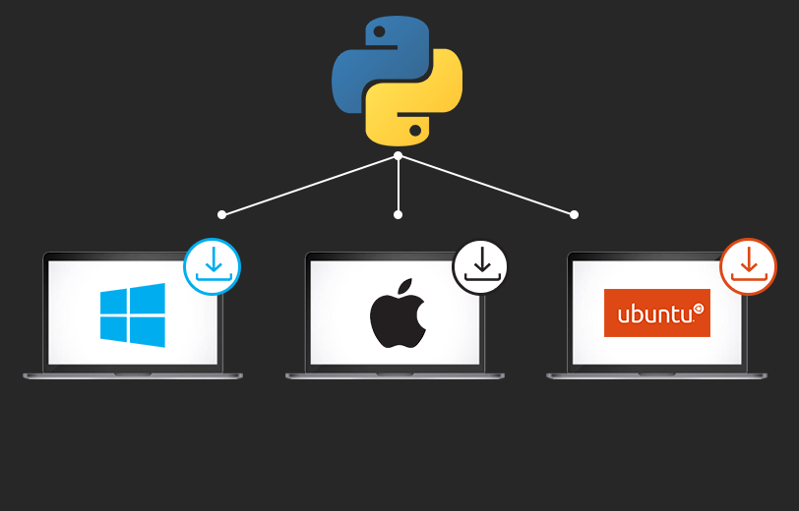
Overview: Problem Statement
Proposed solution
Python can be run on several platforms such as Linux, MacOs, and Windows,
It holds an extensive selection of libraries and frameworks used for machine learning, including Numpy/ Scipy for high data computing performance and Tensorflow/Sklearn for machine learning models.
We choose to rebuild IMLD and improve upon it within Python, rather than other modern programming languages.
Notes:
We have came up with different potential solutions such as updating/refactoring the original java version, rebuilding the applet with C+, and last but not least, rebuilding the applet with Python. We decided to choose Python as our proposed solution for various reason. It can be run on several platforms such as Linux, MacOs, and Windows,
In addition, Python has an ample amount of machine learning libraries that allow for powerful implementations. Even though Python is a simple language to learn, it holds an extensive selection of libraries and frameworks used for machine learning, including Numpy/ Scipy for high data computing performance and Tensorflow/Sklearn for machine learning models. For these reasons we choose to rebuild IMLD and improve upon it within Python, rather than other modern programming languages
on several platforms such as Linux, MacOs, and Windows, such as Linux, MacOs, and Windows,

Slide 5
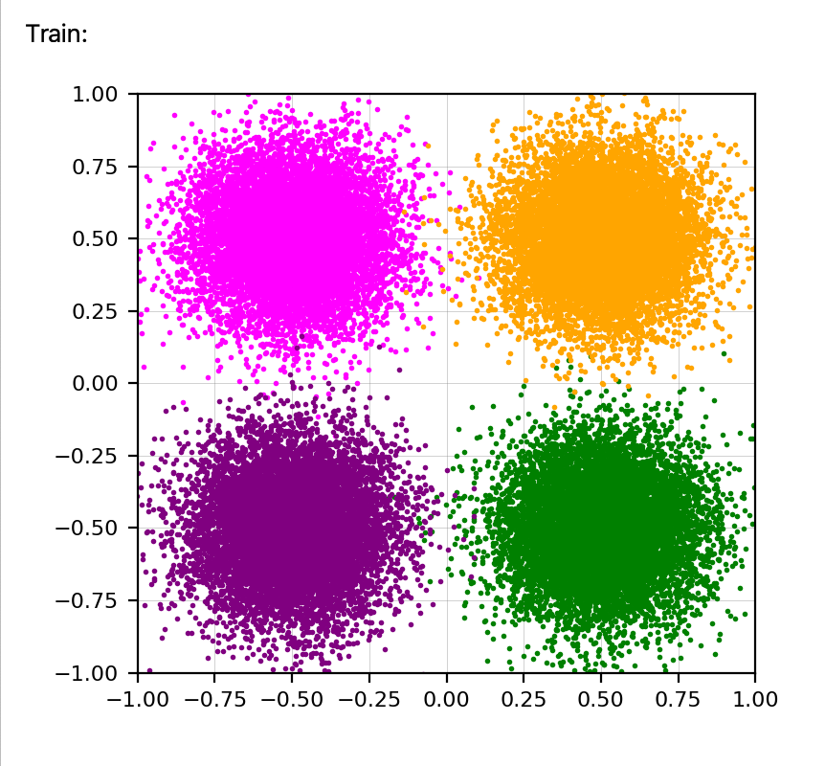
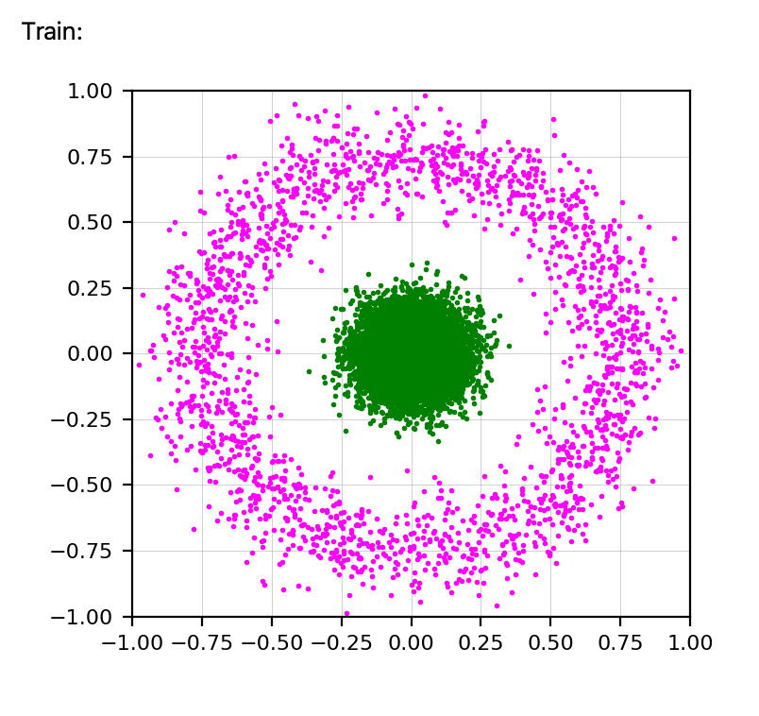
Overview: Functional Requirements
Load/ Save/ Draw Data
IMLD is designed to handle two dimensional data.
Users should be able to draw their own data or import/export created data.
Data needs to be in this format x, y.
IMLD must be able to handle potentially very large datasets consisting of greater than 1 million points.
Provide Demo
Multiple demo datasets are provided in IMLD. These demos must each be fully functional and user-customizable
Demo datasets. (8 different demo)
Notes:
The IMLD applet is an educational tool designed to be used primarily in the classroom. As such, students will be able to draw their own data points within the training and evaluation windows, and/or load previously created datasets directly into the applet for analysis and classification. The data that IMLD is designed to handle is two dimensional, consisting of scatter plots for each class in the dataset. Data that is loaded directly into the applet will need to be in this format (x,y coordinates for each point), while data drawn in the input windows will be automatically saved in this format. These datasets will be diverse in their scope and size, and so IMLD must be able to handle potentially very large datasets consisting of greater than 1 million points.

Slide 6
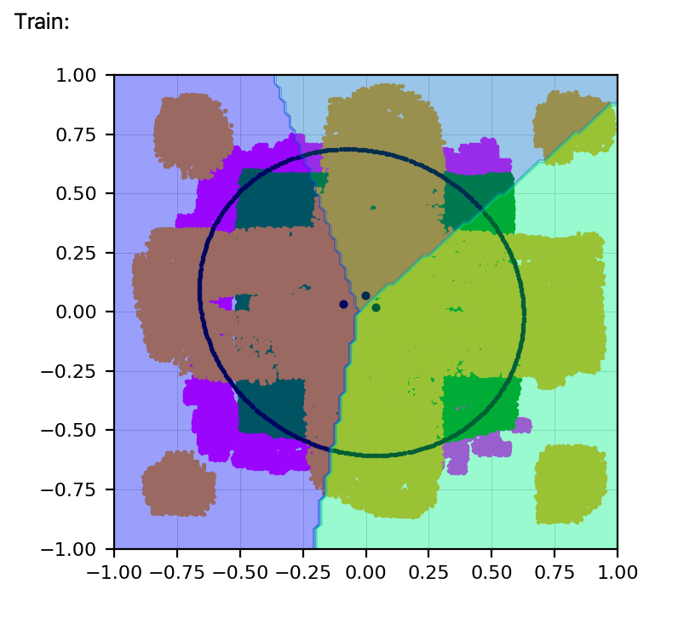
Overview: Functional Requirements
Apply Algorithms
Multiple algorithms are provided in IMLD. These demos must be tested to ensure full functionality. The algorithms must be properly implemented, and successfully handling the data fed to them.
Algorithms include: Principal Component Analysis, K-Nearest Neighbors, and Multilayer Perceptron
Notes:
IMLD supports up to 7 different algorithms which include 2 variations of Principal Component Analysis and Linear Discriminant Analysis, CI and CD. Also included are KNN, Kmeans, SVM, Multilayer Perceptron, and Linde-Buzo-Gray algorithm. Since students will be learning potentially all of the algorithms available in the applet, every algorithm will need to be tested to ensure full functionality. In this respect, full functionality refers to the algorithms being properly implemented and successfully handling the data fed into them. It does not refer to the accuracy of their classifications, which is a separate functional requirement.

Slide 7
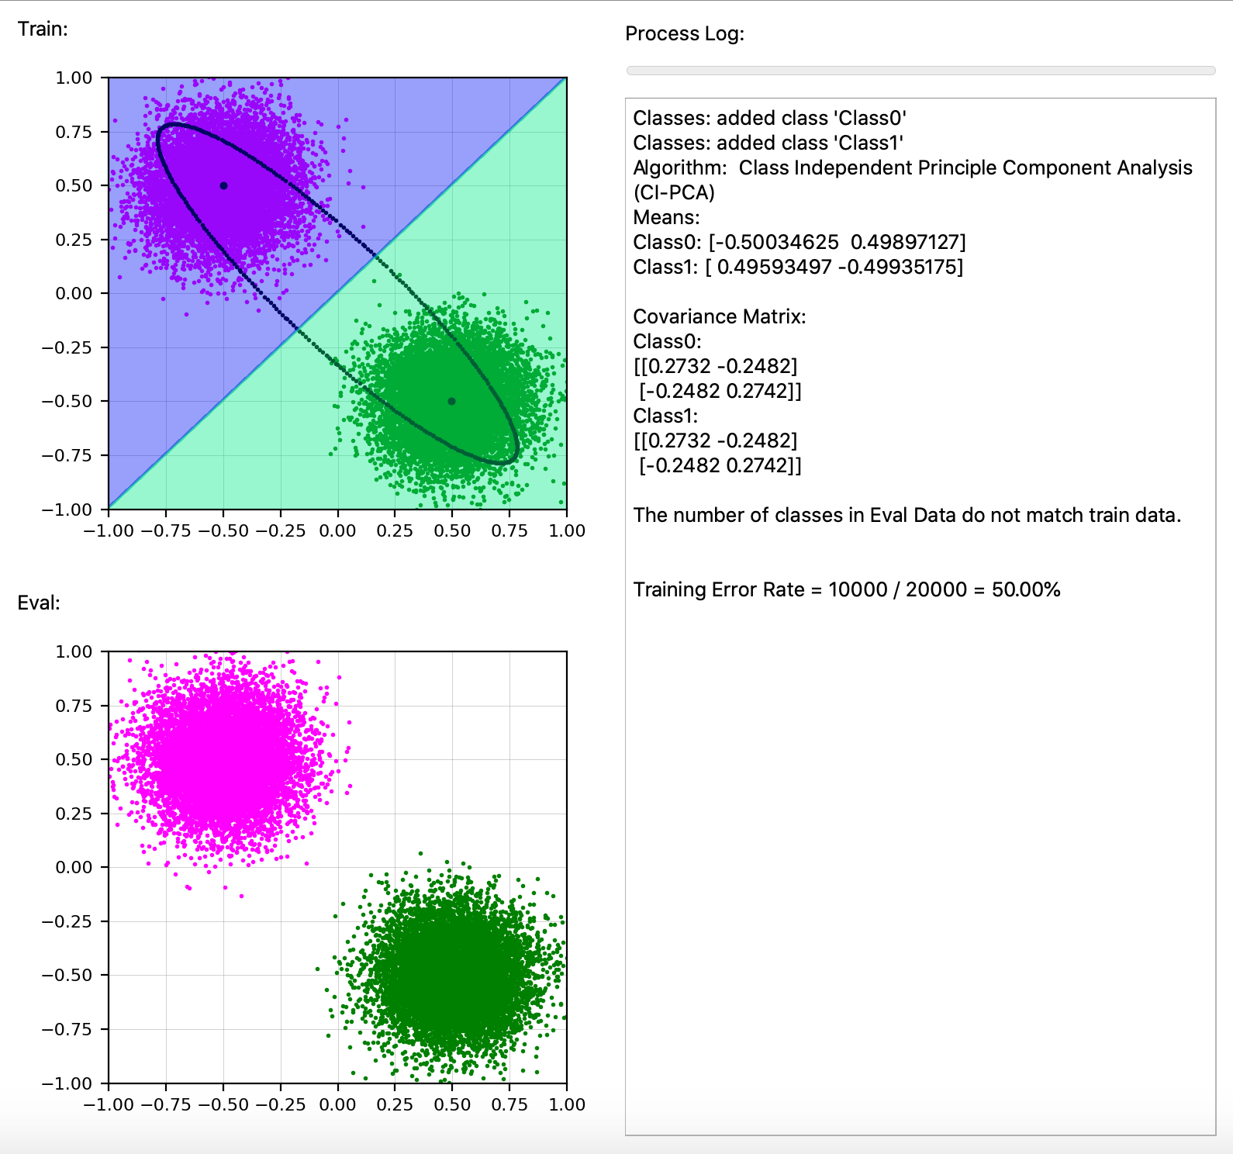
Overview: Functional Requirements
GUI
IMLD’s GUI should be user-directed
Provide clear and unambiguous directions to the user
Provide warning messages
Calculate Data
A minimum accuracy for all algorithms must be reached in order to establish and reinforce the legitimacy of the algorithms and the applet overall.
Notes:
IMLD is designed to be entirely user-directed from data input to analysis completion. Every step must therefore be neatly presented to the user through a GUI. This GUI needs to provide clear and unambiguous directions to the user without being overly invasive. It also needs to catch any errors the user makes and warn the user of said errors before allowing them to continue. While the layout and “usability” of the GUI is discussed further in the design constraints, the functional requirement of the GUI includes these warnings, preventing the user from taking action that would result in inaccurate classifications, loss of data, or program termination (crashing).
As IMLD is an educational machine-learning applet, its different algorithms will classify data sets at varying degrees of accuracy. This is to be expected, however a minimum accuracy for all algorithms must be reached in order to establish and reinforce the legitimacy of the algorithms and the applet overall.

Slide 8
Priority | Requirement | Metric | Target Value | Justification
Non-Negotiable | Load/Save/Draw large amounts of data | Test Cases | > 1 000 000 Data Points | Advisor/ Clients
Non-Negotiable | Provide Demo | Test Cases | Pass/Fail | Advisor/ Clients
Non-Negotiable | Apply Algorithms | Test Cases | Pass/Fail | Advisor/ Clients
Negotiable | GUI | Test Cases | Pass/Fail | Advisor/ Clients
Non-Negotiable | Calculate Data | Test Cases | Pass/Fail | Advisor/ Clients
Functional Requirements

Slide 9
Overview: Design Constraints
User Interface
UI Usability
IMLD team will provide testers with a usability survey, covering metrics such as UI ease of access, learning curve, and overall usability.
Each metric will be scored on a a 1-5 scale. The target score in each category of 3.5 or higher.
PyQt
IMLD needs to be up to date with PyQt library. The GUI has to be stable and able to run on the newest PyQt without significant changes
Notes:
With every release we will be including this survey to continue to improve the applets user interface.
Pyqt is the framework we chose to due to the flexibility with the GUI events and results in a smoother codebase

Slide 10
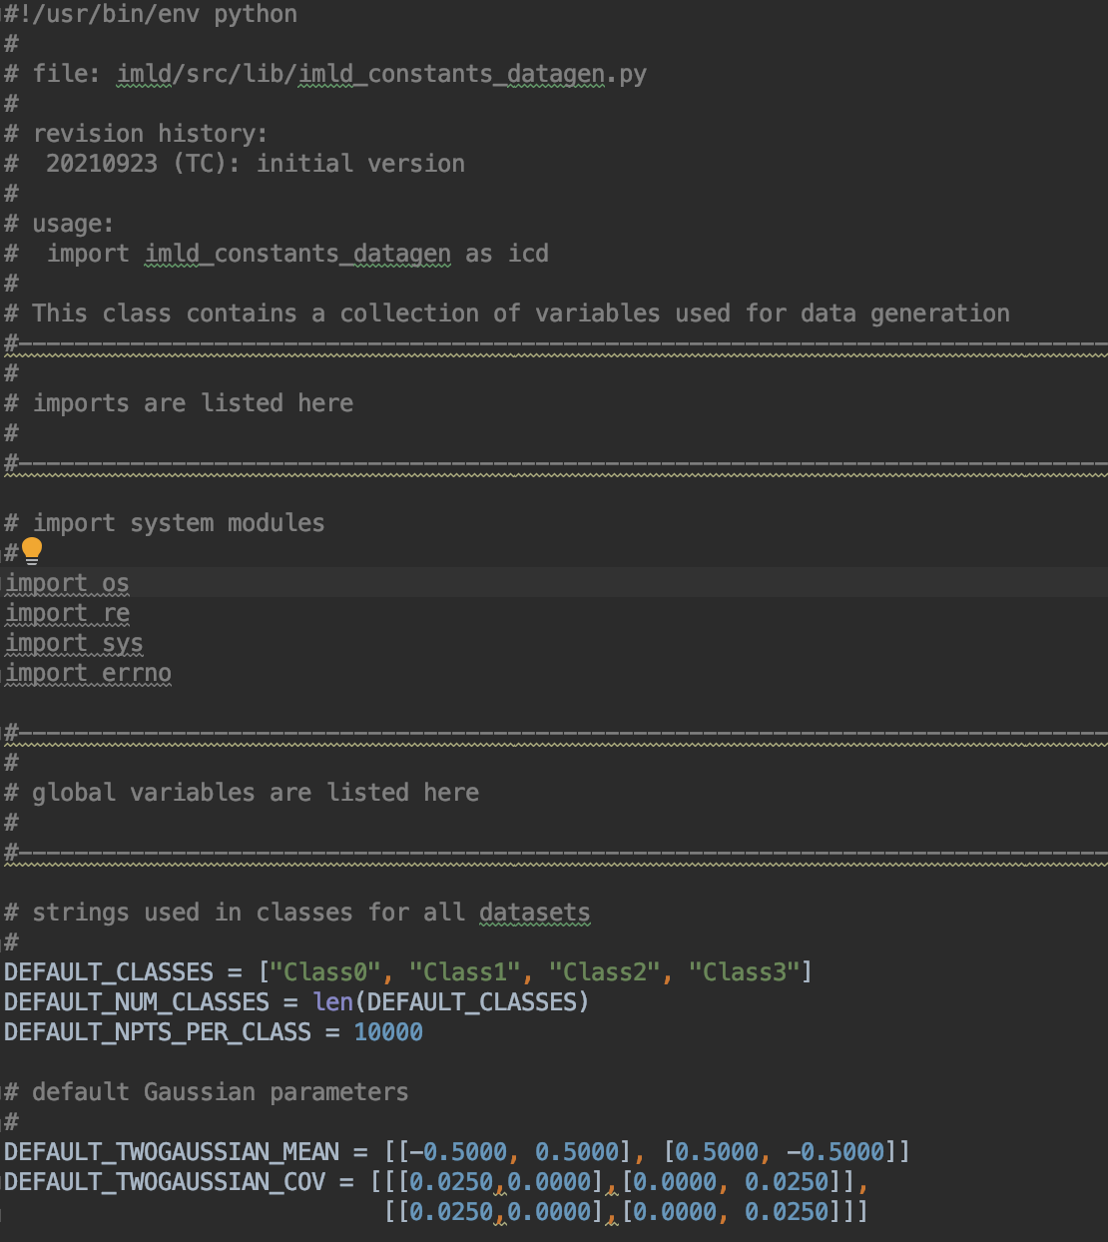
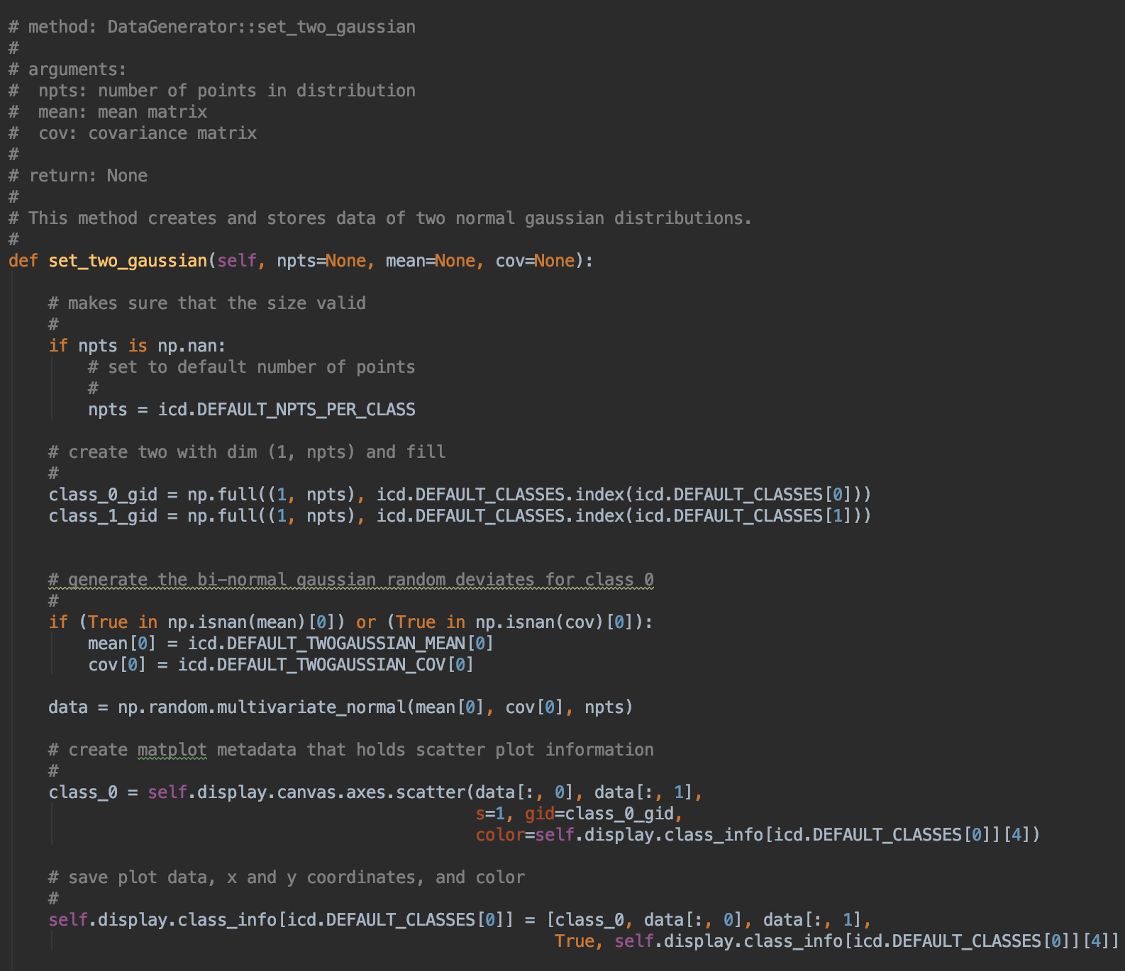
Overview: Design Constraints
Programming Language
IMLD code needs to pass the ISIP standard and be clean as possible.
Hardcode is a hard NO
Notes:
No hard code, 80 characters, and header comments.

Slide 11
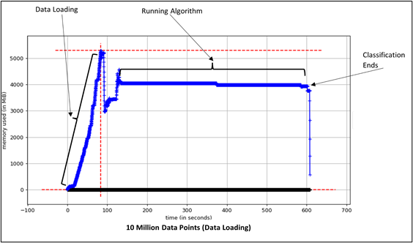
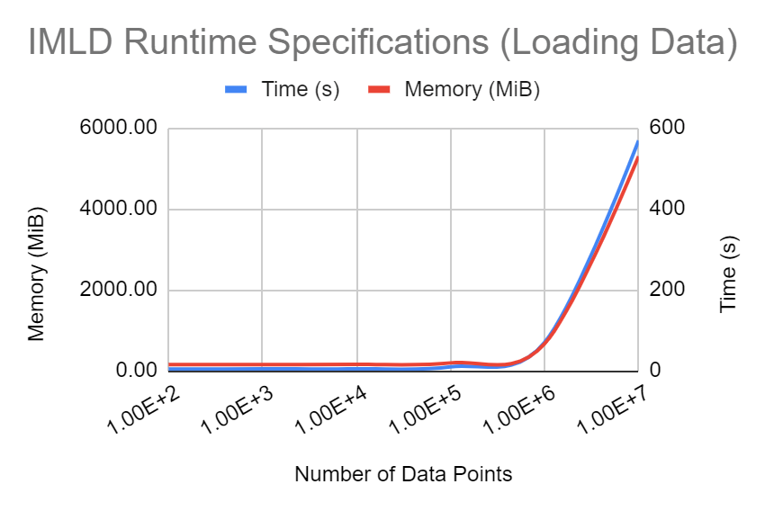
Overview: Design Constraints
Portability
Processor Requirement
The application should be able to load and classify one million points without overflowing the computer’s memory.
Memory Requirement
We are striving for a final memory requirement of less than 3MB for the code to load and analyze data.
Notes:
Dakota - Because IMLD is an educational tool used by students within classrooms, we need to ensure that it can be easily downloaded and run on a typical computer that any student would have access to. We understand that many students’ laptops are already filled with large software packages required by other courses, and so we want to try to limit the size of our program as much as possible while still maintaining its full functionality. Currently, if a student who wishes to download the application does not already have any kind of python compiler installed on their computer, the application will require roughly 400MB. However, if a student already has the software necessary to compile IMLD, they will only need an additional 3MB for the application, and 27MB for the example datasets included with it.
We also need to make sure that when analyzing very large datasets with a million or more points, our application does not use more of the computer’s memory than is available. We know that it is very common for laptops today to have at least 8GB of processor memory, and so we are looking for ways to keep the application’s memory requirement to under that value. Through our testing, we have found that the application uses the most memory when loading in previously saved data. This operation uses roughly 5600 MB of memory when a dataset of 10 million data points is loaded. Generating data and saving data both use significantly less memory, roughly 1800 MB. We do not foresee many students using datasets of greater than 10 million points, but nonetheless we will continue to monitor this memory usage as development continues and will look for ways to reduce it wherever possible.

Slide 12
Priority | Requirement | Metric | Target Value | Justification
Negotiable | User Interface | UI Usability, Ease of access, Learning curve | Average >= 3.5 (1-5 scale) | Advisor/ Clients
Non-Negotiable | User Interface | PyQT | Version | Advisor/ Clients
Non-Negotiable | Programming Language | Python | Pass/Fail | Advisor/ Clients
Negotiable | Portability | Memory Requirement | < 5 MB | Advisor/ Clients
Negotiable | Portability | Processor Requirement | < 6 GB | Advisor/ Clients
Design Constraints
Notes:
Dakota

Slide 13
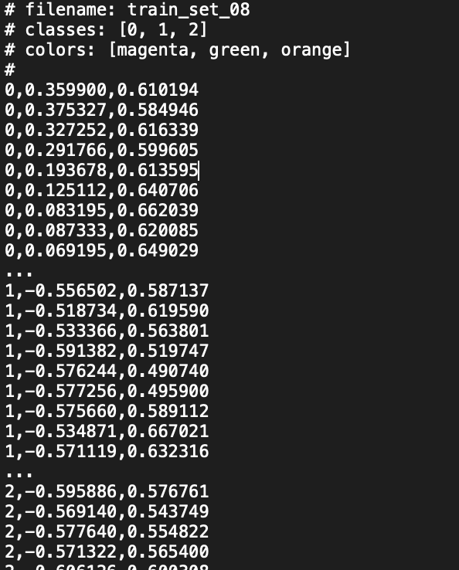
ACCOMPLISHMENT
Evidence of engineering design
Optimization process
V1.3.0 release:
Implemented feedback from V1.2.0
Re-formatted data files
Fixed GUI bugs
Built Use Cases
Restructured module directories
V1.4.0 release:
Implemented feedback from V1.3.0
Implemented 8 Demo datasets
Improved Parameter UI
Built User Survey
Notes:
Dakota - Here we can see a small snippet of our iterative design process. For every release version, we prioritize implementing the feedback provided by testers for the previous version. For these early versions, much of this feedback involves fixing crash-outs and accounting for errors in the application due to unforeseen user activity. In the future, this feedback will focus more on user survey responses, detailed in the section on V1.4.0. After implementing feedback, we have decided to tackle different aspects of the application’s functionality with each version, focusing on specific modules at every step. Here you can see our new format of comma-separated value (.csv) data file, utilizing comments to describe necessary file information such as filename, class names, and colors.

Slide 14
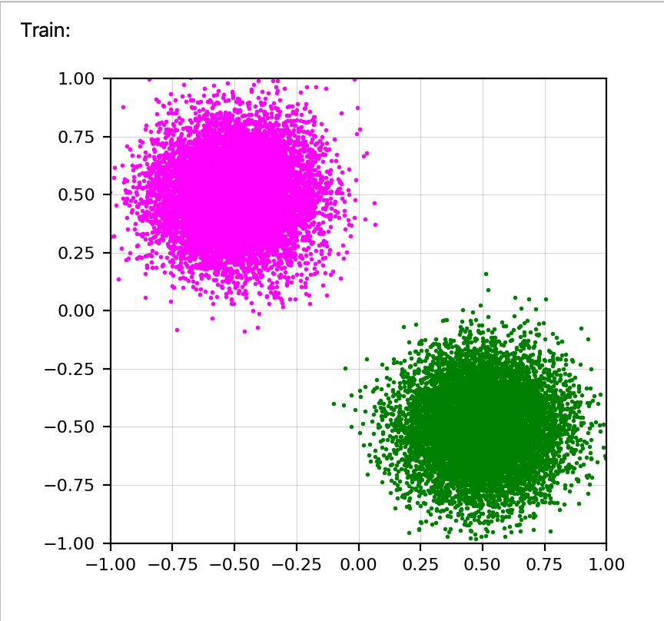
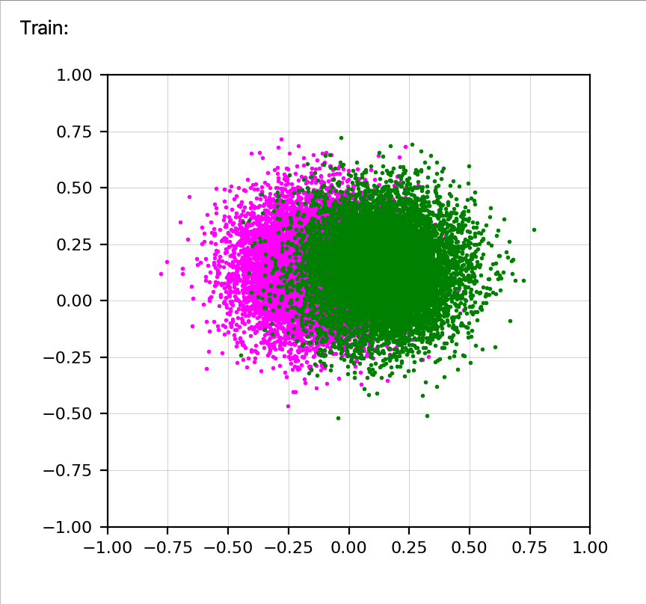
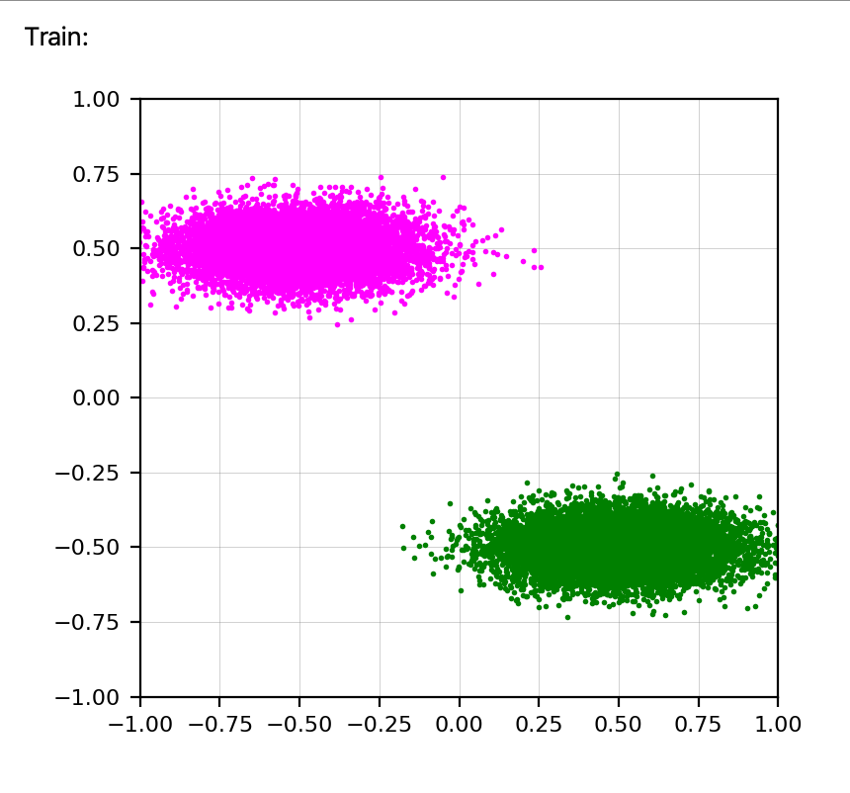
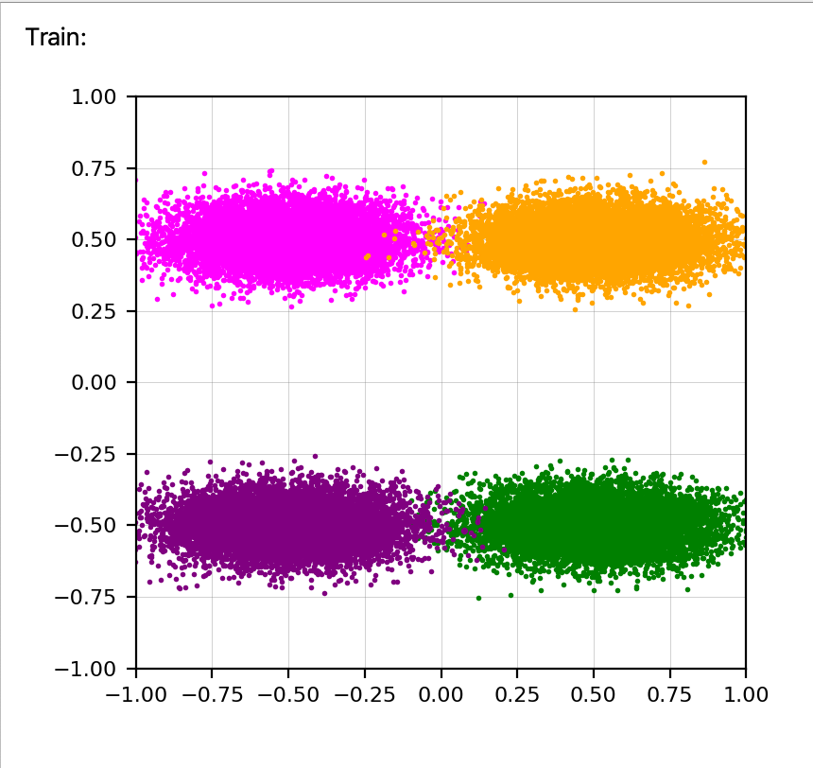
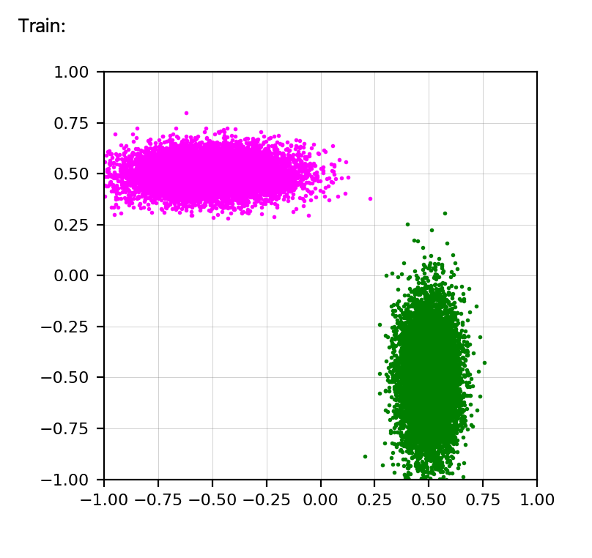
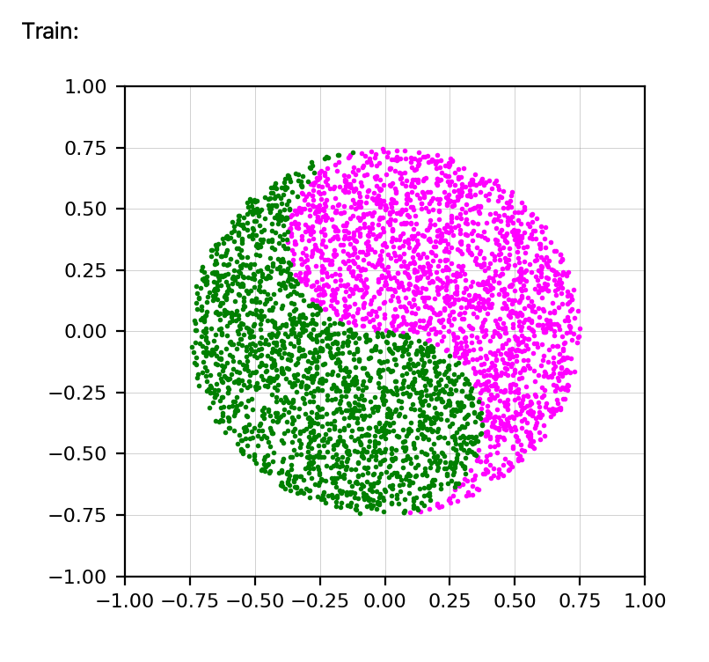
ACCOMPLISHMENT
Evidence of engineering design
8 Demo Datasets
2 Gaussian
4 Gaussian
Overlapped Gaussian
2 Ellipse
4 Ellipse
Rotated Ellipse
Toroidal
Yin-Yang
Notes:
Dakota - Here we can see our 8 demos in action. Users can tweak the parameters of these demos to alter their position on the screen and sizes by changing the class means and covariances. While some of these demos represent datasets that are more realistic than the others, they will all demonstrate to students the functionality of the machine learning algorithms.

Slide 15
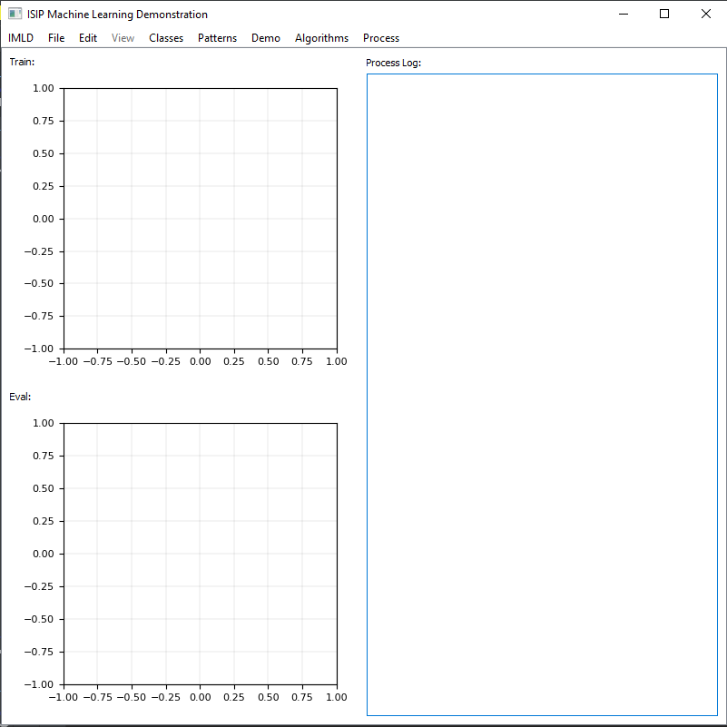
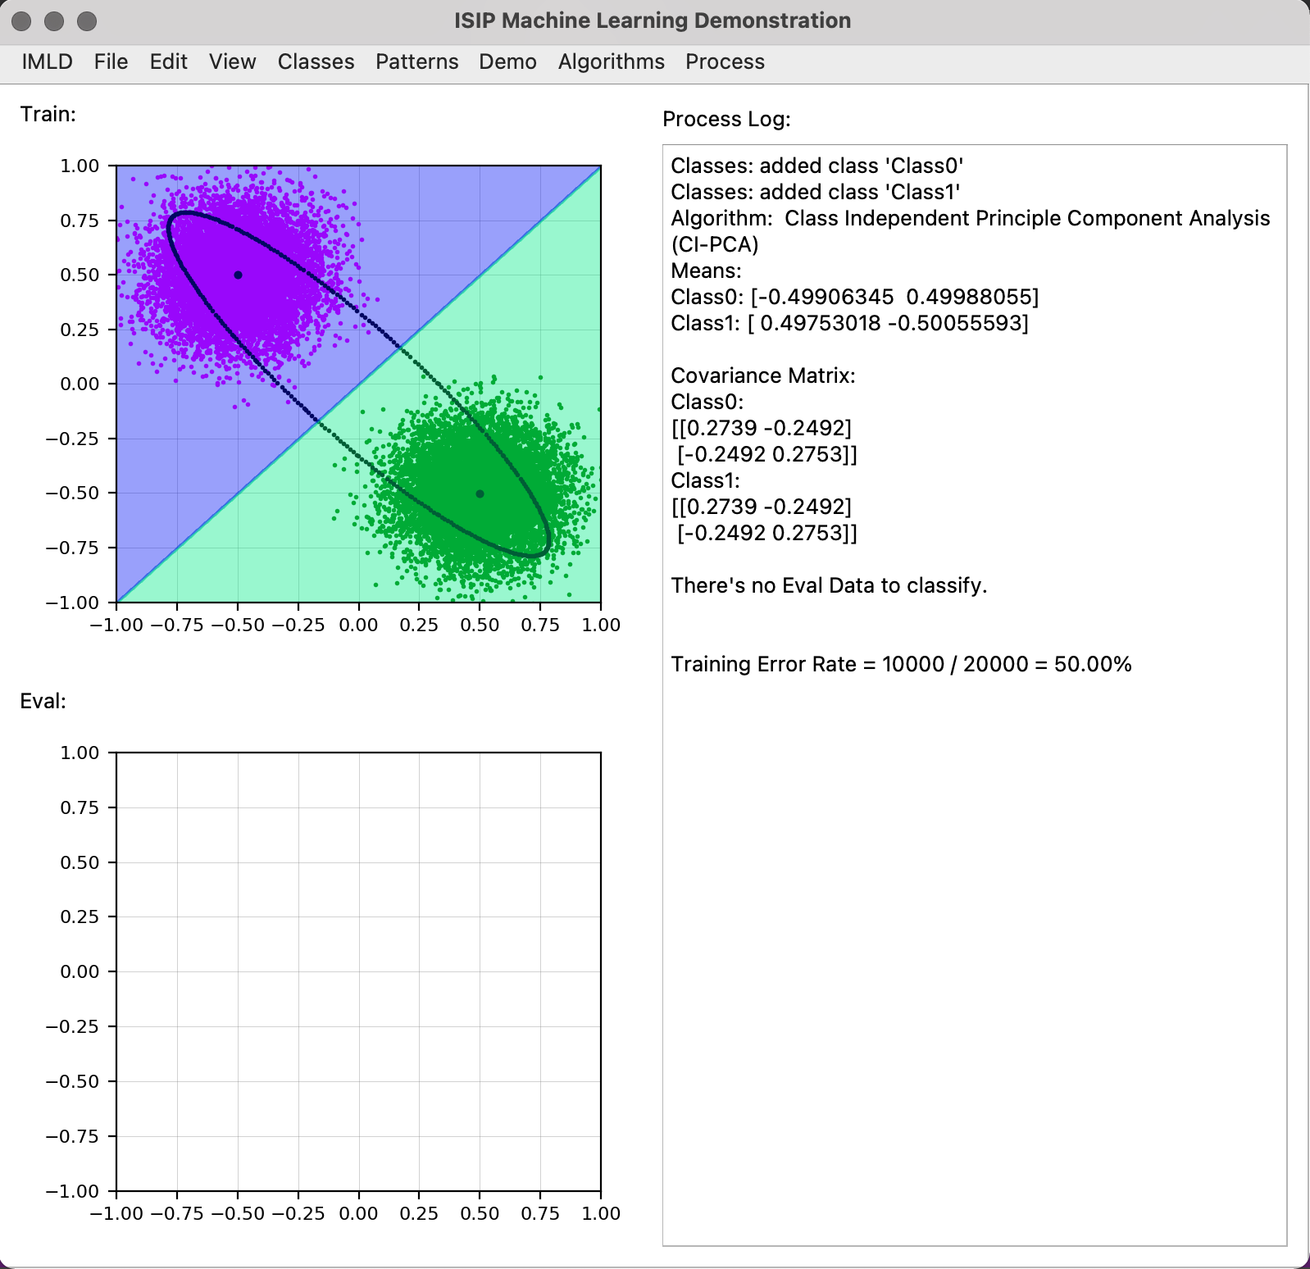
ACCOMPLISHMENT
Evidence of engineering design
Model Input/ Output
Notes:
Data points are stored within a CSV file shown in the leftmost image. Within the heading, denoted by the hashtags or poundsigns, the filename is stored as well as the number of classes and their respective colors. Below the heading is information about each class, each line corresponds to one data point, holding the number of the class it belongs to followed by the x and y coordinates. This is repeated for the potentially millions of data points. This information is then plotted within the Train or Eval windows which are shown in the middle image. Along with the Train and Eval windows the GUI also contains the process log with will output information the user could find useful. The rightmost image shows a completed Class Independent PCA algorithm on a 2 Gaussian distribution demo. The process log shows that 2 classes were added, then the Class Independent PCA algorithm was selected. Showing the means of each class, along with the coveragence matrices then finally the eval and training error rate, although with this image there is no data within the Eval window, thus the Train is only shown.

Slide 16
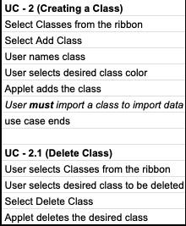
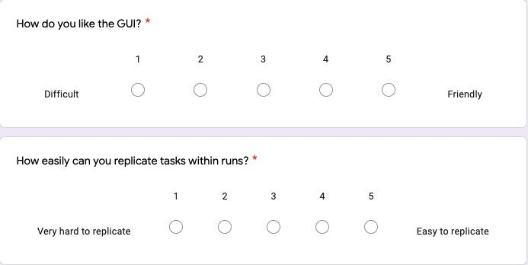
ACCOMPLISHMENT
Test Methods
Testing Goals
Uncover Bugs
Ensure newly added features are working correctly
Allow new users to test intuitiveness
Testers are able to repeat previous tasks without Use Cases
Anyone should be able to use IMLD with Use Cases
Survey for feedback on user friendliness
Notes:
Testing should focus simulating bite size portions of the application in which changes were just made, in addition to ensuring the previous features remain unchanged. We felt the most optimal way to achieve this was by strategically ordering the releases to build up to the most intensive tasks for the application. [Testing Goals] Within the first release we focused on features that have to be in order to run the machine learning algorithms, like adding classes to hold groups of data and drawing data points.These features are broken up into stand alone tasks called use cases, the use cases are then broken down into single steps of what the user should be doing and how the application should respond. [Reference top image] With the second release and all following releases testers also received a survey, to gage their options on how different features are structured. [Reference bottom image]

Slide 17
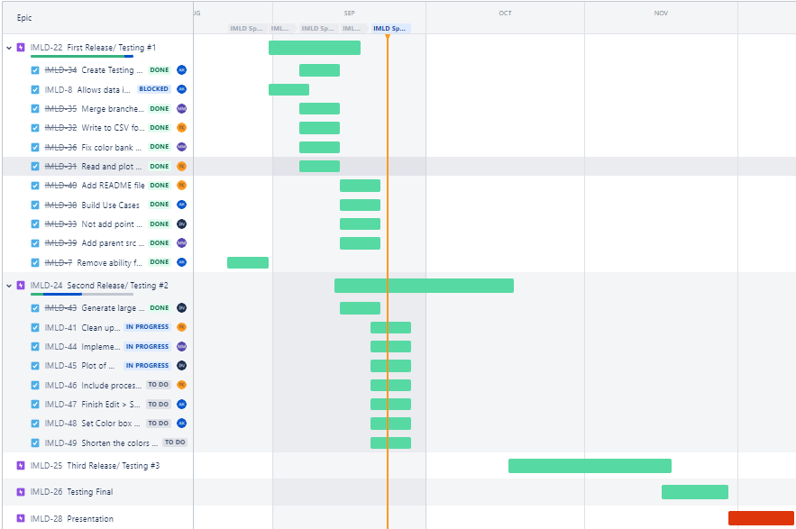
NEXT STEPS
Notes:
This version of the gantt chart, which was first published in September, shows the issues we were focused on in the first and second releases. Currently we are working on the third release which began on October 17th and will be released to testers on November 17th. In preparation for the next release we are currently implementing the feedback from testers in addition to finishing the rest of the machine learning algorithms. Structuring the code to run all the algorithms like how PCA is currently being called upon within the code. Once the algorithms are finished the IMLD applet should have all of the major features working as anticipated for the most part. The final release will primarily be focused on squishing all of the bugs that we can, in order to create the best overall user experience, and will run from November 17th to December 4th. This final release will be slightly shorter than the rest because we will as we will be taking IMLD to the IEEE Signal Processing in Medicine and Biology Symposium on December 4th.

Slide 18
Thank you for attending

