Slide 1
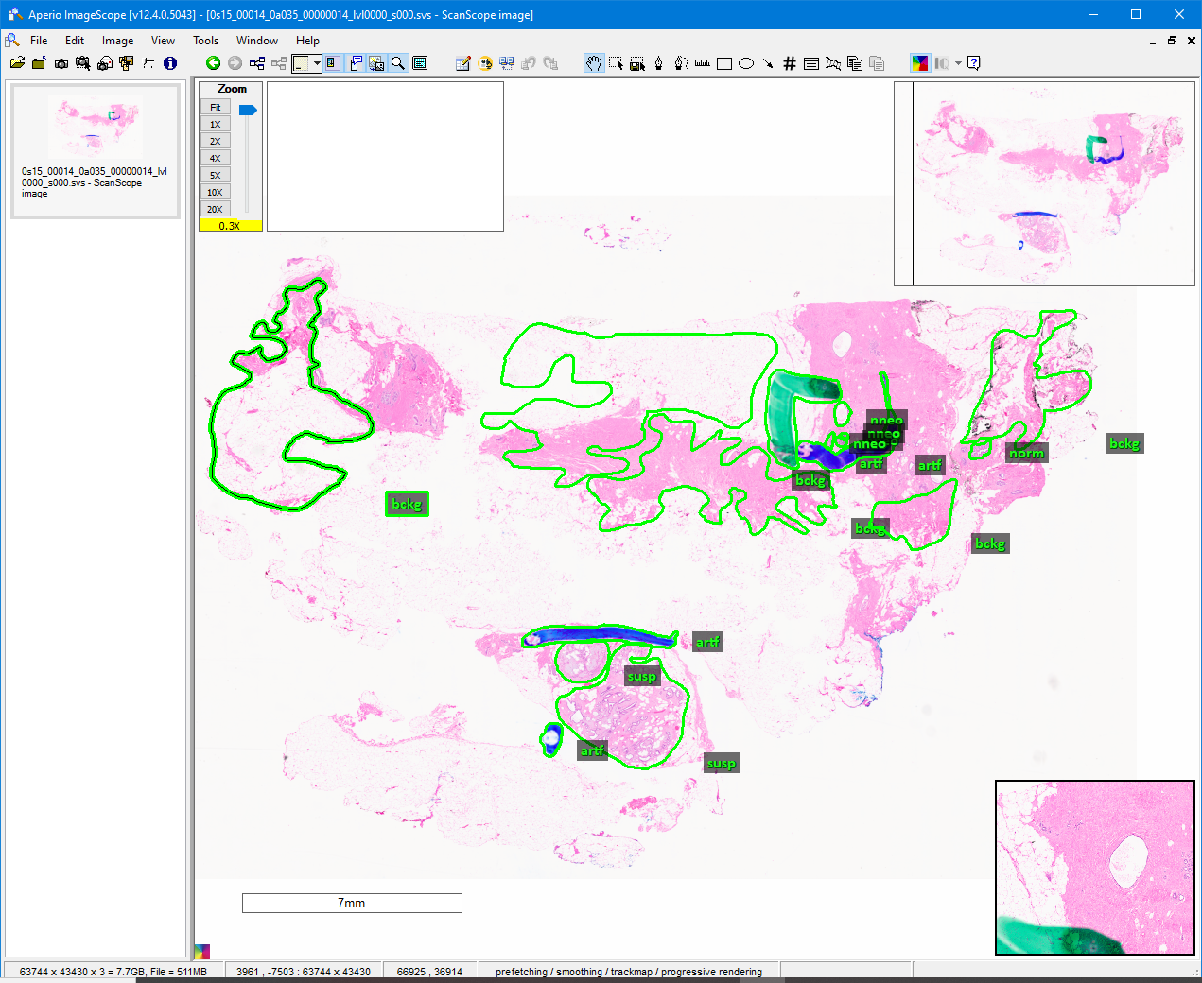
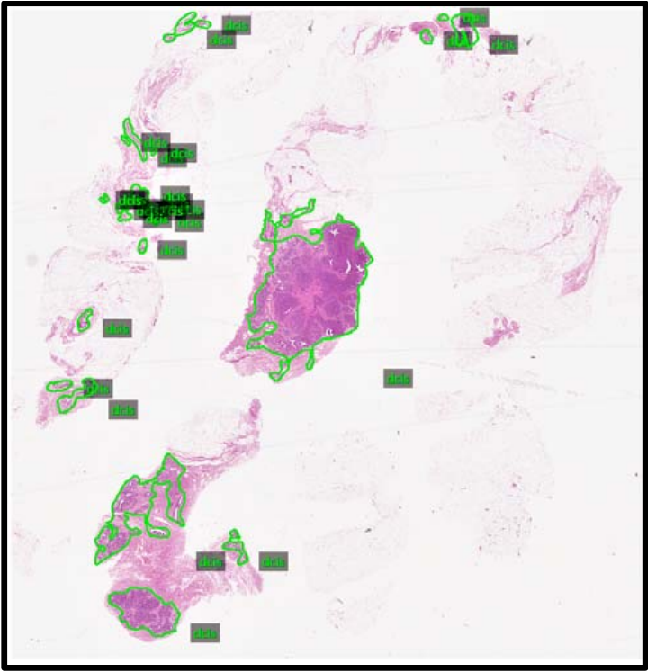
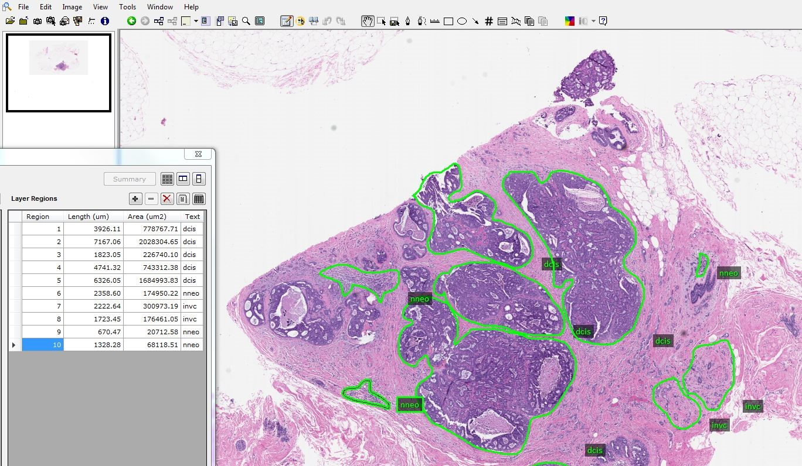
Digital Pathology (DPATH) Breast Tumor Corpus
“Annotation Test”
Presented by Julien Simons
Neural Engineering Data Consortium
Temple University

Slide 2
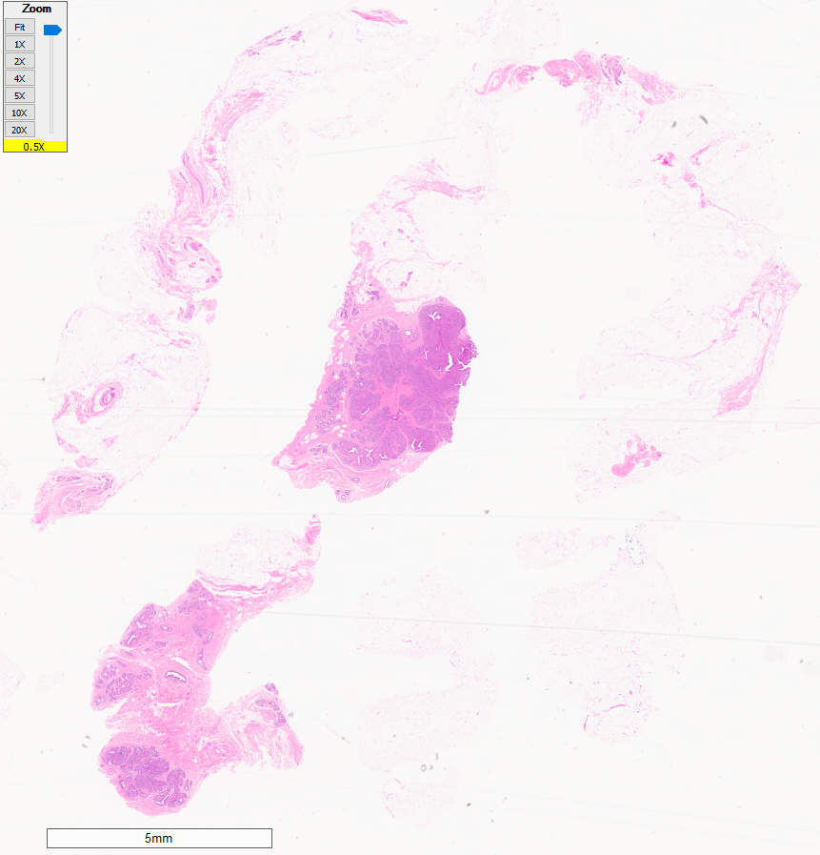
Annotation Test
The Slide Sample
This is an informal test
to see how ambiguous
breast tumor regions are
to inexperienced annotators.
Winner takes home a free
lunch…
Annotators
Nabila
Nader
Nikita
Vahid

Slide 3
Tumor Annotations
Cancerous
Ductal carcinoma in situ (DCIS): dcis
Invasive ductal carcinoma (IDC): indc
Carcinogenic Signs
Non-neoplastic feature: nneo
Inflammation: infl
Suspected carcinogen: susp
Non-Cancerous
Normal cells: norm
Background (stroma): bckg
Artifact (e.g. grease stain, stitches): artf
Indistinguishable tissue: null

Slide 4
Information & Resources
Provided Information
https://www.isip.piconepress.com/tmp/dpath/
https://www.isip.piconepress.com/publications/presentations_misc/2020/nedc/weekly_20200619/
Additional Resources
https://www.dropbox.com/sh/hysm07jg0m9orss/AAApCLS4Y_bNxYnJa93xOig8a?dl=0

Slide 5
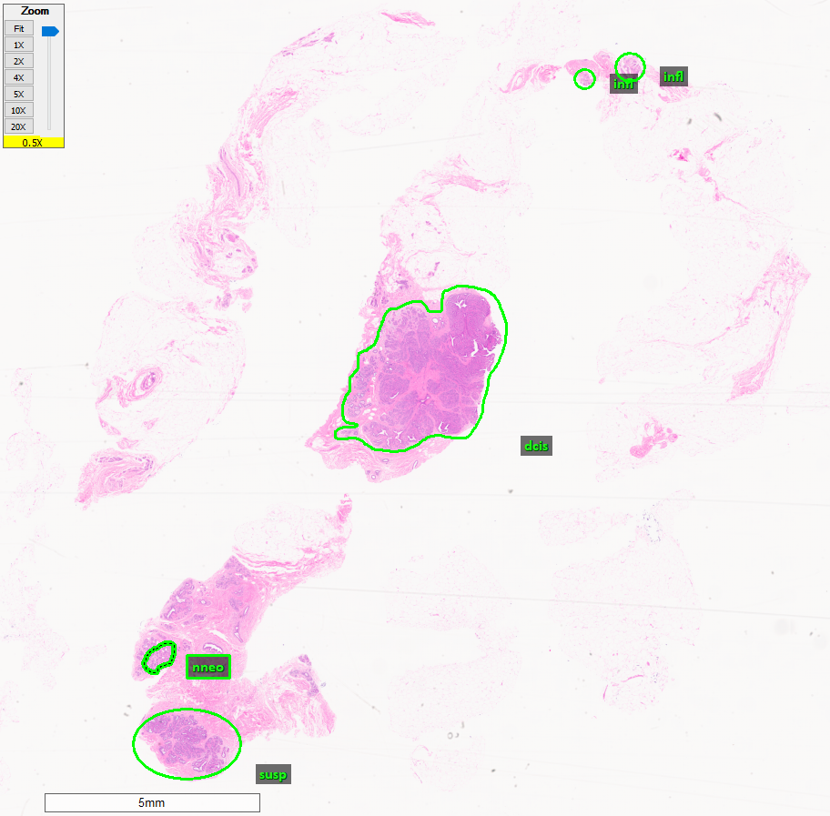
Nabila’s Annotation
Scoring—
[X = 5 annotations] [Y = 4 labels]
1). norm — n/a
2). bckg — 0%, missed
3). null — n/a
4). artf — n/a
5). nneo — 100% correct
6). infl — 5% correct
7). susp — 90% correct
8). dcis — 90% correct
9). indc — n/a
= 57% + (X/2)% + Y%
= 64% total

Slide 6
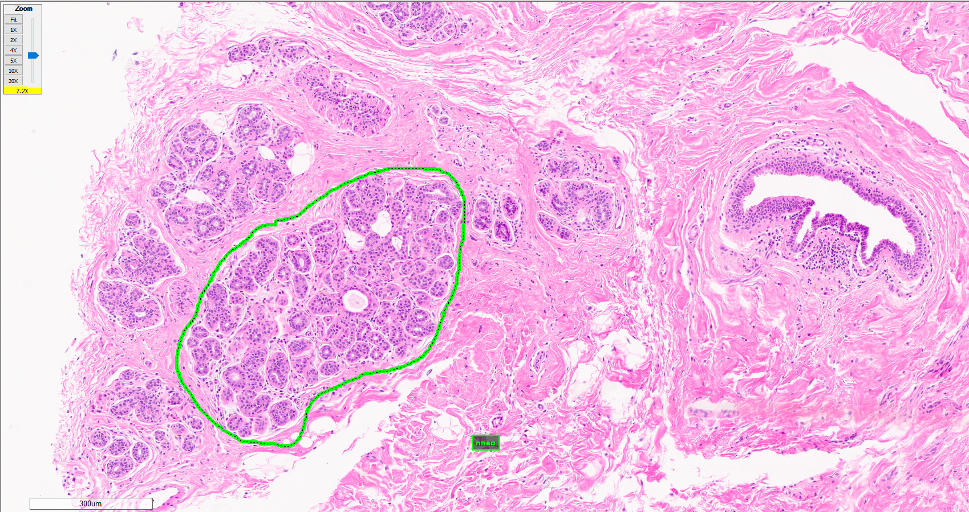
Nabila’s Annotation: Non-neoplastic
nneo—100% correct
Hyperplasia; inflamed, abnormally shaped lobules. Potentially early onset of DCIS.

Slide 7
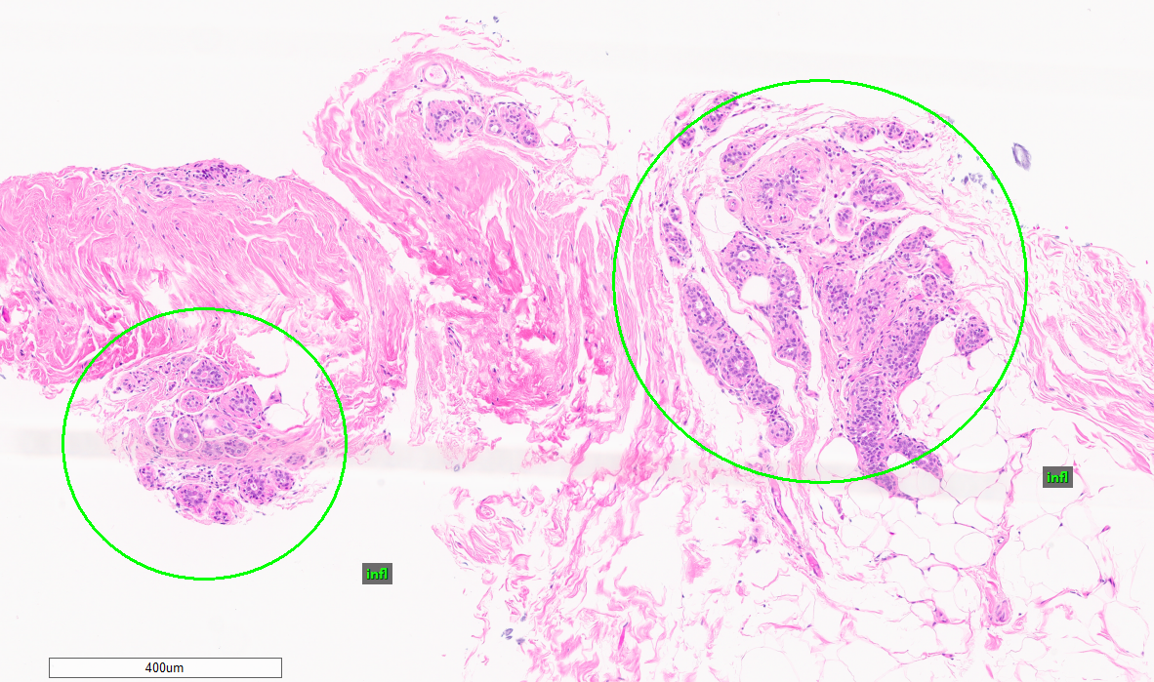
Nabila’s Annotation: Inflammation
infl—5% correct
Mislabeled small groupings of lobules; potentially hyperplastic; far right is suspicious and possibly inflamed on the lower right region.

Slide 8
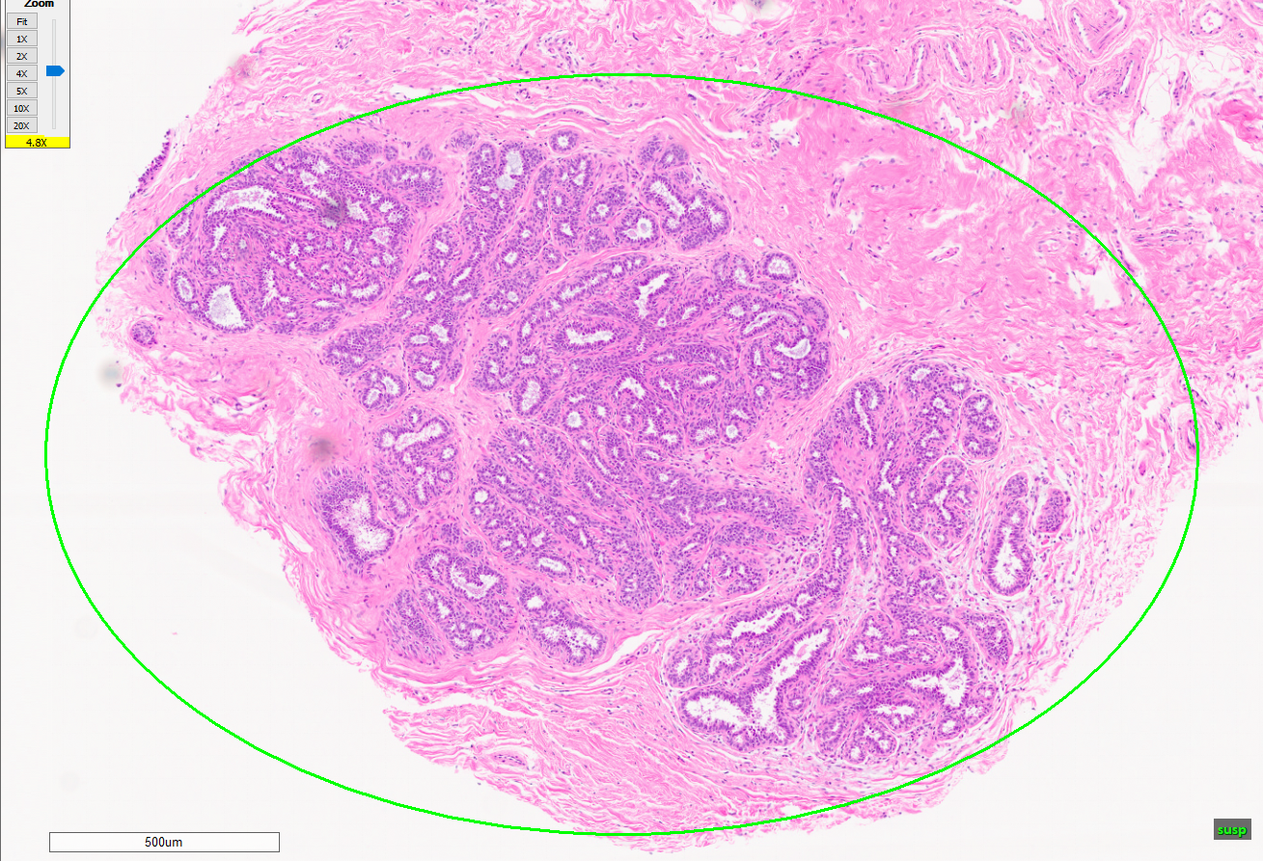
Nabila’s Annotation: Suspected
susp—90% correct
Shows a highly suspected DCIS region. Seems to be breaking apart with high inflammation and irregular groupings of lobules. There is a slight chance they are non-neoplastic features instead.

Slide 9
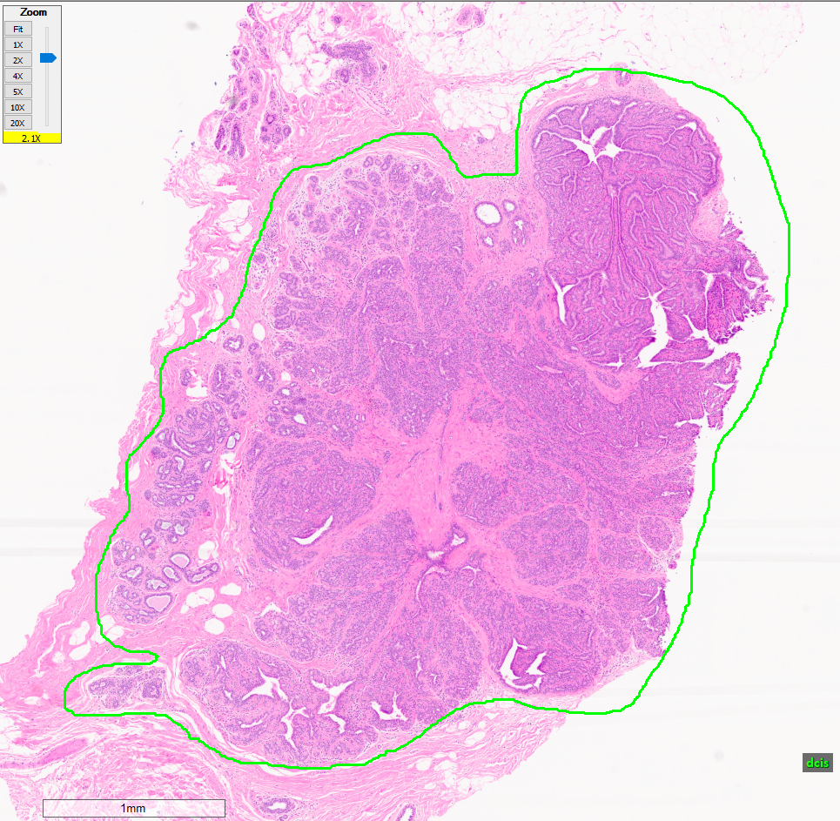
Nabila’s Annotation: Ductal carcinoma in situ
dcis—90% correct
Includes intraductal papilloma (top right) and non-neoplastic features (large portion on the left). All of this surrounding region is inflamed with abnormal features, so including it within the main dcis region might actually be resourceful for the machine learning.

Slide 10
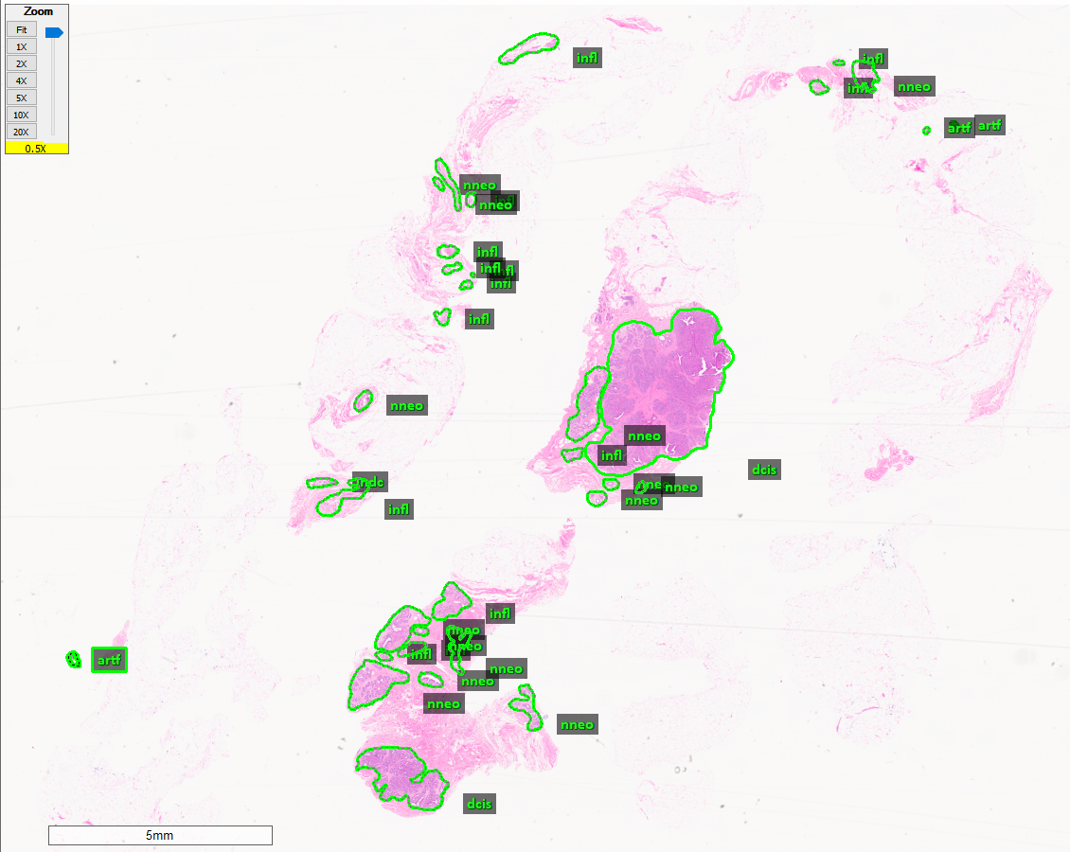
Vahid’s Annotation
Scoring—
[X = 34 annotations]
[Y = 6 labels] 1). norm — n/a
2). bckg — 0%, missed
3). null — n/a
4). artf — 100% correct
5). nneo — 95% correct
6). infl — n/a, 0% correct
7). susp — 100% correct
8). dcis — 90% correct
9). indc — n/a, 0% correct
= 64% + (X/2)% + Y%
= 87% total

Slide 11
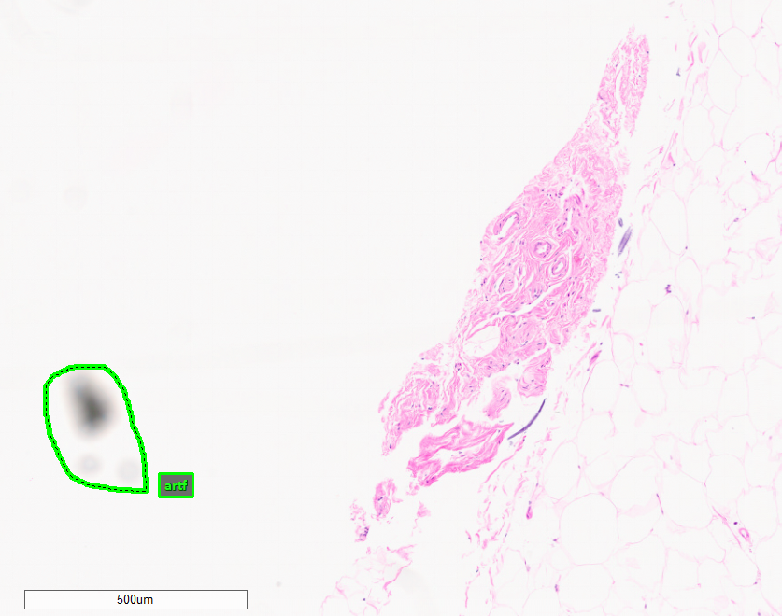
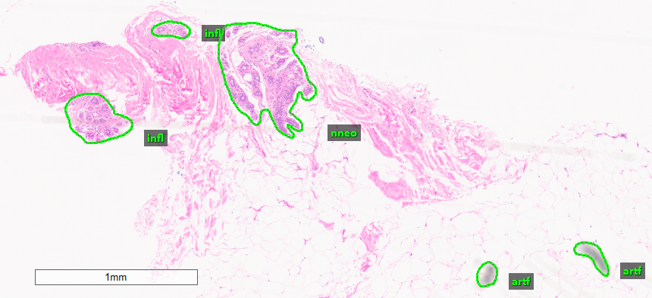
Vahid’s Annotation: Artifact
artf—100% correct
Small, unfocused particles on the slide.

Slide 12
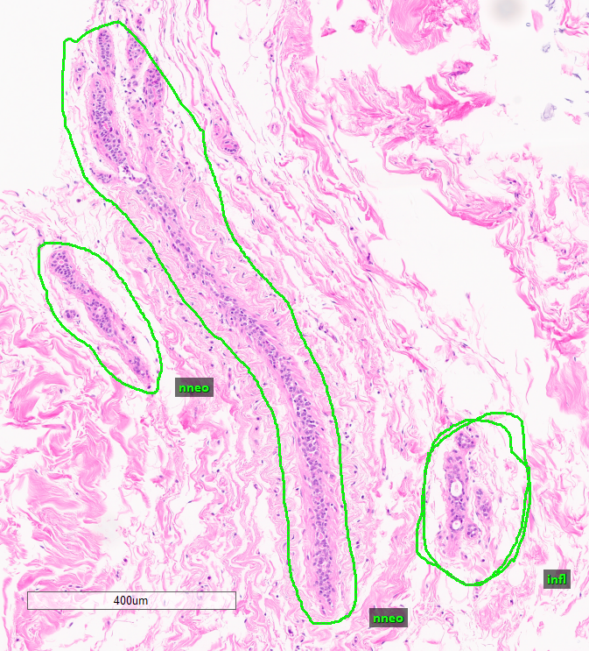
Vahid’s Annotation: Non-neoplastic
nneo—95% correct
All correct, except for this large duct which is potentially normal. Due to being very long and thin, the sample could have been cut so that it grazed the top layer of the shown duct. If done so, it would explain the lack of lumen (white space) within.

Slide 13
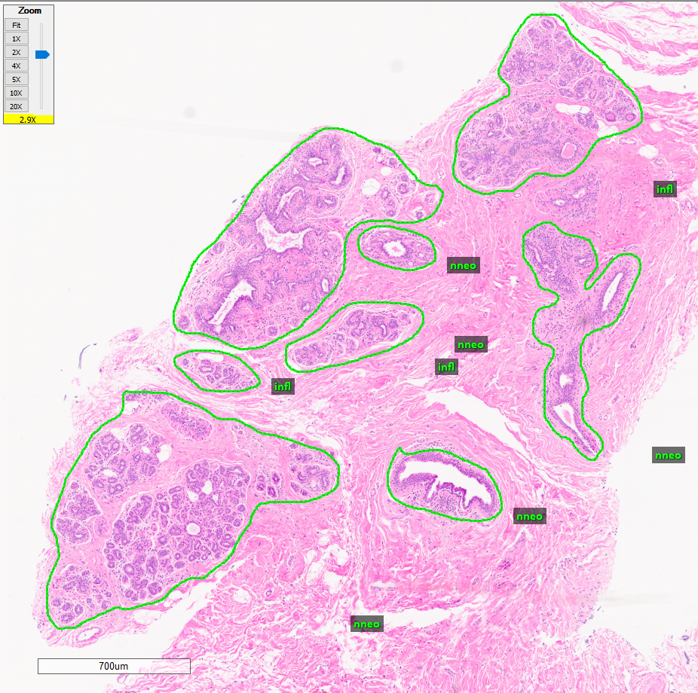
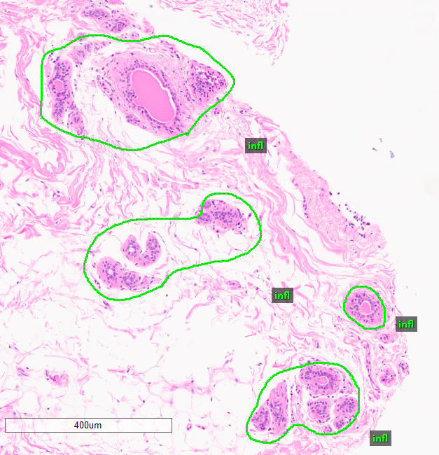
Vahid’s Annotation: Inflammation
infl—0% correct
Mislabeled groupings of non-neoplastic lobules.

Slide 14
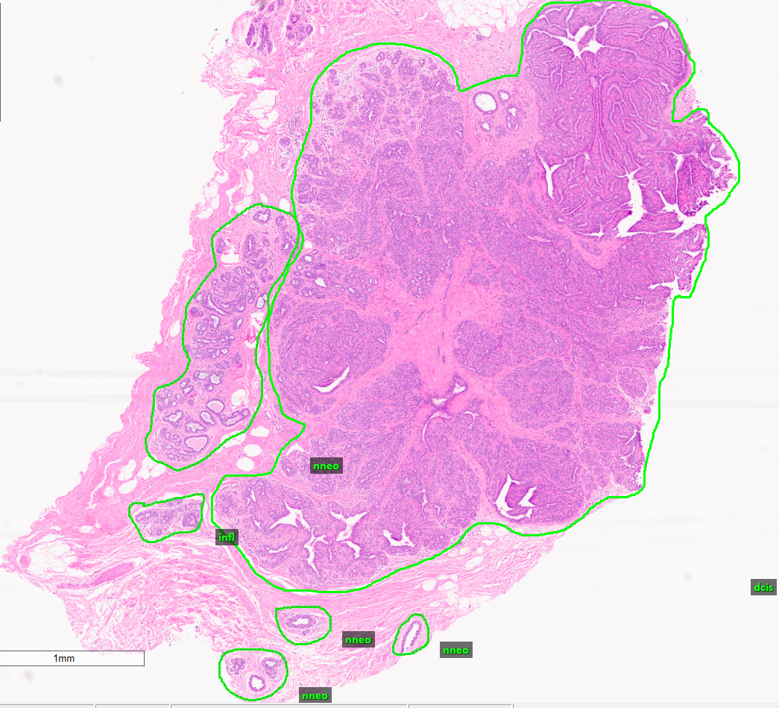
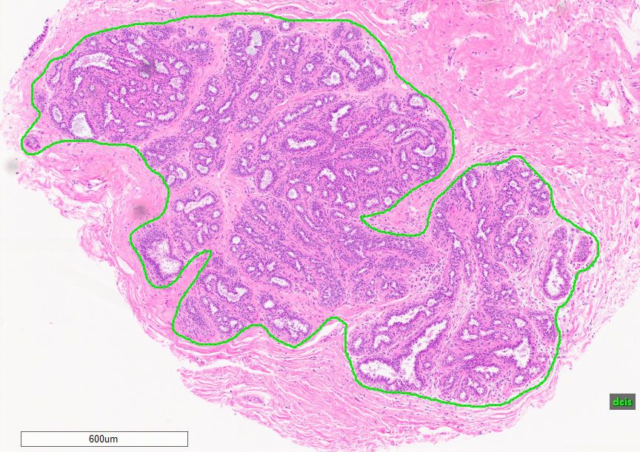
Vahid’s Annotation: Ductal carcinoma in situ
dcis—90% correct
Incorrectly included suspicious intraductal papilloma (top right).
Correctly annotated DCIS.

Slide 15
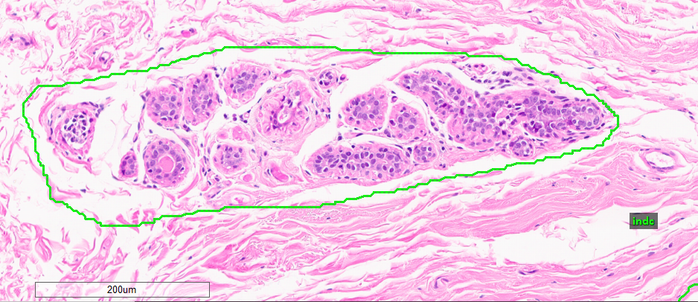
Vahid’s Annotation: Invasive ductal carcinoma
indc—0% correct
Mislabeled groupings of non-neoplastic lobules.

Slide 16
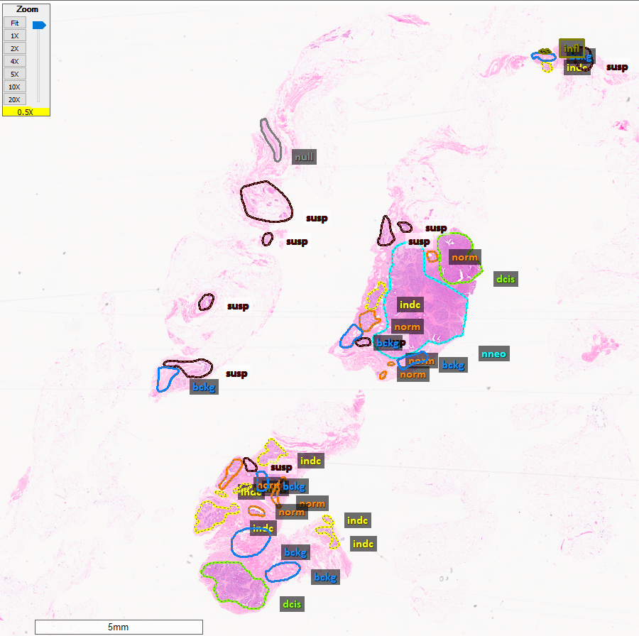
Nader’s Annotation
Scoring—
[X = 34 annotations]
[Y = 8 labels]
[Z = 5% creative bonus] 1). norm — n/a, 0% correct
2). bckg — 100% correct
3). null — n/a, 0% correct
4). artf — n/a
5). nneo — 0% correct
6). infl — 100% correct
7). susp — 70% correct
8). dcis — 50% correct
9). indc — n/a, 0% correct
= 40% + (X/2)% + Y% + Z
= 70% total

Slide 17
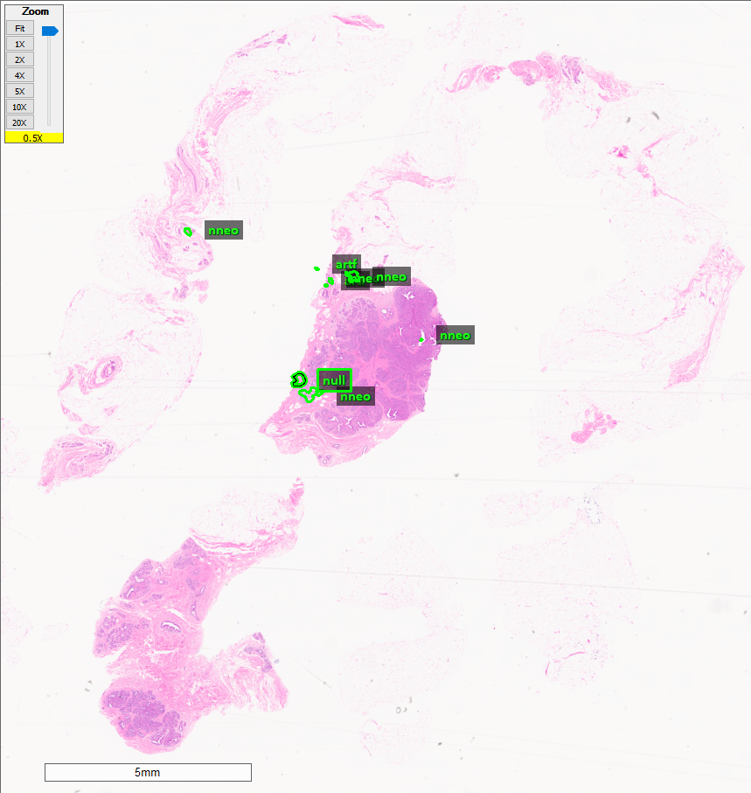
Nikita’s Annotation
Scoring—
[X = 8 annotations]
[Y = 3 labels] 1). norm — n/a
2). bckg — 0%, missed
3). null — 50% correct
4). artf — 100% correct
5). nneo — 100% correct
6). infl — n/a
7). susp — 0%, missed
8). dcis — 0%, missed
9). indc — n/a
= 42% + (X/2) + Y%
= 49% total

Slide 18
Rankings
Rank | Annotator | Score | Feedback
1. | Vahid | 87% | High overall accuracy, quantity, and variety. Make sure to use the Pen Tool—not the Negative Pen Tool beside it.
2. | Nader | 70% | High quantity and variety, and creative intuition using annotation layers (uniquely colored labels).
3. | AVERAGE (All) | 68% | Need better understanding of inflammation and normal cells. Do not forget at least one easy annotation for a purely background region.
4. | Nabila | 64% | High carcinogen accuracy but needs work on other features.
5. | Nikita | 49% | Excellent accuracy but needs more variety. Cannot skip the main features of a sample.

