Slide 1
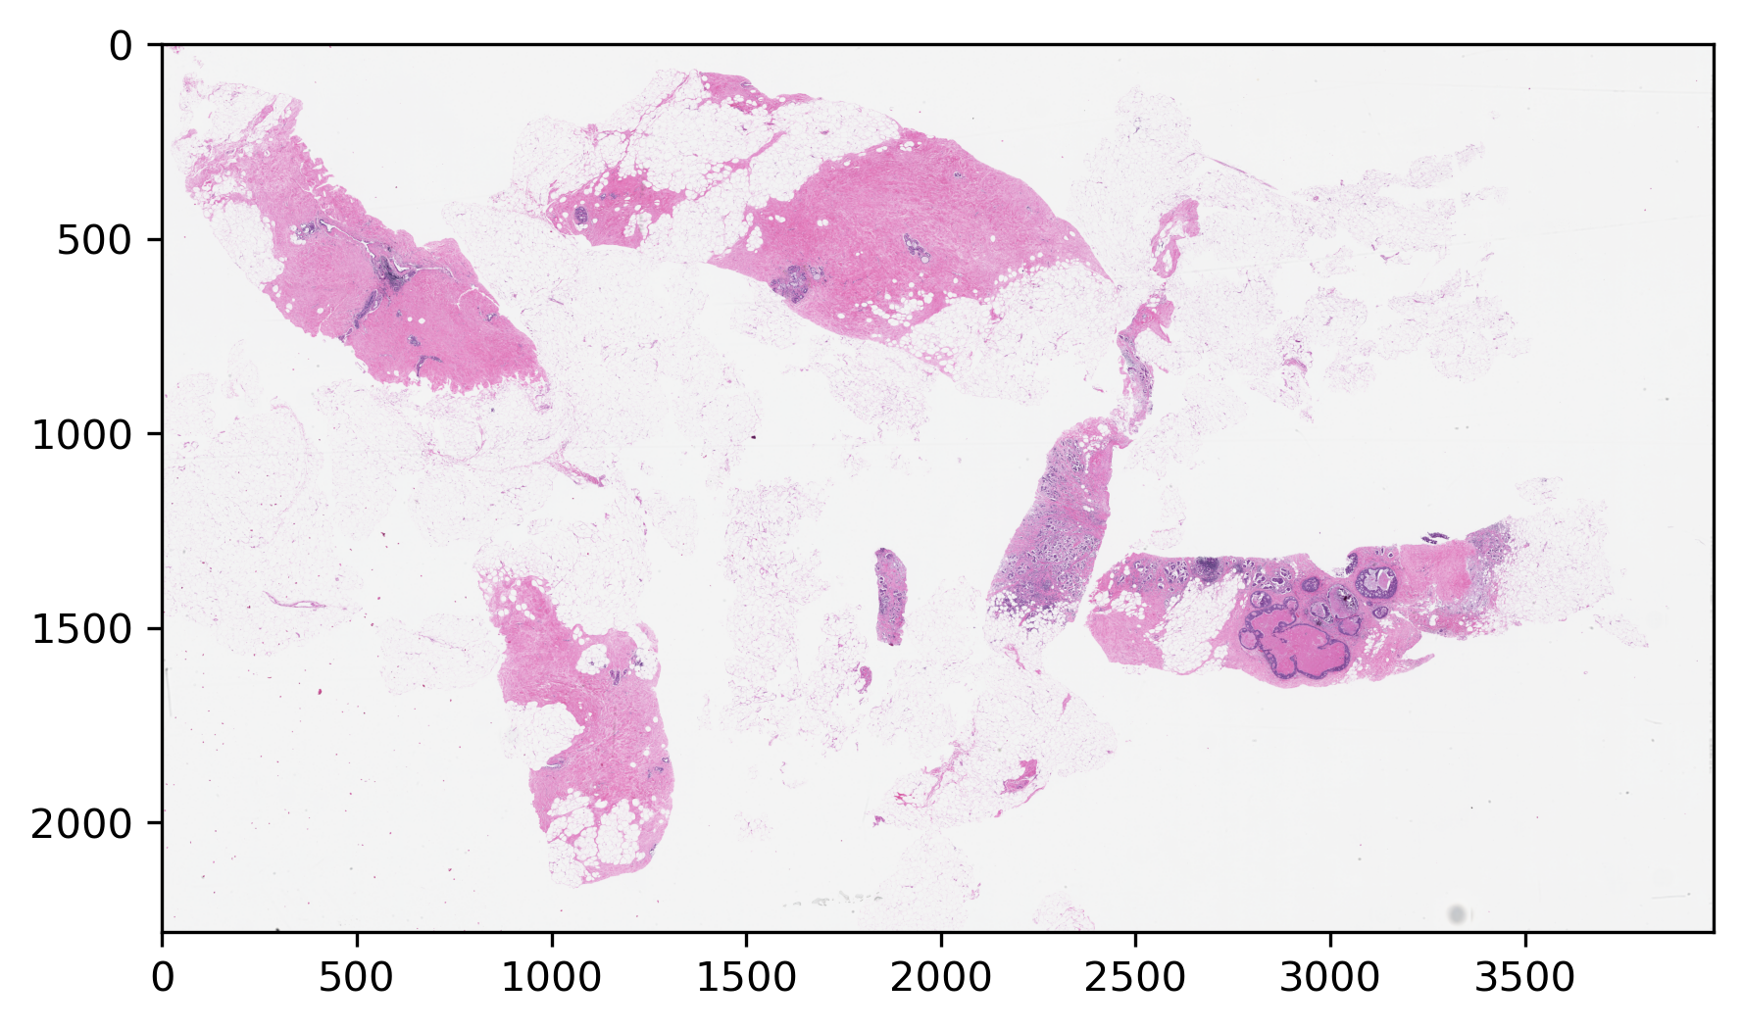
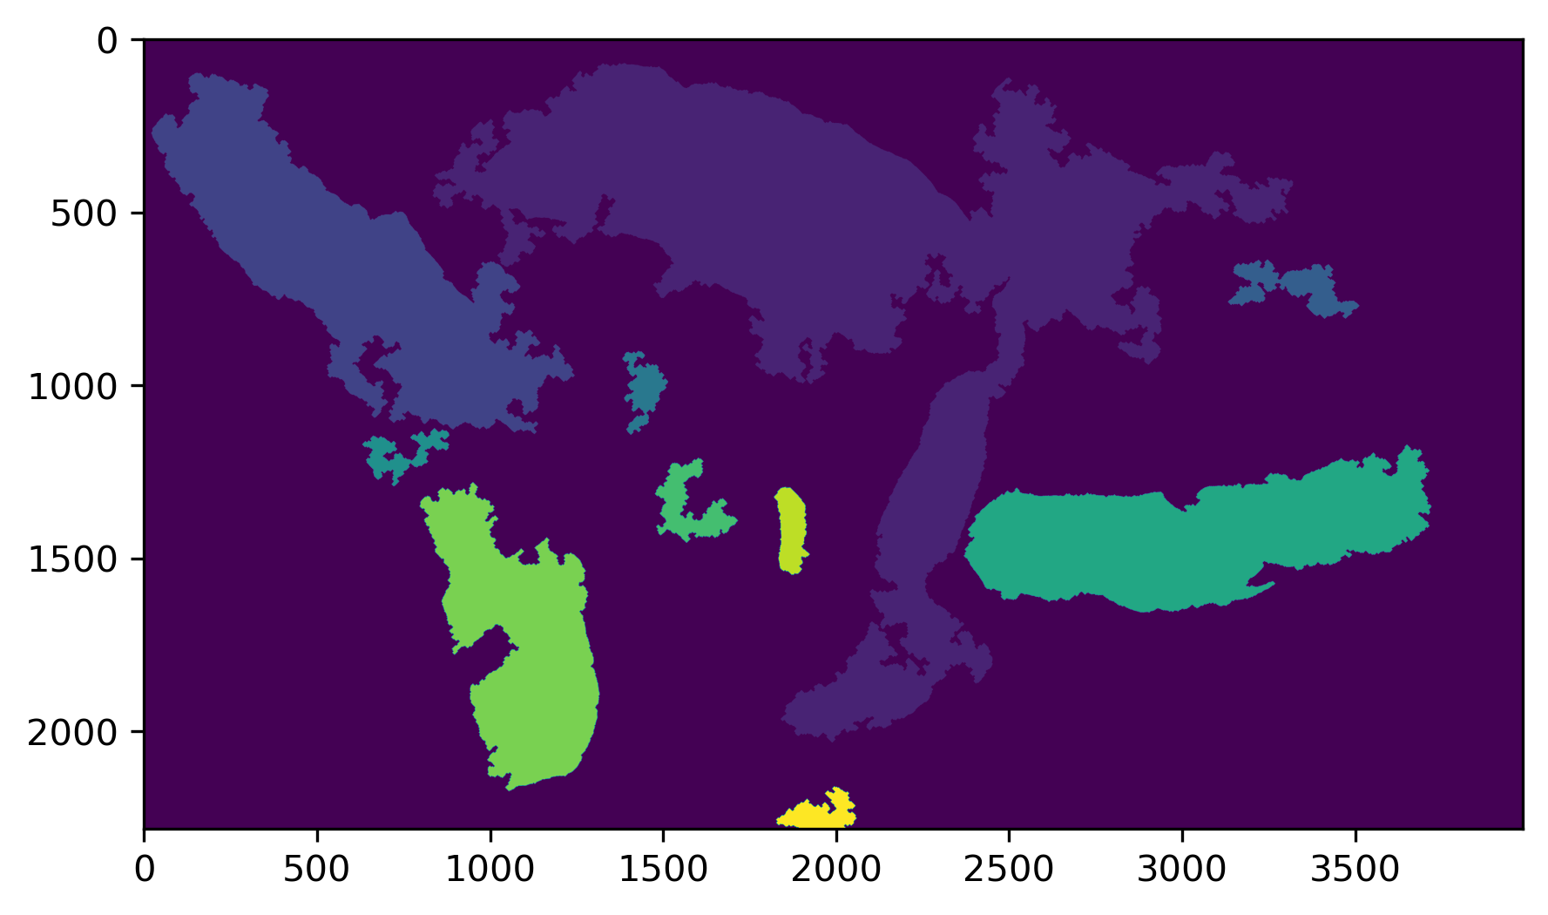
Digital Pathology Image Interpretation
Image Segmentation
Presented By:
Vahid Khalkhali
Neural Engineering Data Consortium,
Temple University

Slide 2
Outline
Pathology Imaging
Why Segmenting?
Segmentation Levels and Methods
Next steps for classification
Appendix 1: Convex Hull
Appendix 2: Segmentation Methods
References

Slide 3
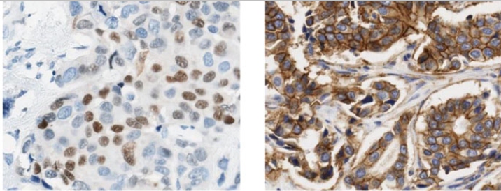
Pathology Imaging
TISSUE PREPARATION AND IMAGING
Formalin fixation and embedding in paraffin
3–5 μm cutting using a microtome (a high precision cutting instrument)
Dyeing with H&E stains (hematoxylin and eosin) that highlight nuclei and cytoplasm.
Our current dataset is H&E
Hematoxylin binds to DNA and thereby dyes the nuclei blue/purple.
Eosin binds to proteins and dyes other structures (cytoplasm, stroma, etc.) pink.
IHC is a more advanced staining technique, which makes use of antibodies to highlight specific antigens in the tissue. In breast cancer, IHC is commonly used to highlight the presence of estrogen (ER), progesterone (PR), and human epidermal growth factor 2 (HER2) receptors.

Slide 4
Why Segmenting?
Greek
Histos: tissue
Pathos: suffering
Logia: study of
Histopathology
Nuclei
Tubules
Mitosis
Nuclear pleomorphism
Lack of tubule formation
Mitotic figures ratio
Bloom–Richardson grading system: The standard approach of assessing tumor proliferation in pathology labs is mitosis counting.
Most distinctive feature of the mitotic figures is their hyperchromicity.

Slide 5
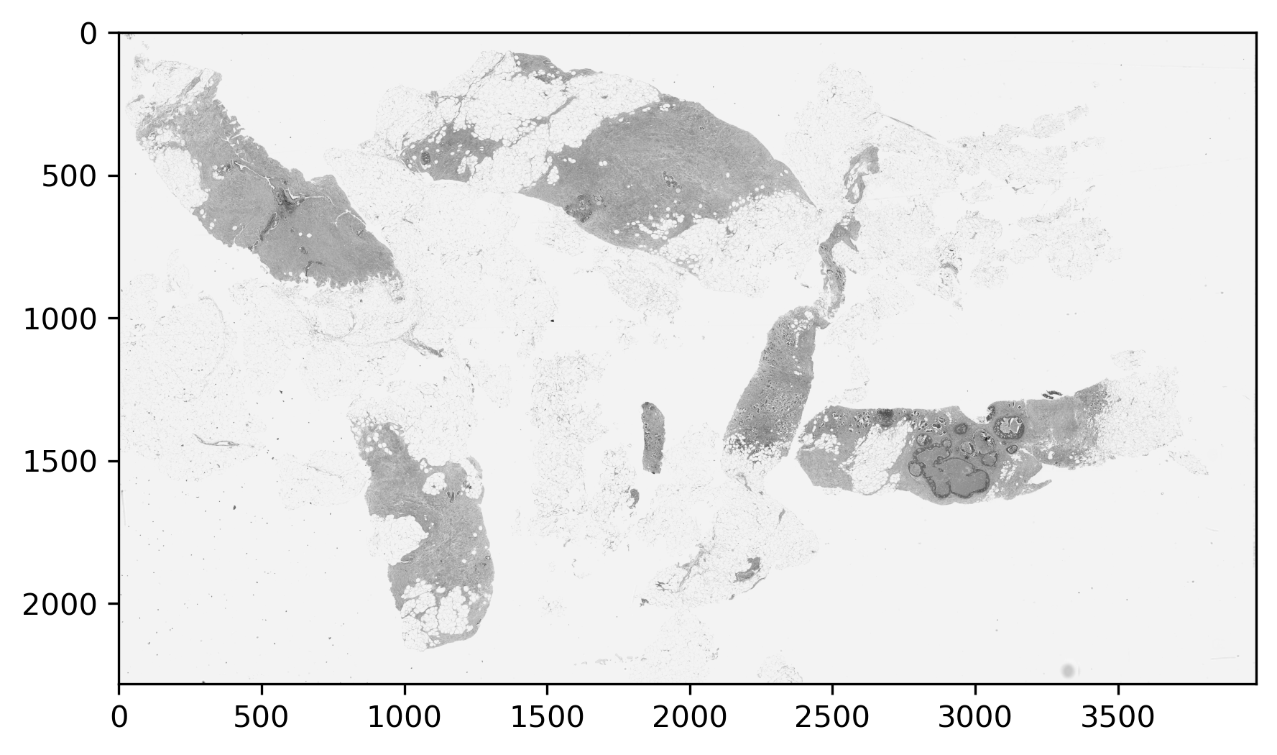
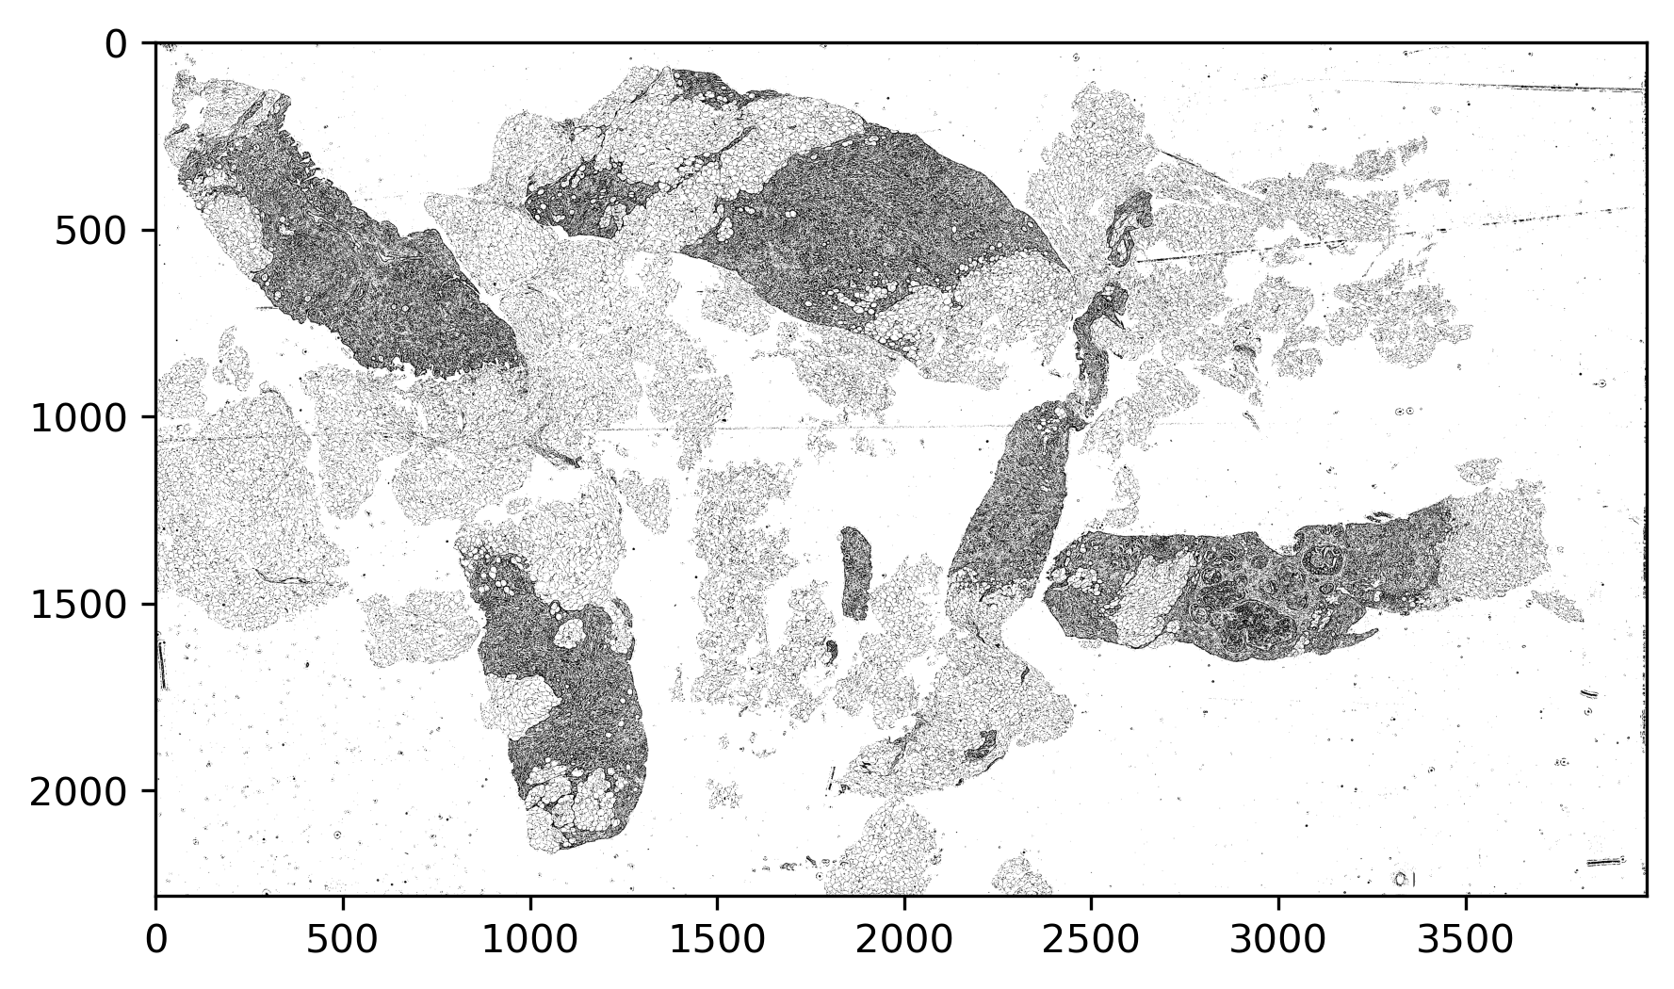
Segmentation Levels and Methods Binarization – Global View
RGB
Gray Scale
Background removal
Global thresholding
Adaptive local thresholding
Black and White

Slide 6
Segmentation Levels and Methods – Detail View
Background removal
Global thresholding
Adaptive local thresholding

Slide 7
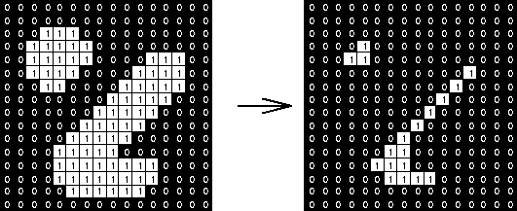
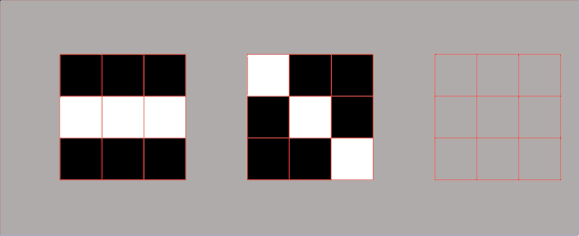
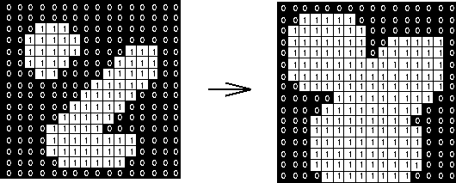
Segmentation Levels and Methods (Morphology)
http://datahacker.rs/006-morphological-transformations-with-opencv-in-python/
Erosion: a 3×3 square structuring element (www.cs.princeton.edu/~pshilane/class/mosaic/)
Dilation: a 3×3 square structuring element (www.cs.princeton.edu/~pshilane/class/mosaic/).

Slide 8
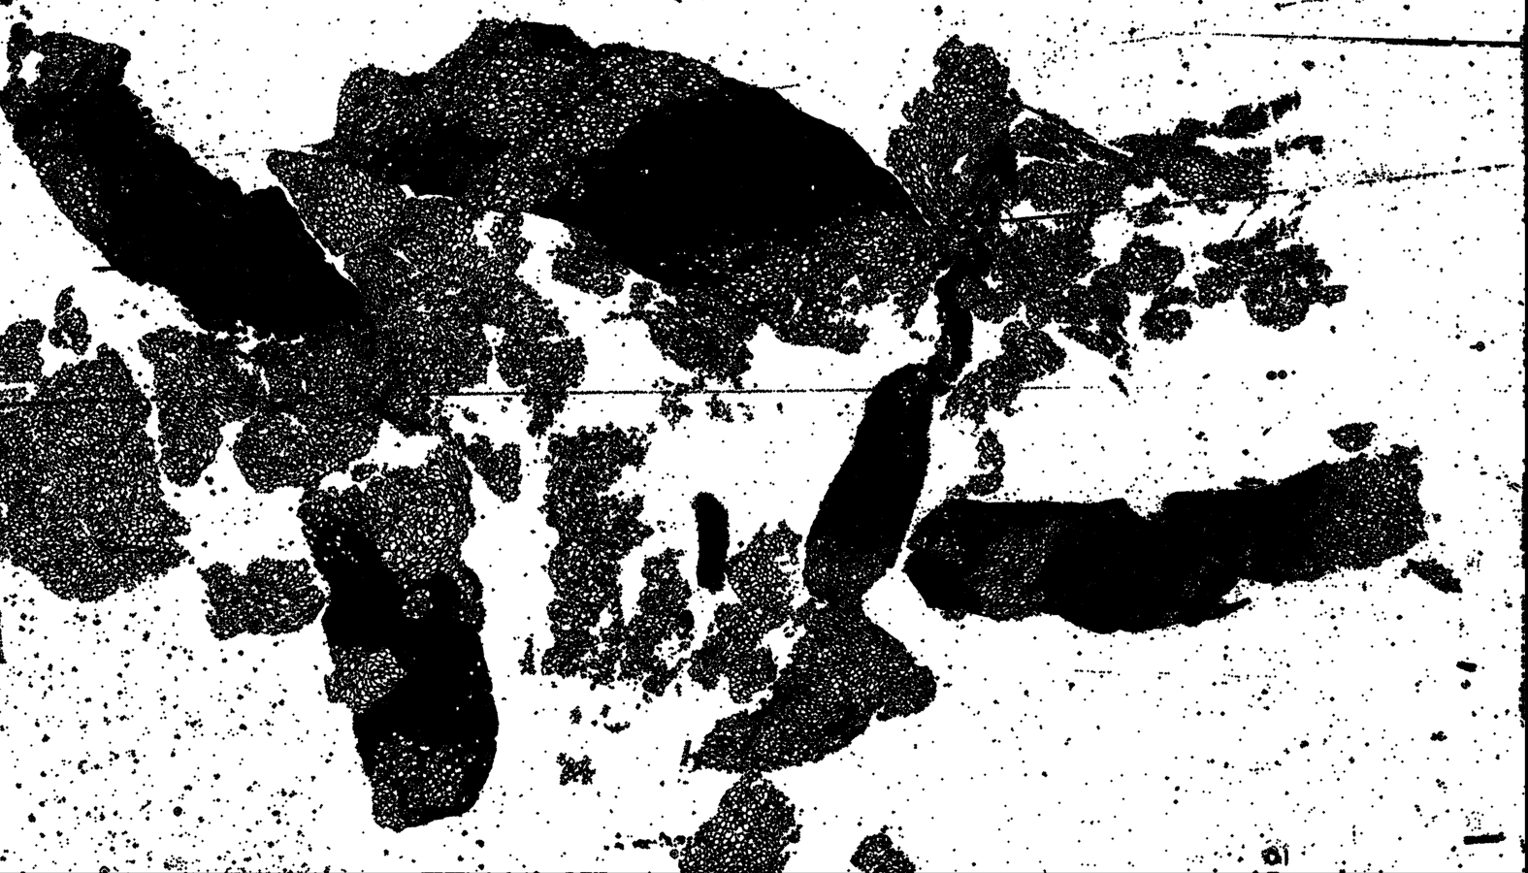
Segmentation Levels and Methods (Morphology)
Holes with noise
Closing: dilation then erosion
Background removal
Global thresholding
Tissue segmentation
Morphological operations (erosion, dilation, opening, closing)
Adaptive local thresholding
Clustering
Opening: erosion then dilation
We have used hole filling and region removal based on area ranks, too.

Slide 9
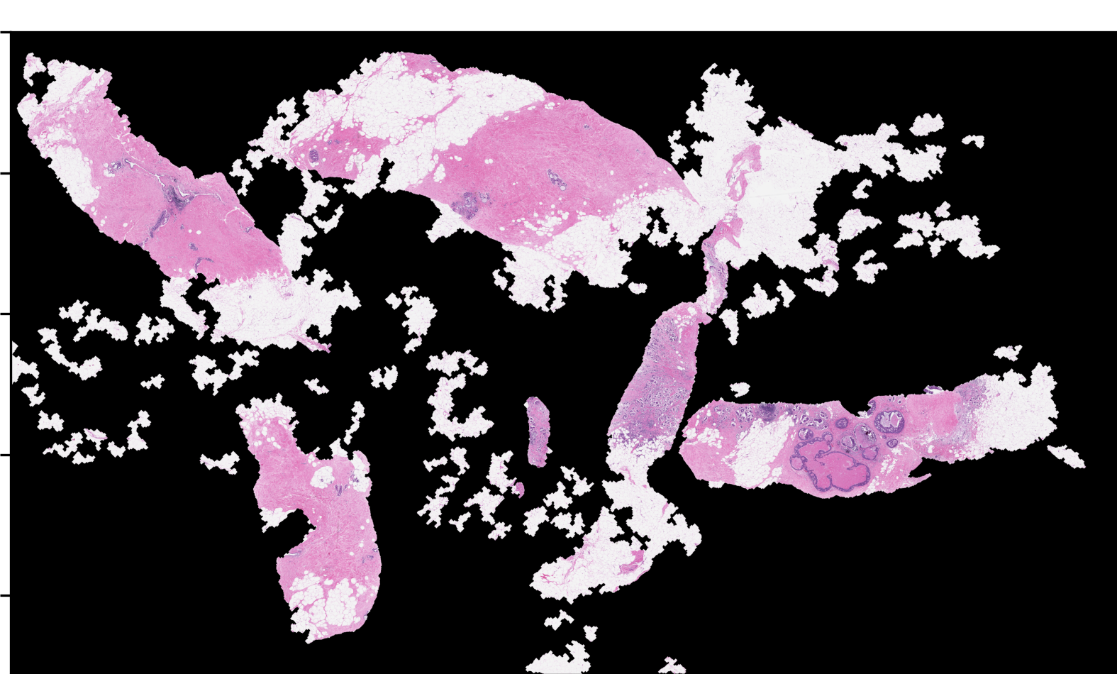
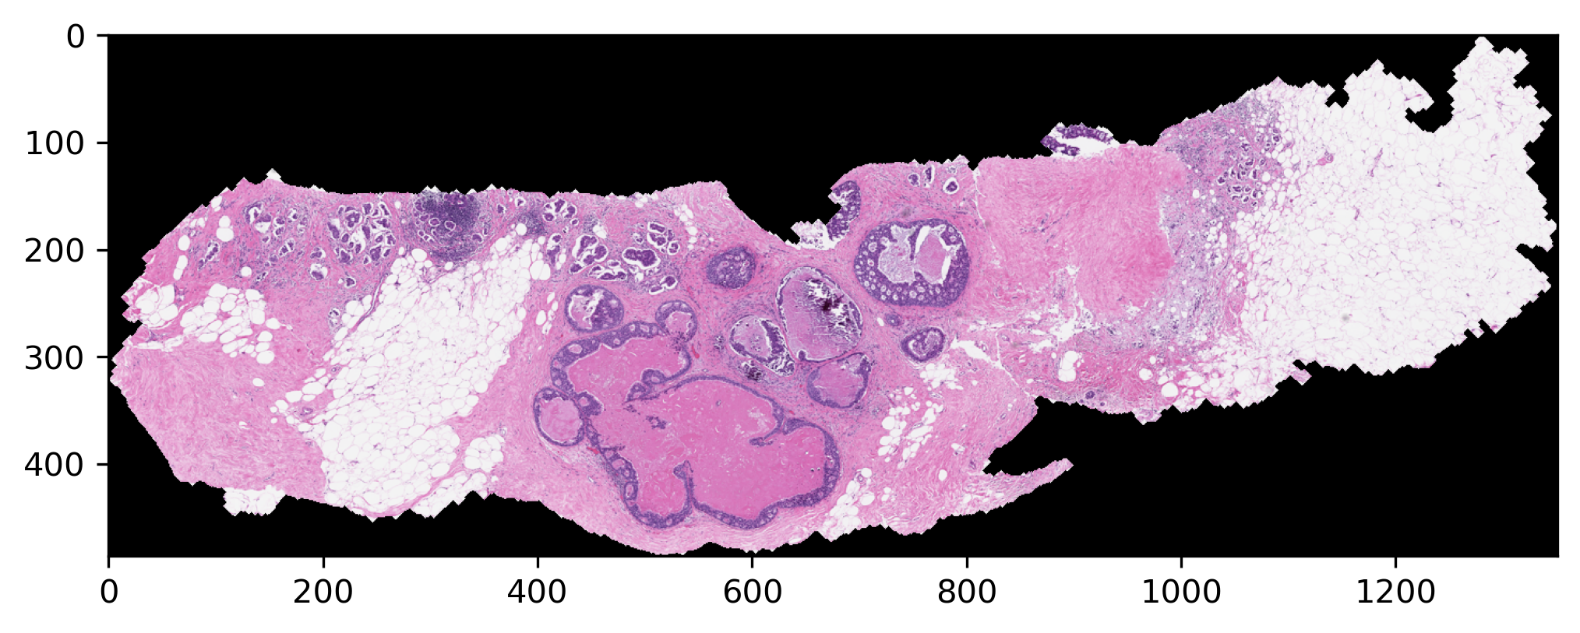
Segmentation Levels and Methods (Labeling)
Remained regions
Removing small regions
A typical area

Slide 10
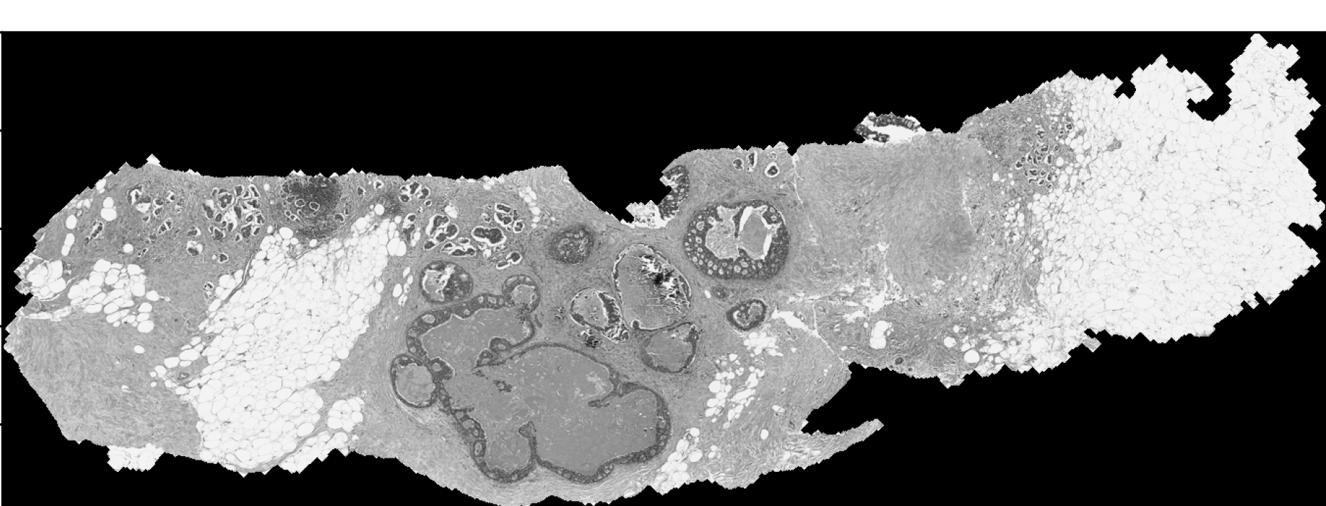
Segmentation Levels and Methods (Lesion Segmentation)
Background removal
Global thresholding
Tissue segmentation
Morphological operations
Lesion segmentation
Adaptive local thresholding
Adaptive local thresholding
Clustering
Global thresholding
Feature based
Edge detection

Slide 11
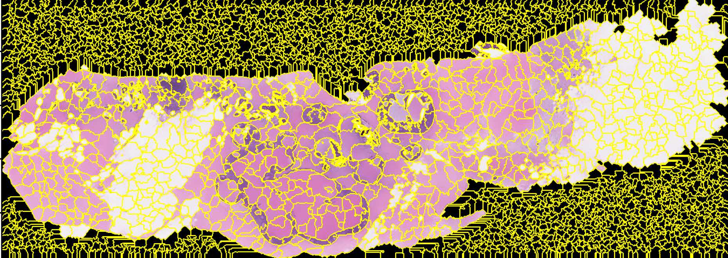
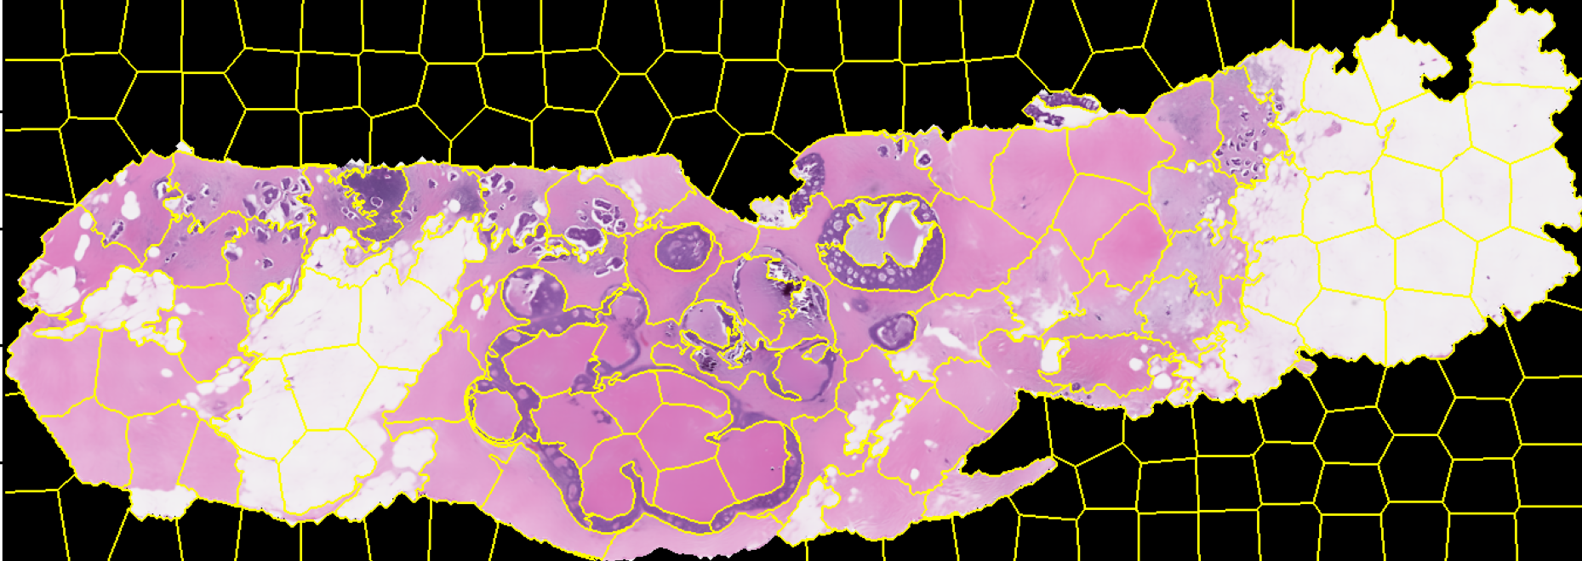
Segmentation Levels and Methods (Lesion Segmentation)
slic algorithm
quick shift algorithm

Slide 12
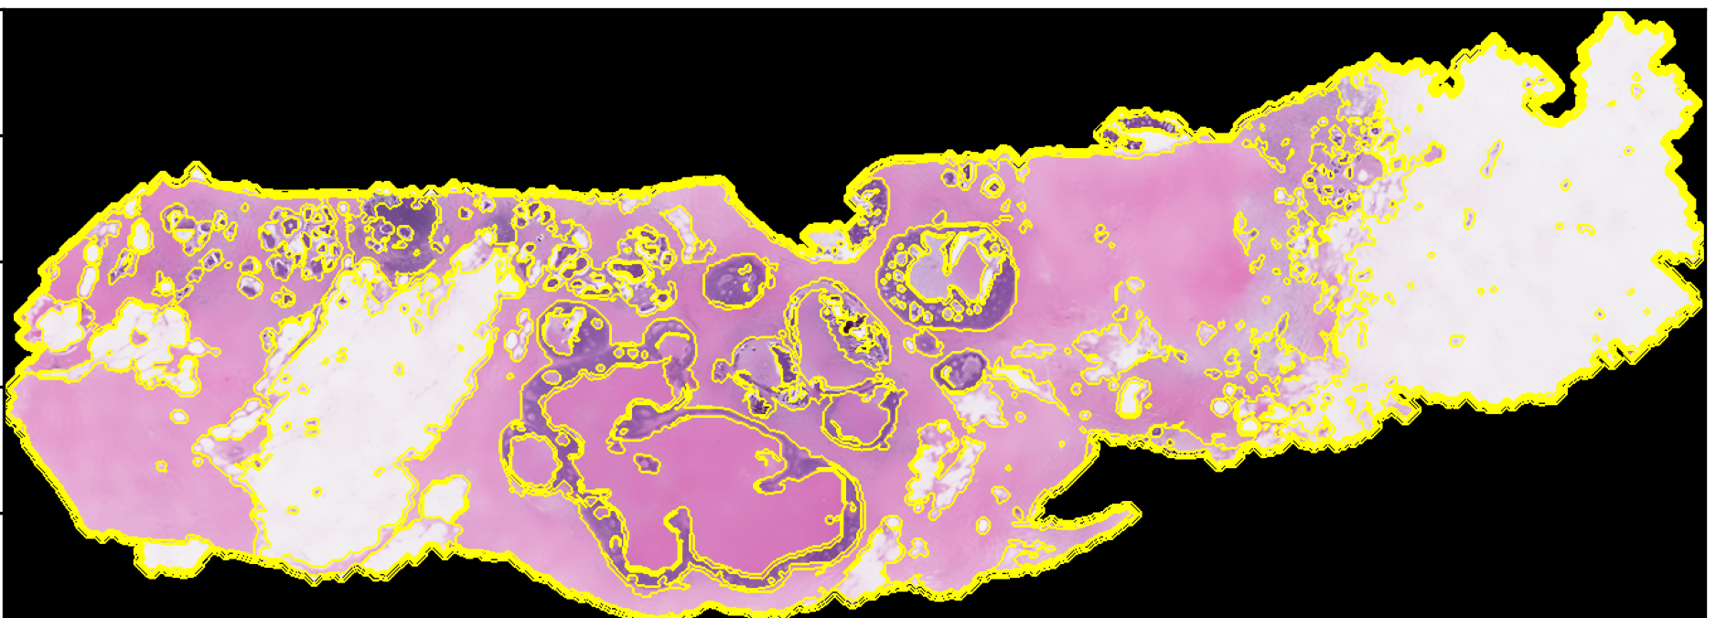
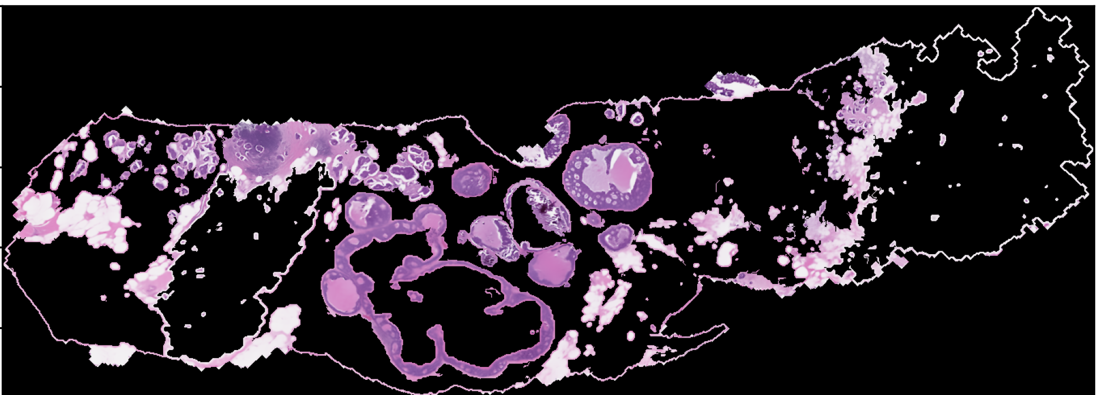
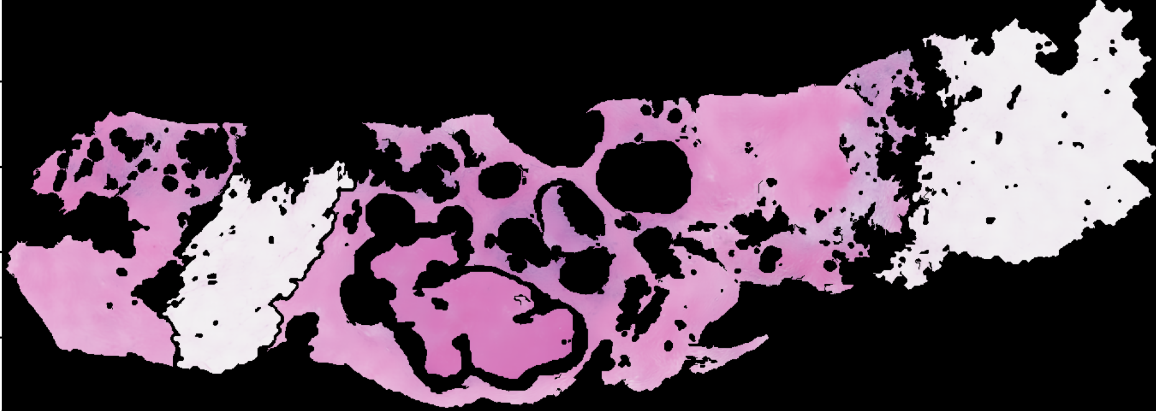
Segmentation Levels and Methods (Lesion Segmentation)
Felzenszwalb segmentation
Features are defined for each segment.
Here we just used the area of region.
Morphology and texture of area are good features too, like aspect ratio.
Small segments
Small and large are defined based on actual scale of imaging.
Large segments
ROI
Empty

Slide 13
Next steps for classification
Background removal
Level 2
Global thresholding
Tissue segmentation
Level 2
Morphological operations
Lesion segmentation
Adaptive local thresholding
Adaptive local thresholding
Clustering
Level 2
Global thresholding
Feature based
Classification
Edge detection
Level 0
Feature based
Convolutional neural network

Slide 14
Next steps for classification
Few and non-precise annotations:
Feature-based methods, semi-supervised or unsupervised learning methods.
Many and precise annotations:
Neural Network
Good suggestion:
Finding the best practices which have won the competitions, then deciding about the next move. Since there are datasets similar to us but with complete annotations, one approach could be combining them with our current dataset and train, develop and evaluate on combination.
Background removal
Level 2
Global thresholding
Tissue segmentation
Level 2
Morphological operations
Lesion segmentation
Adaptive local thresholding
Adaptive local thresholding
Clustering
Level 2
Global thresholding
Feature based
Classification
Edge detection
Level 0
Feature based
Convolutional neural network

Slide 15
Q & A
Thank You!

Slide 16
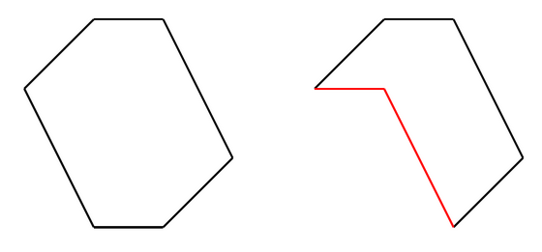
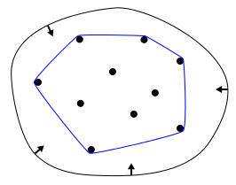
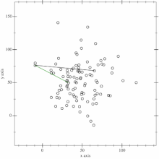
Appendix 1: Convex Hull
The convex hull of a set of points is defined as the smallest convex polygon, that encloses all of the points in the set. Convex means that the polygon has no corner that is bent inwards.
To find the convex hull of a set of points, we can use an algorithm called the Gift Wrapping. Using this algorithm, we can find the subset of points that lie on the convex hull.
A convex polygon on the left side, non-convex on the right side.
Time Complexity:
O(nh)
A useful way to think about the convex hull is the rubber band analogy.
Begins with i=0 and a point p₀ known to be on the convex hull.
Select the point p_{i+1} such that all points are to the right of the line p_{i} p_{i+1} and be a convex angle.
Repeating with until one reaches p_{h}=p₀ again yields the convex hull in h steps.
https://medium.com/@pascal.sommer.ch/a-gentle-introduction-to-the-convex-hull-problem62dfcabee90c#:~:text=What%20is%20the%20convex%20hull,convex%20on%20the%20right%20side.
https://en.wikipedia.org/wiki/Convex_hull_algorithms

Slide 17
Appendix 2: Segmentation Methods
Watershed segmentation:
Needs initial seed around the region. If the object position can be estimated before segmentation, it can work efficiently.
Quickshift segmentation:
As an extension to Mean-Shift algorithm, it approximates kernelized mean-shift and belongs to the family of local mode-seeking algorithms. It is applied to the 5D space consisting of color information and image location.
Slic segmentation:
This algorithm simply performs K-means in the 5d space of color information and image location and is therefore closely related to quickshift. As the clustering method is simpler, it is very efficient.
Felzenszwalb segmentation:
Nearest neighbor graph theory in mathematics is used to implement this method by Felzenszwalb. With some modification to the original pruning method, it runs fast and efficient.

Slide 18
References (1 of 2)
[1] M. Veta, J. P. W. Pluim, P. J. Van Diest, and M. A. Viergever, “Breast cancer histopathology image analysis: A review,” IEEE Trans. Biomed. Eng., vol. 61, no. 5, pp. 1400–1411, 2014, doi: 10.1109/TBME.2014.2303852.
[2] M. N. Gurcan, L. E. Boucheron, A. Can, A. Madabhushi, N. M. Rajpoot, and B. Yener, “Histopathological Image Analysis: A Review,” IEEE Rev. Biomed. Eng., vol. 2, pp. 147–171, 2009, doi: 10.1109/RBME.2009.2034865.
[3] M. Skacel, B. Skilton, J. D. Pettay, and R. R. Tubbs, “Tissue microarrays: A powerful tool for high-throughput analysis of clinical specimens: A review of the method with validation data,” Appl. Immunohistochem. Mol. Morphol., vol. 10, no. 1, pp. 1–6, 2002, doi: 10.1097/00022744-200203000-00001.
[4] E. Rexhepaj et al., “Novel image analysis approach for quantifying expression of nuclear proteins assessed by immunohistochemistry: Application to measurement of oestrogen and progesterone receptor levels in breast cancer,” Breast Cancer Res., vol. 10, no. 5, pp. 1–10, 2008, doi: 10.1186/bcr2187.
[5] T. Amaral, S. J. McKenna, K. Robertson, and A. Thompson, “Classification and immunohistochemical scoring of breast tissue microarray spots,” IEEE Trans. Biomed. Eng., vol. 60, no. 10, pp. 2806–2814, 2013, doi: 10.1109/TBME.2013.2264871.
[6] R. S. Alomari, R. Allen, B. Sabata, and V. Chaudhary, “Localization of tissues in high-resolution digital anatomic pathology images,” Med. Imaging 2009 Comput. Diagnosis, vol. 7260, no. 1, p. 726016, 2009, doi: 10.1117/12.811430.
[7] X. Qi, F. Xing, D. J. Foran, and L. Yang, “Robust segmentation of overlapping cells in histopathology specimens using parallel seed detection and repulsive level set,” IEEE Trans. Biomed. Eng., vol. 59, no. 3, pp. 754–765, 2012, doi: 10.1109/TBME.2011.2179298.
[8] M. Veta, P. J. van Diest, R. Kornegoor, A. Huisman, M. A. Viergever, and J. P. W. Pluim, “Automatic Nuclei Segmentation in H&E Stained Breast Cancer Histopathology Images,” PLoS One, vol. 8, no. 7, pp. 1–12, 2013, doi: 10.1371/journal.pone.0070221.

Slide 19
References (2 of 2)
[9] S. Wienert et al., “Detection and segmentation of cell nuclei in virtual microscopy images: A minimum-model approach,” Sci. Rep., vol. 2, pp. 1–7, 2012, doi: 10.1038/srep00503.
[10] L. Roux et al., “Mitosis detection in breast cancer histological images An ICPR 2012 contest,” J. Pathol. Inform., vol. 4, no. 1, p. 8, 2013, doi: 10.4103/2153-3539.112693.
[11] M. Veta et al., “Assessment of algorithms for mitosis detection in breast cancer histopathology images,” Med. Image Anal., vol. 20, no. 1, pp. 237–248, 2015, doi: 10.1016/j.media.2014.11.010.
[12] E. Cosatto, M. Miller, H. P. Graf, and J. S. Meyer, “Grading nuclear pleomorphism on histological micrographs,” Proc. - Int. Conf. Pattern Recognit., pp. 8–11, 2008, doi: 10.1109/icpr.2008.4761112.

