Slide 1
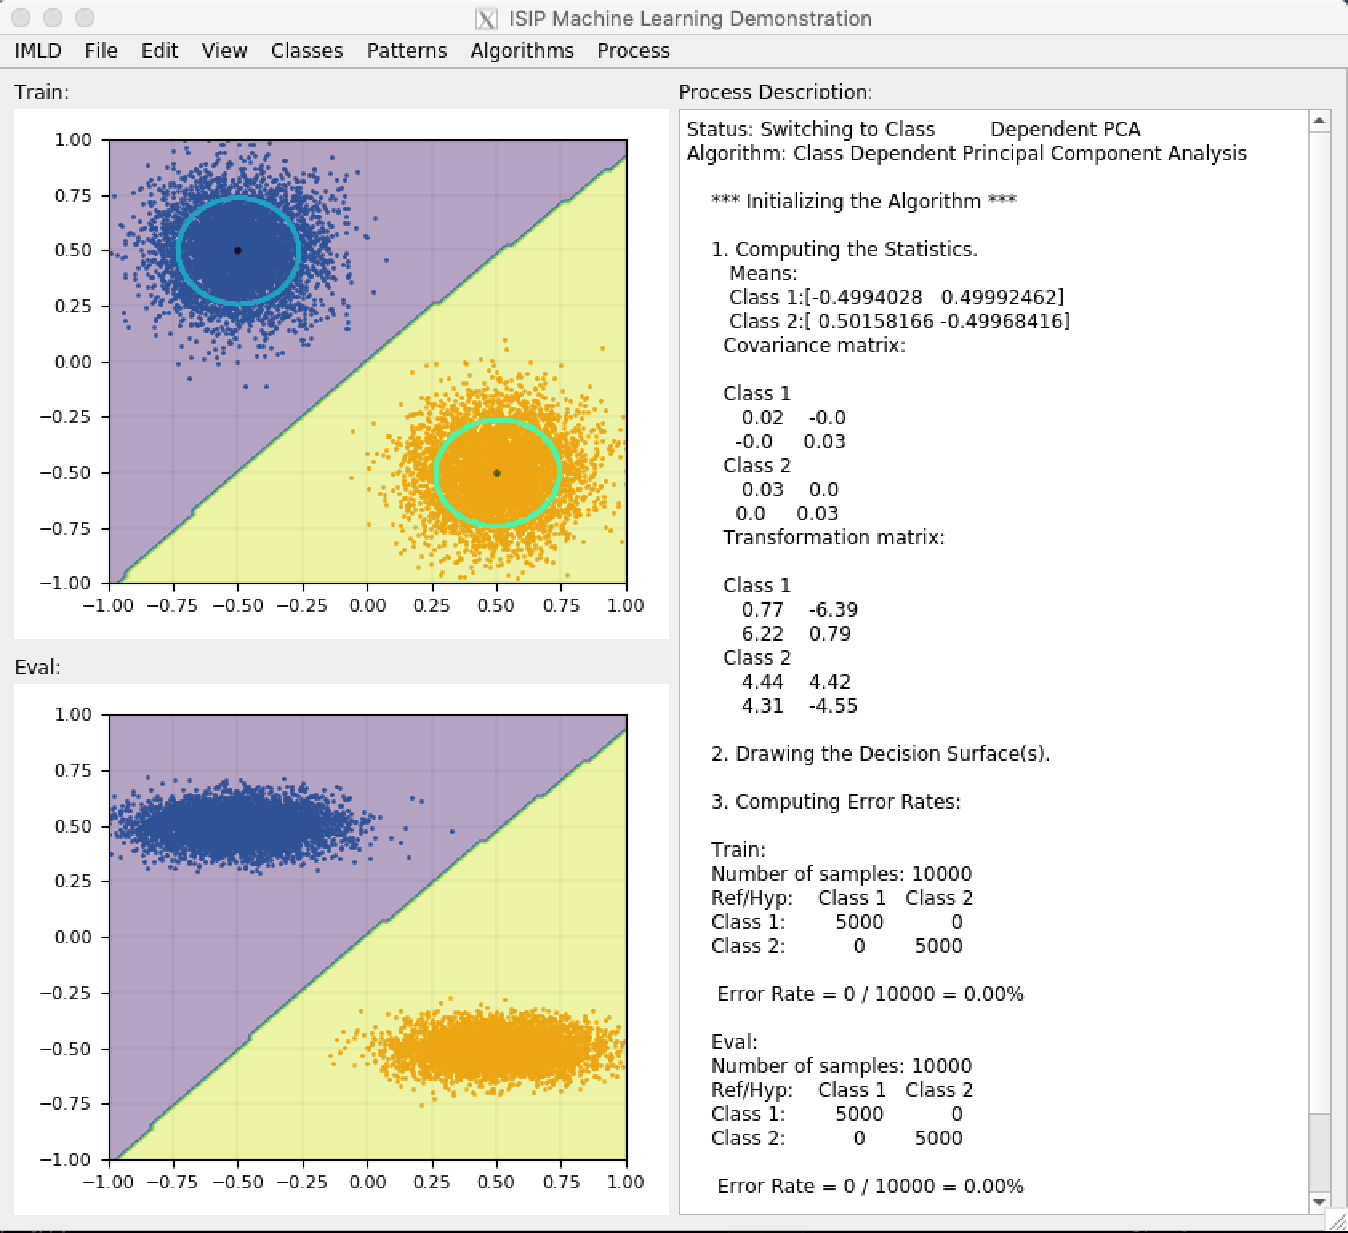
ISIP Machine Learning Demonstration (IMLD)
Presented By:
Lynn Vorwick
Neural Engineering Data Consortium,
Temple University

Slide 2
Overview
Introduction
IMLD user interface
Ways to input data
Parameter setting
Classification algorithms
Other functionality
Demo using IMLD applet
Next steps

Slide 3
Introduction
Learning tool operated with easy-to-use interface
Enables users to observe how various machine learning processes classify user-defined data
Classification algorithms performed step-by-step
Originally developed in Java¹

Slide 4
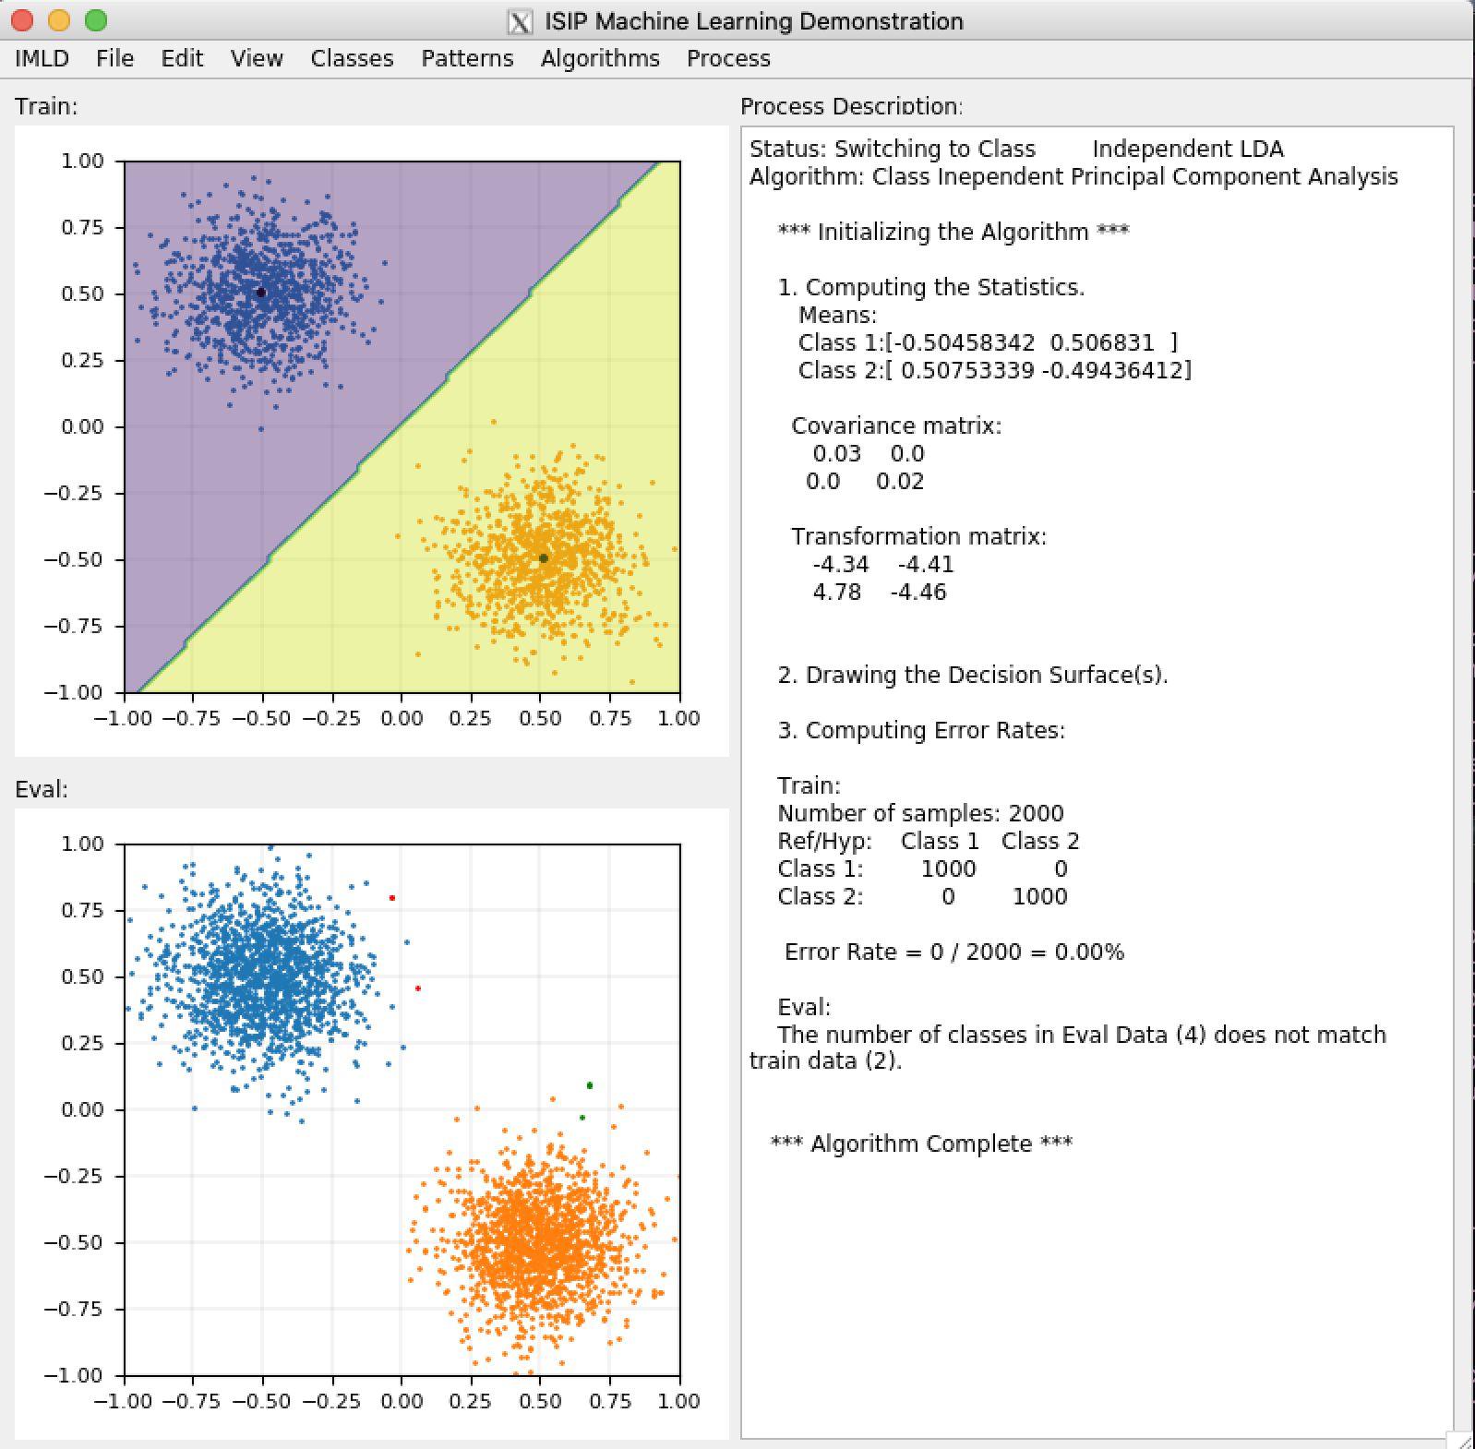
User Interface: Main Modules
Process Description
Train Display
Eval Display

Slide 5
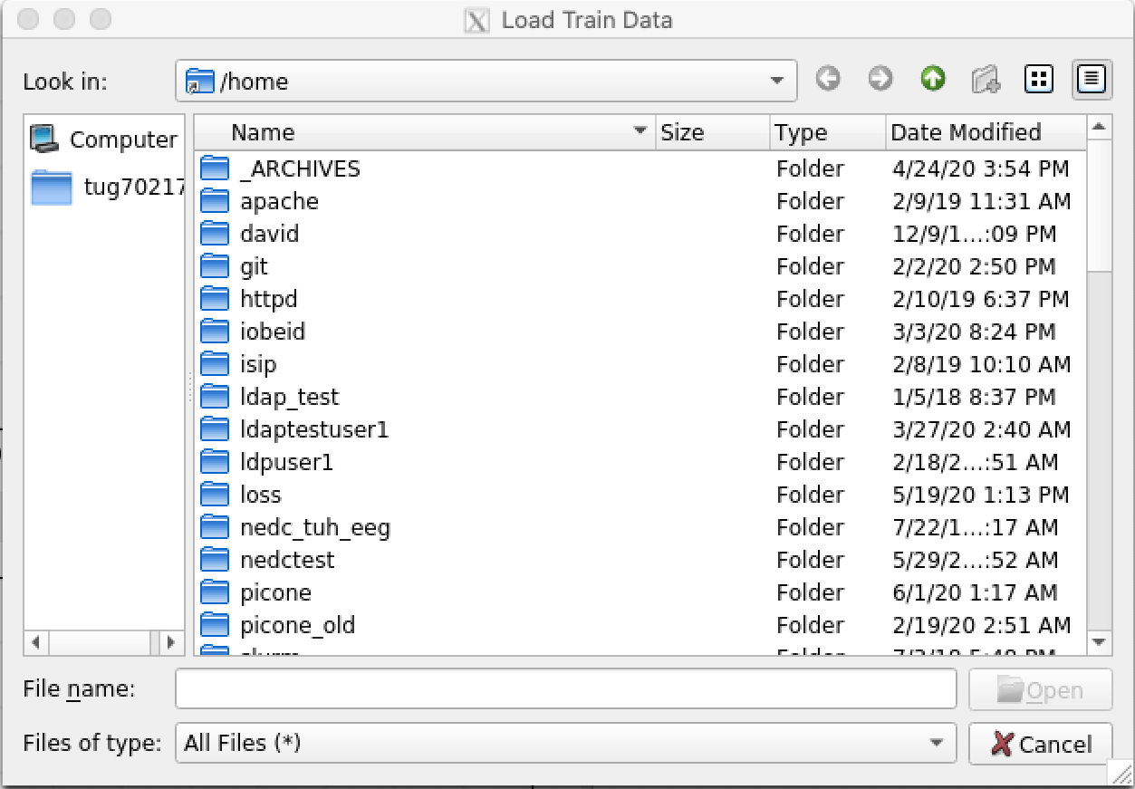
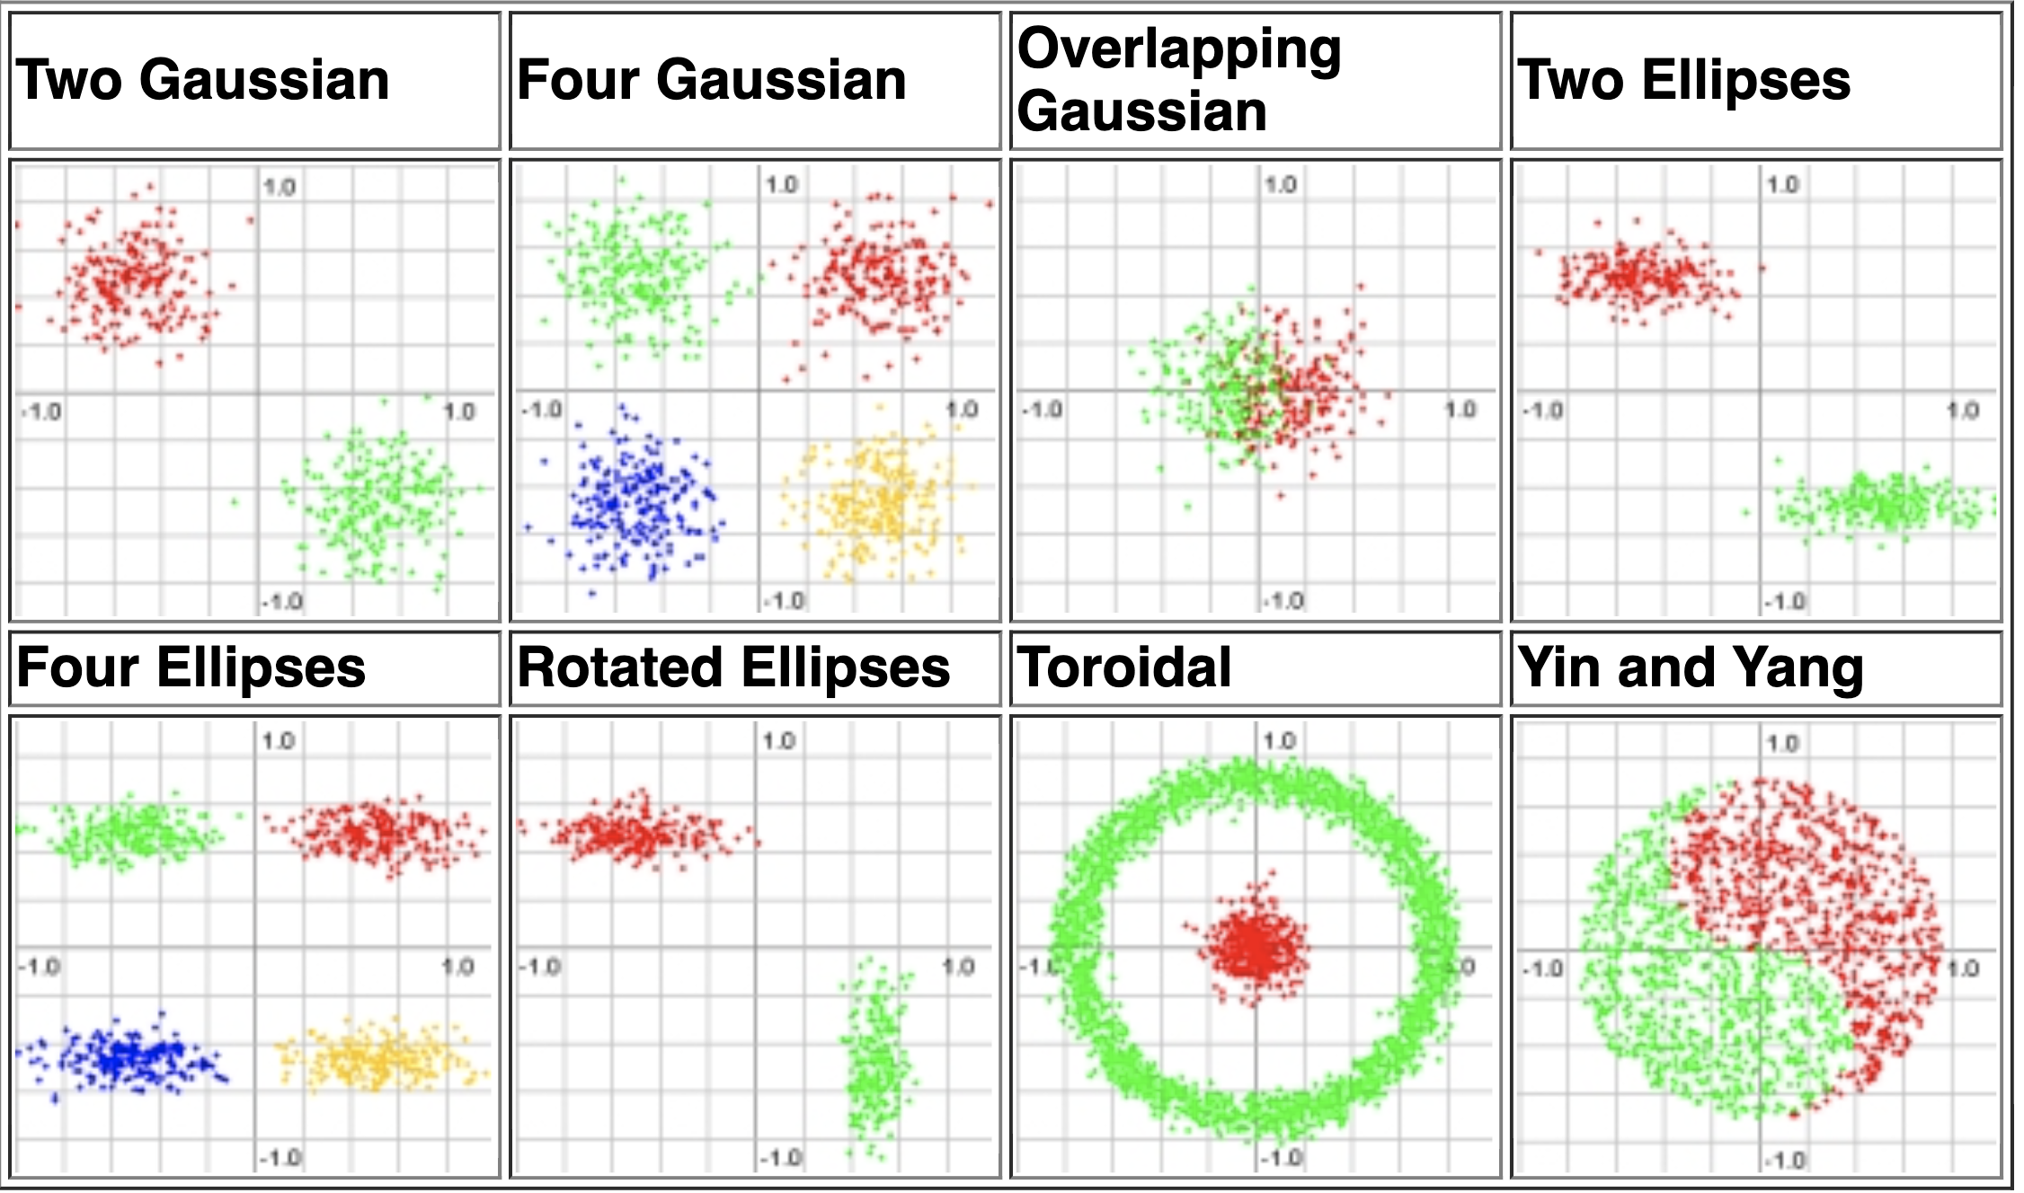
Ways to Input Data into Train and Eval
Import from a file
Use preset patterns

Slide 6
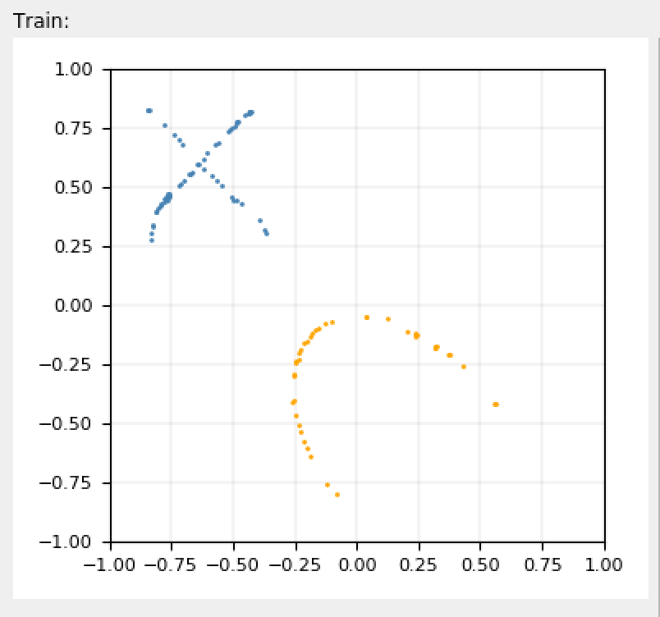
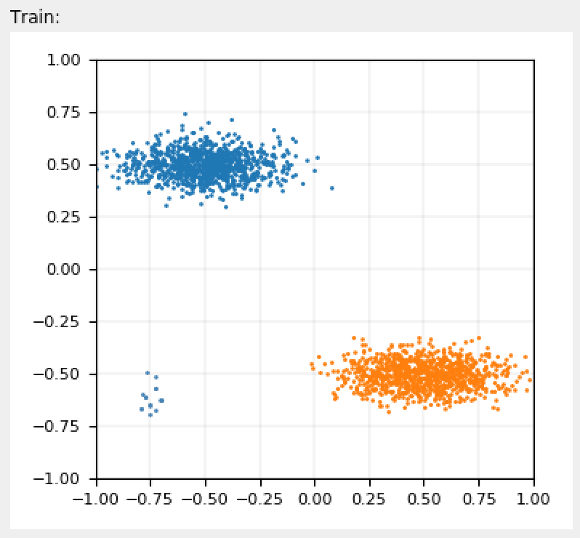
Ways to Input Data into Train and Eval cont.
3) Use mouse to draw data points
From scratch
Add points to a preset pattern
Class 0
Class 1

Slide 7
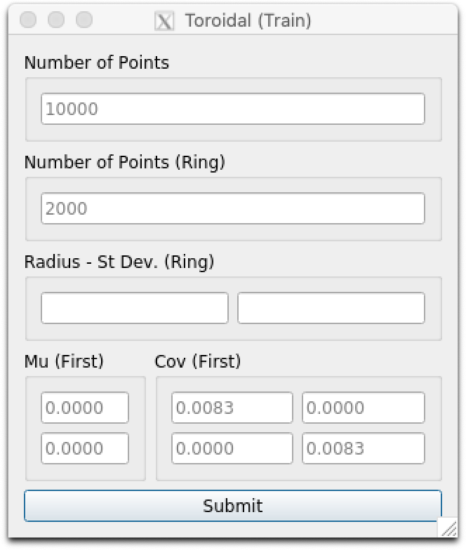
Parameter Customization for Preset Patterns
Gaussian, Ellipse
# points
Mean vector
Covariance matrix
Toroidal
# points (total)
# points (ring)
Radius
Standard Deviation
Mean Vector (Gaussian)
Covariance matrix

Slide 8
Classification Algorithms
Principal Component Analysis (PCA)
Linear Discriminant Analysis (LDA)
Nearest Neighbor
K-Means
Support Vector Machines
Multilayer Perceptron

Slide 9
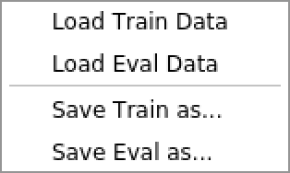
Other Functionalities
Set Ranges of Train and Eval window axes
Step through classification algorithms OR Run all at once
Save Train and Eval data to a file

Slide 10
Next Steps
Fix bugs
Program crashes when:
Preset pattern parameters for mean vector and cov. Matrix are altered
A second algorithm is run before clearing window
Standardize code
Hundreds of lines commented out, many smaller chunks commented out here and there
Files names, class names etc. are non-standard
Ex: Two methods in the same class: initUI and InitUI
Documentation
Add necessary functionality
Process bar
Edit > Clear All
Erase Points
Complete in current state
The following menus are missing options, empty or do nothing
Menu > View
IMLD > About Us
IMLD > Preferences
Patterns > Draw Gaussian
Patterns > Draw Points
Patterns > Toroidal > Eval
Classes > (All options)
Settings > Set Gaussian
Fix so it runs on Mac

Slide 11
Next Steps Cont.
Add machine learning algorithms:
Linde-Buzo-Gray
Support Vector Machines
Relevance Vector Machines
Linear Prediction
Kalman Filter
Unscented Kalman Filter
Add patterns
Yin Yang

Slide 12
References
[1] Shaffer, J., Hamaker, J., & Picone, J. (1998). Visualization of signal processing concepts. Proceedings of the IEEE International Conference on Acoustics, Speech and Signal Processing, 3, 1853–1856. https://doi.org/10.1109/ICASSP.1998.681824.

