Slide 1
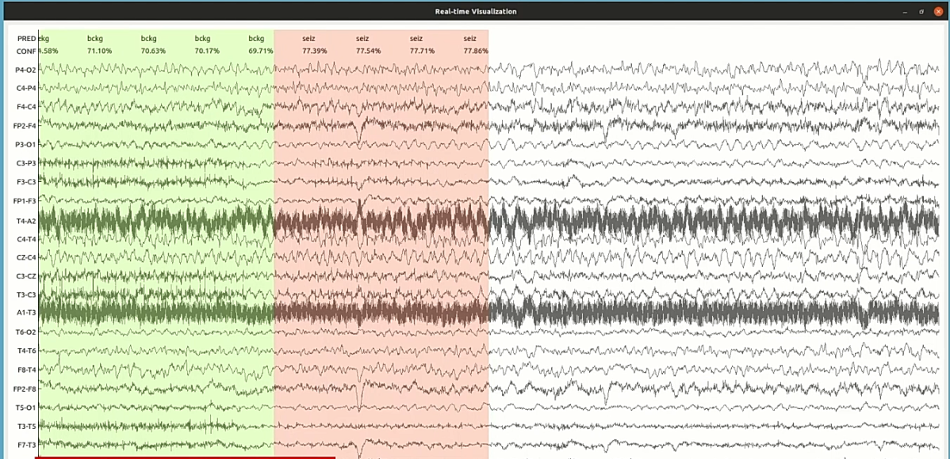
Artifact Detection Experiment with Self-Supervised Learning
Presented By:
Nabila Shawki
Neural Engineering Data Consortium,
Temple University

Slide 2
Introduction
A simple self-supervised learning (SSL) experiment with a small dataset.
Dataset: The Temple University Artifact Database (TUAR) v2.0.0.
Model: ResNet-18 (PyTorch)
Pretext task: Translation in time domain.
The downstream task or artifact detection was evaluated with and without loading the pretext weights.
So far, the model with pretext task performs better.
Data Processing
Downstream Task (Artifact Detection)
Artifact Detection
Pretext Task (Translation)
Self-supervised Learning
Supervised Learning

Slide 3
Self Supervised Learning (SSL)
A branch of unsupervised learning.
A deep learning model becomes familiar with the dataset by predicting another part of the data.
Two major steps: pretext task (familiarization), downstream task (the actual detection task)
Automatic annotation labels are generated for the pretext task with a little or no effort, such as rotating a picture and predicting how much it was rotated given the original and rotated picture.
The downstream task uses the trained model.

Slide 4
TUAR Database and Data Preprocessing
Contains 310 files with an average duration of 20 minutes.
Contains chewing, electrode, eye movement, muscle, and shiver artifacts.
For this experiment, events with more than 9 seconds duration was considered which is applicable for background as well.
A few Files were resampled 250 Hz.
18 montaged channels were chosen.
The dataset was randomly divided into train and test set.
Train: 230, test: 80.
Channels were normalized using read_edf in nedc_eeg_tools.
max_abs_scalar was used after that.
No other preprocessing techniques were used.

Slide 5
The Pretext Task
Translation in time domain was chosen.
250000 labels for training and 65000 labels for testing were generated using a Python script.
The format: filename, label, first epoch, second epoch.
First epoch is the start of the first 11-second window that was randomly chosen.
Second epoch is the start of the second 11-second window which was selected using the following formula: randint(first-10, first).
Example:
00008181_s003_t010 9 393 384
00008181_s003_t010 7 431 424
Epoch: 5
Accuracy: 38%

Slide 6
Downstream Task
We selected 10 second windows from the events that are more than 9 seconds long.
All artifacts were merged under one label: artf
Total training samples: 40000 -> artf: 20000, bckg: 20000
Total test samples: 10000 -> artf: 5000, bckg: 5000
Two ResNet-18 models were trained where one used the weights from the pretext task.

Slide 7
Current Results
The test set used as validation set.
With pretext weights: PW; without pretext weights: NW, learning rate: LR
Exp. No. | Accuracy (%) |  | Sensitivity (%) |  | False Alarm Rate (%) |  | Model Saved | Description
 | PW | NW | PW | NW | PW | NW
1 | 76.2 | 69.4 | 76.0 | 47.3 | 23.4 | 8.4 | No | LR = 0.0001, epoch = 15
2 | 75.9 | 69.9 | 76.4 | 51.1 | 24.7 | 11.2 | No | epoch = 100
3 | 73.4 | 70.3 | 72.5 | 50.4 | 25.6 | 9.8 | Yes | epoch = 15
4 | 75.8 | 60.8 | 75.2 | 74.4 | 23.5 | 52.8 | Yes | random module’s seed changed
5 | 75.7 | 72.9 | 71.8 | 62.8 | 20.4 | 17.2 | Yes | random module’s seed changed, np and torch seeds set to 0
6 | 75.8 | 74.3 | 88.8 | 70.4 | 37.2 | 21.8 | Yes | LR = 0.001, epoch = 50

Slide 8
Current Results
25% of the train set used for validation and the test set was used for blind evaluation.
The table shows the results for the blind eval set.
Exp. No. | Accuracy (%) |  | Sensitivity (%) |  | False Alarm Rate (%) |  | Model Saved | Description
 | PW | NW | PW | NW | PW | NW
1 | 72.5 | 72.2 | 81.6 | 73.0 | 36.6 | 28.7 | Yes | LR = 0.0001, epoch = 10
2 | 71.3 | 69.3 | 66.3 | 68.0 | 23.7 | 28.2 | Yes | Pretext task trained for one epoch
3 | 73.1 | 70.2 | 79.5 | 72.5 | 33.6 | 32.1 | Yes | Previous weights, epoch = 100
4
5
6

Slide 9
Comments and Next Steps
The accuracy for the model with pretext weights is stuck around 70-75% where the other model’s accuracy ranges from 60-74%.
In all cases, the model with pretext weights performed better than the one without.
We can use the result from this model to detect artifacts and then treat the identified segments.
The next step is to do a five-fold cross validation.
We will evaluate the performance of the best models on the full artifact database.
More training data for the pretext task can be generated using more EEG records.

