Slide 1
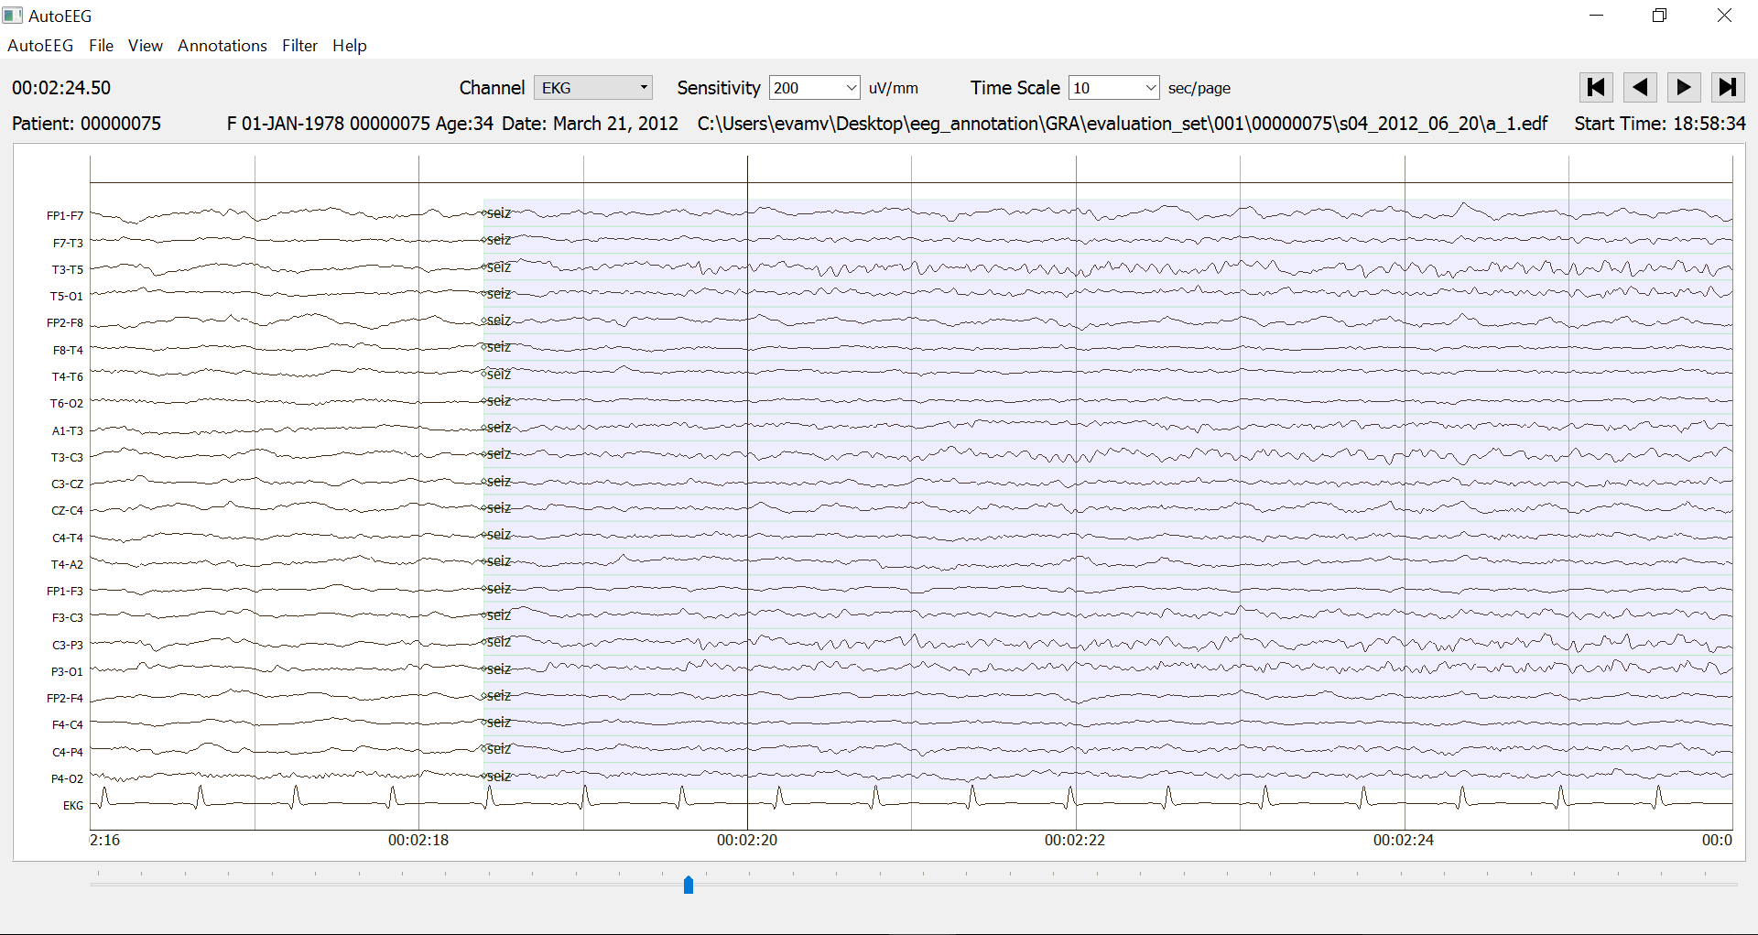
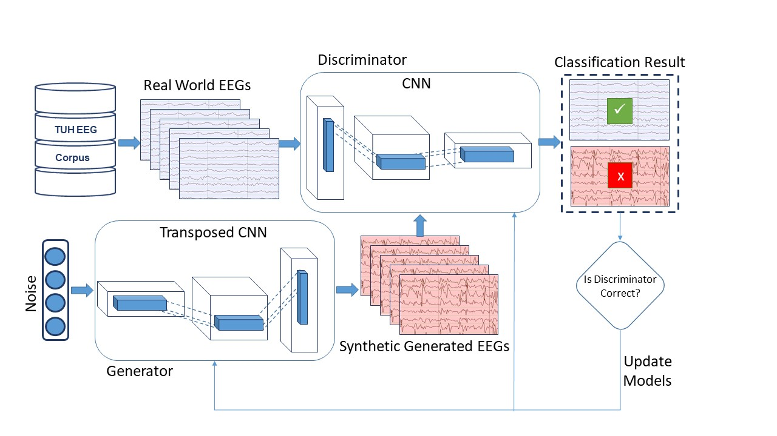
Generative Adversarial Networks For Seizure Detection
Meysam Golmohammadi

Slide 2
Introduction
The promise of deep learning is to discover rich, hierarchical models that represent probability distributions of data.
The most striking successes in deep learning have involved discriminative models, usually those that map a high-dimensional, rich sensory input to a class label.
Deep generative models have had less of an impact, due to the difficulty of approximating many intractable probabilistic computations that arise in maximum likelihood estimation and related strategies.
Generative adversarial networks (GAN's) are a recent popular technique for learning generative models for high-dimensional unstructured data.
In this framework, the generative model is pitted against an adversary: a discriminative model that learns to determine whether a sample is from the model distribution or the data distribution.
This framework can yield specific training algorithms for many kinds of model and optimization algorithm.

Slide 3
Generative adversarial network (GAN)
GAN is a new framework for estimating generative models via an adversarial process, in which we simultaneously train two models:
a generative model G that captures the data distribution.
a discriminative model D that estimates the probability that a sample came from the training data rather than G.
The training procedure for G is to maximize the probability of D making a mistake. This framework corresponds to a minimax two-player game. In the space of arbitrary functions G and D, a unique solution exists, with G recovering the training data distribution and D equal to 1/2 everywhere.
In the case where G and D are defined by multilayer perceptrons, the entire system can be trained with backpropagation.
There is no need for any Markov chains or unrolled approximate inference networks during either training or generation of samples.
Experiments demonstrate the potential of the framework through qualitative and quantitative evaluation of the generated samples.

Slide 4
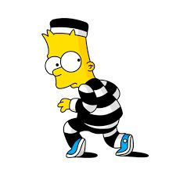
The intuition behind GAN: Counterfeiters vs Police Game
The generative model can be thought of as analogous to a team of counterfeiters, trying to produce fake currency, while the discriminative model is analogous to the police, trying to detect the counterfeit currency. Competition in this game drives both teams to improve their methods until the counterfeits are indistinguishable from the genuine articles.
IT’S FAKE MONEY!
IT’S REAL MONEY!

Slide 5
Unsupervised Learning Using GANs
The special case when the generative model generates samples by passing random noise through a multilayer perceptron, and the discriminative model is also a multilayer perceptron. We refer to this case as adversarial nets.
To learn the generator’s distribution $p_{g}$over data x, we define a prior on input noise variables $p_{z}(z)$, then represent a mapping to data space as $G(z; θ_{g})$, where G is a differentiable function represented by a multilayer perceptron with parameters $θ_{g}$.
We also define a second multilayer perceptron $D(x; θ_{d})$, that outputs a single scalar. $D(x)$represents the probability that x came from the data rather than $p_{g}$.
We train D to maximize the probability of assigning the correct label to both training examples and samples from G.
We simultaneously train G to minimize $log⁡(1 − D(G(z))).$In other words, D and G play the following two-player minimax game with value function $V (G;D):$
$$\min_{G}{\max_{D}{V\left(D,G\right) }}=𝔼_{x\sim p_{data(x)}}\left[\log{D\left(x\right)}\right] +𝔼_{z\sim p_{z(z)}}\left[\log{(1−D(G(z)))}\right]$$

Slide 6
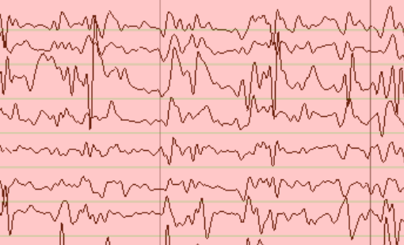
Illustration of Unsupervised Learning by Adversarial Nets
Classification Result
Real World EEGs
✓
TUH EEG
$$X_{U}$$
$$X$$
Discriminator
$$D\left(X\right)$$
+
Corpus
x
$$X_{G}$$
Generator
$$G\left(z\right)=X_{G}$$
Is Discriminator Correct?
Noise
Update Models
Synthetic Generated EEGs

Slide 7
Adversarial Nets Training Algorithm
for number of training iterations do
for k steps do
>Sample minibatch of m noise samples $\{z^{\left(1\right)},…,z^{\left(m\right)}\}$from noise prior $p_{g}(z)$.
>Sample minibatch of m examples$\{x^{\left(1\right)},…,x^{\left(m\right)}\}$from data generating distribution $p_{data}(x)$.
>Update the discriminator by ascending its stochastic gradient:
end for
>Sample minibatch of m noise samples $\{z^{\left(1\right)},…,z^{\left(m\right)}\}$from noise prior $p_{g}(z)$.
>Update the generator by descending its stochastic gradient:
end for
$$∇_{θ_{d}}\frac{1}{m}\sum_{i=1}^{m}{\left[\log{D\left(x^{(i)}\right)+\log{(1−D(G(z^{\left(i\right)})))}}\right]}$$
$$∇_{θ_{g}}\frac{1}{m}\sum_{i=1}^{m}{\left[\log{(1−D(G(z^{\left(i\right)})))}\right]}$$

Slide 8
Unsupervised Learning Using DCGAN
Illustration of Deep Convolutional Generative Adversarial Network (DCGAN):

Slide 9
DCGAN Structure
Generative model:
taking 100 random inputs, and eventually mapping them down to a matrix with size of [21, 22, 250] .
Composed of transposed convolutional neural networks with up-samplers.
Rectified linear units (ReLU) as activation.
Dropout as regularization.
Adam as optimizer and binary cross-entropy as loss function.
Discriminative model
Takes in [21, 22, 250] vectors from two sources, (synthetic data) generators and (real data) features, and then decide if they are real or (synthetic) fake .
Composed of strided convolutional neural networks.
Leaky ReLU as activation.
Adam as optimizer and binary cross-entropy as loss function.

Slide 10
DCGAN Stability
Pretraining of discriminator.
One-sided label smoothing.
Eliminating fully connected layers on top of convolutional features.
Replacing deterministic spatial pooling functions (such as maxpooling) with strided convolutions, which allows the network to learn its own spatial downsampling. I use this approach in the generator, allowing it to learn its own spatial upsampling, and discriminator.
Using ReLU activation in generator for all layers except for the output.
Normalizing the input to [-1, 1] for discriminator.
Using Tanh activation in the last layer except for the output.
Using Leaky ReLU activation in the discriminator for all layers except for the output.
Freezing the weights of discriminator during adversarial training process. Unfreezing during discriminative training.
Eliminating Batch Normalization in all the layers in both of generator and discriminator.

Slide 11
Supervised Learning Using GANs
Let’s assume that our dataset is comprised of n + m Samples of EEGs
$$X = \{X_{1}, …,X_{n},X_{n+1}, …,X_{n+m}\}$$
where the first n samples are annotated as:
$$Y=\{Y_{1}, …,Y_{n}\}$$
In the supervised setting (i.e., m = 0), the goal is to learn a generative model $G_{s}\left(z,y;θ_{s}\right)$that samples from the conditional data distribution $p(x|y$), by transforming vectors of noise $z$ as ${x=G}_{s}\left(z,y;θ_{s}\right)$.
There are two proposed approaches for solving this problem:
Conditional GAN’s (CGAN’s)
Auxiliary-classifier GAN’s (ACGAN’s)

Slide 12
Supervised Learning Using Conditional GAN (CGAN)
In order to learn the conditional distribution of $G_{s}\left(z,y;θ_{s}\right)$, a discriminator $D_{s}\left(x,y;φ_{s}\right)$is trained jointly.
The goal of the discriminator is to distinguish whether the joint samples $\left(x,y \right)$ are samples from the data or from the generator.
The supervised loss functions for the generator and discriminator for conditional GAN (C-GAN) are as follows:
$$ℒ_{d}^{s}\left(D_{s}, G_{s}\right)=\frac{1}{n}\left(\sum_{i=1}^{n}{\log\left(D_{s}\left(x_{i},y_{i};φ_{s}\right)\right)+\log\left(1−D_{s}\left(G_{s}\left(z_{i},y_{i};θ_{s}\right),y_{i};φ_{s}\right)\right)}\right)$$
$$ℒ_{g}^{s}\left(D_{s}, G_{s}\right)=\frac{1}{n}\left(\sum_{i=1}^{n}{\log\left(D_{s}\left(G_{s}\left(z_{i},y_{i};θ_{s}\right),y_{i};φ_{s}\right)\right)}\right)$$
The above equations are alternatively optimized with respect to $φ_{s}$and $θ_{s}$ respectively.

Slide 13
Illustration of Supervised Learning Using CGAN
Classification Result
Real World EEGs
✓
TUH EEG
$$(X,Y)$$
Discriminator
$$D\left(X,Y\right)$$
Seizure Corpus
x
$$Y$$
$$X_{U}$$
+
$$Y$$
$$X_{G}$$
$$Y$$
Is Discriminator Correct?
Generator
$$G\left(z,Y\right)=X_{G}$$
Noise
Update Models
Synthetic Generated EEGs

Slide 14
Supervised Learning Using Auxiliary-classifier GAN
An alternative approach to supervised conditional generation is to only supply the training samples x to the discriminator, and ask the discriminator to additionally recover annotations.
In particular, the discriminator $D_{a}\left(x;φ_{a}\right)$produces two outputs:
$D_{a(rf)}\left(x;φ_{a}\right)$: the probability of x being real or fake,
$D_{a(a)}\left(x,y;φ_{a}\right)$: the estimated conditional probability of y given x.
Define the attribute loss function as
$$ℒ_{a}^{a}\left(D_{a(a)}, G_{a}\right)=\frac{1}{n}\left(\sum_{i=1}^{n}{\log\left(D_{a(a)}\left(x_{i},y_{i};φ_{a}\right)\right)+\log\left(D_{a(a)}\left(G_{a}\left(z_{i},y_{i};θ_{a}\right),y_{i};φ_{a}\right)\right)}\right)$$
The loss function for the discriminator is given by
$$ℒ_{d}^{a}\left(D_{a}, G_{a}\right)=ℒ_{d}^{u}\left(D_{a(rf)}, G_{a}\right)+ℒ_{a}^{a}\left(D_{a(a)}, G_{a}\right)$$
The loss function for the generator is given by
$$ℒ_{g}^{a}\left(D_{a}, G_{a}\right)=ℒ_{g}^{u}\left(D_{a(rf)}, G_{a}\right)+ℒ_{a}^{a}\left(D_{a(a)}, G_{a}\right)$$

Slide 15
Illustration of Supervised Learning Using ACGAN
Predict $Y$
Classification Result
Real World EEGs
✓
TUH EEG
$$X$$
Discriminator
$$D\left(X\right)$$
Seizure Corpus
x
$$Y$$
$$X_{U}$$
+
$$X_{G}$$
$$Y$$
Is Discriminator Correct?
Generator
$$G\left(z,Y\right)=X_{G}$$
Noise
Update Models
Synthetic Generated EEGs

Slide 16
Proposed Supervised Learning Using GAN
Real World EEGs
Real Seizure
TUH EEG
$$X$$
Discriminator
$$D\left(X\right)$$
Fake Seizure
Real Background
Seizure Corpus
Fake Background
$$Y$$
$$X_{U}$$
+
$$X_{G}$$
$$Y$$
Is Discriminator Correct?
Generator
$$G\left(z,Y\right)=X_{G}$$
Noise
Update Models
Synthetic Generated EEGs

Slide 17
Semi-supervised Conditional GANs
Most of the research on GAN's is focused on either the unsupervised setting, where the data is unlabeled, or on supervised setting using conditional GAN's where the goal is to learn a conditional model of the data given labels.
Given that labels are expensive, it is of interest to explore semi-supervised settings where only a small fraction of the data have labels, while a majority of the data are unlabeled.
There are limited work on semi-supervised conditional GANs.
We can use GAN's to perform semi-supervised classification by using a generator-discriminator pair to learn an unconditional model of the data and then tune the discriminator using the small amount of labeled data for prediction.
We can partition the discriminator's task of evaluating if the joint samples of training data and labels are real or fake into two separate tasks: (i) evaluating if the training samples are real or fake, and (ii) prediction of labels.
We subsequently use all the labeled and unlabeled data to assist the discriminator with the first task, and only the labeled images for the second task.

Slide 18
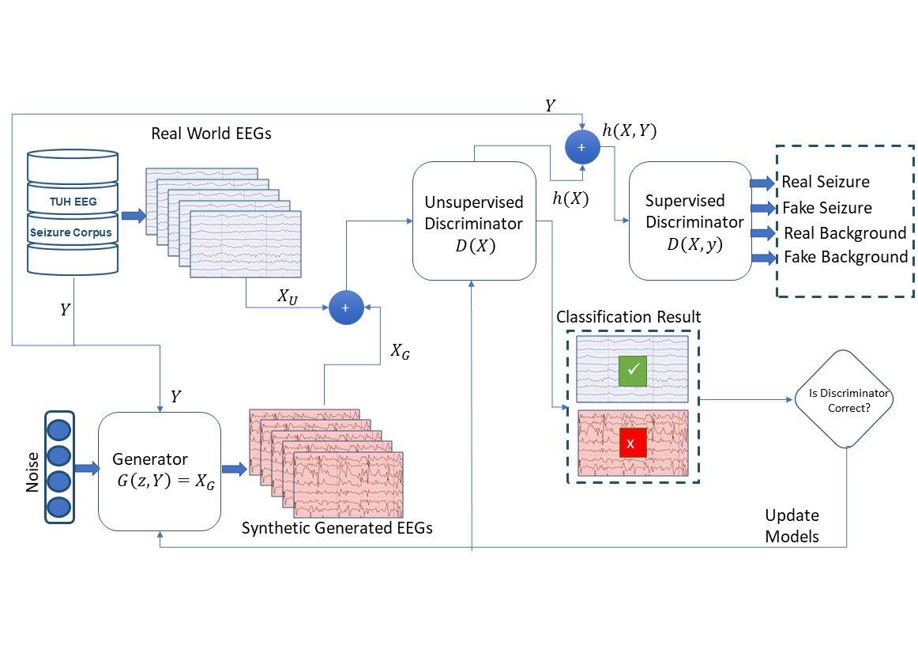
An illustration of Semi Supervised Conditional GANs

Slide 19
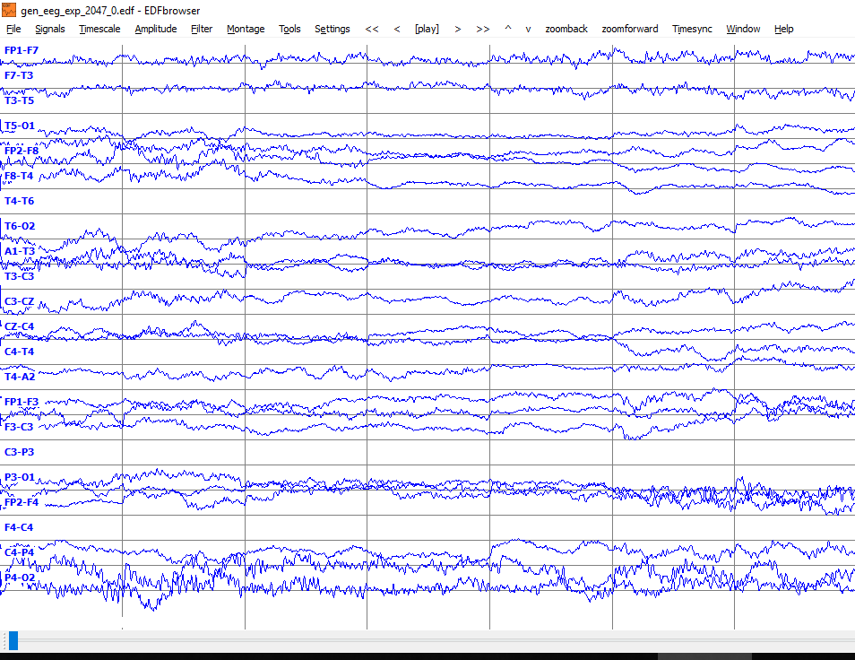
Generated EEG Samples with DCGAN

Slide 20
DCGAN Results
The results of the discriminator in DCGAN for classification of seizure vs bckg.
This is not a common approach.
In summary, I had 56% sensitivity with 210 FA per 24 hrs, using classifier of simple DCGAN with label smoothing technique, batch size of 64, and window length of 7 seconds.
This confirms the hypothesis that GAN structures can be used for automatic seizure detection task.

Slide 21
Contributions
Introducing a new model for building conditional generative models in a semi-supervised setting to conditionally generate and classify data given labels by adapting the GAN framework.
Introducing a new model for building conditional generative models in a supervised setting
Investigation the potential of GANs for increasing interpretability of deep learning and debugging of the data and network based on the observations of the output of generators.
Investigating the input noise in generators. Replacing this block with a feedback from discriminator.
Applying the existing and proposed GAN frameworks for the first time on the task of automatic analysis of EEGs.
Bootstrapping GAN
Developing Recurrent-GANs
Combination of active learning with GANs.

