Slide 1
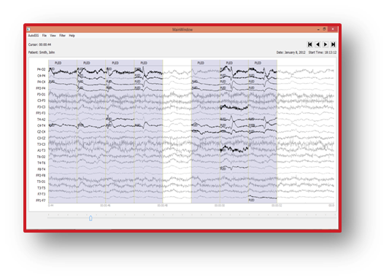
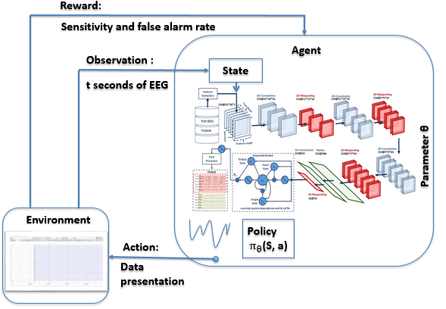
Finding the Optimal Data Presentation Using Reinforcement Learning
Saeedeh Ziyabari
Neural Engineering Data Consortium
Temple University

Slide 2
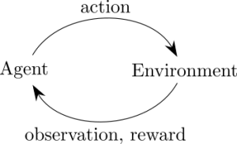
What is Reinforcement learning (RL)?
It is a branch of machine leaning concerned with taking sequence of actions.
Usually described in term of agent interacting with a previously unknown environment, trying to maximize cumulative rewards.
Deep reinforcement learning is reinforcement learning where we are using neural networks as optimizers.
Reinforcement learning using neural network to approximate functions:
Policies (select next action)
Value functions (measure goodness of states of state-action pairs)
Models (prediction next states and rewards)

Slide 3
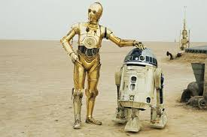
Reinforcement Learning Examples
Robotic:
Observations: Camera images, joint angles
Action: Joint torques
Rewards: Stay balanced, navigate to target locations, Serve and protect
humans

Slide 4
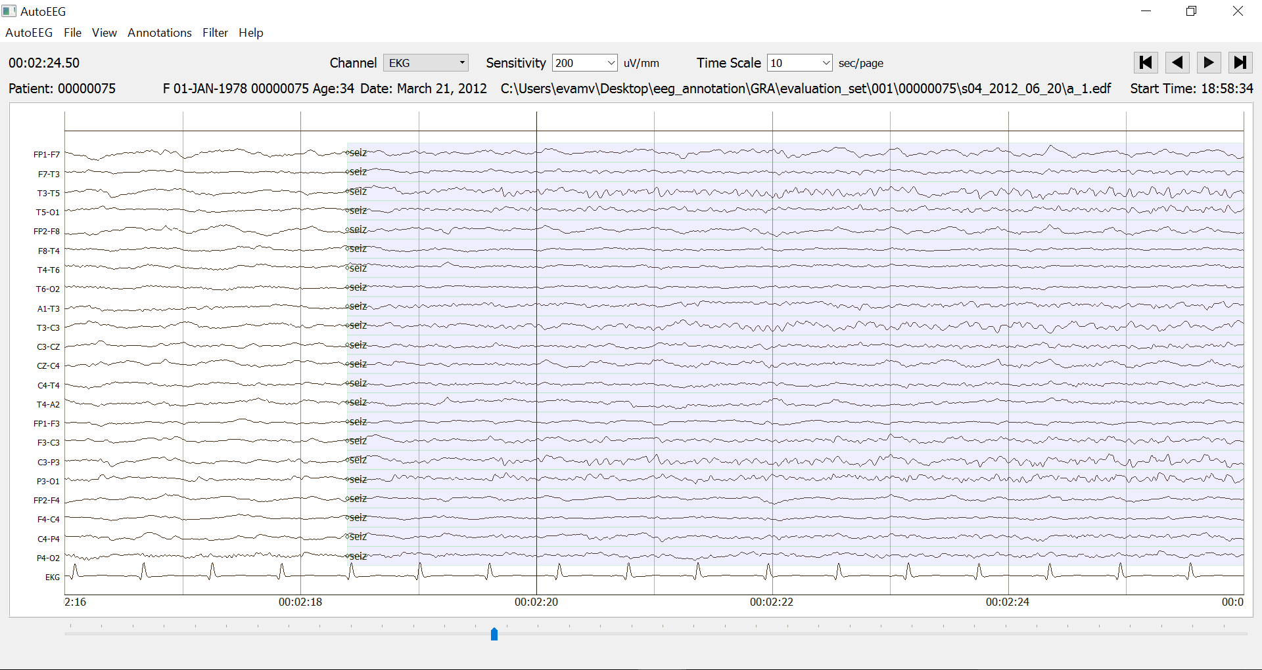
Reinforcement learning examples
Seizure detection:
Agent: AutoEEG
Observations: EEG signal
Action: seizure detection, data presentation
Rewards: higher sensitivity and lower false alarm

Slide 5
How Does RL Related to Other ML problems?
Supervised Learning:
Environment samples input-output pair ($x_{t}$, $y_{t}$) ~ p
Agent predicts ŷ $={f(x}_{t})$
Agent receive loss ${l(y}_{t}, ŷ_{t})$
Environment asks agent a question, and then tells her the right answer
Contextual bandit:
Environment samples input $x_{t}$~ p
Agent takes action ŷ $={f(x}_{t})$
Agent receives cost $C_{t} \sim P (C_{t}$| $x_{t}$, $ŷ_{t}$) where P is an unknown probability distribution
Environment asks agent a question, and gives noisy score on her answer

Slide 6
How Does RL Related to Other ML problems?
Reinforcement learning:
Environment samples input $x_{t}$~ p$\left(X_{t} \right|x_{t−1}$, $y_{t−1})$
Input depends on your previous actions!
Agent takes action ŷ $={f(x}_{t})$
Agent receives cost $C_{t} \sim P (C_{t}$| $x_{t}$, $ŷ_{t}$) where P is an unknown probability distribution
Environment asks agent a question, and gives noisy score on her answer
Summery of differences between RL and supervised learning:
You do not have full access to function that you are trying to optimize- must query it through interaction.
Interacting with a stateful world: input $x_{t}$ depends on your previous actions.

Slide 7
Reinforcement Learning deficiency
Reinforcement learning is the idea of a reward function, which indicates to the learning algorithm what states are preferred, and what states should be avoided.
To make reinforcement learning run in a reasonable amount of time, it is frequently necessary to use a well-chosen reward function that gives appropriate “hints” to the learning algorithm.
The selection of these hints often entails significant trial and error, and poorly chosen shaping rewards often change the problem in unanticipated way that cause poor solutions to be learned.
Developing a theory for shaping the reward function to show how the problem can be eliminated is the main contribution of this work.

Slide 8
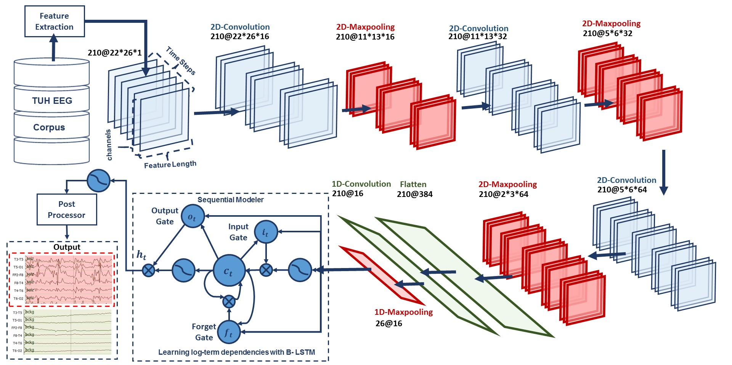
Deep Reinforcement Learning
Reward:
Sensitivity and false alarm rate
Agent
Observation :
State
t seconds of EEG
Parameter θ
Environment
Policy
$π_{θ}$(S, a)
Action:
Data presentation

Slide 9
Contributions
Introducing a new model for automatic discovery of the optimal data presentation using reinforcement learning framework.
Combining the proposed reinforcement learning framework with new robust and reliable optimization algorithm to find the best data presentation faster and thereby achieve the best performance.
Applying the proposed reinforcement learning frameworks to determine the optimal set of hyperparameters in any learning algorithms.
Investigation the potential of applying the reinforcement learning frameworks for the first time on the task of automatic analysis of EEGs.
Developing a theory for shaping the reward function.

