Slide 1
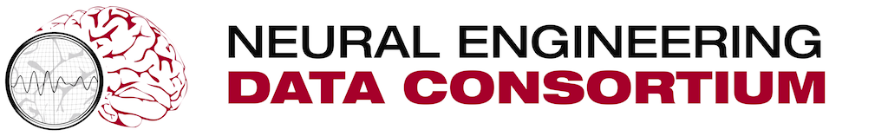

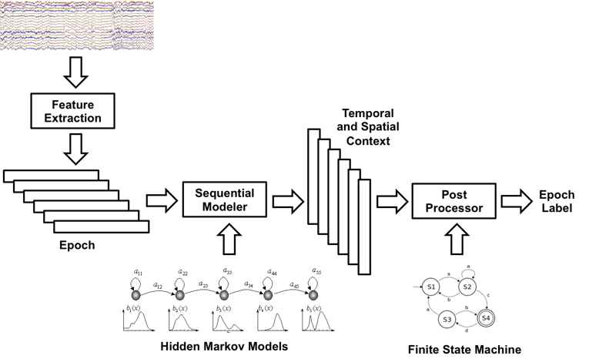
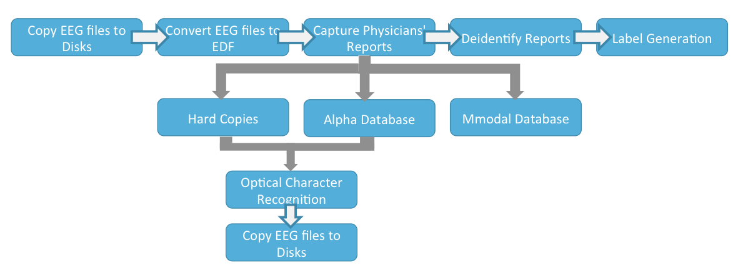
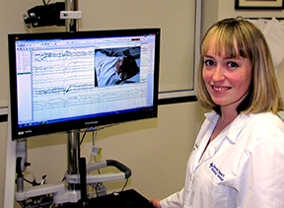

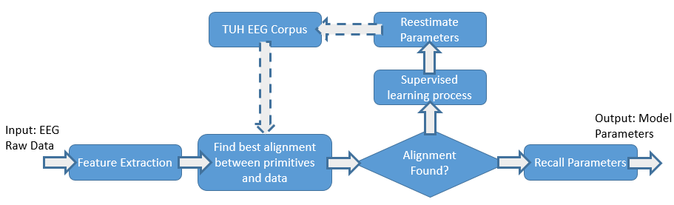
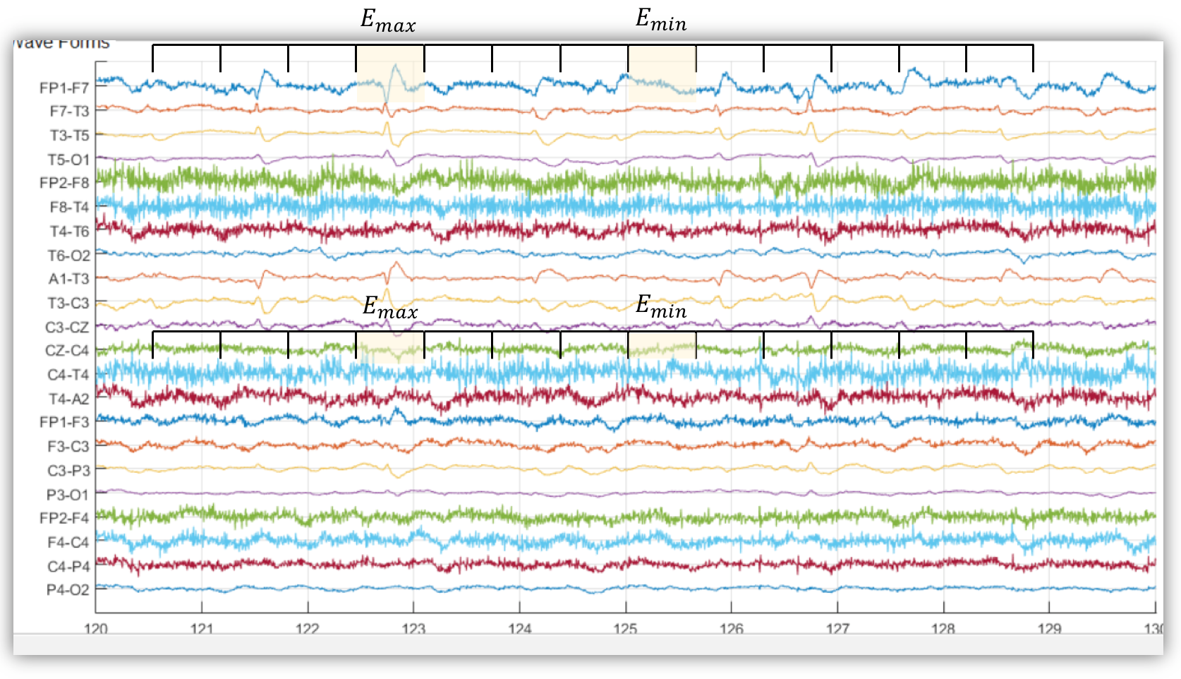
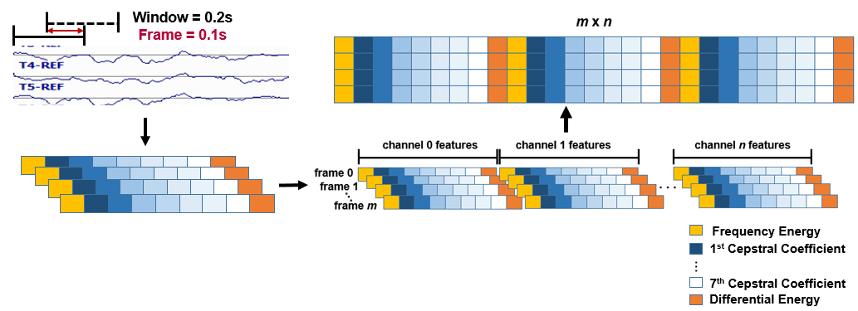
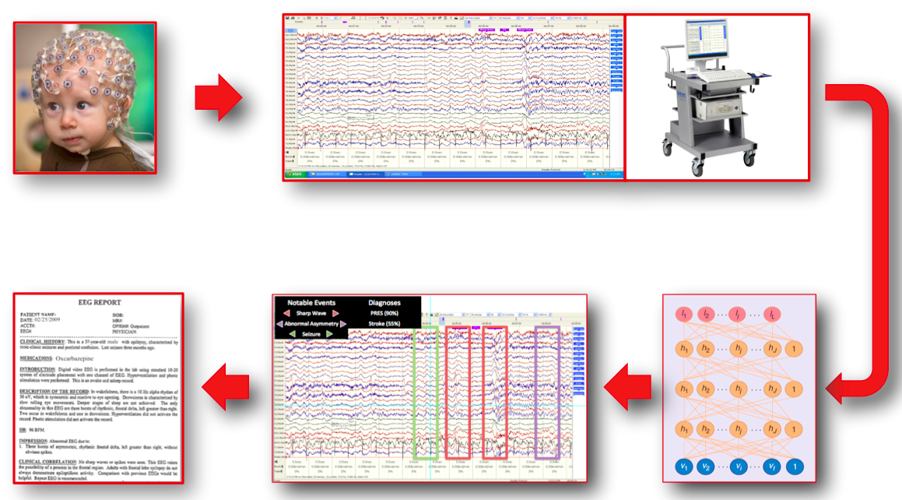
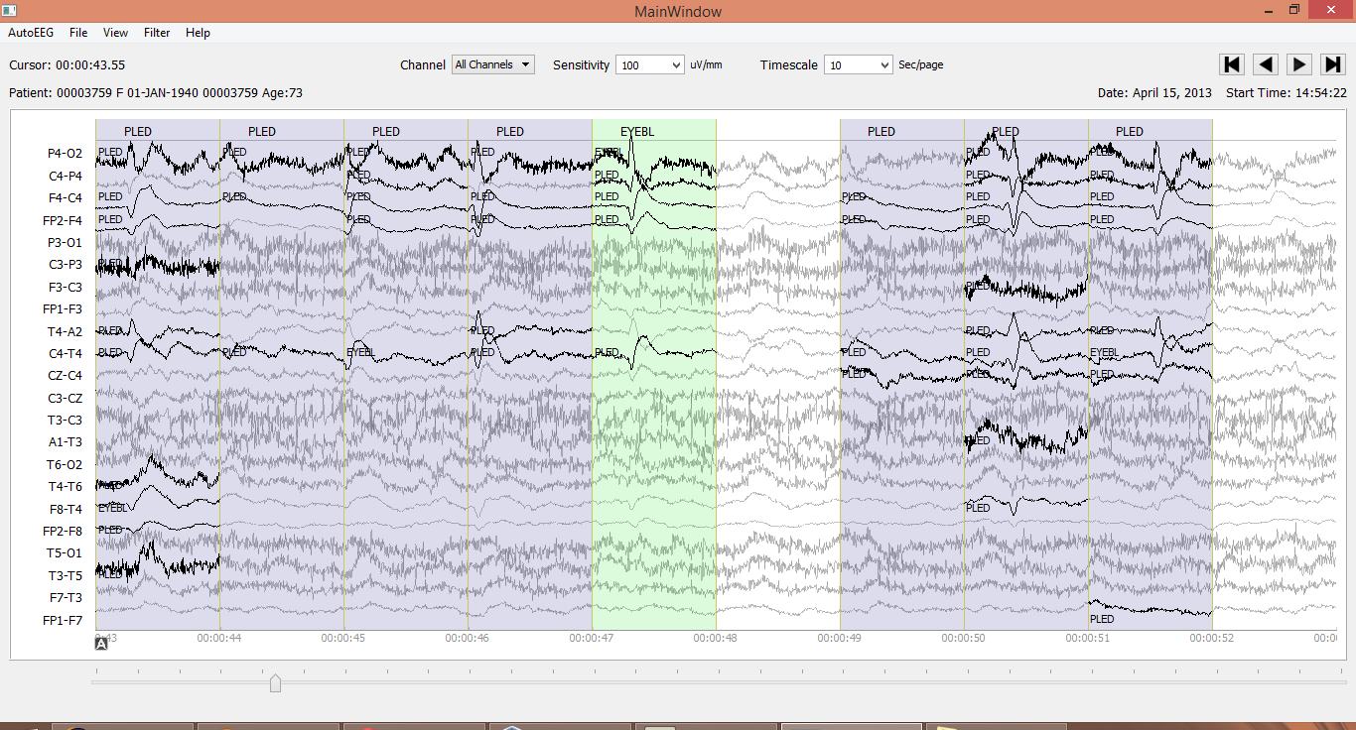
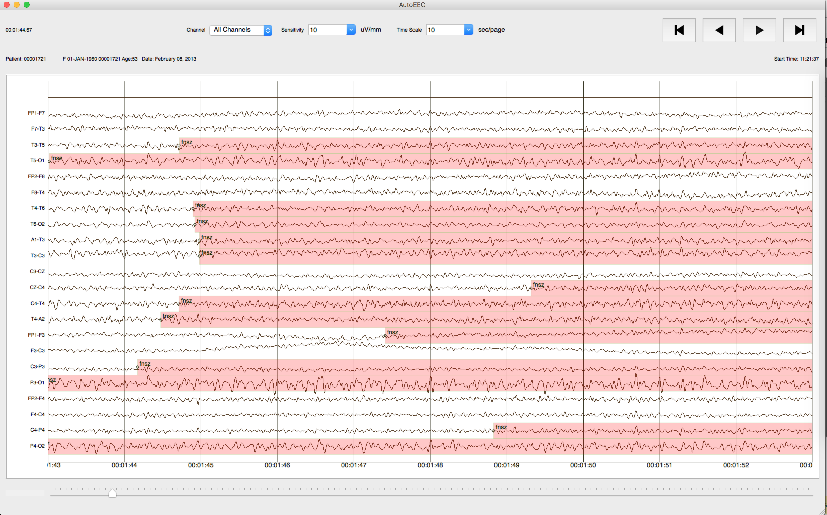
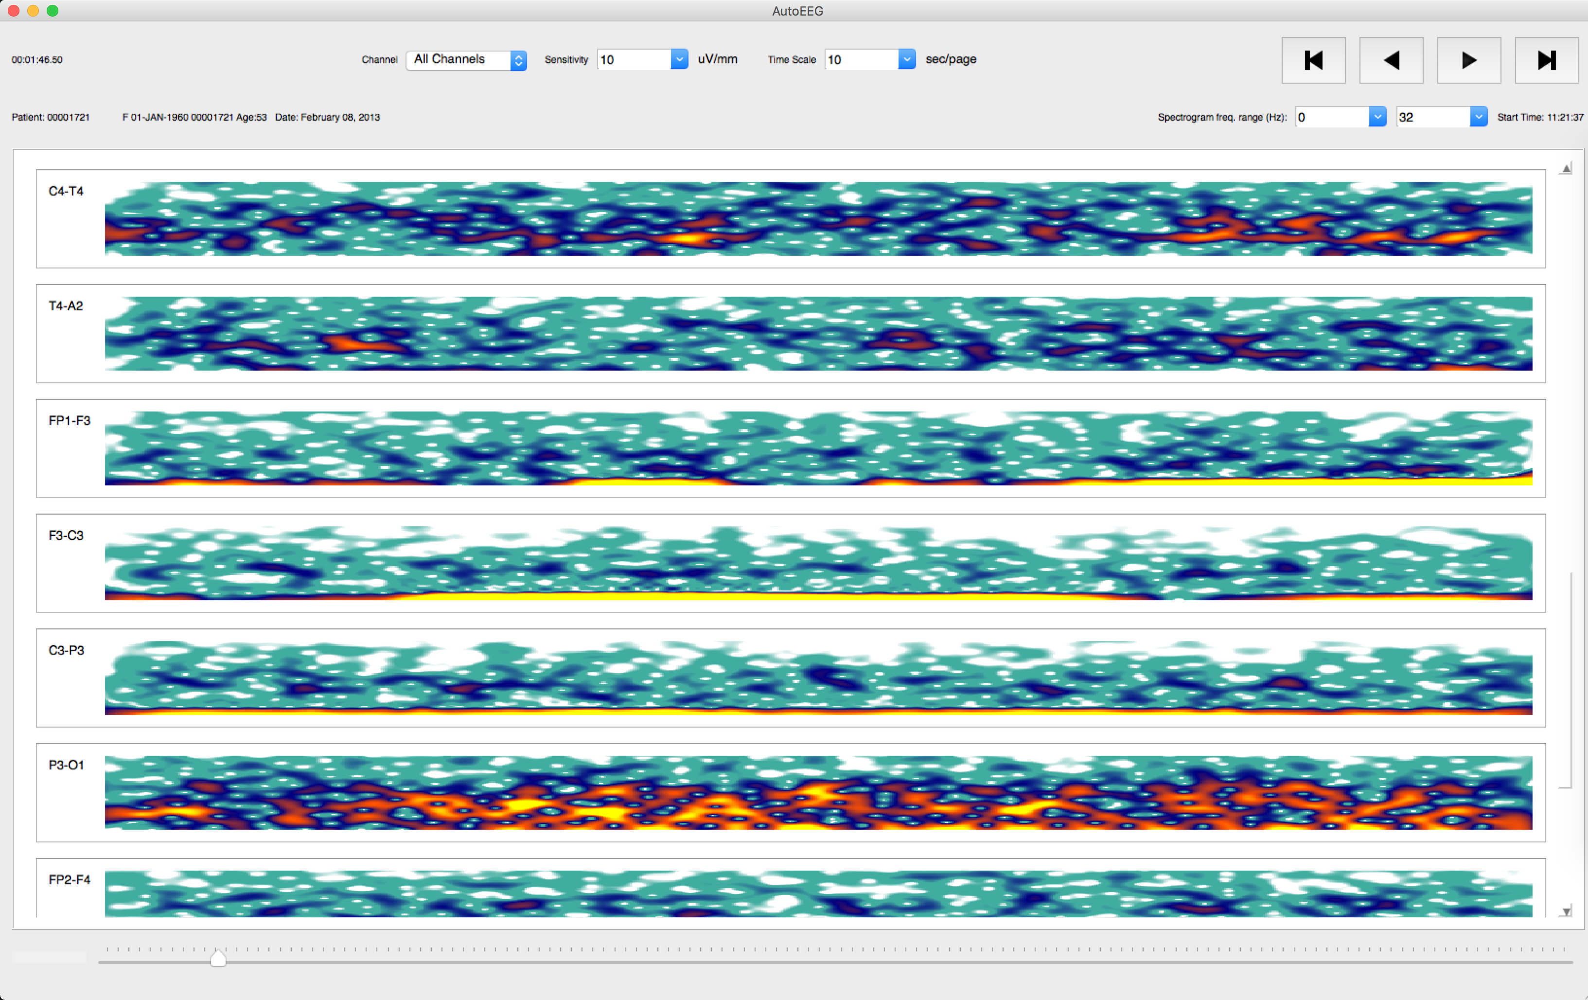
AutoEEG: AUTOmatic Interpretation of EEGs
www.biosignalanalytics.com
Joe Camaratta and Meysam Golmohammadi
BioSignal Analytics, Inc.
University City Science Center
Iyad Obeid and Joseph Picone
The Neural Engineering Data Consortium
Temple University
www.nedcdata.org
Abstract
The emergence of big data and deep learning is enabling the ability to automatically learn how to interpret EEGs from big data.
The TUH EEG Corpus is the largest and most comprehensive publicly-released corpus representing 14 years of clinical data collected at Temple Hospital. It includes over 15,000 patients, 28,000+ sessions, 50,000+ EEGs and deidentified clinical information.
We have developed a system, AutoEEG, that recognizes key EEG signal events, generates time aligned markers indicating points of interest in the signal, and then produces a summarization if its findings based on a statistical analysis.
Performance on EEG signal events is approaching human performance.
Performance on real-time seizure detection is rapidly becoming clinically relevant.
Physicians can access the results from any portable computing device and interactively query the data using standard query tools.
Clinical consequences include real-time feedback and decision making support for ICU and EMU applications.
System Overview
Hybrid hidden Markov models/deep learning:
Market:
Customer Survey: 57 clinicians from academic medical centers and community hospitals, and 44 industry professionals.
Primary Customer Need: 70% of neurologists interviewed reported that the most pressing need for a new product was for more reliable automated seizure detection.
Over 50% believed that real-time automated seizure detection would be highly beneficial in optimizing treatment using antiepileptic drugs.
Critical applications include real-time alerts in ICU and EMU settings, which require extremely low false alarm rates.
Integration of additional information streams.
Big Data Resources:
Customers:
Manufacturers
End-Users:
Neurologists
TAM
$1T
SAM
$1.5B
Target
$10M
Purchasers:
Administrators
Competitors:
Third-Parties
Active learning used during training due to the limited amount of transcribed data:
Problem
Solution
Identify EEG events in the signal and summarize findings based on the events:
enables clinical neurologists employing a volume-based business model to decrease the time spent analyzing an EEG;
allows pharmas to assess changes quantitatively in neural activation during clinical trials.
Live-Input Demonstration System
Summary
High performance EEG signal event detection increases the efficiency and quality of care.
Big data and machine learning together enable unprecedented levels of performance and improve inter-rater agreement.
Automated analysis increases the potential market for EEG technology and addresses many issues faced in critical care.
Future applications include real-time seizure detection for ICU applications, cohort retrieval, and medical student training.
Acknowledgements
This is a collaboration between the University City Science Center and Temple University.
Portions of this work were also sponsored by the Defense Advanced Research Projects Agency (DARPA), National Science Foundation and National Institutes of Health.

