Slide 1
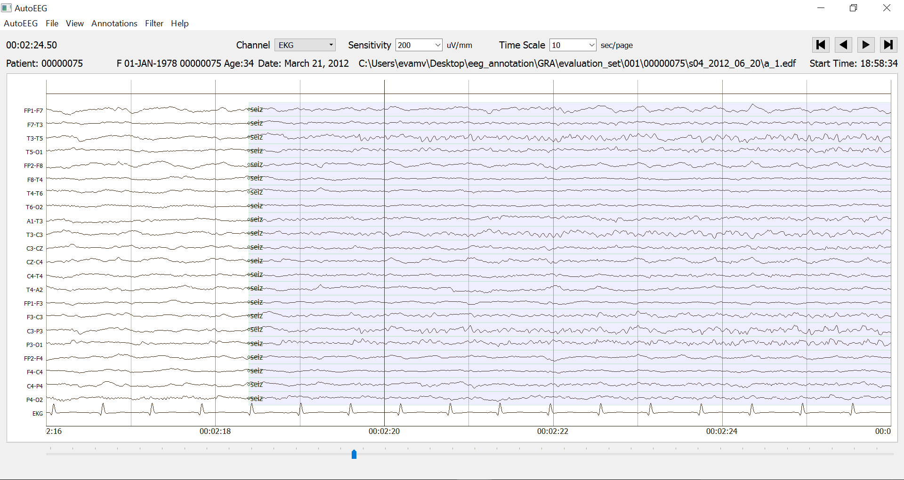
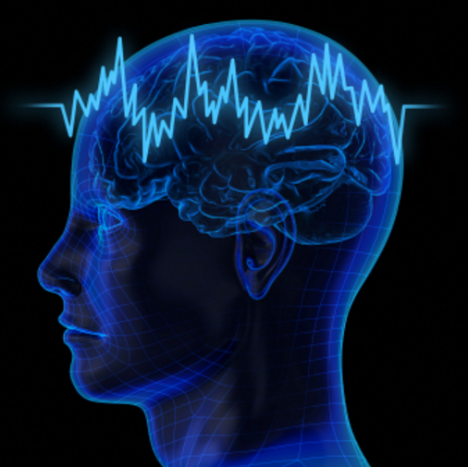
AUTOMATIC SEIZURE DETECTION ON THE TUH EEG SEIZURE CORPUS
Neural Engineering Data Consortium
College of Engineering
Temple University

Slide 2
The TUH EEG Seizure Corpus
The TUH EEG Seizure Corpus is a subset of the TUH EEG Corpus that focuses on the problem of seizure detection.
Natural language processing was used to identify sessions likely to have seizures based on the EEG reports.
Two commercially-available automatic seizure detection tools were also used to find sessions that most likely have seizures.
The intersection of this data was identified as “high yield” data and manually annotated by a team of highly-skilled and well-trained undergraduates.
A community of neurologists were used to annotate portions of the data.
Comparisons between the two groups were extremely favorable – kappa statistic was 0.89 – better than agreement amongst the neurologists.
An FAQ is being used to further discuss and resolve ambiguous cases.
The corpus (v1.0.3) was released to the community.
 | Train | Eval
Patients | 64 | 50
Sessions | 281 | 229
Files | 1,028 | 985
Seizure (secs) | 17,686 | 45,649
Non-Seizure (secs) | 596,696 | 556,033
Total (secs) | 614,382 | 601,682

Slide 3
Performance Metrics
NIST FD4E Keyword Search Evaluations: measures hits and misses on each search term using time-aligned annotations by assessing the degree of overlap in time between the hypothesis and reference.
Actual Term-Weighted Value (ATWV): industry-accepted metric that balances penalties for correct recognition and false alarms (for a system that is useable.
ATWV = 1.0: implies no false alarms; ATWV > 0.5: useable system.
Any Overlap Method: permissive scoring that counts a hit any time there is any overlap between the reference and hypothesis and ignores multiple hypotheses mapping to the same reference event.
Typically reported in terms of sensitivity and specificity.
Tends to report low false alarm rates.
NEDC Time-Aligned Scoring: scores based on the percentage of time the hypothesis matches the reference. Uses fractional scores for partial and overlapping hypotheses.
Reports adjusted sensitivity, specificity and false alarm rate per 24 hours.
Typically reports a lower sensitivity and higher false alarm rate.
Inter-Rater Agreement: Cohen’s kappa statistic used to assess annotator agreement by taking into account the probability a match could have occurred by chance (values of 0.6 are typical for EEGs).

Slide 4
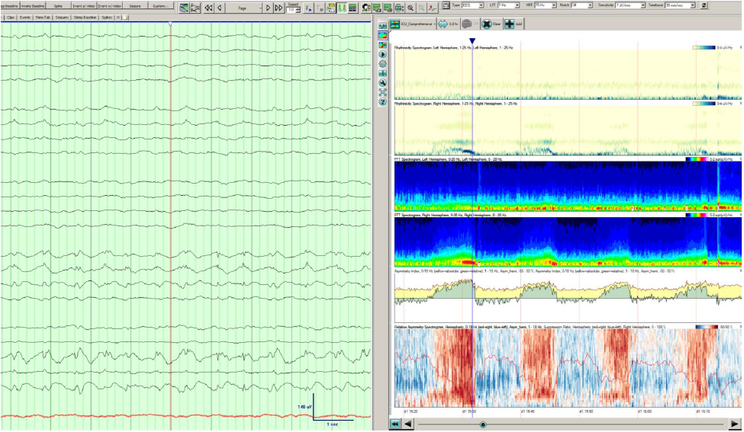
Performance Comparison
Persyst (version 13, Rev. B Build 2016.04)
AutoEEG employs a variety of state of the art deep learning technologies.
AutoEEG identifies critical EEG signal events such as seizures.
Adaptation to other relevant neurology tasks is underway.
The sensitivity of both systems is low (target: 75%).
The false alarm rates are too high (target: 1/24 hrs).
Actual Term-Weighted Value (ATWV) below 0.5 are problematic.
 | Persyst | Baseline | DL
Sensitivity | 38.9% | 29.2% | 31.3%
Specificity | 74.7% | 66.7% | 69.8%
FAs/24 hrs | 35 | 78 | 29
ATWV | 0.1197 | -0.4200 | 0.1485

Slide 5
Performance Comparison
AutoEEG identifies critical EEG signal events such as seizures.
AutoEEG employs a variety of state of the art deep learning technologies.
 | Metric | HMM Baseline | HMM/ SdA | HMM/ LSTM | IPCA/ LSTM | CNN/ MLP | CNN/ LSTM
NIST | Correct | 31.37% | 29.18% | 29.36% | 31.23% | 32.05% | 31.48%
 | Error | 77.40% | 66.69% | 68.24% | 73.26% | 72.10% | 68.52%
 | FAs/24 hrs | 618 | 78 | 70 | 98 | 97 | 25
 | ATWV | -6.010 | -0.5214 | -0.4829 | -0.6843 | -0.6539 | 0.1989
Overlap | Sensitivity | 78.71% | 34.12% | 34.58% | 42.46% | 43.22% | 31.78%
 | Specificity | 24.75% | 78.96% | 79.85% | 78.21% | 77.22% | 92.33%
 | FAs/24 hrs | 549.18 | 58.14 | 56.59 | 67.24 | 65.32 | 18.23
 | Kappa | 0.01 | 0.14 | 0.14 | 0.18 | 0.19 | 0.28
Time-Aligned Scoring | Sensitivity | 45.58% | 23.81% | 24.18% | 28.84% | 29.34% | 14.69%
 | Specificity | 11.43% | 69.72% | 70.51% | 67.13% | 66.64% | 89.35%
 | FAs/24 hrs | 610.54 | 70.14 | 66.09 | 66.14 | 65.32 | 19.69
 | Kappa | -0.1 | -0.05 | -0.05 | -0.04 | -0.04 | 0.05

Slide 6
Summary
The recently released TUH EEG Seizure Corpus presents an opportunity to advance technology using state of the art “big data” machine learning.
The corpus is an ongoing effort that includes:
identifying and annotating the remaining sessions with seizures in the TUH EEG Corpus;
manual review of annotations by a panel of at least three expert neurologists and through a community-wide FAQ;
integrating other publicly available sources of data.
An advanced deep learning system is providing promising results. Improvements are under development with a goal to reach 75% sensitivity and 10 FAs/24hrs by July 1, 2017.
Future extensions include:
Cohort Retrieval: useful as a decision-support tool and and for training medical students.
Normal/Abnormal/Sleep Detection.
We are searching for industry partners to collaborate on a NSF STTR Phase II grant.

