Slide 1
Summer research: Weekly Meeting
Francisco Parente, August 10th 2015

Slide 2
Previous Goals
Finish assigments for the MPLPC project.

Slide 3
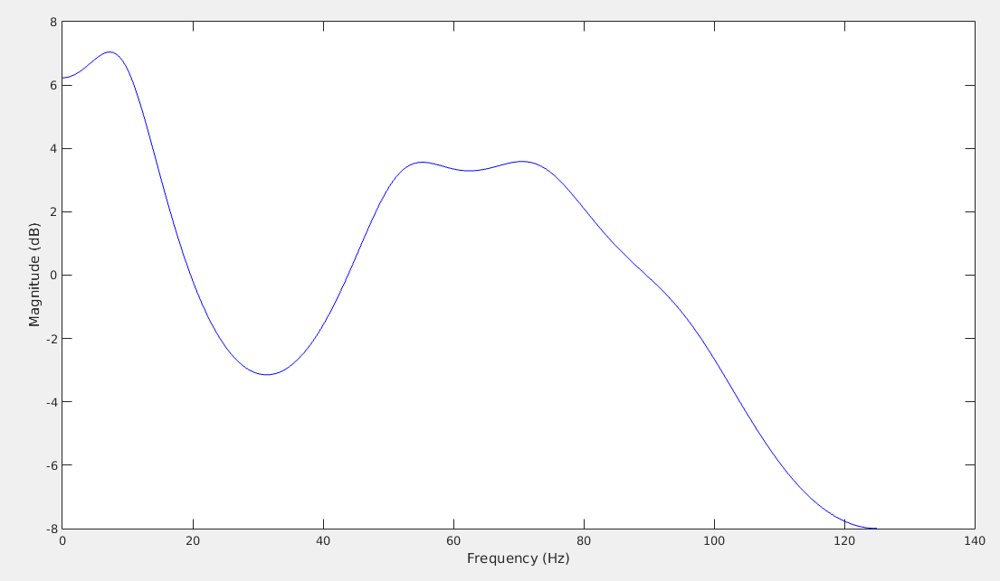
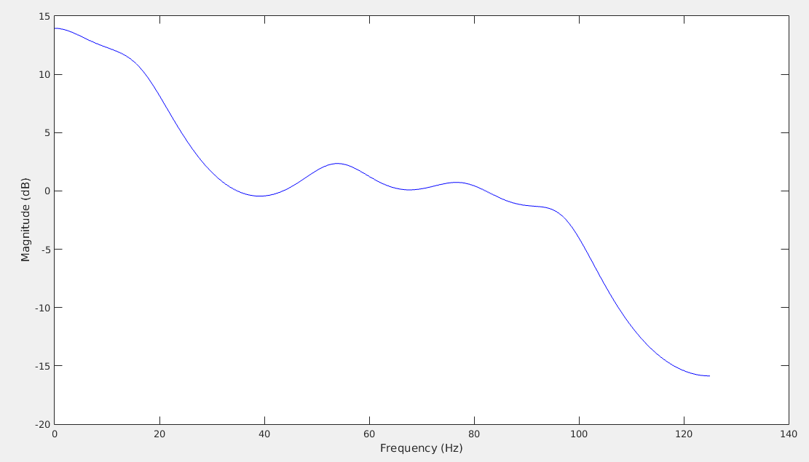
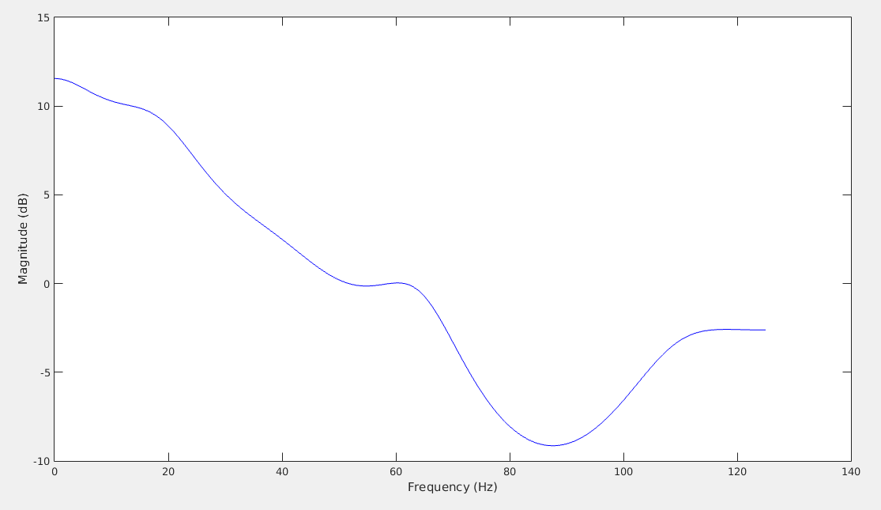
accomplishments
MPLPC:
I implemented a linear prediction model for the spike detection project;
I have used a prediction of order 10;
I selected ilustrative examples using relevant frames, as shown below (we have used a frame-based approach with 10-length windows and 5-length frames):

Slide 4
Plans for THIS week
Obtain more results from training
Deliver the next version of the poster

