Slide 1
Weekly Presentation
Fabricio Teles Dutra Goncalves
06/22/2015

Slide 2
Goals
Perform experiments interpolating multiple new channels using the new parameter file format.
Finish to integrate the code.
Design review.
Check documentation.

Slide 3
Accomplishments
Parsing and channel processing code completely combined.
Multiple new channels interpolated.
Check_montage utility tested.

Slide 4
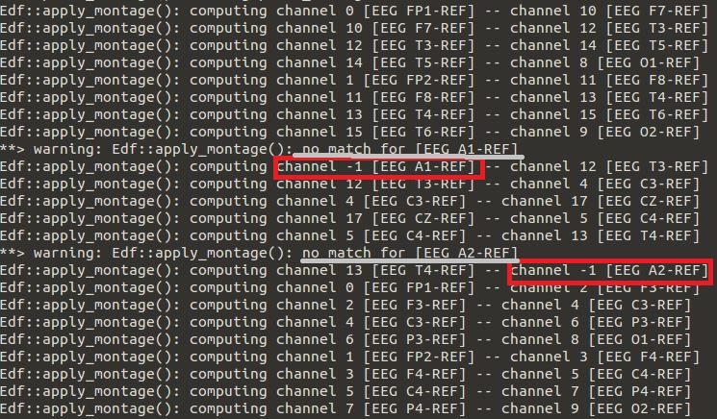
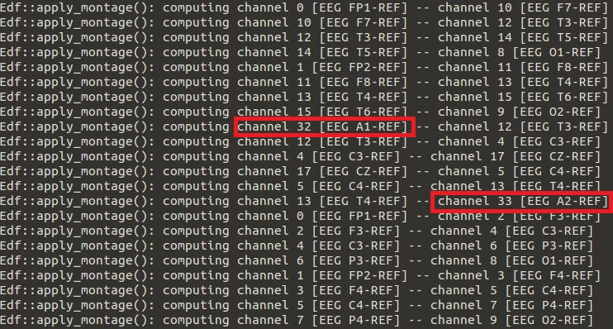
Accomplishments (cont.)

Slide 5
Accomplishments (cont.)
Directory | Support TCP Montage | Do not support TCP Montage | Total of EDF files
/data/isip/data/tuh_eeg/v0.6.0 | 90.27% | 9.73% | 38,437

Slide 6
Next Week
Fix all problems regarding memory leak in interpolation code.
Integrate the parsing montage code to interpolation code.
Work on feature generation in Kaldi/EEG.
Analyze the files with missing channels and check which channels are missing.

