Slide 1
Wavelets
Pedro H. R. Garrit
05/209/2015

Slide 2
MODWPT (Maximum Overlap Discrete Wavelet Packet Transform)
Non-Orthogonal;
Has a Higher computational cost than DWT;
Does not have a down sampling step;
Supports any sample size;
Produces a more asymptotically efficient wavelet variance estimator than the DWT;

Slide 3
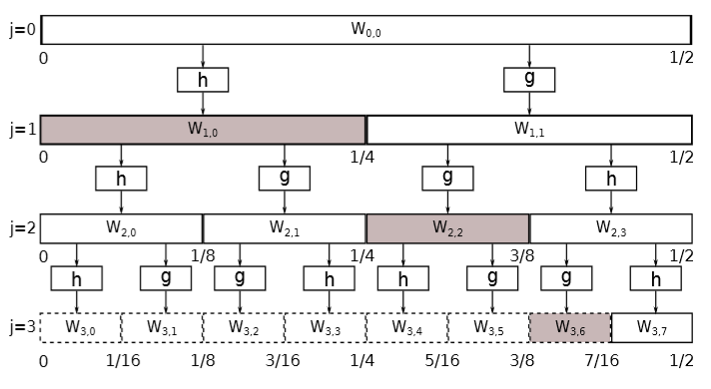
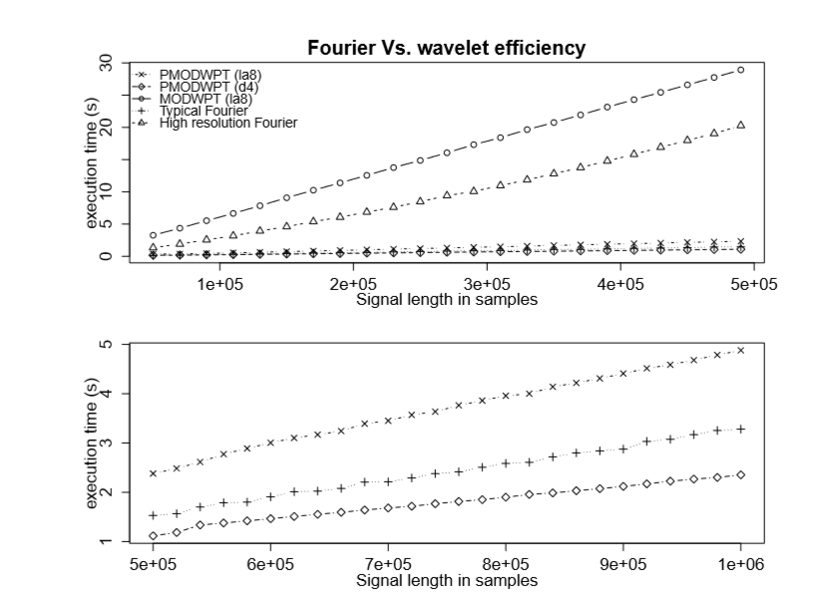
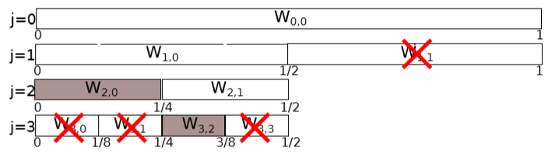
A new algorithm for wavelet-based heart rate variability analysis
Differences between MODWPT (fig.1) and is variation with the pruning algorithm PMODWPT (fig.2).
The difference on the number of calculated coefficients shows a decrease on the execution time for PMODWPT in relation to MODWPT being even comparable to the execution time of the typical Fourier transform (Fig .3)
Fig.1 MODWPT decomposition tree with the nodes selected to cover the band [0,7/16] Hz (Fs=2Hz).
Fig.2 Pruned MODWPT decomposition tree (PMODWPT) with the nodes selected
to cover the band [0,3/8] Hz (Fs=2Hz).
Fig. 3 graph drawing a comparison between the execution time of the wavelets algorithm and the Fourier transform

Slide 4
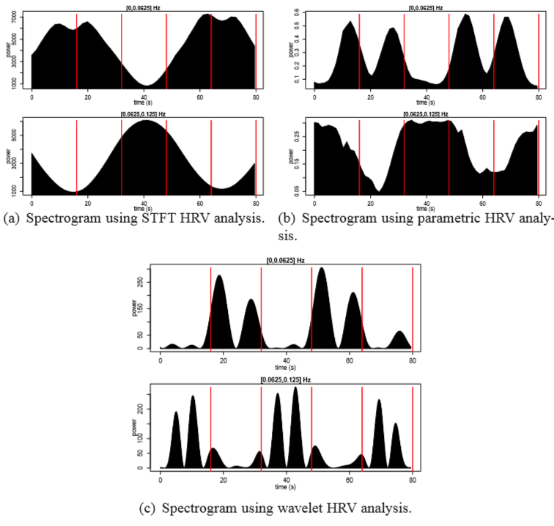
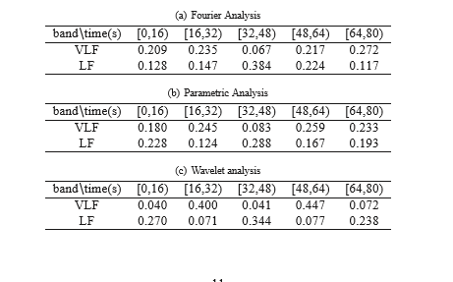
A new algorithm for wavelet-based heart rate variability analysis
In fig.4 we can see the superior time resolution showed by the wavelet based algorithm I’m comparison with the Fourier (STFT) and the parametric estimation methods on a analysis of a simulated RR series
Table 1 shows the relative power values for each of the bands and zones, for this experiment the ideal ratios for the distribution, if the perfect time-frequency discrimination was obtained, are: VLF = [ 0 0.5 0 0.5 0] LF = [1/3 0 1/3 0 1/3]
Fig. 4 Spectrogram analysis of a simulated RR series
Table .1 Relative power per frequency band and zone for each method

Slide 5
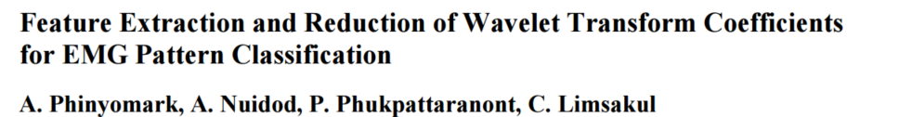
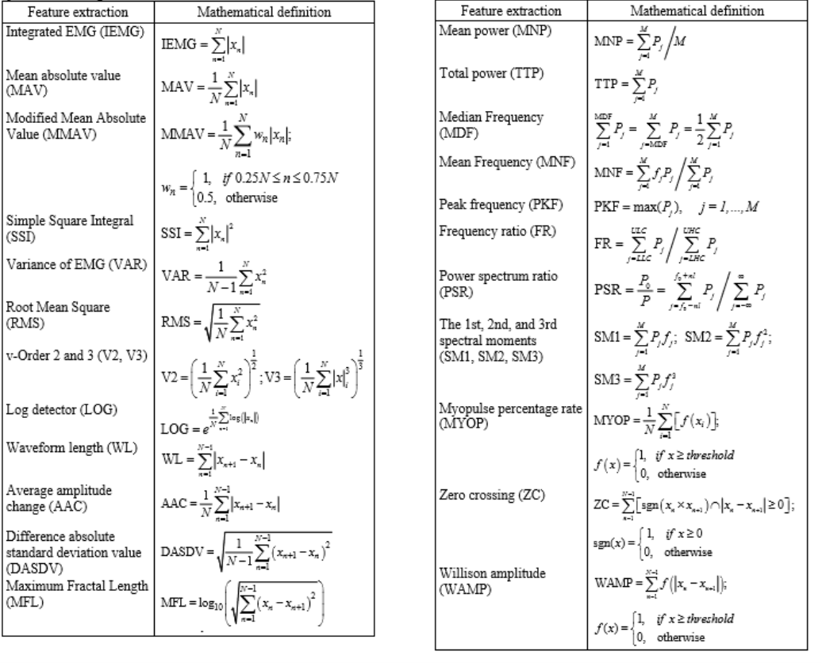
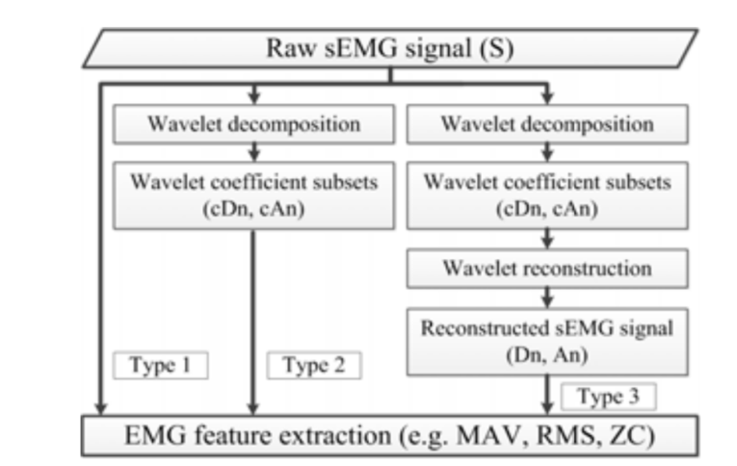
Fig. 5 Procedure for the extraction of sEMG features from the raw wavelet coefficients and the reconstructed sEMG signals.
Fig. 6 Mathematical definition of the 25 Feature extraction Methods tested

Slide 6
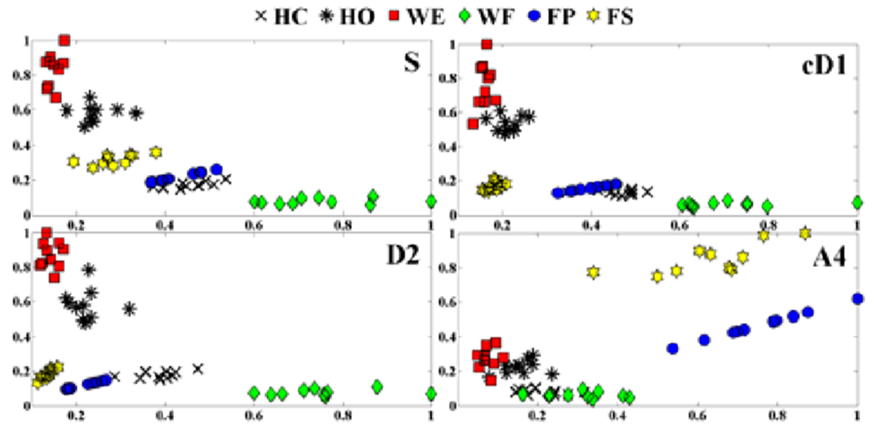
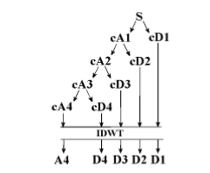
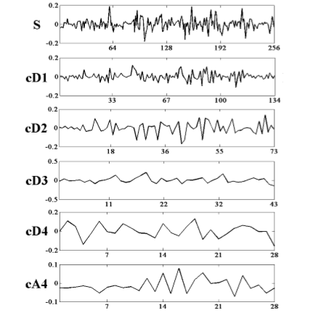
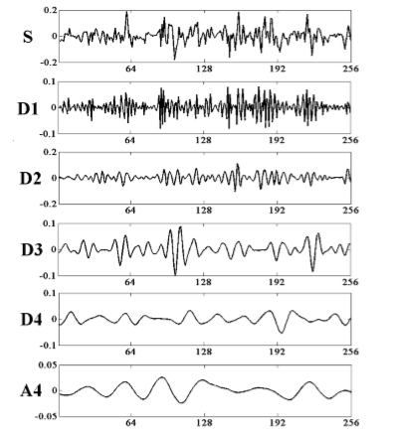
Feature Extraction and Reduction of Wavelet Transform Coefficients for EMG Pattern Classification
The data was recorded for six different hand motions (classes): wrist flexion (WF), wrist extension (WE), hand close (HC), hand open (HO), forearm pronation (FP) and forearm supination (FS).
On Fig .8 we can see a scatter plot for the MAV feature extraction showing the differences on class separability when applied to the different sets of coefficients and the raw data
Fig. 7 Scatter plots of the MAV feature calculated from the raw sEMG signal (S), the wavelet’s detail coefficient subset at the first level (cD1), the reconstructed sEMG signal from the cD2 (D2), and the reconstructed sEMG signal from cA4 (A4)
Fig. 7 decomposition tree from decomposition level 4 and inverse transform of each subset

Slide 7
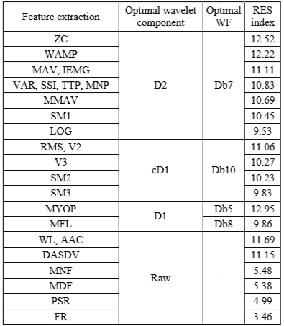
Feature Extraction and Reduction of Wavelet Transform Coefficients for EMG Pattern Classification
Table 2. The optimal wavelet component and wavelet function for the 25 sEMG features considered in this study with their RES indices

Slide 8
Code under development
function [ feat,features ] = wFeat( File,filename,WinTime,WinFrame,Montage_T)
%[ feat ] = wFeat( File,WinTime,WinFrame, Montage_T )
% feat = feature vector
% filename = name of the output .txt file
% File = edf file name within the work space
% WinTime = Windows size in seconds
% WinFrame = frame time in seconds
% Montage_T = montage matrix
[struc,Data]=edfread(File); %reading edf file
%applying Montage to waveforms
Time=floor(size(Data,2)/struc.samples(1));
window=floor(size(Data,2)/Time);
K=Montage_Ver_0_1( Data,Montage_T );
Signal = K';
SF = struc.samples(1); %sampling frequency
winsize =floor(WinTime*SF); %windows size
wininc =floor(WinFrame*SF); %frame size
%feature extration using wavelets
feat = getmswpfeat(Signal,winsize,wininc,SF,'matlab');%Calculate the Wavelet coeficients and
executes the feature extraction
%crop the concatenated Feature vectors for each channel
K=size(feat,2)/size(Montage_T,1);%Calaculates vector size
features=zeros(size(feat,1),K,size(Montage_T,1));%prealocation the matrix of feature vectors
for I=0:(size(Montage_T,1)-1)
features(:,:,I+1)=feat(:,(1+K*I):(K+K*I));
end
%Writing to Features.txt file
for H=1:(size(Montage_T,1))
s='';
for k = 1:size(features,2)
s = cat(2,s,'%f ');
end
s = strcat(s,'\n');
subs=cat(2,'_',num2str(H));
file=cat(2,filename,subs);
file=cat(2,file,'.txt');
fid=fopen(file,'w');
Kstrac=features(:,:,H);
fprintf(fid,s,Kstrac');
End
end
Wavelet type: Daubechies 4 wavelet (db4)
Feature Extraction Method: RMS
Import .edf file to MatLab
Execute Montage on the signal
Calculate wavelet coefficients
Execute feature extraction based on RMS
Export the Feature vectors to Files there are compatible with HTK
Fig.9 simplified flowchart of the code

