Slide 1
Wavelets
Anderson G Moura
05/29/2015

Slide 2
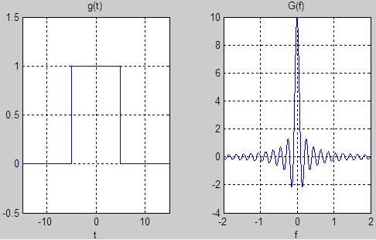
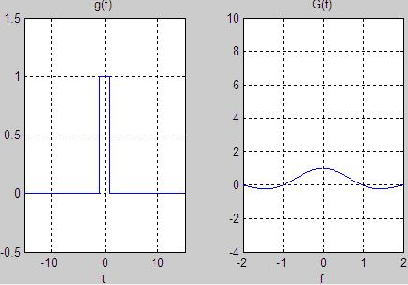
Introduction
Biomedical signals usually consist of brief high-frequency components closely spaced in time, accompanied by long-lasting, low-frequency components closely spaced in frequency[1]
Objective: Detect events and locate them in time
FT and STFT
A state of the art Wavelet Transform is a better tool to analyse time and frequency information simultaneously because it partitions the frequency axis smoothly and recursively analyzing each segment with a resolution matched to its scale[2]

Slide 3
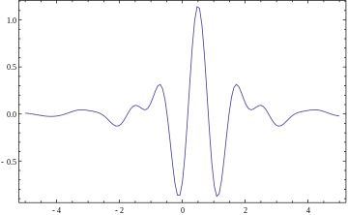
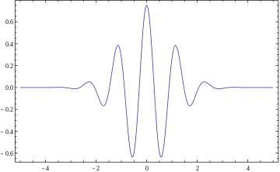
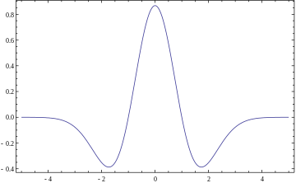
Definition
Wavelet is a waveform oscillation limited in time with RMS=0 (Mother wavelet)
The WT decomposes a signal in a set of scaled and shifted wavelets leading to a 2-dimensional representation of the signal based on scale(a) and translation(b)
The signal can be reconstructed by an integration of all the projections of the signal onto the wavelet basis [5]

Slide 4
Discrete Wavelet Transform
Make it practical:
CWT permits to analyze a signal at arbitrary scales[4]
DWT utilizes orthogonal wavelets at fixed frequencies, allowing the reduction of the redundancy of coefficients[4]
Reducing the amount of scalings and translations
The Scaling Function(Father Wavelet)

Slide 5
Normal or Epileptic
Used Data:
EEG Recordings carried out on five healthy volunteers(set A)
(10-20 International System of Electrode placement)
23.6 seconds – 4096 samples at 173.6 Hz
EEG archive of five pre-surgical diagnosis of five patients that have achieved complete seizure control from MIT-BIH database containing only seizure activity(set E)

Slide 6
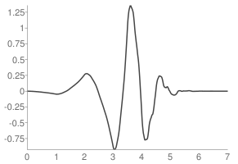
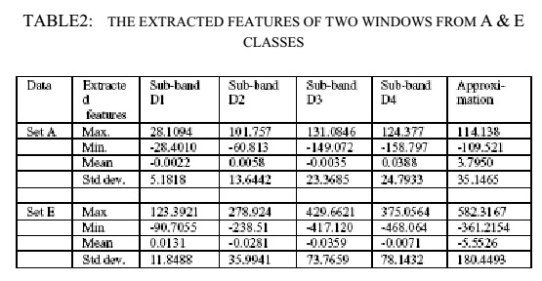
Wavelet transform:
4 levels
Daubechies of order 4
Feature Extraction:
Max, Min, Mean
Std Deviation

Slide 7
Neural Networks:
Multilayer Perceptron Network(MLP)
Most common
Smaller training set requirements
Ease of implementation
Radial Basis Function Network (RBF)
Most powerfull
Fast network training
Orthogonal least squares (OLS) method

Slide 8
Results:
MLP
97% accuracy (96 out of 3200 signals were misclassified between sets A and E)
RBF
98% accuracy
Extremely fast

Slide 9
References
[1] Khushaba, R N, S. Kodagoda, S. Lal, and G. Dissanayake. "Driver Drowsiness Classification Using Fuzzy Wavelet-Packet-Based Feature-Extraction Algorithm." IEEE Transactions on Biomedical Engineering IEEE Trans. Biomed. Eng.: 121-31.
[2] Saito, Naoki. "Frequently Asked Questions on Wavelets." Web. 29 May 2015. https://www.math.ucdavis.edu/~saito/courses/ACHA.suppl/wavelet_faq.pdf
[3] Jahankhani, Pari, Vassilis Kodogiannis, and Kenneth Revett. "EEG Signal Classification Using Wavelet Feature Extraction and Neural Networks." IEEE John Vincent Atanasoff 2006 International Symposium on Modern Computing (JVA'06).
[4] D’Avanzo, C, V. Tarantino, P. Bisiacchi, and G. Sparacino. " A wavelet Methodology for EEG Time-frequency Analysis in a Time Discrimination Task." International Journal of Bioelectromagnetism.: Vol. 11, No. 4, pp.185-188, 2009.
[5] Valens,C. “A Really Friendly Guide to Wavelets”. 1999

