Slide 1


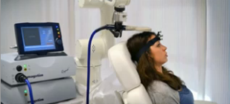
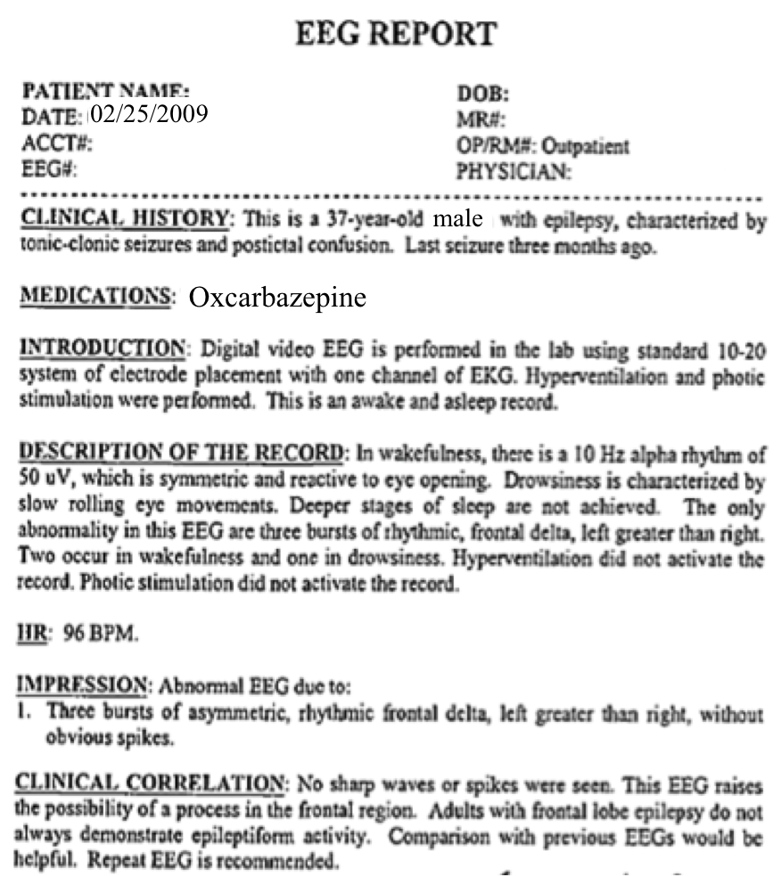
Automatic Labeling of EEGs
Using Deep Learning
M. Golmohammadi, A. Harati, S. Lopez
I. Obeid and J. Picone
Neural Engineering Data Consortium
College of Engineering
Temple University
Philadelphia, Pennsylvania, USA
Mercedes Jacobson, MD
Steven Tobochnik
Department of Neurology
School of Medicine
Temple University
Philadelphia, Pennsylvania, USA

Slide 2
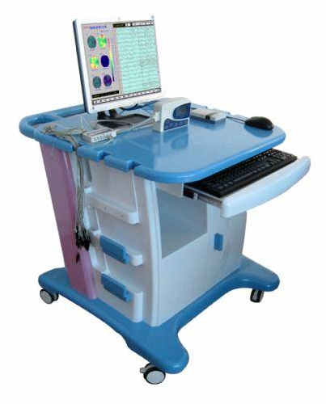
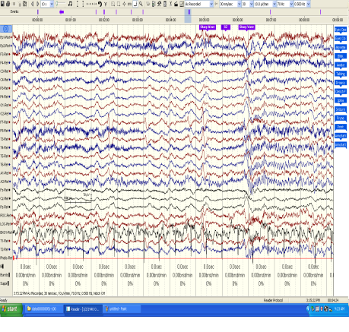
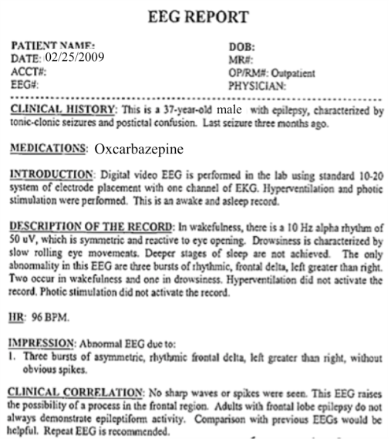
The Temple University Hospital EEG Corpus
Synopsis: The world’s largest publicly available EEG corpus consisting of 20,000+ EEGs collected
from 15,000 patients, collected over 12 years. Includes physician’s diagnoses and patient medical
histories. Number of channels varies from 24 to 36. Signal data distributed in an EDF format.
Impact:
  Sufficient data to support application of state of the art machine learning algorithms
  Patient medical histories, particularly drug treatments, supports statistical analysis of correlations between signals and treatments
  Historical archive also supports investigation of EEG changes over time for a given patient
  Enables the development of real-time monitoring
Database Overview:
  21,000+ EEGs collected at Temple University Hospital from 2002 to 2013 (an ongoing process)
  Recordings vary from 24 to 36 channels of signal data sampled at 250 Hz
  Patients range in age from 18 to 90 with an average of 1.4 EEGs per patient
  Data includes a test report generated by a technician, an impedance report and a physician’s report; data from 2009 forward inlcudes ICD-9 codes
  A total of 1.8 TBytes of data
  Personal information
  has been redacted
  Clinical history and medication history are included
  Physician notes are captured in three fields: description, impression and correlation fields.

Slide 3
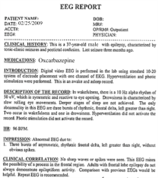
Automated Interpretation of EEGs
Goals: (1) To assist healthcare professionals in interpreting electroencephalography (EEG) tests,
thereby improving the quality and efficiency of a physician’s diagnostic capabilities; (2) Provide
a real-time alerting capability that addresses a critical gap in long-term monitoring technology.
Impact:
  Patients and technicians will receive immediate feedback rather than waiting days or weeks for results
  Physicians receive decision-making support that reduces their time spent interpreting EEGs
  Medical students can be trained with the system and use search tools make it easy to view patient histories and comparable conditions in other patients
  Uniform diagnostic techniques can be developed
Milestones:
  Develop an enhanced set of features based on temporal and spectral measures (1Q’2014)
  Statistical modeling of time-varying data sources in bioengineering using deep learning (2Q’2014)
  Label events at an accuracy of 95% measured on the held-out data from the TUH EEG Corpus (3Q’2014)
  Predict diagnoses with an F-score (a weighted average of precision and recall) of 0.95 (4Q’2014)
  Demonstrate a clinically-relevant system and assess the impact on physician workflow (4Q’2014)

Slide 4
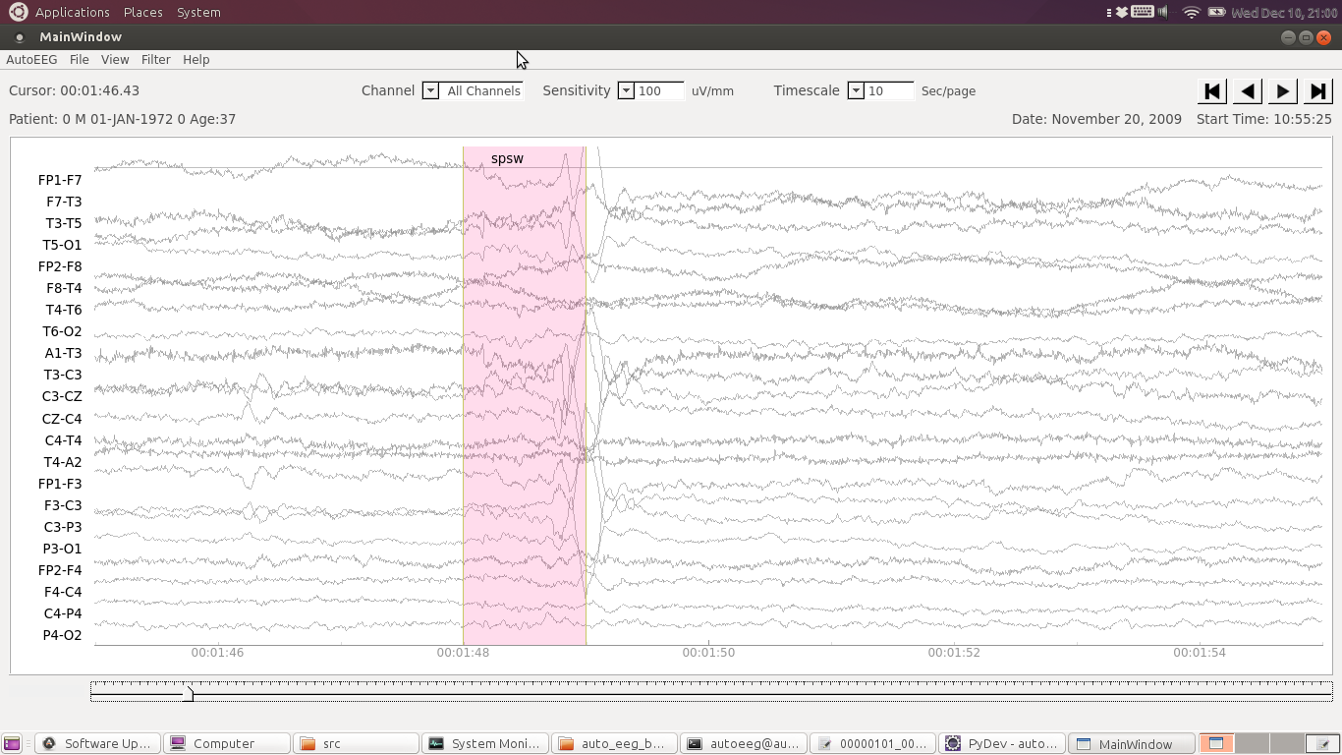
Real-Time Automatic Interpretation

Slide 5
Current Classification System For TUH EEG
  Three classes of events:
  SPSW: spike and sharp wave
  GPED: generalized periodic epileptiform discharges (GPED)
  (includes triphasic)
  PLED: periodic lateralized epileptiform discharges
  Three classes of background models:
  EYBL: eye blink (and other eye artifacts)
  ARTF: Artifact
  BCKG: Background
  Other classifications (eventually):
  Focal: occurs on a subset of the channels
  Generalized: occurs on all channels
  Continuous (CONT): occurs continuously throughout the data
  Intermittent (INTM): occurs sporadically

Slide 6
Performance
  State of the Art on the CHB-MIT Scalp EEG Database:
  Sensitivity: 96.5% False Alarm Rate: 3.8/hr
  TUH EEG Corpus:
  DET: Detection rate – % (spike/gped/pled) detected as (bckg/ar/eb)
  FA: False alarm rate – % (bckg/ar/eb) detected as (spike/gped/pled)
  ERR: Traditional error rate – % incorrect guesses for all 6 classes
System | DET | FA | ERR
Simple Heuristics | 99% | 64% | 74%
Random Forest | 85% | 6% | 37%
System 3 | 84% | 4% | 37%
System 4 | 82% | 4% | 39%
System 5 | 89% | 4% | 36%

Slide 7
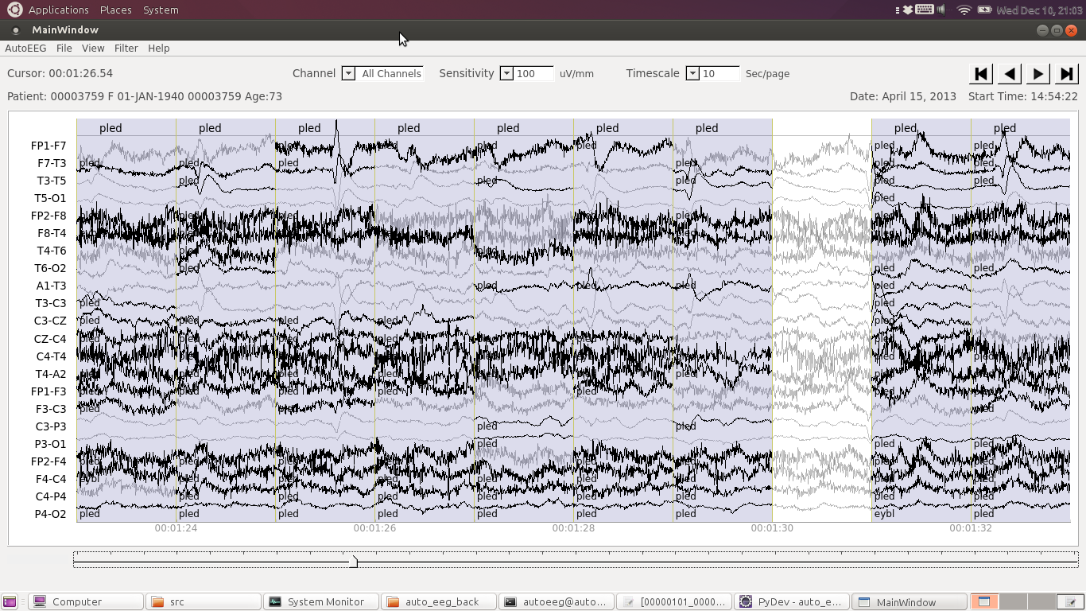
Live Input Demonstration

Slide 8
Summary
  Performance at a level where the system is clinically relevant – need your input
  Commercialization process is underway
  DARPA / NIH / NSF funding is critical
  Sustainable data collection process
  New opportunities (e.g., EEG + MRI?)

