Slide 1
Deep Learning

Slide 2
Deep learning?
MLP-> NN-> Deep Learning
Deep networks trained with backpropagation (without unsupervised pretraining) perform worse than shallow networks
Supervised/unsupervised
Each layer

Slide 3
Advantage
Deep Architectures can be representationally efficient
– Fewer computational units for same function:
sin(sqrt(tan(a^2)))
Deep Representations might allow for a hierarchy or representation
– Allows non-local generalization
– Comprehensibility
Multiple levels of latent variables allow combinatorial sharing of statistical strength
Deep architectures work well (vision, audio, NLP, etc.)

Slide 4
Deep Learning
DBN/DBM
Auto-Encoders
Deep Neural Networks

Slide 5
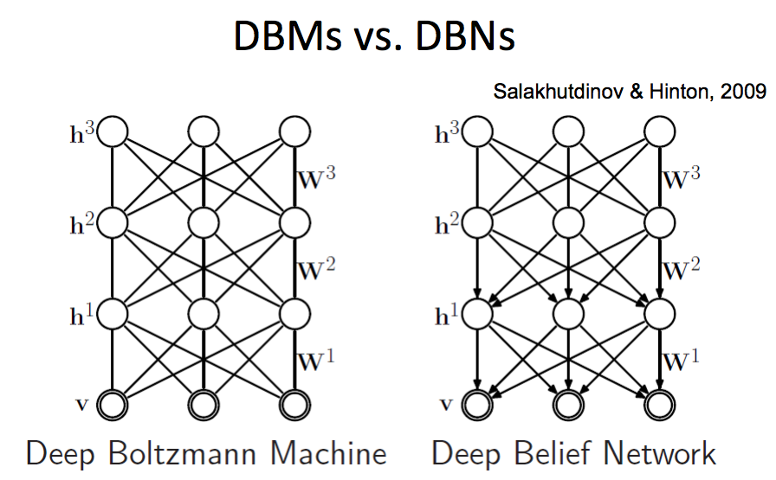

Slide 7
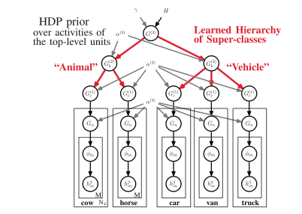
HDP-DBM (2013 PAMI)
can acquire new concepts from very few examples in a diverse set of application domains

Slide 8
HDP-DBN (2009)

Slide 9
Greedy vs. Dynamic Programing
Sub-Optimal -> Global Optimal
Overlapped sub-problems
sub-optimal exist

