Slide 1
EDF+ Data Records and Annotations

Slide 2
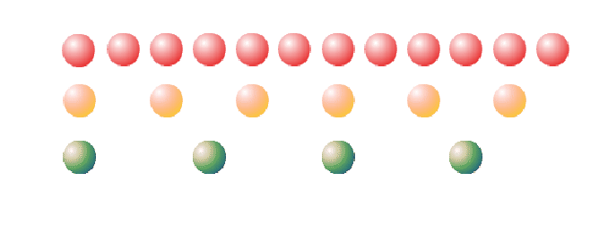
Data Records
Data is stored as 2-byte signed integers
Uses little-endian format
Lower byte, higher byte
EDF+ can store both continuous and discontinuous signals
We can find out which type is stored in a file using label provided in the header
EDF+C = continuous
EDF+D = discontinuous
Does not follow signal by signal storing convention

Slide 3
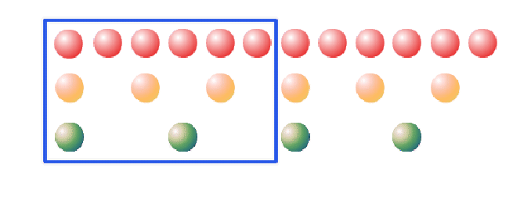
Data Records cont’d…
A data record consists of part of each signal
The duration of each data record is depended on each signal’s sampling rate.
For example, if signal1, 2, and 3 are sampled at every second then each data record will be 1 second long
If signal 1 is sampled at every 2 second, signal 2 at every 4 seconds, and signal 3 at every 8 seconds then the duration would be 2 seconds
Basically, the duration has to be a common multiple of each signal’s sampling rate

Slide 4
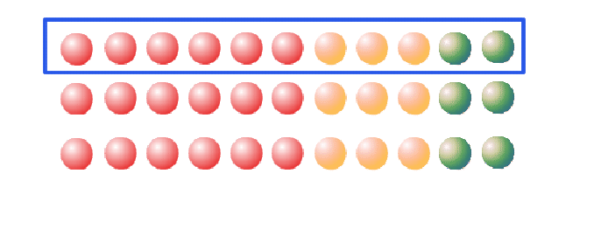
Data Records cont’d…
These data records are then placed one after the other
As we can see from the image below, each data record has part of each signal
This format makes it easier to append data to the file because then you just need to add appropriate data records

Slide 5
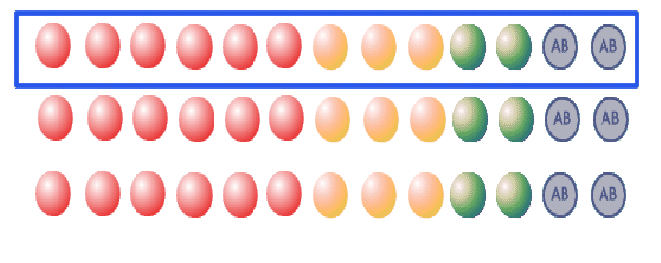
Annotations
Annotations are stored as UTF-8 format
Considered as a signal itself
Stored as any other signal in each data record
It can be stored in a separate file but EDF+ stores it in the same file as other signals
This removes the “endian-ness” problem

Slide 6
Annotation Format
The annotation has three parts
Onset
Tells when the annotation starts using a reference of recording start time
It is always followed by a “+” sign
Duration
Tells how long the event lasts. Can be 0 for a pin point event
Event
This can be anything written using ASCII characters
Examples
Format: onset<TAB>duration<TAB>content<CR>
+120<TAB>Lights On
+1800<TAB>60<TAB>Eyes Open

Slide 7
Main differences between EDF and EDF+
EDF can only store continuous signals where EDF+ can store both continuous and discontinuous signals
EDF does not store annotations in the same file but EDF+ can store them in the same file in a form of a signal
So instead of dealing with multiple files, we can have all the annotations for its signals in the same file

