Slide 1
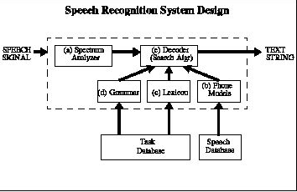
Training Acoustic model using Sphinx Train
Jaykrishna shukla,Mubin Amehed& cara Santin
Department of Electrical and Computer Engineering
Temple University
URL:

Slide 2
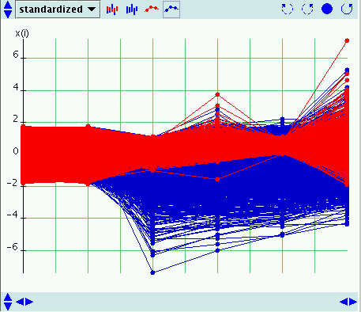
Introduction to Feature generation
The system does not directly work with acoustic signals. The signals are first transformed into a sequence of feature vectors, which are used in place of the actual acoustic signals. Therefore, we run a process called Feature extraction.
process of measuring certain attributes of speech needed by the speech recognizer to differentiate phonemes of a word. It is also known as front-end processing and signal processing.
A feature vector is nothing but a list of numerical measurements of speech attributes
The feature vectors that SphinxTrain 1.0 generates are 13 dimensional vectors by default.

Slide 3
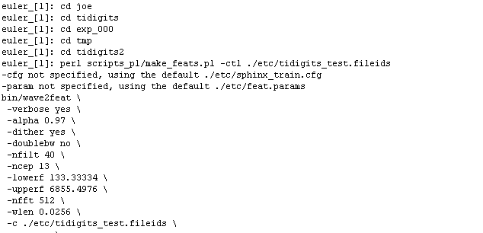
Feature Generation with SphinxTrain 1.0
This week we decided to Switch from windows to Linux so first thing that we compiled SphinxTrain 1.0 in Euler and got the bin files.
SphinxTrain has a Perl script called make_feats.pl, this scripts acts like a environment setter for the bin file called wav2feet.
To generate feature vector for audio data, one has to creat a file called fileids which is a text file with a list of all the audio files for which the user wants to generate feature.
The parameters for the make_feats file are fed in through a configuration file.

Slide 4
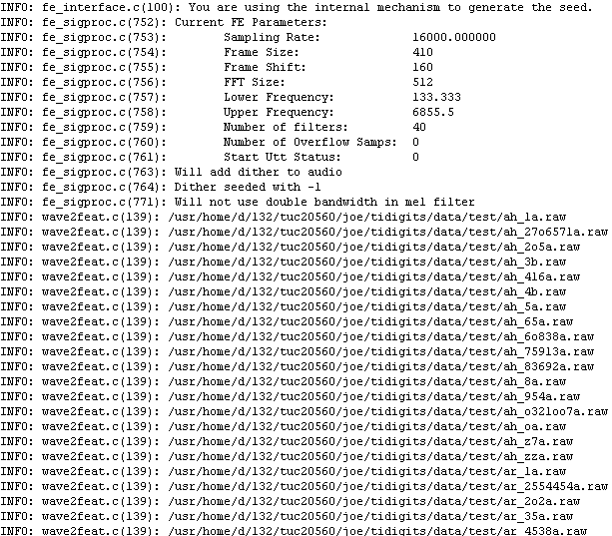
This week’s accomplishment
This week we learned Linux shell commands, Perl and other countless debugging skills using perl debuger in Euler.
We also got feature vectors generated for TIDigits short test and train 8kHz here is the sample output.

Slide 5
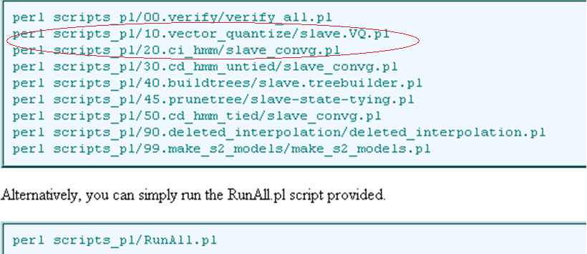
Conclusion and Future
This was the first step in training next week we will generating the ci phone models for TIDigits short 8KHZ.
It will include the following highlighted steps

