Slide 1
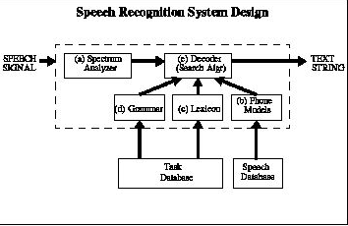
Speech Recognition using Sphinx 4 (Ti Digits test)
Jaykrishna shukla ,Amir Harati,Mubin Amehed,& cara Santin
Department of Electrical and Computer Engineering
Temple University
URL:

Slide 2
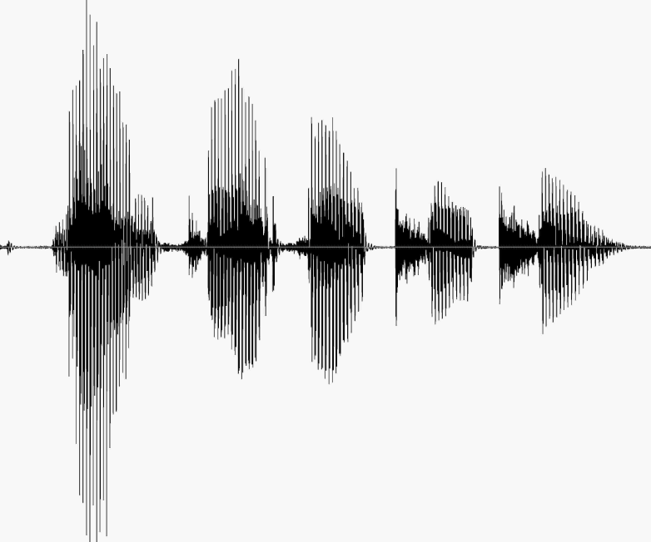
Introduction & Goals
There were two main goals for the week
To run the short Ti digit test data through the cmu sphinx 4’s Regression test and get the results.
Compare the % error results for the Sphinx-4 with ISIP recognizer.
To train a new acoustic model using SphinxTrain 1.0

Slide 3
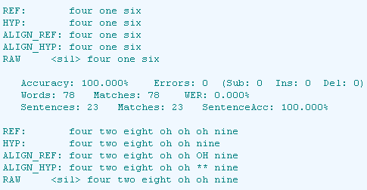
Concept of Regression test
Regression testing is any type of software testing that seeks to uncover software errors by partially retesting a modified program. The intent of regression testing is to provide a general assurance that no additional errors were introduced in the process of fixing other problems. Regression testing is commonly used to efficiently test the system by systematically selecting the appropriate minimum suite of tests needed to adequately cover the affected change. Common methods of regression testing include rerunning previously run tests and checking whether previously fixed faults have re-emerged.

Slide 4
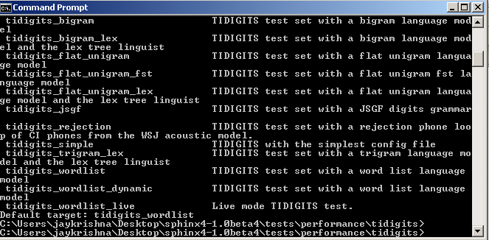
Steps for initiating the regression test in sphinx 4
The first step was to create our own batch file from the provided Ti digits short test data. This was done manually by referencing each raw file one by one (it was time taking)
the second step was to initiate the test from the command line. In this case we choose to do the flat unigram test
A user can run the test on 10 different parameters. To get the menu for the parameter list ant -projecthelp
The user than can initiate the test by typing: ant followed by the type of test of their choice

Slide 5
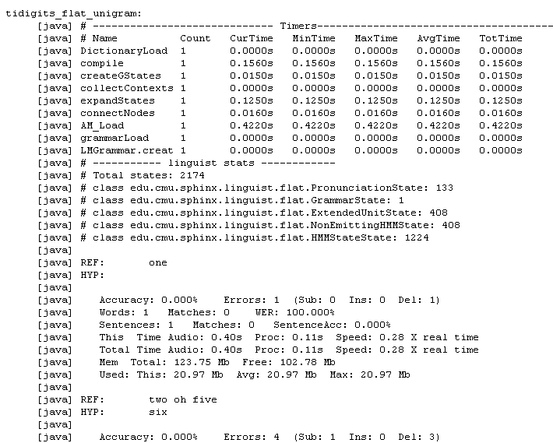
Sample out put of a regression test
Sample output for the word list test

Slide 6
Sample out put of a regression test (cont)
The summary of the results from running 10 sample data from TIDigit_short file
In Sphinx
[java] # --------------- Summary statistics ---------
[java] Accuracy: 4.348% Errors: 22 (Sub: 4 Ins: 0 Del: 18)
[java] Words: 23 Matches: 1 WER: 95.652%
[java] Sentences: 11 Matches: 0 SentenceAcc: 0.000%
[java] Total Time Audio: 6.55s Proc: 2.15s Speed: 0.33 X real time
[java] Mem Total: 122.69 Mb Free: 113.46 Mb
[java] Used: This: 9.23 Mb Avg: 18.53 Mb Max: 31.38 Mb
Error rate is way high..is this due to Small data base

Slide 7
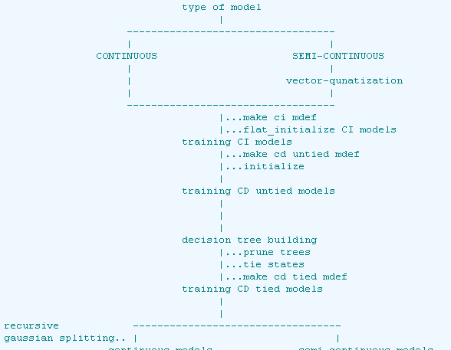
Training acoustic model using SphinxTrain 1.0
The Flow chart for the Training Procedure

Slide 8
Detailed Training procedure
The sphinxTrain 1.0 has a total of 12 steps
The fire
The to step we covered this week were
1. creating the model definition file
2. creating the HMM topology file.
The major problem was that the documentation for SphinxTrain. The web documentation was out dated and did not match with their software.

