Slide 1



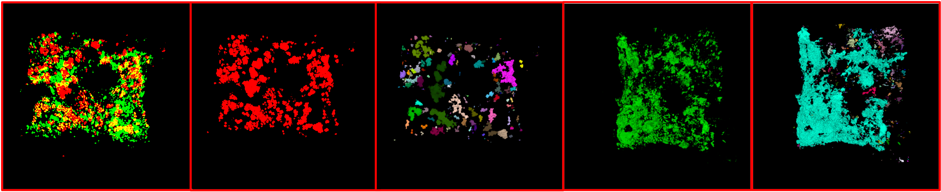
Machine Learning Challenges
in Biofilm Engineering
J. Picone¹ and B. Buttaro² A. Parker³ and H. Smith³
1. The Neural Engineering Data Consortium 3. The Center for Biofilm Engineering
2. The Lewis Katz School of Medicine Montana State Univerisity
Temple University

Slide 2
Abstract
Research Purpose:
Automated analysis of biofilm images has the potential to accelerate scientific discovery by enabling the quantitative analysis of large image datasets. In this work, we describe the challenges in applying deep-learning-based approaches to the quantitative characterization of biofilm structure and properties.
Methods and Results:
Achieving high-performance image segmentation with deep learning methods requires large, carefully annotated training datasets. To address this need, we are developing a comprehensive library of manually annotated biofilm images to support the training and evaluation of advanced machine learning models. We will present our progress in demonstrating the feasibility of this approach and establishing proof of concept.
Industrial Relevance:
The industrial relevance of this work lies in its potential to improve the monitoring, control, and optimization of biofilms across a wide range of sectors. By enabling automated, high-throughput, and quantitative analysis of biofilm images, we can provide more rapid and objective assessments than traditional manual methods.
Keywords:
biofilm imaging, image segmentation, deep learning, quantitative microscopy, artificial intelligence

Slide 3
But First, a Little Background on Biofilms From An Expert...

Slide 4
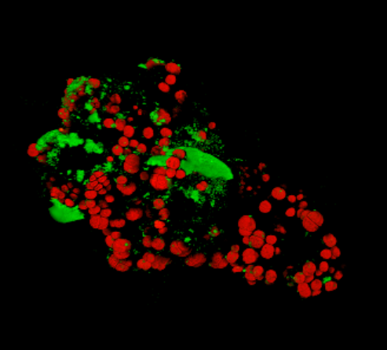
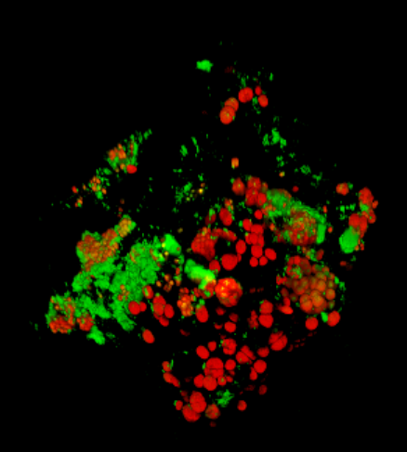
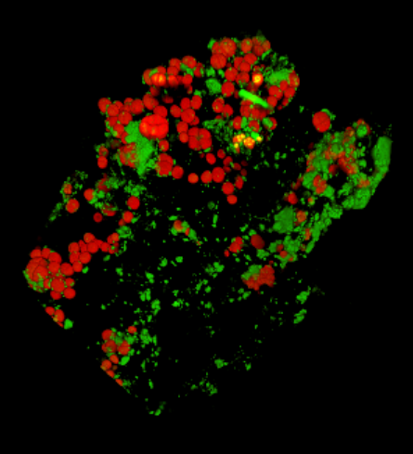
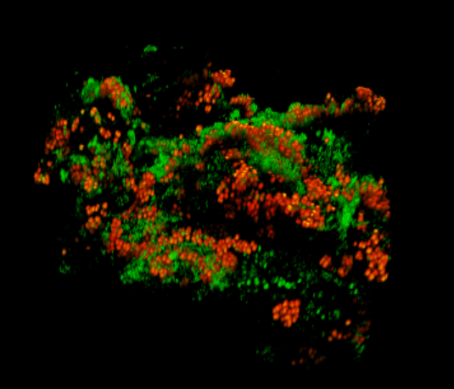
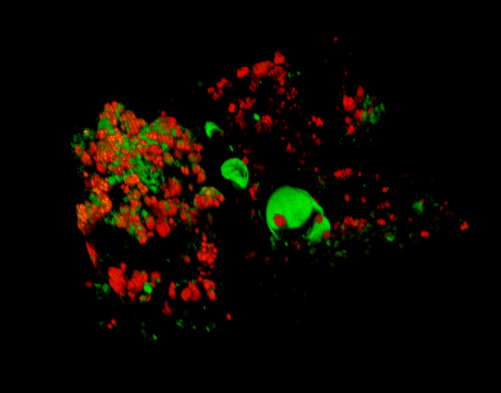
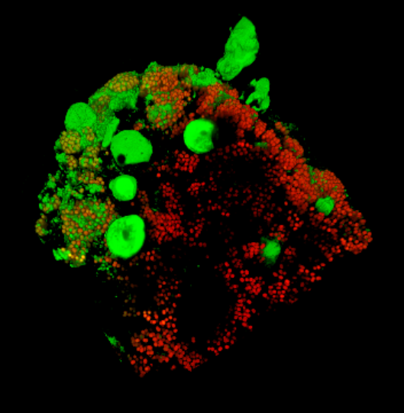
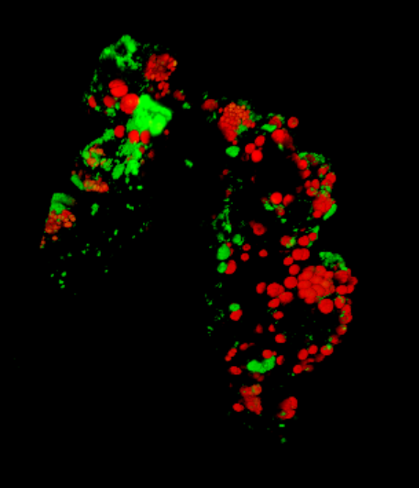
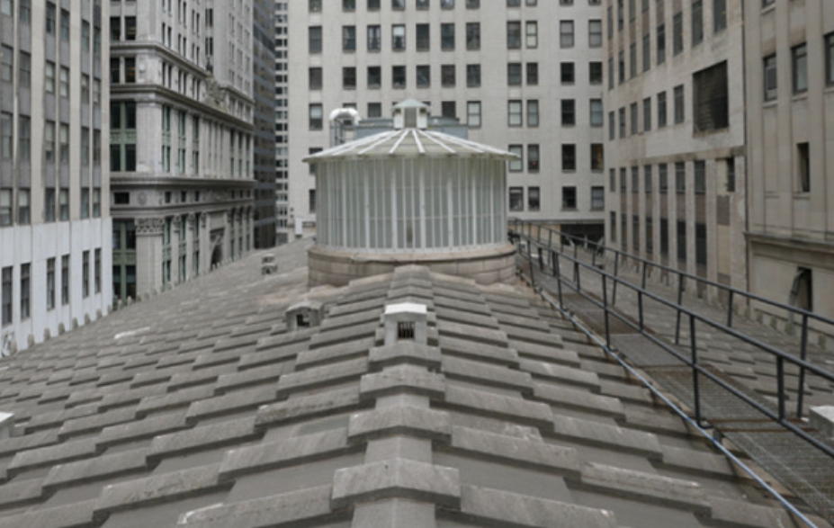
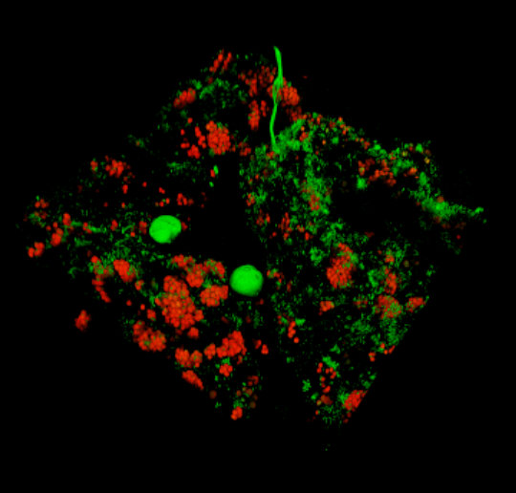
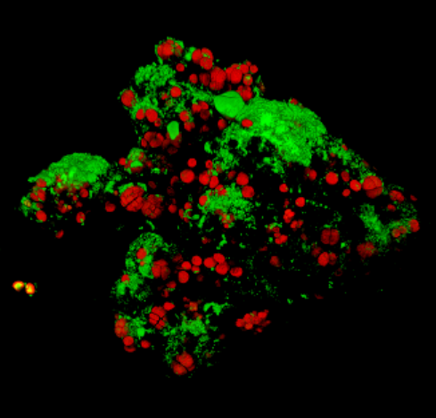
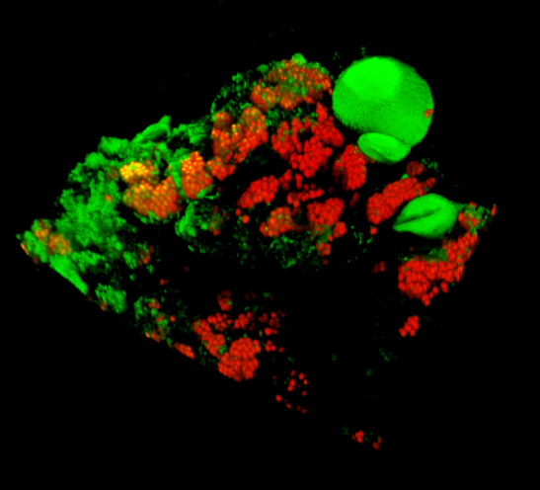
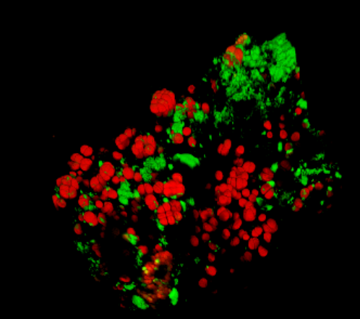
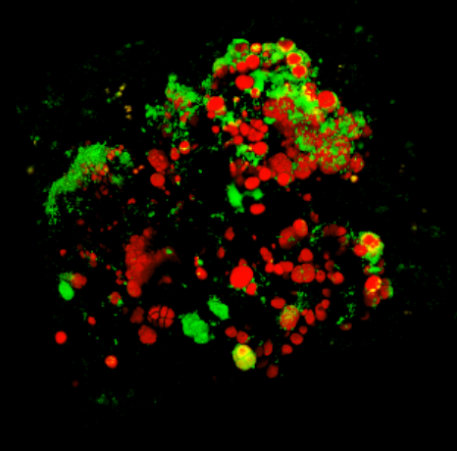
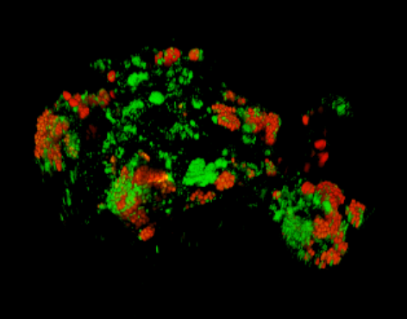
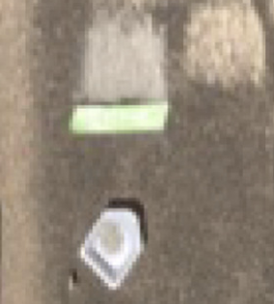
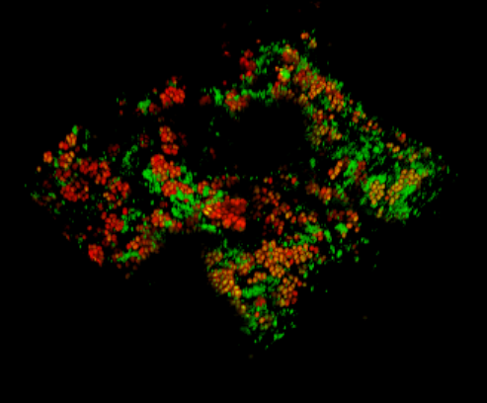
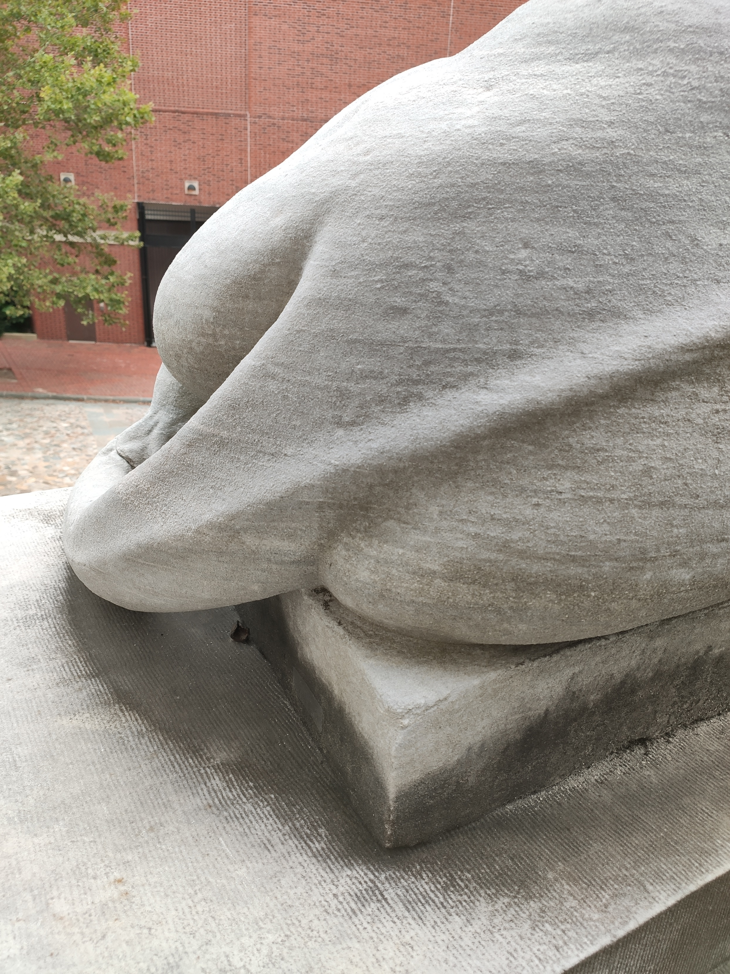
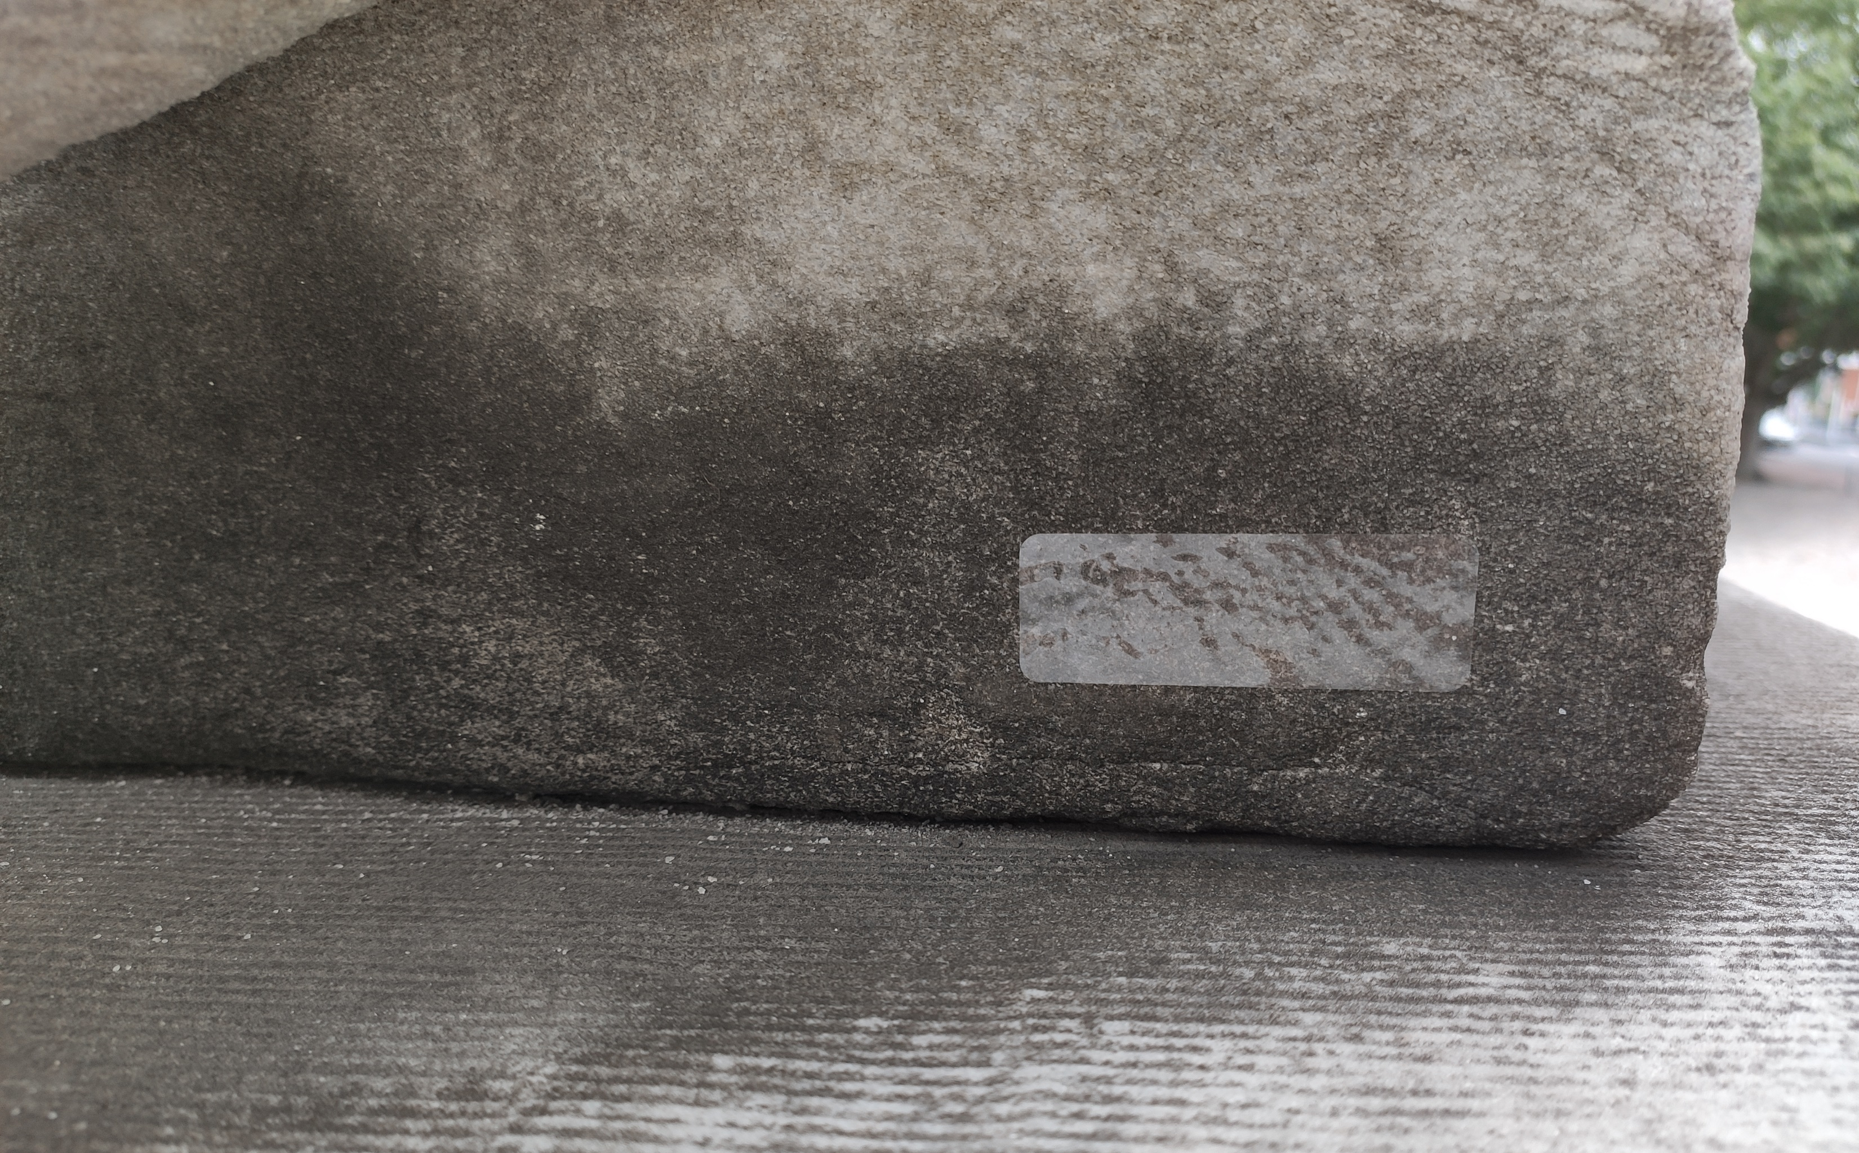
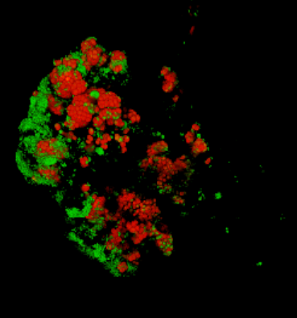
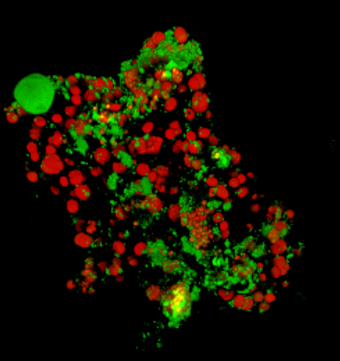
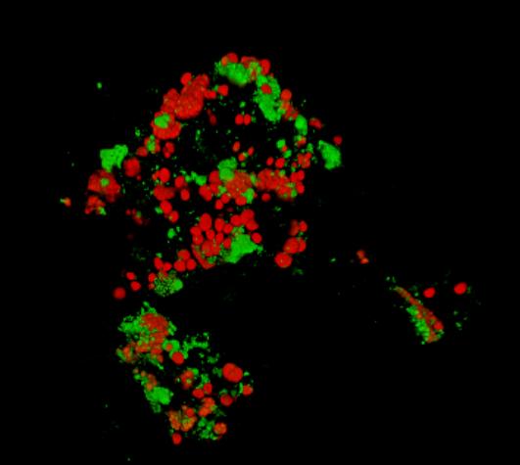
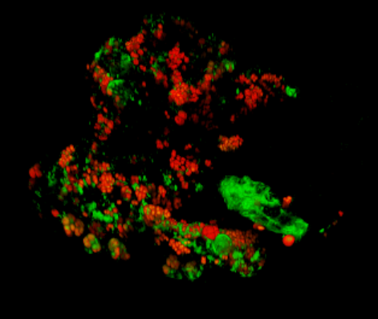
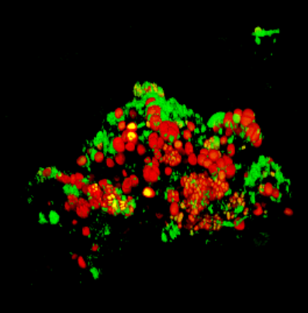
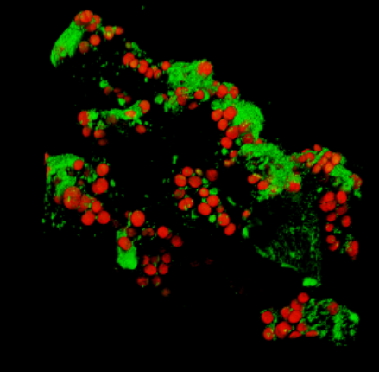

Slide 5
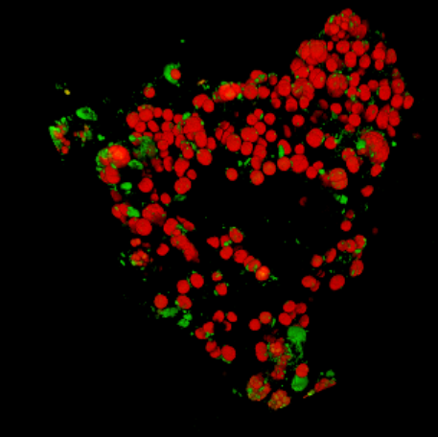
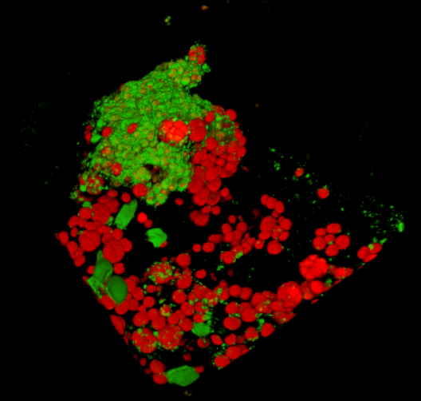
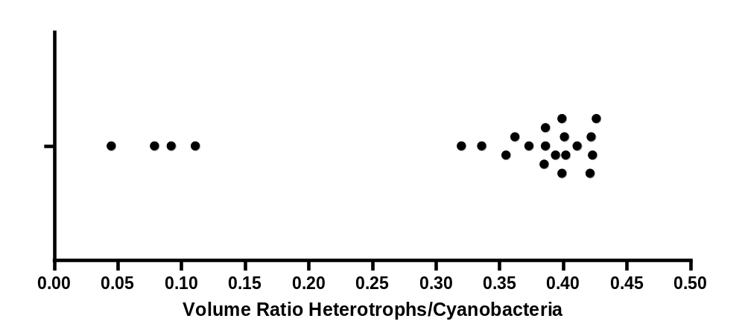

Slide 6
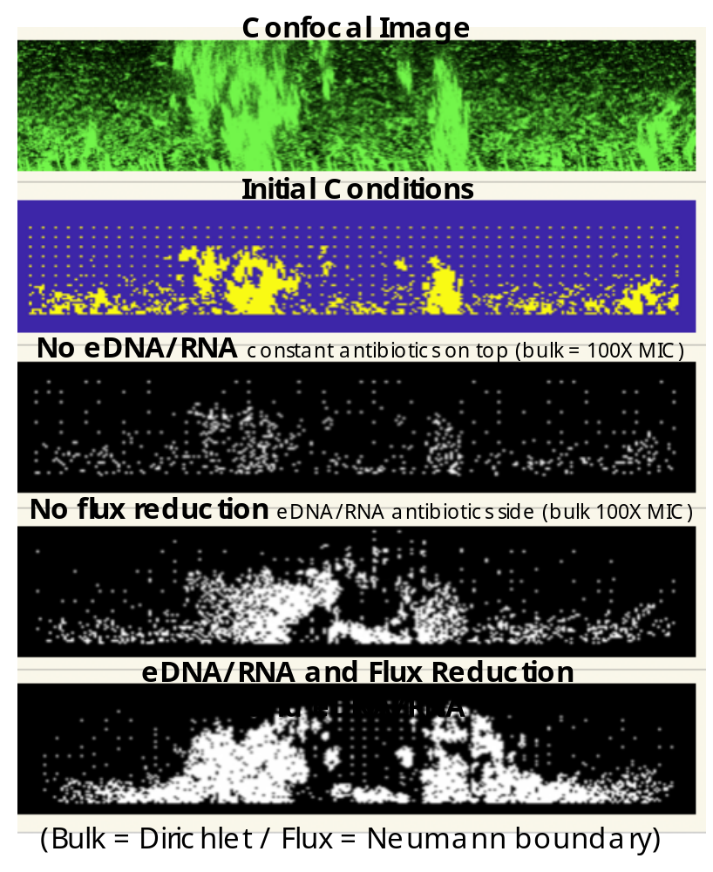

Slide 7
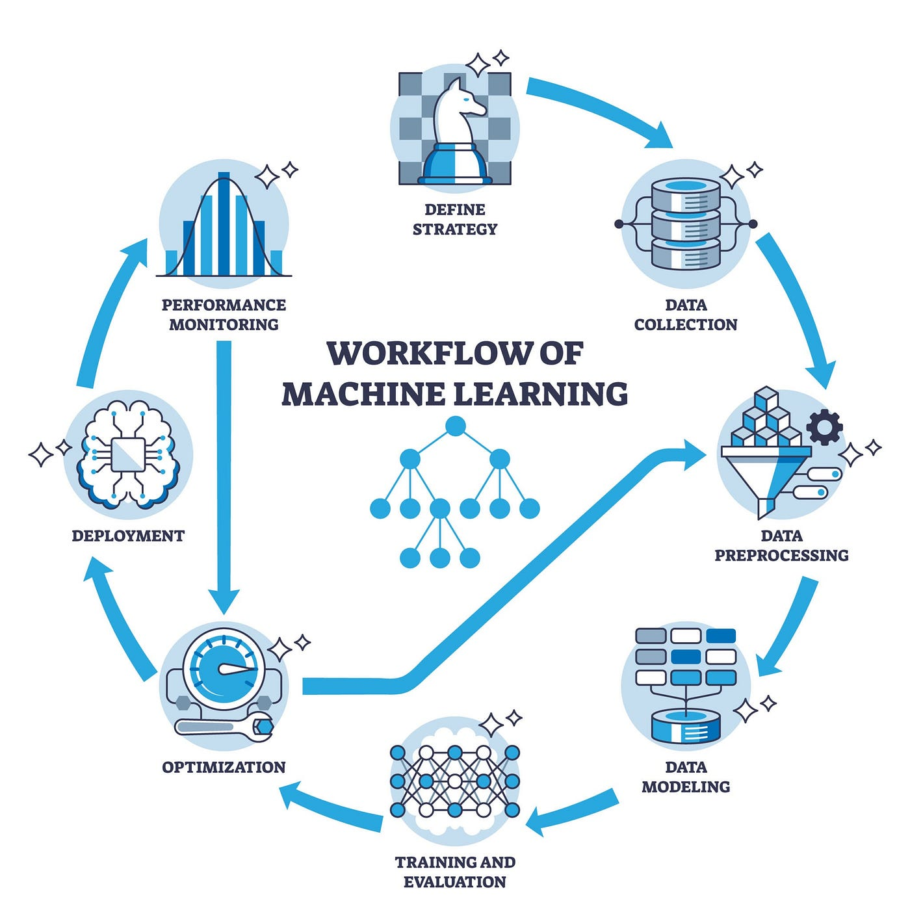
What is Machine Learning?
Machine learning (ML) develops algorithms to infer predictive or descriptive models from data.
ML formalizes learning as the estimation of functions or distributions under explicit loss functions and inductive biases.
Learning paradigms relevant to computational biology:
  Supervised: estimate mappings from image pixels or patches to labels (region masks, classes) using risk minimization from labelled data.
  Weakly-/semi-supervised: learn from coarse, incomplete, or noisy labels (slide-level annotations), often via multiple-instance learning, pseudo-labeling, or consistency regularization.
  Unsupervised and self-supervised: discover structure in unlabeled images by optimizing proxy tasks (contrastive objectives, masked prediction, rotation/patch-prediction), which yield transferable features for downstream segmentation or detection.
  Domain adaptation and transfer learning: adapt models trained on one distribution (scanner, stain, institution) to perform robustly on another by minimizing distributional discrepancy or aligning feature spaces.
Modern architectures (convolutional networks, vision transformers) combine hierarchical representation learning with attention mechanisms to encode rich spatial context.

Slide 8
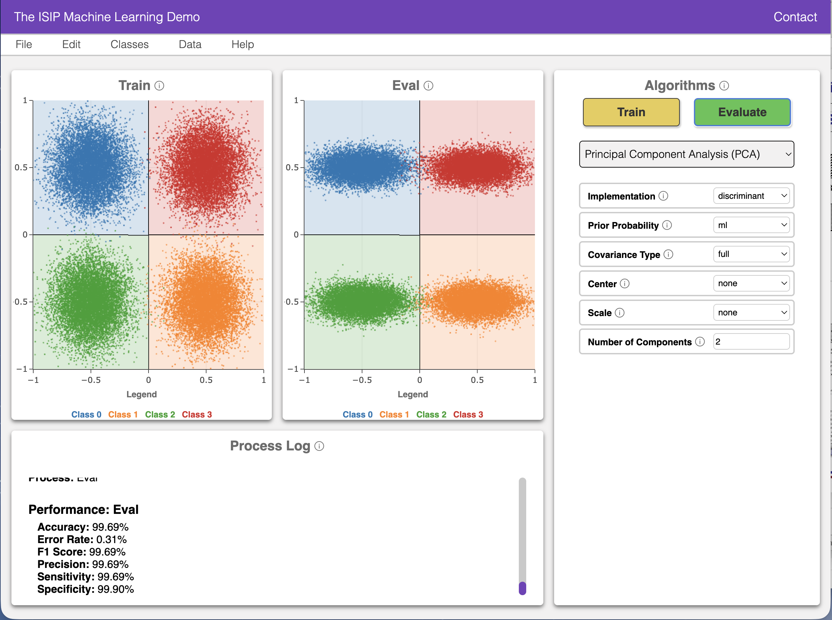
The ISIP Machine Learning Demo (IMLD)
There are many excellent resources on the Internet that demonstrate pattern recognition.
There are many toolboxes that implement state of the art algorithms, but Python is by far the most popular.
One such resource is the ISIP Machine Learning Demo (IMLD) that lets you quickly explore how a variety of algorithms process the same data.
Users can create data sets with the application, save them to disk, or upload new data sets.
Users can select from a variety of machine learning algorithms.
Users can test generalization by creating training and open-set evaluation sets.
Includes many quantum computing algorithms with a wide variety of programmable options
Client/server web–based app
Written in Python and includes modular libraries for classical and quantum machine learning

Slide 9
Philosophical Musings
Which has had more impact on artificial intelligence:
  Data: Do we have access to more data than ever before? Have we learned how to better use data?
  Computational Resources: Has cloud and cluster computing revolutionized our ability to run large experiments?
  Algorithms: Have machine learning algorithms gotten better? Or are we simply using more parameters and memorizing more data?
For example, ChatGPT and similar technologies use trillions of parameters, tens of thousands of graphical processing units (GPUs) and petabytes of data to train. They also leverage large amounts of manually annotated data.
This was not possible 50 years ago for many reasons...

Slide 10
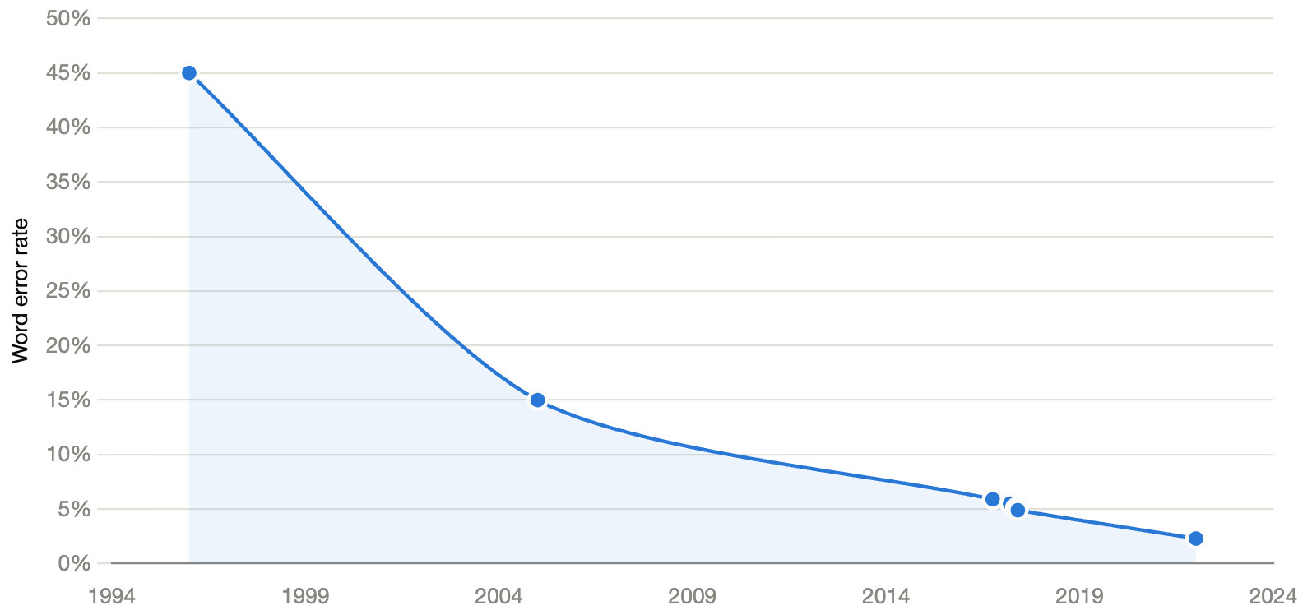
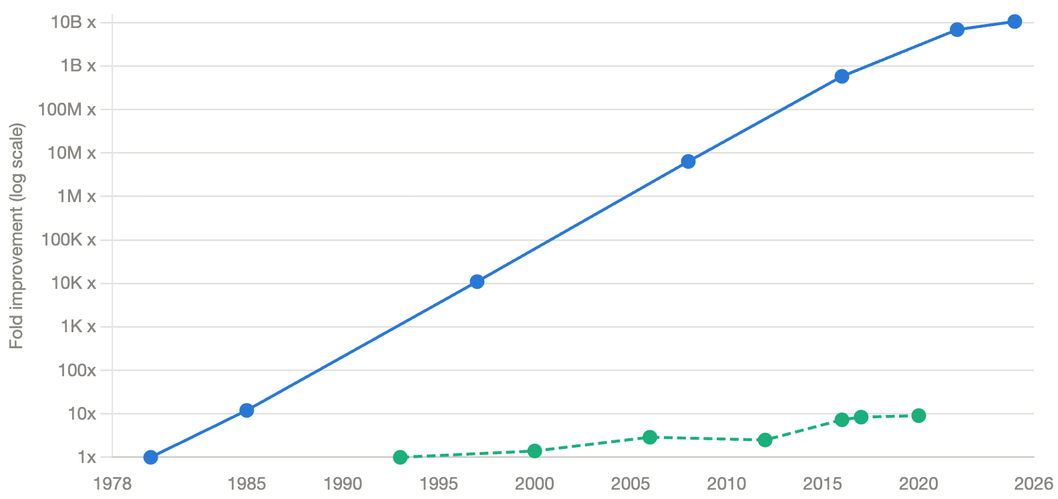
Progress in Machine Learning Has Accelerated Since 2005
Word error rates (WER) have been systematically reduced for 35 years.
Speech recognition was not an overnight success.
The introduction of deep learning in 2005 accelerated progress.
We normally expect error rates to decline over time.
But a key catalyst in the development of machine learning technology was the introduction of the graphics processing unit (GPU) chip and the advancement of cloud computing frameworks.
Compute power has grown faster than algorithm performance.
State of the art systems use tremendous amounts of compute power.

Slide 11
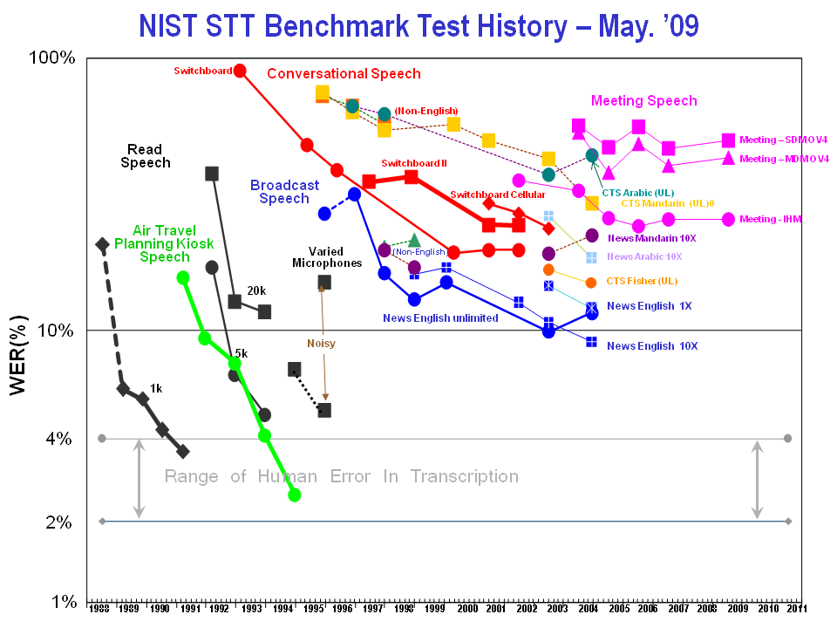
But Data Has Played An Important Role
An overview of the so-called common evaluation paradigm.
Researchers evaluated their technology on the same data using the same evaluation metrics.
Annual workshops were hosted to share information and discuss progress.
Tasks were made successively more difficult.
The Linguistic Data Consortium was founded in 1992 to develop and distribute resources.

Slide 12
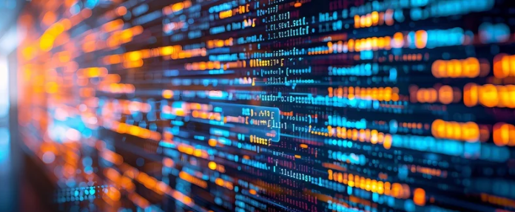
Why is Data Important?
High-quality, well-documented annotations are the substrate of rigorous ML research.
Annotation protocols (label definition, inter-rater training, adjudication, and QA checks) directly affect attainable model performance and interpretability.
A dataset must capture biologically and technically relevant variability (e.g., multiple tissue types, stains, scanners, slide preparation protocols, and disease presentations) to enable models to generalize.
Large labeled corpora increase statistical power for supervised tasks, while very large unlabeled collections are indispensable for pretraining representations via self-supervision; both reduce variance and mitigate overfitting to narrow cohorts.
Hybrid strategies (limited expert annotations, augmented by student annotators under adjudication, plus weak labels) can optimize the label-effort vs. performance frontier.
Standardized training/validation/test splits, cross-validation across institutions, pre-registered evaluation metrics, and reporting of confidence intervals are critical to reproduce and compare results.

Slide 13
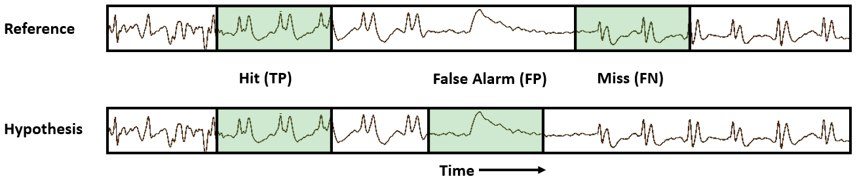
Evaluation of ML Systems Is Extremely Important and Underappreciated
ML systems reverse engineering the performance metric to achieve optimum performance.
How do we evaluate the performance?
There are 4 fundamental quantities that must be calculated to derive most performance measures:
  True Positive (TP) False Positive (FP)
  False Negative (FN) True Negative (TN)
From these we calculate traditional measures such as:
Sensitivity = TP / (TP + FN) Accuracy = (TP+TN)/(TP+FN+TN+FP)
Specificity = TN / (TN + FP) Precision = TP/(TP + FN)
There are many ways to compute quantities such as TP and FP. Standardization of these approaches is an on-going challenge. But it makes a huge difference!

Slide 14
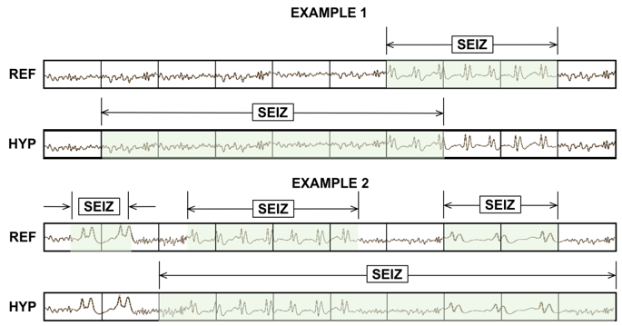
Evaluation Metrics – Any-Overlap (OVLP)
If a hypothesis event overlaps within
the proximity of the reference event,
it is considered a hit.
No penalty when multiple reference
events overlap with a single large
hypothesis event.
Misses and false alarms are counted
when no overlap between hypothesis
and reference is found.
Short and long events are weighed equally.
A very permissive metric that scores a match
as correct even though the accuracy of the time alignment might be very poor.
Widely used in the neuroengineering community because it tends to produce a high sensitivity. Used in FDA submissions which has created an overly optimistic view of the accuracy of state of the art systems.
These kinds of issues become extremely important when the data sets are unbalanced.

Slide 15
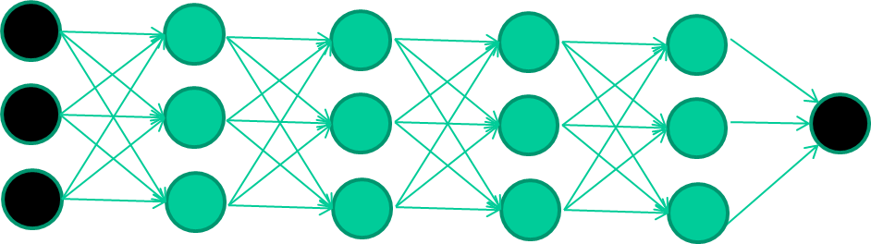
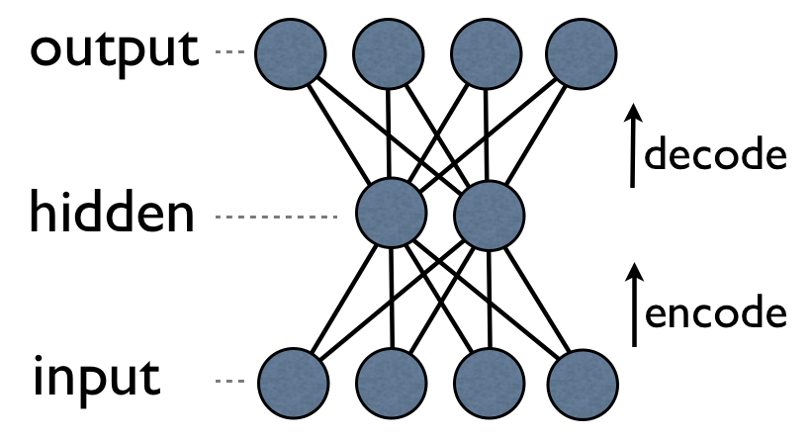
What Enabled The Emergence of Deep Learning?
We never could get deep networks to converge to something useful using backpropagation across many levels:
Solution: train each layer independently starting with the input layer.
Another Problem: how can we use backpropagation when
we don’t have intermediate labels?
A better solution is what is known as an autoencoder: train each
layer to reproduce the input, and then split the model in half.
Generative models extend these concepts even further.

Slide 16
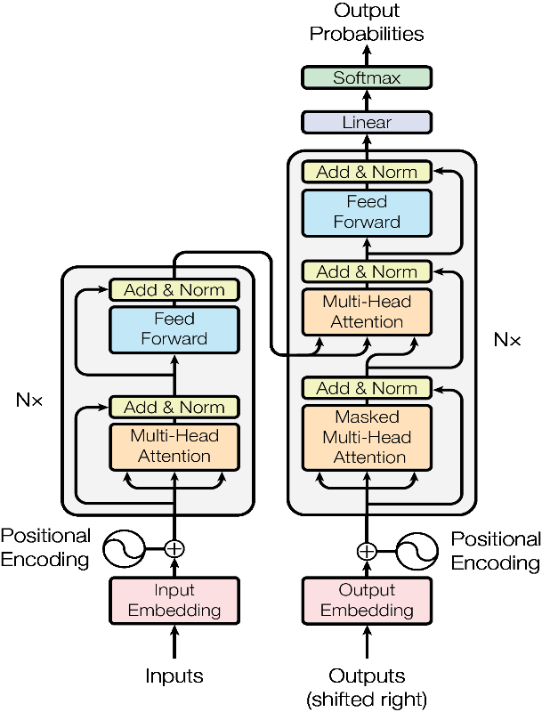
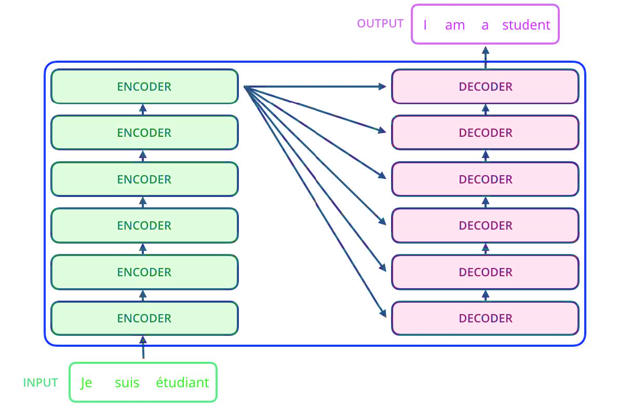
The Emergence of Transformers Using Attention
Encoder:
Decoder:

Slide 17

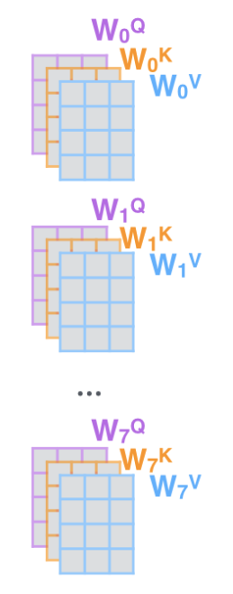
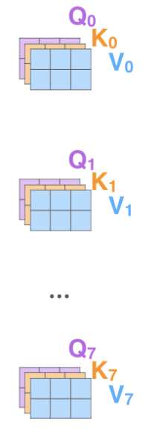
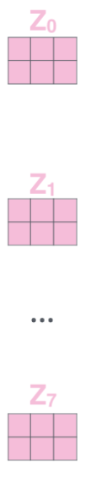

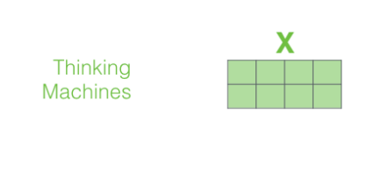
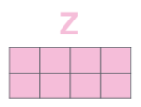
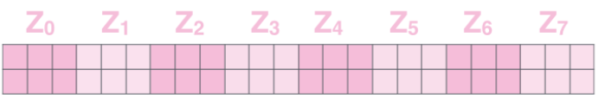
Multihead Attention Captures Multi-Timescale Context
The self-attention mechanism, when trained properly, represented a huge breakthrough in machine learning.
It enabled the current generation of chatbots.
But vector embedding, the process of converting an input into a vector, also has played a huge role in artificial general intelligence (AGI).

Slide 18
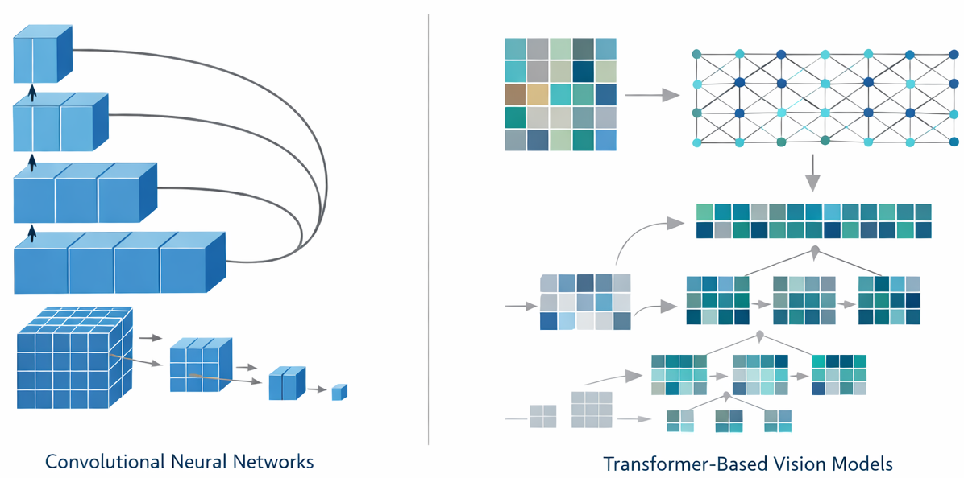
Deep Learning Models
Model Selection Criteria: evaluated a small set of
robust and widely adopted common off-the-shelf (COTS)
models to establish strong baseline performance.
Convolutional Neural Networks (CNNs)
  ResNet-18: a residual network that leverages skip
  connections to mitigate vanishing gradients, enabling
  stable training of deeper models.
  EfficientNet (B0 / B7): a family of models that
  jointly scale network depth, width, and input
  resolution to tradeoff accuracy and efficiency.
Transformer-Based Models
  Vision Transformer (ViT-16 / ViT-32): processes images as sequences of fixed-size patches and applies self-attention to capture global context and long-range spatial dependencies.
  Swin Transformer V2 a hierarchical, window-based Transformer that introduces shifted windows and improved normalization, enabling efficient modeling of both local and global structure while scaling effectively to high-resolution images.
  Implementation Details: All models were fine-tuned from pretrained weights using standard PyTorch implementations. To reduce overfitting, we applied common data augmentation techniques.

Slide 19
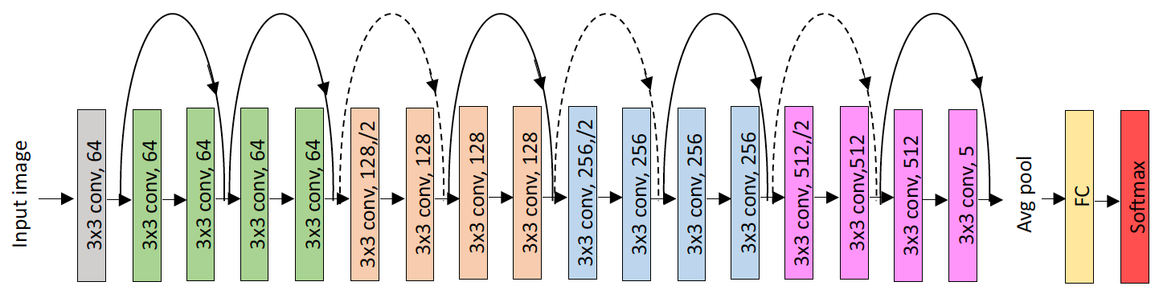
Deep Residual Networks (ResNet-18)
Architecture: ResNet-18 is a convolutional neural network that introduced residual (skip) connections, allowing gradients to bypass intermediate layers. Mitigates the vanishing gradient problem and enables stable training of deeper networks.
Impact: ResNet-18 is effective at capturing local texture patterns. However, modeling broader tissue architecture typically requires deeper networks, which can be less efficient.
Performance Summary: In baseline experiments, ResNet-18 provided stable and reproducible results but was generally outperformed by EfficientNet variants.
Performance (MDICE): 33.28 (TUBR) / 42.11 (FCBR)
Size: 11.69M parameters
Training: 2,356 secs/epoch
Decoding: 1,597 secs/image

Slide 20
A Comparison of Performance of Leading Deep Learning Systems
MDICE measures the percentage of an annotated region that was correctly classified, and ignores background.
MDICE scores are shown for TUBR and FCBR.
EB0, which is a smaller and more computationally efficient, is the highest performing model.
Results are statistically significant.
Arch | TUBR |  |  | FCBR
 | Train | Dev | Eval | Train | Dev | Eval
ResNet18 | 40.87 | 37.42 | 33.28 | 44.40 | 44.34 | 42.11
EB0 | 62.32 | 55.31 | 51.10 | 66.83 | 49.49 | 46.02
EB7 | 56.03 | 47.10 | 43.81 | 31.53 | 31.31 | 32.41
ViT-16 | 62.68 | 48.32 | 44.72 | 26.11 | 24.44 | 25.07
ViT-32 | 57.12 | 46.34 | 41.39 | 29.58 | 26.11 | 28.06
The complexity of each algorithm in terms of memory (no. of parameters) and compute times (secs) is shown.
EB0 has the smallest memory footprint and yet delivers the best performance. Its decoding time is comparable to ResNet18 while training time is reasonably close.
The ViT models are our most complex models, and expected to deliver best performance. However, on DPATH data they did not exceed the performance of EB0.
Arch | No. Parameters | Training Time | Decoding Time
ResNet-18 | 11.69M | 2,356 (1.0x) | 1,597 (1.0x)
EB0 | 5.30M | 3,900 (1.7x) | 1,520 (1.0x)
EB7 | 66.35M | 4,883 (2.1x) | 1,735 (1.1x)
ViT-16 | 86.60M | 3,713 (1.6x) | 1,726 (1.1x)
ViT-32 | 88.20M | 3,869 (1.6x) | 1,623 (1.0x)

Slide 21
What Can Machine Learning Do For Biofilm Engineering?
Evolution of Capabilities: Machine learning (ML) based analysis of biofilm images has progressed from simple binary classification (e.g., cell vs. background) to the detection of multiple types of image patterns.
Microsegmentation at Full Resolution: A key challenge is microsegmentation: accurately identifying individual cell structure at whole-slide resolution, and then aggregating these individual cells into groups. This task is computationally demanding due to extreme class imbalance, as only a small fraction (~2%) of image regions are typically annotated.
Advanced Diagnostic Insights: Beyond classification and segmentation, ML enables the discovery of subtle features and research relevant biomarkers. These approaches support more precise modeling and open pathways toward more application-specific treatment, with potential integration of multimodal information.
Systems Explored: We explored a range of Common-Off-The-Shelf (COTS) technology to establish baseline performance benchmarks:
  Napari: A free, open-source Python application for interactive visualization, annotation, and analysis of large multidimensional biological images.
  StarDist OPP: StarDist integrated into the OPP (Open Pixel Processing) platform. A deep learning algorithm designed to segment individual cells or nuclei in microscopy images.
  Assorted Deep Learning Tools: ResNet18 (CNN-based), EfficientNet (EB0/EB7: CNN-based), Vision Transformers (ViT-16/ViT-32: Transformer-based).

Slide 22
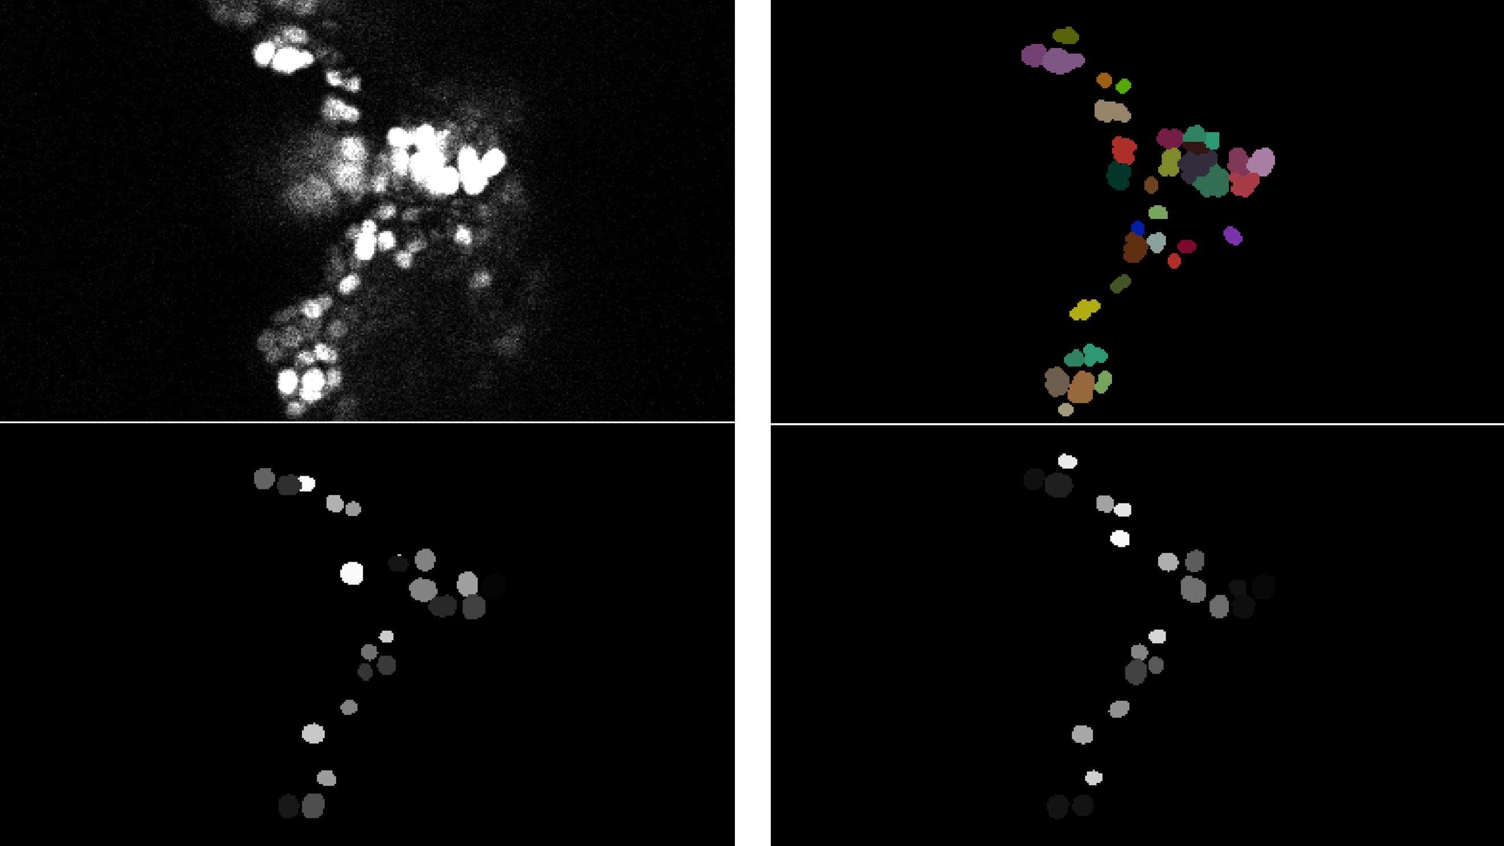
Annotation of Images and Supervised Learning
Original image
Manually annotated image
Automatically annotated image using fully annotated data
Automatically annotated image using partially annotated data
Partially annotated data is providing results comparable to fully annotated data at significantly reduced cost and time.
Due to the limitations with StarDist doing multi-class segmentation, we preprocess the partially annotated images to produce fully annotated images that consist of a collage of subimages.
Adaption of StarDist segmentation models appears to be working well.

Slide 23


The Biofilm Imaging Library Founded in 2025

Slide 24

The Biofilm Imaging Library Distributes Data, Software and Models

Slide 25
Vibe Research Is Coming
Conceptual Experiment: Ask Claude Code to improve a state of the art machine learning system (EEG seizure detection).
A Complex System:
many years of development
used state of the art models (e.g., ResNet18)
involved numerous scripts (e.g., training, evaluation, optimization)
many custom file formats (e.g., models, hypothesis files, parameter files).
Claude was able to create a fully working system and make minor optimizations.
Did not improve on state of the art, but came very close in a matter of minutes.
Ongoing experiments to understand the impact of providing auxiliary information and evaluate its ability to reason about previously unseen data.
# Seizure Detector — Findings Report (v2.0.3, study #3: new approaches)
...
**No approach beats the incumbent at the strict 2.77 FA/24h budget...
**The binding constraint is the evaluation granularity, not the model.** At slightly looser FA (5–14/24h) the new models clearly pull ahead (up to ~70% vs the baseline's ~64%), but the tiny eval set can't resolve that at budget.
**The temporal sequence model is the strongest detector built** (best dev, best frontier) and is the right foundation *if* the FA budget is relaxed or the eval/dev sets are enlarged. The highest-leverage next step is **more data**, not another architecture.
...
## 4. The real bottleneck: evaluation granularity
The decisive observation: **baseline+post-processing, the sequence model, and the blend all give ~59.45% at 2.77 FA/24h.** ... The eval set is simply **too small to resolve the differences between models at the strict budget** — and the dev set (same size) is too small to *calibrate* the operating point, which is why v01, v02, and the
sequence model all mis-mapped dev→eval.
...
This is the same wall that sank the earlier retrains, now shown to also cap what is *demonstrable* on eval... there is no room to prove it at 1-FA granularity.

Slide 26
The Research Pipeline is Changing
Yesterday:
We started with an iterative process that can require years of development.
Researchers were constrained by ‘programming’: what algorithms could be implemented with local software engineers.
Research was framed around what programming solutions were accessible.
Today:
There is only data and basic science – everything else in between can be automated.
Data Sourcing:
sensors, ingestion, selection
Signal Processing:
denoising, artifact removal, conditioning
Feature Engineering:
identifying mathematical invariants
Modeling and Training:
algorithm design and optimization
Hypothesis Synthesis:
evaluation, analysis, diagnosis
Basic Science:
Advancement of fundamental laws ad theory
Data Sourcing:
ingestion, selection. annotation
Basic Science:
advancement of fundamental laws and theory

Slide 27
Summary, Conclusions and Future Work
Research Foundation: By releasing open, standardized corpora with rigorously defined baselines, we significantly lower the barrier to entry for new technologists and researchers, and accelerate innovation.
Image Segmentation: The ability to generate accurate microsegmentation of high resolution images enables new research into modeling and understanding of biofilms.
Automated Segmentation: The ability to generate large amounts of data cost-effectively will enable new science and technology development in biofilms.
Future Directions:
We need your data!
Evaluating the impact of vibe coding, fine-tuning of large language models (LLMs), reasoning will be crucial in accelerating the pace of innovation.
Renewed appreciation (and funding) for large amounts of annotated data.
A central repository of best practices with supporting tools can make research significant more efficient and cost-effective.

Slide 28
Acknowledgements
This material is based on work supported by several organizations over the years, including:
The National Science Foundation (grant no. 2450549)
The Center for Biofilm Engineering, Montana State University
The Temple University Catalytic Collaborative Funding Initiative
The Sol Sherry Thrombosis Research Center in the Lewis Katz School of Medicine at Temple University
The Neural Engineering Data Consortium in the College of Engineering at Temple University
Any opinions, findings, and conclusions or recommendations expressed in this material are those of the author(s) and do not necessarily reflect the views of these organizations.

Slide 29
A
APPENDIX
A
Supplementary Materials
Supporting data, figures, and extended analysis

Slide 30

Book Chapter
Title:
The Biofilm Image Library: Enabling Machine Learning for 3D Biofilm Analysis
Publication:
Signal Processing in Medicine and Biology: Applications of Artificial Intelligence in Medicine and Biology
Springer (2027)
Authors:
Al Parker, Heidi Smith, Bettina Buttaro and Joseph Picone
Contribution:
Microbial biofilms are complex, spatially heterogeneous, three-dimensional (3D) communities that play critical roles in medicine, industry, environmental systems, and space exploration. This chapter introduces the Biofilm Image Library (BIL), an open-access, community-driven infrastructure designed to support the development of next-generation computational tools for biofilm analysis.

Slide 31


Annotation Protocol
Establish explicit label definitions, annotation guidelines, and class ontologies collaboratively with pathologists to ensure clinical relevance and reduce ambiguity in region boundary decisions.
Define annotation granularity:
full pixel-level segmentation for core regions of interest
(e.g., tumors, significant lesions)
slide-level tags for global diagnoses to support weak supervision
(e.g., cancer severity, tissue site, tumor site).
Use multi-rater annotation in which each case receives annotations from at least two independent annotators, with an adjudication step by a senior annotator in consultation with TUH and FCCC pathologists.
Train undergraduate (UG) students with backgrounds in relevant disciplines like bioengineering and biochemistry.
Provide annotator training materials and calibration tasks (example cases with feedback), plus routine inter-rater reliability assessments. Annotators train for about 6 months before they reach an expert level of accuracy.

