Slide 1
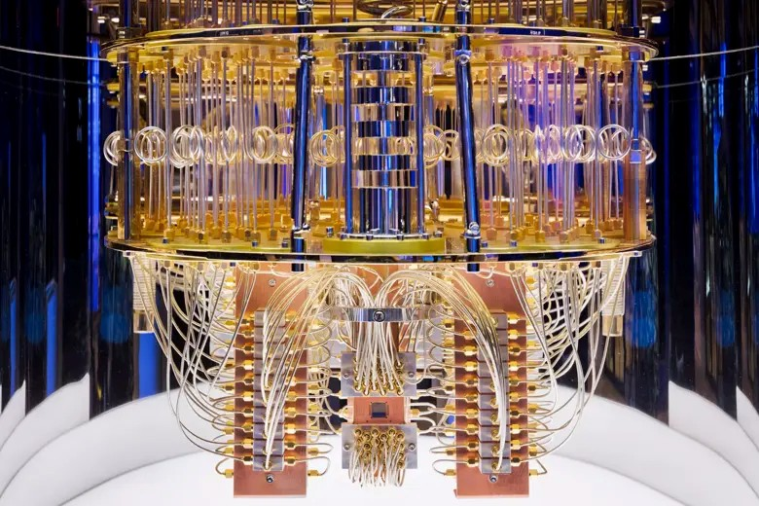
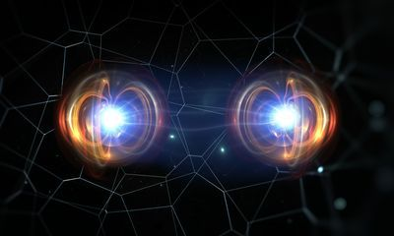
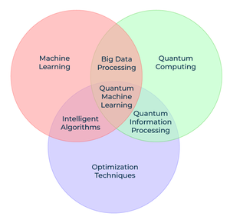
Is There a Quantum Advantage for Machine Learning?
Though recent theoretical advances suggest improved
machine learning (ML) performance is possible, results
on many practical problems of scale have been inconclusive.
We have recently been focused on data sets, such as
electroencephalography (EEG), that show evidence of
quantum entanglement (QE):
Mutual information (on which many ML systems are based) and QE provide alternate views of correlation in the data.
Potential for new features and algorithms
Applications that exhibit entanglement are promising
for demonstration of a quantum advantage (QA) on existing
quantum hardware.
Also exploring parameter reduction and acceleration of training
for classical machine learning systems.

