Slide 1
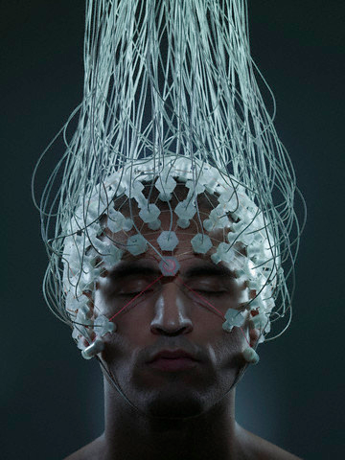
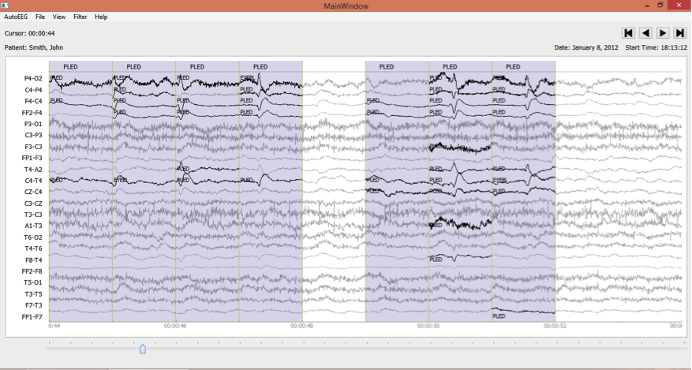
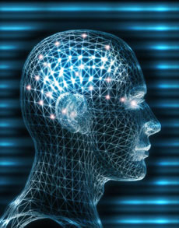
Unencumbered Electroencephalogram (EEG) Corpora:
Advancing Technology Using Big Data Resources
J. Picone
Neural Engineering Data Consortium
Temple University
Samuel McKenzie and Masoom Desai
UNM Health Sciences Center
University of New Mexico

Slide 2
The Classic Machine Learning Paradigm
Key issues:
Is the data representative of the problem?
Do the features capture meaningful differences between patterns?
How do we find the best model?
How do we estimate the parameters of the model?
How do we evaluate performance?
Collect Data
Evaluate Classifier
Select Features
Train Classifier
Choose Model
Other considerations:
The answers are often application specific and data dependent.
Customers/users don’t often completely understand their requirements.
Data collection is often an on-going process that drives the technology.

Slide 3
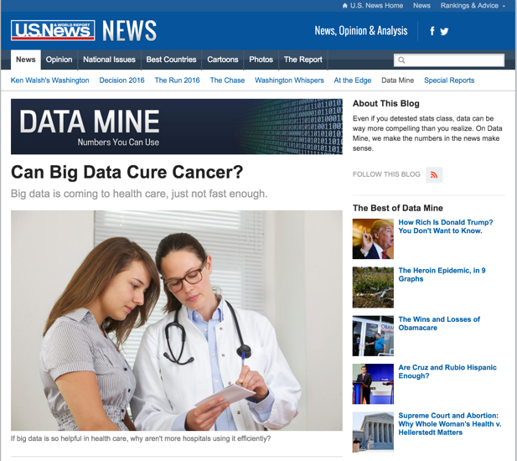
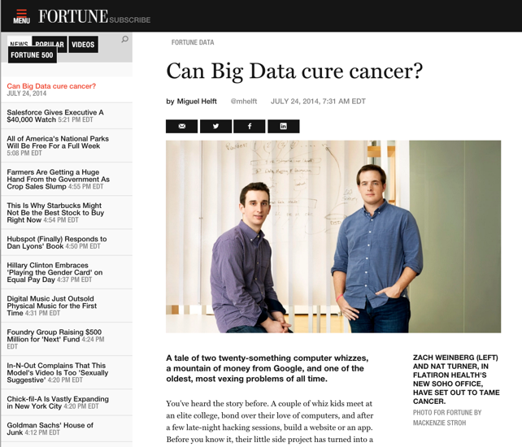
The Importance of Driving Research Using Big Data
Bob Mercer, IBM Speech Research (1985):
“There is no data like more data.”
Dan Ariely, Duke University (2013):
“Big Data is like teenage sex: everyone talks about it, nobody really knows how to do it, everyone thinks everyone else is doing it, so everyone claims they are doing it.”
Douglas Merrill, Zestfinance.com (2013):
“Given enough data, everything is statistically significant.”

Slide 4
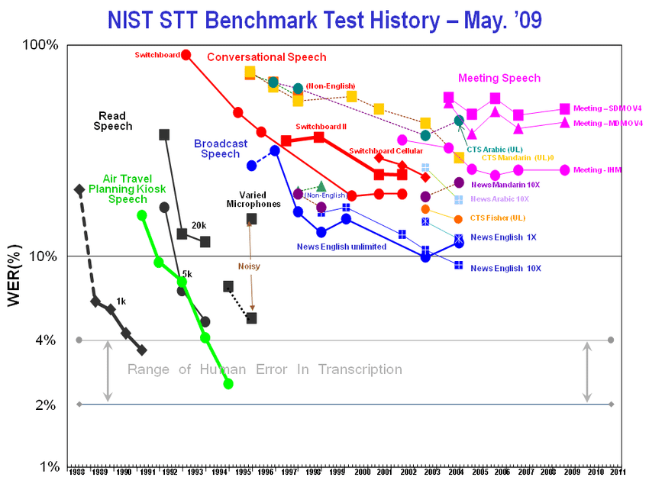
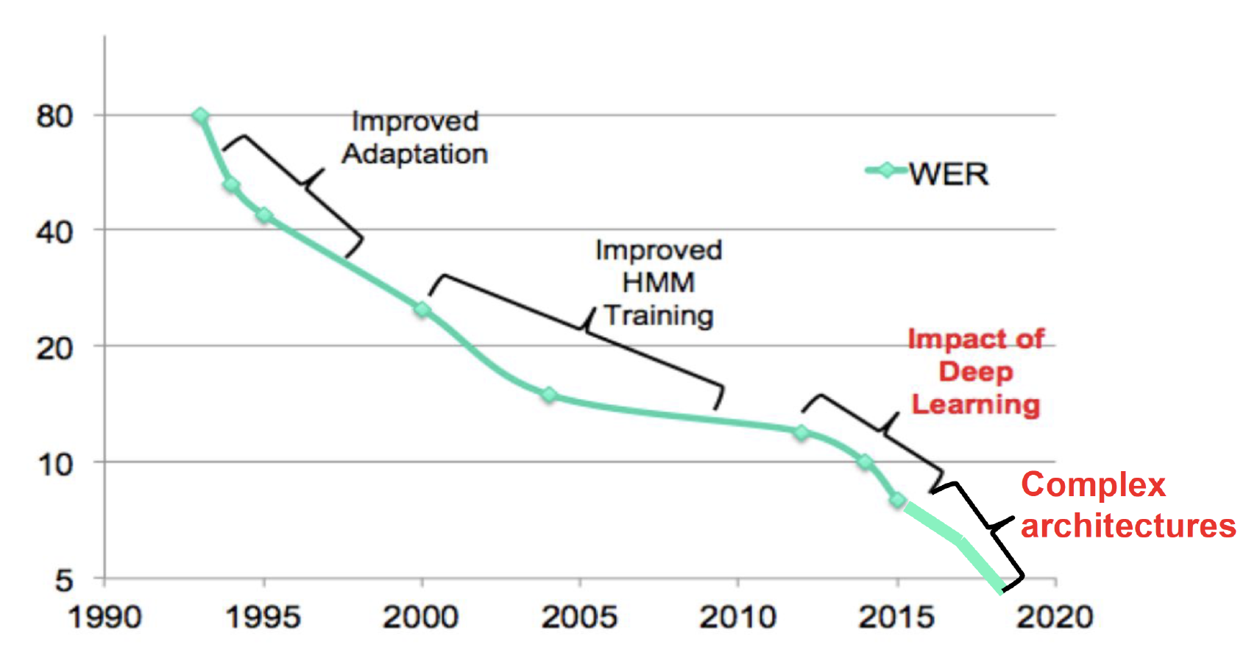
Speech Recognition Did Not Happen Overnight
Services like Siri and Alexa were overnight successes that were 50 years in the making…
The common evaluation paradigm in speech recognition dates back to the 1980’s when the first industry-wide speech recognition evaluation results were published.
The Linguistic Data Consortium was established by DoD in 1992 to provide human language technology data and resources to the community to drive research and standardize evaluation.

Slide 5
Data Must Be Unencumbered and Freely Available
Provider
Provider
Provider
Provider
Provider
Provider
Provider
Provider
Provider
Provider
User
User
User
User
User
User
User
User
User
User
Adapted from Chris Cieri and Mark Liberman, The Linguistic Data Consortium, University of Pennsylvania

Slide 6
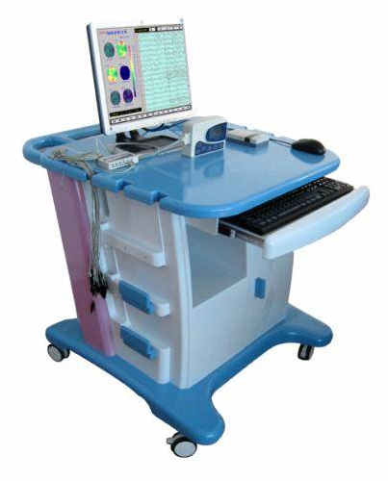
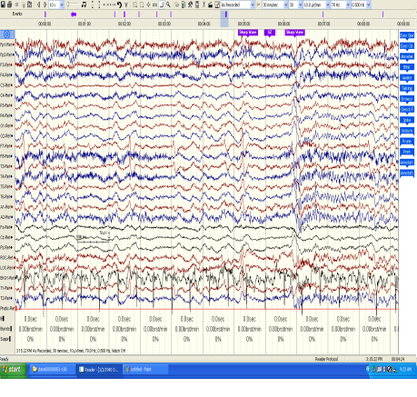
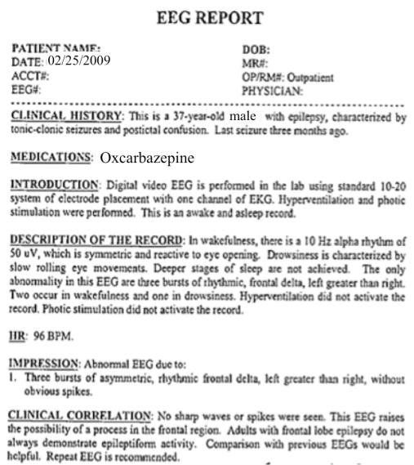
The Temple University Hospital EEG Corpus Synopsis: The world’s largest publicly available EEG corpus consisting of 60,000+ EEGs collected from 37,500+ patients, collected over 20 years. Curated data includes EEG signal data, physician’s diagnoses and patient medical histories. A total of 16 Tbytes of data.
Outcomes:
See: https://isip.piconepress.com/projects/tuh_eeg/
Over 7,000 subscribers to our resources
The Neureka 2020 Epilepsy Challenge (https://neureka-challenge.com/)
Manually annotated subsets include seizure (TUSZ), artifacts (TUAR) and abnormal (TUAB)
Real-time seizure detection (isip.piconepress.com/projects/nsf_pfi_tt)
Database Overview:
Collected at Temple University Hospital from 2002 to Present in a variety of clinical settings. Recordings vary from 24 to 36 channels of signal data sampled at 250 Hz or greater
Patients range in age from 6 months to 90+ with an average of 1.6 EEGs per patient. Most patients are adults in the range 18 to 65 years old.
Recordings are not contiguous but are “pruned” by technicians (removal of uninteresting parts)
Data includes a test report, an impedance report, a video in some cases, and a physician’s report
Personal information has been redacted
Clinical history and medication history are included
Physician notes are captured in three fields: description, impression and correlation fields.

Slide 7
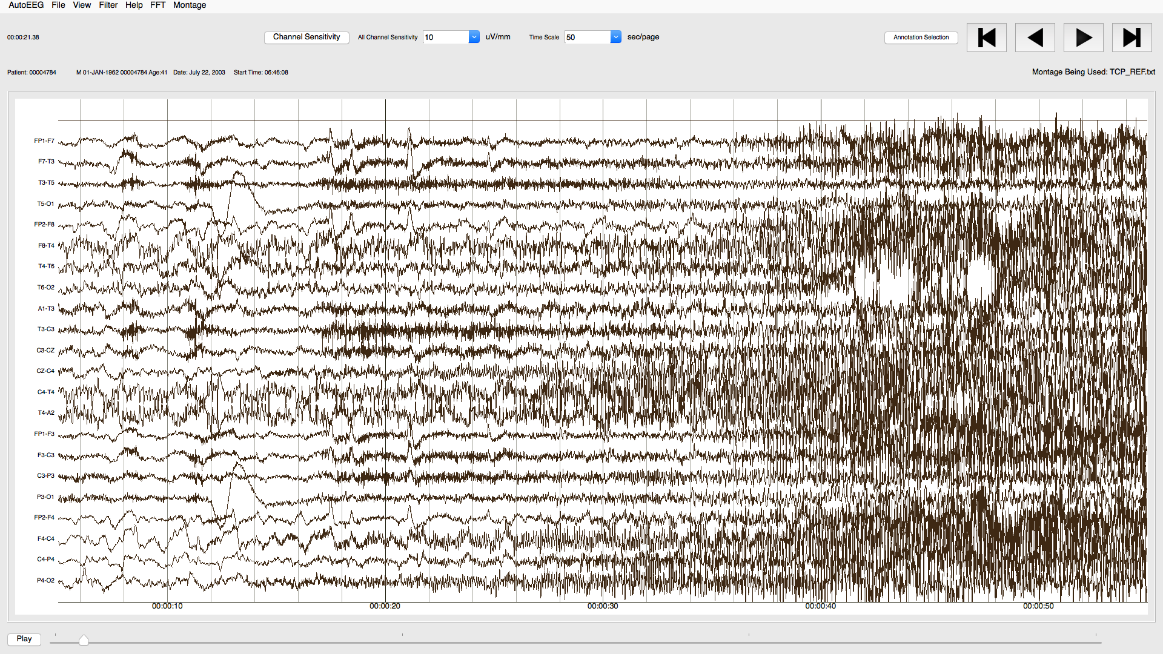
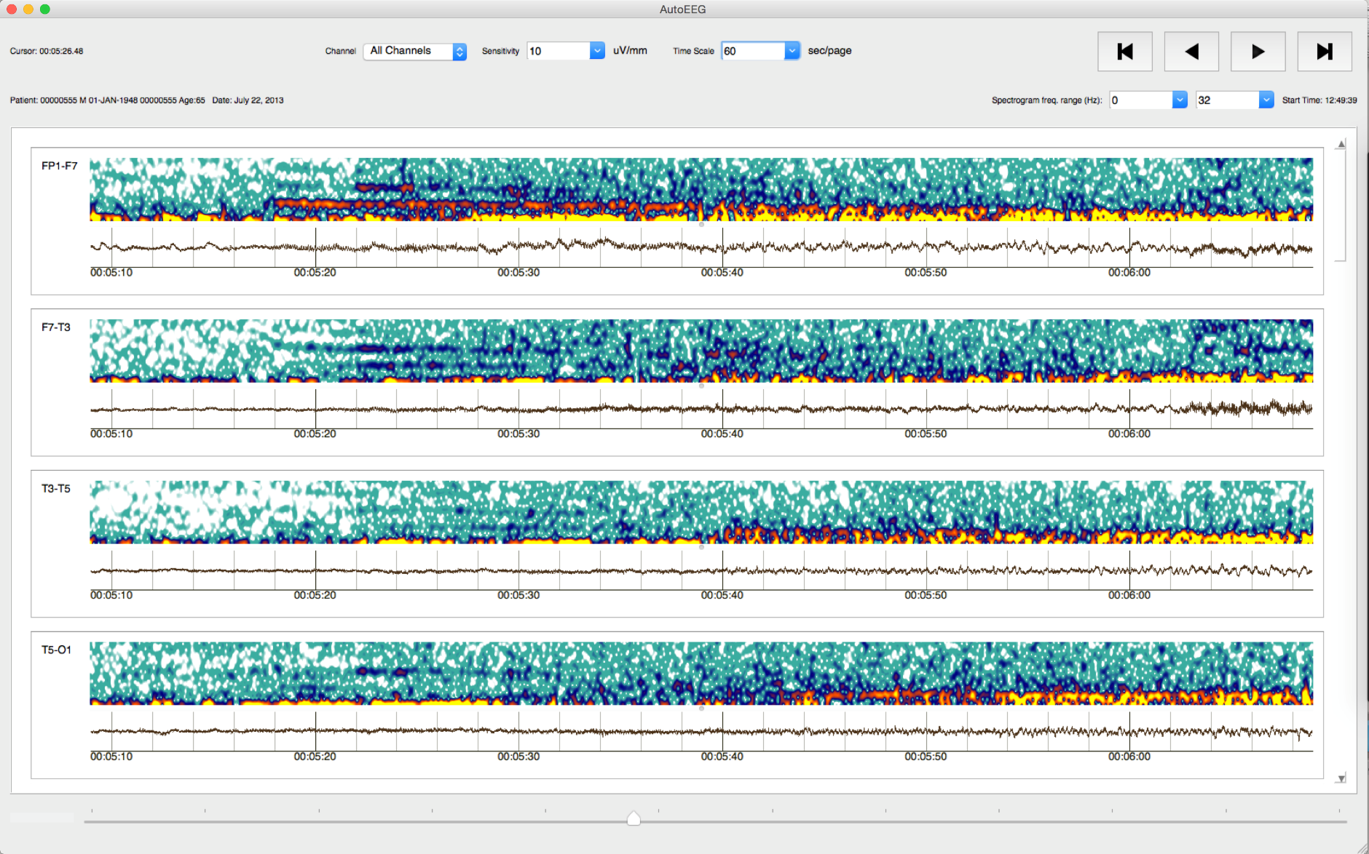
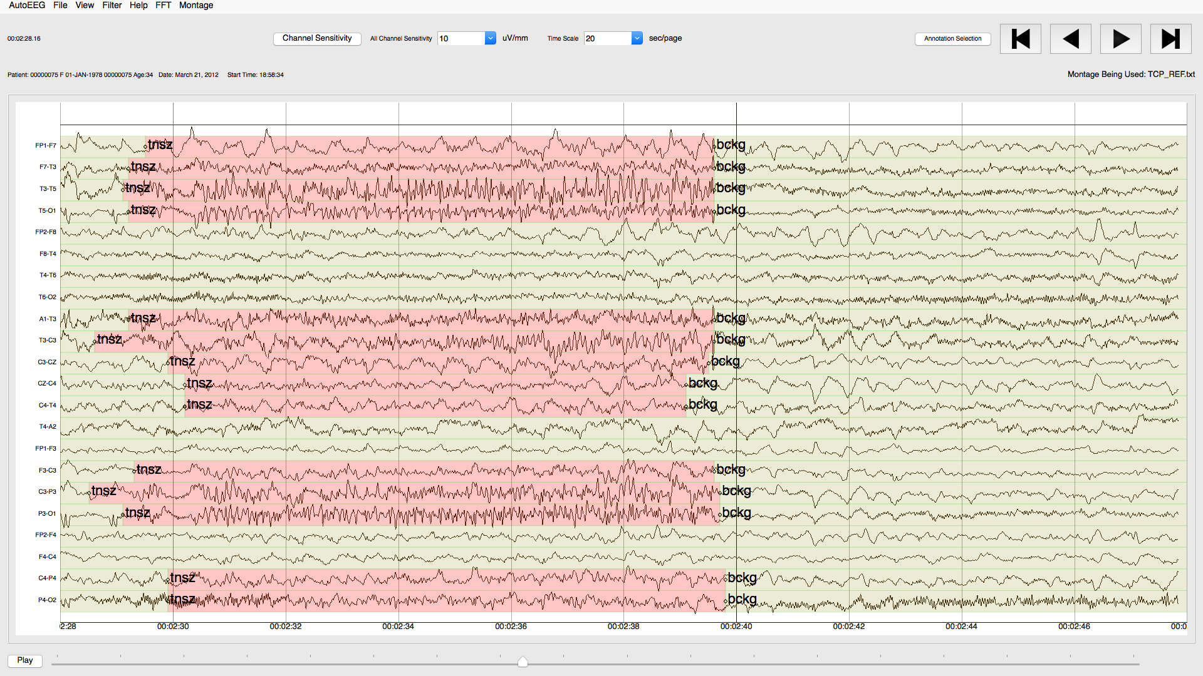
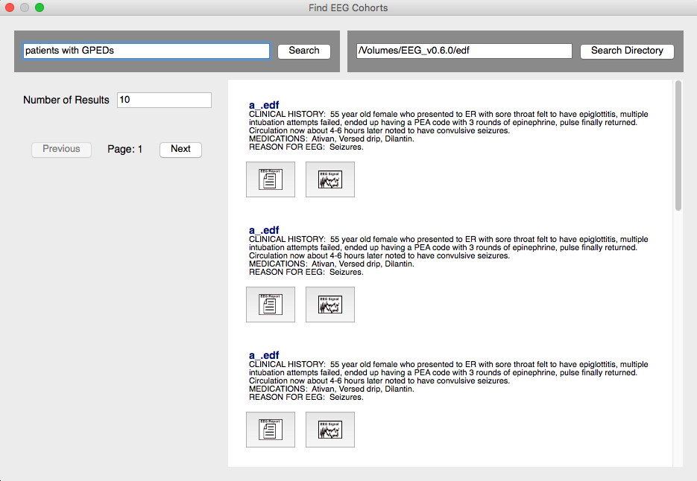
Manual Annotations
We distribute a powerful Python-based visualization and annotation tool:

Slide 8
Cohort Retrieval
Queries can be submitted that search signals and reports.
A simple query building interface is supported.
Search results are displayed in a way that link signals and reports.
Users can easily review and select the top-ranked results.
The user interface is being co-developed with feedback from expert neurologists.

Slide 9
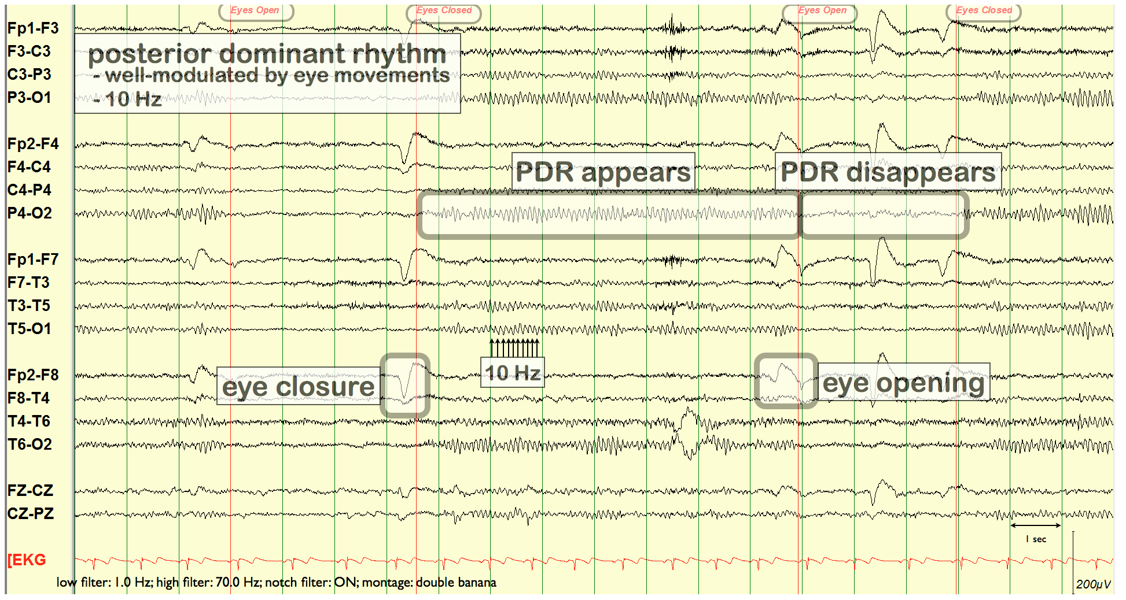
Future Directions in EEG Corpora
The clinical recordings for TUH EEG were pruned at the time of data collection.
Technicians mark interesting portions of the signals, while the remaining portions were discarded.
Segments are stored in separate files.
This make it difficult to do ‘real-time’ experiments such as seizure prediction, patient adaptation, artifact detection, latency reduction, etc.
In a collaboration between University of New Mexico and Temple University, we are proposing the development and release, as open source data, ~15,000 patients who sought treatment over the last decade at the Comprehensive Epilepsy Center at the University of New Mexico Hospital.
These will be continuous recordings that will accelerate the development of a new generation of deep learning technology.

Slide 10
Related Resources
Data:
Abnormal: Over 2,000 EEGs classified as normal or abnormal. The eval set includes about 150 patients with normal EEGs and 105 patients with abnormal EEGs.
Artifact: Over 300 EEGs that have been carefully annotated for artifacts (e.g., chewing, slowing) appearing during non-seizure intervals. Used to train deep learning background models.
Epilepsy: Over 100 patients with a confirmed patient history of epilepsy and 100 ‘normal’ patients (no history of epilepsy).
Events: A small corpus that has been labeled for events such as SPWS, PLED and GPED. Over 150 files in eval and over 350 files in train.
Seizure: A very large dataset (over 6,000 files) manually annotated for seizure events. Includes train, dev_test and a blind eval set. This data was used for several Kaggle-style challenges.
Software Resources:
Our web site also contains standardized scoring software, a Python visualization and annotation tool, and various libraries to support manipulation of annotation files.

Slide 11
Summary
The TUH EEG Corpus:
Represents a unique opportunity to advance EEG analysis using state of the art machine learning.
Coming Soon:
A large corpus of continuous clinical recordings collected at University of New Mexico.
This data will be instrumental in reducing the false alarm rate, evaluating seizure prediction technology and reducing the latency of real-time systems.
To access our resources:
Sign up:
https://www.isip.piconepress.com/projects/tuh_eeg/html/downloads.shtml
Receive a username and password via an email.
Access resources at:
https://www.isip.piconepress.com/projects/tuh_eeg/downloads/

Slide 12
Brief Bibliography
Khalkhali, V., Shawki, N., Shah, V., Golmohammadi, M., Obeid, I., & Picone, J. (2021). Low Latency Real-Time Seizure Detection Using Transfer Deep Learning. In I. Obeid, I. Selesnick, & J. Picone (Eds.), Proceedings of the IEEE Signal Processing in Medicine and Biology Symposium (SPMB) (pp. 1–7). Philadelphia, Pennsylvania, USA.
Shah, V., Golmohammadi, M., Obeid, I., & Picone, J. (2021). Objective Evaluation Metrics for Automatic Classification of EEG Events. In I. Obeid, I. Selesnick, & J. Picone (Eds.), Biomedical Signal Processing: Innovation and Applications (1st ed., pp. 223–256).
Buckwalter, G., Chhin, S., Rahman, S., Obeid, I., & Picone, J. (2021). Recent Advances in the TUH EEG Corpus: Improving the Interrater Agreement for Artifacts and Epileptiform Events. In I. Obeid, I. Selesnick, & J. Picone (Eds.), Proceedings of the IEEE Signal Processing in Medicine and Biology Symposium (SPMB) (pp. 1–3). Philadelphia, Pennsylvania, USA.
Hamid, A., Gagliano, K., Rahman, S., Tulin, N., Tchiong, V., Obeid, I., & Picone, J. (2020). The Temple University Artifact Corpus: An Annotated Corpus of EEG Artifacts. Proceedings of the IEEE Signal Processing in Medicine and Biology Symposium (SPMB) (pp. 1–3). Philadelphia, Pennsylvania, USA.
Golmohammadi, M., Shah, V., Obeid, I., & Picone, J. (2019). Deep Learning Approaches for Automatic Analysis of EEGs. In S.-M. Chan & W. Pedrycz (Eds.), Deep Learning: Algorithms and Applications (1st ed., p. 45). New York, New York, USA: Springer-Verlag.
Obeid, I., & Picone, J. (2018). The Temple University Hospital EEG Data Corpus. In Augmentation of Brain Function: Facts, Fiction and Controversy. Volume I: Brain-Machine Interfaces (1st ed., pp. 394–398). Lausanne, Switzerland: Frontiers Media S.A.
Shah, V., von Weltin, E., Lopez, S., McHugh, J. R., Veloso, L., … Picone, J. (2018). The Temple University Hospital Seizure Detection Corpus. Frontiers in Neuroinformatics, 12, 1-83.

