Slide 1



Data Wrangling, normalization & preprocessing: Signals
The Big Data to Knowledge (BD2K)
Guide to the Fundamentals of Data Science
Speaker: Dr. Joseph Picone, Temple University
November 18, 2016

Slide 2

Joseph Picone, PhD
Professor, Department of Electrical and Computer Engineering, Temple University
Research interests:
  machine learning approaches to acoustic modeling in speech recognition
  technology to automatically interpret EEGs
PI on an NIH BD2K grant titled “Automatic discovery and processing of EEG cohorts from clinical records”

Slide 3
Abstract
Data wrangling is defined as the process of mapping data from an unstructured format to another format that enables automated processing.
Many decision support systems in healthcare can be successfully automated if such big data resources existed.
Automated data wrangling is crucial to the application of deep learning to healthcare.
In this talk, we will discuss data wrangling challenges for physiological signals commonly found in healthcare, such as electroencephalography (EEG) signals.
For signal and image data to be useful in the development of machine learning systems, identification and localization of events in time and/or space plays an important role.
Normalization of data with respect to annotation standards, recording environments, equipment manufacturers and even standards for clinical practice, must be accomplished for technology to be clinically relevant.
We will specifically discuss our experiences in the development of a large clinical corpus of EEG data, the annotation of key events for which there is low inter-rater agreement (such as seizures), and the development of technology that can mitigate the variability found in such clinical data resources.

Slide 4
The Classic Machine Learning Paradigm
Key issues:
  Is the data representative of the problem?
  Do the features capture meaningful differences between patterns?
  How do we find the best model?
  How do we estimate the parameters of the model?
  How do we evaluate performance?
Collect Data
Evaluate Classifier
Select Features
Train Classifier
Choose Model
Other considerations:
The answers are often application specific and data dependent.
Customers/users don’t often completely understand their requirements.
Data collection is often an on-going process that drives the technology.

Slide 5
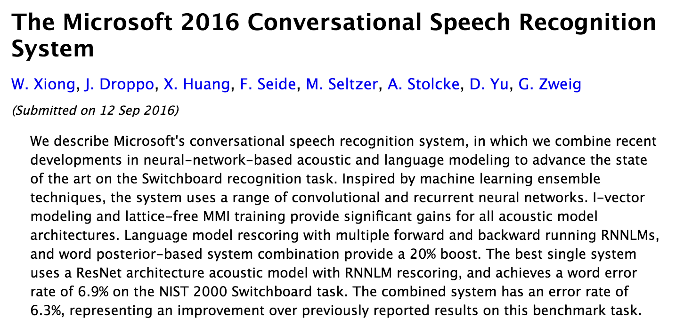
Why Is Big Data So Important?
  Deep learning systems have contributed to reductions in error rates in speech recognition from 80% in the 1990’s to 6.9% in 2016.
  Progress in the last 5 years alone has been significant.
Markov
Model
Deep Learning
  Deep learning systems require large amounts of data:
Corpus | Training Speech | SGMM WER | DNN WER
BABEL Pashto | 10 hours | 69.2% | 67.6%
BABEL Pashto | 80 hours | 50.2% | 42.3%
Fisher English | 2000 hours | 15.4% | 10.3%

Slide 6

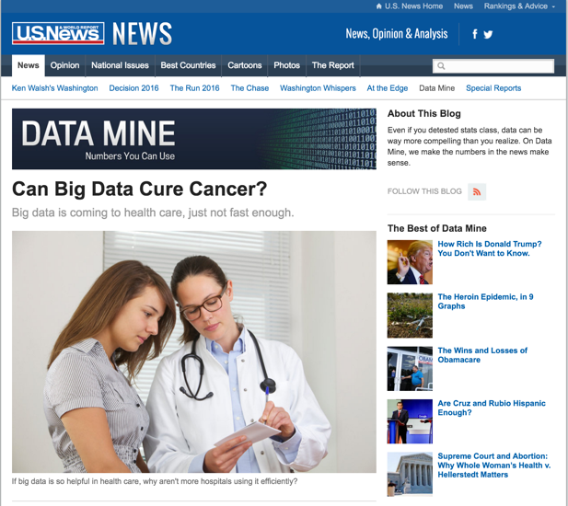
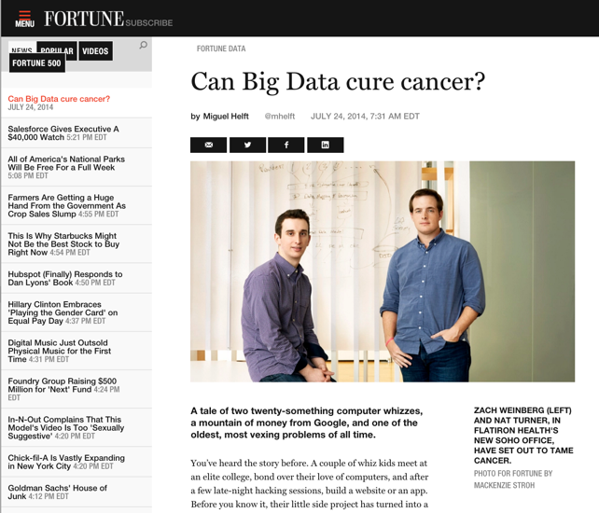
Big Data is Everywhere
Bob Mercer, IBM Speech Research (1985):
“There is no data like more data.”
Dan Ariely, Duke University (2013):
“Big Data is like teenage sex: everyone talks about it,
nobody really knows how to do it,
everyone thinks everyone else is doing it,
so everyone claims they are doing it.”
Douglas Merrill, Zestfinance.com (2013):
“Given enough data, everything is statistically significant.”

Slide 7
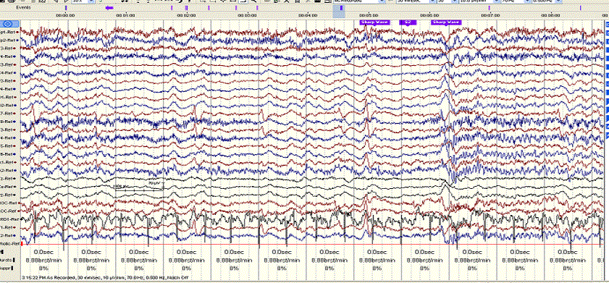
Where Does This Data Come From?
  In commercially viable applications, there are significant economic motivations to develop large data resources.
  In many bioengineering applications, the commercial opportunities are not as significant, so the development of data resources is lagging.
  However, the healthcare industry is awash in vast amounts of unstructured data:
  The TUH EEG Corpus: over 30,000 EEGs from over 16,000 patients in the last 14 years collected in a clinical setting at an urban public hospital.
  At least 4 Petabytes of data including raw EEGs and video.
  At least 1M pathology slides are read and interpreted daily across the U.S.
  Little of this data is being captured for research purposes due to IRB and HIPAA concerns.

Slide 8
Why Big Data Is Critical
  Medicine by its nature deals with statistical outliers and rare events. Rare diseases are often hard to diagnose yet are critical to effective healthcare:
  Example: Temple Hospital’s Department of Neurology conducts about 3,000 EEGs per year, and less than 1% of these patients are diagnosed with posterior reversible encephalopathy syndrome (PRES).
  It is difficult to build powerful analytics with such small sample sizes.
  Every patient seems to be unique in some way:
  “CLINICAL HISTORY: This is a 50-year-old male with previous surgery for a left frontal glioma now with accelerating complex partial seizures.
  MEDICATIONS: Dilantin, Ativan, and others.”
  “CLINICAL HISTORY: A 69-year-old male with known ascending arch aneurysm, recent worsening after GI bleed.”
  MEDICATIONS: Etomidate, midazolam fentanyl, vecuronium, protamine, gabapentin, scopolamine patch, others.”
  Clinicians see a small percentage of the total population throughout their career, and must stay current through continuing education.

Slide 9
Case Study: Manual Interpretation of EEGs
  EEGs are used to diagnose a variety of brain-related illnesses including seizures and epilepsy.
  EEG data is recorded for a period of time ranging from 20 minutes (short-term, outpatient) to several days (long-term, inpatient).
  Approximately 93% of short-term EEGs are inconclusive. It is very difficult to replicate the conditions under which a patient seizes.
  Manual interpretation of an EEG is performed by a board-certified neurologist. It takes several years to receive this certification.
Patient Preparation
EEG Recording
EEG ranging from 22 minutes to several days is recorded
EEG is Interpreted
Certified physicians interpret EEG
Patients are prepared for the test
EEG Report is Produced
Report of findings (e.g. abnormality) is prepared

Slide 10
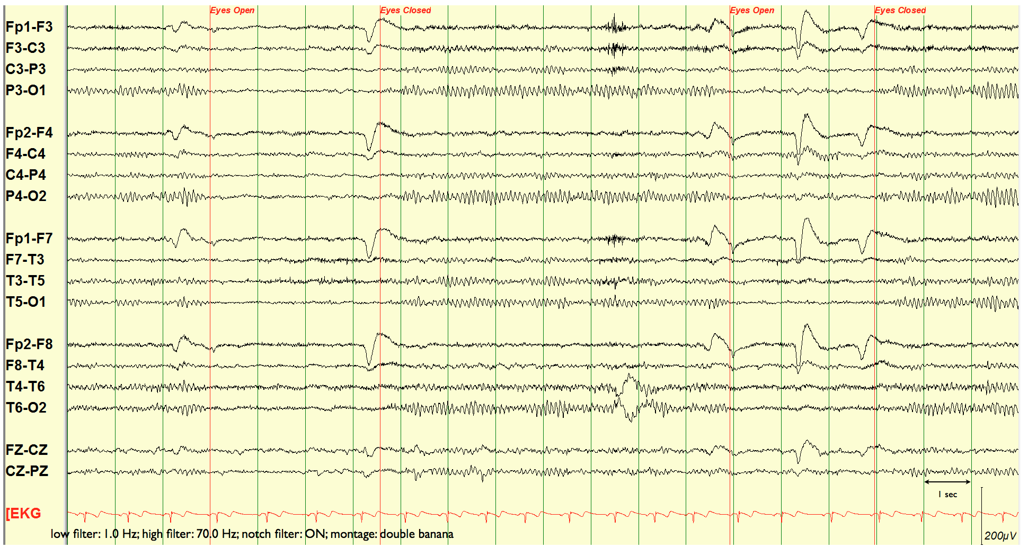
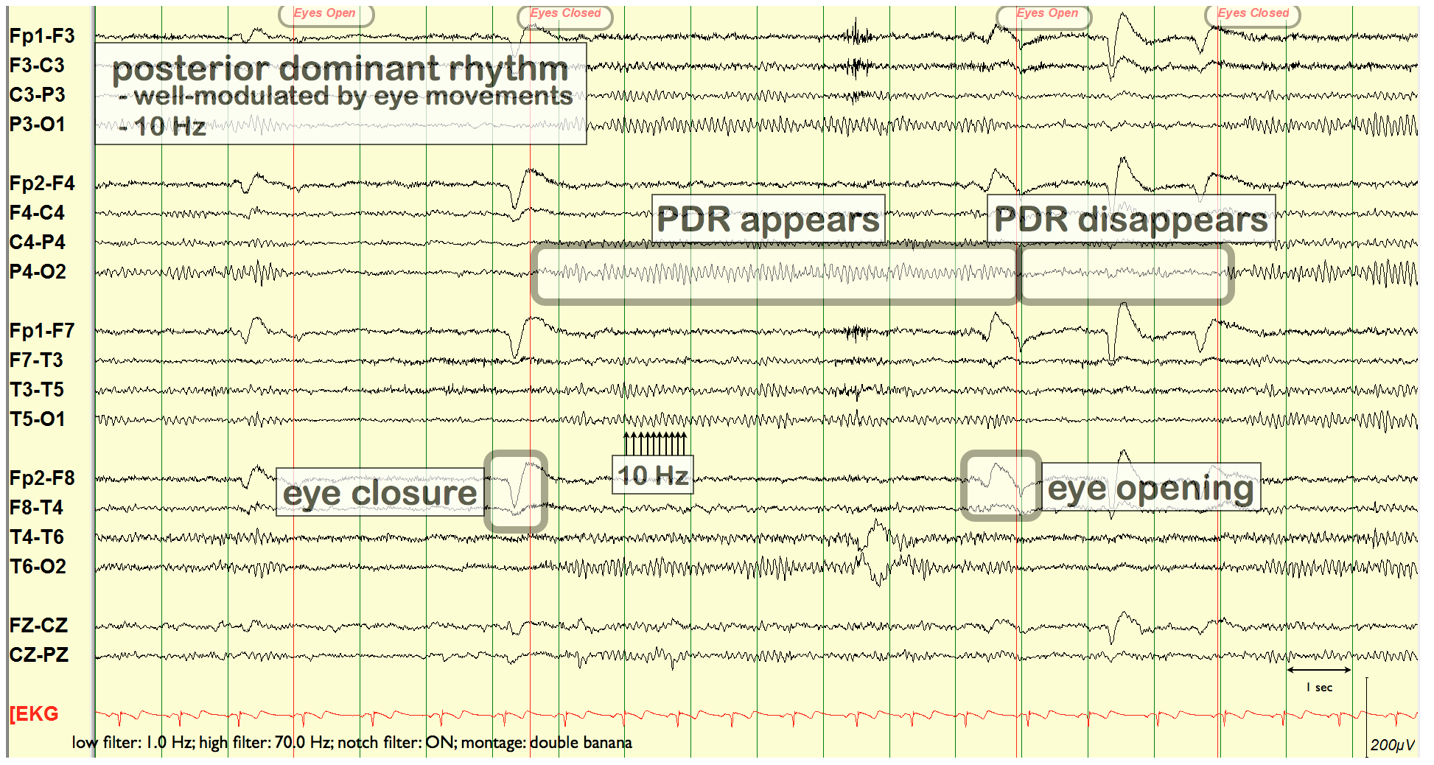
EEG Signals Are Challenging To Interpret
  Neurologists visually inspect waveforms looking for epileptiform discharges (e.g., spikes) that are an indication of abnormalities.
  Though there is general agreement on a diagnosis, interrater agreement on annotation of local events is low.

Slide 11
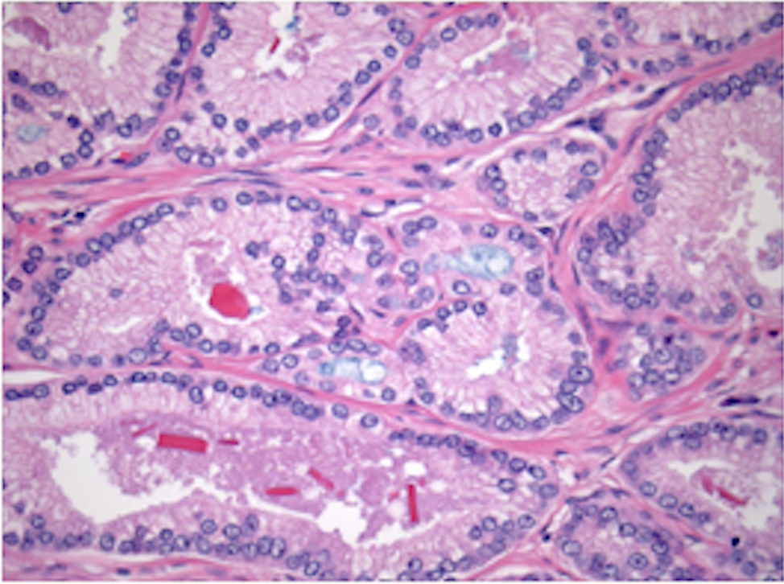
Case Study: Surgical Pathology
  Pathology laboratories provide 7/24 support by providing an analysis of various samples (e.g., surgical biopsies) in real-time.
  Interpretation skills take years to develop (4 years of college, 4 years of medical school, 4 years of residency followed by another 1-2 years of fellowship).
  Machine learning aided diagnosis only exists in cytology.
  Slide digitization enabling remote diagnosis and consulting is still very expensive and not pervasive. However, in certain applications (e.g., military) it is more common.
  Above image is a textbook case of low-grade prostrate cancer. When it is simple, a first-year resident with 2 months of training can diagnose it. But there are many different grades, variants and sometimes only a few glands.
  Each diagnosis can be life-altering, so accuracy is critical.
Notes:
The features are: acinar forming cells with high nuclear/cytoplasmic ratio with large nucleoli; it even shows bright red crystals and blue mucin. )
When it is this classic, a first year resident with 2 months in training can diagnose it. Except it is not always this easy. There are many different grades, variants and sometimes there are only a few glands, hence biopsies are like 1 mm threads of tissue.

Slide 12
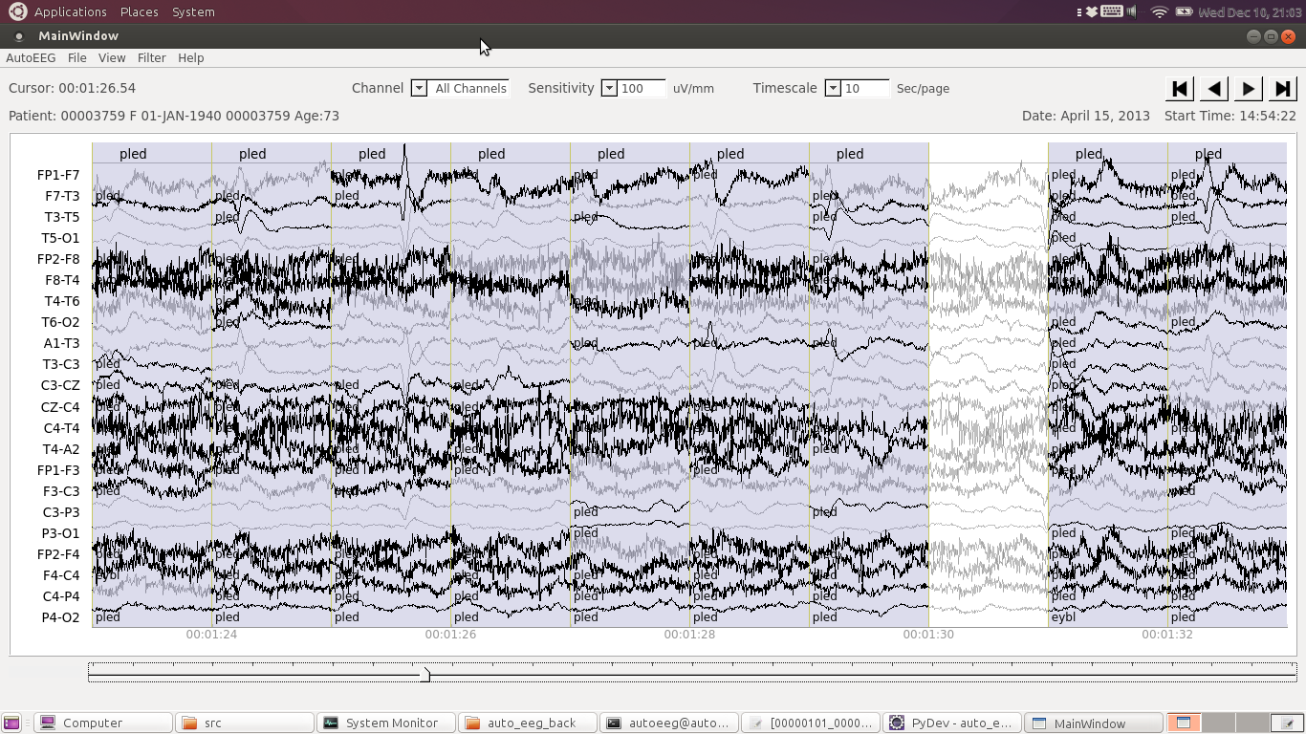
AutoEEG: Real-Time Automatic Interpretation

Slide 13
AutoEEG: Real-Time Seizure Detection
Detecting the onset and type of seizure:
Time Localization: start time and stop time.
Spatial Localization: focal, generalized, hemispheric.
State: non-convulsive or convulsive.
Artifacts: psychomotor variant, ventilatory artifact and lead artifacts, prominent Mu/Breach rhythm, POSTs.
Seizure detection using surface EEG recordings is an extremely challenging task. Real-time clinical applications demand extremely low false alarm rates (e.g., less than 1 false alarm every 8 hours).

Slide 14
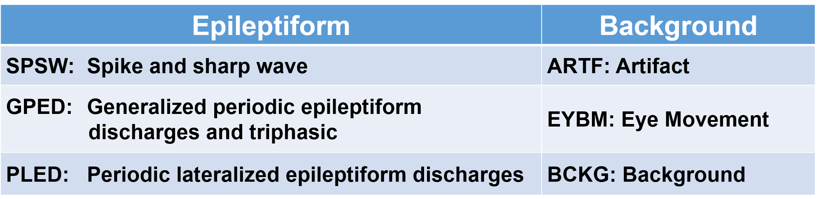
AutoEEG: Clinically-Relevant Signal Events
Six events of interest based on multiple iterations with board certified neurologists:
Clinical data contains many artifacts that can easily be interpreted as spikes, such as patient movement.
Manual review of the data is a time-consuming process, especially for long-term EEG recordings.
In ICU applications, real-time response is critical.
Performance requirements for this application is a detection rate above 95% with a false alarm rate below 5%.
For ICU applications, the false alarm rate must be extremely low
(e.g., 1/8 FA/hr.).

Slide 15
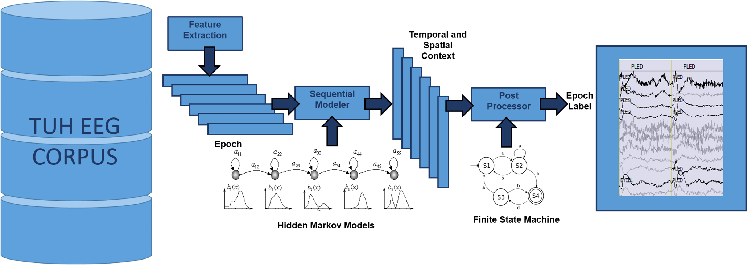
AutoEEG: Automatic Interpretation of EEGs
  AutoEEG is a hybrid system that uses three levels of processing to achieve high performance event detection on clinical data:
  Pass 1 (P1): sequential decoding of each channel using channel-independent hidden Markov models
  Pass 2 (P2): Deep learning is used to add spatial and temporal context to differentiate between periodic events (e.g., PLEDs) and isolated spikes
  Pass 3 (P3): A statistical language model is used to model event sequences

Slide 16
Dismissing the “Easy” Stuff: Anonymization
  The Health Insurance Portability and
  Accountability Act (HIPAA), 1996:
  “The HIPAA Privacy Rule establishes
  national standards to protect individuals’
  medical records and other personal health
  information and applies to health plans,
  health care clearinghouses, and those
  health care providers that conduct certain
  health care transactions electronically.
  The Rule requires appropriate safeguards
  to protect the privacy of personal health
  information, and sets limits and conditions
  on the uses and disclosures that may be made of such information without patient authorization. The Rule also gives patients rights over their health information, including rights to examine and obtain a copy of their health records, and to request corrections.”
  Health Information Privacy, Department of Health and Human Services
  Note: A similar act exists for education – Family Educational Rights and Privacy Act (FERPA), 1974.

Slide 17
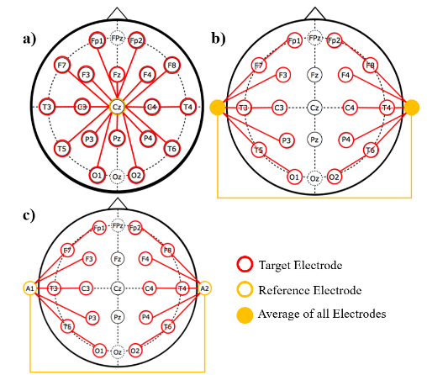
Dismissing the “Easy” Stuff: Channels and Montages
  Clinical EEG data varies significantly depending on a number of operational conditions (e.g., the type and placement of electrodes, the type of electrical grounding used).
  Montages: neurologists often prefer a differential view of the channels so noise is reduced (e.g., Temporal Central Parasagittal, or TCP, montage).
  Channel Labels: Even the channel labels are not standard across institutions (e.g. T2, FP1).
  Three common referential montages:
  a) the Common Vertex Reference (CVR),
  b) the Average Reference (REF),
  c) the Linked Ears Reference (LE).
  Channel identity, which allows us to spatially localize events, is important in determining key signal events such as seizures.
  Technology must be robust to these types of operational variations.
  Intelligent signal processing based on deep learning can provide solutions.

Slide 18
Dismissing the “Easy” Stuff: Artifacts
  Artifact removal is an essential part of dealing with physiological signals.
  EEGs are extremely low-voltage signals (microvolts). Many electrical phenomena (e.g., grounding, movement) impact the quality of the signals.
  Clinical data tends to be much more complex than research data collected under controlled conditions.
  Neurologists typically apply various filters (e.g., 60 Hz notch) to remove noise and enhance the signals of interest.
  The best way to deal with artifact removal is to develop explicit models of these events (e.g., background models).
  (a) electrode impedance
  (b) grounding artifact
  (c) eye movement

Slide 19
Feature Selection: Standard Visualizations
  Most EEGs are analyzed based on waveforms, but there is growing use of frequency domain visualizations:

Slide 20
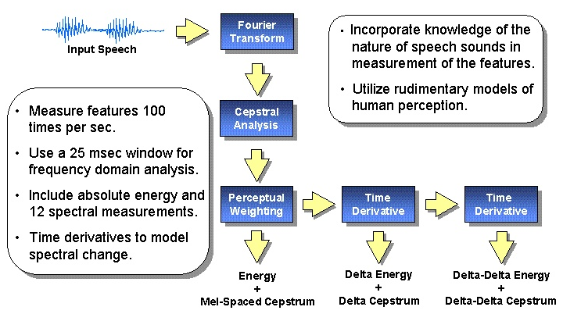
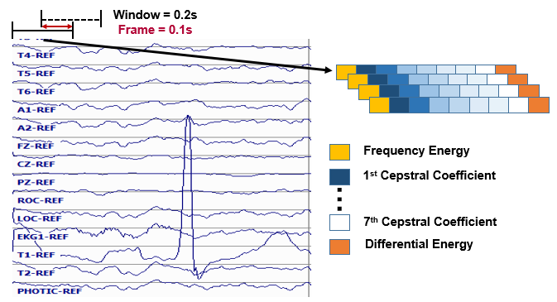
Feature Selection: Classic Approaches
  Designing feature extraction and selection approaches used to be a big part of signal processing research.
  Most systems use a combination of frequency domain (e.g., cepstral) and time domain (e.g., energy) features, along with derivatives.
  More advanced approaches, such as wavelets, do not provide much of a performance improvement on EEG signals.
  Deep learning systems are increasingly performing feature analysis within the neural network framework, allowing the optimal feature set to be automatically learned.

Slide 21
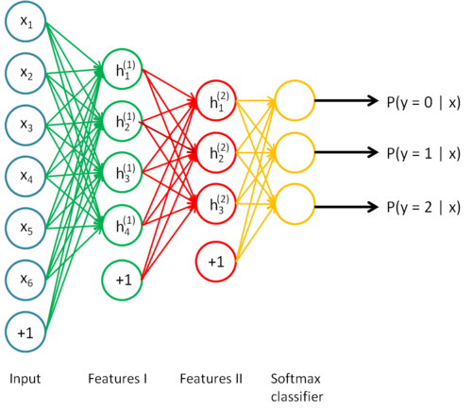
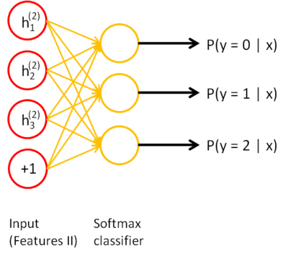
Feature Selection: Stacked Autoencoders
  Using a hierarchy of artificial neural networks, systems are able to learn important features for a problem (e.g., frequency domain mappings).
  Advantage: features are optimized as part of the training process.
  The learning process is unsupervised, so annotated data is not needed.

Slide 22
Classification: Bidirectional Long Short-Term Memory Nets
  There are many proposed architectures for deep learning systems.
  The distinguishing feature of these systems are that they contain many levels and many nodes.
  Only in the past decade have techniques emerged that allow these networks to be trained.
  An iterative, or gradient descent approach is used for training.
  Maintaining good generalization is very challenging.
  Advantage: self-organization of data can lead to new scientific insights.
  Disadvantage: computationally very intensive, requiring highly optimized code and special processors (e.g., GPUs).

Slide 23
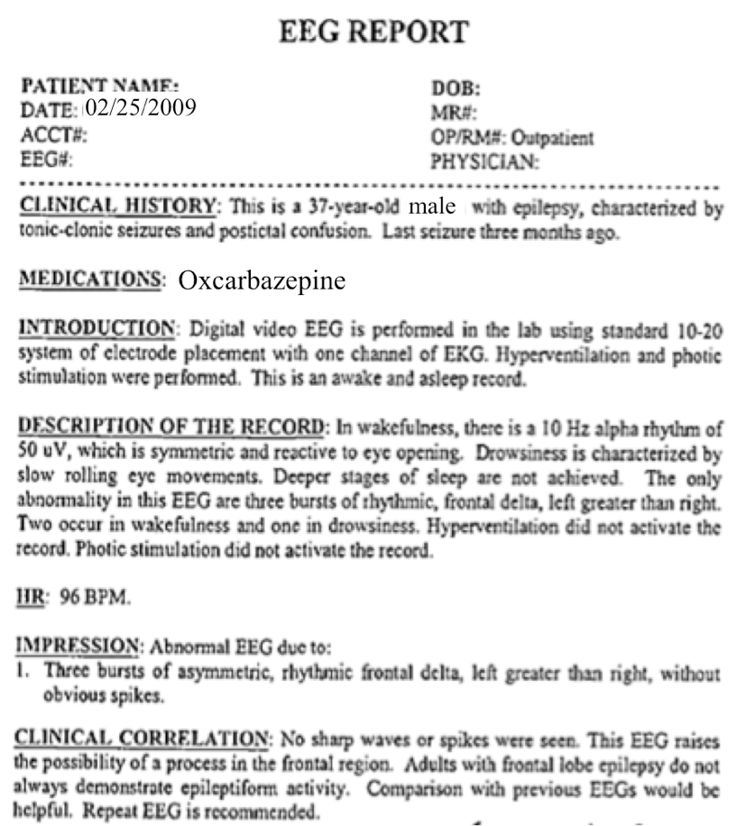
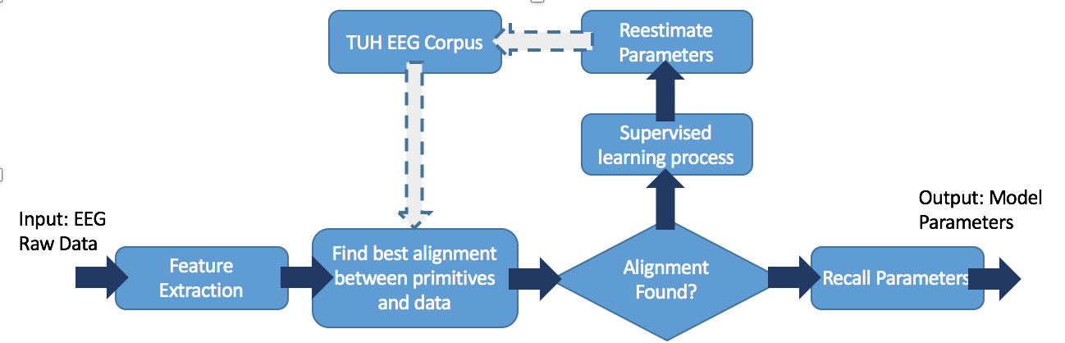
Big Data: Unsupervised Training Is Critical
  Medical reports are essentially unstructured text.
  The language used is indirect and purposefully defensive.
  The report structure evolves over time (TUH EEG contains at least 6 different report formats).
  Temporal events are not annotated or localized in the signal.
  Fully supervised training is not possible.
  An active learning strategy is used to automatically label data.
  The process is bootstrapped from a small amount of manually labeled data.

Slide 24
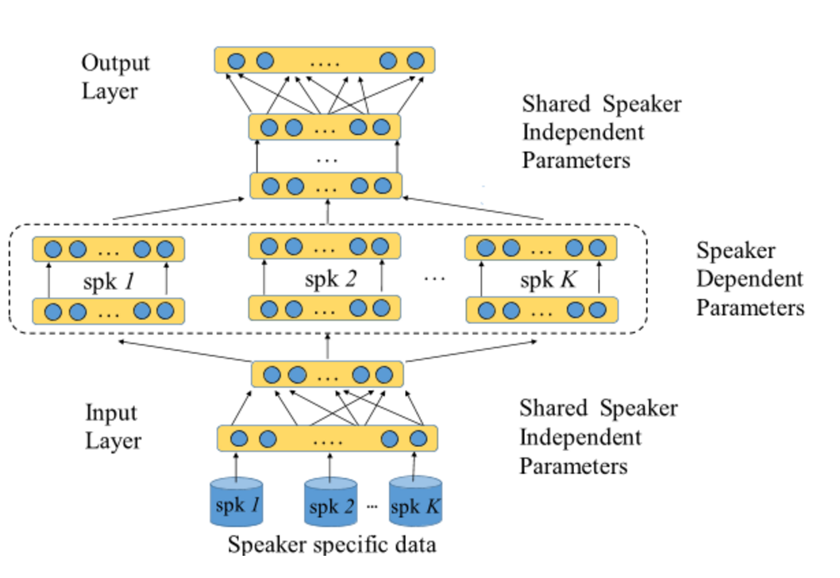
Big Data: Channel Normalization and Adaptation
  Some physiological signals are collected under controlled conditions so that channel variations are minimal (e.g., EEGs, pathology, MRIs).
  However, even within a specific application like EEGs, electrodes, electrical wiring and even technician “art” can cause systematic variations.
  These can be very damaging to statistical learning systems.
  Adaptation approaches attempt to separate these differences, or biases, from variations in the signal.
  A mapping function is estimated and used to transform the data.
  In some applications, detecting changes in the nominal behavior can be meaningful (e.g., epilepsy).

Slide 25
Summary
Big Data Can Be Transformative:
The artisan mentality can be informed by science based on statistically significant outcomes validated on scales never before investigated.
Patient care can be personalized and yet informed by best practices validated over worldwide data resources.
Training and certification can be accelerated and enriched by providing students with searchable data.
Deep Learning Can Play An Important Role:
Data wrangling is critical because there is a lack of adequately annotated data, and many applications will not support the development of annotated big data resources.
Robust parsing of unstructured data is critical since diagnoses and reports are still largely entered as unstructured text (see you on December 2).
But... it is also important that technology positively impacts quality of care, efficiency and cost. Usability engineering still plays a major role in motivating engineers and scientists to solve the most meaningful problems.

Slide 26
Acknowledgements
Automatic Discovery of EEG Cohorts:
Research reported in this poster was supported by National Human Genome Research Institute of the National Institutes of Health under award number 1U01HG008468.
The TUH EEG Corpus:
Portions of this work were sponsored by the Defense Advanced Research Projects Agency (DARPA) MTO under the auspices of Dr. Doug Weber through the Contract No. D13AP00065, Temple University’s College of Engineering and Office of the Senior Vice-Provost for Research, and the National Science Foundation through Major Research Instrumentation Grant No. CNS-09-58854 and Grant No. CNS-1305190.
AutoEEG Commercialization:
This effort is a collaboration between the University City Science Center (Grant No. S1313), Temple University, the National Science Foundation’s Innovation Corps Program (Grant No. IIP-1545814), and the National Science Foundation’s Small Business Technology Transfer Program (STTR) Phase I (Grant No. IIP-1622765).
Disclaimers:
Any opinions, findings, and conclusions or recommendations expressed in this material are those of the author(s) and do not necessarily reflect the views of the National Science Foundation.
The content is solely the responsibility of the authors and does not necessarily represent the official views of the National Institutes of Health.

Slide 27
Brief Bibliography
[1] Ng, A. Machine Learning. A Coursera course available at https://www.coursera.org/learn/machine-learning.
[2] Van Veen, F. (2016). The Neural Network Zoo. Available at http://www.asimovinstitute.org/neural-network-zoo/.
[3] Ebersole, J. S. and Pedley, T. A. Current Practice of Clinical Electroencephalography, 4th ed. Philadelphia, Pennsylvania, USA: Wolters Kluwer, 2014.
[4] Obeid, I., & Picone, J. (2016). The Temple University Hospital EEG Data Corpus. Frontiers in Neuroscience, Section Neural Technology, 10, 00196. Data is available at https://www.isip.piconepress.com/projects/tuh_eeg/.
[5] Golmohamaddi et al. (2017). The TUH EEG Seizure Corpus. Submitted to the Annual Meeting of the American Clinical Neurophysiology Society. Phoenix, Arizona, USA.
[6] Yang, S., López, S., Golmohammadi, M., Obied, I. and Picone, J. (2016). Semi-Automated Annotation of Signal Events in Clinical EEG Data. Proceedings of the IEEE Signal Processing in Medicine and Biology Symposium. Philadelphia, Pennsylvania, USA.

Slide 28

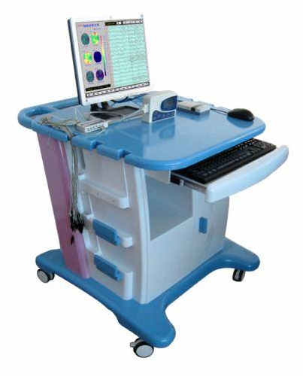
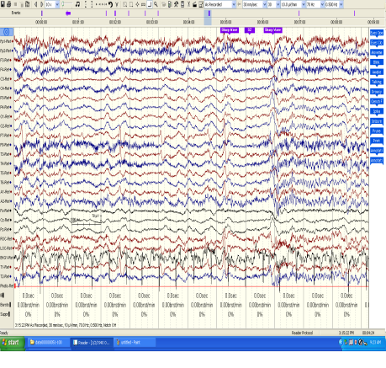
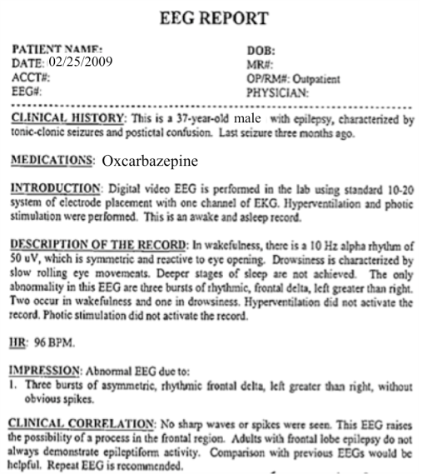
The Temple University Hospital EEG Corpus
Synopsis: The world’s largest publicly available EEG corpus consisting of 28,000+ EEGs collected
from 15,000 patients, collected over 14 years. Includes EEG signal data, physician’s diagnoses
and patient medical histories. A total of 1.4 Tbytes of data.
Impact:
  Sufficient data to support application of state of the art machine learning algorithms
  Patient medical histories, particularly drug treatments, supports statistical analysis of correlations between signals and treatments
  Historical archive also supports investigation of EEG changes over time for a given patient
  Enables the development of real-time monitoring
Database Overview:
  28,000+ EEGs collected at Temple University Hospital from 2002 to 2016 (an ongoing process)
  Recordings vary from 24 to 36 channels of signal data sampled at 250 Hz
  Patients range in age from 18 to 90+ with an average of 1.6 EEGs per patient
  72% of the patients have one session; 16% have two sessions; 12% have three or more sessions
  Data includes a test report generated by a technician, an impedance report and a physician’s report
  Personal information
  has been redacted
  Clinical history and medication history are included
  Physician notes are captured in three fields: description, impression and correlation fields.

Slide 29
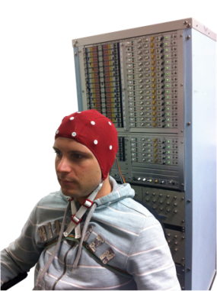
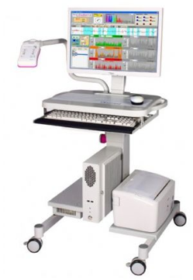
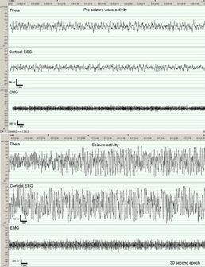
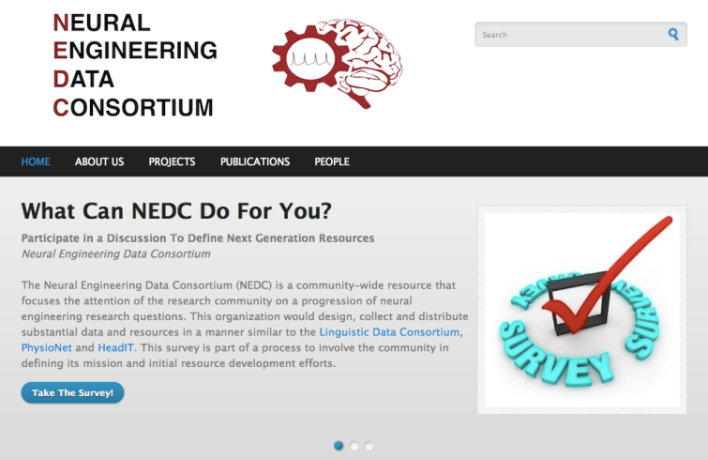
The Neural Engineering Data Consortium
Mission: To focus the research community on a progression of research questions and to
generate massive data sets used to address those questions. To broaden participation by making
data available to research groups who have significant expertise but lack capacity for data generation.
Impact:
  Big data resources enables application of state of the art machine-learning algorithms
  A common evaluation paradigm ensures consistent progress towards long-term research goals
  Publicly available data and performance baselines eliminate specious claims
  Technology can leverage advances in data collection to produce more robust solutions
Expertise:
  Experimental design and instrumentation of bioengineering-related data collection
  Signal processing and noise reduction
  Preprocessing and preparation of data for distribution and research experimentation
  Automatic labeling, alignment and sorting of data
  Metadata extraction for enhancing machine learning applications for the data
  Statistical modeling, mining and automated interpretation of big data
  To learn more, visit www.nedcdata.org

Slide 30

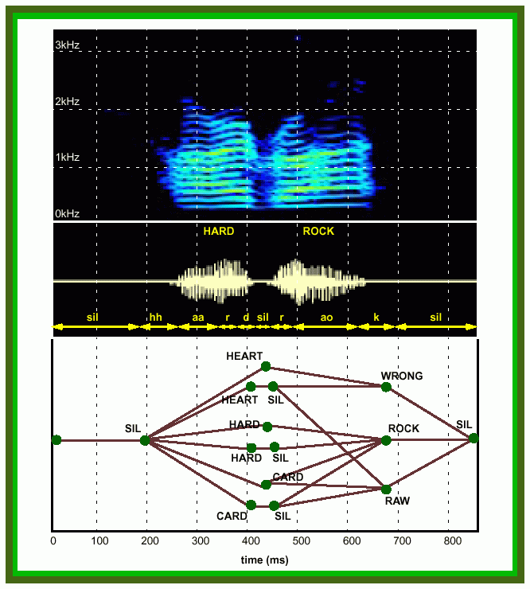
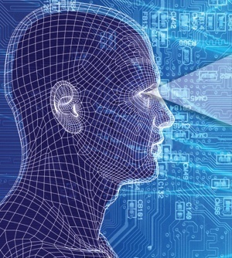
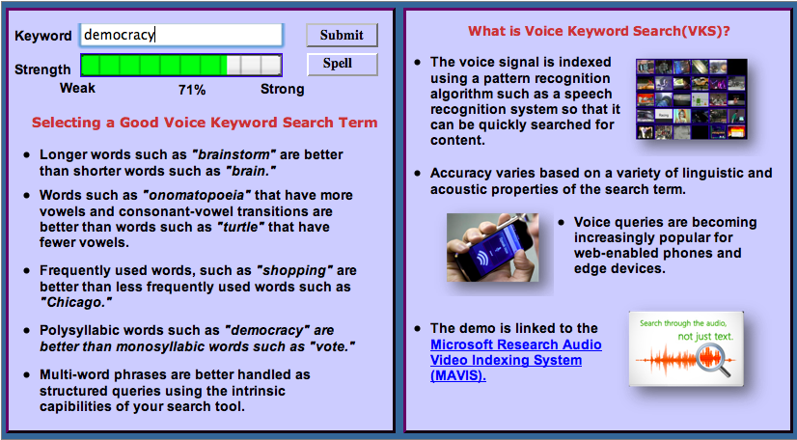
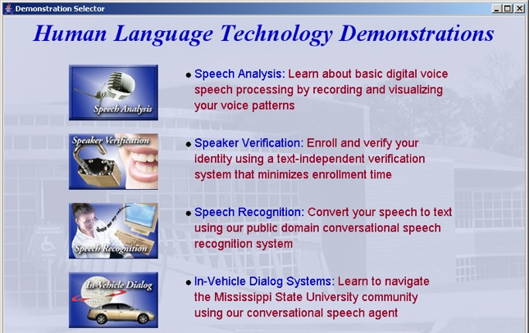
Institute for Signal and Information Processing
Mission: Automated extraction and organization of information using advanced statistical
models to fundamentally advance the level of integration, density, intelligence and performance
of electronic systems. Application areas include speech recognition, speech enhancement and biological systems.
Impact:
  Real-time information extraction from large audio resources such as the Internet
  Intelligence gathering and automated processing
  Next generation biometrics based on nonparametric statistical models
  Rapid generation of high performance systems in new domains involving untranscribed big data using models that self-organize information
Expertise:
  Statistical modeling of time-varying data sources in human language, imaging and bioinformatics
  Speech, speaker and language identification for defense and commercial applications
  Metadata extraction for enhanced understanding
  and improved semantic representations
  Intelligent systems and machine learning
  Data-driven and corpus-based methodologies utilizing big data resources have been proven to result in consistent incremental progress

