Slide 1
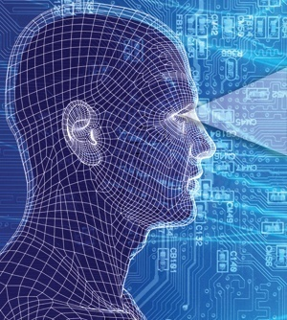
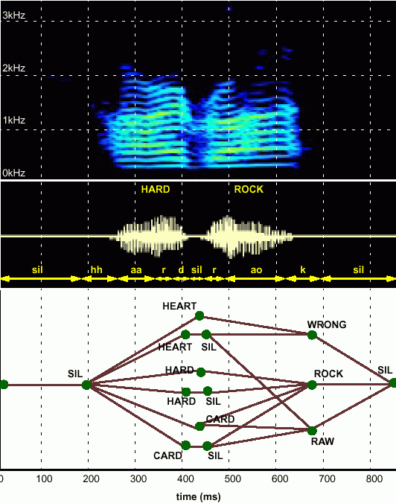
HUMAN LANGUAGE TECHNOLOGY:
From Bits to Blogs
Joseph Picone, PhD
Professor and Chair
Department of Electrical and Computer Engineering
Temple University
URL:

Slide 2
Abstract
What makes machine understanding of human language so difficult?
“In any natural history of the human species, language would stand out as the preeminent trait.”
“For you and I belong to a species with a remarkable trait: we can shape events in each other’s brains with exquisite precision.”
S. Pinker, The Language Instinct: How the Mind Creates Language, 1994
In this presentation, we will:
Discuss the complexity of the language problem in terms of three key engineering approaches: statistics, signal processing and machine learning.
Introduce the basic ways in which we process language by computer.
Discuss some important applications that continue to drive the field (commercial and defense/homeland security).

Slide 3
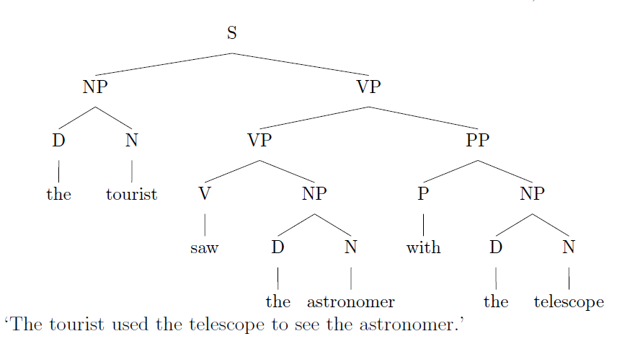
Language Defies Conventional Mathematical Descriptions
According to the Oxford English Dictionary, the 500 words used most in the English language each have an average of 23 different meanings. The word “round,” for instance, has 70 distinctly different meanings.
(J. Gray, http://www.gray-area.org/Research/Ambig/#SILLY )
Are you smarter than a 5th grader?
“The tourist saw the astronomer on the hill with a telescope.”
Hundreds of linguistic phenomena we must take into account to understand written language.
Each can not always be perfectly identified (e.g., Microsoft Word)
95% x 95% x … = a small number
D. Radev, Ambiguity of Language
Is SMS messaging even a language? “y do tngrs luv 2 txt msg?”

Slide 4
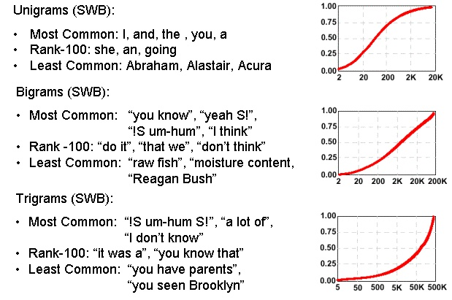
Communication Depends on Statistical Outliers
A small percentage of words constitute a large percentage of word tokens used in conversational speech:
Conventional statistical approaches are based on average behavior (means) and deviations from this average behavior (variance).
Consider the sentence:
“Show me all the web pages about Franklin Telephone in Oktoc County.”
Key words such as “Franklin” and “Oktoc” play a significant role in the meaning of the sentence.
What are the prior probabilities of these words?
Consequence: the prior probability of just about any meaningful sentence is close to zero. Why?

Slide 5
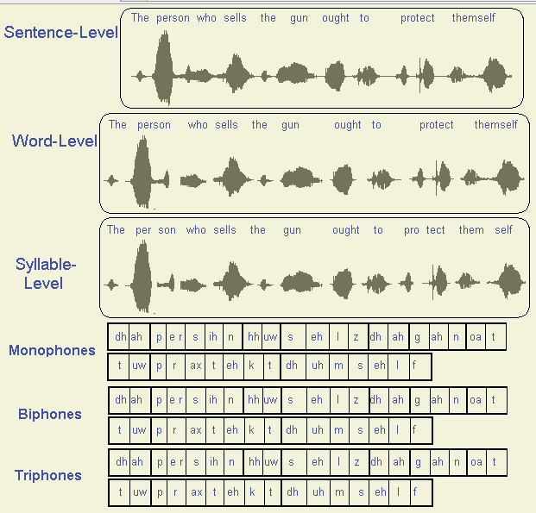
Maybe We Don’t Need to Understand Language?
See ISIP Phonetic Units to run a demo of the influence of phonetic units on different speaking styles.

Slide 6
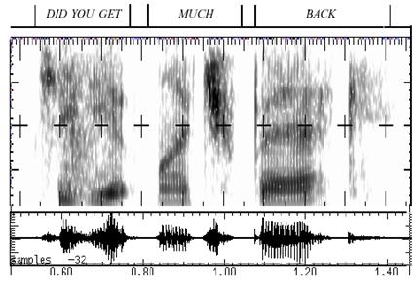
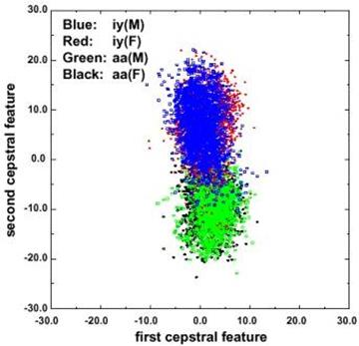
Fundamental Challenges in Spontaneous Speech
Common phrases experience significant reduction (e.g., “Did you get” becomes “jyuge”).
Approximately 12% of phonemes and 1% of syllables are deleted.
Robustness to missing data is a critical element of any system.
Linguistic phenomena such as coarticulation produce significant overlap in the feature space.
Decreasing classification error rate requires increasing the amount of linguistic context.
Modern systems condition acoustic probabilities using units ranging from phones to multiword phrases.

Slide 7
Human Performance is Impressive
Human performance exceeds machine performance by a factor ranging from 4x to 10x depending on the task.
On some tasks, such as credit card number recognition, machine performance exceeds humans due to human memory retrieval capacity.
The nature of the noise is as important as the SNR (e.g., cellular phones).
A primary failure mode for humans is inattention.
A second major failure mode is the lack of familiarity with the domain (i.e., business terms and corporation names).
Word Error Rate
20%
Wall Street Journal (Additive Noise)
15%
Machines
10%
5%
Human Listeners (Committee)
0%
10 dB
16 dB
22 dB
Quiet
Speech-To-Noise Ratio

Slide 8

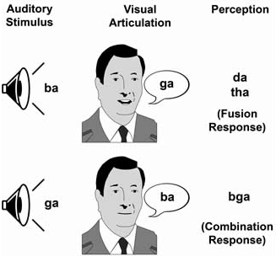
Human Performance is Robust
Cocktail Party Effect: the ability to focus one’s listening attention on a single talker among a mixture of conversations and noises.
McGurk Effect: visual cues of a cause a shift in perception of a sound, demonstrating multimodal speech perception.
Sound localization is enabled by our binaural hearing, but also involves cognition.
Suggests that audiovisual integration mechanisms in speech take place rather early in the perceptual process.

Slide 9
Human Language Technology (HLT)
Audio Processing:
Speech Coding/Compression (mpeg)
Text to Speech Synthesis (voice response systems)
Pattern Recognition / Machine Learning:
Language Identification (defense)
Speaker Identification (biometrics for security)
Speech Recognition (automated operator services)
Natural Language Processing (NLP):
Entity/Content Extraction (ask.com, cuil.com)
Summarization and Gisting (CNN, defense)
Machine Translation (Google search)
Integrated Technologies:
Real-time Speech to Speech Translation (videoconferencing)
Multimodal Speech Recognition (automotive)
Human Computer Interfaces (tablet computing)
All technologies share a common technology base: machine learning.

Slide 10
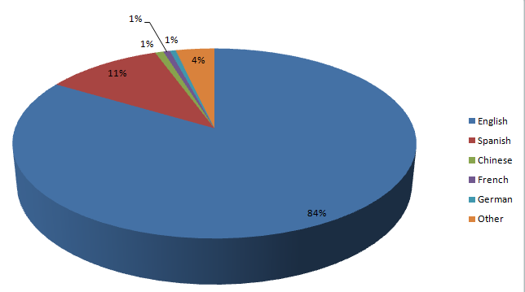
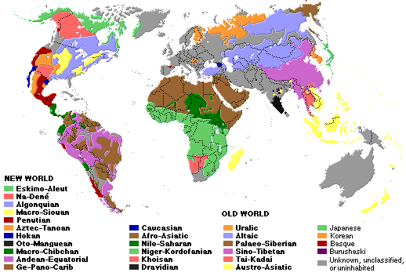
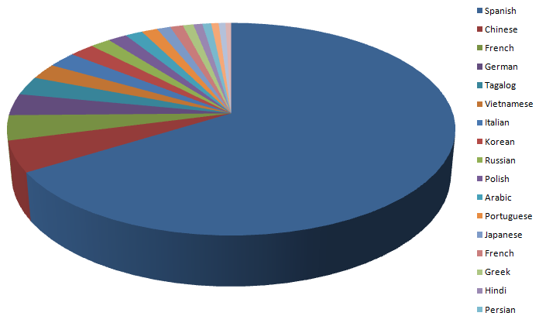
The World’s Languages
There are over 6,000 known languages in the world.
The dominance of English is being challenged by growth in Asian and Arabic languages.
Common languages are used to facilitate communication; native languages are often used for covert communications.
U.S. 2000 Census
Non-English Languages

Slide 11
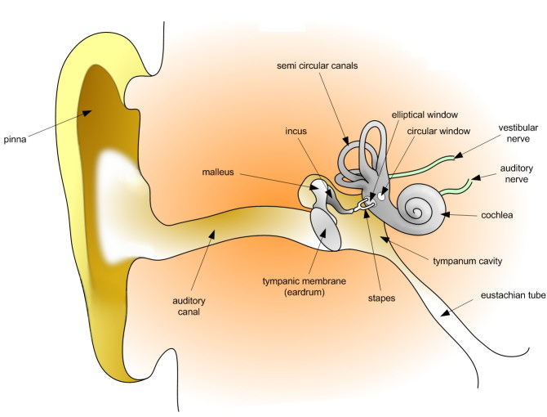
Basic Hardware: Acoustic to Electrical Transducer

Slide 12
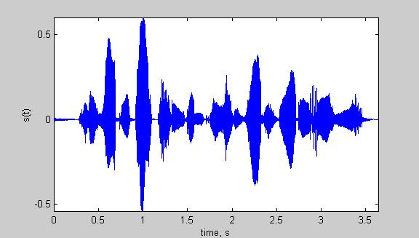
Speech Recognition Architectures
Core components of modern speech recognition systems:
Transduction: conversion of an electrical or acoustic signal to a digital signal;
Feature Extraction: conversion of samples to vectors containing the salient information;
Acoustic Model: statistical representation of basic sound patterns (e.g., hidden Markov models);
Language Model: statistical model of common words or phrases (e.g., N-grams);
Search: finding the best hypothesis for the data using an optimization procedure.
Input
Speech
Acoustic
Front-end
Acoustic Models
P(A/W)
Language Model
P(W)
Search
Recognized Utterance

Slide 13
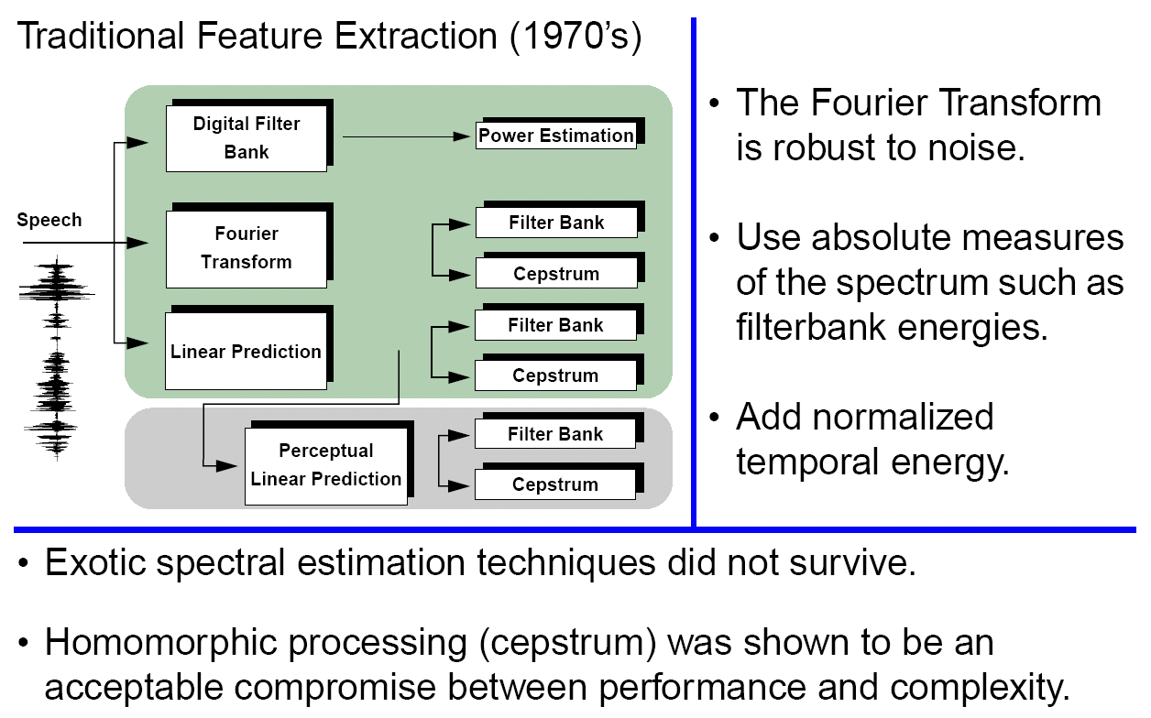
Signal Processing in Speech Recognition

Slide 14
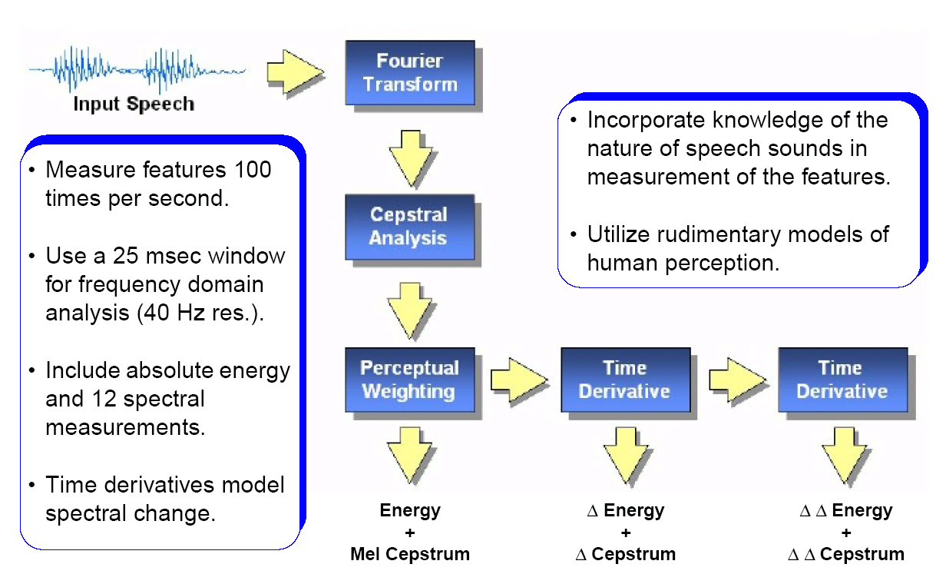
Feature Extraction in Speech Recognition

Slide 15
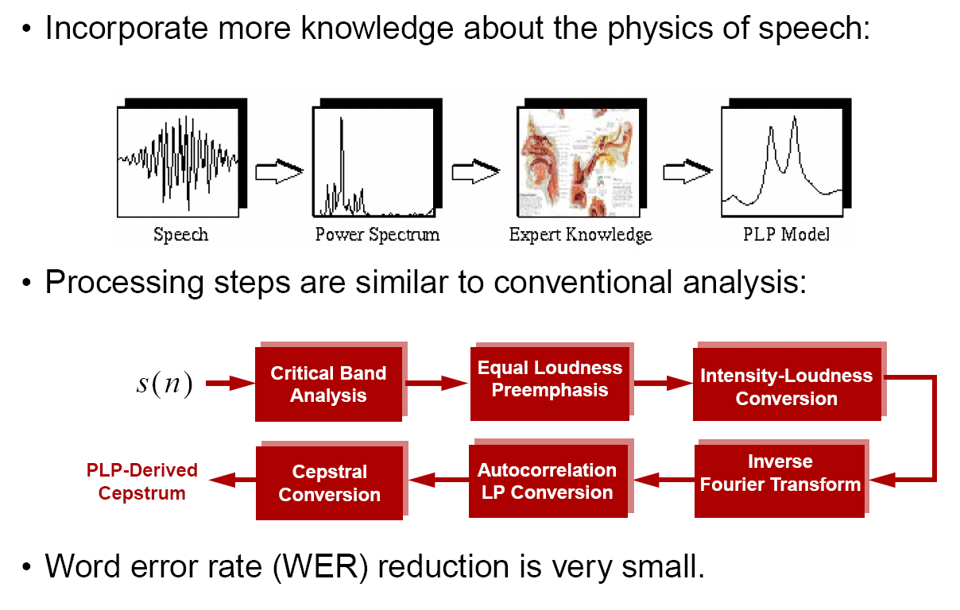
Adding More Knowledge to the Front End

Slide 16
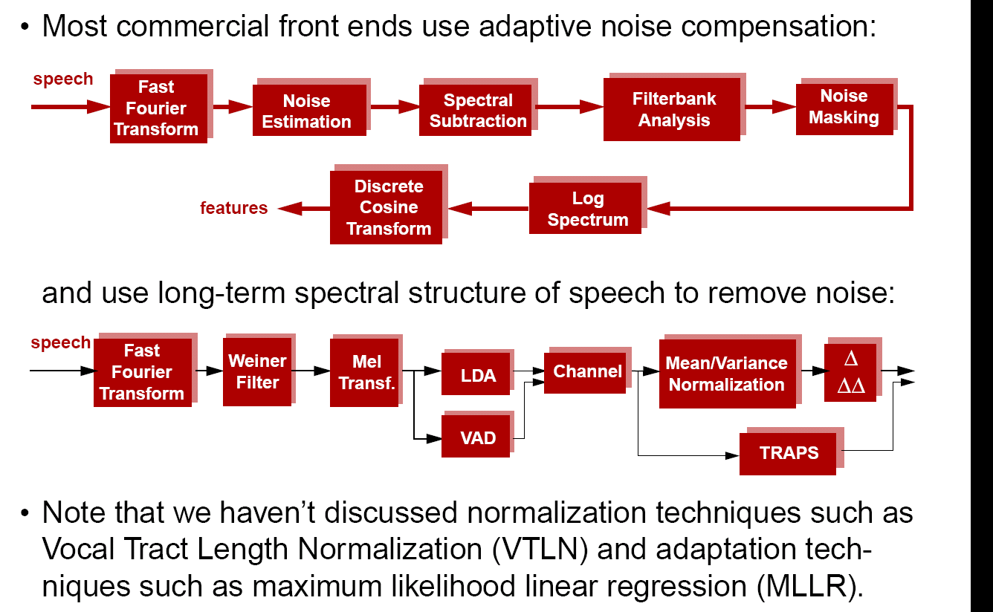
Noise Compensation Techniques

Slide 17
Speech Recognition Architectures
Core components of modern speech recognition systems:
Transduction: conversion of an electrical or acoustic signal to a digital signal;
Feature Extraction: conversion of samples to vectors containing the salient information;
Acoustic Model: statistical representation of basic sound patterns (e.g., hidden Markov models);
Language Model: statistical model of common words or phrases (e.g., N-grams);
Search: finding the best hypothesis for the data using an optimization procedure.
Input
Speech
Acoustic
Front-end
Acoustic Models
P(A/W)
Language Model
P(W)
Search
Recognized Utterance

Slide 18
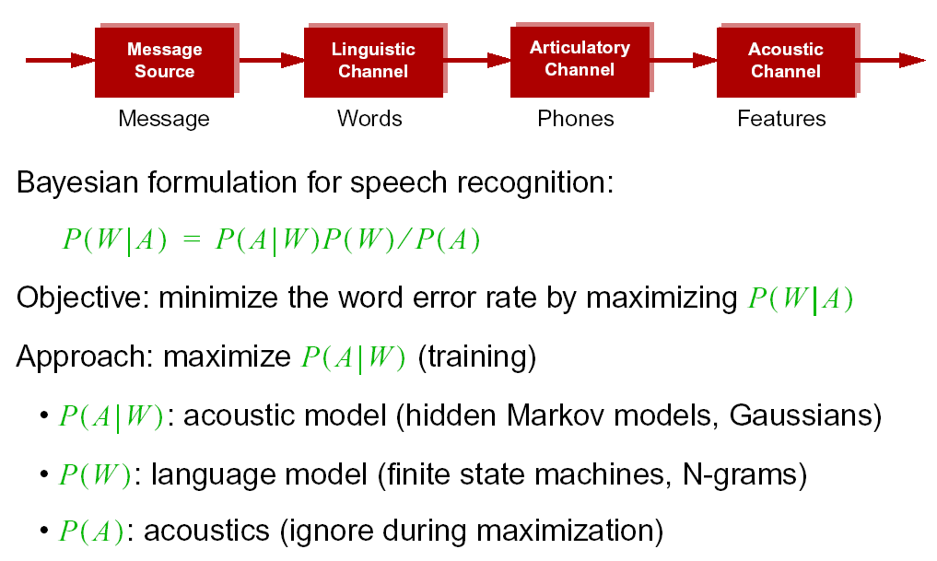
Statistical Approach: Noisy Communication Channel Model

Slide 19
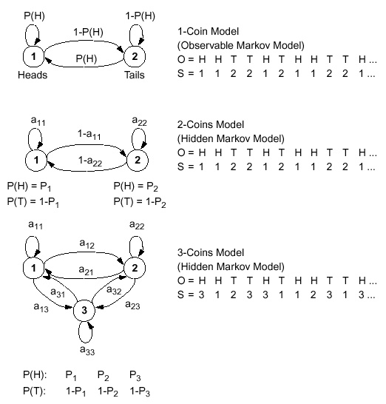
Doubly Stochastic Systems
Modeling acoustics in speech involves using models with hidden parameters that self-organize information.
The 1-coin model to the left is observable because the output sequence can be mapped to a specific sequence of state transitions.
The remaining models are hidden because the underlying state sequence cannot be directly inferred from the output sequence.
With hidden Markov models, we can learn the parameters of these models from data. One approach is to maximize the likelihood of the data given the model.

Slide 20
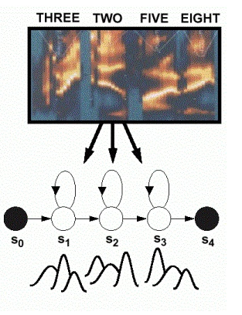
Acoustic Modeling: Hidden Markov Models
Acoustic models encode the temporal evolution of the features (spectrum).
Gaussian mixture distributions are used to account for variations in speaker, accent and pronunciation.
Phonetic model topologies are simple left-to-right structures.
Skip states (time-warping) and multiple paths (alternate pronunciations) are also common features of models.
Sharing model parameters is a common strategy to reduce complexity.
Model parameters are optimized using data-driven training techniques.

Slide 21
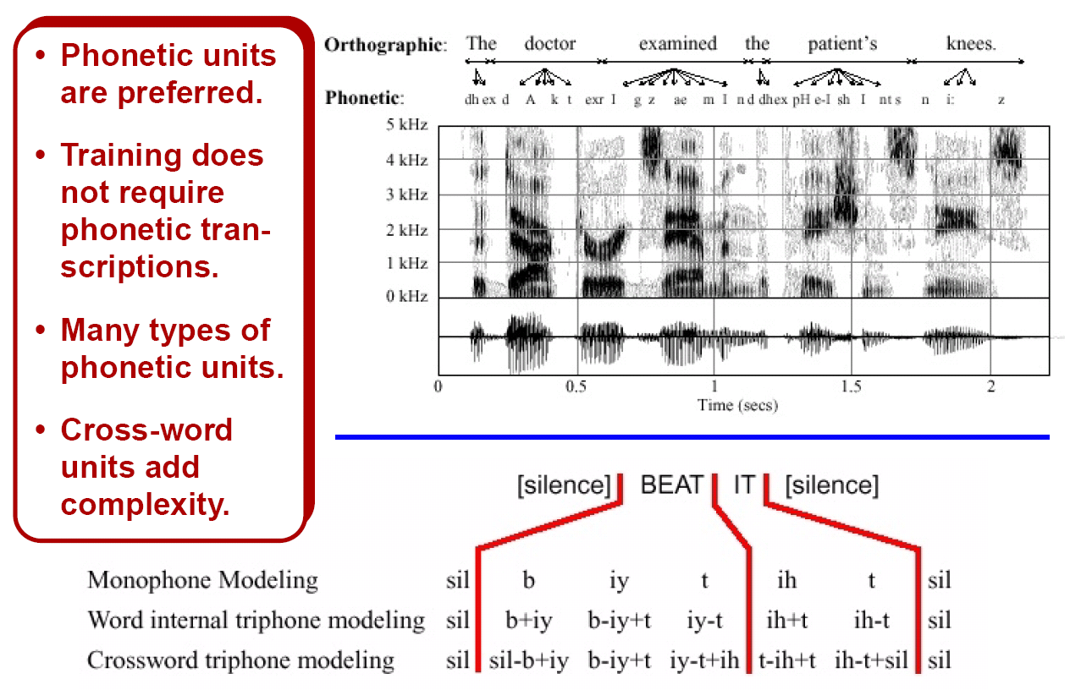
Context-Dependent Acoustic Units

Slide 22
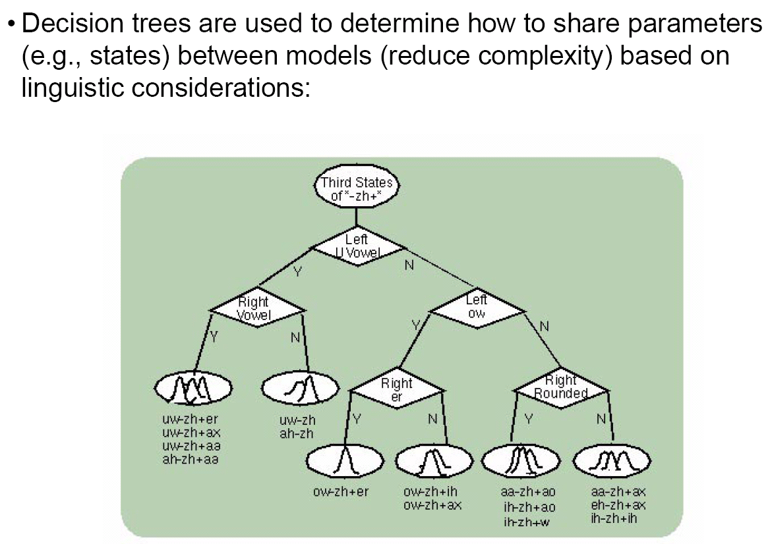
Data-Driven Parameter Sharing Is Crucial

Slide 23
Speech Recognition Architectures
Core components of modern speech recognition systems:
Transduction: conversion of an electrical or acoustic signal to a digital signal;
Feature Extraction: conversion of samples to vectors containing the salient information;
Acoustic Model: statistical representation of basic sound patterns (e.g., hidden Markov models);
Language Model: statistical model of common words or phrases (e.g., N-grams);
Search: finding the best hypothesis for the data using an optimization procedure.
Input
Speech
Acoustic
Front-end
Acoustic Models
P(A/W)
Language Model
P(W)
Search
Recognized Utterance

Slide 24
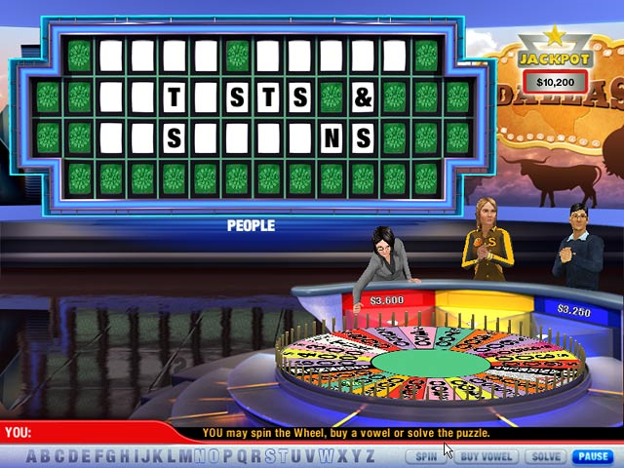
Language is Redundant
Written languages such as English are redundant – words and phrases can be guessed even when many letters are missing.
Logographic languages do not share this property.
Some languages are inflected (words change according to grammatical function).
Some languages do not have word boundaries (e.g., spaces) in text.
English as a spoken language is considered to be of average difficulty for automated speech recognition.
Combinations of words, known as N-grams, are a simple yet powerful, yet imperfect, way to model spoken English.

Slide 25
Language Defies a Mathematical Description
Finite state machines are one of many types of grammar formalisms that can be used to process language. We categorize these formalisms by their generative capacity (the Chomsky hierarchy).
Type of Grammar | Constraints | Automata
Phrase Structure | A -> B | Turing Machine (unrestricted)
Context-Sensitive | aAc -> aBc | Linear Bounded Automata (N-grams, Unification)
Context-Free | A -> w A -> BC | Push down automata (CFG, BNF, JSGF, RTN)
Regular | A -> w A -> wB | Finite State Automata (transducers)
CFGs offer a good compromise between parsing efficiency and representational power, and provide a natural bridge between speech recognition and natural language processing.

Slide 26
The Best and Worst of N-grams
Bigram Language Model: the probability of a word sequence is factored into a product of its bigrams.

Slide 27
Speech Recognition Architectures
Core components of modern speech recognition systems:
Transduction: conversion of an electrical or acoustic signal to a digital signal;
Feature Extraction: conversion of samples to vectors containing the salient information;
Acoustic Model: statistical representation of basic sound patterns (e.g., hidden Markov models);
Language Model: statistical model of common words or phrases (e.g., N-grams);
Search: finding the best hypothesis for the data using an optimization procedure.
Input
Speech
Acoustic
Front-end
Acoustic Models
P(A/W)
Language Model
P(W)
Search
Recognized Utterance

Slide 28
Search Algorithms are Based on Dynamic Programming
Finding optimal solutions is expensive.
Suboptimal solutions work well.
Search complexity must be linear w.r.t. length/duration to be practical.
Most systems use multiple passes and invoke several search algorithms.
Lookahead and pruning are essential parts of search
Search is time synchronous and
“left-to-right.”
Arbitrary amounts of silence must be permitted between each word.
Words are hypothesized many times with different start/stop times, which significantly increases search complexity.

Slide 29
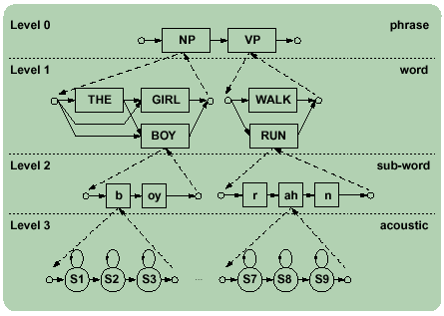
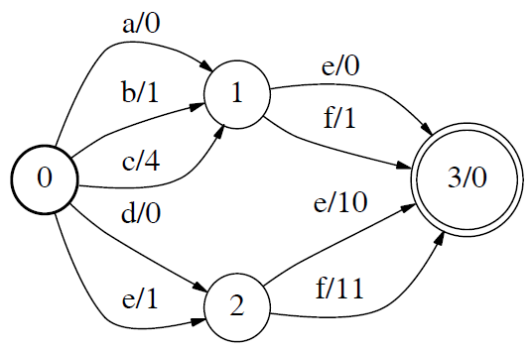
Hierarchical Search vs. Finite State Transducers
Breadth-first time‑synchronous hierarchical
search is very convenient for integrating
linguistic constraints.
Efficient Viterbi search of a hierarchical
network is a much more complicated
problem because of ambiguity in the network
(e.g., the same word sequence can appear
multiple places in the network.
Special care must be taken to synchronize
all hypotheses so each acoustic model is
evaluated as few times as possible.
Since many hypothesis might need the
same phone at the same time, coordinating
this search becomes a nontrivial problem.
Finite state transducers which compile the
hierarchical network into one large, flat
network are now commonly used, trading
memory for speed.

Slide 30
Cross-Word Decoding Using Lexical Trees
Cross-word decoding: since word boundaries don’t occur in spontaneous speech, we must allow for sequences of sounds that span word boundaries.
Cross-word decoding significantly increases memory requirements. The lexicon can be converted to a tree structure (lexical trees) to improve efficiency.

Slide 31
Speech Recognition Architectures
Core components of modern speech recognition systems:
Transduction: conversion of an electrical or acoustic signal to a digital signal;
Feature Extraction: conversion of samples to vectors containing the salient information;
Acoustic Model: statistical representation of basic sound patterns (e.g., hidden Markov models);
Language Model: statistical model of common words or phrases (e.g., N-grams);
Search: finding the best hypothesis for the data using an optimization procedure.
Input
Speech
What applications can be built from this type of technology?
Speech recognition applications continue to evolve from simple speech to text to complex information retrieval tasks.
Acoustic
Front-end
Acoustic Models
P(A/W)
Language Model
P(W)
Search
Recognized Utterance

Slide 32
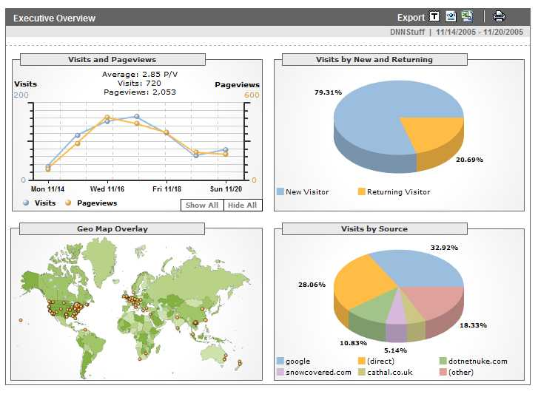
Analytics
Definition: A tool or process that allows an entity (i.e., business) arrive at an optimal or realistic decision based on existing data. (Wiki).
Google is building a highly
profitable business around
analytics derived from people
using its search engine.
Any time you access a web page,
you are leaving a footprint of
yourself, particularly with respect
to what you like to look at.
This has allows advertisers to tailor
their ads to your personal interests
by adapting web pages to your
habits.
Web sites such as amazon.com, netflix.com and pandora.com have taken this concept of personalization to the next level.
As people do more browsing from their telephones, which are now GPS enabled, an entirely new class of applications is emerging that can track your location, your interests and your network of “friends.”

Slide 33


Information Retrieval From Voice Enables Analytics
Speech Activity Detection
“What is the number one complaint of my customers?”
Gender Identification
Language Identification
Speaker Identification
Keyword Search
Speech to Text
Relationship
Analysis
Entity
Extraction
Relational Database

Slide 34
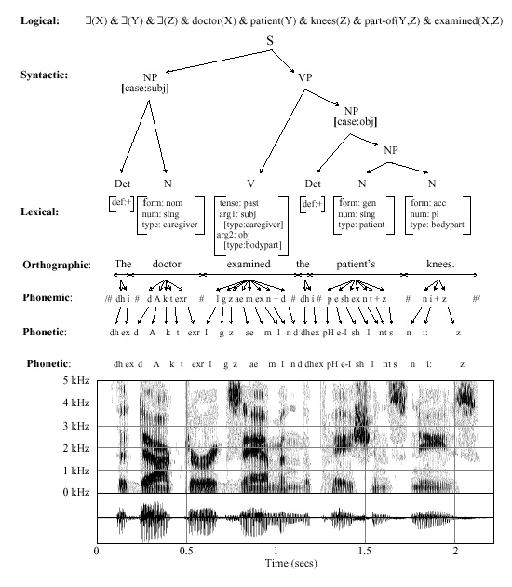
Speech Recognition is Information Extraction
Traditional Output:
  best word sequence
  time alignment of information
Other Outputs:
  word graphs
  N-best sentences
  confidence measures
  metadata such as speaker identity, accent, and prosody
Applications:
  Information localization
  data mining
  emotional state
  stress, fatigue, deception

Slide 35

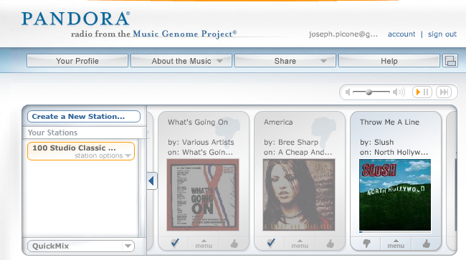
Predicting User Preferences
These models can be used to generate alternatives for you that are consistent with your previous choices (or the choices of people like you).
Such models are referred to as generative models because they can generate new data spontaneously that is statistically consistent with previously collected data.
Alternately, you can build graphs in which movies are nodes and links represent connections between movies judged to be similar.
Some sites, such as Pandora, allow you to continuously rate choices, and adapt the mathematical models of your preferences in real time.
This area of science is known as adaptive systems, dealing with algorithms for rapidly adjusting to new data.

Slide 36


Content-Based Searching
Once the underlying data is analyzed and “marked up” with metadata that reveals content such as language and topic, search engines can match based on meaning.
Such sites make use several human language technologies and allow you to search multiple types of media (e.g., audio tracks of broadcast news).
This is an emerging area for the next generation Internet.

Slide 37
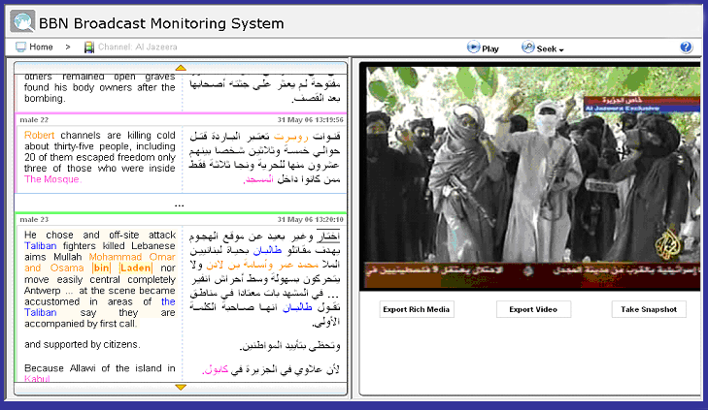
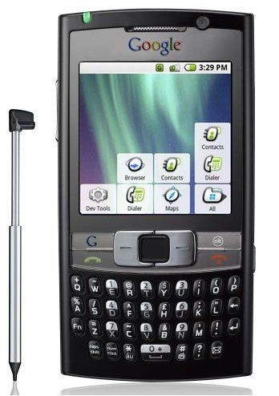
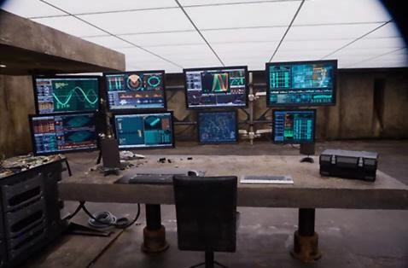
Applications Continually Find New Uses for the Technology
Real-time translation of news broadcasts in multiple languages (DARPA GALE)
Google search using voice queries
Keyword search of audio and video
Real-time speech translation in 54 languages
Monitoring of communications networks for military and homeland security applications

Slide 38


Future Directions
How do we get better?
Supervised transcription is slow, expensive and limited. Unsupervised learning on large amounts of data is viable.
More data, more data, more data…
YouTube is opening new possibilities
Courtroom and governmental
proceedings are providing significant
amounts of parallel text
Google???
But this type of data is imperfect…
… and learning algorithms are still very primitive
And neuroscience has yet to inform our learning algorithms!

Slide 39
Brief Bibliography of Related Research
S. Pinker, The Language Instinct: How the Mind Creates Language, William Morrow and Company, New York, New York, USA, 1994.
F. Juang and L.R. Rabiner, “Automatic Speech Recognition - A Brief History of the Technology,” Elsevier Encyclopedia of Language and Linguistics, 2nd Edition, 2005.
M. Benzeghiba, et al., “Automatic Speech Recognition and Speech Variability, A Review,” Speech Communication, vol. 49, no. 10-11, pp. 763–786, October 2007.
B.J. Kroger, et al., “Towards a Neurocomputational Model of Speech Production and Perception,” Speech Communication, vol. 51, no. 9, pp. 793-809, September 2009.
B. Lee, “The Biological Foundations of Language”, available at http://www.duke.edu/~pk10/language/neuro.htm (a review paper).
M. Gladwell, Blink: The Power of Thinking Without Thinking, Little, Brown and Company, New York, New York, USA, 2005.

Slide 40
Biography
Joseph Picone received his Ph.D. in Electrical Engineering in 1983 from the Illinois Institute of Technology. He is currently Professor and Chair of the Department of Electrical and Computer Engineering at Temple University. He recently completed a three-year sabbatical at the Department of Defense where he directed human language technology research and development.
His primary research interests are currently machine learning approaches to acoustic modeling in speech recognition. For over 25 years he has conducted research on many aspects of digital speech and signal processing. He has also been a long-term advocate of open source technology, delivering one of the first state-of-the-art open source speech recognition systems, and maintaining one of the more comprehensive web sites related to signal processing. His research group is known for producing many innovative educational materials that have increased access to the field.
Dr. Picone has previously been employed by Texas Instruments and AT&T Bell Laboratories, including a two-year assignment in Japan establishing Texas Instruments’ first international research center. He is a Senior Member of the IEEE, holds several patents in this area, and has been active in several professional societies related to human language technology.

