Slide 1
Virtual White Matter:
A NOVEL SYSTEM FOR CROSS-DISH NEURAL INTERACTION AND MODULATION
A Thesis
Submitted to
the Temple University Graduate Board
In Partial Fulfillment
of the Requirements for the Degree
DOCTOR OF PHILOSOPHY
By Mehdi Khantan
May 4th 2026

Slide 2
INTRODUCTION
Outlines:
Introduction
Biological vs. Artificial Neural Networks
Applications of Biological Neural Networks (BNNs)
Research Gaps in BNNs
Current Limitations
Unexplored Opportunities
Aim One: Establishing a Virtual White Matter (VWM)
Concept and Objectives
Experimental System Setup
Technical Barriers and Solutions
Metrics for Evaluation
Bidirectional Connectivity in VWM
Aim Two: Information Transmission via VWM
Concept and Objectives
Electrode Selection
System Architecture
Temporal Stability
Results of Monodirectional and Bidirectional communication
Threshold Based Decoding
Publication

Slide 3
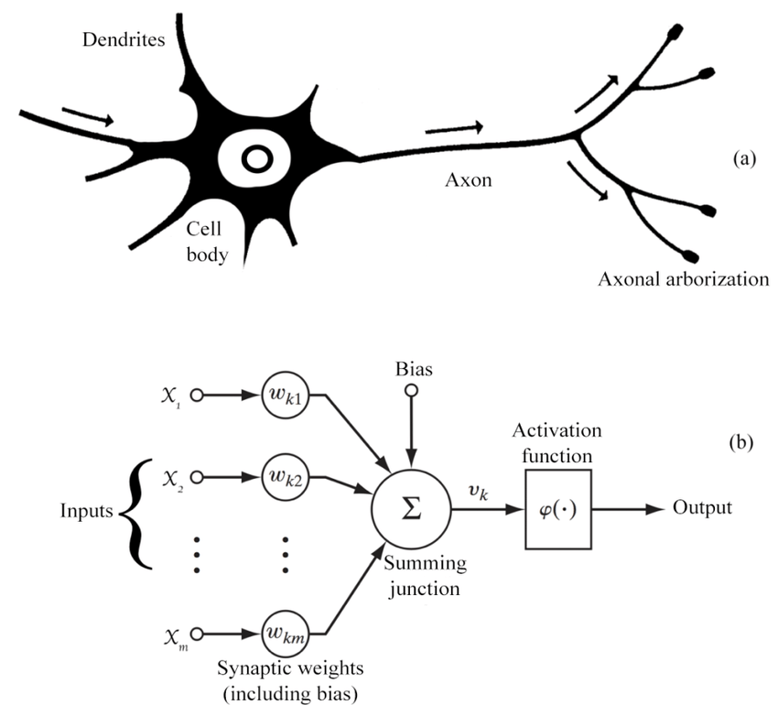
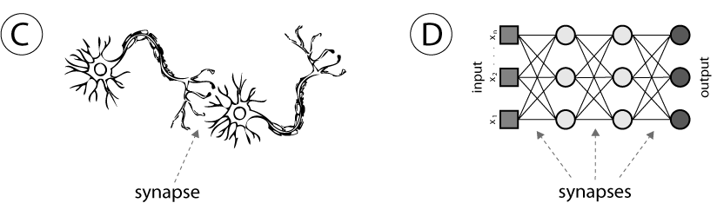
INTRODUCTION
Biological vs. Artificial Neural Networks:
(A)
Feature | Biological Neural Networks (BNNs) | Artificial Neural Networks (ANNs)
Basic Unit | Neuron (cell) | Node (mathematical function)
Signal Type | Electrochemical (spikes, synapses) | Numerical (floating-point values)
Speed | Milliseconds | Microseconds or faster
Energy Efficiency | Extremely efficient (20W for whole brain) | Power hungry (Requires large GPUs and electricity)
Biological Realism | Natural, evolved over millions of years | Inspired by biology, but simplified
(B)
Question: Can we use BNNs for problem solving?
(C)
(D)

Slide 4
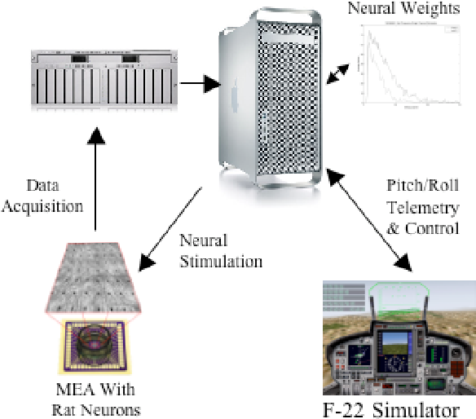
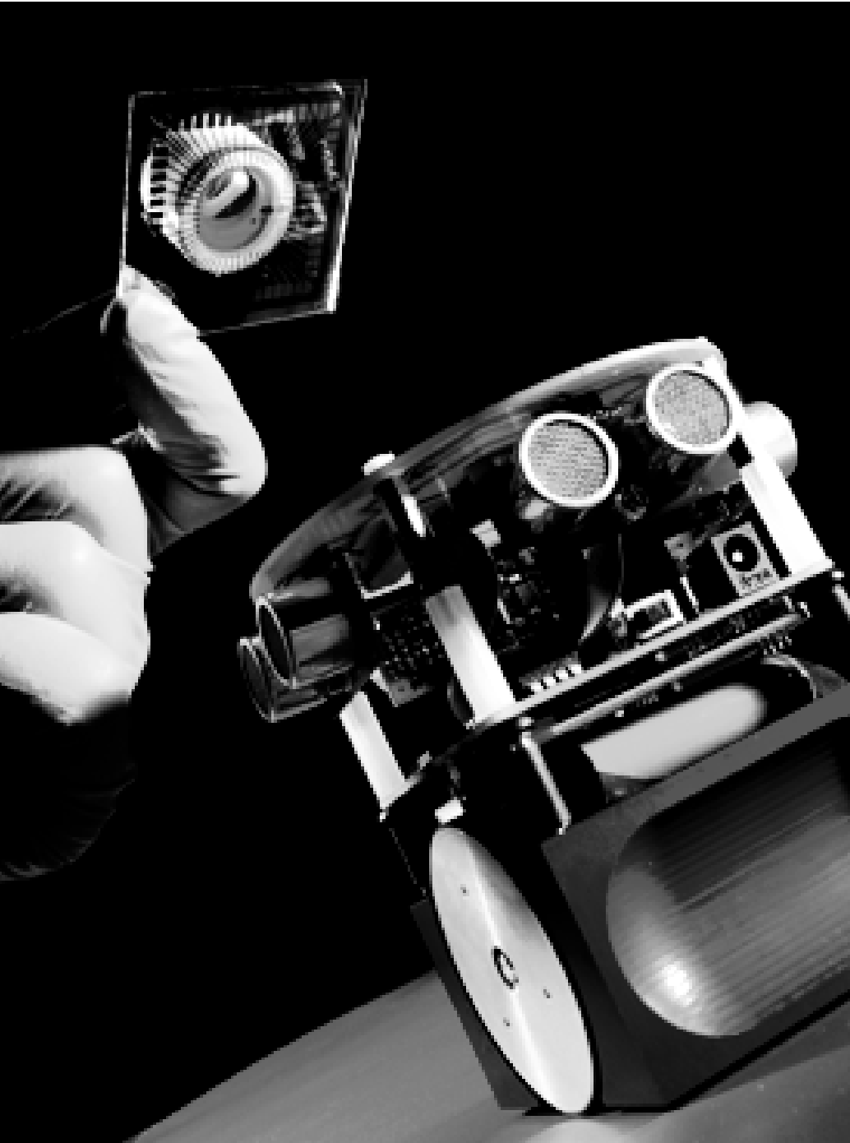
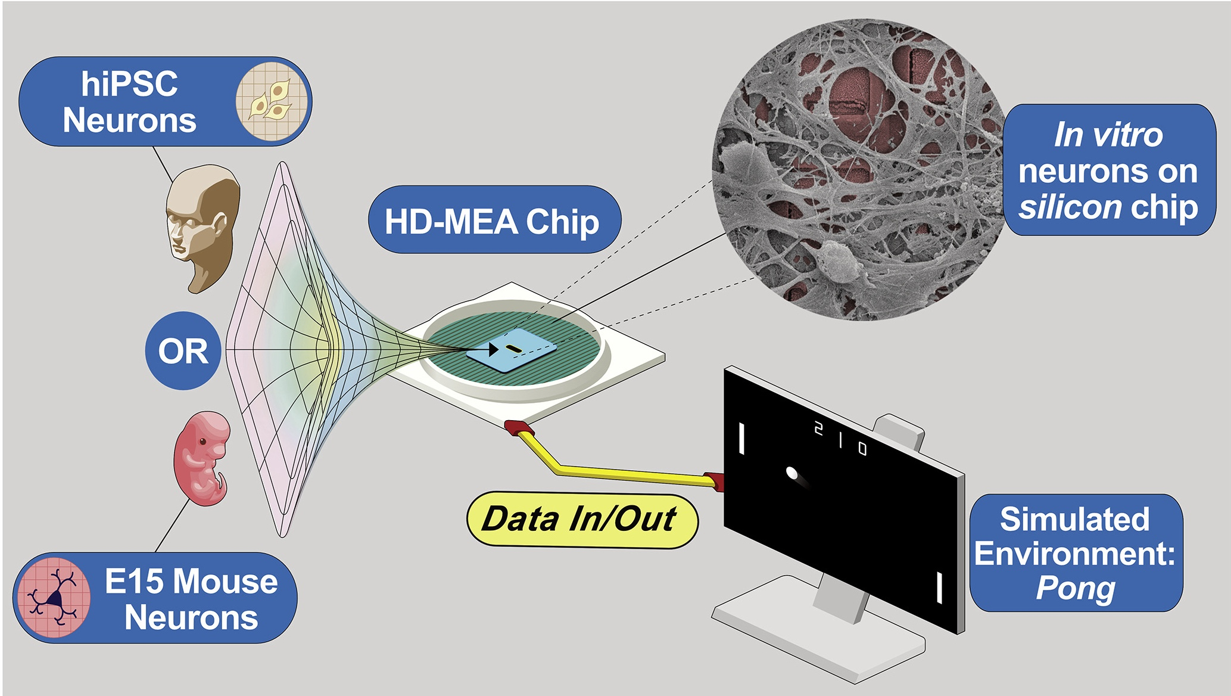
Applications of BNNs:
DeMarse, University of Florida, 2005.
Warwick, University of Reading, 2008.
Cai, Monash University & Cortical Labs, 2023.

Slide 5
Next Steps:
BNNs abilities are limited to simple tasks.
Achieving complex functionality requires new ways to interconnect them.
VWM acts as a virtual bridge to link multiple neural cultures, enabling dynamic, user-controlled communication.
It supports building complex systems like full brain models or virtual embodiments by interconnecting separate brain regions.

Slide 6
Aim One - Proof of Concept :
Spike Detection
Synchronization
Stimulation
Recording
Source MEA
Target MEA
Mono Directional VWM

Slide 7
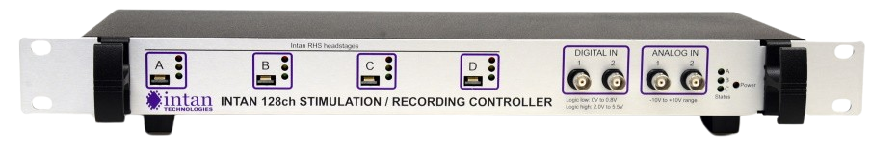
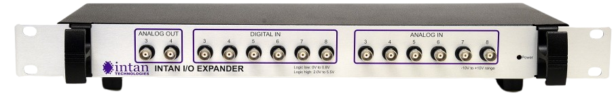
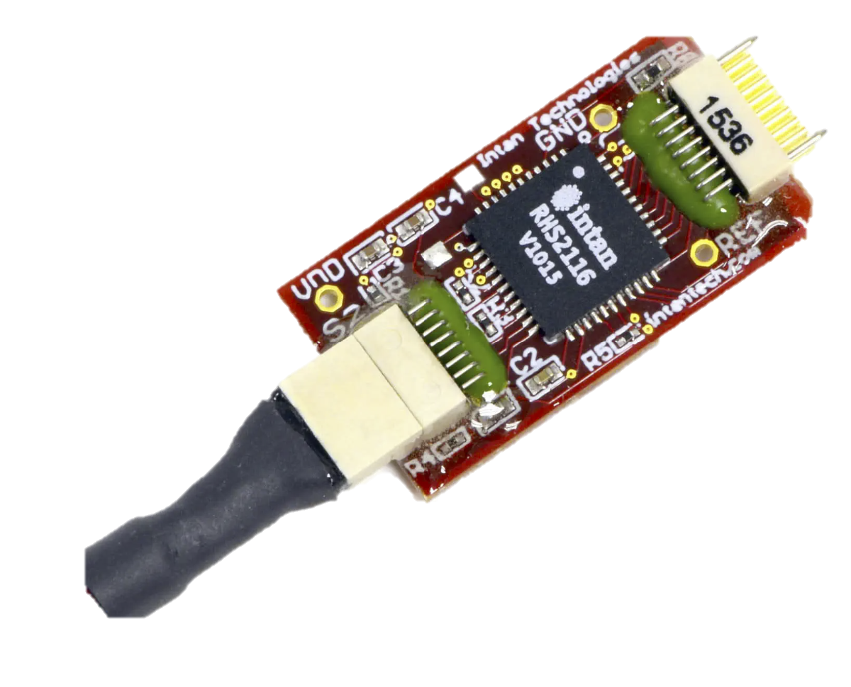
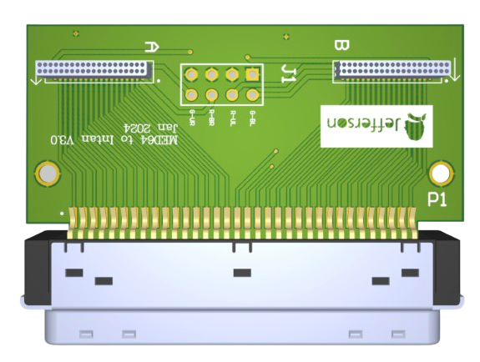
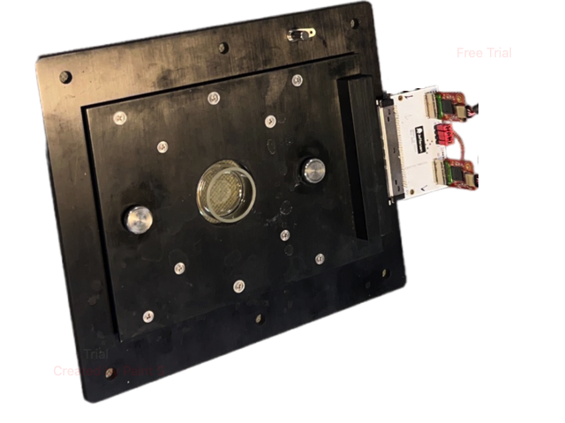
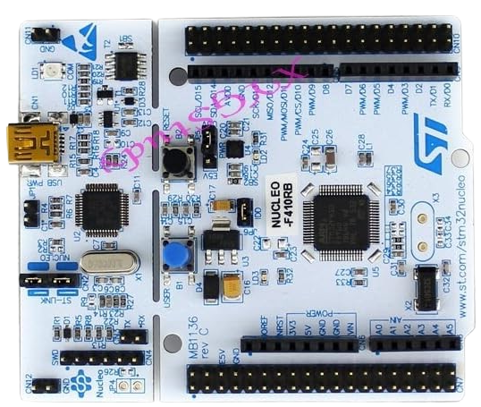
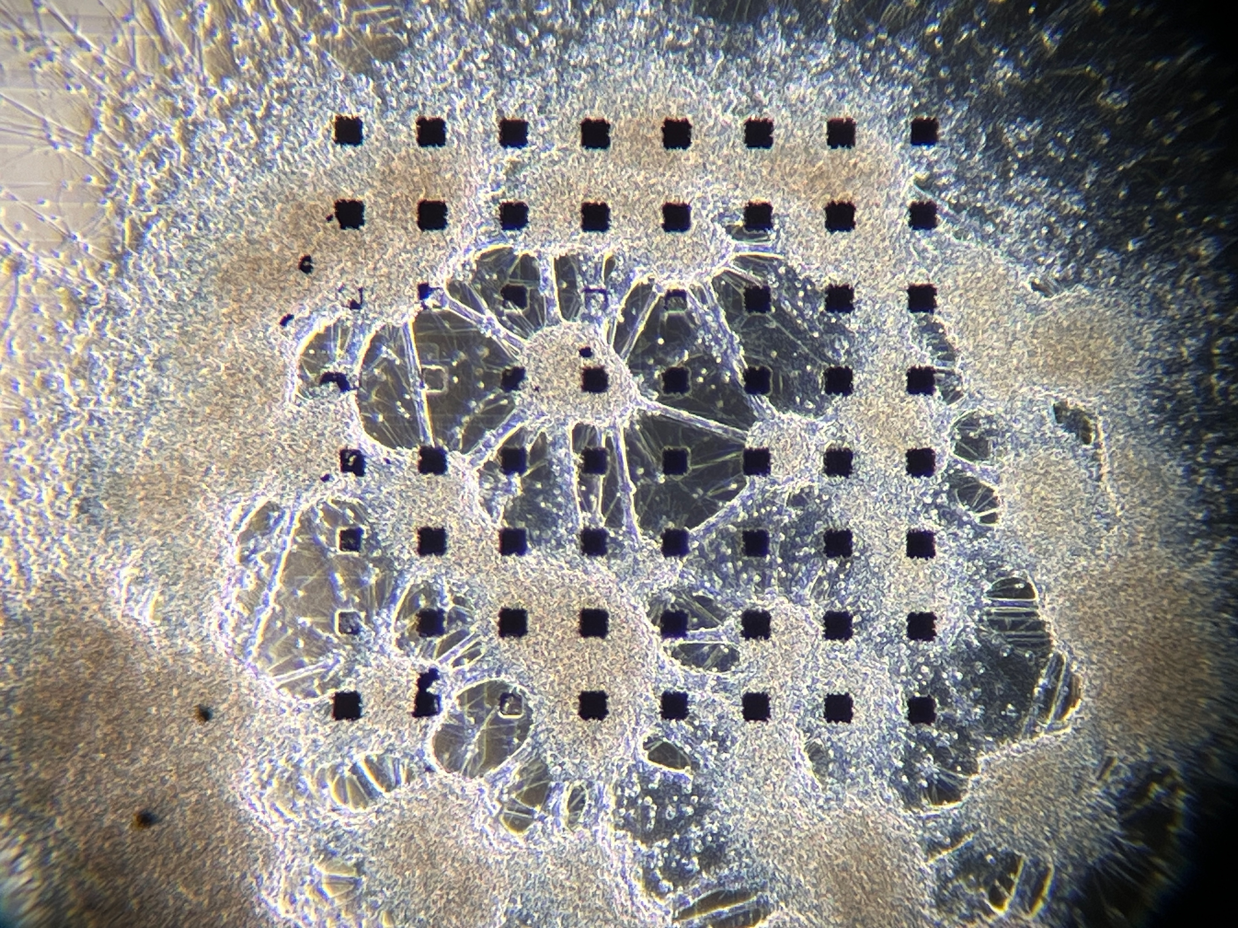
Setup Diagram:
SPI
SPI
Digital Inputs
Head stages
Intan I/O Expander
Custom
Adapters
Computer
USB
USB
Intan RHX
USB
TCP
VWM Software
ARM STM32F410
Source MEA
Target MEA

Slide 8
Details of the system:
Intan System
VWM Software
Target MEA
Intan RHX Software
Read Thread
Signal Processing Thread
Data
TCP
Circular Buffer
Fetching
Save Data (Binary)
TCP
Band-pass Filter
250Hz-5kHz
Head stages A-B
USB
GUI Thread
Spike Detection
Command
TCP
Save Settings (JSON)
Intan Controller
SPI
User Interface
Head stages C-D
Artificial Intelligence
Microcontroller
USB
Intan I/O Expander
ARM STM32F410
Source MEA
Digital I/O
Synchronization Unit
Circular Data Buffer

Slide 9
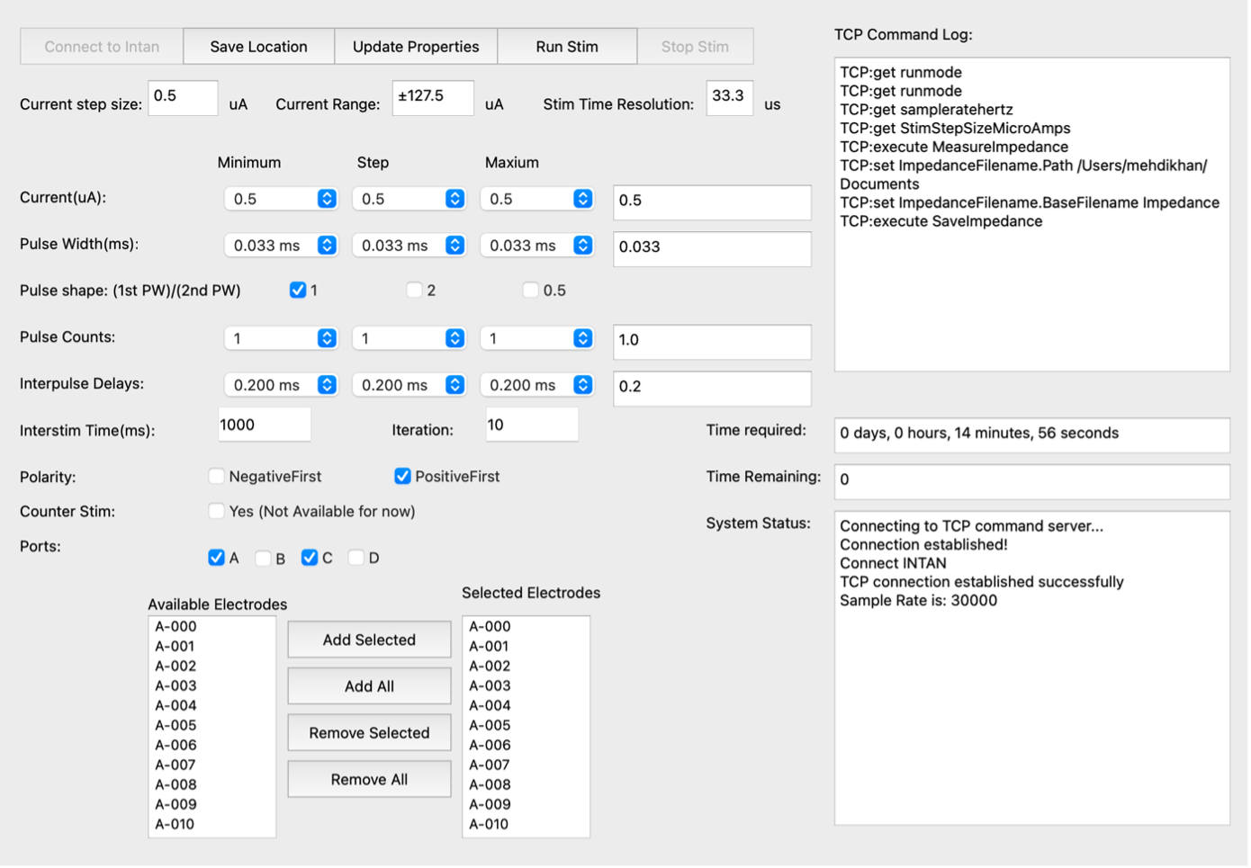
Stimulation:
Charge-balanced, bidirectional pulses were used for stimulation.
The NeuroTuner (NT) software was developed to optimize pulse parameters and electrode selection.
NT allows systematic sweeping of:
Pulse amplitude
Pulse width
Electrode selection
Pulse shape
Number of pulses
Future studies may expand on NT for more advanced pulse shape and type tuning.

Slide 10
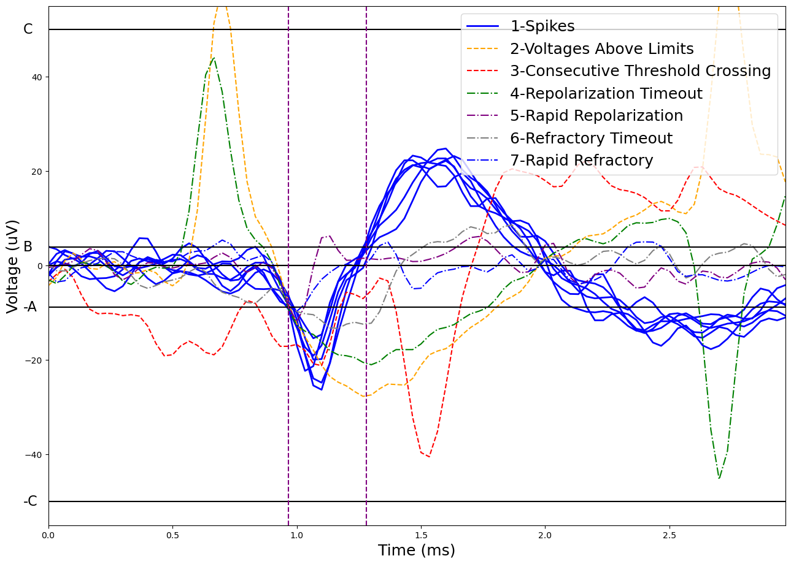
Spike Detection:
Find t₀ where V crosses A:
If |V| > C in window (-1ms, 2ms): AP[i] = 2 (Voltages Above Limits)
If V crosses A in 1ms before t0: AP[i] = 3 (Consecutive Threshold Crossing)
For T2 after t0:
If V crosses B in less than T1: AP[i] = 5 (Rapid Repolarization)
If V crosses B between T1 & T2:
Find t1 where crossing occurs
For T4 after t₁:
If V crosses zero in less than T3: AP[i] = 7 (Rapid Refractory)
If V crosses zero between T3 & T4: AP[i] = 1 (Spike Detected)
If V does not cross zero in T4: AP[i] = 6 (Refractory Timeout)
If V does not cross B in T2:
AP[i] = 4 (Repolarization Timeout)
T1
T2
T3
T4

Slide 11
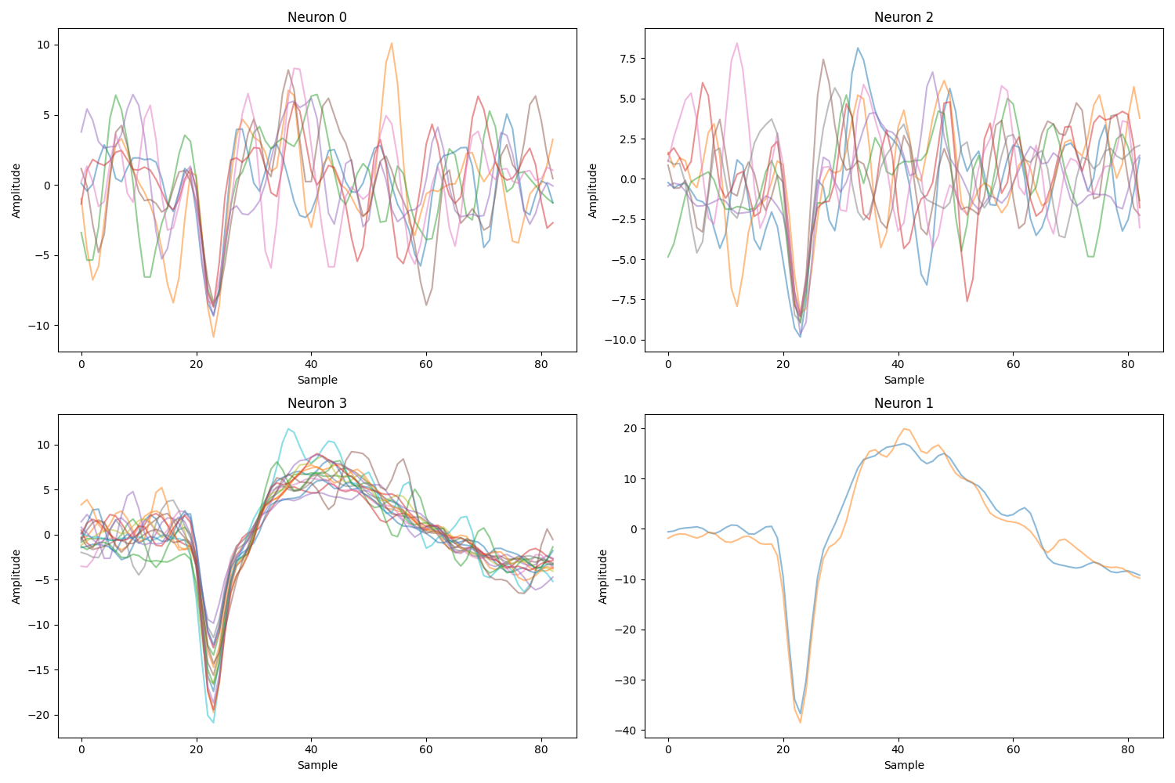
Threshold Selection by spike sorting:
RMS-Based Thresholding Thresholds are set as a multiple of the signal’s Root Mean Square (RMS).
Threshold Selection Choosing the correct multiplier is a critical step for reliable spike detection.
Spike Sorting Validation Spike sorting is used to evaluate and refine the selected threshold multiplier having the RMS of the signal.
Detect Spikes Using Low Threshold
PCA
K Means Classifier
Plot sorted Neurons
Visualize Spikes
Select Thresholds

Slide 12
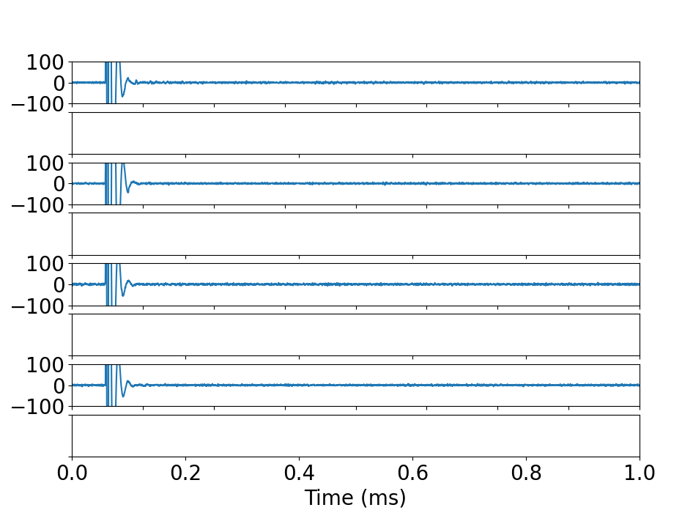
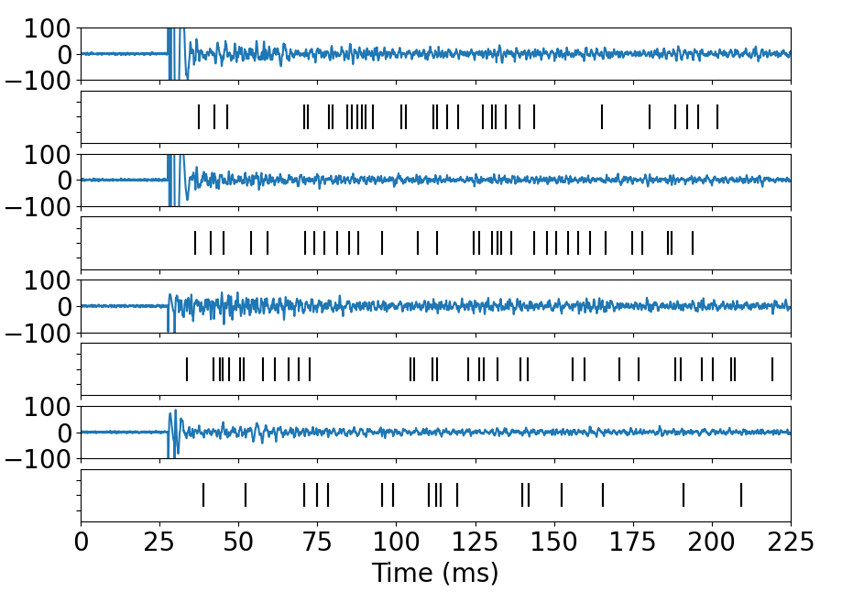
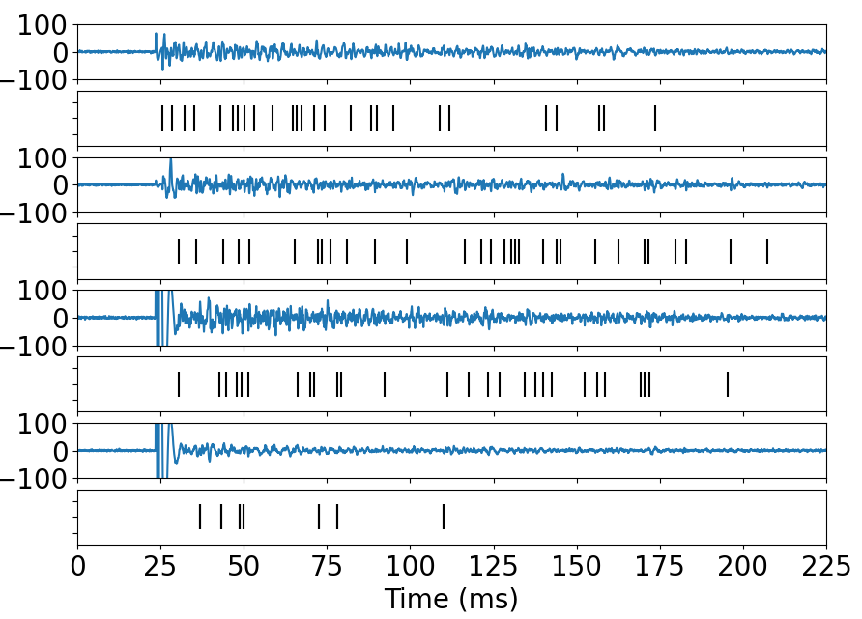
Spike Detection Test:
MK-801 (a receptor antagonist) applied to inhibit synaptic activity
Post-stimulus responses were silenced, confirming suppression of biological activity
Removal of MK-801 led to reappearance of post-stimulus activity
Confirms that responses are biologically mediated, not stimulation artifacts
Voltage (µv)
Voltage (µv)
Voltage (µv)
Before adding blocker
After adding blocker
After removing the blocker

Slide 13
Details of the system:
Intan System
VWM Software
Target MEA
Intan RHX Software
Read Thread
Signal Processing Thread
Data
TCP
Circular Buffer
Fetching
Save Data (Binary)
TCP
Band-pass Filter
250Hz-5kHz
Head stages A-B
USB
GUI Thread
Spike Detection
Command
TCP
Save Settings (JSON)
Intan Controller
SPI
User Interface
Head stages C-D
Artificial Intelligence
Microcontroller
USB
Intan I/O Expander
ARM STM32F410
Source MEA
Digital I/O
Synchronization Unit
Circular Data Buffer

Slide 14
Synchronization Process:
Data is processed in discrete chunks of 25.6 ms
Each chunk takes a variable amount of time to be processed
This introduces inconsistent delays in the system
A microcontroller is added to synchronize timing
Ensures consistent delays
Triggers stimulation at
precise intervals
Data Timing
Start Button
First Data Entry
Last Data entry
Data Entry Times to CB
t
Data Read Times from CB
Fixed Delay
200.0±1.0ms
First Data Process
Last Data Process

Slide 15
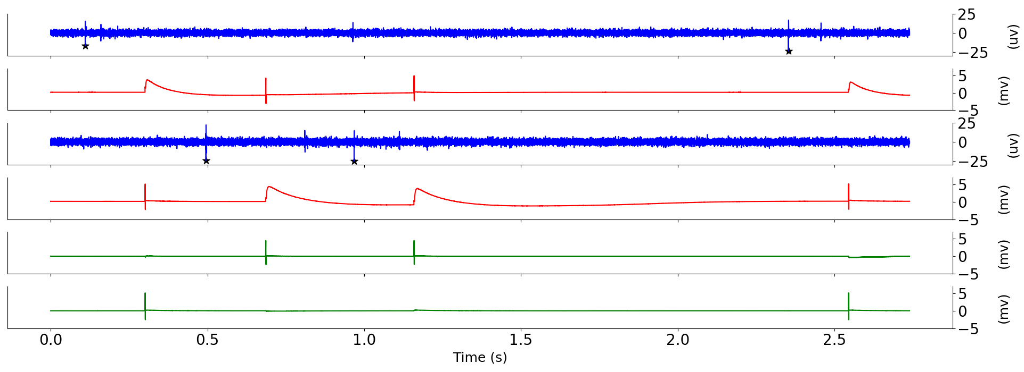
Timing Test:
A timing test shows that the delays between an activity detection and delivering the stimulation are consistent (200.0±1.0ms)
Source E0
(µV)
Target E0
T=200ms
(mV)
T=200ms
Source E1
(µV)
Voltage
Target E1
(mV)
Recording E10
T=200ms
T=200ms
(mV)
Recording E45
(mV)

Slide 16
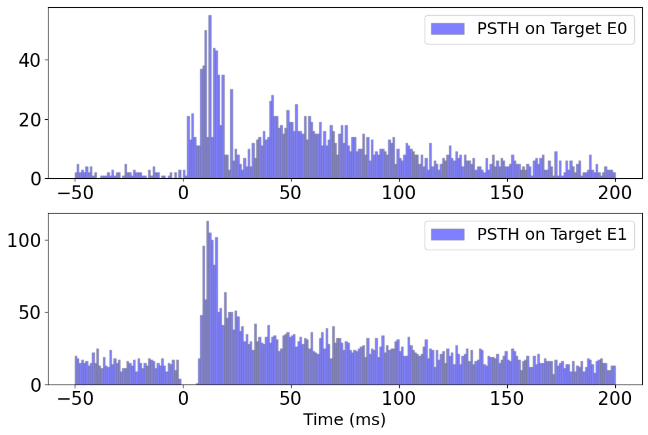
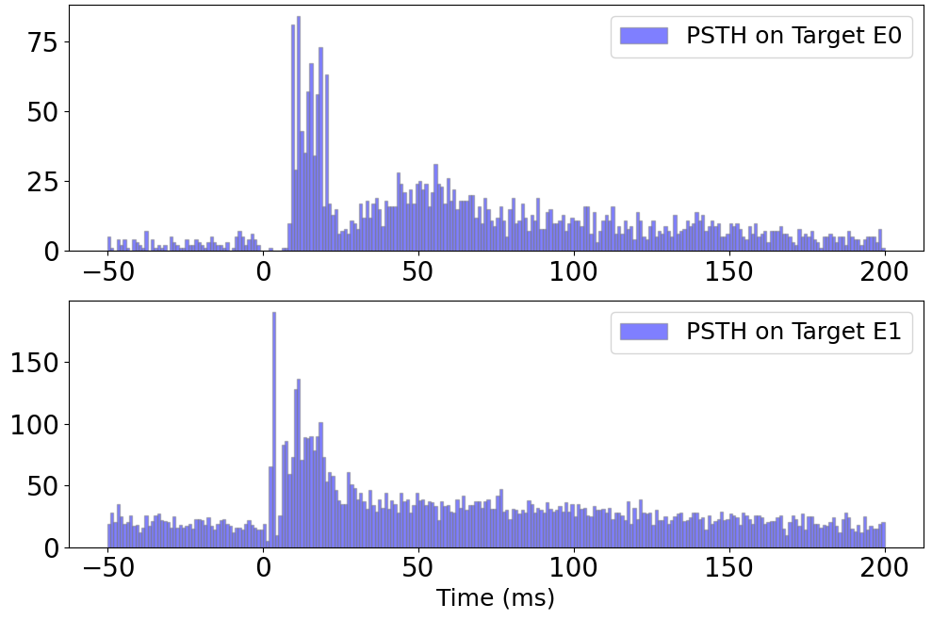

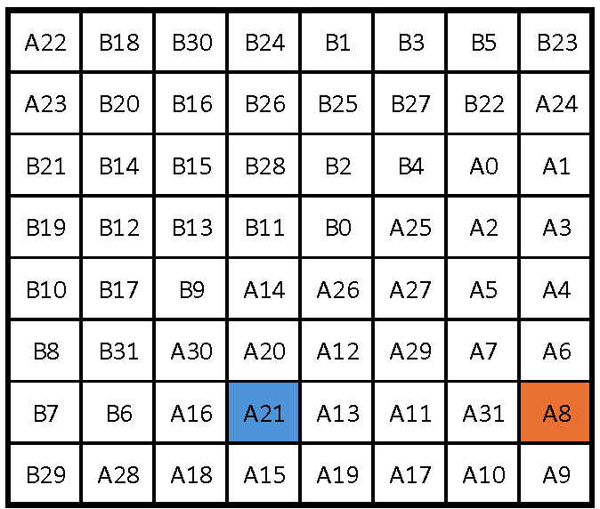
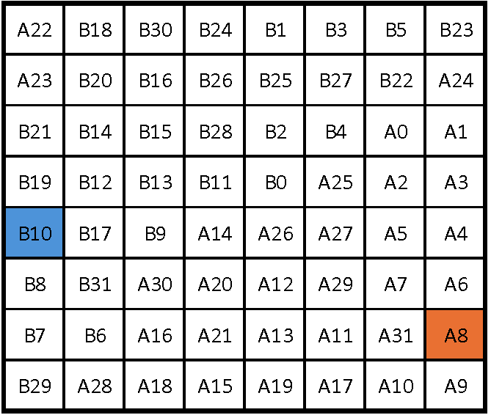
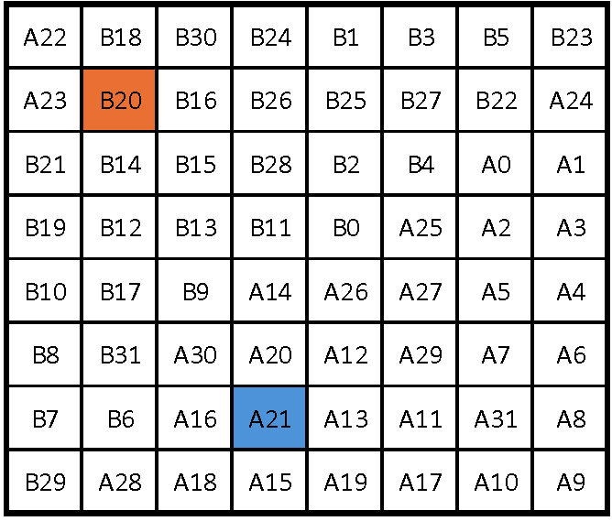
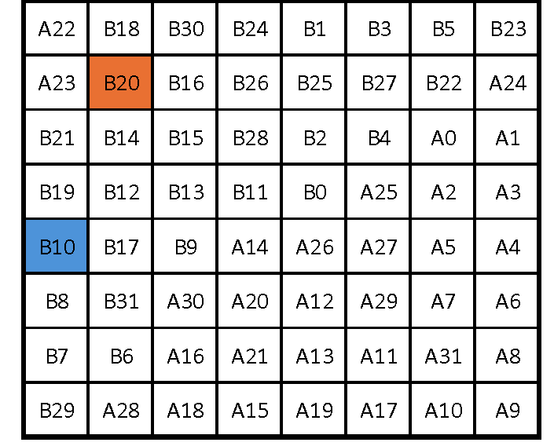
Post-Stimulus Time Histogram (PSTH) :
PSTH on A21 with stimulation at A8
PSTH on B10 with stimulation at A8
PSTH on A21 with stimulation at B20
PSTH on B10 with stimulation at B20

Slide 17
Spike-Based Classification Workflow:
Spike Detection & Binning
Spikes from post-stimulus activity were binned using 1 ms bins
200 ms window → 200 bins per sample
Data used as input for machine learning models
Support Vector Machine (SVM), K-nearest neighbor (KNN), and Random Forest (RF) were used.
Features
Raw Data
Band-pass Filter
250Hz-5kHz
Spike Detection
SVM
Bins of 1ms
200ms
window
PCA
0.95
KNN
RF
Label
Stimulation Source

Slide 18
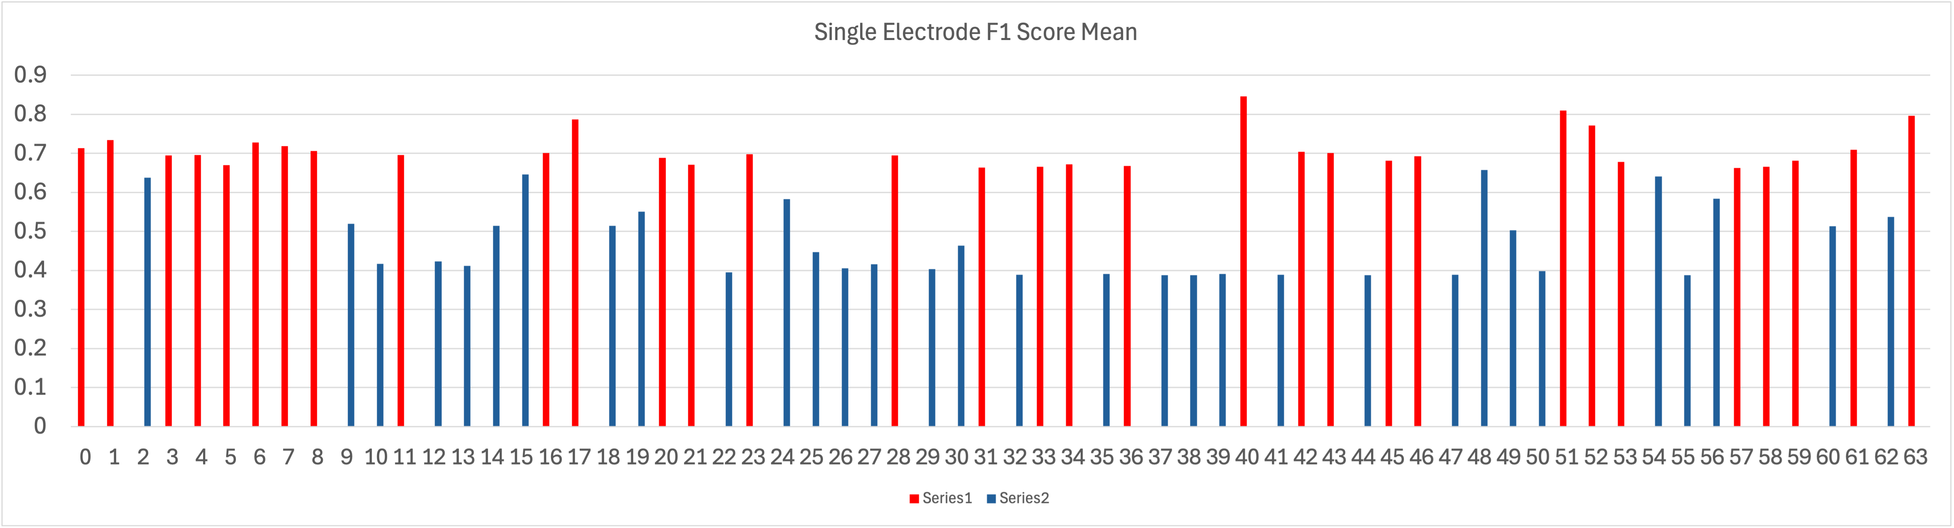
Single Electrode Analysis:
Classification individually on all 64 electrodes
Top-performing 32 electrodes selected

Slide 19
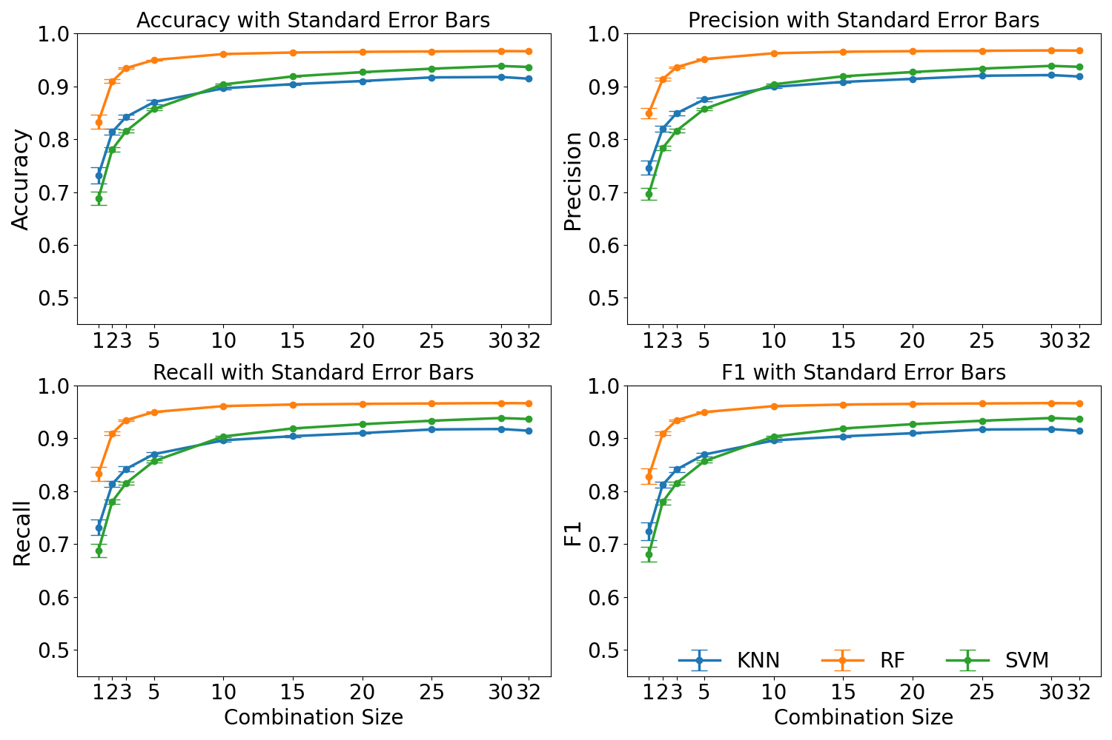
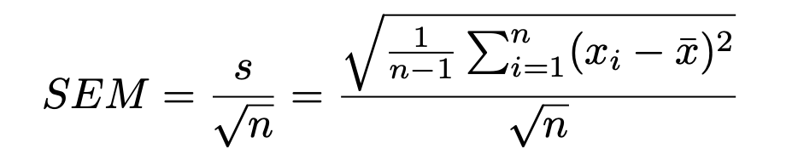
Multiple Electrode Analysis:
Combined data from selected electrodes used for classification (max combination =100)
Explored multiple electrode combinations
Standard Error Mean:

Slide 20
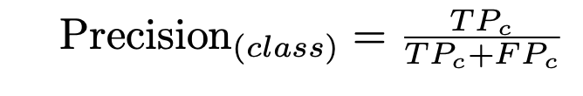
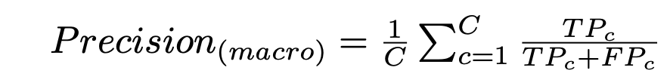
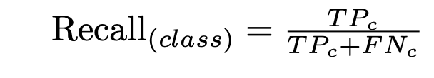
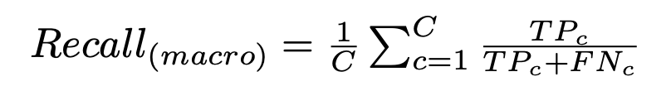
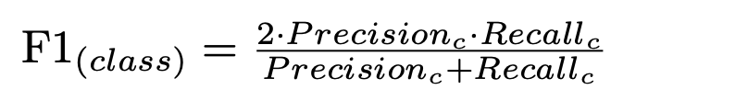
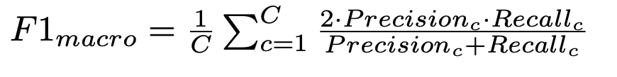
Cross-Validation and Scoring Metrics:
StratifiedKFold Cross-Validation Ensures each fold has the same class distribution as the full dataset.
n_splits=10: Split dataset into 10 folds
shuffle=True: Randomly shuffle before splitting
Metrics:

Slide 21
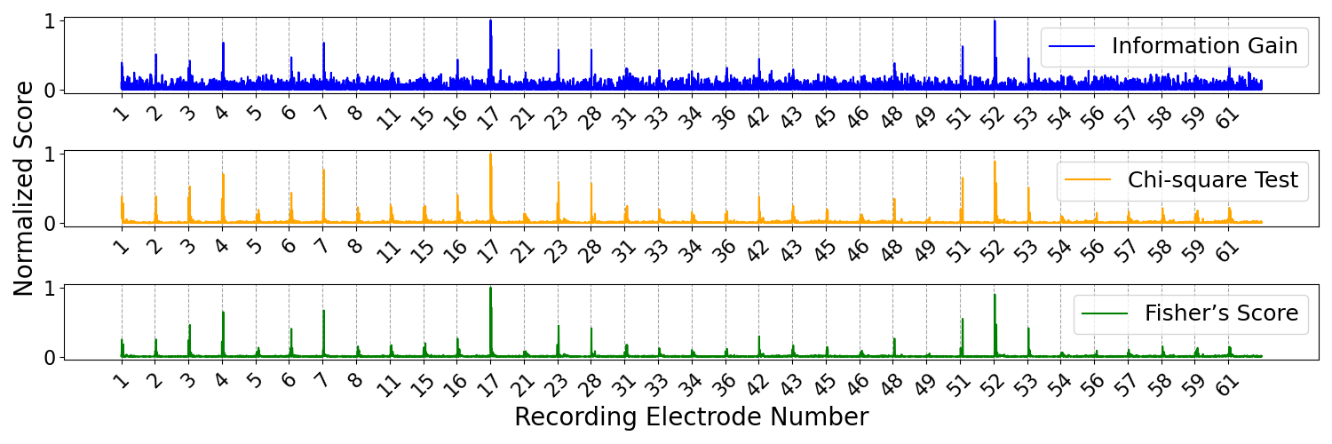
Information Richnesfiss test:
Information Gain
Chi-Square (X²)
Fisher Score

Slide 22
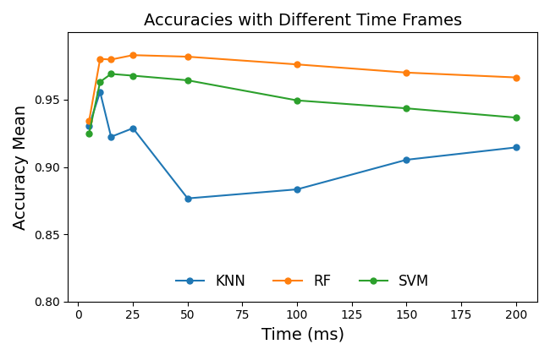
Analysis using different time frames:
Analysis across multiple time windows using features from 32 selected electrodes
Results showed that the 10 ms window yielded the acceptable results, as expected.

Slide 23
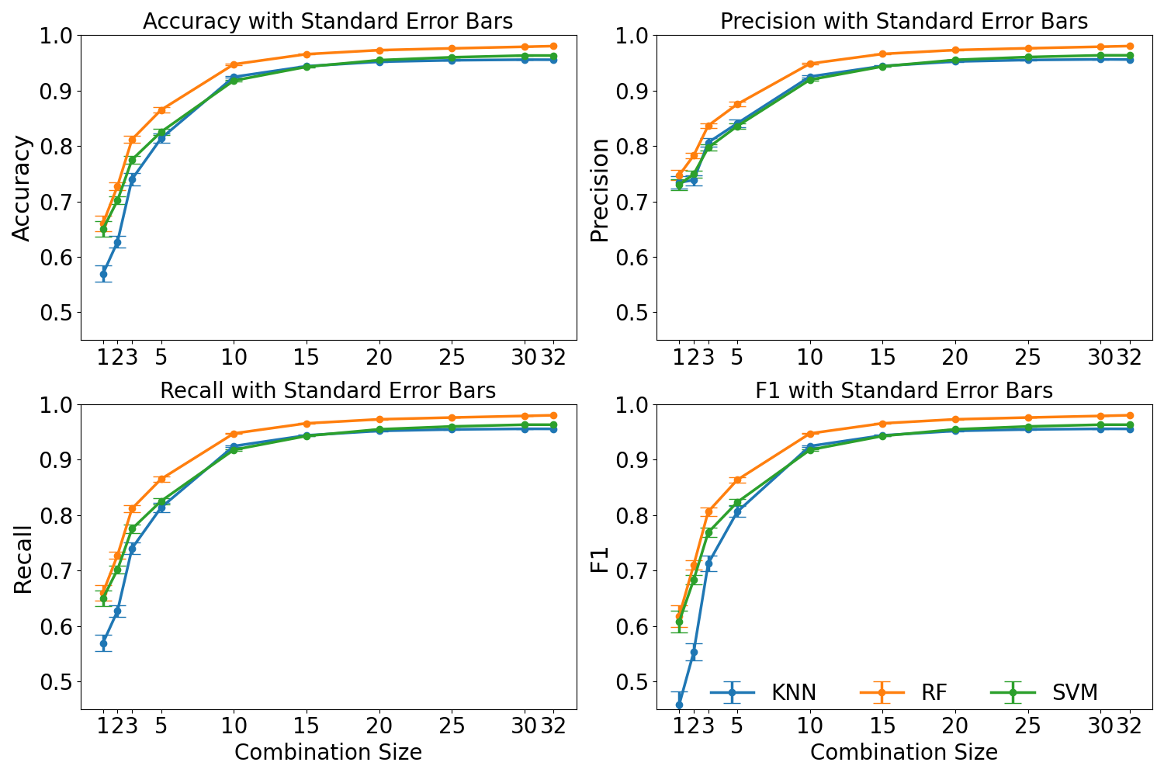
Analysis using different number of electrodes:
Analysis across different electrode combinations using data from the initial 10 ms
Results revealed that meaningful results can be achieved even with a small subset of electrodes.

Slide 24
Single vs Double Threshold Spike Detection:
Classification results analyzed for single and double threshold
Results show that the using double threshold was neccasary

Slide 25
Bidirectional VWM:
Most neural regions are interconnected bidirectionally.
Reconstructing more complete brain-like BNNs requires establishing such two-way communication.
Spike Detection
Processing
Stimulation
Recording
Stimulation
Processing
Spike Detection
MEA 1
MEA 2

Slide 26
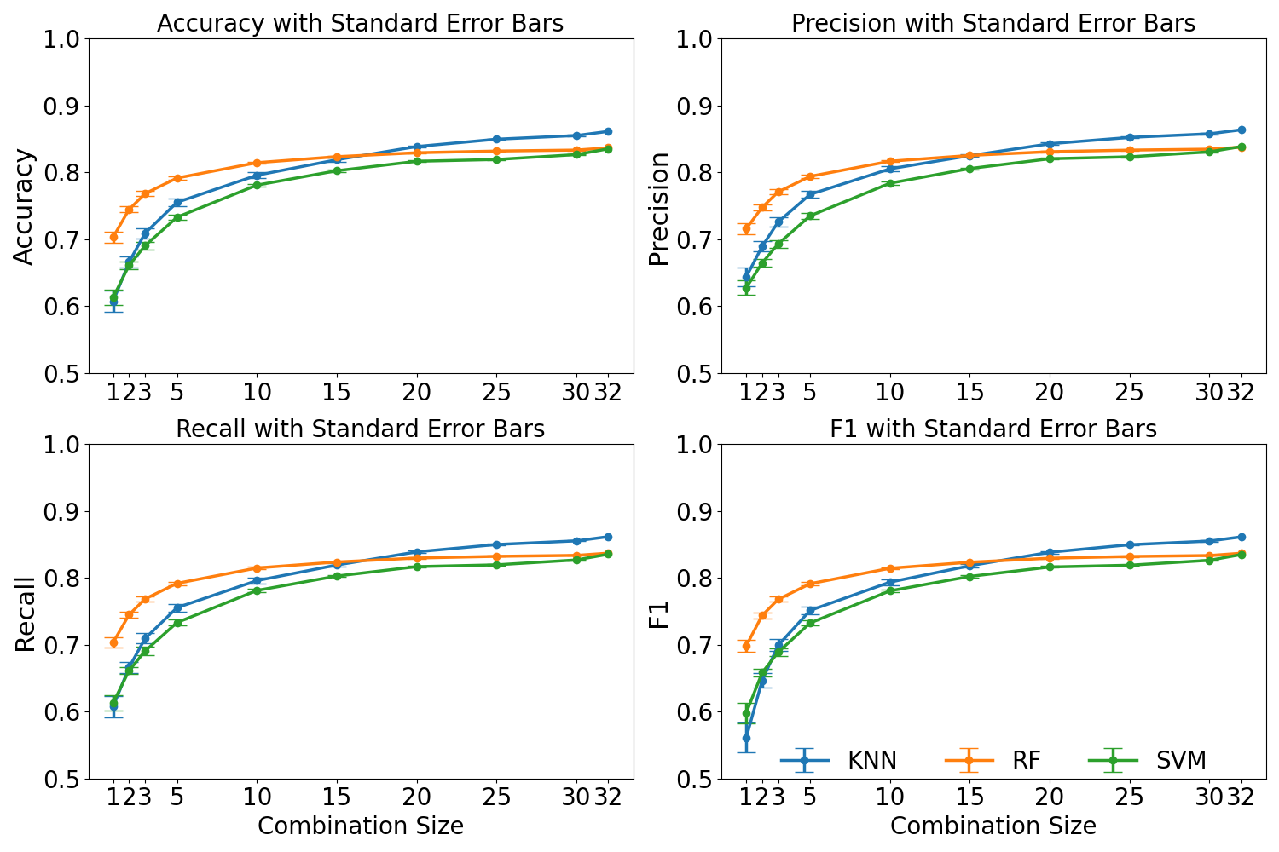
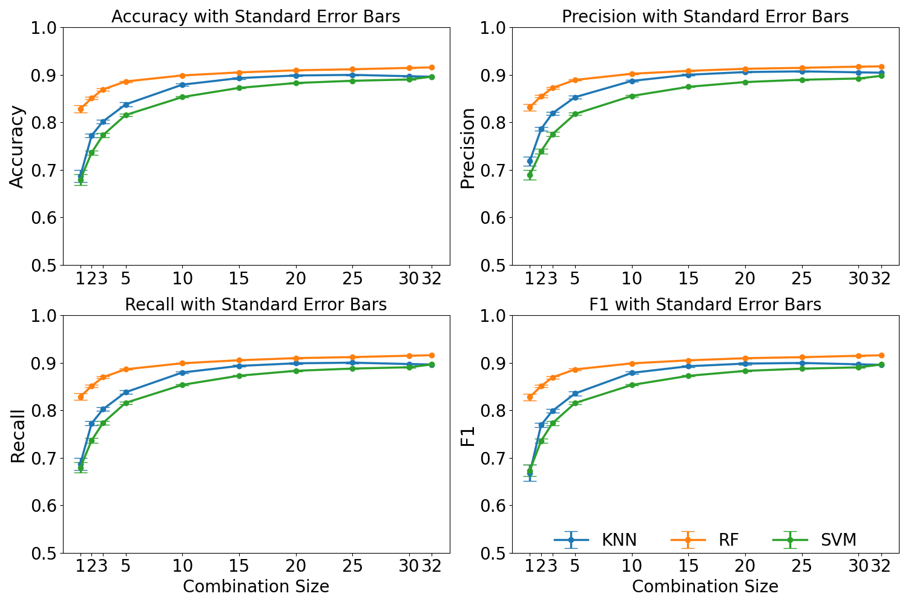
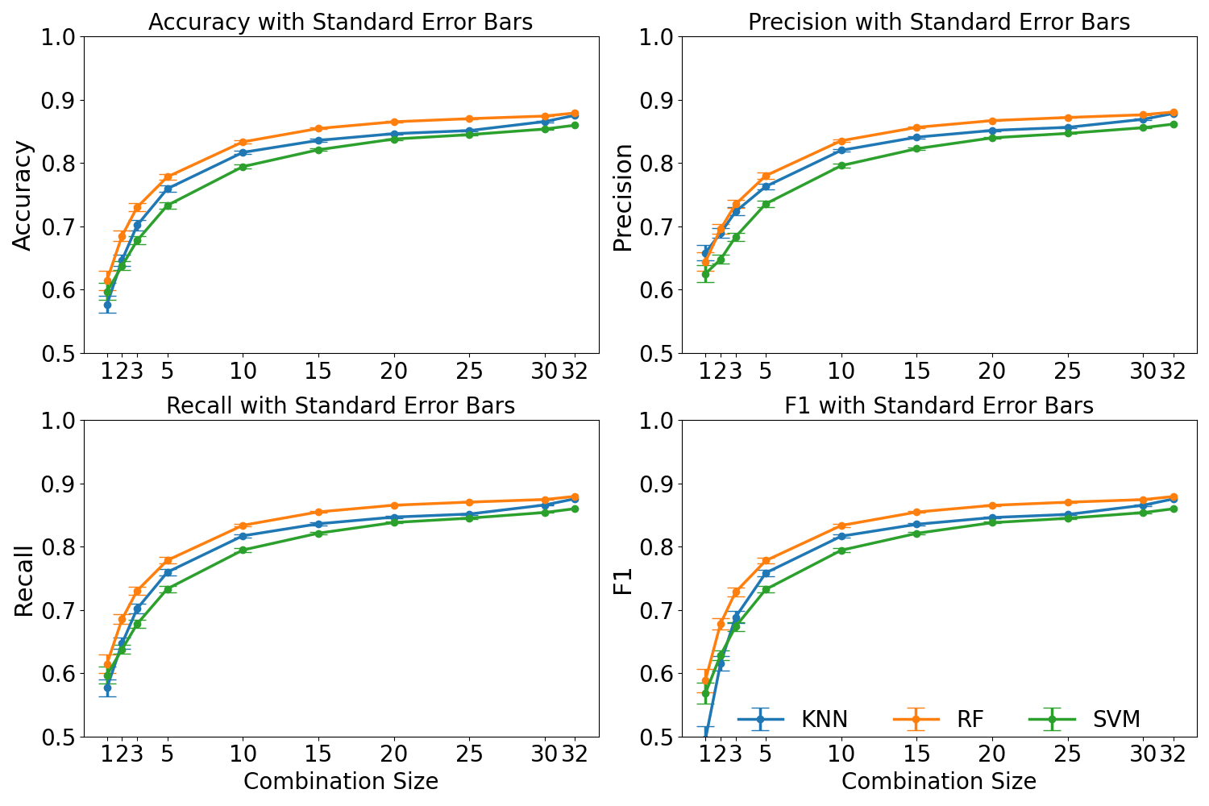
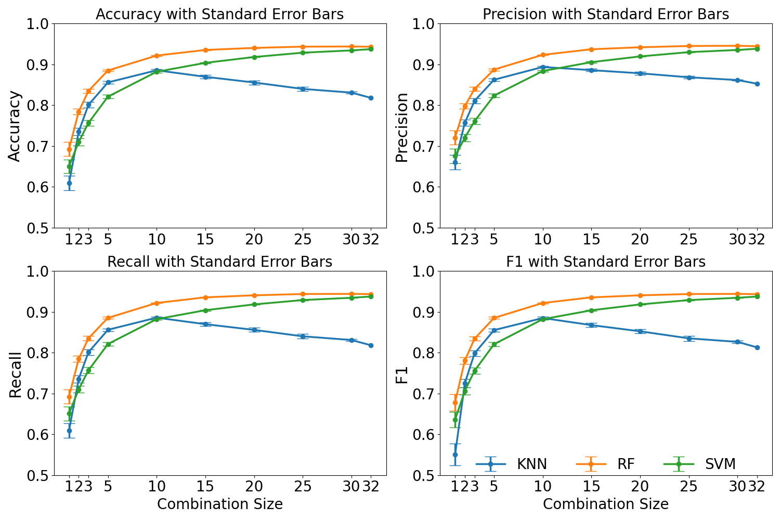
Bidirectional VWM Classification Results:
a
b
a: MEA 1 using 200ms post stimulus activity
b: MEA 2 using 200ms post stimulus activity
c: MEA 1 using 10ms post stimulus activity
d: MEA2 using 10ms post stimulus activity
c
d

Slide 27
Conclusion of Aim One:
VWM System Performance
• Delays between event detection and stimulation were fixed at 200.0 ± 1.0 ms
• Double-threshold spike detection successfully rejected stimulation artifacts in the first 10 ms post-stimulus, a window conventionally blanked entirely, and outperformed single-threshold classification
Classification Results
• Stimulation-source classification exceeded 85% accuracy
• Optimal feature window: 10 ms post-stimulus using 32 electrodes at 1 ms bins; 200 ms window using top 6 electrodes at 1 ms bins
• SVM, KNN, and RF validated via 10-fold StratifiedKFold cross-validation with PCA (95% variance retained); SVM showed the best classification across all conditions
Key Outcome
• Established mono- and bidirectional VWM; published in Journal of Neural Engineering (2025): “Virtual white matter: a novel system for cross-dish neural interaction and modulation”

Slide 28
Aim Two:
Structured Binary Communication Between Dissociated Cortical Cultures in Physically Separate MEA dishes
Stimulation
Biphasic, 10 μA, 500 μs/phase Charge density: 2×10⁻⁴ C/cm² per phase
Timing
1 s inter-bit interval
2 s inter-word interval
Electrodes
2 stimulation electrodes per MEA
6 recording electrodes per MEA
Monodirectional
Encoding
Dataset → MEA1 (encode) → decode A-bits → error correct → re-encode → MEA2 → decode B-bits → compare output
Electrode one represents as binary 0
Electrode two represents as binary 1
Bidirectional
Data Structure
Mono path completed first, then decoded word from MEA2 re-encoded → transmitted back to MEA1 → decoded → compared to original message for round-trip fidelity
3-bit data words + 1 parity bit
400-word pre-generated dictionary
Comparative Baseline
Error Correction
ML decoder replaced with spike-count threshold classifier to evaluate contribution of classifier complexity to decoding performance
Even parity check; lowest-confidence
bit toggled on parity failure

Slide 29
Electrode Selection – Target Electrodes
Selection Protocol — Step by Step
1
Sequential Electrode Stimulation
Each MEA electrode stimulated individually using NeuroTuner
2
Spike Detection
Evoked spikes detected across all electrodes post-stimulation
3
Feature Extraction (0–200 ms)
Stimulation-evoked spikes summed per event within post-stim window
4
Evoked Response Quantification
Total evoked spikes per stimulation event computed per electrode
5
Electrode Impact Ranking
Electrodes ranked by aggregate evoked spike count
6
Topological Active Selection
Top two electrode selected spatially distant from each other

Slide 30
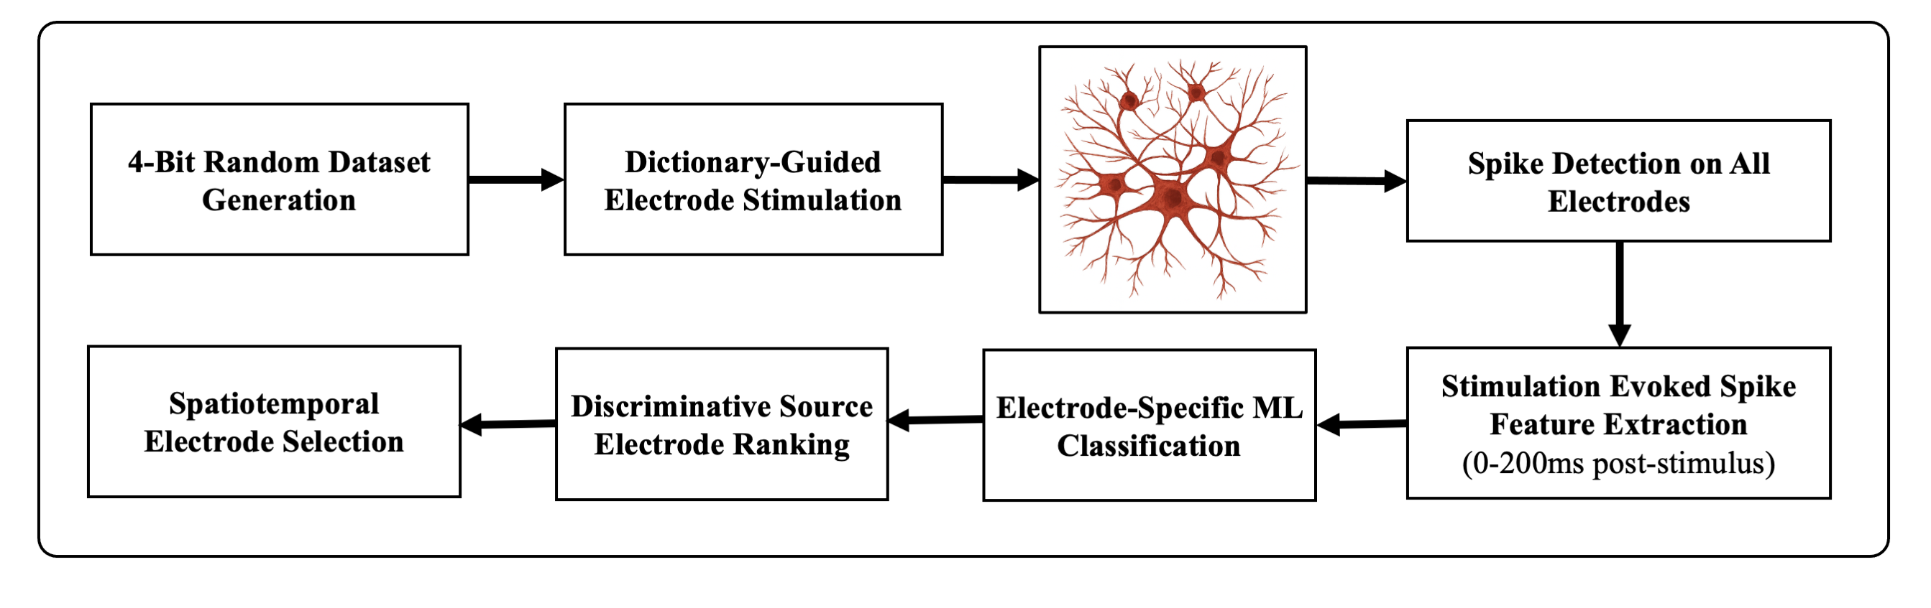
Electrode Selection – Source Electrodes
Selection Protocol — Step by Step
1
4-Bit Random Dataset Generation
Randomized dictionary of 4-bit packets (3 data + 1 parity bit) generated
2
Dictionary-Guided Stimulation
Two target electrodes stimulated sequentially per dictionary entry
3
Spike Detection on All Electrodes
Post-stim spike activity recorded across all 64 MEA channels
4
Feature Extraction (1 ms bins)
Binary spike train binned at 1 ms resolution over 0–200 ms window
5
Electrode-Specific ML Classification
Classifier trained per electrode; each evaluated individually for accuracy
6
Ranking & Aggregated Model Training
Top 6 electrodes selected; final model trained on combined feature set

Slide 31
System Architecture
Main Improvements:
Main data flow was made based on the initial architecture
Real time feature extractions and real time machine learning was added
Real time parity-based error correction was added to the system
Timing constraints was added to send the 4-bit data on each section
All the data flow was done using python in a multi threaded form

Slide 32
Machine Learning for
Realtime Neural Decoding
Feature Extraction
Cumulative Accuracy for 5 data sets across 400-word Transmission
200 × 6 binary matrix per trial (1 ms bins, 0–200 ms)
6 preselected output electrodes from 64-electrodes
PCA retaining 95% variance
Use Spikes Detected on the Six Selected Source Electrodes 400*4-bit trials
Aggregate the Binned Spikes of 200 per electrodes 1200*1
Train Machine Learning in Offline Mode
Classifier Design
Error Correction
Using a new database run the machine learning in real time mode
Save Job Lib files
Classifiers evaluated: SVM, Random Forest, K-Nearest Neighbors
Stratified 10-fold cross-validation; 400 Word communication for training
SVM (sigmoid kernel, C=10) selected — highest accuracy
Each 4-bit word decoded bit-independently via real-time pipeline
Error Correction
Parity bit appended to each 3-bit transmission word
Even parity check performed after all bits decoded
On failure: lowest-confidence bit toggled to correct error
Improves reliable word reconstruction over raw decoding

Slide 33
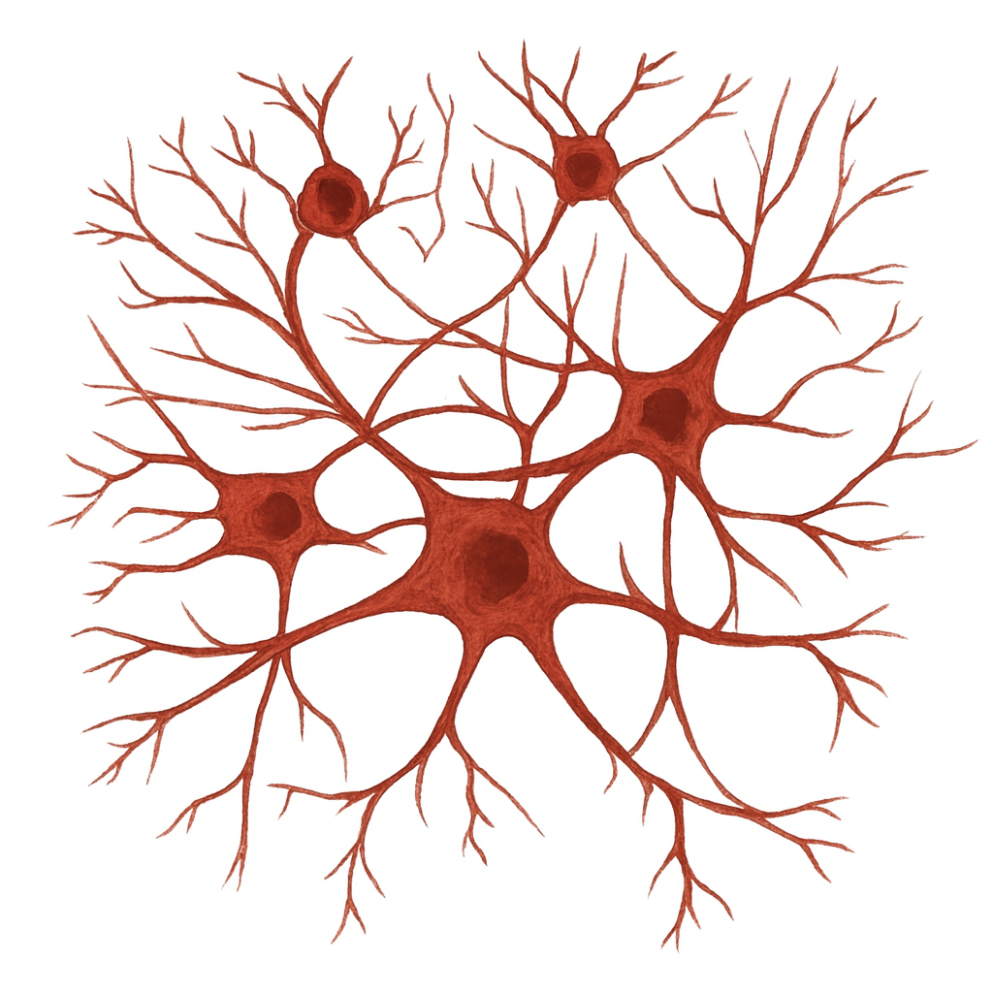
Results of Monodirectional VWM
A-bits
B-bits
MEA1
MEA2
Data Set
Neural Decoder for
A-bits
Neural Decoder for
B-bits
Higher than success rate shows that the system can act as a reliable communication
Results show a meaningful contribution of the parity error correction

Slide 34
Temporal Stability in
Monodirectional Neural Communication
Background
Cumulative Accuracy for 5 data sets across 400-word Transmission
Electrical stimulation drives neural plasticity by modifying synaptic efficacy, reorganizing and altering network connectivity. Since the machine learning classifier relies on spike-timing relationships, plasticity-induced reconfiguration may degrade decoder performance over time.
Findings
Most Data sets stay stable during the 400-word transmission.
Dataset 2 exhibited a sustained decline after ~100 trials (converging near chance level).
Dataset Performance Summary
Recommendation
Dataset 1:
Stable
Dataset 2:
Declined to ~0.52 after trial 100
Periodic classifier retraining or online adaptive machine learning is recommended to sustain optimal decoding performance during extended stimulation protocols.
Dataset 3:
Stable
Dataset 4:
Stable
Dataset 5:
Stable

Slide 35
Results of Bidirectional VWM
A-bits
B-bits
C-bits
D-bits

Slide 36
Threshold-Based Decoding
Monodirectional Neural Communication
Background
Spike Count Distribution by Stimulus Electrode over 1000 Stimulation
To assess the contribution of classifier complexity to decoding performance, the SVM-based decoder on MEA1 (A-Bits) was replaced with an optimal minimum-error threshold classifier.
Findings
The spike counts from the six electrodes stimulated through the two electrode overlap with each other making the classification complicated.
The Architecture of the Decoders

Slide 37
Results of Threshold-Based Decoding
A-bits
B-bits
MEA1 — Threshold Decoding
MEA2 — ML Decoding (SVM)
Overall System Outcome
Bits A1–A4: 60–75% accuracy
Only marginally above chance (50%)
Bits_A1–A3 aggregate 30% with parity but remains near chance.
Bits B1–B4: 63–84% accuracy
Substantially outperforms threshold stage across all channels
Demonstrates ML necessity for reliable multi-MEA communication
Final word success rate: around 18%
Bottleneck is threshold-based MEA1 stage
Errors compound across pipeline stages

Slide 38
Publications
Peer-Reviewed Journal Articles
2023
The NuroSleeve: A User-Centered, 3D-Printed Hybrid Orthosis for Individuals with Upper Extremity Impairment
[1]
Journal of NeuroEngineering and Rehabilitation
Published
Khantan, M., Avery, M., Aung, P. T., Zarin, R. M., Hammelef, E., Shawki, N., Serruya, M. D., & Napoli, A.
2024
Initial Feasibility Evaluation of the RISES System: An Innovative Activity-Based Closed-Loop Framework for Spinal Cord Injury Rehabilitation and Recovery
[2]
Journal of Rehabilitation and Assistive Technologies Engineering
Published
Madarshahian, S., Guerrero, T., Aung, P. T., Gustafson, K., Harrop, J. S., Johnson, D. R., Khantan, M., et al.
2025
Virtual White Matter: A Novel System for Cross-Dish Neural Interaction and Modulation
[3]
Published
Journal of Neural Engineering
Khantan, M., Lim, J., Napoli, A., Obeid, I., & Serruya, M. D.
Developing a Binary Communication Protocol Between Biological Neural Networks Using Virtual White Matter
2026
Developing a Binary Communication Protocol Between Biological Neural Networks Using Virtual White Matter
[4]
Journal of Neural Engineering
Submitted
Khantan, M., Lim, J., Bernhardt, A., Napoli, A., Obeid, I., & Serruya, M. D.
2026
Machine Learning-Assisted Characterization of Hippocampal Input-Output Transformations on an Ex Vivo 3D MEA Platform
[5]
Biomedical Engineering Education
Submitted
38
Lim, J. T., Khantan, M., Napoli, A., & Serruya, M. D.

Slide 39
Publications
Poster Presentations at International Scientific Meetings
2023
Linking Physically Isolated In Vitro Neural Specimens on Separate Three-Dimensional Microelectrode Arrays
[1]
Society for Neuroscience (SfN) Annual Meeting
Khantan, M., Lim, J. T., Napoli, A., Obeid, I., & Serruya, M. D.
2023
Microstimulation-Induced Spatiotemporal Dynamics of Organotypic Visual Thalamocortical Slices on a 3D Multi-Electrode Array
[2]
Society for Neuroscience (SfN) Annual Meeting
Lim, J. T., Khantan, M., Shawki, N., Napoli, A., Obeid, I., & Serruya, M. D.
2023
The RISES System: An Innovative and Activity-Based Closed-Loop Platform for Spinal Cord Injury Rehabilitation and Recovery
[3]
Progress in Clinical Motor Control II — Movement and Rehabilitation Sciences
Madarshahian, S., Guerrero, T., Aung, P. T., Grampurohit, N., Gustafson, K., Harrop, J., Khantan, M., et al.
Developing a Binary Communication Protocol Between Biological Neural Networks Using Virtual White Matter

Slide 40
Thank You
Thank you for your time and attention. I welcome your questions and feedback.

Slide 41
Acknowledgements:
1. Dr. Iyad Obeid, Thesis Advisor
For his guidance, support, and help shaping this research and building good scientific habits.
2. Center for Neurorestoration, Thomas Jefferson University, Dr. Mijail D. Serruya & Dr. Alessandro Napoli
For their funding, equipment, ideas, and collaborative spirit that supported this work.
3. Doctoral Committee — Dr. Picone · Dr. Spence · Dr. Serruya · Dr. Napoli · Dr. Smith
For their feedback, expertise, and time given throughout this dissertation.
4. The Broader Scientific Community — Neural Engineering · Biocomputing · Machine Learning
For the foundational work that made the Virtual White Matter system possible. I hope this work adds to that ongoing effort.

Slide 42
Information Richness test:
Information Gain
Chi-Square (X²)
Fisher Score

Slide 43
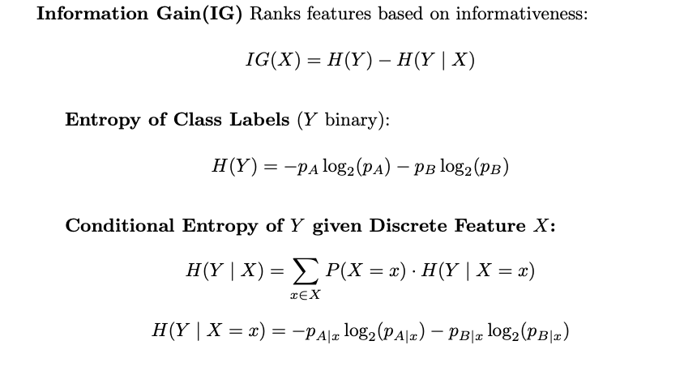
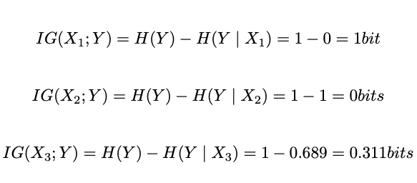
Information Gain:
Sample* | X1 | X2 | X3 | Y
1 | 0 | 0 | 0 | A
2 | 0 | 1 | 0 | A
3 | 1 | 0 | 0 | B
4 | 1 | 1 | 1 | B
IG(X) | 1 | 0 | 0.31 | -
*Sample = Electrode Number, X_{i}=Bin number

Slide 44
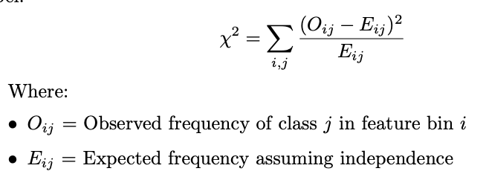
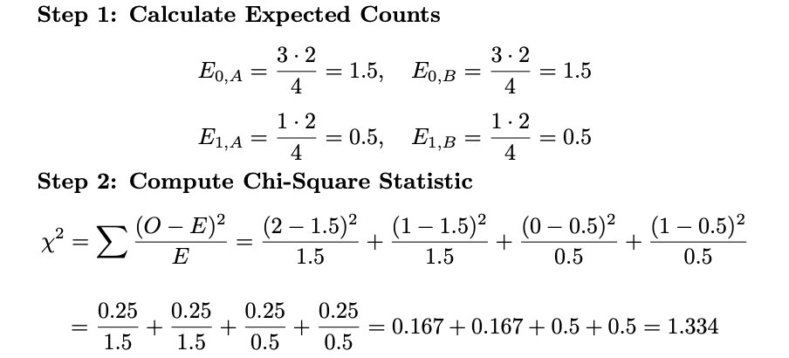
Chi-Square (X2):
Sample* | X₁ | X₂ | X₃ | Y
1 | 0 | 0 | 0 | A
2 | 0 | 1 | 0 | A
3 | 1 | 0 | 0 | B
4 | 1 | 1 | 1 | B
X² | 4 | 0 | 1.33 | -
Observed = Expected → Feature and class label are independent
Observed ≠ Expected → There's a deviation from independence → possible dependence
*Sample = Electrode Number, X_{i}=Bin number

Slide 45
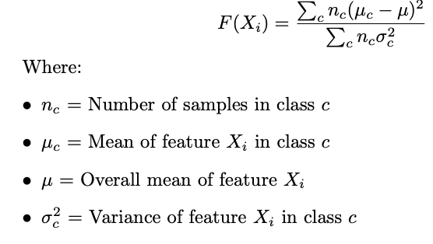
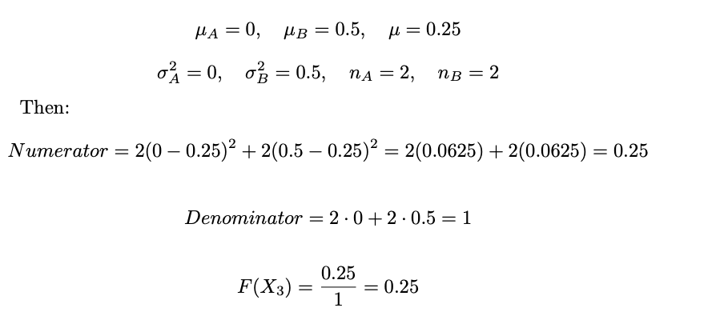
Fisher Score:
Sample* | X₁ | X₂ | X₃ | Y
1 | 0 | 0 | 0 | A
2 | 0 | 1 | 0 | A
3 | 1 | 0 | 0 | B
4 | 1 | 1 | 1 | B
F(X) | ∞ | 0 | 0.25 | -
Numerator: How different the class means are from the overall mean → bigger = more separation between classes
Denominator: How spread out the feature values are within each class → smaller = tighter, more compact clusters per class
*Sample = Electrode Number, X_{i}=Bin number

