Slide 1
Virtual White Matter:
A Novel System for Cross-Dish Neural Interaction and Modulation
A Thesis Proposal
Submitted to
the Temple University Graduate Board
In Partial Fulfillment of the Requirements for the Degree
DOCTOR OF PHILOSOPHY
By Mehdi Khantan
24th of April 2025

Slide 2
INTRODUCTION
Outlines:
Introduction
  Biological vs. Artificial Neural Networks
      Key Differences and Complementary Strengths
  Neuronal Biology
  Applications of Biological Neural Networks (BNNs)
  Research Gaps in BNNs
      Current Limitations
      Unexplored Opportunities
Aim One: Establishing a Virtual White Matter (VWM)
  Concept and Objectives
  Experimental System Setup
  Technical Barriers and Solutions
  Metrics for Evaluation
  Bidirectional Connectivity in VWM
Aim Two: Information Transmission via VWM
  Encoding and Sending a Message
Timeline

Slide 3
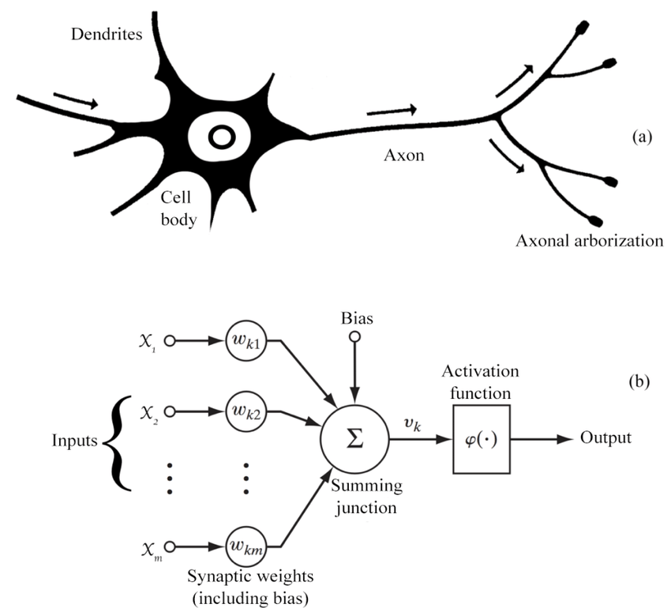
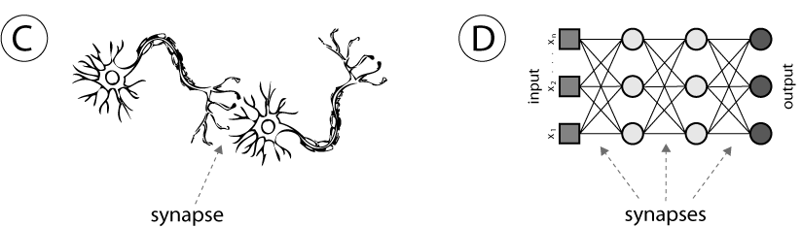
INTRODUCTION
Biological vs. Artificial Neural Networks:
(A)
Feature | Biological Neural Networks (BNNs) | Artificial Neural Networks (ANNs)
Basic Unit | Neuron (cell) | Node (mathematical function)
Signal Type | Electrochemical (spikes, synapses) | Numerical (floating-point values)
Speed | Milliseconds | Microseconds or faster
Energy Efficiency | Extremely efficient (20W for whole brain) | Power hungry (Requires large GPUs and electricity)
Biological Realism | Natural, evolved over millions of years | Inspired by biology, but simplified
(B)
Question: Can we use BNNs for problem solving?
(C)
(D)

Slide 4
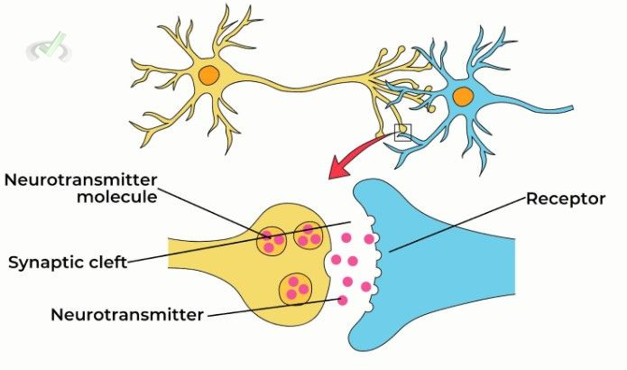
Neuronal Communication:
Dendrites
Axon Terminal
Soma (Cell Body)
Electrical Signal: impulse travels down axon
Synaptic Transmission: triggers neurotransmitter release - Glutamate ( Excitatory) GABA (Inhibitory)
Chemical Messengers: neurotransmitters bind to next neuron
Signal Propagation: new impulse starts in receiving neuron
Axon

Slide 5
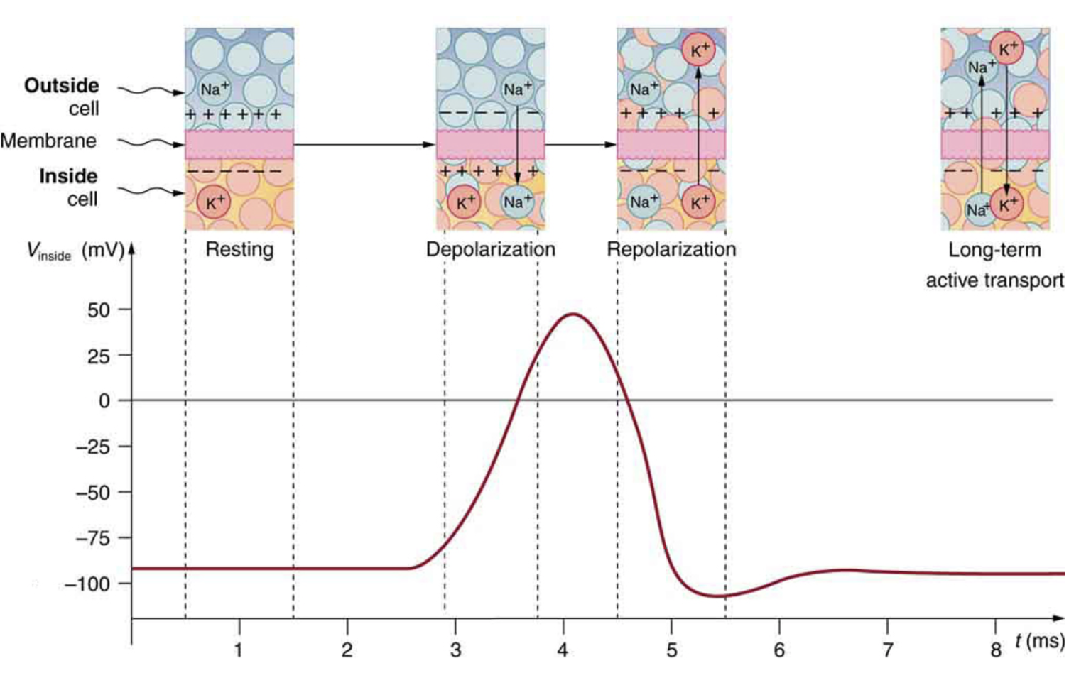
Action Potentials:
Resting State: negative membrane potential around -70mV
Depolarization: Na⁺ channels open → Na⁺ enters → inside becomes positive
Repolarization: K⁺ channels open → K⁺ exits → inside becomes negative
Hyperpolarization: excess K⁺ leaves → more negative than resting
Return to Resting: Na⁺/K⁺ pump and leak channels restore balance

Slide 6
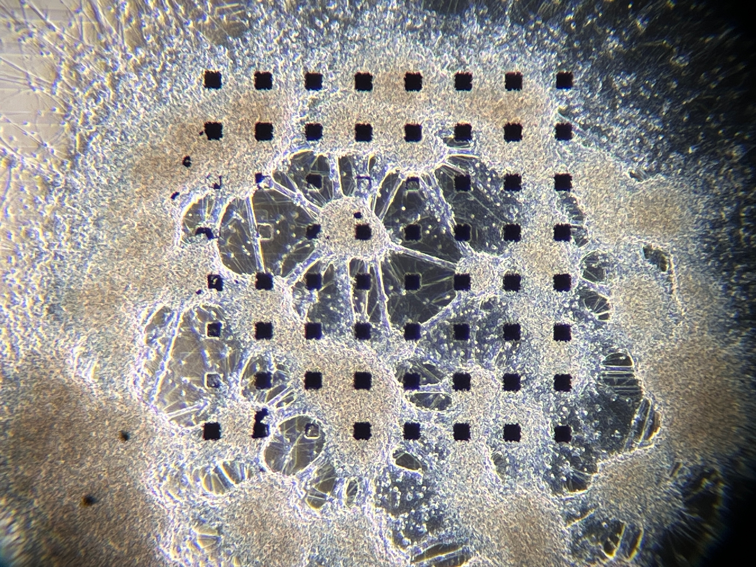
Interface with Biological Neural Networks (BNNs):
Information Encoding: Deliver patterned electrical stimulation to induce neural activity
Information Decoding: Record extracellular action potentials
Preparation: Cultured dissociated neurons or acute brain slices plated on Microelectrode Arrays (MEAs)

Slide 7
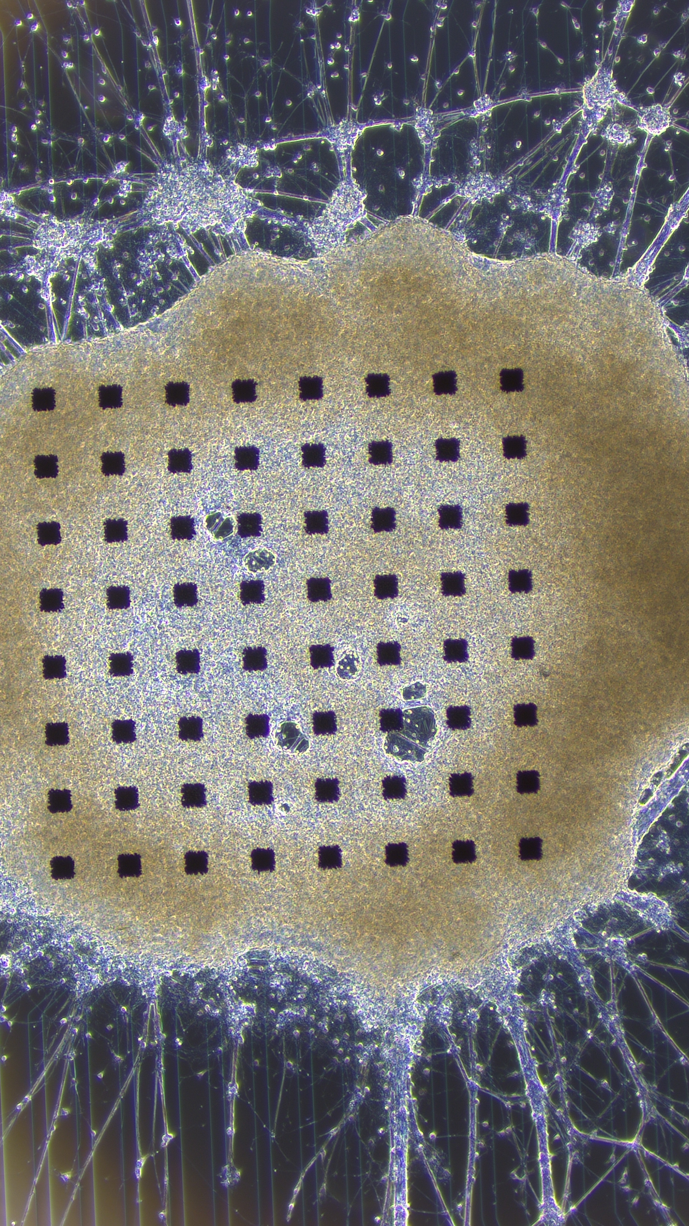
Cell Culture Overview:
Dissociated hippocampal neurons from Embryonic Rat E18
Used MED64 Micro Electrode Arrays (MEA)
Poly-D-Lysine (PDL) Coating
Laminin Coating
Cell Placement
Media Change: Twice a week (NBActive4)
Incubation: 14 – 41 days at 37 °C, 95% humidity
150µm

Slide 8
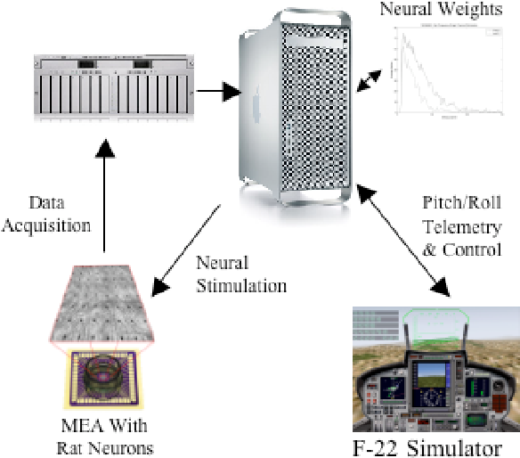
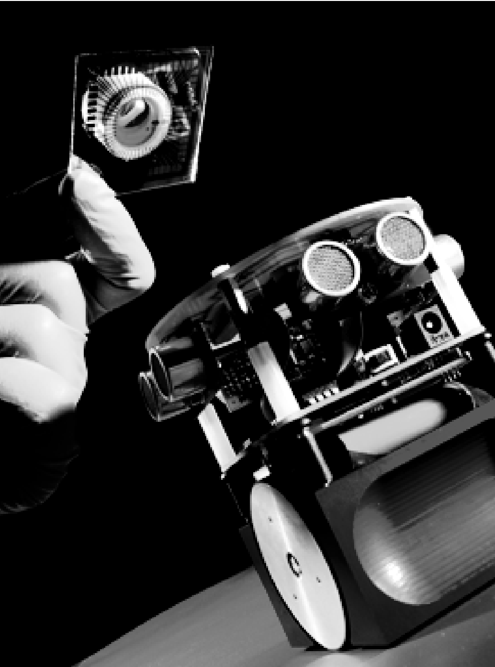
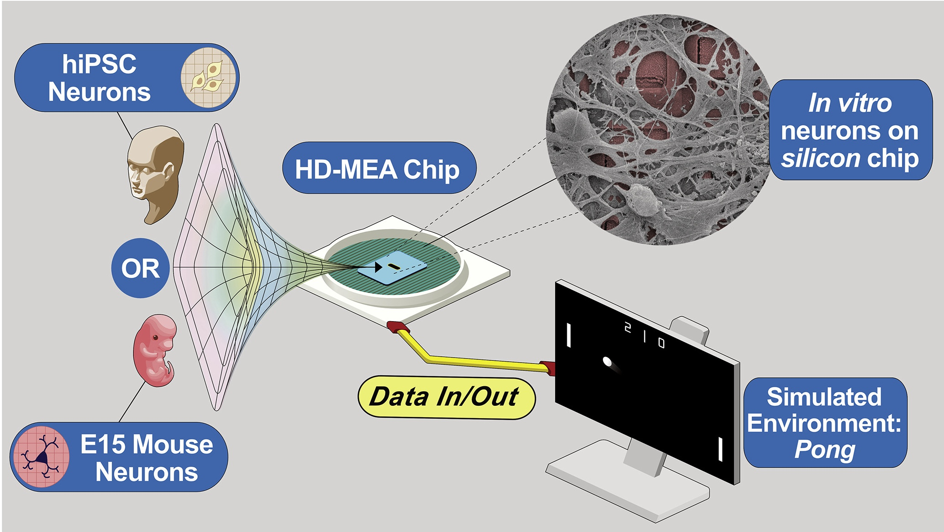
Applications of BNNs:
DeMarse, University of Florida, 2005.
Warwick, University of Reading, 2008.
Cai, Monash University & Cortical Labs, 2023.

Slide 9
Next Steps:
BNNs abilities are limited to simple tasks.
Achieving complex functionality requires new ways to interconnect them.
VWM acts as a virtual bridge to link multiple neural cultures, enabling dynamic, user-controlled communication.
It supports building complex systems like full brain models or virtual embodiments by interconnecting separate brain regions.

Slide 10
Proof of Concept :
Spike Detection
AI
Synchronization
Stimulation
Recording
Source MEA
Target MEA
Mono Directional VWM

Slide 11
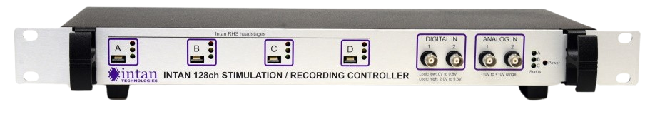
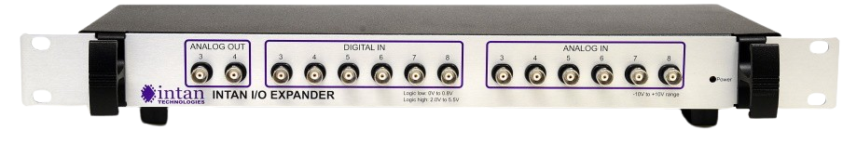
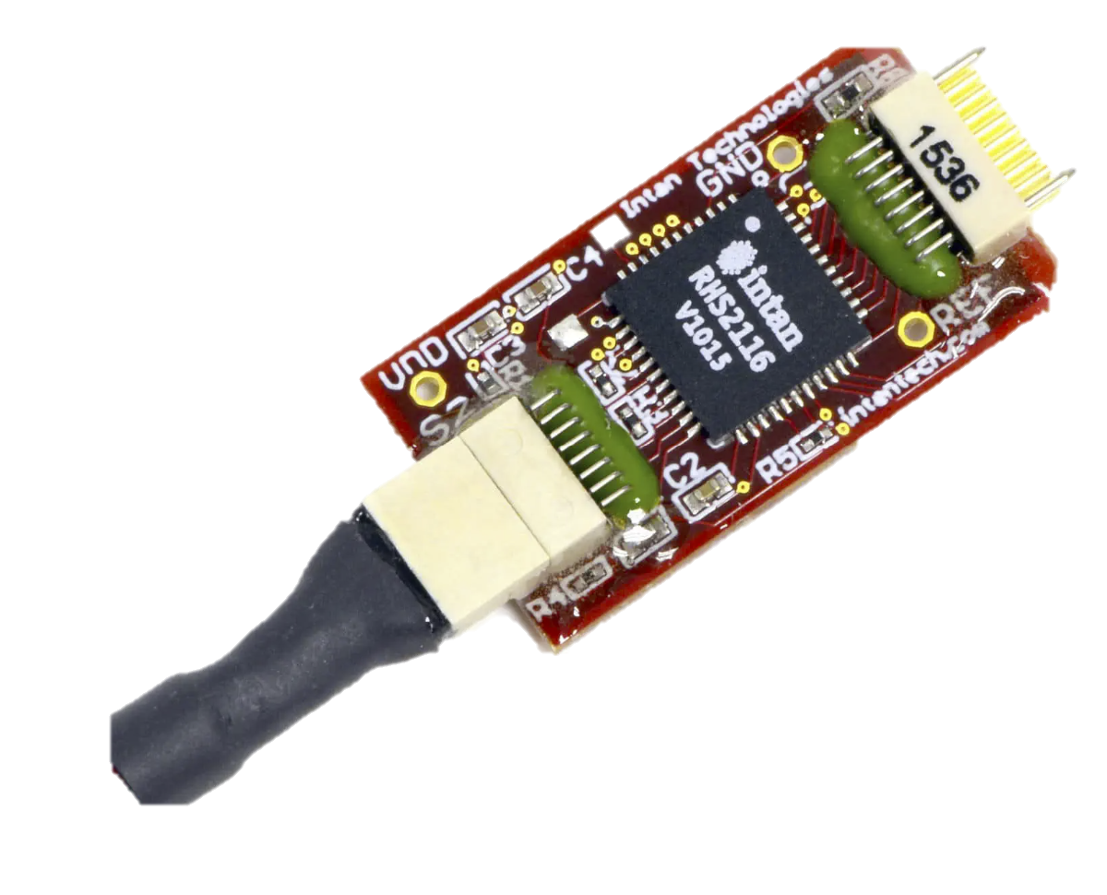
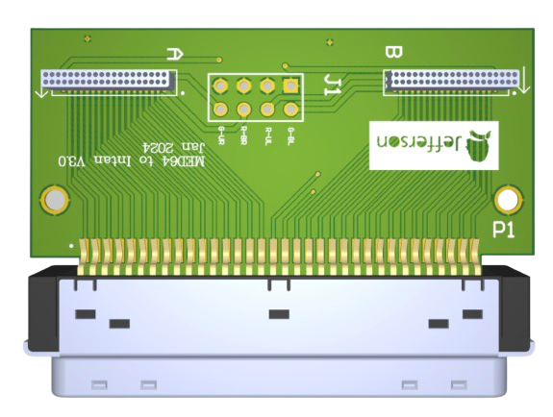
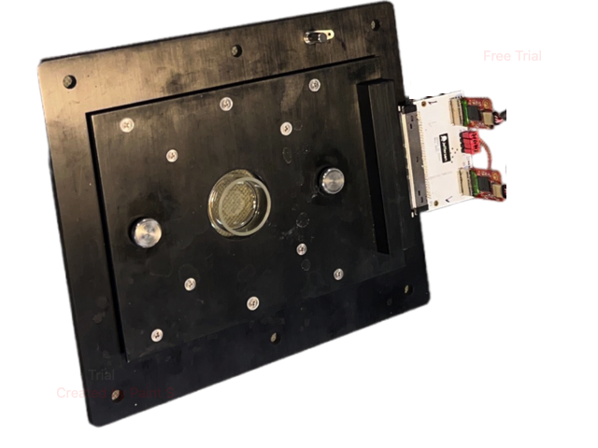
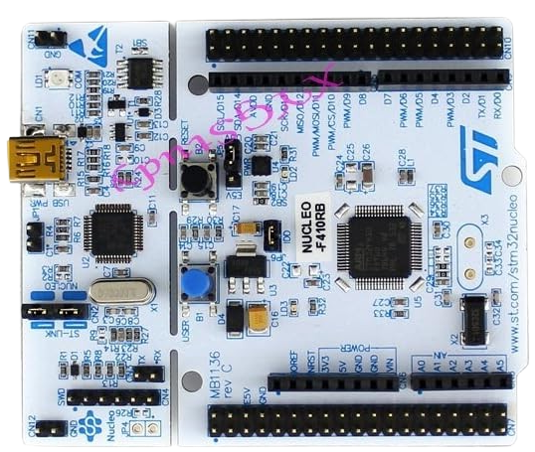
Setup Diagram:
SPI
SPI
Digital Inputs
Head stages
Intan I/O Expander
Custom
Adapters
Computer
USB
USB
Intan RHX
USB
TCP
VWM Software
ARM STM32F410
Source MEA
Target MEA

Slide 12
Details of the system:
a
Intan System
VWM Software
Target MEA
Intan RHX Software
Read Thread
Signal Processing Thread
Data
TCP
Circular Buffer
Fetching
Save Data (Binary)
TCP
Band-pass Filter
250Hz-5kHz
Head stages A-B
USB
GUI Thread
Spike Detection
Command
TCP
Save Settings (JSON)
Intan Controller
SPI
User Interface
Head stages C-D
Artificial Intelligence
Microcontroller
USB
Intan I/O Expander
ARM STM32F410
Source MEA
Digital I/O
Synchronization Unit
Circular Data Buffer

Slide 13
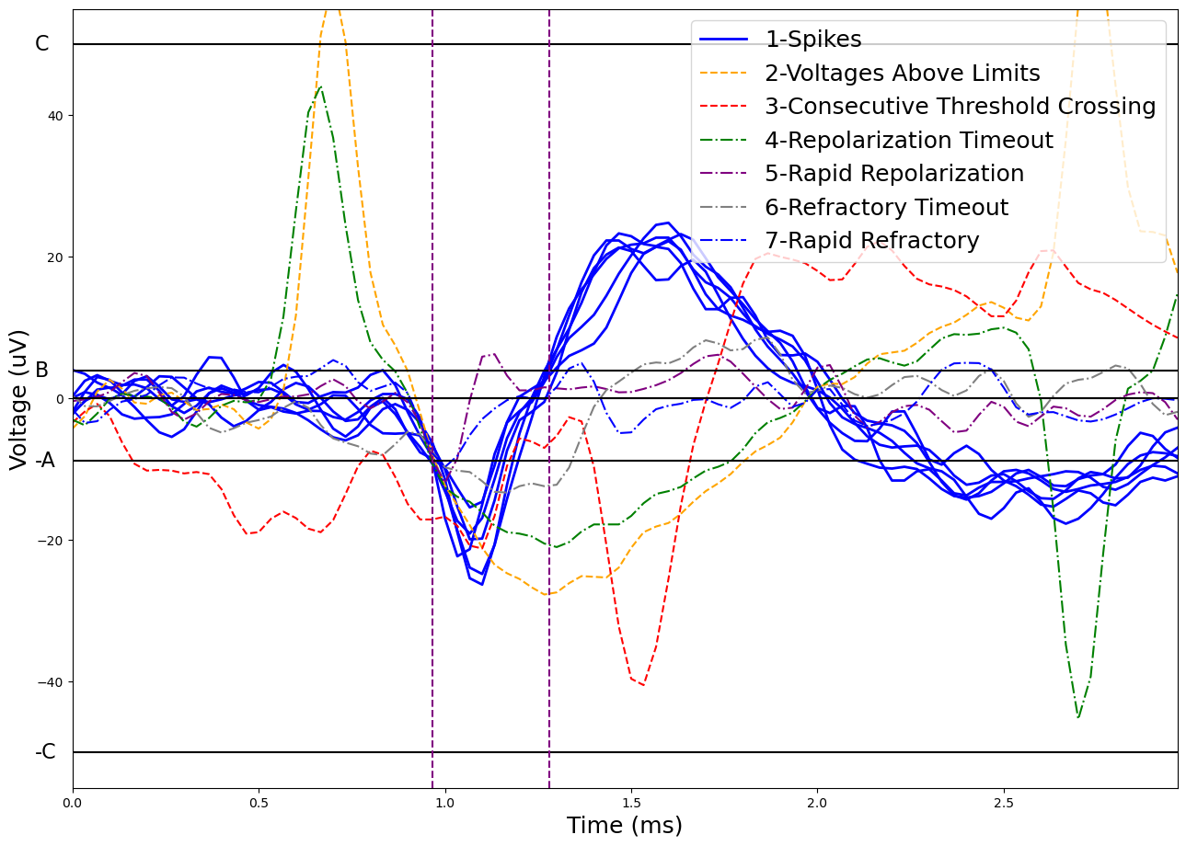
Spike Detection:
Find t0 where V crosses A:
  If |V| > C in window (-1ms, 2ms):
  AP[i] = 2 (Voltages Above Limits)
  If V crosses A in 1ms before t0:
  AP[i] = 3 (Consecutive Threshold Crossing)
For T2 after t0:
  If V crosses B in less than T1:
  AP[i] = 5 (Rapid Repolarization)
  If V crosses B between T1 & T2:
    Find t1 where crossing occurs
    For T4 after t1:
      If V crosses zero in less than T3:
      AP[i] = 7 (Rapid Refractory)
      If V crosses zero between T3 & T4:
      AP[i] = 1 (Spike Detected)
      If V does not cross zero in T4:
      AP[i] = 6 (Refractory Timeout)
  If V does not cross B in T2:
  AP[i] = 4 (Repolarization Timeout)
T1
T2
T3
T4

Slide 14
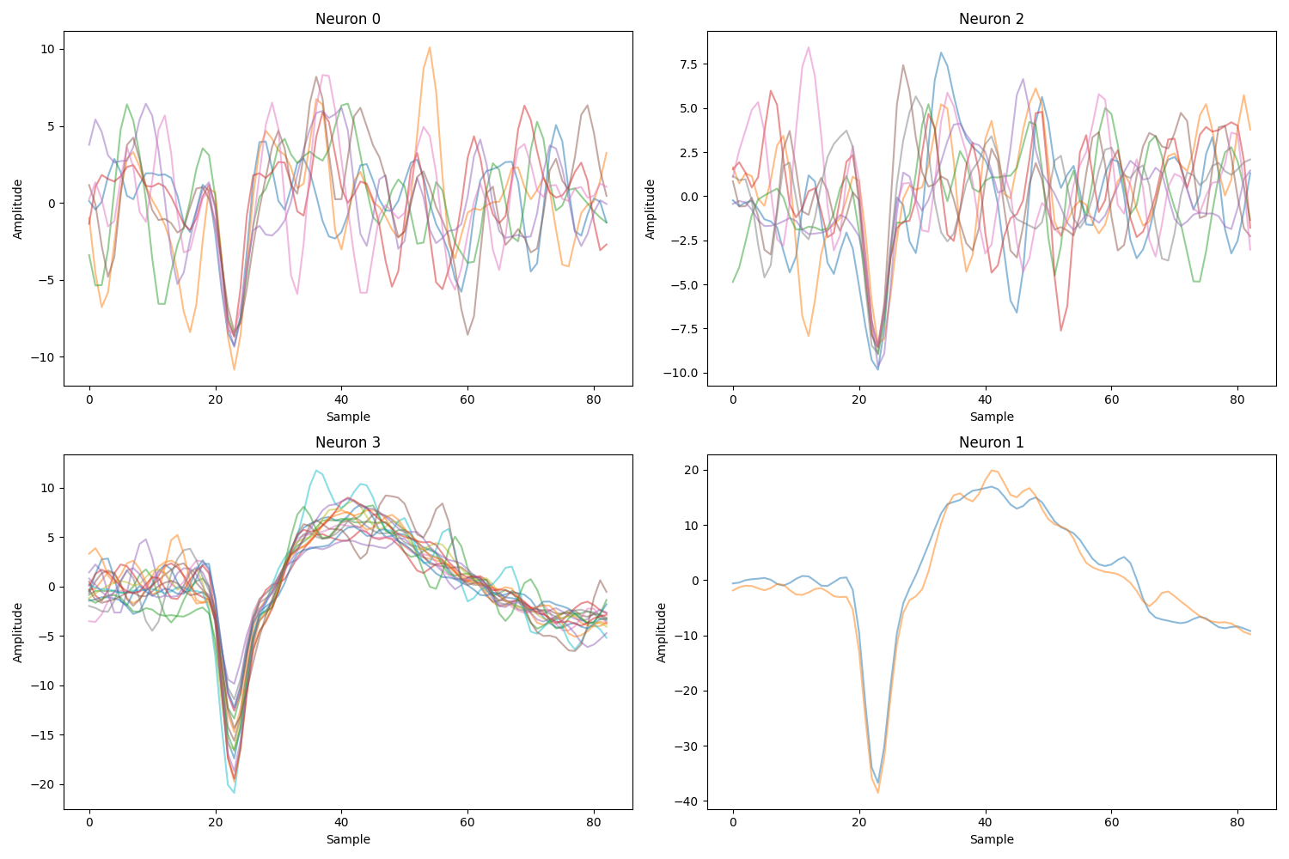
Threshold Selection by spike sorting:
RMS-Based Thresholding
Thresholds are set as a multiple of the signal’s Root Mean Square (RMS).
Threshold Selection
Choosing the correct multiplier is a critical step for reliable spike detection.
Spike Sorting Validation
Spike sorting is used to evaluate and refine the selected threshold multiplier having the RMS of the signal.
Detect Spikes Using Low Threshold
PCA
K Means Classifier
Plot sorted Neurons
Visualize Spikes
Select Thresholds

Slide 15
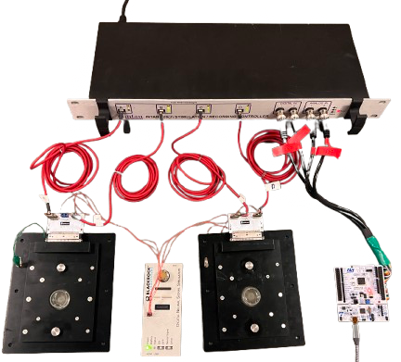
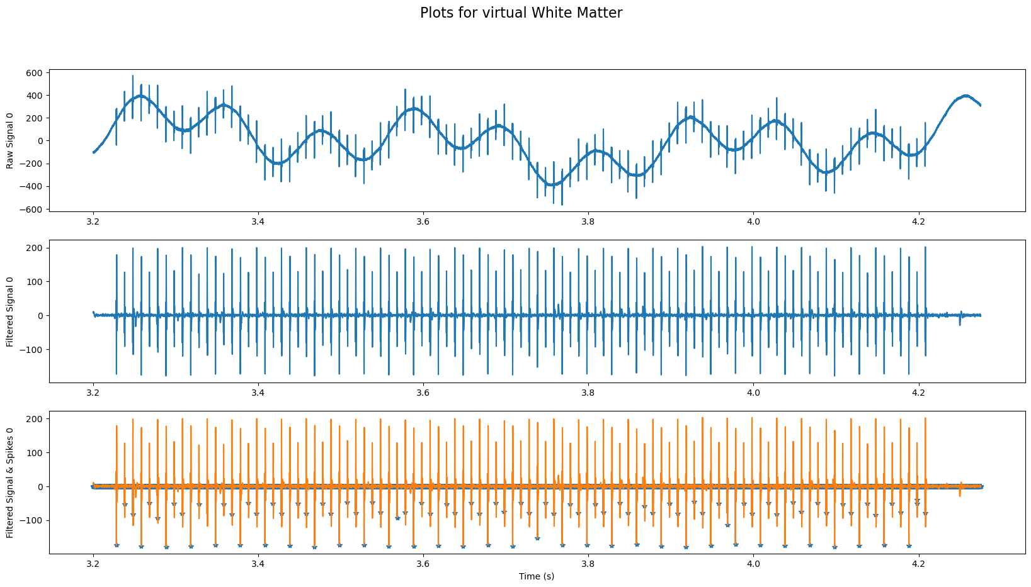
Spike Detection Development:

Slide 16
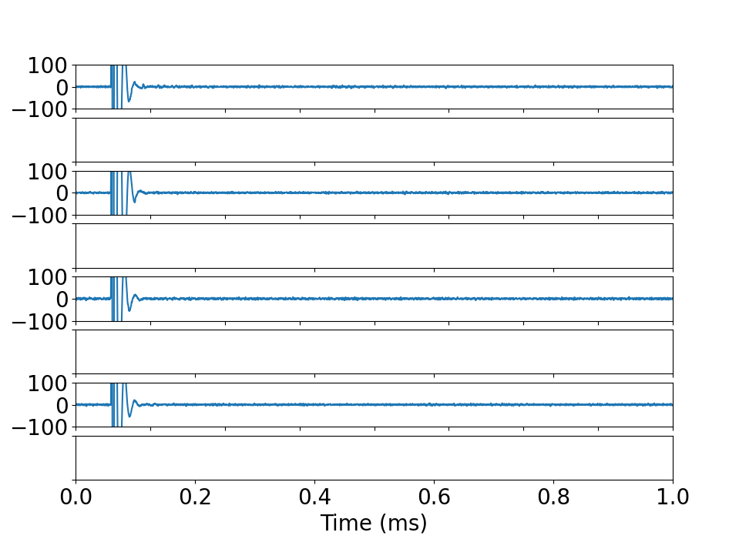
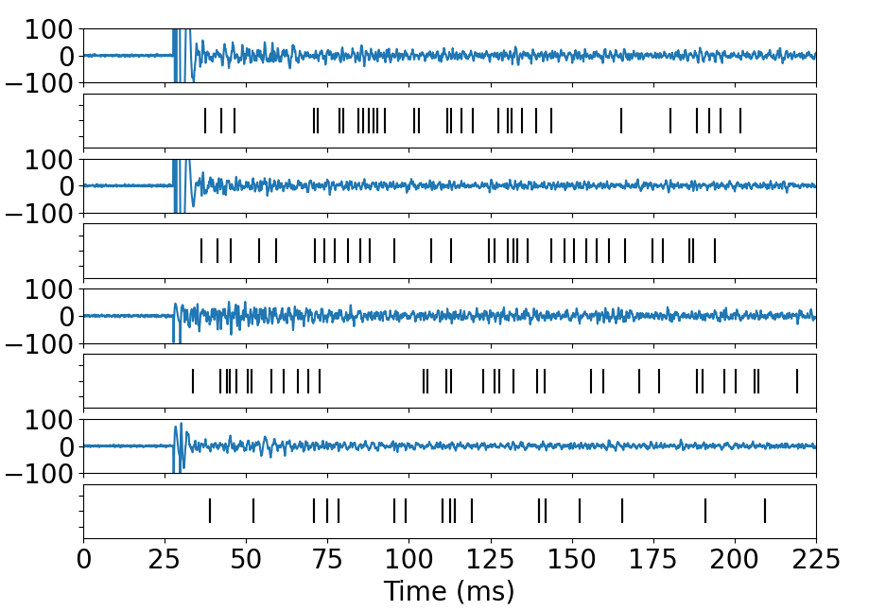
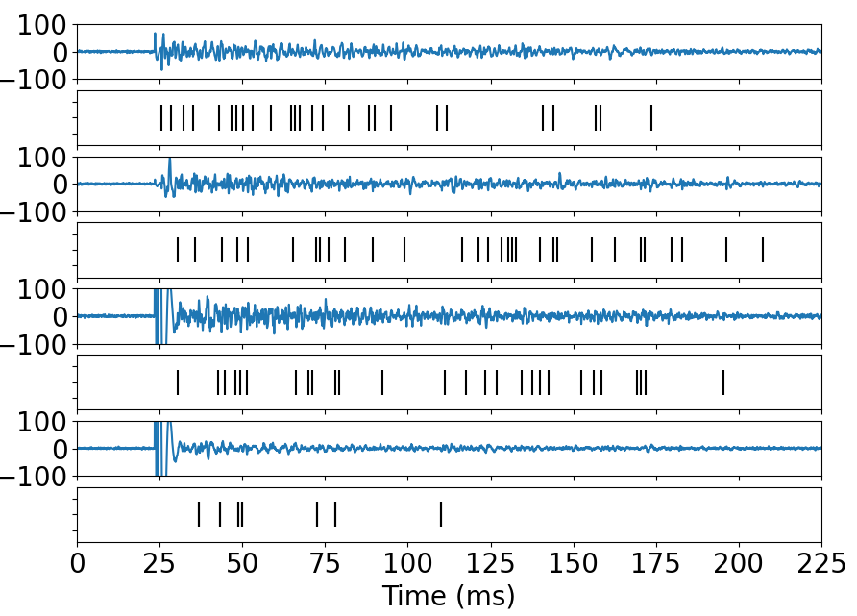
Spike Detection Test:
MK-801 (a receptor antagonist) applied to inhibit synaptic activity
Post-stimulus responses were silenced, confirming suppression of biological activity
Removal of MK-801 led to reappearance of post-stimulus activity
Confirms that responses are biologically mediated, not stimulation artifacts
Voltage (µv)
Voltage (µv)
Voltage (µv)
Before adding blocker
After adding blocker
After removing the blocker

Slide 17
Details of the system:
a
Intan System
VWM Software
Target MEA
Intan RHX Software
Read Thread
Signal Processing Thread
Data
TCP
Circular Buffer
Fetching
Save Data (Binary)
TCP
Band-pass Filter
250Hz-5kHz
Head stages A-B
USB
GUI Thread
Spike Detection
Command
TCP
Save Settings (JSON)
Intan Controller
SPI
User Interface
Head stages C-D
Artificial Intelligence
Microcontroller
USB
Intan I/O Expander
ARM STM32F410
Source MEA
Digital I/O
Synchronization Unit
Circular Data Buffer

Slide 18
Synchronization Process:
Data is processed in discrete chunks of 25.6 ms
Each chunk takes a variable amount of time to be processed
This introduces inconsistent delays in the system
A microcontroller is added to synchronize timing
  Ensures consistent delays
  Triggers stimulation at
  precise intervals
Data Timing
Start Button
First Data Entry
Last Data entry
Data Entry Times to CB
t
Data Read Times from CB
Fixed Delay
200.0±1.0ms
First Data Process
Last Data Process

Slide 19
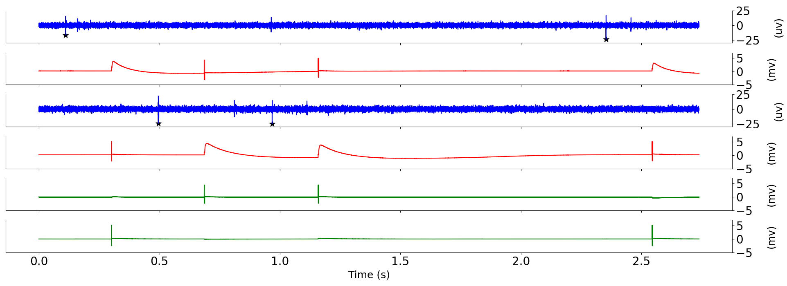
Timing Test:
A timing test shows that the delays between an activity detection and delivering the stimulation are consistent (200.0±1.0ms)
Source E0
(µV)
Target E0
T=200ms
(mV)
T=200ms
Source E1
(µV)
Voltage
Target E1
(mV)
Recording E10
T=200ms
T=200ms
(mV)
Recording E45
(mV)

Slide 20
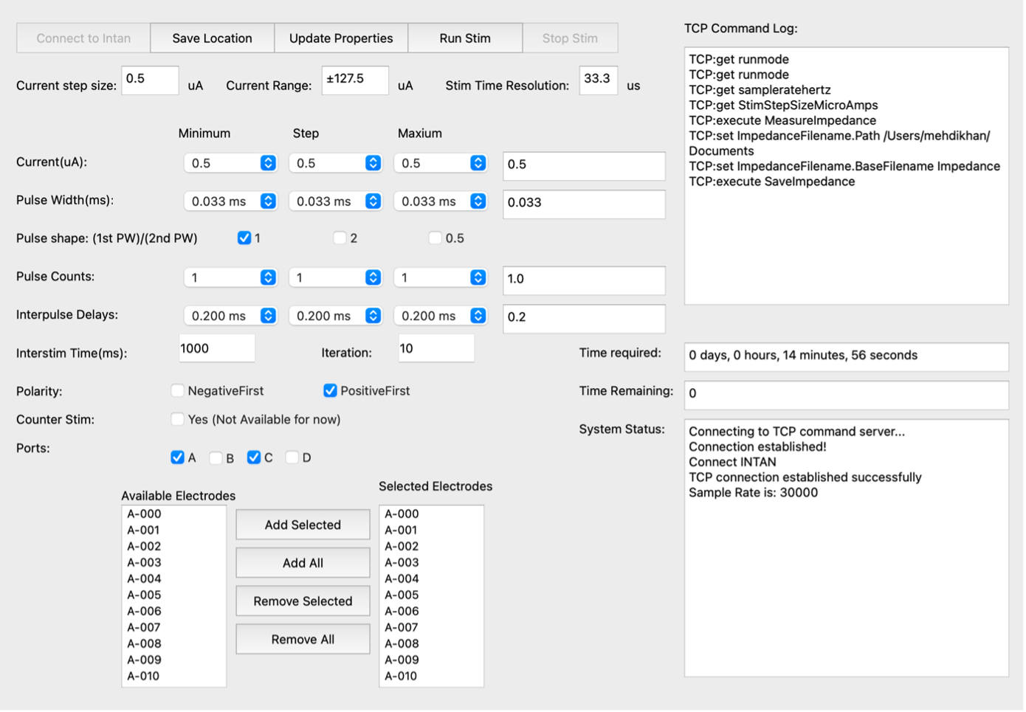
Stimulation:
Charge-balanced, bidirectional pulses were used for stimulation.
The NeuroTuner (NT) software was developed to optimize pulse parameters and electrode selection.
NT allows systematic sweeping of:
  Pulse amplitude
  Pulse width
  Electrode selection
  Pulse shape
  Number of pulses
Future studies may expand on NT for more advanced pulse shape and type tuning.

Slide 21
Stimulation Electrode Selection:
Stimulation Sweep:
Retrieve settings from Intan RHX
Update GUI
Receive user settings via GUI
Configure Intan acquisition system
Send stimulation commands
Record data
Spike Counts:
Load Raw Data
Band-pass Filter
250Hz-5kHz
Spike Detection
Post-Stim Spike Counting
Sums spike counts per stimulation event
Generate Spike Matrix
64*1
A semi-automated analysis script identifies electrodes with the strongest post-stimulus responses.
21

Slide 22
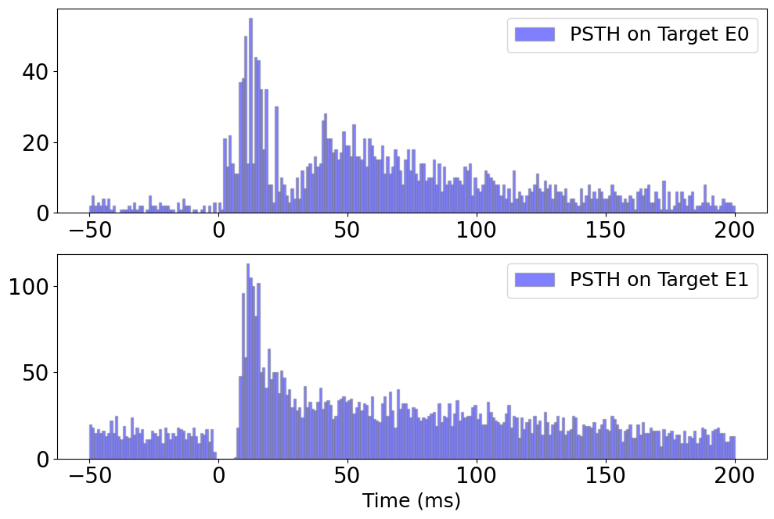
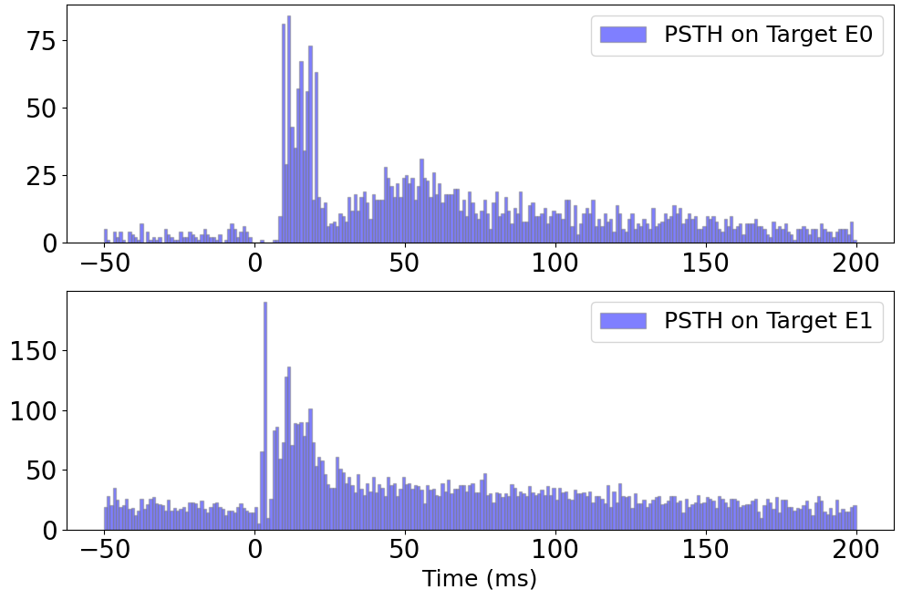

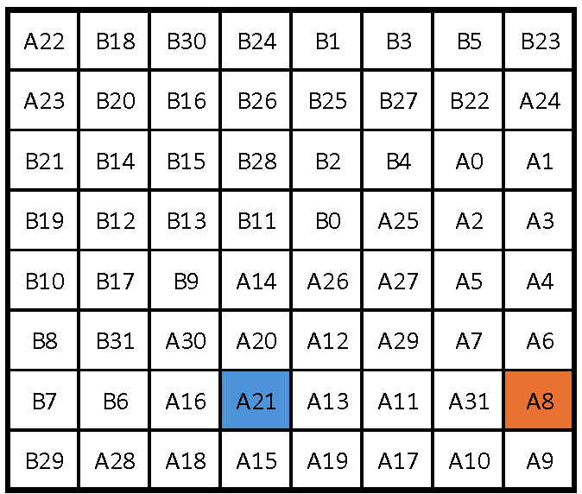
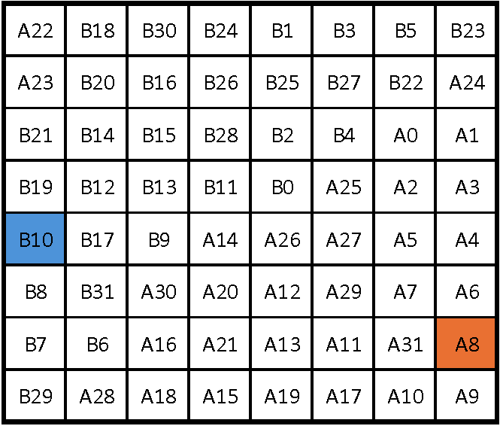
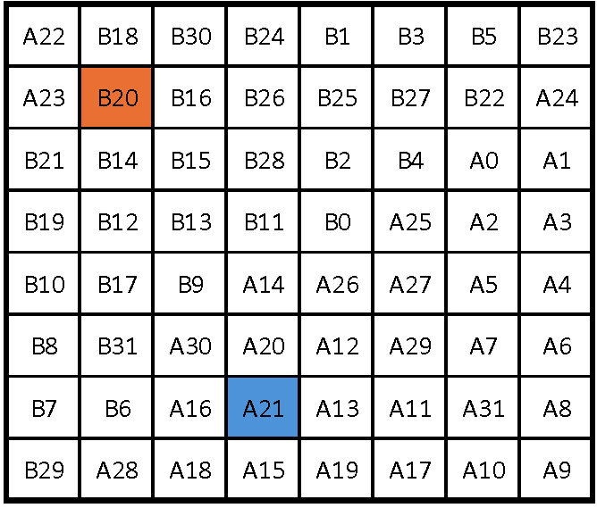
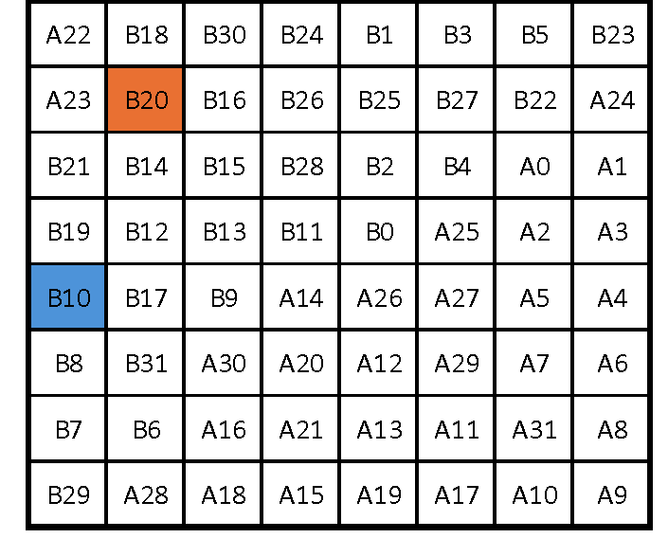
Post-Stimulus Time Histogram (PSTH) :
PSTH on A21 with stimulation at A8
PSTH on B10 with stimulation at A8
PSTH on A21 with stimulation at B20
PSTH on B10 with stimulation at B20

Slide 23
Spike-Based Classification Workflow:
Spike Detection & Binning
  Spikes from post-stimulus activity were binned using 1 ms bins
  200 ms window → 200 bins per sample
  Data used as input for machine learning models
  Support Vector Machine (SVM), K-nearest neighbor (KNN), and Random Forest (RF) were used.
Features
Raw Data
Band-pass Filter
250Hz-5kHz
Spike Detection
Bins of 1ms
Normalized
SVM
PCA
0.95
KNN
RF
Label
Stimulation Source

Slide 24
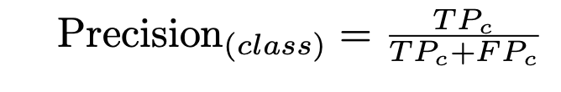
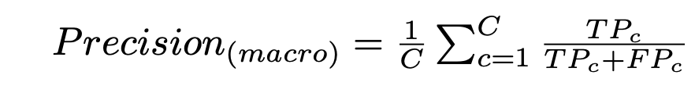
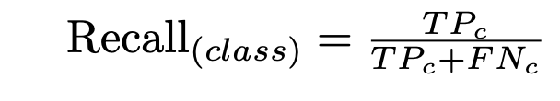
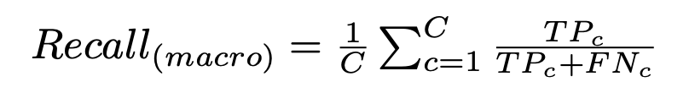
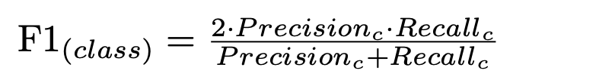
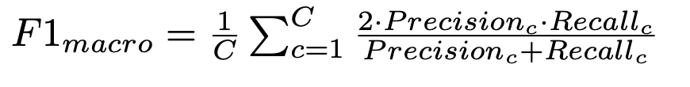
Cross-Validation and Scoring Metrics:
StratifiedKFold Cross-Validation Ensures each fold has the same class distribution as the full dataset.
  n_splits=10: Split dataset into 10 folds
  shuffle=True: Randomly shuffle before splitting
Metrics:

Slide 25
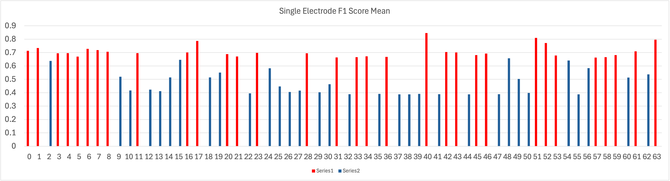
Single Electrode Analysis:
Classification individually on all 64 electrodes
Top-performing 32 electrodes selected

Slide 26
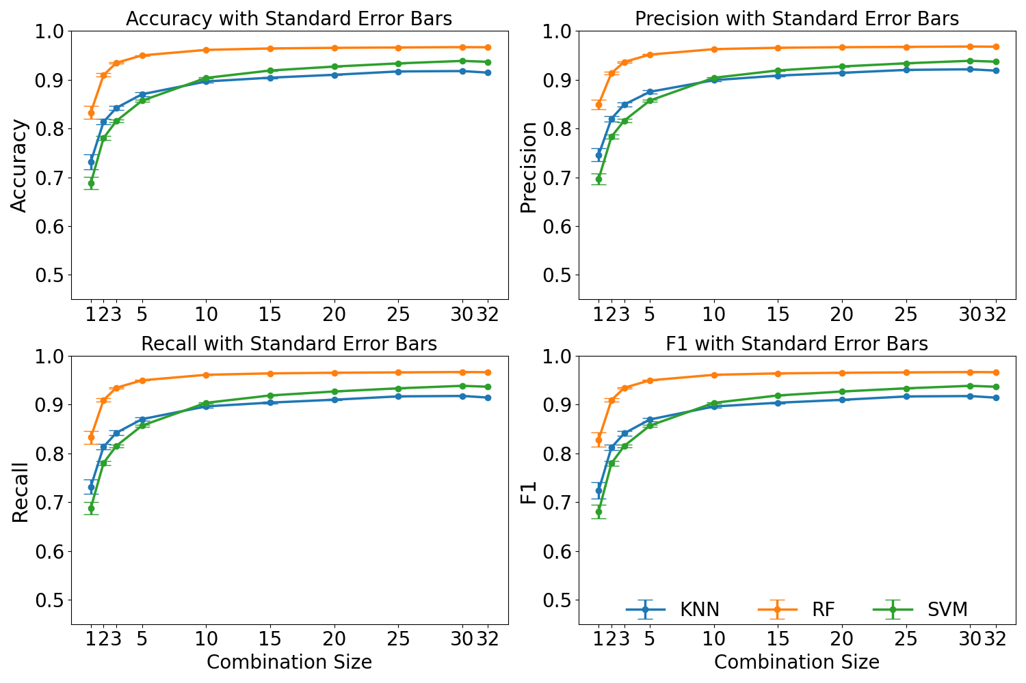
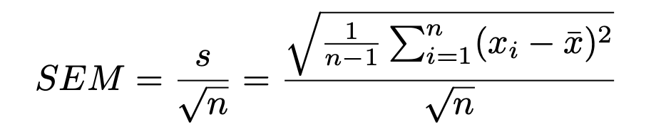
Multiple Electrode Analysis:
Combined data from selected electrodes used for classification (max combination =100)
Explored multiple electrode combinations
Standard Error Mean:

Slide 27
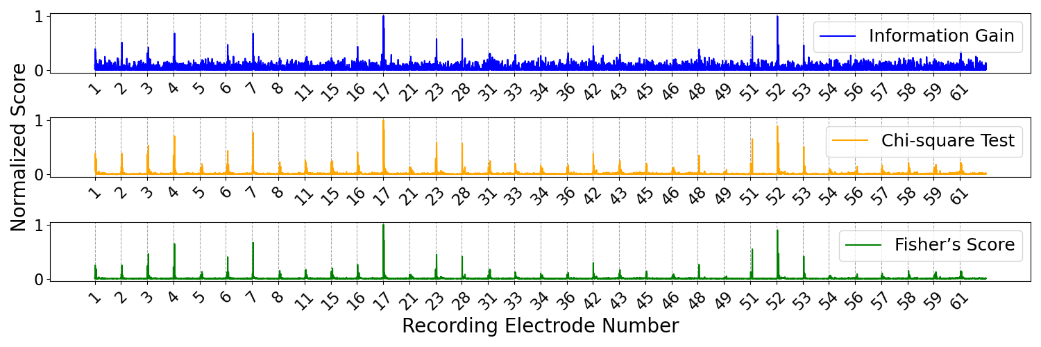
Information Richness test:
Information Gain
Chi-Square (X²)
Fisher Score

Slide 28
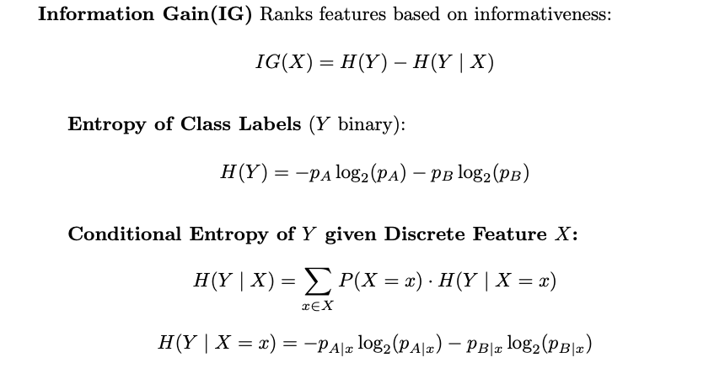
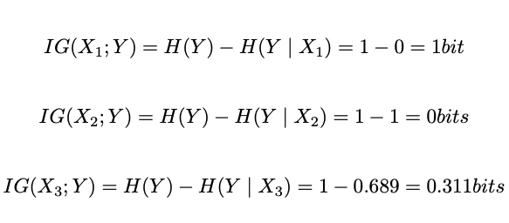
Information Gain:
Sample* | X1 | X2 | X3 | Y
1 | 0 | 0 | 0 | A
2 | 0 | 1 | 0 | A
3 | 1 | 0 | 0 | B
4 | 1 | 1 | 1 | B
IG(X) | 1 | 0 | 0.31 | -
*Sample = Electrode Number, X_{i}=Bin number

Slide 29
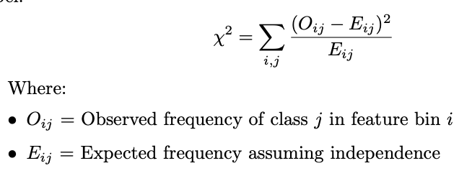
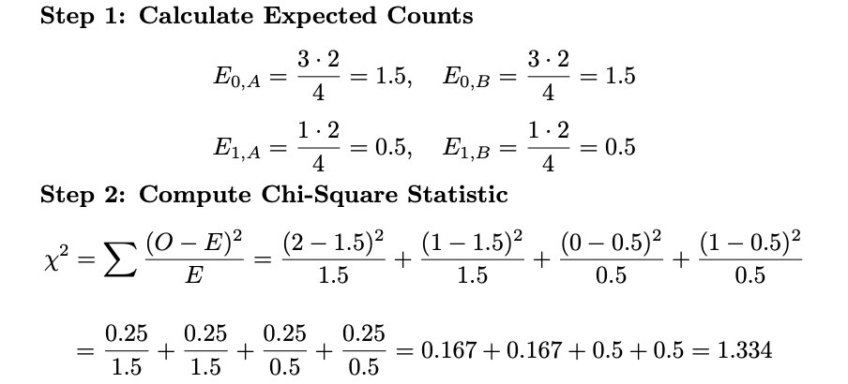
Chi-Square (X2):
Sample* | X₁ | X₂ | X₃ | Y
1 | 0 | 0 | 0 | A
2 | 0 | 1 | 0 | A
3 | 1 | 0 | 0 | B
4 | 1 | 1 | 1 | B
X² | 4 | 0 | 1.33 | -
Observed = Expected → Feature and class label are independent
Observed ≠ Expected → There's a deviation from independence → possible dependence
*Sample = Electrode Number, X_{i}=Bin number

Slide 30
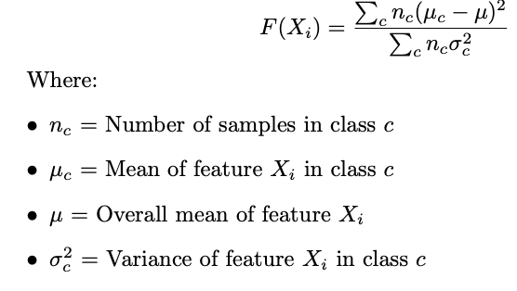
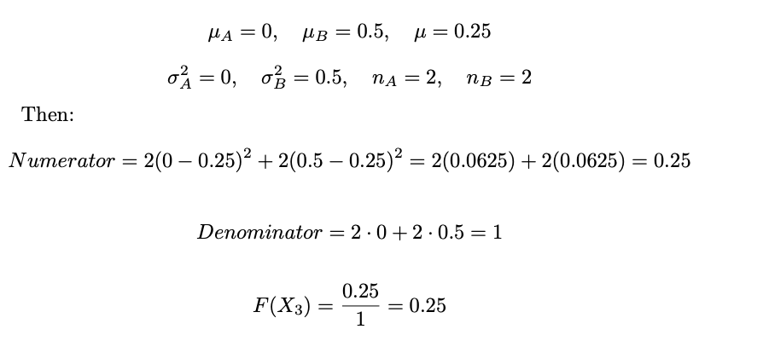
Fisher Score:
Sample* | X₁ | X₂ | X₃ | Y
1 | 0 | 0 | 0 | A
2 | 0 | 1 | 0 | A
3 | 1 | 0 | 0 | B
4 | 1 | 1 | 1 | B
F(X) | ∞ | 0 | 0.25 | -
Numerator: How different the class means are from the overall mean
→ bigger = more separation between classes
Denominator: How spread out the feature values are within each class
→ smaller = tighter, more compact clusters per class
*Sample = Electrode Number, X_{i}=Bin number

Slide 31
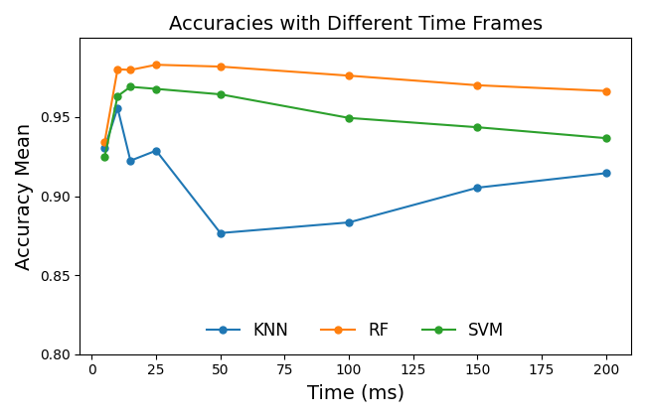
Analysis using different time frames:
Analysis across multiple time windows using features from 32 selected electrodes
Results showed that the 10 ms window yielded the best results, as expected.

Slide 32
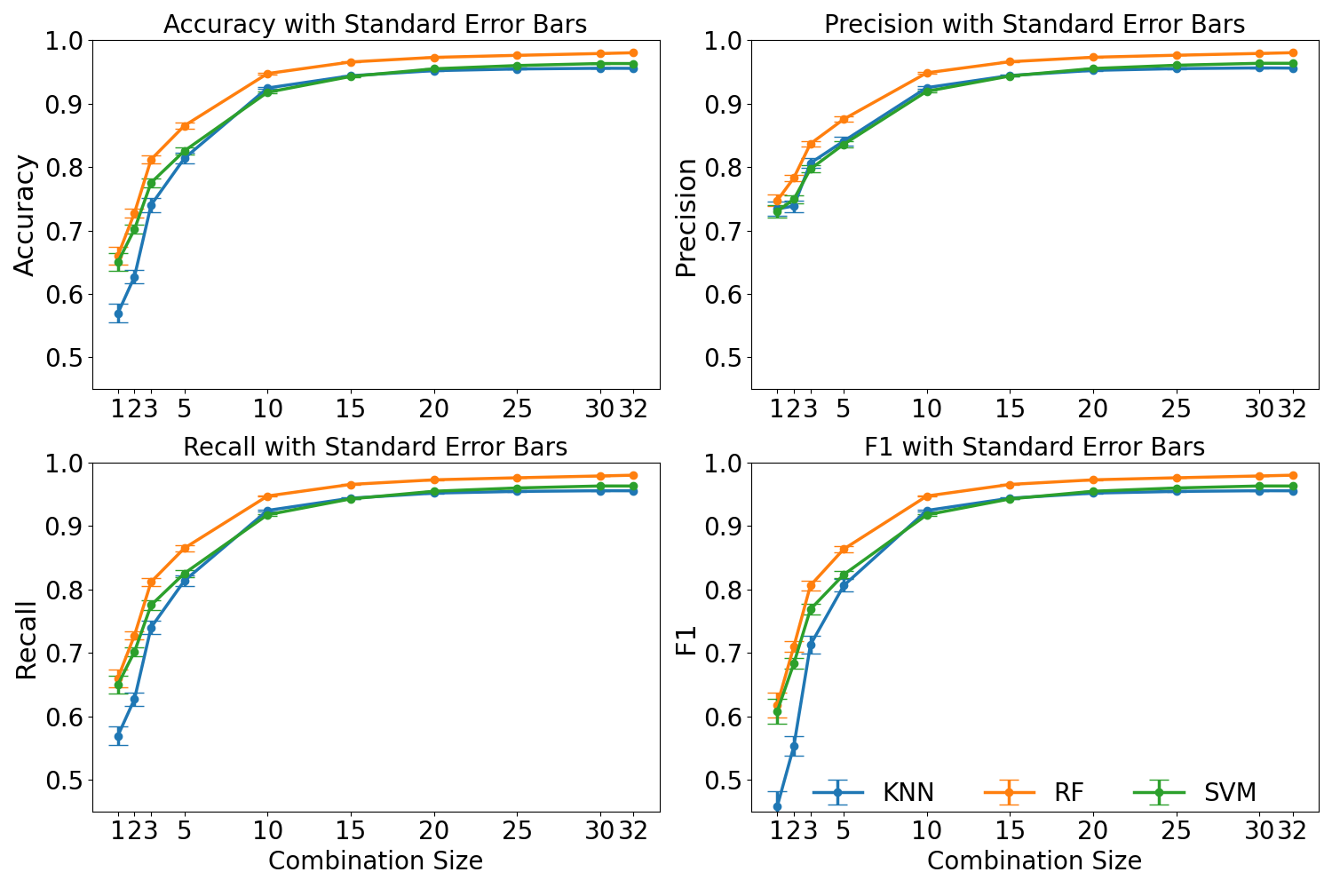
Analysis using different number of electrodes:
Analysis across different electrode combinations using data from the initial 10 ms
Results revealed that meaningful results can be achieved even with a small subset of electrodes.

Slide 33
Single vs Double Threshold Spike Detection:
Classification results analyzed for single and double threshold
Results show that the using double threshold was neccasary

Slide 34
Bidirectional VWM:
Most neural regions are interconnected bidirectionally.
Reconstructing more complete brain-like BNNs requires establishing such two-way communication.
Spike Detection
Synchronization
Stimulation
Recording
Stimulation
Synchronization
Spike Detection
MEA 1
MEA 2

Slide 35
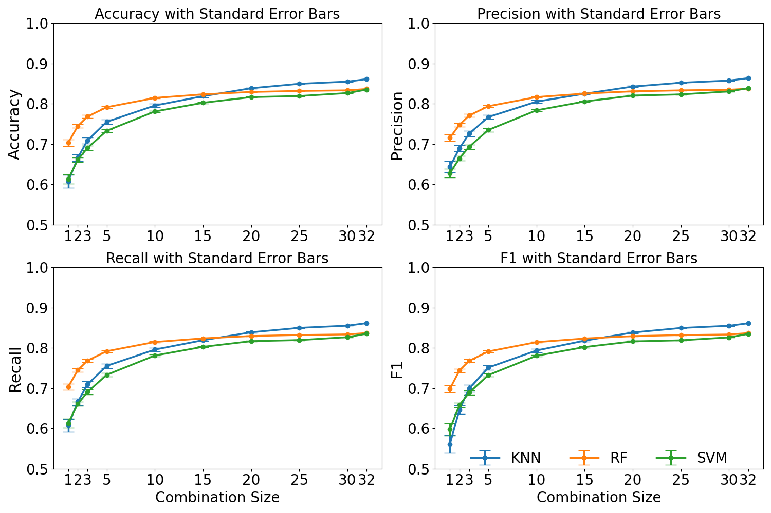
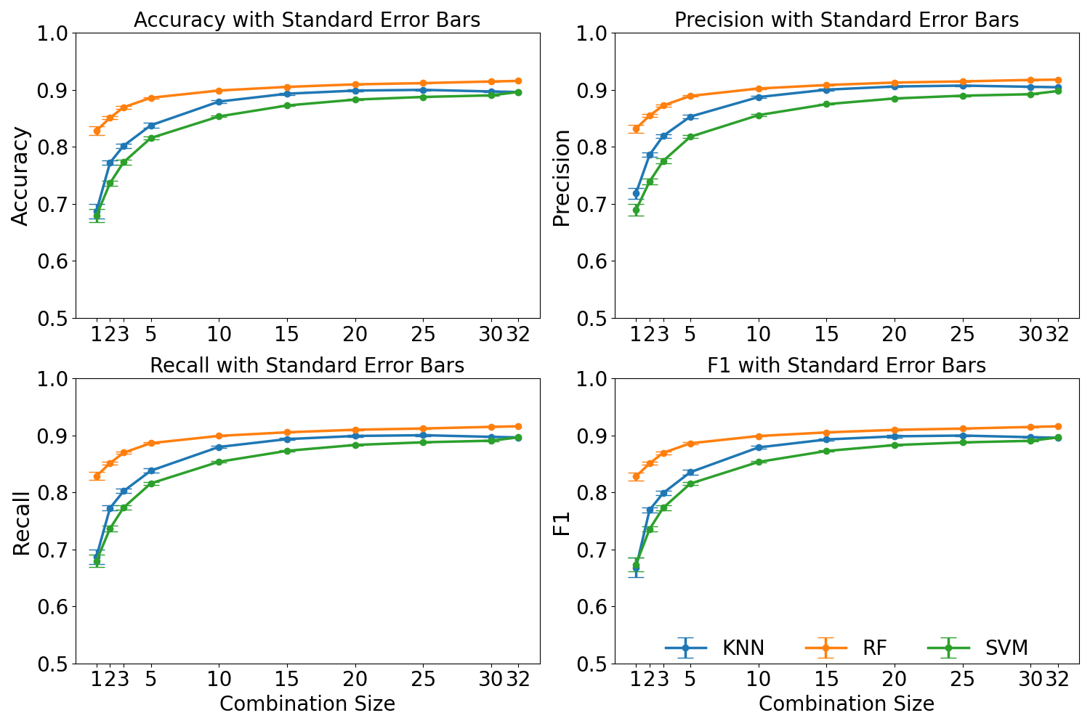


Bidirectional VWM Classification Results:
a
b
a: MEA 1 using 200ms post stimulus activity
b: MEA 2 using 200ms post stimulus activity
c: MEA 1 using 10ms post stimulus activity
d: MEA2 using 10ms post stimulus activity
c
d

Slide 36
Sending a message through VWM:
Replace spontaneous activity with controlled stimulation to encode binary messages
Two electrodes represent binary values: “0” and “1”
Enables transmission of structured data (letters, numbers, Morse code)
Uses a simplified 3-bit binary system for demonstration
Number | Code
0 | 000
1 | 001
2 | 010
3 | 011
4 | 100
5 | 101
6 | 110
7 | 111
Decoding the Message
Encoding the Message
Machine Learning
Encoding a Message
Machine Learning
Decoding the Message

Slide 37
Direct interface with BNN:
Goal: Remove ML inference between MEA1 and MEA2
Direct stimulation of MEA2 using binned spike data from MEA1
Prior ML results: >80% accuracy using spike data from 5 electrodes
Select 6 top-performing electrodes to build stimulation patterns
Binned spike data from three electrode stimulates one electrode
Recovered code proves data transfer without ML inference
Number | Code
0 | 000
1 | 001
2 | 010
3 | 011
4 | 100
5 | 101
6 | 110
7 | 111
Decoding the Message
Encoding the Message
Spike Detection
32
Encoding a Message
Spike Detection
Decoding the Message
32

Slide 38
Experiment Timeline:
Plating Date | Usable Window (DIV 14 –35) | Purpose
April 9 | April 23 – May 5 | First round of experiments (Step one)
April 30 | May 14 – May 28 | Continued Fig. Step 1 + ML training
May 21 | June 4 – June 25 | BNN-based testing (Step 2)
June 11 | June 25 – July 16 | Repetition of Step 1 and step 2
July 2 | July 16 – August 6 | Redundant ML training
July 23 | August 6 – August 27 | Final testing and creating manuscript figures
August 13 | August 27 – September 17 | Backup MEAs for extended data recording
September 3 | September 17 – October 8 | Final experimental, replication, refinement

Slide 39
Experiment Timeline:
May: Step 1 – ML-based decoding of 3-bit codes; train 4 models; collect initial decoding data.
June–July: Step 2 – biological signal transfer without ML in transmission; continue data collection across MEAs for Step 1.
Aug–Sept: Redundant testing on different MEA; validate optimal configurations.
Oct–Dec: Focus on final analysis, writing manuscript #2, and completing PhD thesis for submission by year-end.

Slide 40
Publications:
The NuroSleeve – A user-centered, 3D-printed hybrid orthosis developed for individuals with upper extremity impairment.
Published in: Journal of NeuroEngineering and Rehabilitation, 2023
Linking physically isolated in vitro neural specimens on separate three-dimensional microelectrode arrays.
Presented at: Society for Neuroscience Annual Meeting (SfN), Washington, D.C., 2023
Microstimulation of Visual Thalamocortical Slices – Investigated spatiotemporal neural dynamics via microstimulation on 3D MEAs.
Presented at: Society for Neuroscience Annual Meeting (SfN), Washington, D.C., 2023
Initial feasibility evaluation of the RISES system: An innovative and activity-based closed-loop framework for spinal cord injury rehabilitation and recovery
Published in: Journal of Rehabilitation and Assistive Technologies Engineering, 2024
Virtual White Matter - A Novel System for Cross-Dish Neural Interaction and Modulation
Accepted in: Journal of Neural Engineering, 2025

Slide 41
Acknowledgements:
I would like to thank Dr. Iyad Obeid, Dr. Mijail Serruya, and Dr. Alessandro Napoli for their mentorship, feedback, and continued support.
Special thanks to the Raphael Center for Neurorestoration team
at Thomas Jefferson University for their collaboration and contributions to this research.

Slide 42
Thank You
Thank you for your time and attention.
I welcome your questions and feedback.

