Slide 2
Introduction (1)
The spinal cord plays a critical role in regulating motor, sensory, and autonomic functions.
Injuries can lead to significant and lifelong neurological deficits.
Accurate severity assessment is crucial for guiding effective clinical management.
Current clinical assessments rely heavily on manual neurological examinations that are often subjective, time-consuming, and highly dependent on examiner expertise.
These assessments can be particularly challenging in pediatric populations, where cooperation may be limited, or in acute/critical settings, where patients may be unconscious or in pain.
1

Slide 3
Introduction (2)
These challenges highlight the need for objective, imaging-based tools that can complement or enhance clinical assessments.
Project Goal: Integrate multimodal MRI and machine learning to develop objective, quantitative tools to facilitate precise diagnosis, prognosis, and treatment planning for spinal cord injury (SCI).
Quantitative multimodal MRI enables objective measurement of spinal cord structure and microstructure.
Machine learning methods can detect complex and subtle patterns that are often invisible to the human eye, enabling more accurate and reproducible assessment.
2

Slide 4
Introduction (3)
Ultimate Objective: Enable data-driven, reproducible, and age-aware diagnosis, improving clinical outcomes.
Aim 1: Collecting and Analyzing Pediatric MRI to Establish a Normative Spinal Cord Biomarker Database
Aim 2: Multimodal Machine Learning for Chronic Pediatric SCI Severity Assessment
Aim 3: Deep Learning-Based Severity Assessment in Acute Adult SCI
3

Slide 5
Outline
Background
Research Objective and Approach
Preliminary Results
Proposed Timeline and Future Work
4

Slide 6
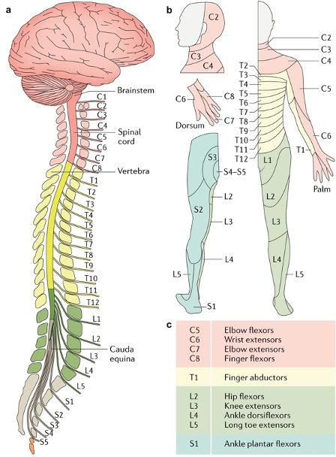
Spinal Cord Anatomy and Segmental Function
The spinal cord serves as the main communication pathway between the brain and the body.
It is divided into four regions and a total of 31 segments, with each segment contributing to specific motor and sensory:
Cervical (C1–C8): Head, neck, diaphragm, arms, and hands
Thoracic (T1–T12): Trunk muscles and sympathetic nervous system
Lumbar & Sacral (L1–S5): Legs, bladder, bowel, and sexual function
Christopher S Ahuja, Jefferson R Wilson, Satoshi Nori, Mark Kotter, Claudia Druschel, Armin Curt, and Michael G Fehlings. Traumatic spinal cord injury. Nature reviews Disease primers, 3(1):1–21, 2017.
5

Slide 7
Spinal Cord Injury: Pathophysiology and Clinical Phases
Spinal Cord Injury (SCI) is a devastating neurological condition that results from damage to the spinal cord, often caused by trauma, such as impact, compression, or penetration.
It leads to the disruption of motor, sensory, and autonomic pathways, resulting in partial or complete loss of function below the injury level.
Clinical Phases of SCI:
Acute Phase: Immediate response to injury (hours to days)
Sub-acute/Chronic Phase: Weeks to months post-injury
Why assessment matters:
Acute: Early and reliable severity classification is critical for prognosis, treatment planning, and determining the need for surgical or intensive interventions.
Chronic: Tracking structural and functional changes supports rehabilitation planning and guides long-term care decisions.
6

Slide 8
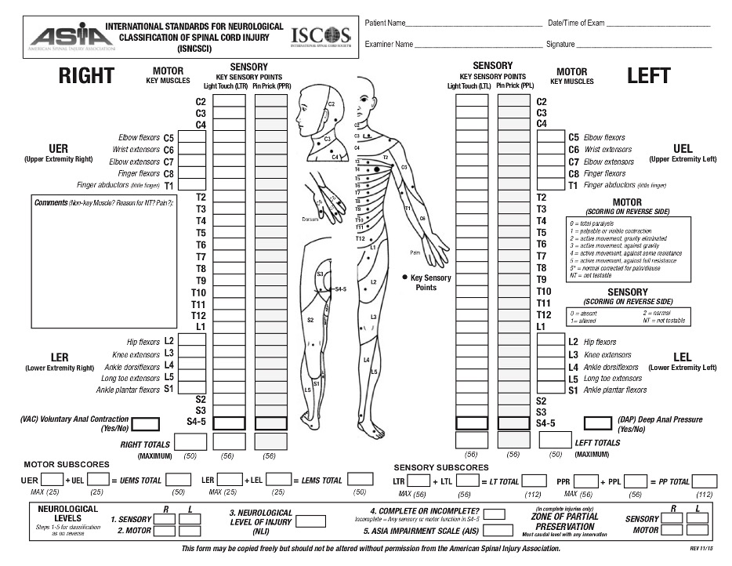
Spinal Cord Injury: Assessment
Standardized Assessment (ASIA/ISNCSCI):
Developed by the American Spinal Injury Association
Assesses motor and sensory function across dermatomes and myotomes
Yields ASIA Impairment Scale (AIS) grades
Challenging in pediatric, non-cooperative patients, and in acute/critical settings
Severity Group | AIS Grade
Motor Complete | A | Complete. No sensory or motor function is preserved below the neurological level of injury.
 | B | Sensory incomplete. Sensory but not motor function is preserved below the neurological level of injury.
Motor Incomplete | C | Motor incomplete. Motor function is preserved and more than half of key muscle functions below the single neurological level of injury have a muscle grade less than 3.
 | D | Motor incomplete. Motor function is preserved below the neurological level and at least half of key muscle functions below the NLI have a muscle grade of 3 or greater.
Normal | E | Motor and sensory function are normal
7
International standards for neurological classification of spinal cord injury (revised 2011). The journal of spinal cord medicine, 34(6):535–546, 2011.

Slide 9
Magnetic Resonance Imaging (1)
MRI Provides comprehensive assessment of the entire spinal cord
Superior visualization of injury components
Enables quantitative analysis of spinal cord structure and microstructure
Allows noninvasive longitudinal follow-up to monitor recovery
8

Slide 10
Magnetic Resonance Imaging (2)
MRI uses the body’s hydrogen atoms (mainly in water) to generate detailed internal images.
A strong magnetic field aligns these atoms in one direction (longitudinal field).
Radiofrequency (RF) pulses temporarily disturb this alignment (transverse field).
When the RF pulses stop, atoms return to their original alignment and release energy.
This emitted energy is captured by receiver coils and processed into high-resolution images.
Relaxation Time
H
H
H
H
B0
9

Slide 11
Magnetic Resonance Imaging (3)
There are multiple MRI sequences, each is optimized to highlight different tissue properties.
MRI Modalities for Spinal Cord Imaging:
Structural MRI (T1, T2): Visualizes spinal cord anatomy.
Magnetization Transfer (MT): Sensitive to macromolecular content; provides insights into myelin integrity.
Diffusion MRI (DTI, NODDI, DKI): Evaluates white matter microstructure by measuring water diffusion.
10

Slide 12
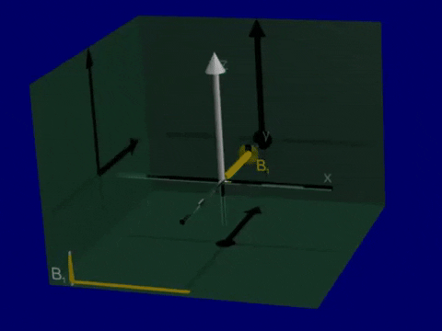
Structural MRI (1)
T1 and T2-weighted images are fundamental structural imaging types used in neuroimaging, capturing different tissue contrasts based on the relaxation properties.
Relaxation (Return to equilibrium of net magnetization)
Longitudinal magnetization recovery
Transverse magnetization decay
T1 relaxation refers to the process by which protons return to their equilibrium alignment with the main magnetic field.
T2 relaxation is the process by which the transverse components of magnetization decay or dephase.
11

Slide 13
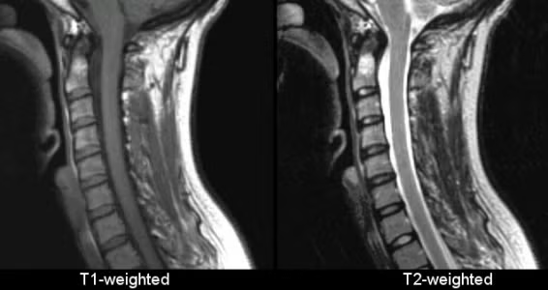
Structural MRI (2)
T1-weighted images: Emphasize differences in the longitudinal relaxation time (T1) of tissues.
T2-weighted images: Highlight differences in the transverse relaxation time (T2) of tissues.
Tissue Type | T1 Image | T2 Image
Water or Fluid Tissue | Dark | Bright
Fat Tissue | Bright | Bright
Some Bones (no free protons) | Dark | Dark
Cross-Sectional Area (CSA)
Right–Left (RL) Width
Anterior–Posterior (AP) Width
12

Slide 14
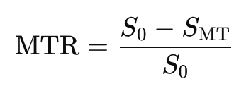
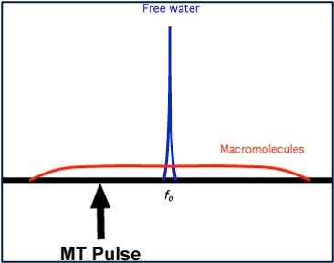
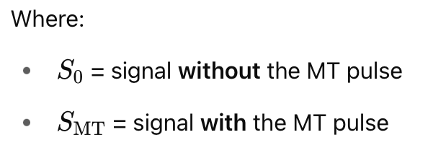
Magnetization Transfer Imaging (MTI)
In standard MRI, we mostly detect signals from free water protons, macromolecules don’t produce much signal directly.
MTI Measures the interaction between free water protons and macromolecular-bound protons (e.g., in myelin).
MTI uses a special off-resonance pulse to saturate macromolecular protons.
These saturated protons exchange energy with nearby water → reducing water signal.
Magnetization Transfer Rate (MTR) quantifies signal reduction caused by MT effect:
13

Slide 15
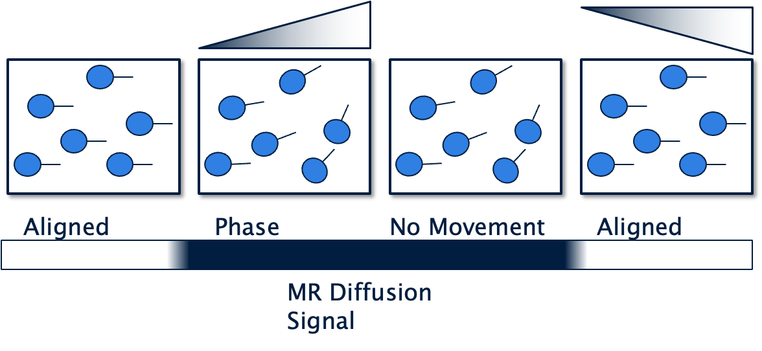
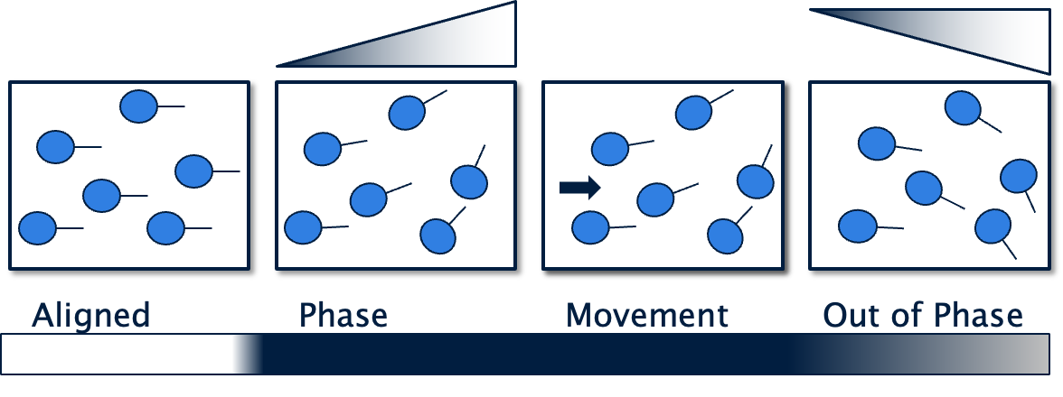
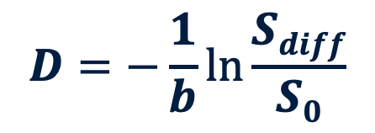
Diffusion MRI (1)
Measures the random motion of water molecules in tissue
Diffusion Measurement using Pulsed Gradient: Without Diffusion
Diffusion Measurement using Pulsed Gradient: With Diffusion
14

Slide 16
Diffusion MRI (2)
Acquisition:
Diffusion Directions:
Gradients applied in multiple directions (e.g., 6, 30, 64+)
Captures anisotropic diffusion along axons
b-values (diffusion weighting):
Low b-values (0–800 s/mm²): General water mobility
Moderate b-value (800-1500 s/mm²): Detect restricted diffusion in white matter
High b-values (2000–3000 s/mm²): Detect slow or complex diffusion
Diffusion Tensor Imaging (DTI)
Neurite Orientation Dispersion and Density Imaging (NODDI)
Diffusion Kurtosis Imaging (DKI)
The b-value determines diffusion sensitivity in MRI;
the reciprocal (1/b) represents the rate of diffusion (mm²/s) that the sequence is tuned to detect.
15

Slide 17
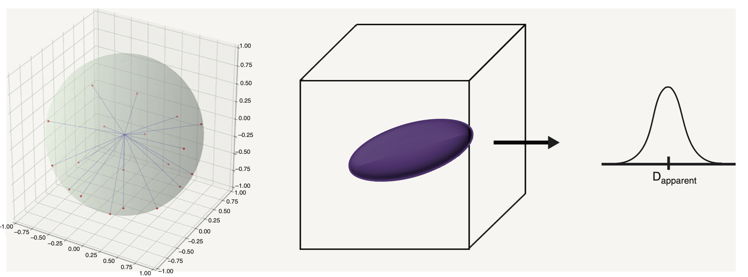
Diffusion Tensor Imaging (1)
Diffusion Tensor Imaging (DTI) is a mathematical model describing the magnitude and direction of water diffusion in three dimensions.
Models diffusion using a 3×3 tensor (D matrix) representing water movement in 3D
Assumes Gaussian diffusion in tissue
Generates an ellipsoid at each voxel that reflects directional diffusivity
Devon M Middleton and Chris J Conklin. Advanced diffusion imaging in neuroradiology. In Functional Neuroradiology: Principles and Clinical Applications, pages 933–947. Springer, 2023.
16

Slide 18
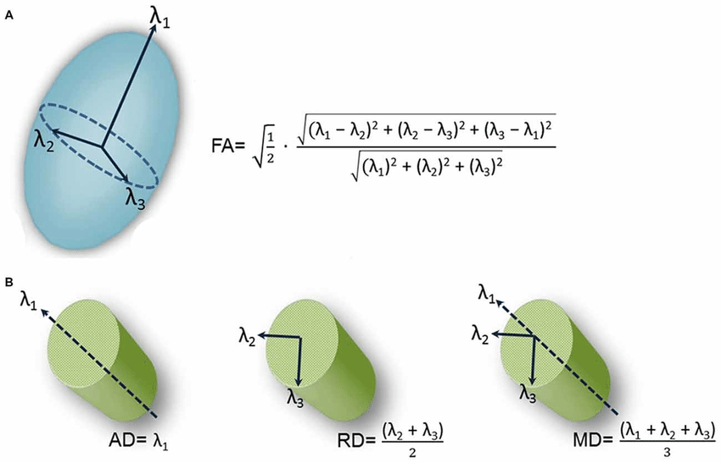
Diffusion Tensor Imaging (2)
DTI generates diffusion metrics:
Fractional Anisotropy (FA): Quantifies the degree of anisotropy of water diffusion, reflecting the directionality of fiber tracts within tissues.
Mean Diffusivity (MD): Average rate of water diffusion within tissues, regardless of directionality.
Radial Diffusivity (RD) and Axial Diffusivity (AD): Quantify diffusion perpendicular and parallel to the primary axis of fiber tracts.
17

Slide 19
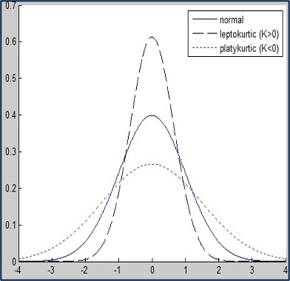
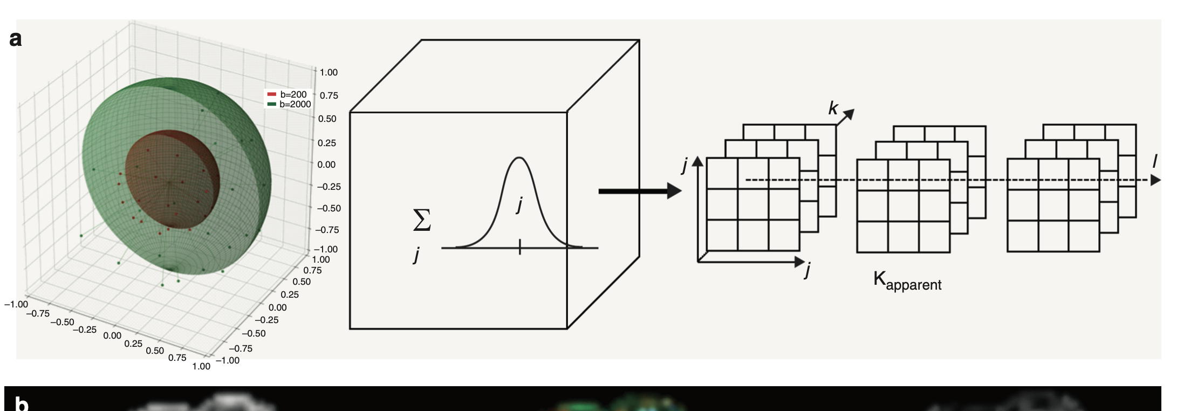
Diffusion Kurtosis Imaging (DKI)
DTI assumes Gaussian diffusion, which oversimplifies how water moves in biological tissues.
In reality, diffusion is non-Gaussian due to:
Cell membranes
Organelles
Myelin and other microstructural barriers
Indicates how much the water movement deviates from normal/Gaussian behavior
Higher kurtosis reflects greater microstructural complexity
MK (Mean Kurtosis): Average diffusional kurtosis across all directions
AK (Axial Kurtosis): Kurtosis along principal direction
RK (Radial Kurtosis):Kurtosis perpendicular to principal direction
Devon M Middleton and Chris J Conklin. Advanced diffusion imaging in neuroradiology. In Functional Neuroradiology: Principles and Clinical Applications, pages 933–947. Springer, 2023.
18

Slide 20
Neurite Orientation Dispersion and Density Imaging (1)
NODDI is another Diffusion MRI model based on a multi-compartmental diffusion model
NODDI models tissue as a combination of distinct compartments:
Intra-cellular (restricted): tightly packed neurites (blue stick)
Extra-cellular (hindered): space between neurites (purple ellipsoid)
Isotropic (free): CSF or edema (blue sphere)
Devon M Middleton and Chris J Conklin. Advanced diffusion imaging in neuroradiology. In Functional Neuroradiology: Principles and Clinical Applications, pages 933–947. Springer, 2023.
19

Slide 21
Neurite Orientation Dispersion and Density Imaging (2)
NDI (Neurite Density Index): Reflects the proportion of restricted diffusion along neurites (axons/dendrites)
Higher NDI = higher axonal density
ODI (Orientation Dispersion Index): Measures angular variation of neurite orientations within a voxel
Low ODI: fibers are highly aligned (e.g., healthy white matter)
High ODI: fibers are dispersed (e.g., crossing fibers, injury-induced disorganization)
ISOVF (Isotropic Volume Fraction): Estimates free water content, e.g., CSF, inflammation, edema
High ISOVF may indicate inflammation
NDI Decrease
ODI Decrease
20

Slide 22
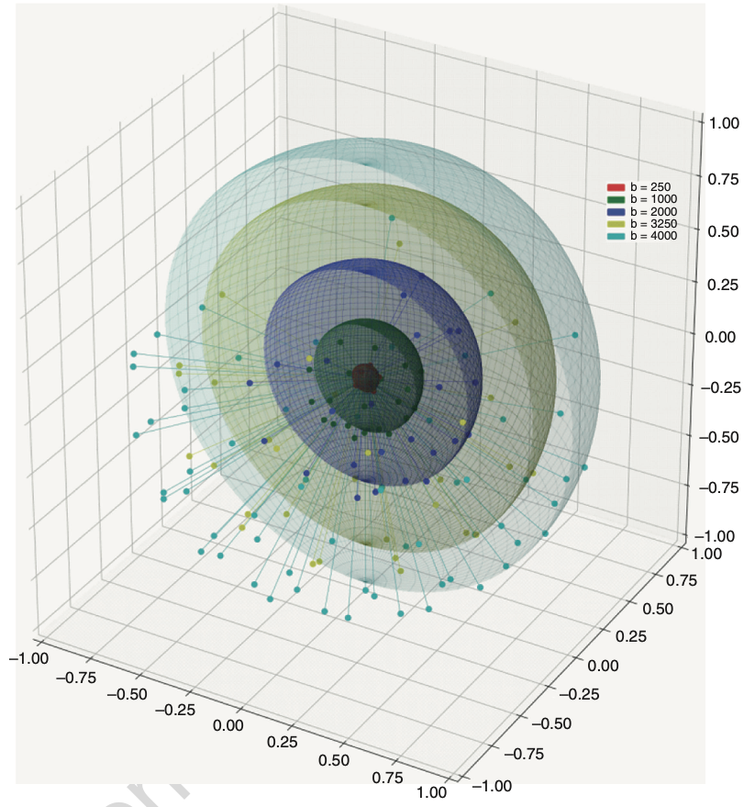
Hybrid Diffusion Imaging (HYDI)
A diffusion MRI acquisition framework that collects data across multiple b-values and diffusion directions (multi-shell).
Supports multiple diffusion models from a single acquisition:
DTI (e.g., FA, MD)
NODDI (e.g., NDI, ODI)
DKI (e.g., MK, AK, RK)
Reduces scan time by consolidating multiple contrasts into one protocol
VIC Decrease
ODI Decrease
Devon M Middleton and Chris J Conklin. Advanced diffusion imaging in neuroradiology. In Functional Neuroradiology: Principles and Clinical Applications, pages 933–947. Springer, 2023.
21

Slide 23
Summary
Modality | Type | Key Biomarkers | What It Measures
Structural MRI (T1, T2) | Anatomical | CSA, AP width, RL width | Cord shape and size
MTI | Magnetization transfer | MTR | Macromolecular content (myelin)
DTI | Diffusion (Gaussian) | FA, MD, AD, RD | Directional water diffusion
DKI | Diffusion (Non-Gaussian) | MK, AK, RK | Diffusion complexity
NODDI | Diffusion (Multi-compartment) | NDI, ODI, ISOVF | Axonal density, orientation dispersion, free water
22

Slide 24
Machine learning in Medical Imaging
ML in medical imaging transforms how we analyze radiological data by enabling:
Quantitative analysis (e.g., lesion volume, biomarkers)
Automated diagnosis (e.g., tumor detection, SCI classification)
Prognostic modeling (e.g., recovery prediction)
Advantages:
Scales analysis across large datasets
Extracts patterns beyond human perception
Categories:
Traditional ML:
Requires handcrafted features (e.g., shape, intensity)
Examples: SVM, Decision Trees, Random Forest
Deep Learning:
Learns features directly from images
Uses multi-layer neural networks (e.g., CNNs, Transformers)
23

Slide 25
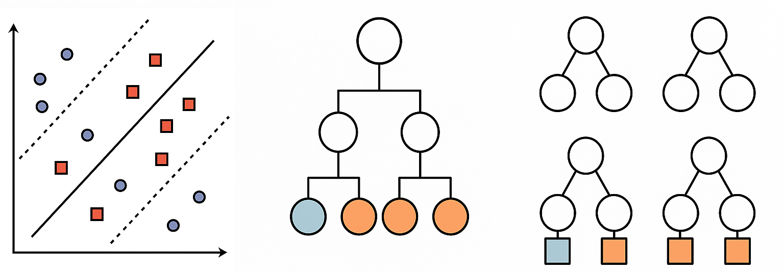
Traditional Machine learning in Medical Imaging
Support Vector Machine (SVM): Finds the optimal boundary (hyperplane) that separates data points from different classes.
Decision Trees: Classify data by splitting it into branches based on feature thresholds, creating an easy-to-follow set of rules.
Successes in tumor detection, lesion classification, survival prediction
Requires manual feature extraction
Struggles with complex, high-dimensional image data
24

Slide 26
Deep Learning in Medical Imaging
Deep Learning combines feature learning with prediction in an end-to-end framework.
It learns hierarchical representations directly from raw data, eliminating the need for manual feature extraction.
Common Architectures:
Convolutional Neural Networks (CNNs) CNNs extract spatial features from medical images and serve as the backbone for many clinical imaging applications.
Transformers and Self-Attention Mechanisms These models capture long-range dependencies in 2D and 3D data and are increasingly used in large-scale image modeling.
Outbreak COVID-19 in Medical Image Processing Using Deep Learning: A State-of-the-Art Review. Archives of computational methods in engineering : state of the art reviews, 29(4), 2351–2382. https://doi.org/10.1007/s11831-021-09667-7
25

Slide 27
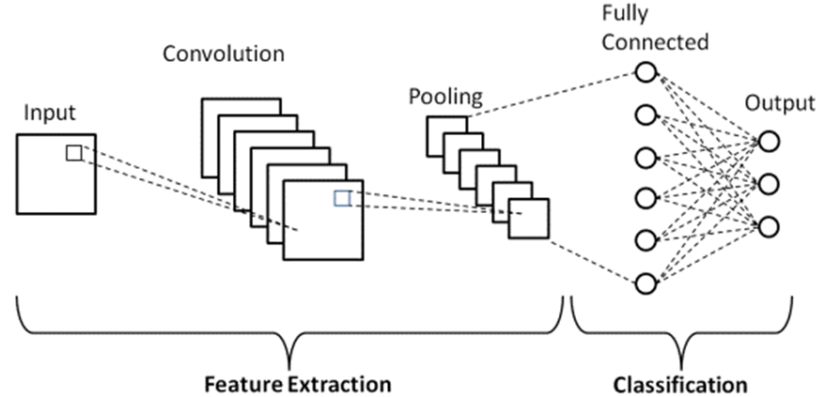
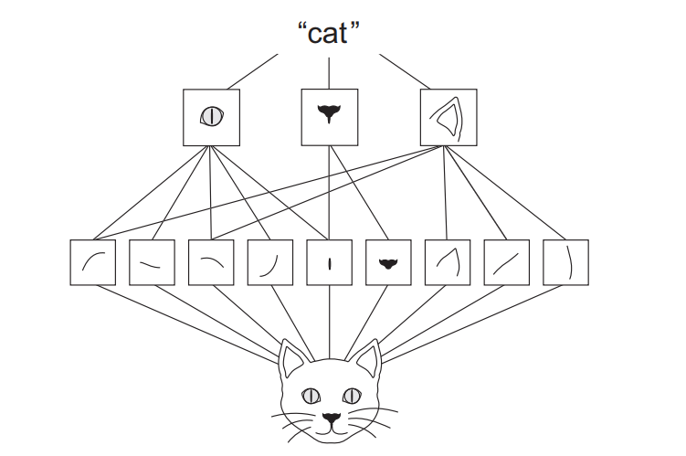
Convolutional Neural Networks (CNNs)
CNNs use convolutional filters to scan images and extract local patterns such as edges, textures, and shapes.
Multiple layers build on each other to learn complex hierarchical representations.
26

Slide 28
CNNs in Medical Imaging
CNNs are widely used in medical imaging for tasks like classification and segmentation due to their strong ability to capture local spatial features.
2D CNNs: Slice-based; simpler, faster, less context
3D CNNs: Full volume context; better performance on volumetric data
Trade-offs:
Efficient and well-suited for small datasets
Strong at modeling local patterns
But limited in capturing global context or long-range dependencies across large spatial areas
27

Slide 29
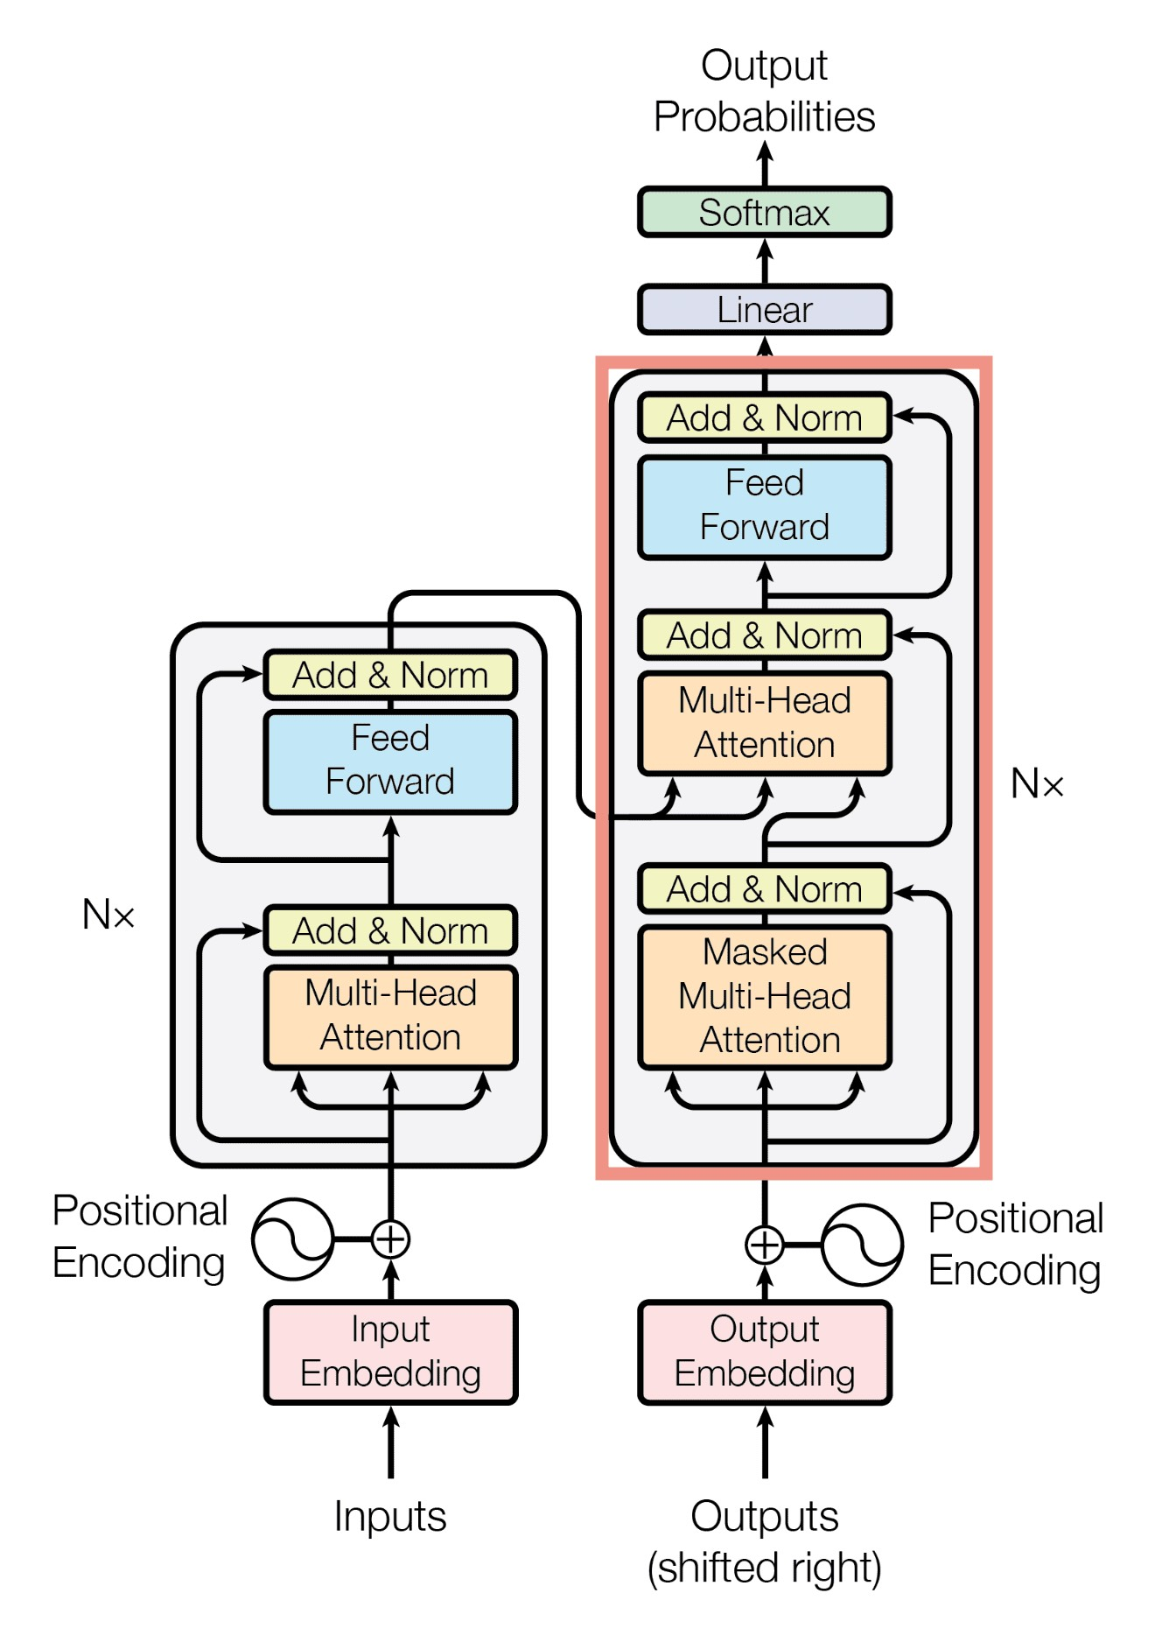
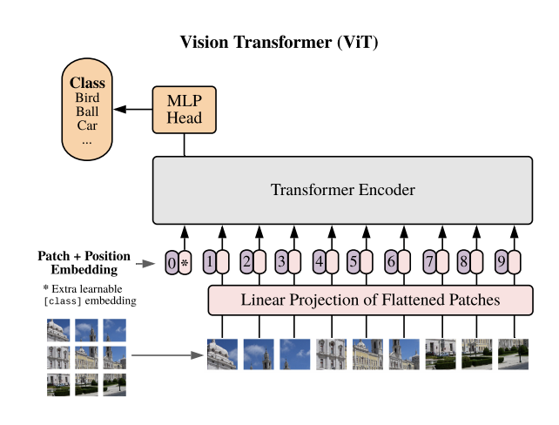
Transformers
Originally introduced for Natural Language Processing (NLP) (Vaswani et al., 2017)
Designed to handle sequences by capturing relationships between elements, without relying on recurrence (RNNs)
Core building block: Attention
Widely used in NLP, and now computer vision (e.g., ViT)
28

Slide 30
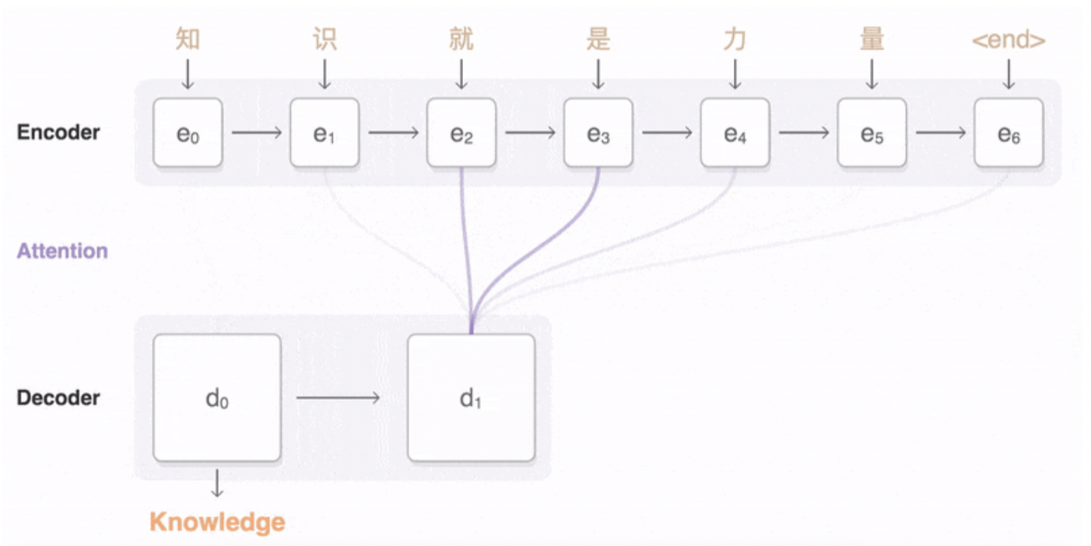
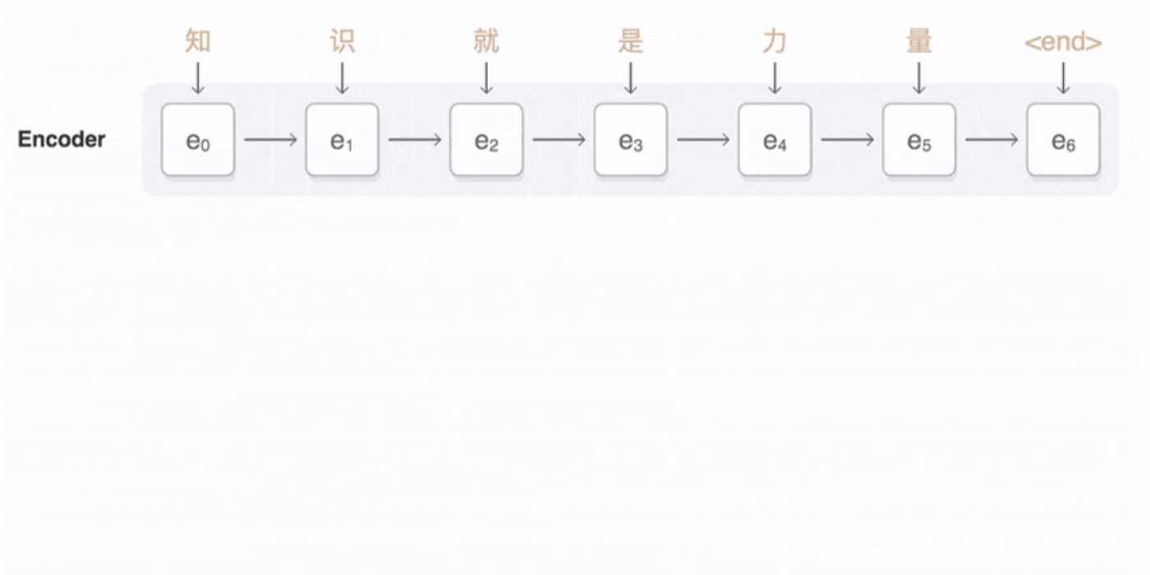
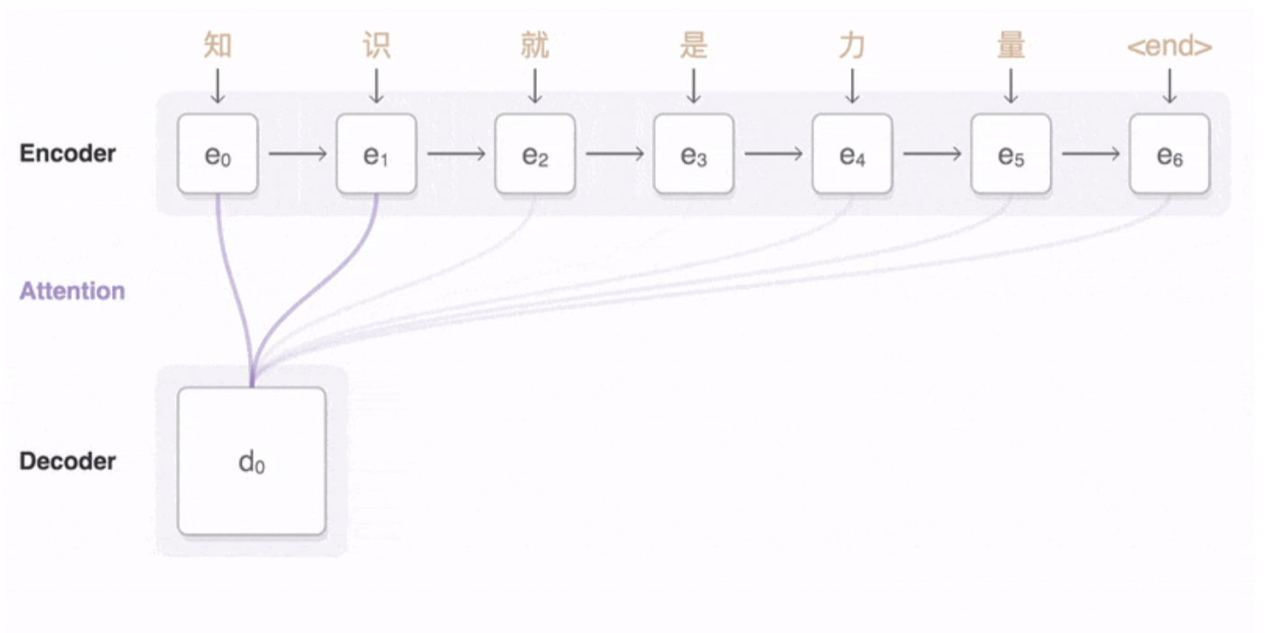
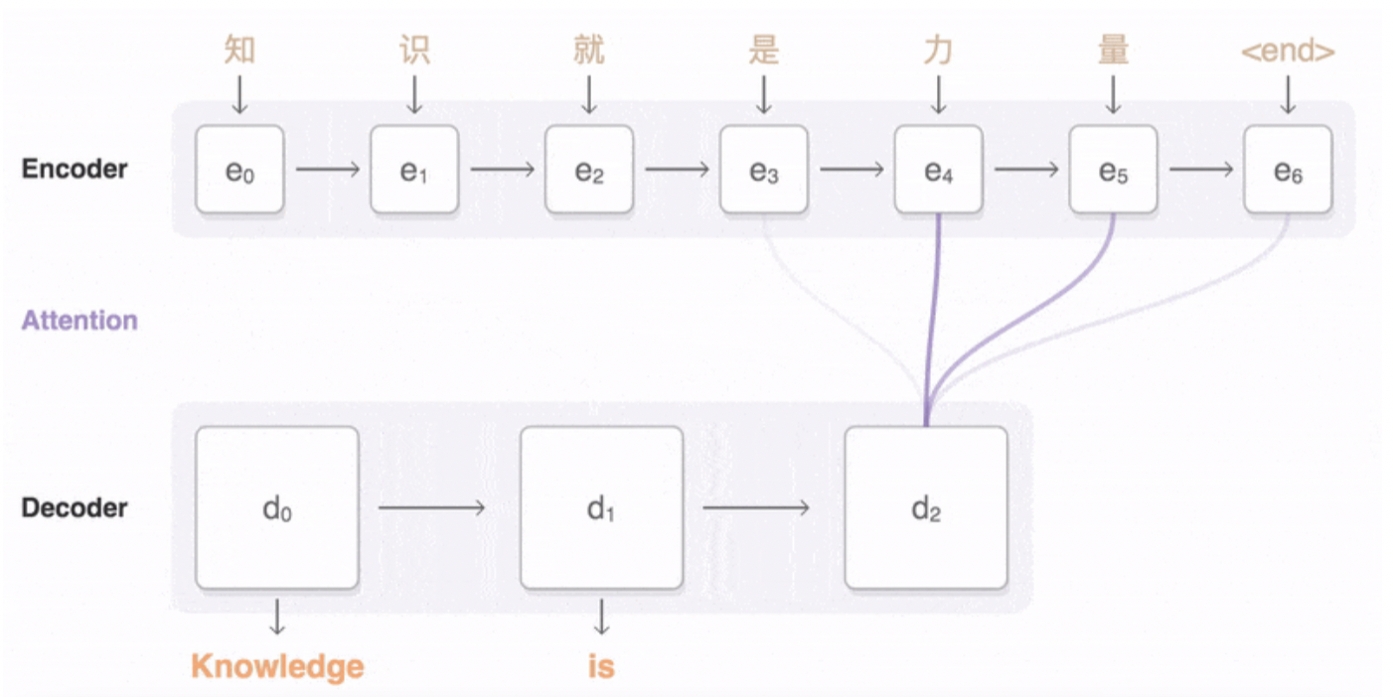
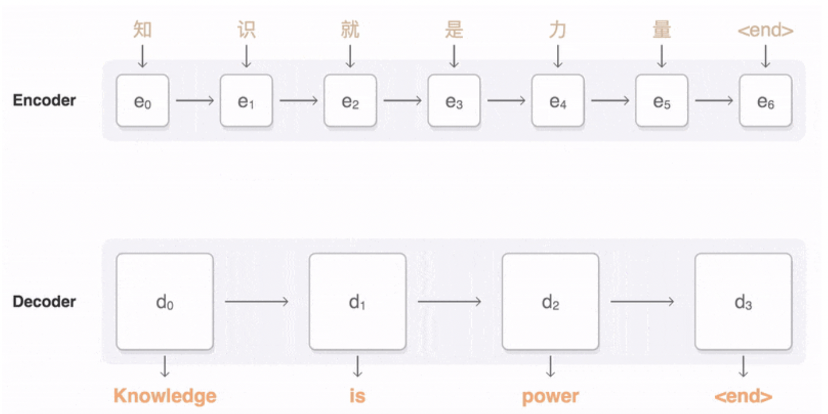
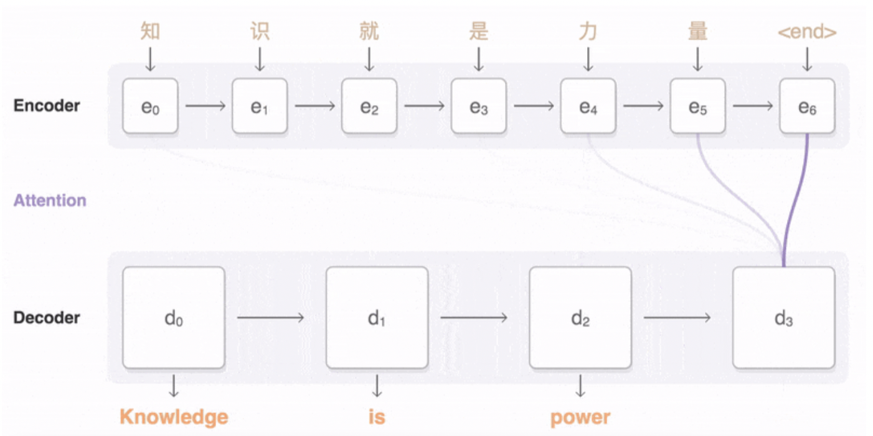
Attention Mechanisms
Attention:
Allows the model to weigh the importance of different parts of the input when making a prediction.
Instead of focusing equally on all regions, it learns to “attend” to the most relevant areas of the input.
29

Slide 31
Attention Mechanisms
Attention:
Output is a weighted sum of values, where weights come from similarity between queries and keys
Enables context-aware representation at each position
Component | Comes From | Description
Q | The query input | What is asking the question
K | The context input | The reference for similarity
V | The context input | The actual content you want to extract
30

Slide 32
Self-Attention Mechanisms
Self-Attention:
Each element in the input (a word, pixel, patch) computes its relation to every other element, enabling global context modeling.
Useful in medical images where pathology may span across regions (e.g., spinal cord damage across levels).
31

Slide 33
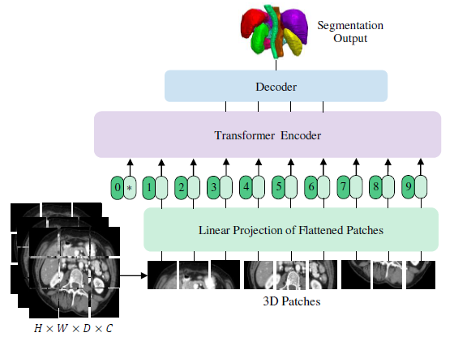
Attention in Medical Imaging
Attention mechanism is increasingly used in medical imaging for their ability to model long-range dependencies and global context.
UNETR applies self-attention to 3D MRI volumes using a transformer encoder and connects it to a U-Net decoder for accurate volumetric segmentation.
Trade-offs:
High accuracy, especially on complex tasks
But also high parameter count (e.g., UNETR ~91M)
Require large training datasets
Ali Hatamizadeh, et al. UNETR: Transformers for 3d medical image segmentation. In Proceedings of the IEEE/CVF winter conference on applications of computer vision, pages 574–584, 2022.
32

Slide 34
Machine Learning in Spinal Cord Imaging
Segmentation: ML models like 2D CNN automate spinal cord and lesion segmentation from T2-weighted MRI.
Diagnostic Classification: Studies using SVM and k-NN have classified SCI based on extracted diffusion features (e.g., FA), yet most lack direct image-based, end-to-end learning.
Prognostication: Models have been developed to predict AIS grade and motor recovery using clinical/demographic data, but often avoid learning directly from full imaging volumes.
Gaps:
Few studies assess SCI severity
Most are limited to manual feature extraction, only one using imaging
Rare use of multimodal input (e.g., DTI, NODDI)
Lack of volumetric 3D deep learning approaches
33

Slide 35
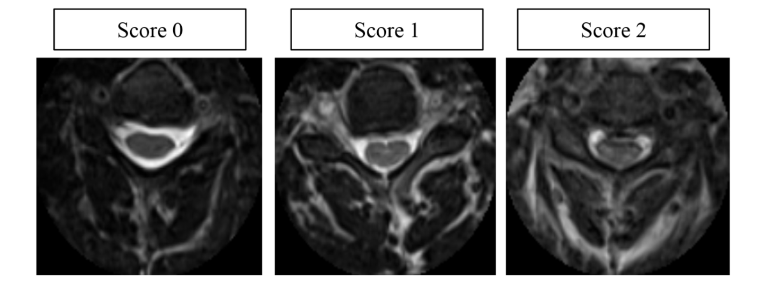
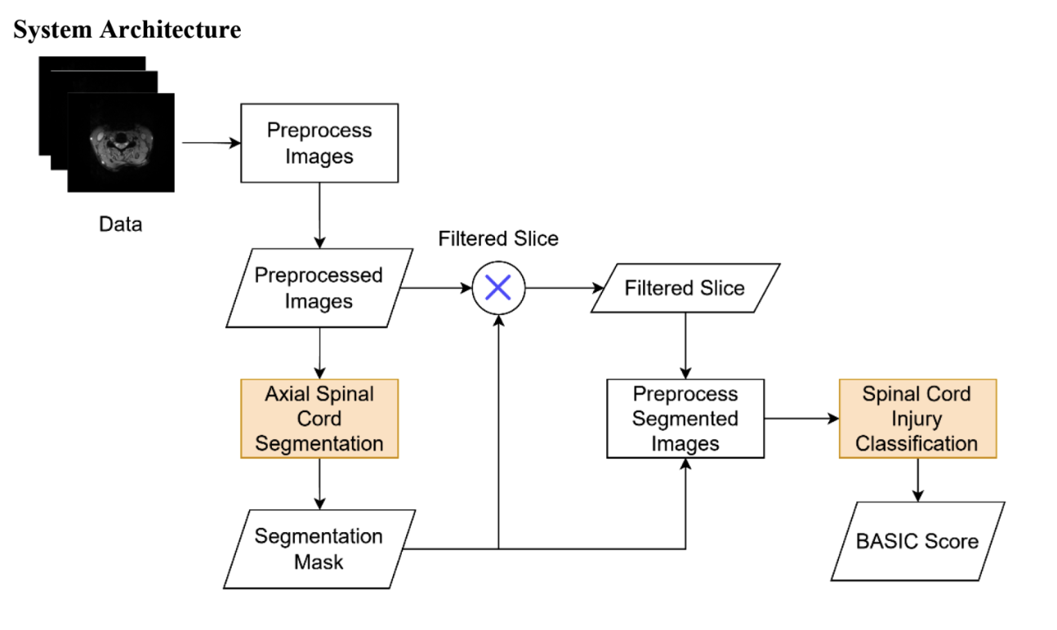
Machine Learning in Spinal Cord Imaging
Dataset: 294 cervical SCI patients
Severity classified using a modified BASIC score (3-class system) determined by expert raters using axial T2-weighted MRI
ResNet-50 (~20 million parameters) with F1: 0.72, AUC: 0.79.
Limitations:
2D model only; lacks volumetric integration
It assumes that slices above or below the lesion are “healthy” if they appear normal in isolation. However, in SCI, retrograde and anterograde degeneration can lead to structural and functional changes in regions both above and below the primary injury site.
I. Gusti Lanang Ngurah Agung Artha Wiguna, et al. A deep learning approach for cervical cord injury severity determination through axial and sagittal magnetic resonance imaging segmentation and classification. European Spine Journal, 33(11):4204–4213, 2024.
34

Slide 36
Outline
Background
Research Objective and Approach
Preliminary Results
Proposed Timeline and Future Work
35

Slide 37
Research Objectives and Approach
Ultimate Objective: Enable data-driven, reproducible, and age-aware diagnosis, improving clinical outcomes.
Aim 1: Collecting and Analyzing Pediatric MRI to Establish a Normative Spinal Cord Biomarker Database
Aim 2: Multimodal Machine Learning for Chronic Pediatric SCI Severity Assessment
Aim 3: Deep Learning-Based Severity Assessment in Acute Adult SCI
36

Slide 38
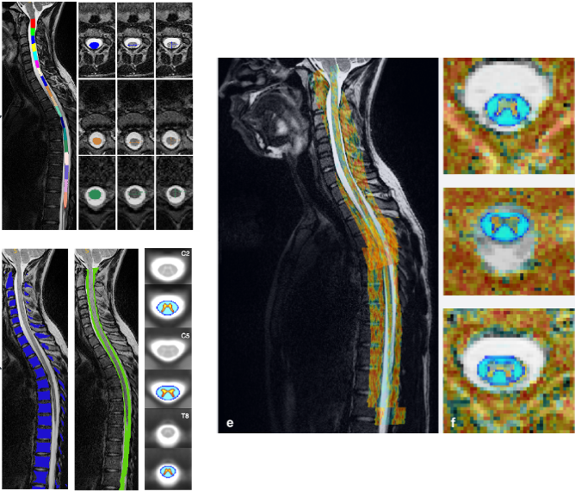
Aim 1:Collecting and Analyzing Pediatric Multimodal MRI to Establish a Normative Spinal Cord Biomarker Database
Pediatric spinal cord imaging currently lacks standardized reference values
Without age-appropriate benchmarks, it is difficult to distinguish between normal developmental variations and indicators of pathology.
We will collect and analyze multimodal MRI from 150 typically developing kids, to produce the first large-scale normative dataset of spinal cord structural and diffusion biomarkers in children.
To improve accuracy in diagnosis and clinical decision-making
To support future research into spinal cord development, injury response, and neurodevelopmental disorders.
45 min Scan
T1, T2, HYDI, MT 2 Slabs (C1- T11)
 | CSA | RL | AP | FA | MD | RD | AD | Vic | ODI | ISOVF | MK | RK | AK | MTR
C1
C2
…
T10
T11
150 TD
6 - 17
Hypothesis: MRI-derived biomarkers will show statistically significant linear or nonlinear correlations with age.
37

Slide 39
Aim 1: Study Population
Sample: 150 typically developing (TD) children, ages 6–17
Inclusion criteria:
No known neurological or musculoskeletal disorders
Normal motor and cognitive development
Exclusion criteria:
Significant motion artifacts
IRB Approval: Study approved by the Institutional Review Board (IRB) at Thomas Jefferson University
Consent: Written informed consent will be obtained from parents/guardians
38

Slide 40
Aim 1: Data Acquisition
45 min Scan
2 Slabs (C1- T11)
38

Slide 41
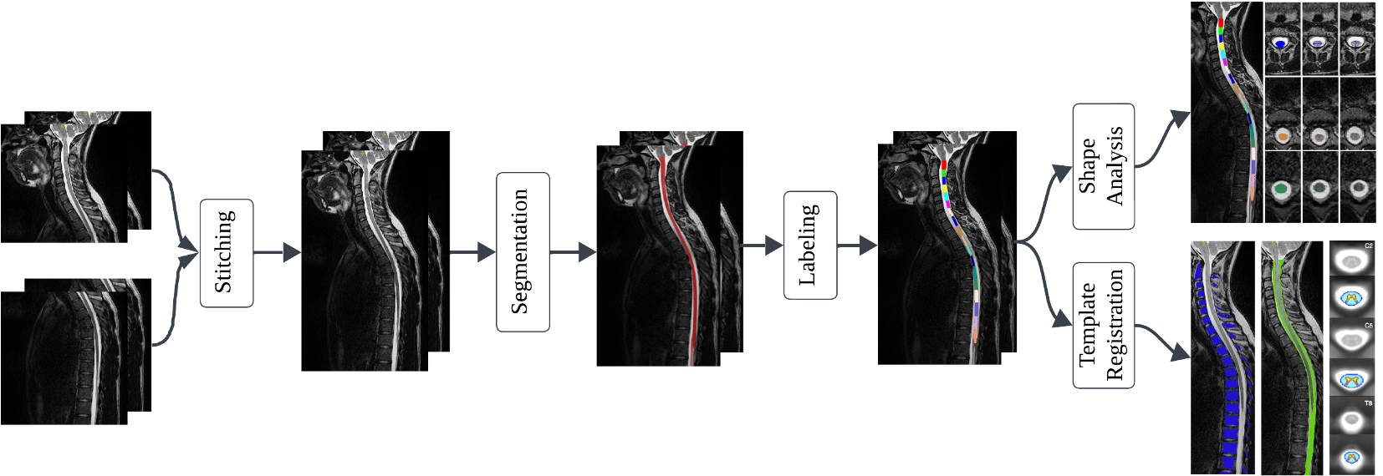
Aim 1: Processing Pipeline (1)
1. Structural Images:
Multi-slab stitching (C1–T11)
Spinal cord segmentation and vertebral labeling using Spinal Cord Toolbox (SCT), automated, reproducible pipeline for spinal cord image processing
Shape analysis to extracted features: CSA, AP, RL widths per vertebral level
Register to Template to get white matter grey matter maps
Benjamin De Leener, et al. Sct: Spinal cord toolbox, an open-source software for processing spinal cord MRI data. Neuroimage, 145:24–43, 2017.
39

Slide 42
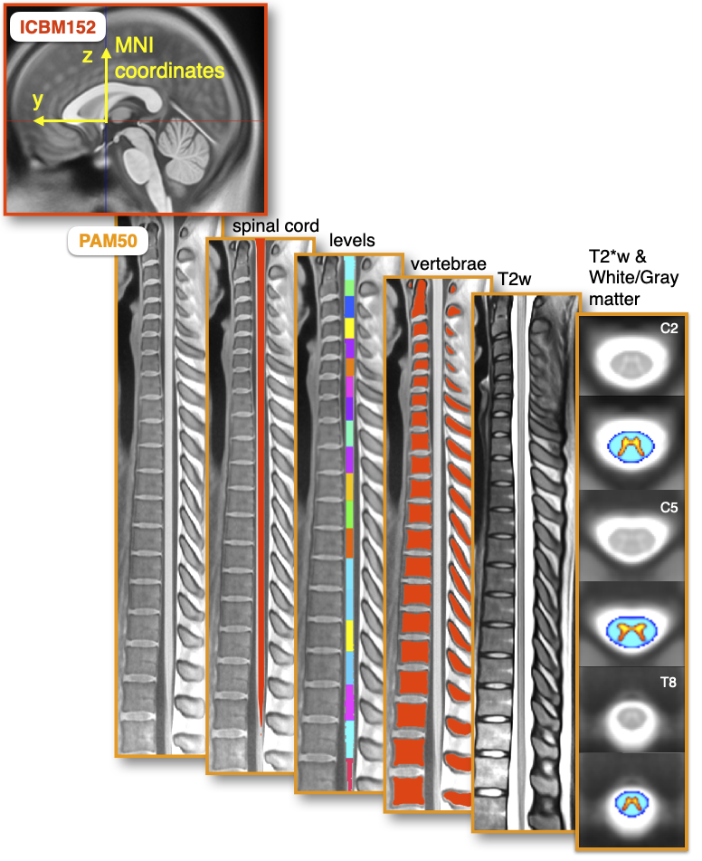
Aim 1: Processing Pipeline (2)
1.1. Registration to PAM50 spinal template:
PAM50 is a high-resolution anatomical template of the spinal cord and brainstem. Built from T1-, T2-weighted images of 50 healthy subjects.
Provides standardized spinal cord anatomy:
white and gray matter probabilistic maps
spinal levels (C1–T12)
tissue labels
Supports automated labeling of spinal levels and regions of interest.
De Leener, B et. al, Pam50: Unbiased multimodal template of the brainstem and spinal cord aligned with the icbm152 space. Neuroimage, 165:170179, 2018.
40

Slide 43
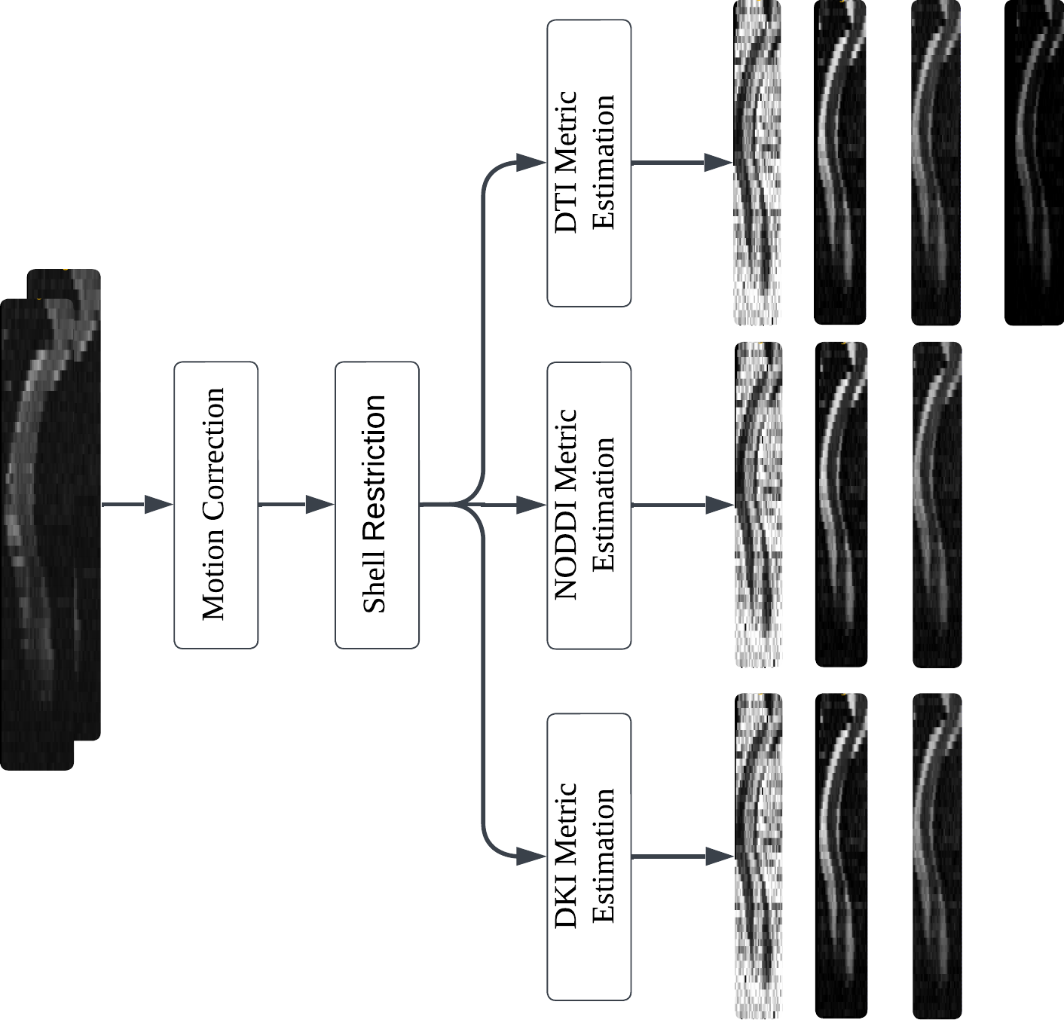
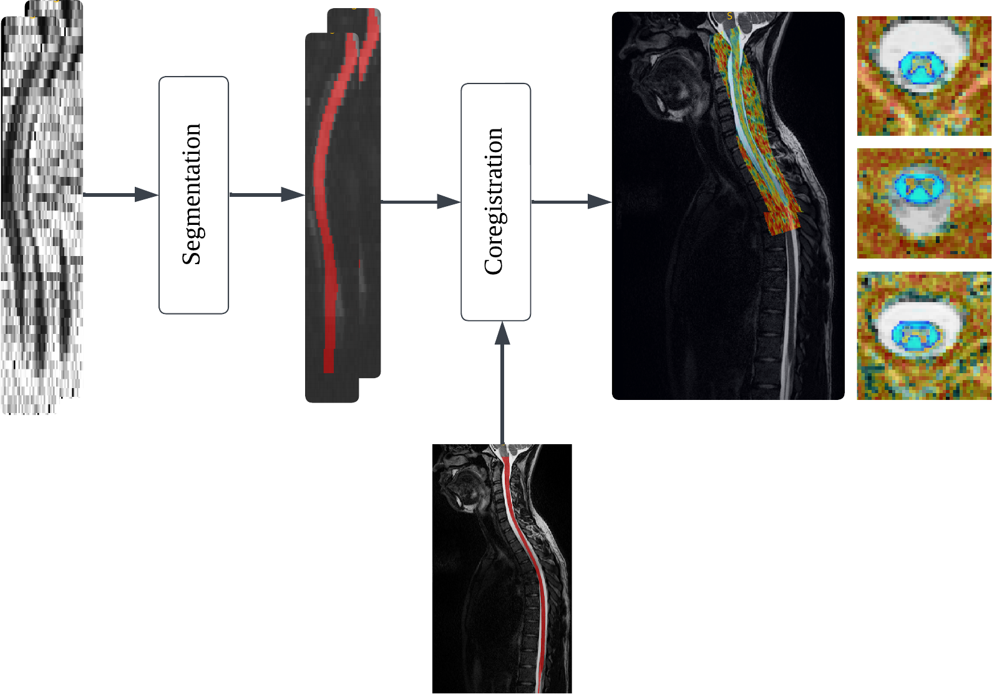
Aim 1: Processing Pipeline (3)
2. Diffusion Images:
From HYDI -> Extract DTI (FA, MD, AD, RD), NODDI (NDI, ODI), DKI (MK, AK, RK)
DTI (FA, MD, AD, RD), NODDI (NDI, ODI), DKI (MK, AK, RK) -> Coregister to Structural (T2)
41

Slide 44
Aim 1: Preprocessing Pipeline (4)
3. Final Level-wise Extraction:
Segmented
Levels
 | CSA | RL | AP | FA | MD | RD | AD | Vic | ODI | ISOVF | MK | RK | AK | MTR
C1
C2
…
T10
T11
Segmented
White matter
All metrics
42

Slide 45
Aim 1: Statistical Analysis Plan
Modeling Age, Sex, and Height Effects on MRI Biomarkers:
Descriptive statistics (mean, SD, 95% CI) will be computed for each metric by grouped by age and sex.
Correlational analysis to assess trends with age/height.
*Raw imaging data and extracted biomarkers will be made publicly available to support open science and reproducibility.
 | CSA | RL | AP | FA | MD | RD | AD | Vic | ODI | ISOVF | MK | RK | AK | MTR
C1
C2
…
T10
T11
Age
Sex
Height
43

Slide 46
Aim 1: Impact
Establishes the first pediatric multimodal spinal MRI database — Integrates structural and diffusion imaging across a wide pediatric age range.
Addresses the critical lack of normative references — Fills a major gap in pediatric SCI assessment by providing age-specific benchmarks.
Provides a foundation for age-aware clinical interpretation — Enables more accurate, developmentally appropriate analysis of pediatric spinal MRI.
Supports future diagnostic and prognostic tool development — Facilitates machine learning models and clinical tools for early detection and outcome prediction in pediatric spinal cord disorders.
44

Slide 47
Aim 2: Multimodal Machine Learning for Chronic Pediatric SCI Severity Assessment
Pediatric SCI diagnosis often relies on clinical assessments, such as the AIS scale, which are challenging for pediatric.
No prior study has used machine learning to assess SCI severity in pediatric patients.
Our framework introduces the first AI-driven severity grading tool using multimodal spinal cord MRI data.
Help in tracking patient progress over time
Builds an objective and data-driven assessment
 | CSA | RL | AP | FA | MD | RD | AD
C1
C2
…
T10
T11
Hypothesis: Multimodal ML models will outperform unimodal models in classifying severity.
45

Slide 48
Aim 2: Study Population
175 total subjects:
150 TD controls (from Aim 1)
25 chronic pediatric SCI patients with T2, DTI, and AIS scores
Subjects categorized into: TD, Motor Incomplete SCI, Motor Complete SCI
 | CSA | RL | AP | FA | MD | RD | AD
C1
C2
…
T10
T11
25 Chronic SCI (6-17)
T1, T2, DTI Severity: motor complete, motor incomplete
?
 | CSA | RL | AP | FA | MD | RD | AD
C1
C2
…
T10
T11
Aim 1: 150 TD (6 - 17)
46

Slide 49
Aim 2: Machine Learning Model Design
Input: 18×7 matrix (18 levels × 7 features),demographic info (Age, Height, Gender)
CNN captures spatial patterns across spinal levels for each modality
Output: 3-class softmax (TD, motor incomplete, motor complete)
Imbalance handling:
Weighted loss function
Class oversampling
Data augmentation:
Gaussian noise injection
Feature scaling
Gender
47

Slide 50
Aim 2: Evaluation and Hypothesis Testing
Evaluate model performance using cross-validation
Metrics: Accuracy, Precision, Recall, F1-Score
Compare:
Multimodal (structure + diffusion + demographics) vs.
Unimodal (structure or diffusion only)
Gender
49

Slide 51
Aim 2: Expected Impact and Innovation
Introduces the first ML-based framework for pediatric SCI severity grading — Leverages structural and diffusion MRI biomarkers to classify motor severity.
Offers a data-driven tool to support AIS assessment — Complements clinical evaluation and may enable partial automation of severity classification.
Improves objectivity and reduces reliance on invasive testing — Provides a non-invasive alternative for assessing motor function, potentially reducing the need for procedures like anorectal testing.
50

Slide 52
Aim 3: Deep Learning-Based Severity Assessment in Acute Adult SCI
Accurate early severity assessment is critical for treatment planning in acute SCI.
Prior ML studies on adult SCI were limited to 2D slices and single modalities.
Aim 3 introduces the first 3D multimodal model for SCI severity classification based on full T2 and DTI volumes.
?
AIS Grade
Hypothesis: Multimodal deep learning models will outperform single-modality models in classification performance.
51

Slide 53
Aim 3: Study Population and Imaging Data
190 Adults
Cervical SCI (C1–C8)
Acute (1-24 hours post injury)
T2-weighted (C1-T1) 256 × 256 × 58 0.7 × 0.7 × 1.8 mm³
DTI (C1–T1) 144 × 144 × 37
Acute AIS Grade
All images collected at Jefferson as a part of routine clinical care under IRB approval.
52

Slide 54
Aim 3: Data Preprocessing Pipeline
Spinal cord segmentation on both T2 and DTI modalities (SCT)
Co-Registration (SCT): Align all DTI maps to the T2 space for voxel-wise correspondence.
53

Slide 55
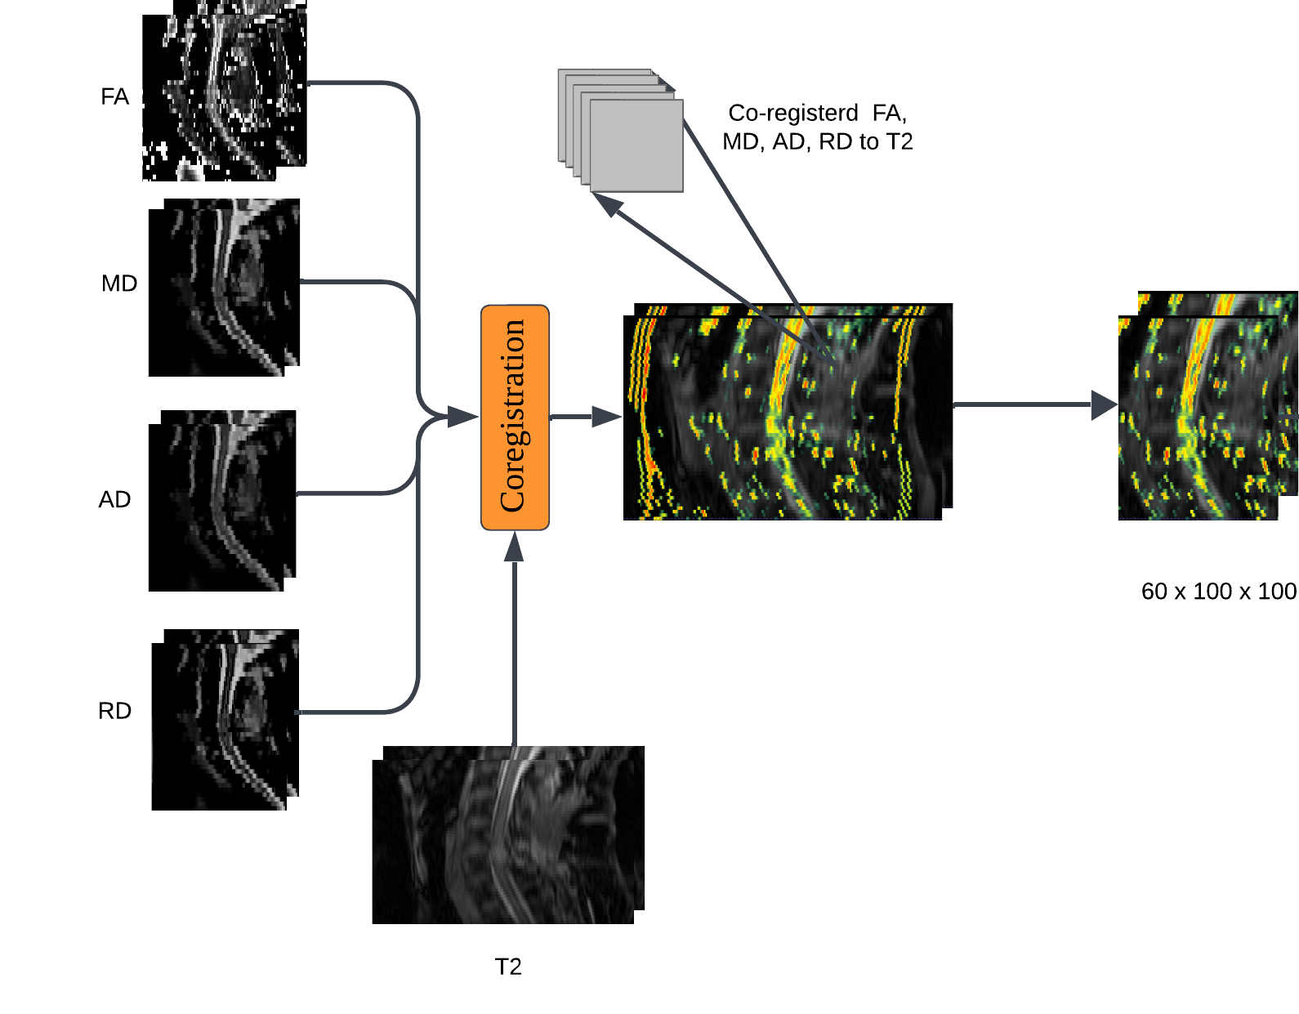
Aim 3: Input Structure and Model Objective
5-channel 3D image for each subject: T2, FA, MD, AD, RD.
Crop based on the center of spine: (100 × 100 x 60 × 5)
Output: Predicted probability across four AIS grades (A, B, C, D)
54

Slide 56
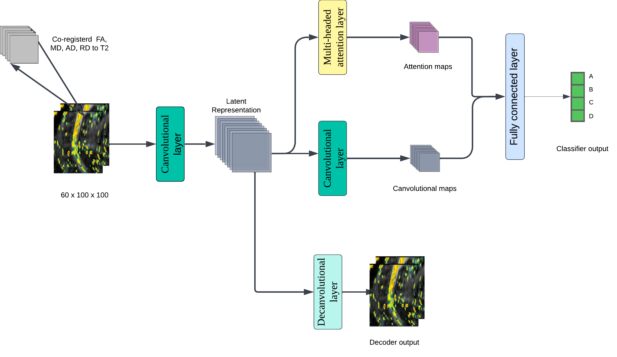
Aim 3: Model Architecture Overview
A 3D convolutional autoencoder is used as the base architecture to pretrain and extract spatial features.
The encoder output is branched into two parallel modules:
A Multi-Head Self-Attention module
An additional 3D convolutional block
The outputs are concatenated and passed to a fully connected layer for final classification
Captures both local spatial features (via CNN) and global contextual information (via attention).
55

Slide 57
Aim 3: Autoencoder and Latent Feature Compression
Encoder compresses the input into a low-dimensional latent space z
Decoder used during pretraining to reconstruct input and regularize feature space
Latent features retain the most relevant information and reduce noise
56

Slide 58
Aim 3: Attention Augmentation Mechanism Integration
The encoder extracts meaningful spatial features.
Applying attention after encoding ensures the attention module is working on high-level representations, semantically relevant features (edges, structure, abnormalities) rather than raw intensity values.
This is like "attending over concepts" instead of "attending over pixels."
58

Slide 59
Aim 3: Model Training and Evaluation
Evaluate model performance using cross-validation
Metrics: Accuracy, Precision, Recall, F1-Score
Compare: Multimodal vs. T2-only vs. DTI-only models
Model Complexity and memory use:
A 3-layer 3D convolutional encoder (channels: 16, 32, 64), followed by a 128-dimensional 4-head self-attention module and an additional 128-channel convolutional block results in approximately 500,000 trainable parameters.
59

Slide 60
Aim 3: Anticipated Outcomes and Impact
Introduces the first fully 3D, multimodal deep learning model — Integrates coregistered T2-weighted and diffusion MRI for acute SCI severity classification.
Provides objective AIS grade predictions — Assists clinicians in fast-paced acute care settings by delivering data-driven, interpretable outputs.
Reduces reliance on subjective MRI interpretation — Enhances consistency and reproducibility of spinal cord injury assessments during early diagnosis.
60

Slide 61
Outline
Background
Research Objective and Approach
Preliminary Results
Proposed Timeline and Future Work
61

Slide 62
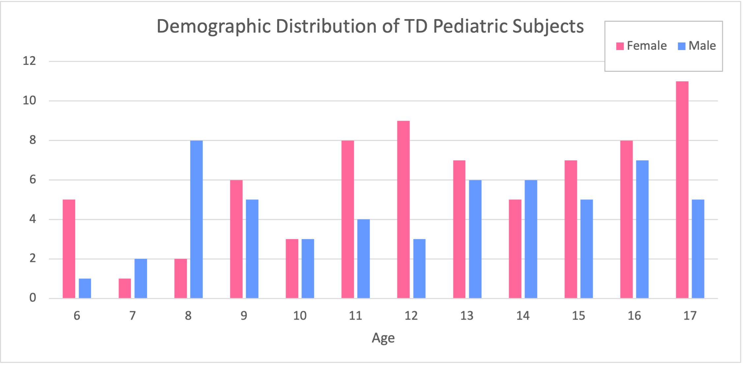
Preliminary Results: Aim 1
To date, MRI data from 127 typically developing (TD) children have been collected.
Age range: 6 to 17 years.
Sex distribution: 72 females (mean age = 12.66± 3.40), 55 males(mean age = 12.32± 3.23).
62

Slide 63
Preliminary Results: Aim 1
For all subjects, T2-weighted and DTI sequences were processed to extract:
Structural metrics: CSA, AP width, RL width
Diffusion metrics: FA, MD, AD, RD
Statistical analysis revealed positive correlations between CSA and age, especially in upper cervical regions.
63

Slide 64
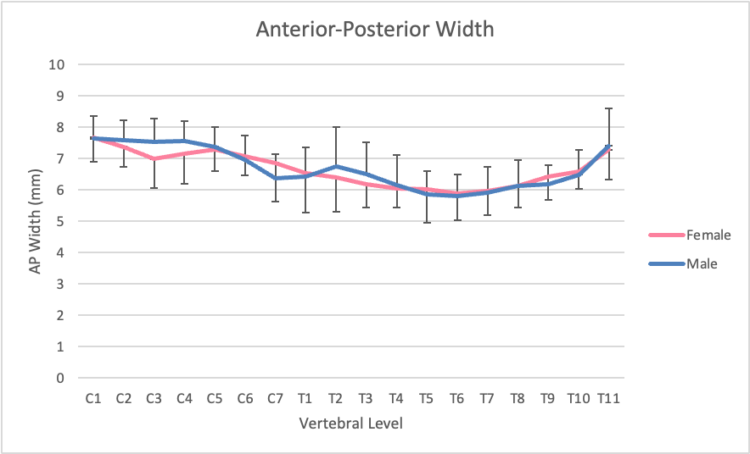
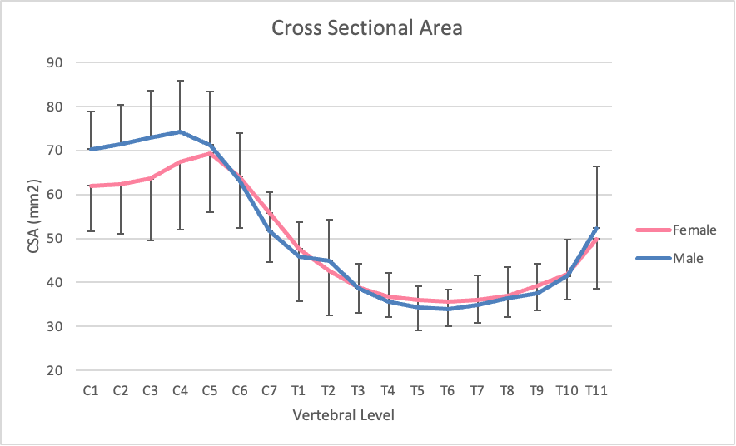
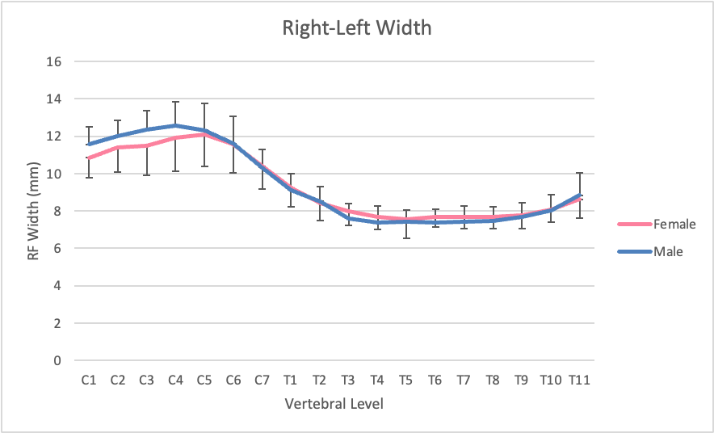
Preliminary Results: Aim 1
Males exhibited consistently larger CSA and RL widths than females across cervical cord.
AP width showed smaller differences.
64

Slide 65
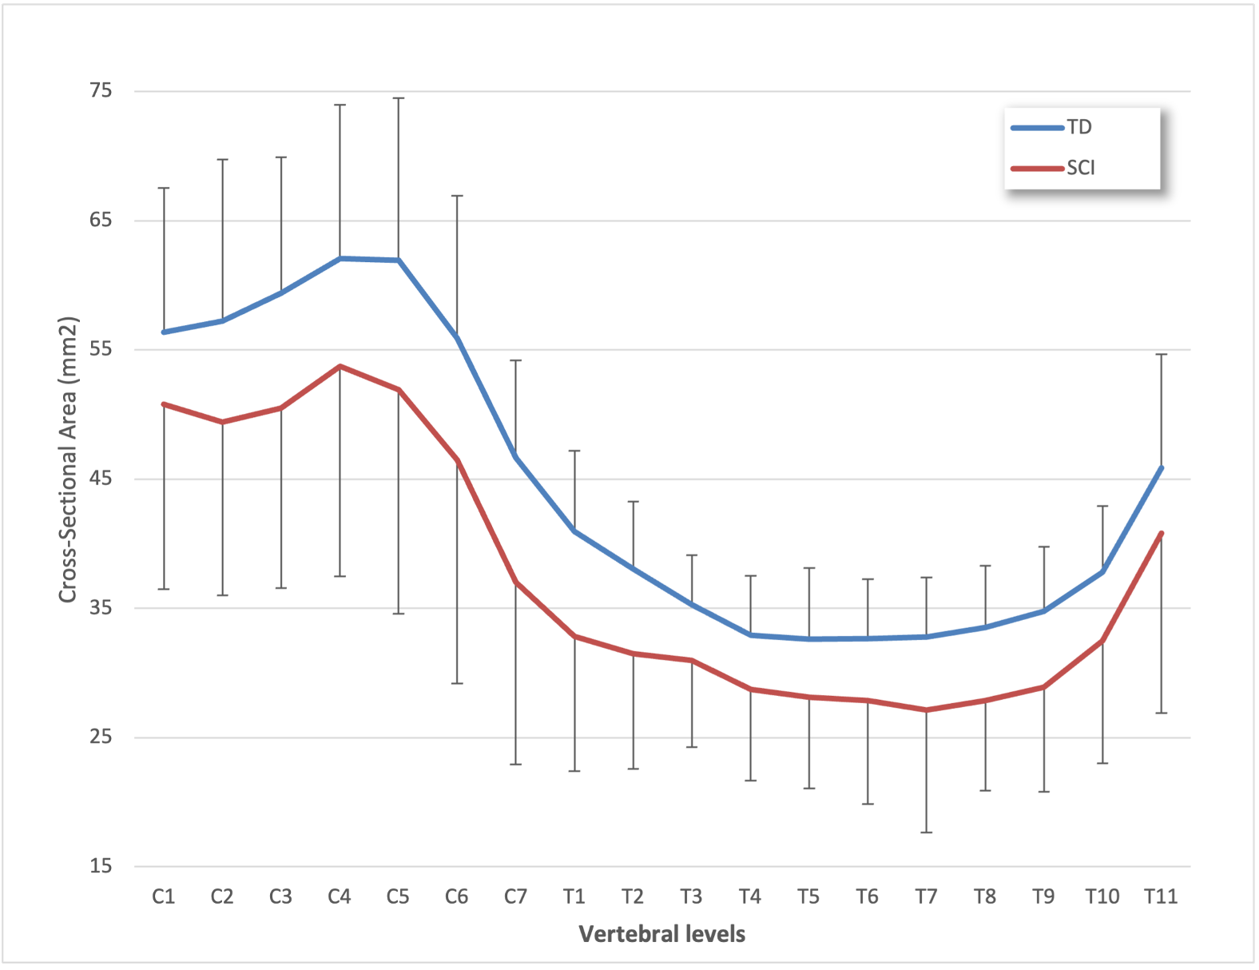
Preliminary Results: Aim 2
Processed structural MRI data from 25 (mean age = 12.41± 3.27), pediatric SCI subjects, in addition to the 127 TD (mean age = 12.51± 3.23), subjects from Aim 1.
Initial statistical analyses confirmed significant reductions in CSA in SCI subjects compared to TD controls at all vertebral levels.
All SCI scans were reviewed by a radiologist to identify and label abnormal signal intensities.
65

Slide 66
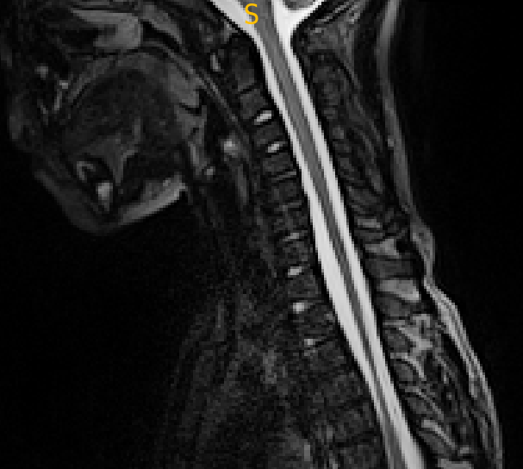
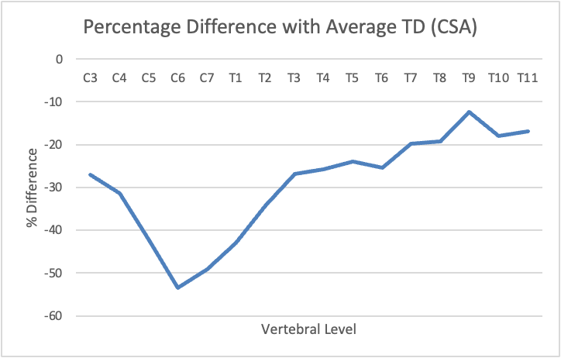
Preliminary Results: Aim 2
Example SCI:
Vertebral Level | CSA (mm2)
C1 | 41.26
C2 | 40.53
C3 | 42.49
C4 | 42.52
C5 | 35.83
C6 | 25.77
C7 | 23.69
T1 | 23.53
T2 | 25.01
T3 | 25.47
T4 | 23.98
T5 | 24.30
T6 | 23.80
T7 | 25.72
T8 | 26.87
T9 | 30.47
T10 | 31.17
T11 | 37.34
AIS Grade: B
No Abnormal Signal!
ASIA NL: C6
66

Slide 67
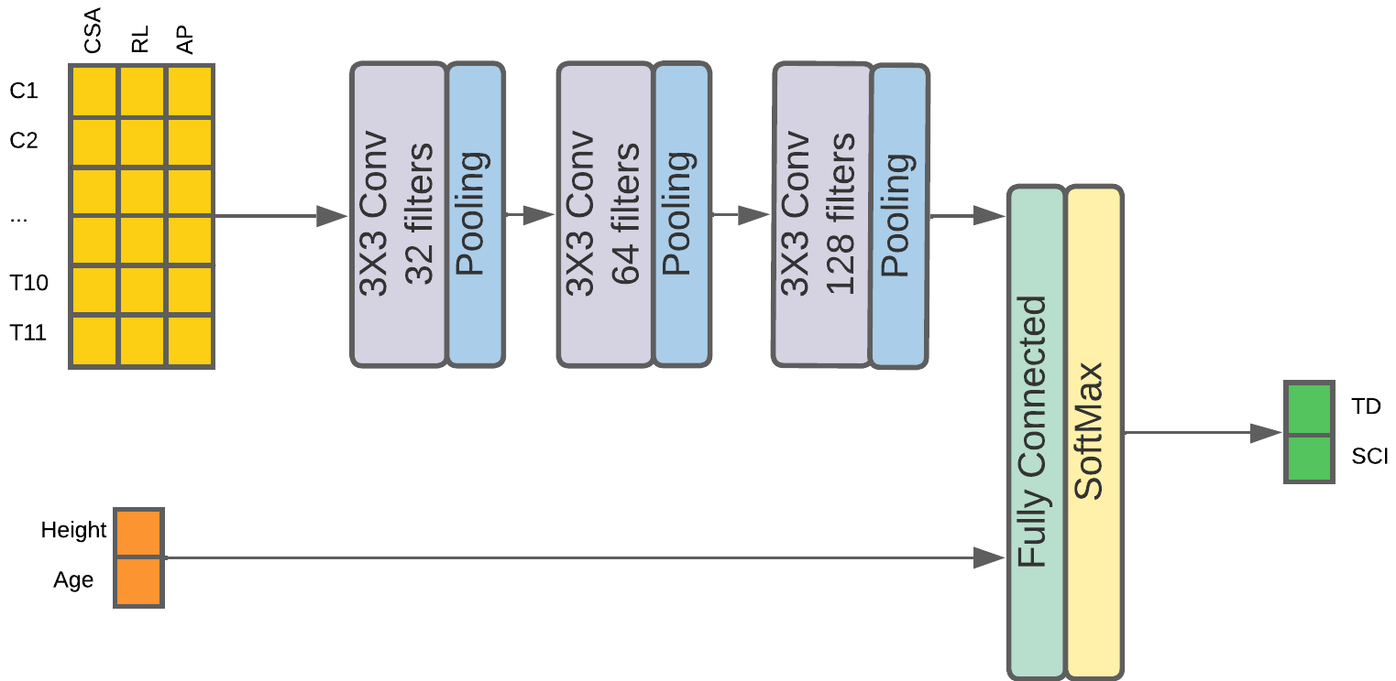
Preliminary Results: Aim 2
Built a CNN-based classifier to distinguish between TD, Motor Complete, Motor Incomplete groups, using structural features: CSA, AP width, and RL width
Model trained on 60 TD + 20 SCI subjects (80–20 train-test split).
Total parameters: ~40K (small enough for this dataset)
Used early stopping, loss monitoring, and weighted loss for class imbalance
67

Slide 68
Preliminary Results: Aim 2
Results for 30 models trained on different 80/20 data splits
Classification Accuracy of SVM, Random Forest, and CNN models
 | RF | SVM | CNN
TD/SCI | 0.7635 | 0.7842 | 0.9559
TD/Motor Complete/ Motor Incomplete | 0.6889 | 0.7400 | 0.9492
CNN model performance
Category | Precision | Recall | F1-Score
TD | 0.88 | 0.98 | 0.93
Motor Complete | 0.99 | 0.95 | 0.97
Motor Incomplete | 0.97 | 0.93 | 0.94
Sadeghi-Adl, Z., Naghizadehkashani, S., Middleton, D., Krisa, L., Alizadeh, M., Flanders, A. E., Faro, S. H., Wang, Z., & Mohamed, F. B. (2025). Severity classification of pediatric spinal cord injuries using structural MRI measures and deep learning: A comprehensive analysis across all vertebral levels. American Journal of Neuroradiology.
68

Slide 69
Preliminary Results: Aim 3
Done Structural and DTI preprocessing for all 190 adult SCI patients.
The preprocessing pipeline included motion correction, spinal cord segmentation, and coregistration of DTI metrics (FA, MD, AD, RD) with T2-weighted images for spatial alignment.
Now ready for training multimodal models to classify SCI severity based on MRI images
69

Slide 70
Future Work and Research Timeline
Task Description | Start | End
Aim 1: Pediatric Data Collection & Analysis
Pediatric Data Collection | In Process | Nov 2025
Pediatric Data Analysis | In Process | Nov 2025
Statistical Analysis | Sep 2025 | Nov 2025
Aim 2: Pediatric Model Development & Testing
Model Development and Testing on Collected Data | Sep 2025 | Nov 2025
Final Development and Testing on the Whole Data | Nov 2025 | Jan 2026
Aim 3: Adult Deep Learning Model Implementation
Implement baseline models (Simple CNN / Single Modality/Multimodal) | In Process | July 2025
Implement final models (CAE and Attention-based Multimodal) | Jul 2025 | Sep 2025
Writing & Finalization
Thesis Drafting | Oct 2025 | Mar 2026
Revision & Feedback | Jan 2026 | Mar 2026
Defend Thesis | Apr 2026 | Apr 2026
Incorporate Final Corrections & Submit Thesis | Apr 2026 | May 2026
70

Slide 71
Publications
[1] Sadeghi-Adl, Z., Naghizadehkashani, S., Middleton, D., Krisa, L., Alizadeh, M., Flanders, A. E., Faro, S. H., Wang, Z., & Mohamed, F. B. (2025). Severity classification of pediatric spinal cord injuries using structural MRI measures and deep learning: A comprehensive analysis across all vertebral levels. American Journal of Neuroradiology.
[2] Naghizadeh Kashani, S., Vel, I., Sadeghi-Adl, Z., Shahrampour, S., Middleton, D., Alizadeh, M., Krisa, L., Faro, S., Tounekti, S., Cohen-Adad, J., & Mohamed, F. B. (2025). Magnetization transfer ratio in the typically developing pediatric spinal cord: Normative data and age correlation. Journal of Neuroimaging, 35(1), e70019.
[3] Ahmad, F., Sadeghi-Adl, Z., Hagen, C., Hiremath, S., Uhl, A., Ferretti, L., & McCallion, P. (2024). Gait pattern analysis of older adults via radar micro-Doppler signatures and wrist-worn accelerometer data. In Radar Sensor Technology XXVIII, Proc. SPIE 13048, 180–184.
[4] Sadeghi-Adl, Z., & Ahmad, F. (2023). Whitening-aided learning from radar micro-Doppler signatures for human activity recognition. Sensors, 23(17), 7486.
[5] Sadeghi-Adl, Z., & Ahmad, F. (2023). Radar-based whitening-aided human activity recognition. In Proceedings of the IEEE Radar Conference (RadarConf23) (pp. 1–5).
[6] Sadeghi-Adl, Z., & Ahmad, F. (2023). Semi-supervised convolutional autoencoder with attention mechanism for activity recognition. In Proceedings of the 31st European Signal Processing Conference (EUSIPCO) (pp. 785–789).
71

Slide 72
Conference Abstracts and Posters
[1] Sadeghi-Adl, Z., Naghizadehkashani, S., Raimondo, C., Middleton, D., Krisa, L., Alizadeh, M., Flanders, A. E., Faro, S. H., & Mohamed, F. B. (2024, November). Structural assessment and ASIA impairment scale prediction in pediatric spinal cord injuries: Integrating imaging parameters and deep learning methods. Poster presented at the RSNA 2024 Annual Meeting, Chicago, IL.
[2] Sadeghi-Adl, Z., Naghizadehkashani, S., Krisa, L., Middleton, D., Alizadeh, M., Flanders, A. E., Faro, S. H., & Mohamed, F. B. (2025). Deep learning-driven prediction of pediatric spinal cord injury severity using comprehensive structural MRI analysis. Abstract accepted at ISMRM 2025 and ASNR 2025.
[3] Naghizadehkashani, S., Alizadeh, M., Talekar, K., Middleton, D., Tammiraju, S., Sadeghi-Adl, Z., Monadi, S., Faro, S., & Mohamed, F. (2025). Exploring neural alterations in patients with tumor-related language deficits using graph theory measures: A resting-state fMRI study. Abstract accepted at ISMRM 2025 and ASNR 2025.
[4] Naghizadehkashani, S., Shoraka, O., Talekar, K., Middleton, D., Sadeghi-Adl, Z., Faro, S., Mohamed, F., & Alizadeh, M. (2025). Exploring neural dynamics: How visual disturbances and hallucinations impact dynamic brain connectivity in Parkinson’s disease. Abstract accepted at ASNR 2025.
[5] Suresh, S., Middleton, D., Thippeswamy, P. B., Ramachandran, K., Talekar, K., Sadeghi-Adl, Z., Krisa, L., Shanmuganathan, R., & Mohamed, F. (2025). Pre- and postoperative cross-sectional and diffusion measurements distal from spinal cord injury site. Abstract accepted at ASNR 2025.
72

Slide 73
Thank you!

