Slide 1
Online Co-Estimation of State of Charge and Voltage Dynamics of Li-ion Batteries via Physics-Inspired Modeling
Doctoral Dissertation Defense
Department of Mechanical Engineering
Omidreza Ahmadzadeh
Committee:
Dr. Damoon Soudbakhsh, Department of Mechanical Engineering (Advisor)
Dr. Philip Dames, Department of Mechanical Engineering
Dr. Daniel A. Jacobs, Department of Mechanical Engineering
Dr. Haijun Liu, Department of Mechanical Engineering
Dr. Joseph Picone, Department of Electrical and Computer Engineering
Dr. Yan Wang, Technical Specialist, Nikola Motors
Notes:
Hello, I am omid from dynamical system lab of temple university and I am going to talk about

Slide 2
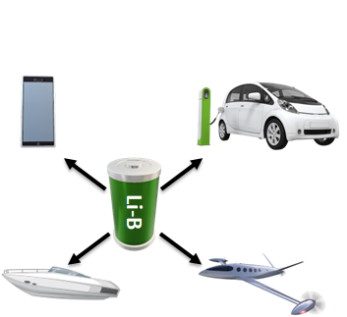



Introduction
Introduction
Review
Objective
Method
Simulation
Noise Mitigation
Experiment
Estimation
Conclusion
Li-ion batteries (LiBs) in modern life
  High energy density
  Low self-discharge
  Rechargeable
Battery Management Systems (BMS)
  Performance
  Safety
  Reliability
BMS need State-of-Charge (SOC)
  SOC is the remaining charge in battery
  Not measurable (Need to be estimated)
  Complex dynamics (Need to be predicted)
  Current technology limits the operating range of batteries
Objective
  Create accurate, efficient, and control-oriented SOC model
  Develop algorithm to estimate SOC
Power System
Li-ion in anode
?
BMS
Controller
20
80
0
100
SOC
(Range)
Notes:
Batteries are ubiquitous in everyday applications suchas electric vehicles, laptops, and cell phones. Lithium-ion batteries (LiBs) are one of the most preferred battery types due to their high energy and power density
regulated
Low self discharge, when not being used, the rate of self-discharge is extremely low.
Lithium-ion batteries are popular for their low maintenance batteries too. Most other cells like Nickel Cadmium batteries have a huge cost of ownership and maintenance.
This task is further complicated by the complex dynamics of lithium-ion batteries, which makes SOC modeling and prediction difficult. Let’s look at an example: if we plot the battery’s voltage against SOC, we observe a highly non-linear behavior at both low and high voltages. This non-linearity creates significant challenges for accurate SOC estimation and limits how much of the battery’s capacity can be safely utilized. Typically, only about 60% of the battery’s capacity—from 20% to 80% SOC—is usable in most applications.
This limitation highlights the need for better SOC modeling and estimation techniques. My objective is to develop an accurate, efficient, and control-oriented SOC model, along with an advanced algorithm for SOC estimation. This work will help expand the operating range of lithium-ion batteries and improve their performance and reliability."

Slide 3
Outline
Introduction
Review
Objective
Method
Simulation
Noise Mitigation
Experiment
Estimation
Conclusion
Literature Review on SOC Estimation and Modeling
Objectives
Methods
  Interpretable data-driven model
  Physics-inspired model
  Tuning parameters
  Noise mitigation
  Framework to estimate SOC
  Experiments
Results and Discussion
Conclusion and Future work
Prior Knowledge
Experimental Design
Domain Knowledge
Data Collection
Fitting Criteria
Validation Data
Training Data
Model
Evaluate
No
Yes
Physics Informed Model
Filtering & Co-estimation
Notes:
I am going to talk about the motivation and we go over literature review, then we talk about the objective and methods, and finaly we have the results and conclusion

Slide 4



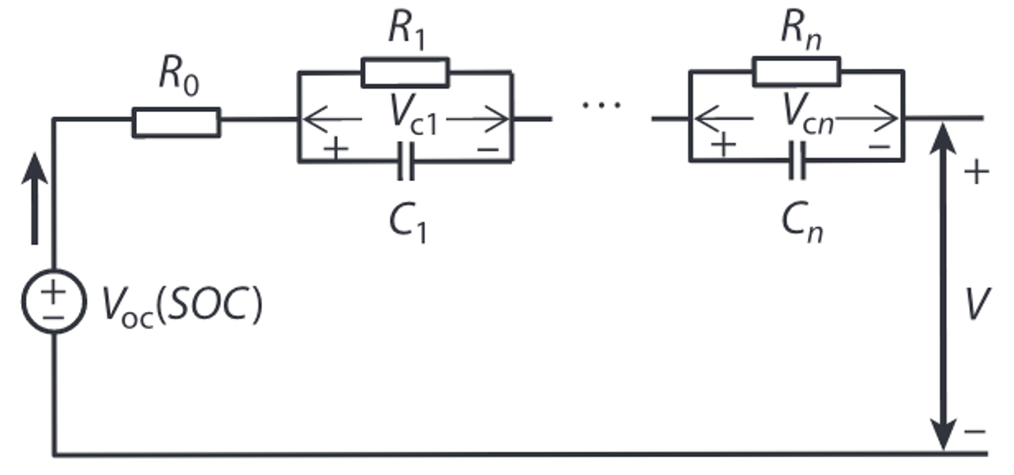
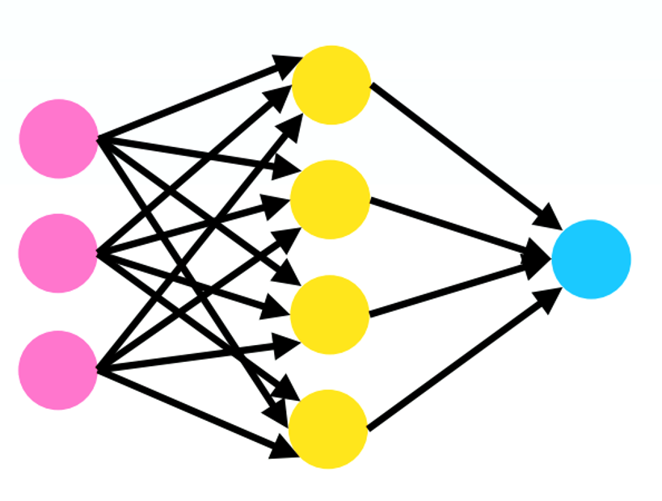



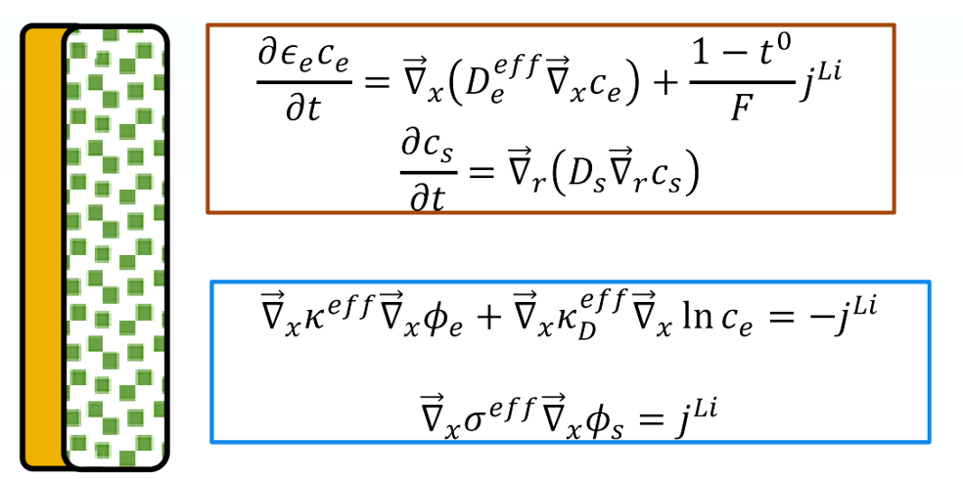
Battery Dynamics Modeling
Introduction
Review
Objective
Method
Simulation
Noise Mitigation
Experiment
Estimation
Conclusion
SOC and Voltage have Complex Dynamics
?
Empirical Models
Equivalent Circuit Models (ECM)
Machine Learning Models
Mechanistic Models
Simplicity
Fidelity

Slide 5
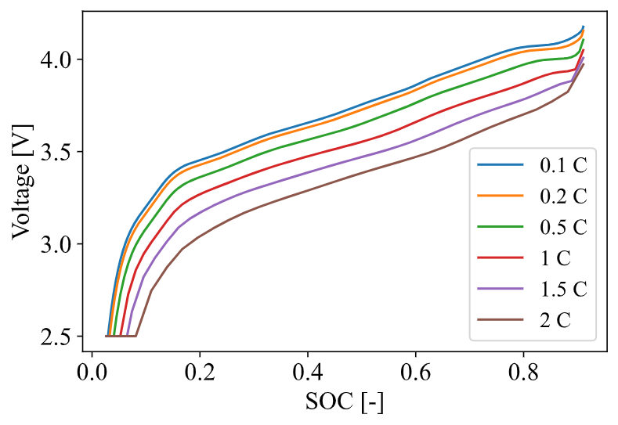

Battery Dynamics Modeling: Empirical Models
Introduction
Review
Objective
Method
Simulation
Noise Mitigation
Experiment
Estimation
Conclusion
Historical data
Statistical methods
Coulomb counting; e.g. Ghoulam et al., 2022
SOC-voltage mapping; e.g. Xing et al., 2014
Very simple
Very sensitive to operating condition
Require large and high-quality datasets to build model
Current [A]
~SOC
Time [H]
Notes:
There are some modeling based on electrochemical processes inside of the battery that we called them physics-based model
ECM: batteries are represented by groups of electrical components such as resistors and capacitors,
forming resistor–capacitor networks across a range of operation conditions such as ageing and dynamics environments in real-life applications, due to parameterization of model parameters based on laboratory conditions.
In addition, the lack of physics-based information of the system states and parameters makes it hard to predict the SOH and RUL of batteries precisely.
Sparse Identification of nonlinear dynamics with control (SINDYc)
Sulzer, Valentin, et al. "The challenge and opportunity of battery lifetime prediction from field data." Joule 5.8 (2021): 1934-1955.
analytical equation
newman
simplified

Slide 6
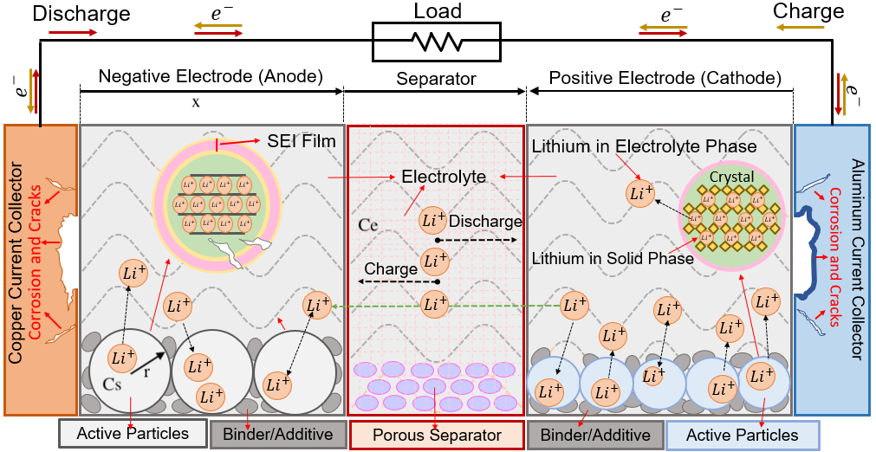
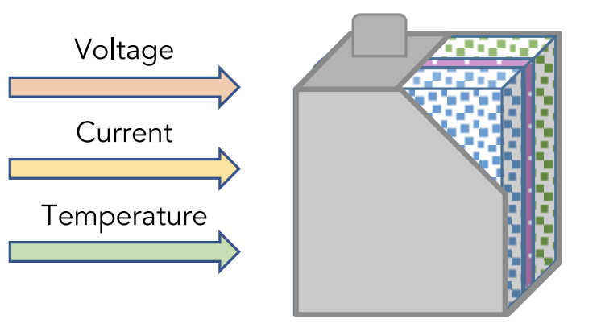
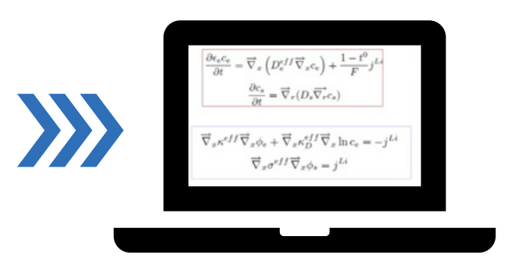
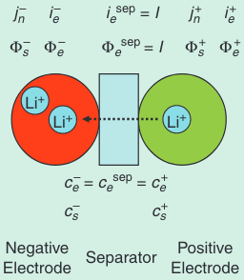
Battery Dynamics Modeling: Mechanistic Models (1)
Introduction
Review
Objective
Method
Simulation
Noise Mitigation
Experiment
Estimation
Conclusion
Express the process inside the battery with analytical equations
  Electrochemical reactions
  Heat and mass transport
Porous Electrode Theory (Started by Newman’s Group)
  Pseudo-two-Dimensional (P2D) model; Doyle et al., 1993
  P2D model with aging; Ramadass et al., 2004
  Doyle-Fuller-Newman (DFN) (P2D with thermal dynamics); Thomas et al., 2002
Suitable for analysis and diagnosis
Simplified P2D models
  Single Particle Model (SPM); Chaturvedi et al., 2010
  Single Particle Model with electrolyte and Temperature (SPMeT); Park et al., 2021
  Multiple Particle Model (MPM); Majdabadi et al., 2015
Suitable for control and optimization
Notes:
There are some modeling based on electrochemical processes inside of the battery that we called them physics-based model
ECM: batteries are represented by groups of electrical components such as resistors and capacitors,
forming resistor–capacitor networks across a range of operation conditions such as ageing and dynamics environments in real-life applications, due to parameterization of model parameters based on laboratory conditions.
In addition, the lack of physics-based information of the system states and parameters makes it hard to predict the SOH and RUL of batteries precisely.
Sparse Identification of nonlinear dynamics with control (SINDYc)
Sulzer, Valentin, et al. "The challenge and opportunity of battery lifetime prediction from field data." Joule 5.8 (2021): 1934-1955.
analytical equation
newman
simplified

Slide 7
Battery Dynamics Modeling: Mechanistic Models (2)
Introduction
Review
Objective
Method
Simulation
Noise Mitigation
Experiment
Estimation
Conclusion
Capture the dynamics of the modeled processes, detailed insight
High interpretability, allow for design and performance optimization
Extrapolatable to a wide range of conditions for complex models
Require many parameters, several not available
Based on idealized principles, not always apply
Only predict the modeled phenomena
Computationally expensive with added complexity
Model | Number of parameters | Computational Complexity
DFN | 33 | High
SPMeT | 31 | Medium
SPM | 20 | Low
Notes:
There are some modeling based on electrochemical processes inside of the battery that we called them physics-based model
ECM: batteries are represented by groups of electrical components such as resistors and capacitors,
forming resistor–capacitor networks across a range of operation conditions such as ageing and dynamics environments in real-life applications, due to parameterization of model parameters based on laboratory conditions.
In addition, the lack of physics-based information of the system states and parameters makes it hard to predict the SOH and RUL of batteries precisely.
Sparse Identification of nonlinear dynamics with control (SINDYc)

Slide 8
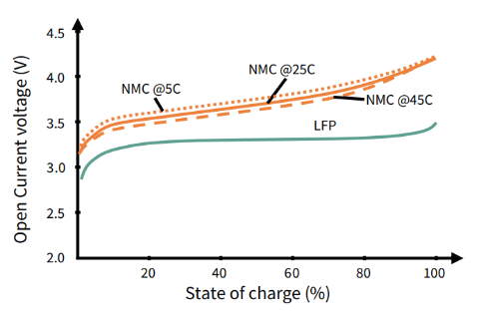
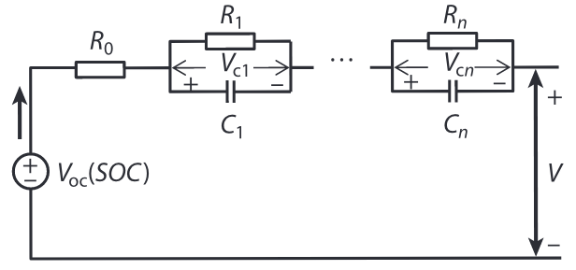
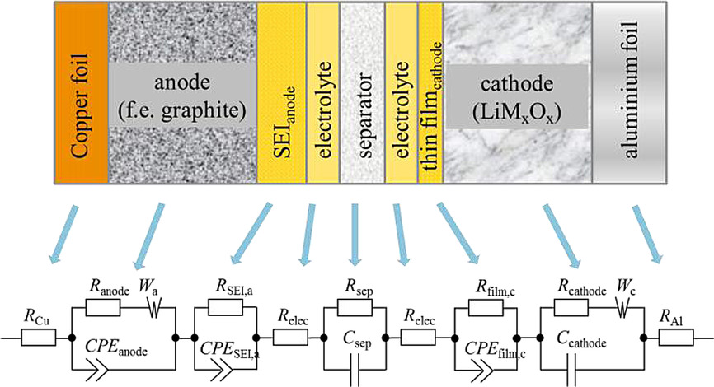
Battery Dynamics Modeling: ECMs (1)
Introduction
Review
Objective
Method
Simulation
Noise Mitigation
Experiment
Estimation
Conclusion
Equivalent Circuit Model (ECM)
Express the battery’s dynamic with electrical components
ECM with simple passive electrical elements; e.g. Schmidt et al., 2016
  Determine Open circuit voltage (OCV) from voltage and current
  Estimate SOC via SOC-OCV mapping
ECM with fractional-order or distributed elements; Wildeuer et al., 2021
  Using impedance spectra
Notes:
There are some modeling based on electrochemical processes inside of the battery that we called them physics-based model
ECM: batteries are represented by groups of electrical components such as resistors and capacitors,
forming resistor–capacitor networks across a range of operation conditions such as ageing and dynamics environments in real-life applications, due to parameterization of model parameters based on laboratory conditions.
In addition, the lack of physics-based information of the system states and parameters makes it hard to predict the SOH and RUL of batteries precisely.
Westerhoff, Uwe, et al. "Analysis of lithium‐ion battery models based on electrochemical impedance spectroscopy." Energy Technology 4.12 (2016): 1620-1630.

Slide 9
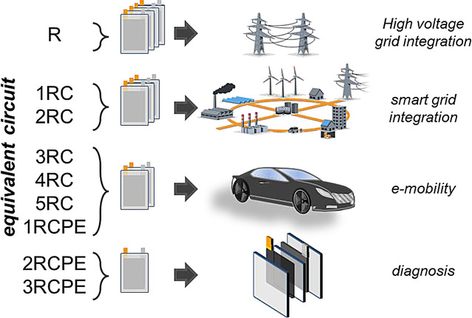
Battery Dynamics Modeling: ECMs (2)
Introduction
Review
Objective
Method
Simulation
Noise Mitigation
Experiment
Estimation
Conclusion
ECM
  Use measurable data (current and voltage)
ECM with passive electrical components:
  Simple with low computational cost
  Narrow operating range due to lack of physics-based information
  Need to use look-up tables with many sets, still limited due to being linear
ECM with fractional-order or distributed elements:
  Connections to internal processes of LiBs
  Larger operating conditions
  Require impedance spectra
  Need specific devices with careful experimental control
  Not suitable for real-time applications
Notes:
Require filter for separating data it can distort or disturb the model

Slide 10

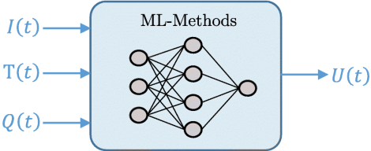
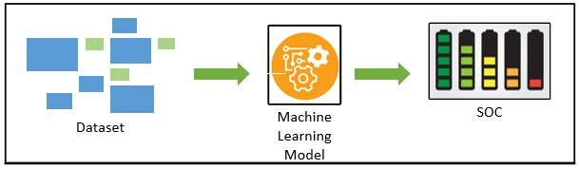
Battery Dynamics Modeling: ML (1)
Introduction
Review
Objective
Method
Simulation
Noise Mitigation
Experiment
Estimation
Conclusion
Data-driven Model/Machine Learning
  Express the battery’s dynamic from measurable data
  Black box modeling
Support vector machine (SVM); Feng et al., 2019
Clustering with genetic algorithm; Hu et al., 2016
Neural network (NN); How et al., 2020
  Recurrent NN; Vidal et al., 2022
  Long short-term memory recurrent NN; Chemali et al., 2018
Notes:
There are some modeling based on electrochemical processes inside of the battery that we called them physics-based model
ECM: batteries are represented by groups of electrical components such as resistors and capacitors,
forming resistor–capacitor networks across a range of operation conditions such as ageing and dynamics environments in real-life applications, due to parameterization of model parameters based on laboratory conditions.
In addition, the lack of physics-based information of the system states and parameters makes it hard to predict the SOH and RUL of batteries precisely.
Sparse Identification of nonlinear dynamics with control (SINDYc)

Slide 11
Battery Dynamics Modeling: ML (2)
Introduction
Review
Objective
Method
Simulation
Noise Mitigation
Experiment
Estimation
Conclusion
Data-driven Model/Machine Learning
No need for internal parameters (using measurable data)
Adaptable to new chemistries or conditions by retraining
Can use novel features instead of traditional metrics (e.g., voltage, current)
Low implementation cost, suitable for real-time applications
Require rich and informative dataset to capture operating conditions
Needs an extensive set of data to build model
Risk of overfitting with complex algorithms
Can lead physically inconsistent results and lack interpretability (no connection to physics)
Too many features reduce stability (ill-conditioned problem due to correlated terms)
Notes:
Require filter for separating data it can distort or disturb the model

Slide 12
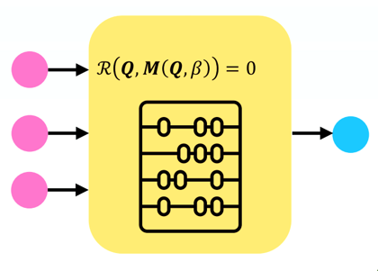

Battery Dynamics Modeling
Introduction
Review
Objective
Method
Simulation
Noise Mitigation
Experiment
Estimation
Conclusion
?
Empirical Models
Equivalent Circuit Models (ECM)
Machine Learning Models
Mechanistic Models
Hybrid
ECM+ML
Mechanistic+ML

Slide 13

Battery Dynamics Modeling: Hybrid Models (1)
Introduction
Review
Objective
Method
Simulation
Noise Mitigation
Experiment
Estimation
Conclusion
ECM: Increasing operating range and accuracy
  ECM + Machine learning
    ECM + deep learning; Su et al., 2023
    ECM + NN; Borah et al., 2024
  ECM + Kalman filter; Yao et al., 2024
Refine estimates; suitable for aggressive input
Mitigate noise effect
Extend ECM operating range
Lack of interpretability
Require large datasets for training
Limited accuracy in low SOC regions
Measurement
Input
Kalman Filter
SOC
ECM
Output
Notes:
Depends on offline SOC-OCV map, accuracy issue with flat curves (e.g., LFP)

Slide 14
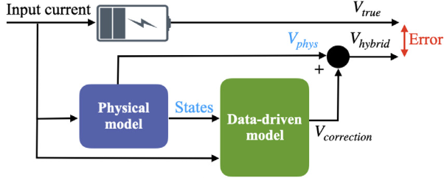
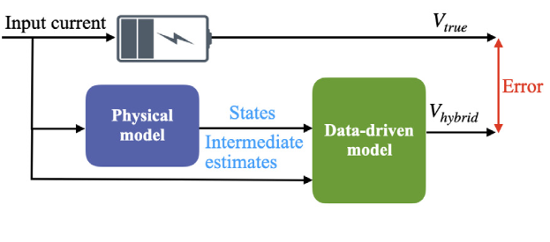
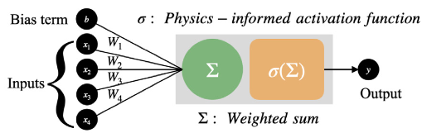
Battery Dynamics Modeling: Hybrid Models (2)
Introduction
Review
Objective
Method
Simulation
Noise Mitigation
Experiment
Estimation
Conclusion
Mechanistic: Increasing accuracy and reducing computational time
  SPM + Machine learning
    SPM + recurrent NN; Saehong Park et al., 2017
    SPM with thermal dynamics + feed forward NN; Tu et al., 2023
  Mechanistic models + Kalman filter
    SPM + Kalman filter; Fang et al., 2014
    P2D + Kalman filter; Smiley et al., 2018
  Physics-informed NN, Hofmann et al., 2023
  Solving SPM with electrolyte equations with NN; Xue et al., 2023
Improve accuracy by capturing complex unmodeled dynamics with ML
Extend operating range of simplified model (ECM and SPM)
Require large datasets for training machine learning
Need many internal parameters for mechanistic models
Increase complexity in balancing mechanistic and machine learning components
Notes:
Additionally, a physics-informed neural network in~\cite{hofmann_PhysicsinformedNeural_2023} was developed to correlate internal battery states using a P2D model and experimental data, showcasing the potential of combining mechanistic insights with machine learning. In another study~\cite{xue_EnhancedSingleParticle_2023}, neural networks were used to solve the PDEs of the SPMe model, reducing computation time and extending the model’s operating range.

Slide 15
Proposed Approach
Introduction
Review
Objective
Method
Simulation
Noise Mitigation
Experiment
Estimation
Conclusion
Desired Model:
Interpretable and control-oriented data-driven model
  Uncover governing equations not fitting data only
Connection to physics
Perform well in unseen data
Interpretable input/output modeling techniques:
Dynamic mode decomposition (DMD); Tu, 2013
  Approximate linear system
Sparse identification of nonlinear dynamics (SINDy); Brunton et al., 2016
  Nonlinear reduced order model through sparsification of a library of potential terms
  Require remarkably less data comparing to NN
Dynamics of LiB is highly nonlinear
SINDy challenges:
Selecting library terms
Selecting sparsification parameters
Notes:
Designing controller is very challenging since the observable is linear
The dynamic of LiB are highly nonlinear
Remarkable require less data comparing to NN since its based on linear regression

Slide 16
Objective
Introduction
Review
Objective
Method
Simulation
Noise Mitigation
Experiment
Estimation
Conclusion
Main objective: Develop a tractable data-driven model to discover the governing equations of Li-ion batteries
Hypothesis: Voltage and SOC dynamics can be represented by a few terms from the measured data, and SOC levels can be accurately estimated via these learned dynamics
Aim 1: Discovering Battery's Voltage and SOC dynamics
  Create a nonlinear interpretable data-driven model for Li-ion battery
  Enhance the modeling technique by including physics-inspired terms
  Formulate a multi-objective cost function to capture the dynamics
Aim 2: Robust Modeling with Noisy Data
  Extend data-driven model using a Joint Unscented Kalman Filter to mitigate noise effects
  Develop a co-estimation framework to update model parameters using measurement data
Aim 3: Data Generation and Model Development
  Generate data from a detailed cylindrical cell battery model
  Design experiments on a single cell at different temperatures
  Conduct experimental studies and collect data
Notes:
As We already know Batteries are ubiquitous in everyday applications suchas electric vehicles, laptops, and cell phones. Lithium-ion batteries (LiBs) are one of the most preferred battery types due to their high energy and power density therefore their elechrochemical behaviour of them are important for us
Parameters are costly to calculate/
Parameters are only applicable to the specific battery/system
We are going to use equation of the physics based model to build our model
I developed a reduced order model of li-ion cell based on a method called sparse identification of nonlinear dynamics with control..(SINDYc). this method was originally developed for fluid system.
suitable for real-time analysis
relato make it more general u dont know the charge. whty we want the model. this one everyone can undderstand. thanks.
add sentences
use pictures.
explain
background sindyc not used

Slide 17

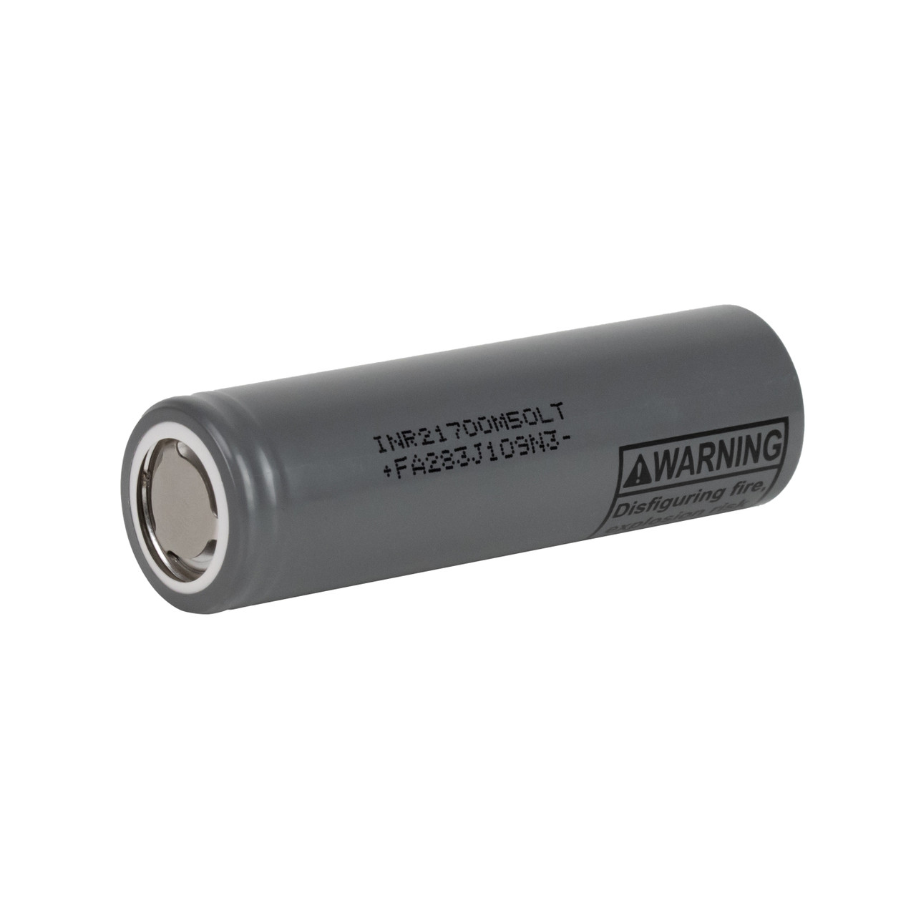
Roadmap
Introduction
Review
Objective
Method
Simulation
Noise Mitigation
Experiment
Estimation
Conclusion
Discover governing equation of Li-ion batteries
  Using the measurable data
  Physics-inspired
  Generalizability
Reduce measurement noise effect
  Using Joint Unscented Kalman Filter
Co-estimation framework
Initial model
Simulation data
Sparse Identification
Contribution
Link to physics
Tuning parameters
Experimental data
Noise mitigation
Online estimation
Future work
Cell designing
Fast charging
Complex systems
Notes:
As We already know Batteries are ubiquitous in everyday applications suchas electric vehicles, laptops, and cell phones. Lithium-ion batteries (LiBs) are one of the most preferred battery types due to their high energy and power density therefore their elechrochemical behaviour of them are important for us
Parameters are costly to calculate/
Parameters are only applicable to the specific battery/system
We are going to use equation of the physics based model to build our model
I developed a reduced order model of li-ion cell based on a method called sparse identification of nonlinear dynamics with control..(SINDYc). this method was originally developed for fluid system.
suitable for real-time analysis
relato make it more general u dont know the charge. whty we want the model. this one everyone can undderstand. thanks.
add sentences
use pictures.
explain
background sindyc not used

Slide 18






Sparse Identification of Nonlinear Dynamics
Introduction
Review
Objective
Method
Simulation
Noise Mitigation
Experiment
Estimation
Conclusion
SINDy is based on sparse linear regression; Brunton et al., 2016
  Results in reduced order nonlinear model
  Detect the governing equation
Notable extensions to SINDy
SINDy with control (SINDyC); Brunton et al., 2016
AIC-inspired on training data; Mangan et al., 2017
Constraint dynamics; Loiseau & Brunton, 2018
Including switching dynamic; Li et al., 2019; Mangan et al., 2019
PDE; Messenger & Bortz, 2021
MPC; Fasel et al., 2021
Sensitivity analysis: Naozuka et al., 2022
Ensemble model; Fasel et al., 2022
There are several extensions; however, they mostly left the choice of library terms and sparsification parameters which based on the original formulation overfits the model
$$\dot{x}=x+{3u}^{2}$$
$$\dot{x}$$
$$1 x x^{2} x^{3 }u{ u}^{2}$$
$$Ξ$$
$$=$$
Library: $Θ(X,U)$

Slide 19

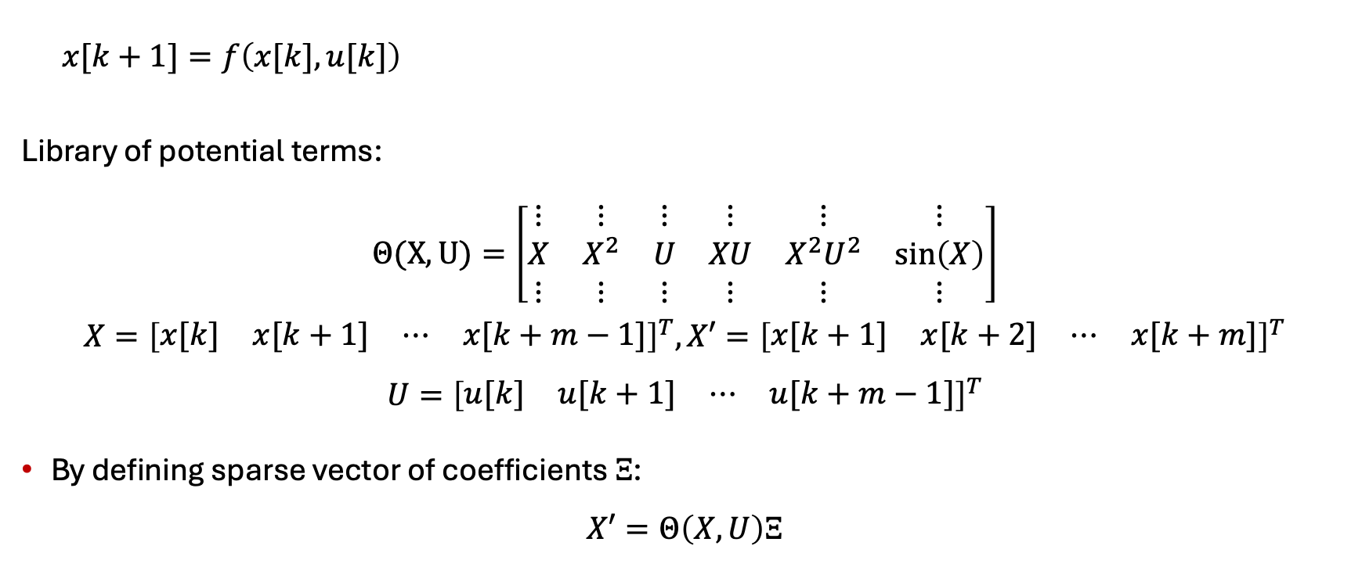




Sparse Identification Method
Introduction
Review
Objective
Method
Simulation
Noise Mitigation
Experiment
Estimation
Conclusion
$$0$$
$$1$$
$$0$$
$$4$$
$$−1.4$$
$$0$$
$x[k+1]=f\left(x[k],u[k]\right)$
Library of potential terms:
$$Θ(X,U)=\left[\begin{matrix}⋮ & ⋮ & ⋮ & ⋮ & ⋮ & ⋮ \\ X & X^{2} & U & XU & X^{2}U^{2} & \sin\left(X\right) \\ ⋮ & ⋮ & ⋮ & ⋮ & ⋮ & ⋮\end{matrix}\right]$$
$$X={\left[\begin{matrix}x[k] & x[k+1] & ⋯ & x[k+m−1]\end{matrix}\right]}^{T},X′={\left[\begin{matrix}x[k+1] & x[k+2] & ⋯ & x[k+m]\end{matrix}\right]}^{T}$$
$$U={\left[\begin{matrix}u[k] & u[k+1] & ⋯ & u[k+m−1]\end{matrix}\right]}^{T}$$
By defining sparse vector of coefficients $Ξ$:
$$X′=Θ\left(X,U\right)Ξ$$
$$: ax[k]+bx^{2}[k]+cu[k]+dx[k]u[k]+ex^{2}[k]u^{2}[k]+fsin⁡[k]$$
$$x[k+1]=x^{2}[k]+4x[k]u[k]−1.4x^{2}[k]u^{2}[k]$$
Notes:
Most physical systems have only a few relevant terms that define the dynamics.
Here is the SINDYc algorithm that Renato discussed previously.
We are seeking a model in this form.
We try to find active terms in the dynamics of the system
no monotone
be happy
Ax +Bx^2, we start with the larger library.
the reason for library is not good
change the f(x)

Slide 20


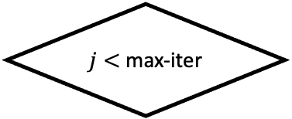


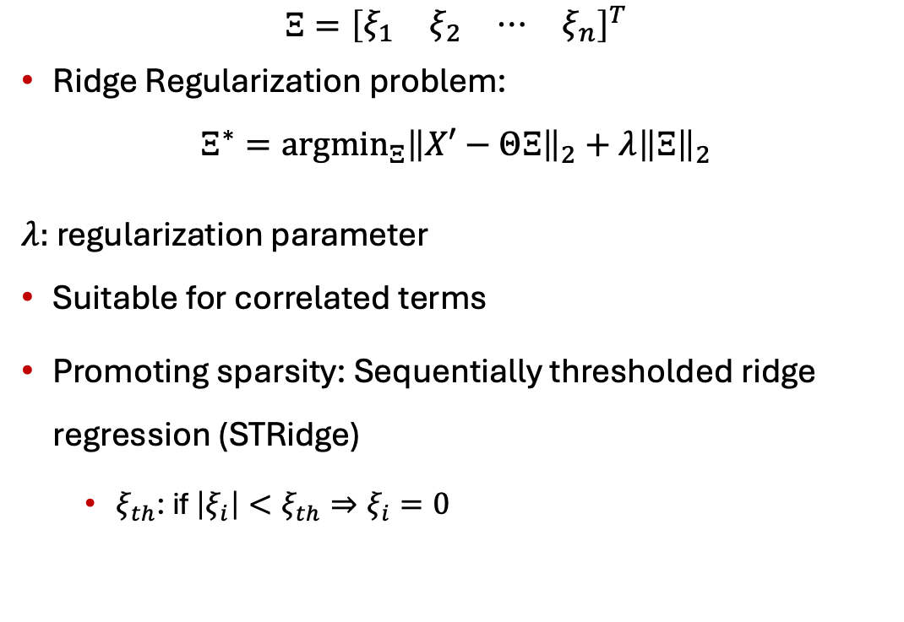

Identifying Sparse Vector of Coefficients $Ξ$
Introduction
Review
Objective
Method
Simulation
Noise Mitigation
Experiment
Estimation
Conclusion
$$Ξ={\left[\begin{matrix}ξ_{1} & ξ_{2} & ⋯ & ξ_{n}\end{matrix}\right]}^{T}$$
Ridge Regularization problem:
$$Ξ^{∗}=argmin_{Ξ}{\left\|X′−ΘΞ\right\|}_{2}+λ{\left\|Ξ\right\|}_{2}$$
$λ:$ regularization parameter
Suitable for correlated terms
Promoting sparsity: Sequentially thresholded ridge regression (STRidge)
  $ξ_{th}$: if $\left|ξ_{i}\right|<ξ_{th}⇒ξ_{i}=0$
$$X′=Θ\left(X,U\right)Ξ$$
$$+ ξ_{th}{\left\|Ξ\right\|}_{0}$$
Ridge
$$Ξ\left(\left|ξ_{i}\right|<ξ_{th}\right)==0$$
No
$j<$ max-iter
Yes
$Ξ^{∗}=$ ${\left[\begin{matrix}ξ_{1} & ξ_{2} & ⋯ & ξ_{n}\end{matrix}\right]}^{T}$
Notes:
. An approach based on Ridge regression, called sequentially thresholded ridge regression (STRidge) is more suitable for this purpose. STRidge nullifies any coefficient that is smaller than a threshold, {\it tol}, and repeats until the nonzero coefficients of $\mathbf{\Xi}$ converge.
avoid write full sentences
Sparsity , columns to
make it bolder us as fewer ass possible to
highlighted
the idea is to use less math. u have to say sentences. this is error make it error. to make sense.

Slide 21


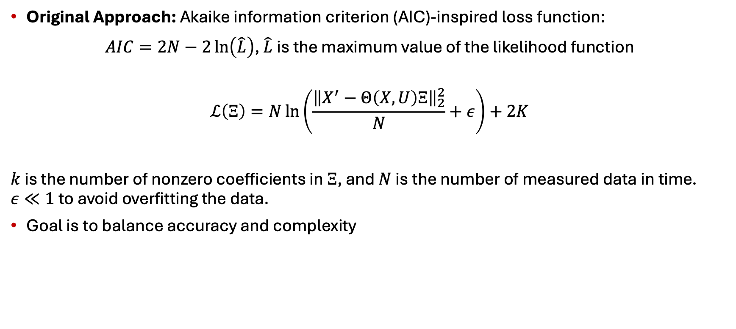
Tuning Sparsification Parameters ($λ, ξ_{th}$)
Introduction
Review
Objective
Method
Simulation
Noise Mitigation
Experiment
Estimation
Conclusion
Original Approach: Akaike information criterion (AIC)-inspired loss function:
$AIC=2N−2\ln\left(\hat{L}\right)$, $\hat{L}$ is the maximum value of the likelihood function
$$ℒ\left(Ξ\right)=N\ln\left(\frac{{\left\|X^{′}−Θ\left(X,U\right)Ξ\right\|}_{2}^{2}}{N}+ε\right)+2K$$
$k$ is the number of nonzero coefficients in $Ξ$, and $N$ is the number of measured data in time. $ε≪1$ to avoid overfitting the data.
Goal is to balance accuracy and complexity
$$Ξ^{∗}=argmin_{Ξ}{\left\|\dot{X}−ΘΞ\right\|}_{2}+λ{\left\|Ξ\right\|}_{2}+ξ_{th}{\left\|Ξ\right\|}_{0}$$
Notes:
One way was to fit is using MSE that result in the best fit, but it tends to overfit the data
Our goal is to balance between accuracy and complexity and AIC inspired loss function used a lot for this purpose which is defined in the box.

Slide 22
Limitations of Generic Model
Introduction
Review
Objective
Method
Simulation
Noise Mitigation
Experiment
Estimation
Conclusion
Preliminary results using SINDy: predict voltage with generic terms and AIC cost function
Very limited operating condition
  Lack of connection to physics
  Exact terms to be included in the library
    Adding too many terms results in ill-conditioned problems with correlated terms
  Cost function using only training data
Next Steps
  Create physics-inspired library
  Design multi-objective cost function
  Predict both voltage and SOC simultaneously

Slide 23

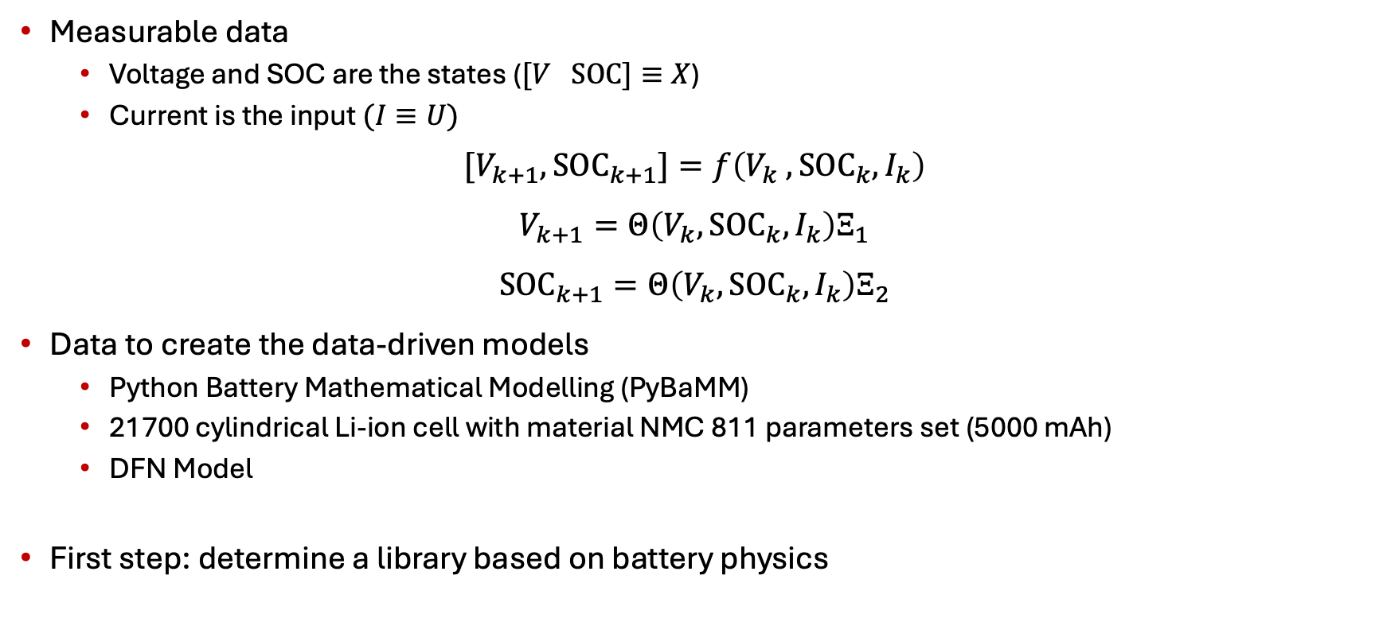






NL Control-Oriented Model of Batteries
Introduction
Review
Objective
Method
Simulation
Noise Mitigation
Experiment
Estimation
Conclusion
Measurable data
  Voltage and SOC are the states ($[V SOC]≡X$)
  Current is the input $(I≡U)$
$$[V_{k+1},{SOC}_{k+1}]=f\left(V_{k} ,{SOC}_{k},I_{k}\right)$$
$$V_{k+1}=Θ\left(V_{k},{SOC}_{k},I_{k}\right)Ξ_{1}$$
$${SOC}_{k+1}=Θ\left(V_{k}, {SOC}_{k},I_{k}\right)Ξ_{2}$$
Data to create the data-driven models
  Python Battery Mathematical Modelling (PyBaMM)
  21700 cylindrical Li-ion cell with material NMC 811 parameters set (5000 mAh)
  DFN Model
First step: determine a library based on battery physics
Battery
$$SOC, V$$
$$\tilde{ SOC }$$
$$I$$
$$+$$
$$−$$
DDM
$$\tilde{ V }$$
$$\hat{ SOC }, \hat{ V }$$
Notes:
explain pybamm python battery package
ncm811

Slide 24
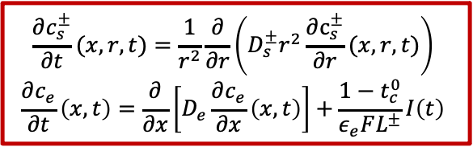




Physics-Informed Library (1)
Introduction
Review
Objective
Method
Simulation
Noise Mitigation
Experiment
Estimation
Conclusion
DFN model
Solid and electrolyte concentrations: $\sin{(⋅)},\exp\left(⋅\right)$
$$\frac{∂c_{s}^{±}}{∂t}(x,r,t)=\frac{1}{r^{2}}\frac{∂}{∂r}\left(D_{s}^{±}r^{2}\frac{∂c_{s}^{±}}{∂r}(x,r,t)\right)$$
$$\frac{∂c_{e}}{∂t}\left(x,t\right)=\frac{∂}{∂x}\left[D_{e}\frac{∂c_{e}}{∂x}\left(x,t\right)\right]+\frac{1−t_{c}^{0}}{ε_{e}FL^{±}}I\left(t\right)$$
$$Φ_{e}$$
$$Φ_{s}$$
$$J_{n}(x)$$
Notes:
We include terms associated to the DFN model which is one of the most accurate model in the library as opposed to including many terms that are not based on physics.
Here I am just going to show the equations.
Solid and electrolyte concentrations are similar to heat transfer and their solution have sinusoidal terms.

Slide 25


Physics-Informed Library (2)
Introduction
Review
Objective
Method
Simulation
Noise Mitigation
Experiment
Estimation
Conclusion
DFN model:$\sin\left(⋅\right), \exp\left(⋅\right)$
Overpotential (Butler-Volmer): $\sinh{(⋅)}$
$$j_{n}^{±}\left(x,t\right)=\frac{1}{F}i_{0}^{±}\left(x,t\right)\left[\sinh{\frac{α_{a}F}{RT}η^{±}\left(x,t\right)}\right]$$
$$Φ_{e}$$
$$Φ_{s}$$
$$J_{n}(x)$$
Notes:
The overpotential eta corresponds to the reaction of solidphase
intercalation of lithium in the electrodes;
voltage is the difference between the solid electric potential of the positive and negative electrode.
We combine terms up to polynomial of order 2 to add more nonlinearity as well.
use from figure, modified approach to connect
less world explain more
solid
diffusion
over potential

Slide 26
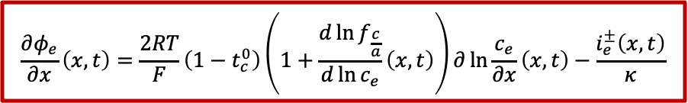


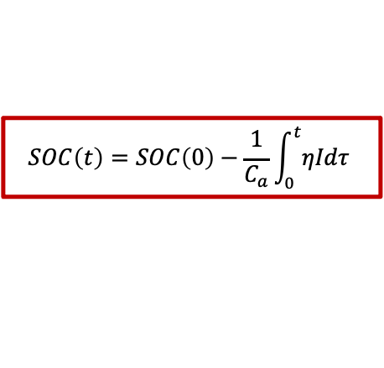



Physics-Informed Library (3)
Introduction
Review
Objective
Method
Simulation
Noise Mitigation
Experiment
Estimation
Conclusion
DFN model:$\sin\left(⋅\right), \exp\left(⋅\right), \sinh{(⋅)}$
Electrolyte’s electric potential: $f(I,c_{e})$
Solid electric potential: $f\left(η,φ_{e},U\right)$
SOC: $∫I$
$$\frac{∂φ_{e}}{∂x}\left(x,t\right)=\frac{2RT}{F}\left(1−t_{c}^{0}\right)\left(1+\frac{d\ln{f_{\frac{c}{a}}}}{d\ln{c_{e}}}\left(x,t\right)\right)∂\ln{\frac{c_{e}}{∂x}\left(x,t\right)−\frac{i_{e}^{±}\left(x,t\right)}{κ}}$$
$$φ_{s}^{±}\left(x,t\right)=η^{±}\left(x,t\right)+φ_{e}\left(x,t\right)+U^{±}\left(c_{ss}^{±}\right)−FR_{f}^{±}j_{n}^{±}\left(x,t\right)$$
$$Φ_{e}$$
$$Φ_{s}$$
$$V\left(t\right)=φ_{s}^{+}\left(0^{+},t\right)−φ_{s}^{−}(0^{−},t)$$
$$J_{n}(x)$$
$$SOC\left(t\right)=SOC\left(0\right)−\frac{1}{C_{a}}\int_{0}^{t}{ηIdτ}$$
Notes:
voltage is the difference between the solid electric potential of the positive and negative electrode.
We combine terms up to polynomial of order 2 to add more nonlinearity as well.
use from figure, modified approach to connect
less world explain more
solid
diffusion
over potential
Open circuit voltage

Slide 27
Automated Optimization Algorithm
Introduction
Review
Objective
Method
Simulation
Noise Mitigation
Experiment
Estimation
Conclusion
Three datasets for modeling:
Training dataset:
  Building the model
  Input and output of this set are known
Validation dataset:
  Optimizing the hyperparameters of the identified model
Test dataset:
  Evaluating the performance of the identified model
Cost
Model complexity
Cost
Model complexity
$$Ξ^{∗}=argmin_{Ξ}{\left\|X′−ΘΞ\right\|}_{2}+λ{\left\|Ξ\right\|}_{2}+ξ_{th}{\left\|Ξ\right\|}_{0}$$
Notes:
Trade off between sparsity and error helps not to overfits the data and we want to remove unnecessary terms by treating threshold parameter lambda and tolerance as hyperparameters and tunes them with validation data,
show the fiigure first
put the rectangle around the last and second

Slide 28
Training Dataset
Introduction
Review
Objective
Method
Simulation
Noise Mitigation
Experiment
Estimation
Conclusion
Electrical current is employed to generate data
Stochastic current signal up to 2C/4C-rate charge/discharge with 50 ms sampling time
Design Space
Notes:
SOC varies from 90% to 40%
SOC varies from 90% to 70% at from the beggining till the end
here is the histogram of the corresponding voltage and current, so this is our design space and
For any current and voltage on that range the model should work

Slide 29
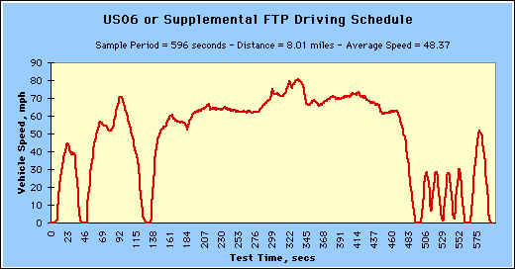
Validation Dataset
Introduction
Review
Objective
Method
Simulation
Noise Mitigation
Experiment
Estimation
Conclusion
EPA aggressive highway drive cycles for validation
US06 drive cycle
Current profile
Notes:
he US06 drive cycle simulates the condition of driving an electric vehicle at high speed and aggressively. Similarly, the UDDS profile represents the urban environment driving condition. We repeated the drive cycle profiles for validation and test data until the battery voltage reaches $2.5$~V.

Slide 30
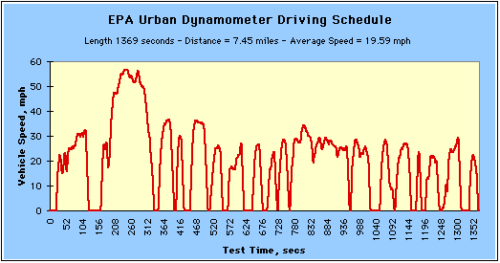
Test Dataset
Introduction
Review
Objective
Method
Simulation
Noise Mitigation
Experiment
Estimation
Conclusion
EPA urban drive cycles for test
Urban Dynamometer Driving Schedule (UDDS)
Current profile
Notes:
he US06 drive cycle simulates the condition of driving an electric vehicle at high speed and aggressively. Similarly, the UDDS profile represents the urban environment driving condition. We repeated the drive cycle profiles for validation and test data until the battery voltage reaches $2.5$~V.

Slide 31

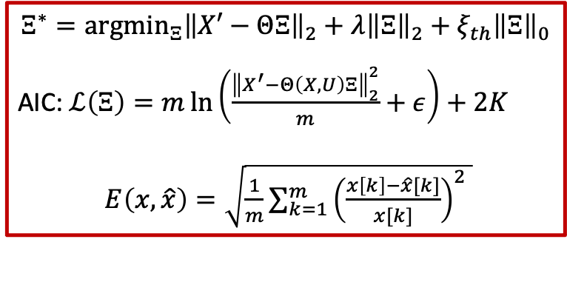
Introducing Hyperparameter Formulation
Introduction
Review
Objective
Method
Simulation
Noise Mitigation
Experiment
Estimation
Conclusion
The sparsification parameters are tuned with the training, validation set and number of terms
$$\min_{λ,ξ_{th}}𝒥\left(Ξ\right)≔{{ρ_{1}E_{t}\left(x,\hat{x}\right)+ρ_{2}E}_{v}(x,\hat{x})+ρ_{3}K}$$
$$Ξ^{∗}=argmin_{Ξ}{\left\|X′−ΘΞ\right\|}_{2}+λ{\left\|Ξ\right\|}_{2}+ξ_{th}{\left\|Ξ\right\|}_{0}$$
AIC: $ℒ\left(Ξ\right)=m\ln\left(\frac{{\left\|X^{′}−Θ\left(X,U\right)Ξ\right\|}_{2}^{2}}{m}+ε\right)+2K$
$E\left(x,\hat{x}\right)=\sqrt{\frac{1}{m}{\sum_{k=1}^{m}{\left(\frac{x\left[k\right]−\hat{x}[k]}{x[k]}\right)}}^{2} }$
AIC of the training data
NRMSE of the validation data
Notes:
We change that and we introduce this cost function in-sample and extra sample

Slide 32

Optimal Voltage Dynamics Model
Introduction
Review
Objective
Method
Simulation
Noise Mitigation
Experiment
Estimation
Conclusion
Number of active terms depends on the hyperparameters ($λ, ξ_{th}$)
Red region suggests diminishing returns
Notes:
For visualizing the sparsity and show how to pick the model, we shows the NRMSE with respect to the number of active or nonzero terms.
For more than 100 terms we have diminishing returns which means that adding extra terms do not change the accuracy of the system and we over fit the data
As it is shown in validation data, by having large number of active terms we cannot achieve low NRMSE and we have additional unnecessary terms.

Slide 33

Simulation Results (1)
Introduction
Review
Objective
Method
Simulation
Noise Mitigation
Experiment
Estimation
Conclusion
Voltage and SOC are calculated simultaneously
Training data NRMSE
  Voltage: $3.2×{10}^{−4}$
  SOC: ${10}^{−8}$

Slide 34


Simulation Results (2)
Introduction
Review
Objective
Method
Simulation
Noise Mitigation
Experiment
Estimation
Conclusion
US06 validation data NRMSE:
  Voltage: $6.1×{10}^{−3}$
  SOC: $2.2×{10}^{−5}$
UDDS test data NRMSE:
  Voltage: $6.3×{10}^{−3}$
  SOC: $2.8×{10}^{−3}$
Notes:
T_valid = 18879
T_test = 26792
Each udds 1369 sec

Slide 35









Enhancing Model
Introduction
Review
Objective
Method
Simulation
Noise Mitigation
Experiment
Estimation
Conclusion
Current Model
    Works for perfect measurement
    No uncertainty (e.g., with simulated data)
Issue on actual implementation
  Noisy data both in training and validation
  Error in estimations
Solution for noisy data and improve estimation
  Kalman Filter $→$Adapt the model
    Mitigate noise effect
    Connect SOC dynamics and SOC-Voltage map
Offline
Physics-Inspired Data-Driven Model
Training and Validation data
Online
Integrated Model
Test data
$$I$$
$$\hat{SOC}$$
Discovered Dynamics
$$V$$
$$\hat{ V }$$
$$+$$
JUKF
$$−$$

Slide 36

Joint Unscented Kalman Filter
Introduction
Review
Objective
Method
Simulation
Noise Mitigation
Experiment
Estimation
Conclusion
Avoid needs for linearization, suitable for nonlinear systems
Address uncertainty in voltage state and coefficients concurrently
$Ξ_{r,1}\left[k+1\right]=Ξ_{r,1}\left[k\right]+w_{Ξ}\left[k\right]$
$V\left[k+1\right]=θ_{r,1}\left[k\right]Ξ_{r,1}\left[k\right]+w_{V}\left[k\right]$
$V_{o}\left[k\right]=V\left[k\right]+v_{V}[k]$
Update $V$and $Ξ_{r,1}$ with the noisy output (Voltage)
Utilize the updated voltage for the SOC prediction
$SOC\left[k+1\right]=θ_{r,2}\left[k\right]Ξ_{r,2}\left[k\right]$
Nonzero sparse coefficients
Voltage dynamics
NMC 811
Noisy voltage data
Notes:
Mitigate the noise effect
Enhance the accuracy of the prediction
Avoid needs for linearization, suitable for nonlinear systems

Slide 37

Simulation Results with Added Noise (1)
Introduction
Review
Objective
Method
Simulation
Noise Mitigation
Experiment
Estimation
Conclusion
Voltage data has $5\%$ Gaussian noise as a measurement noise
Training data NRMSE
  Voltage: ${10}^{−3}$
  SOC: $1.008×{10}^{−7}$

Slide 38


Simulation Results with Added Noise (2)
Introduction
Review
Objective
Method
Simulation
Noise Mitigation
Experiment
Estimation
Conclusion
US06 validation data NRMSE:
  Voltage: $1.1×{10}^{−3}$
  SOC: $5.0963×{10}^{−5}$
UDDS test data NRMSE:
  Voltage: $9.0568×{10}^{−4}$
  SOC: $1.1585×{10}^{−4}$
Notes:
T_valid = 18879
T_test = 26792
Each udds 1369 sec

Slide 39
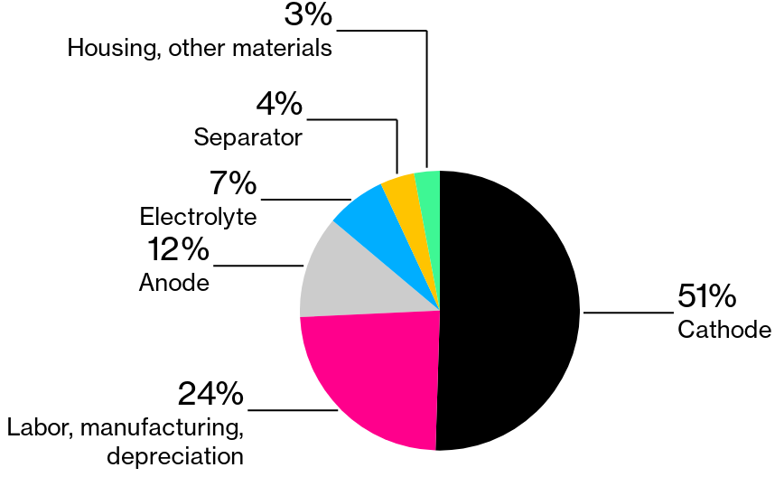
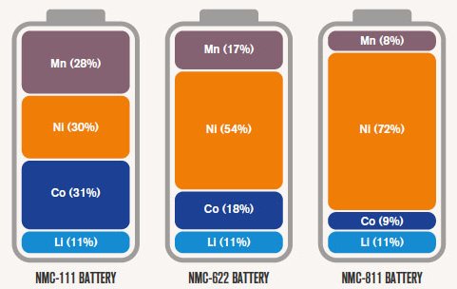
Selecting Battery for Experiment
Introduction
Review
Objective
Method
Simulation
Noise Mitigation
Experiment
Estimation
Conclusion
NMC batteries: Efficient, dependable
  Less Cobalt: Reduce price
  Increasing Nickel: Higher capacity and lower weight
LGM50 21700 cylindrical cell with NMC 811 cathode
Average cost structure of Li-ion cell
https://www.bloomberg.com/news/newsletters/2021-09-14/ev-battery-prices-risk-reversing-downward-trend-as-metals-surge
Notes:
One of the main battery chemistries used in EVs

Slide 40
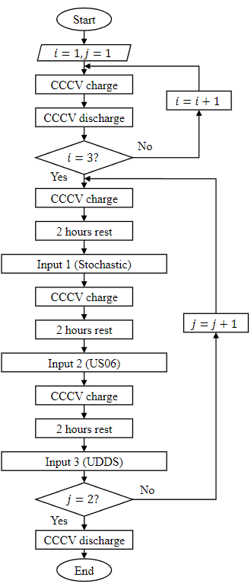
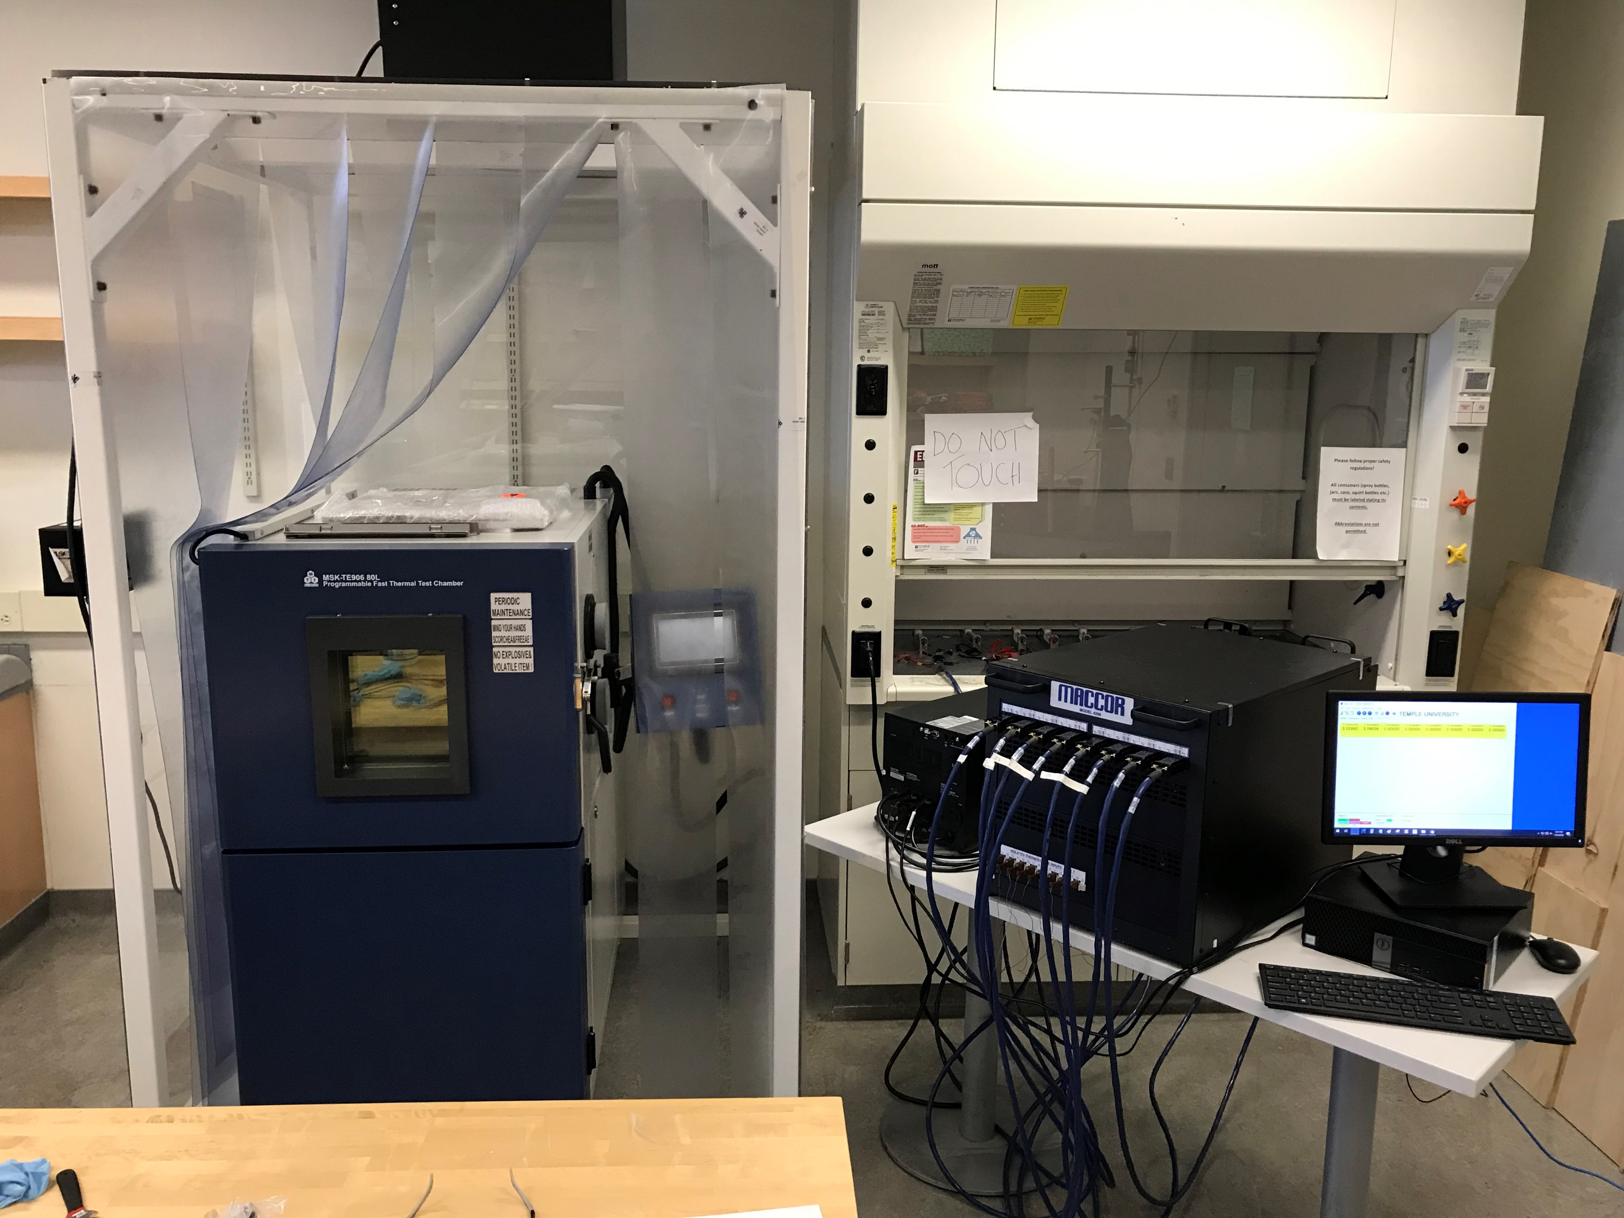
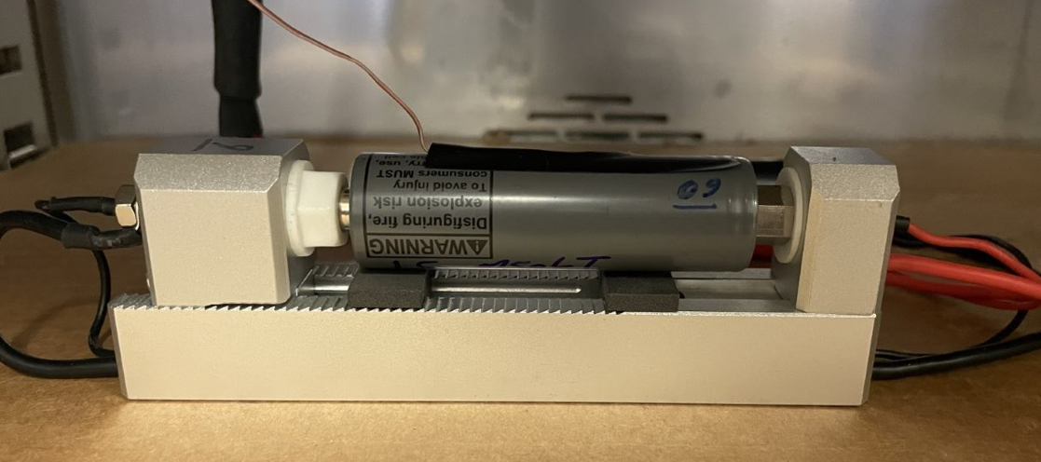

Designing Experiment
Introduction
Review
Objective
Method
Simulation
Noise Mitigation
Experiment
Estimation
Conclusion
Electrical current is employed to generate data
1C-rate: 4.8 A, fully charge the battery in 1 hour with constant current
Max current for constant current charging: 0.3C-rate
$T=10℃, 25℃, 40℃$
Notes:
Beyond the maximum constant current charge range
0.3 C which is 1.44
Aggressive highway driving US06
City driving udds

Slide 41
Experimental Results
Introduction
Review
Objective
Method
Simulation
Noise Mitigation
Experiment
Estimation
Conclusion
Stochastic electrical current signal up to 1C/2C-rate charge/discharge with 50 ms sampling time
Design Space
S
CCCV
Highway
CCCV
City
Notes:
SOC varies from 90% to 70% at from the beggining till the end
here is the histogram of the corresponding voltage and current, so this is our design space and
For any current and voltage on that range the model should work

Slide 42

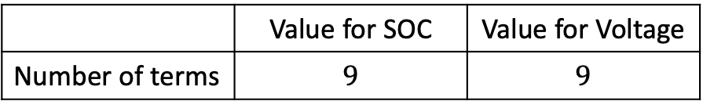
Tuning Sparsification Hyperparameters
Introduction
Review
Objective
Method
Simulation
Noise Mitigation
Experiment
Estimation
Conclusion
Multi-objective cost function
$$\min_{λ,ξ_{th}}𝒥\left(Ξ\right)≔{{ρ_{1}E_{t}\left(x,\hat{x}\right)+ρ_{2}E}_{v}(x,\hat{x})+ρ_{3}K}$$
 | Value for SOC | Value for Voltage
Number of terms | $$9$$ | $$9$$
Notes:
For visualizing the sparsity and show how to pick the model, we shows the NRMSE with respect to the number of active or nonzero terms.
For more than 40 terms we have diminishing returns which means that adding extra terms do not change the accuracy of the system and we over fit the data
As it is shown in validation data, by having large number of active terms we cannot achieve low NRMSE and we have additional unnecessary terms.
15 active terms give us the best results for the voltage training data

Slide 43

Model Using Experimental Data (1)
Introduction
Review
Objective
Method
Simulation
Noise Mitigation
Experiment
Estimation
Conclusion
calculate SOC with Coulomb counting:
  $SOC\left(t\right)=SOC\left(0\right)−\frac{1}{Q}\int_{0}^{t}{η_{c}Idτ}$
$η_{c}:\frac{Q_{discharged}}{Q_{charged}}$
Training data RMSE
  Voltage: $2.1×{10}^{−3}$V
  SOC: $8.6×{10}^{−3}$

Slide 44


Model Using Experimental Data (2)
Introduction
Review
Objective
Method
Simulation
Noise Mitigation
Experiment
Estimation
Conclusion
Aggressive highway validation data RMSE:
  Voltage: $8×{10}^{−4}$ V
  SOC: $9.9×{10}^{−3}$(ECM+EKF: $6.3×{10}^{−2}$)
City test data RMSE:
  Voltage: $6×{10}^{−4}$ V
  SOC: $1.2×{10}^{−2}$
Notes:
T_valid = 18879
T_test = 26792
Each udds 1369 sec
RMSE ECM SOC= 0.063
RMSE ECM Volt: 0.0155

Slide 45

SOC Estimation: Co-estimation Framework
Introduction
Review
Objective
Method
Simulation
Noise Mitigation
Experiment
Estimation
Conclusion
Adding uncertainty in SOC dynamics due to noisy current and unknown initial value
Address uncertainty in both states and coefficients concurrently
$Ξ_{r,1}\left[k+1\right]=Ξ_{r,1}\left[k\right]+w_{Ξ}\left[k\right]$
$V\left[k+1\right]=θ_{r,1}\left[k\right]Ξ_{r,1}\left[k\right]+w_{V}\left[k\right]$
$SOC\left[k+1\right]=θ_{r,2}\left[k\right]Ξ_{r,2}\left[k\right]+w_{S}[k]$
$V_{o}\left[k\right]=V\left[k\right]+v_{V}[k]$
Update $V, SOC$ and $Ξ_{r,1}$ with the noisy output (Voltage)
Nonzero sparse coefficients
SOC-Voltage map
SOC dynamics
Noisy voltage data
Notes:
Mitigate the noise effect
Enhance the accuracy of the prediction
Avoid needs for linearization, suitable for nonlinear systems

Slide 46
Co-estimation Results (1)
Introduction
Review
Objective
Method
Simulation
Noise Mitigation
Experiment
Estimation
Conclusion
US06 Validation data
Initial SOC: 0.8 (20% uncertainty)
SOC RMSE after convergence: 0.0102
ECM+EKF fails to estimate SOC
Voltage RMSE: 0.0008V

Slide 47
Co-estimation Results (2)
Introduction
Review
Objective
Method
Simulation
Noise Mitigation
Experiment
Estimation
Conclusion
UDDS Test data
Initial SOC: 0.8 (20% uncertainty)
SOC RMSE after convergence: 0.0130
ECM+EKF fails to estimate SOC
Voltage RMSE: 0.0006V
Battery tester voltage accuracy: ±0.02% full-scale range (±0.0004V)
Similar to maximum absolute error of voltage (0.0004V)

Slide 48


Co-estimation Result on Different Conditions
Introduction
Review
Objective
Method
Simulation
Noise Mitigation
Experiment
Estimation
Conclusion
Evaluate the transferability of the model to cold and warm environments by only adjusting the coefficients
Temperature:$10℃$
Temperature:$40℃$
RMSE | SOC | Voltage
US06 | 0.0283 | 0.0026 V
UDDS | 0.0325 | 0.0019 V
RMSE | SOC | Voltage
US06 | 0.0144 | 0.0006 V
UDDS | 0.0158 | 0.0005 V
Notes:
T_valid = 18879
T_test = 26792
Each udds 1369 sec
RMSE ECM SOC= 0.063
RMSE ECM Volt: 0.0155

Slide 49
Conclusion
Introduction
Review
Objective
Method
Simulation
Noise Mitigation
Experiment
Estimation
Conclusion
Developed tractable data-driven modeling techniques for complex systems:
Formulating nonlinear sparse modeling with hyperparameters
Tuning of sparsification hyperparameters via a novel cost function
Augmented the technique with a joint unscented Kalman filter to work with noisy data and co-estimation
Contributions to energy storage systems:
Detailed analysis of complex electrochemical models of Li-ion batteries to determine physics-informed library terms
Validated the modeling technique on DFN models
Designed and conducted experiments to generate modeling data
Created a control-oriented, tractable, interpretable battery model
Developed a technique to determine voltage-SOC mapping to replace the currently used look-up tables from extensive experiments
Online SOC estimation via introduced co-estimation framework
Validated performance across diverse operating ranges, proving robustness and adaptability
Simulation data
Sparse Identification
Link to physics
Tuning parameters
Experimental data
Noise mitigation
Online estimation
Improved Sparse Identification method
Accurate SOC estimation

Slide 50
Future Work
Introduction
Review
Objective
Method
Simulation
Noise Mitigation
Experiment
Estimation
Conclusion
Testing in other Operating Conditions: Assess model performance in extreme conditions
Fast Charging: Design optimal current profile using the model to reduce charging time
Applications to other Cell Chemistries: Evaluate and extend the model to other chemistries (e.g., sodium-ion)
Ensemble Machine Learning: Improve model accuracy and generalizability
Adaptive Modeling: Evaluate model’s online adaption on aged cells

Slide 51
Publications
Journals:
“Augmented Sparse Nonlinear Identification of Nonlinear Dynamics (aSINDy),” SIAM Journal on Optimization, (In Preparation)
“Online Co-Estimation of State of Charge and Voltage Dynamics of Li-ion Batteries via Physics-Inspired Modeling,” IEEE Trans. Transp. Electrif, (Under Review), IF: 7.2
“Homogenized Mechanical-Electrochemical-Thermal Model of a Lithium-ion Cell,” eTransportation, (Under Review), IF: 15
“The Impact of Lightweighting and Battery Technologies on the Sustainability of Electric Vehicles: A Comprehensive Life Cycle Assessment,” Environmental Impact Assessment Review (2024), IF: 9.8
“A Data-Driven Framework for Learning Governing Equations of Li-ion Batteries and Co-Estimating Voltage and State-of-Charge,” Journal of Energy Storage (2024), IF: 8.9
“Data-driven Discovery of Lithium-Ion Battery State of Charge Dynamics,” Journal of Dynamic Systems, Measurement, and Control (2023)
Conferences:
“Bootstrap-Based Sparse Modeling for Temperature-dependent State-Of-Charge Prediction of Batteries,” 2025 American Control Conference (ACC’25), (Under Review)
“Real-time Internal Short Circuit Detection in Li-ion Battery Modules During Field Use,” ACC’24
“A Physic-Inspired Machine Learning Nonlinear Model of Li-ion Batteries,” ACC’23
“Sparse Modeling of Energy Storage Systems in Presence of Noise,” IFAC-PapersOnLine (2023)
“Discovering Governing Equations of Li-ion Batteries Pertaining State of Charge Using Input-Output Data,” ACC’23
“Modeling of Li-ion batteries for real-time analysis and control: A data-driven approach,” ACC’22

