Slide 1


Tactile and Multispectral Bimodal Imaging for Breast Cancer Risk Assessment
Doctoral Dissertation Defense Presentation
Department of Electrical and Computer Engineering
Vira Oleksyuk
Advisor :
Committee Members :
Dr. Chang-hee Won
Dr. Joseph Picone
Dr. Iyad Obeid
Dr. Nancy Pleshko
Dr. Xiaojiang Du
July 9, 2021

Slide 2

Motivation
American Cancer Society estimates that in 2021 in the United States
  300,000 women will be diagnosed with invasive breast cancer,
  additional 50,000 with non-invasive (in-situ) breast cancer,
  and about 45,000 women will die from breast cancer
While there are many advance techniques, women from rural or underdeveloped communities often have limited access to cancer screening and healthcare
There is a need for an inexpensive and easy-to-use breast cancer identification device to support primary care physicians.

Slide 3
Outline
Background and research goal
Bimodal Imaging: Tactile Imaging Probe
  Tactile Profile Diagrams
  Tactile Index using CNN classification
Bimodal Imaging: Multispectral Imaging Probe
  Multispectral Profile Diagrams
  Spectral Index using CNN classification
Multimodal breast cancer risk assessment
  Multimodal Index
Conclusions

Slide 4
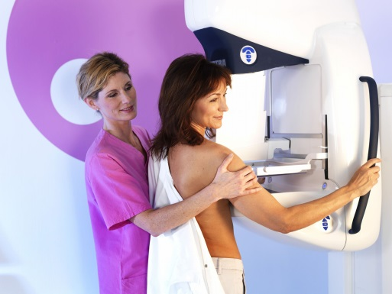
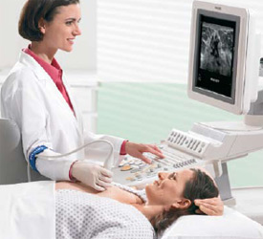
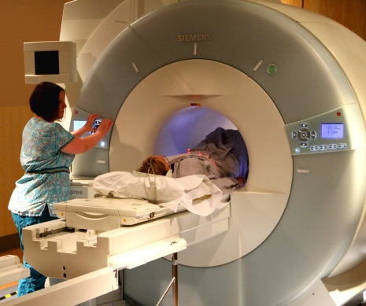
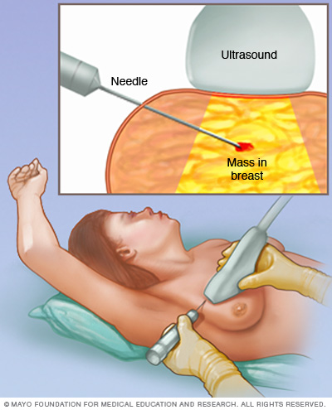
Background
Mammography
powerful screening method
x-ray radiation
high number of false positives
Ultrasound
can show certain breast changes
low spatial resolution
low sensitivity
Magnetic Resonance Imaging (MRI)
used for detailed examination
costly
limited specificity
  Biopsy
  gold standard to confirm BC
  highly invasive
  cancerous tumors often missed

Slide 5
Background
Breast malignancies are most often diagnosed after detection of a breast tumor; however, in more rare cases, breast cancer (like IBC) can cause breast tissue changes without an underlying tumor.
Alternative breast cancer detection and characterization methods aim to quantify tumor stiffness or tissue chromophores concentration
Cancerous lesions are stiffer than benign lesions
  Tactile sensors characterize tumor stiffness, location, and size
  Most are electromechanical pressure sensors
Breast tissue optical properties change when the tissue becomes malignant (angiogenesis and hypermetabolic activity)
  Hyperspectral/multispectral imaging can characterize superficial optical properties of suspicious breast tissues
  Hyperspectral imaging is available, yet costly and time consuming.

Slide 6
Research Goal
The primary goal of this research is to develop a bimodal imaging system for quantitative breast tumor and tissue characterization using tactile and multispectral imaging.
Tactile Imaging Probe's hardware and software are developed to measure tactile properties, such as the tumor size, stiffness, and depth within the breast tissue.
Multispectral Imaging Probe's hardware and software are developed to characterize superficial breast tissue properties, such as asymmetry, texture, and inflammation area.
Finally, we developed the Multimodal Index method for individualized breast cancer risk assessment using characterization indexes obtained from the two imaging modalities, and the patient's health information.

Slide 7
Tactile Imaging Probe
Malignant breast tumors tend to be stiffer and larger than benign tumors
With tactile imaging modality,
we characterize tumors’ size, stiffness, and depth

Slide 8
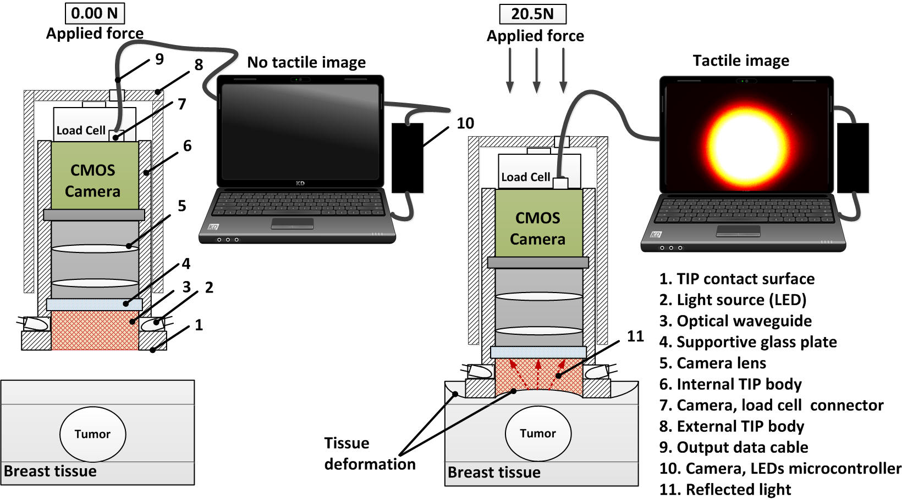
Tactile Imaging Probe - Design
Figure : Tactile Imaging Probe design and sensing principle

Slide 9
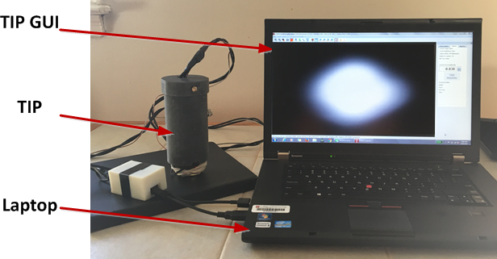
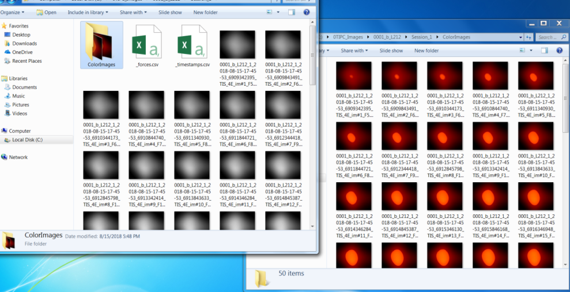
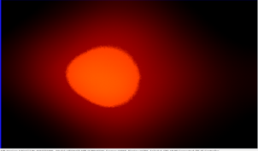

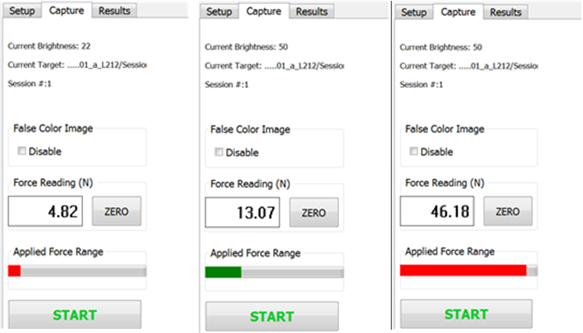
Tactile Imaging Probe - Acquisition
Figure : TIP connected to a laptop with TIP GUI
Figure : Acquired grayscale and colored tactile images
Figure : GUI parameters setup view
Figure : GUI capture view

Slide 10
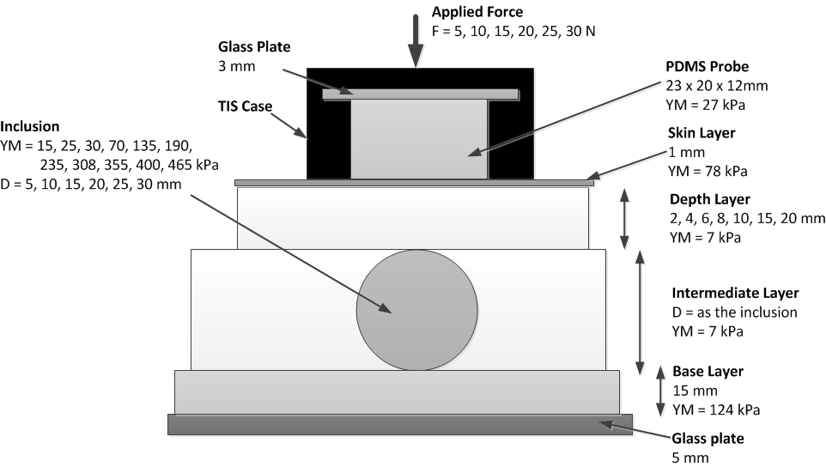
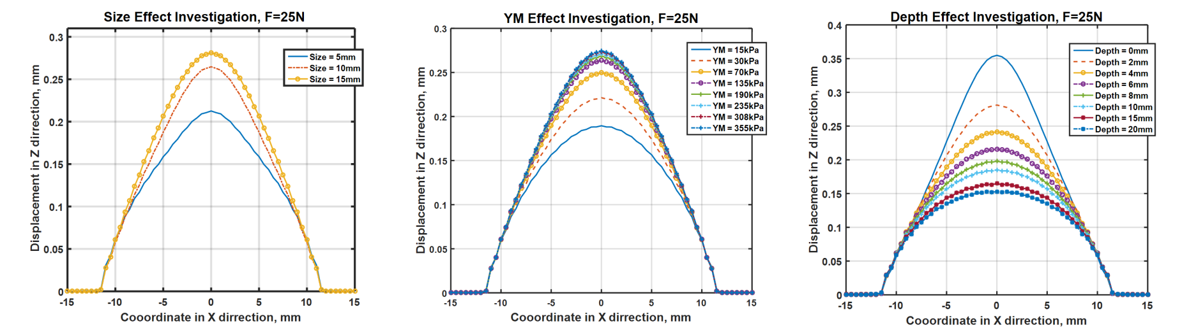
Tactile Imaging Probe - Simulation
Figure : Abaqus simulation model setup
Figure : Abaqus TIP sensing element simulation results

Slide 11

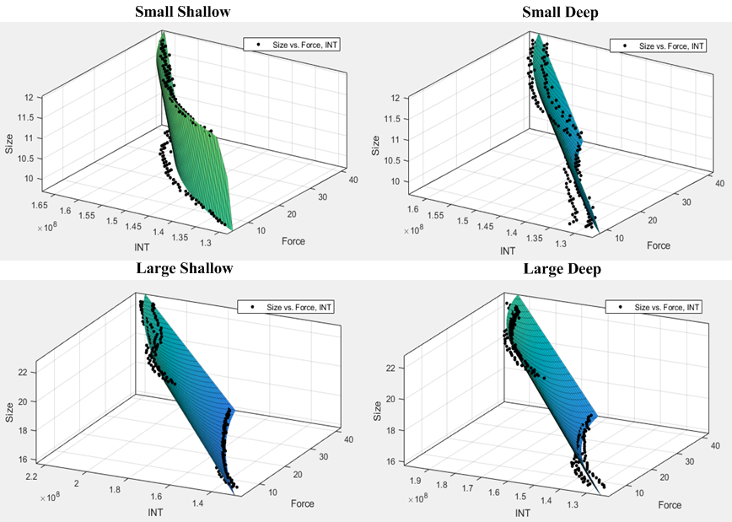
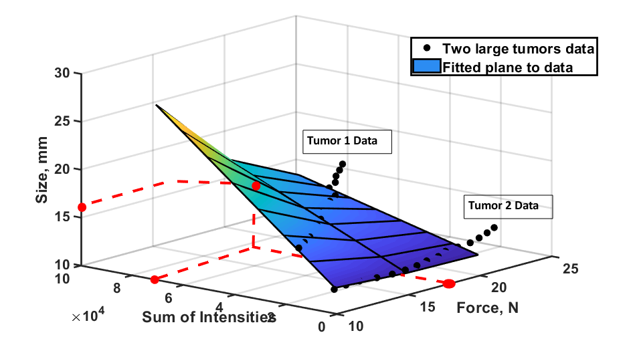
Tactile Imaging Probe – Tumor Size
Size Estimation
Figure : 3D interpolation model
Figure : Four 3D interpolation models

Slide 12
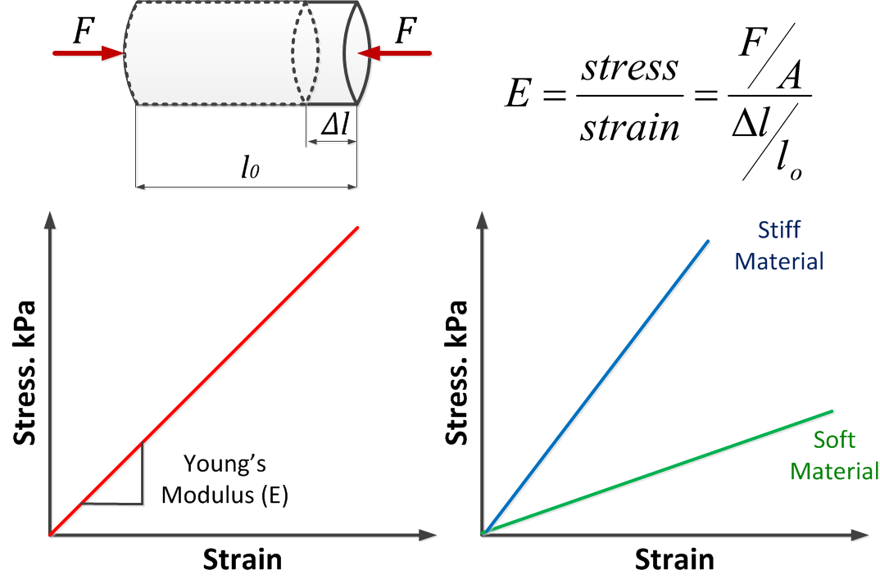
Tactile Imaging Probe – Tumor Stiffness
Figure : Conventional Young’s modulus estimation test in compression

Slide 13
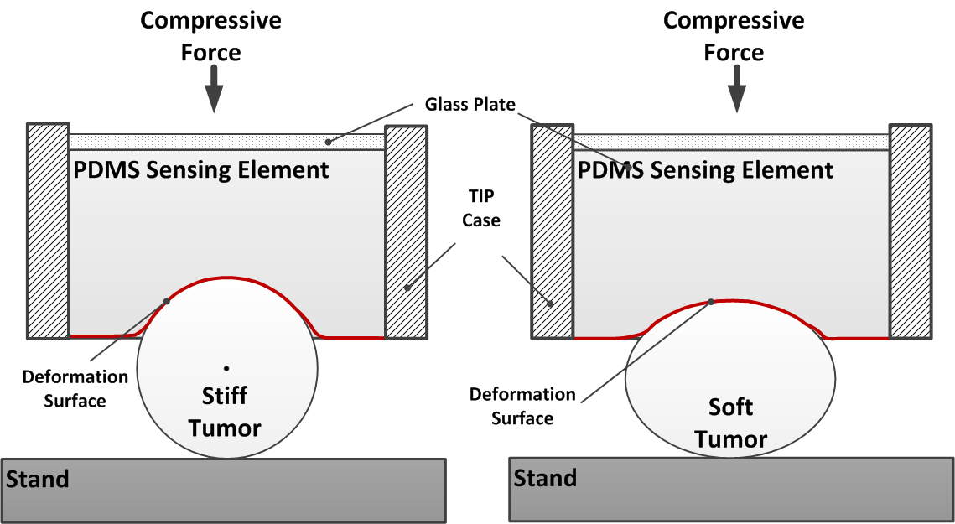

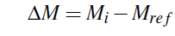

Tactile Imaging Probe – Tumor Stiffness
Figure : Stiff and soft tumors under TIP compression
Stiffness Estimation
Deformation force
TIP sensing element deformation image
Deformation Index of the imaged tumor

Slide 14
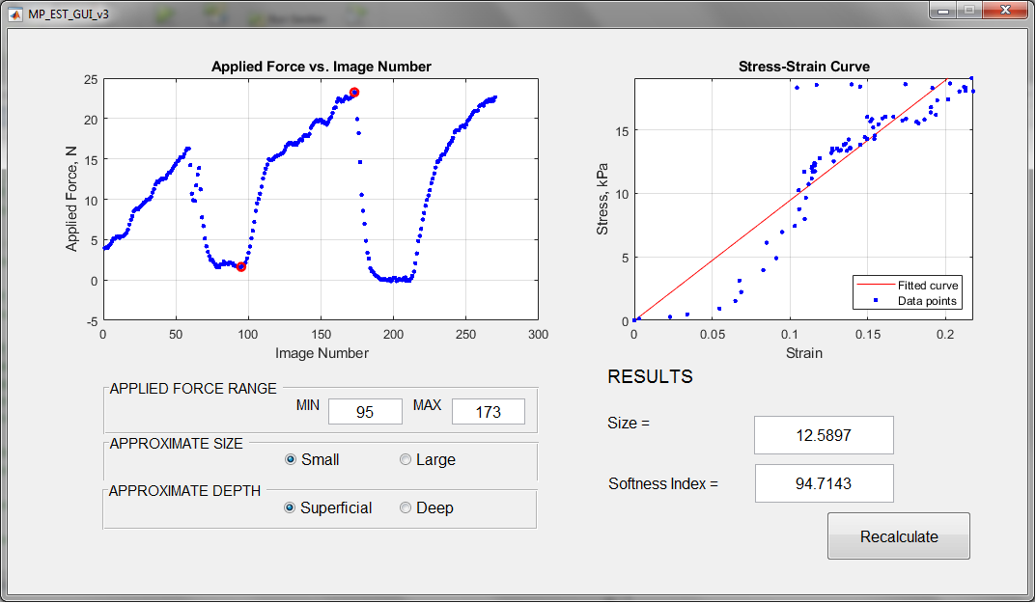
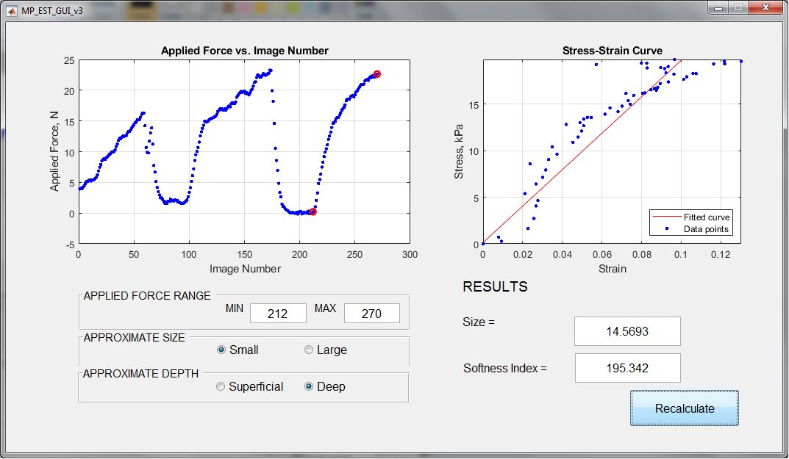
Tactile Imaging Probe - GUI
TIP Calculation GUI

Slide 15

Tactile Imaging Probe - Imaging
TIP imaging acquisition video recording for a soft and a stiff tumors
Notes:
Time series represented as a pattern image

Slide 16
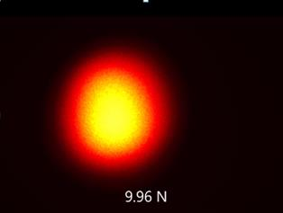
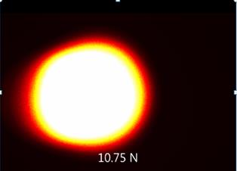
Tactile Imaging Probe - Imaging
Soft Tumor
Size 15 mm
Stiff Tumor
Size 15 mm

Slide 17
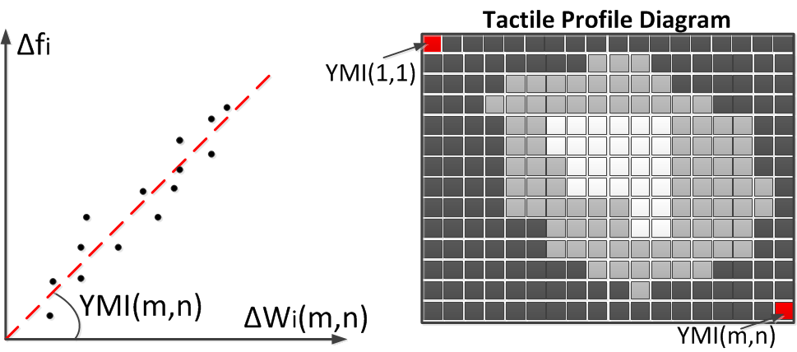


Tactile Imaging Probe - TPD
Tactile Profile Diagram is a complex tactile image, which encodes differential tactile information from a set of TIP images.
Figure : Construction of a Tactile Profile Diagram
Change in compression force
TIP sensing element deformation
Tissue with tumor deformation image

Slide 18
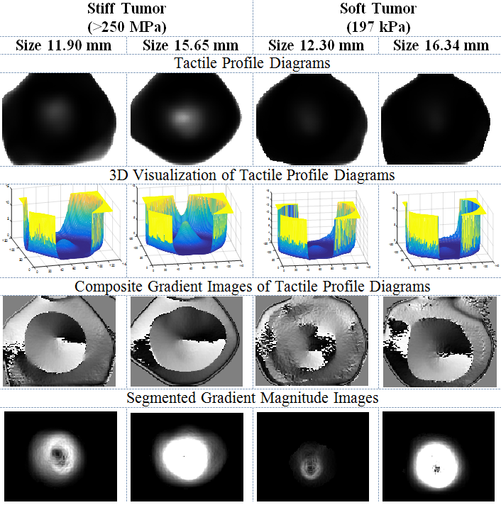
Tactile Imaging Probe - TPDs
Figure : Examples of TPDs for the tumors with different size and stiffness

Slide 19
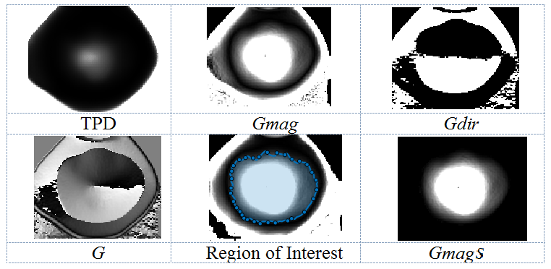
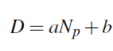
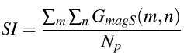
Tactile Imaging Probe – TPD Calculation
Figure : TPD segmentation for the tumor size and stiffness estimation
Size Estimation
Stiffness Estimation

Slide 20
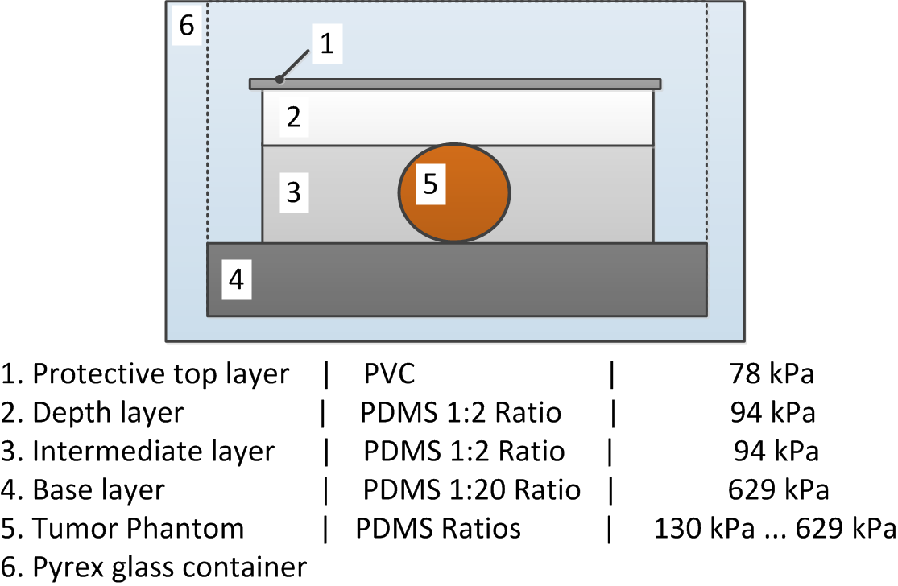
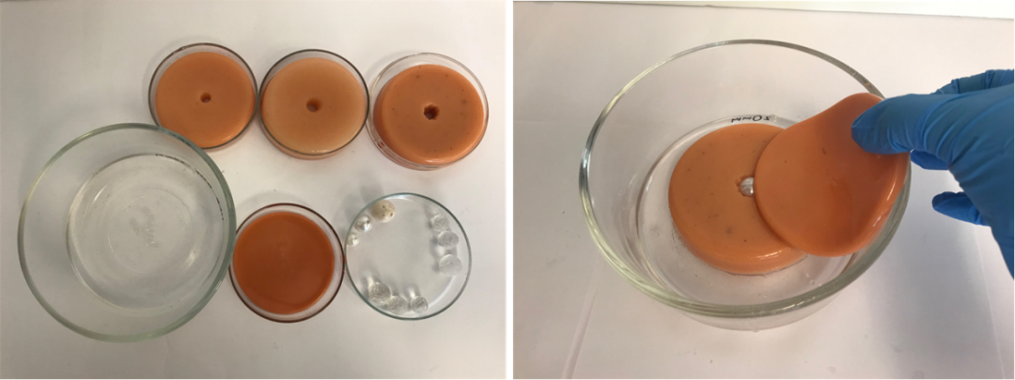

Tactile Imaging Probe - Phantom
Figure : TIP imaging phantom components
Figure : Example of the imaging phantom implementation

Slide 21
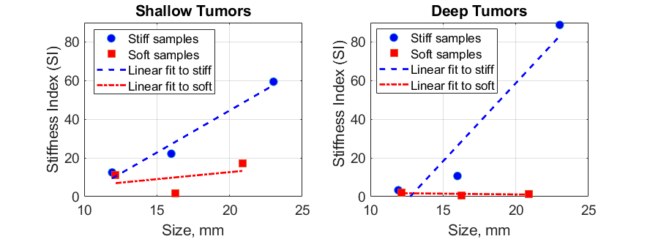
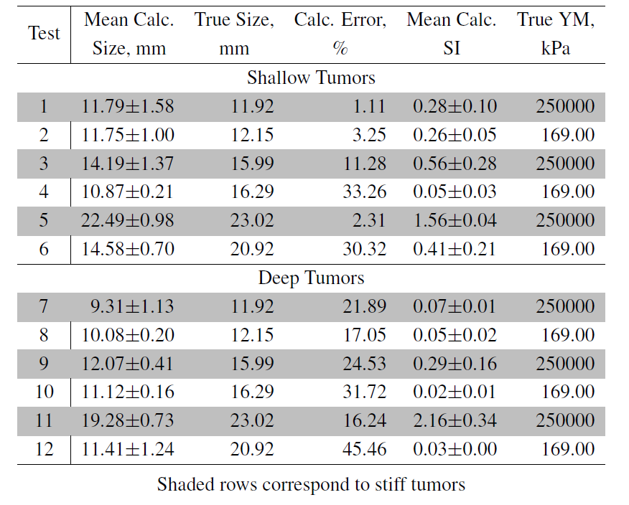
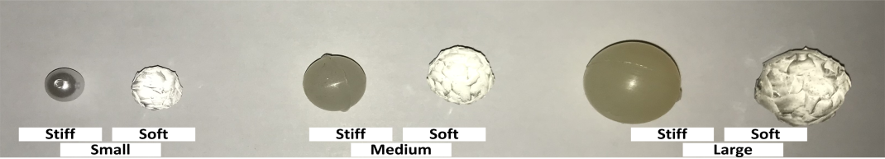
Tactile Imaging Probe – Phantom Results
Table: Results for tumor size and stiffness estimation from TPDs
Figure : Stiffness estimation from TPDs
Figure : Test samples

Slide 22
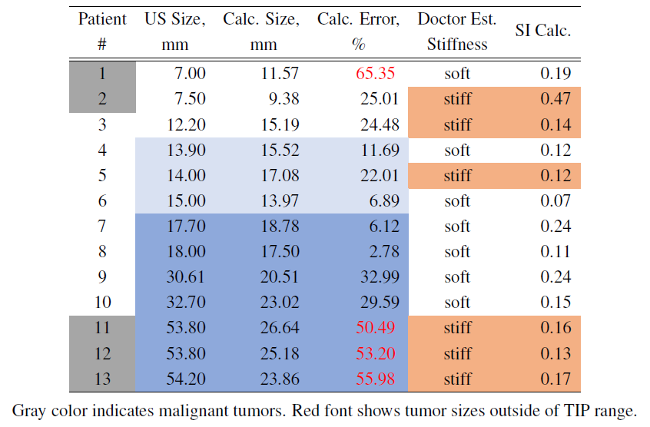
Tactile Imaging Probe – in-Vivo Results
Table : Size and SI results for the in-vivo data
5 malignant and 8 benign cases (IRB# 22050 Temple University).

Slide 23
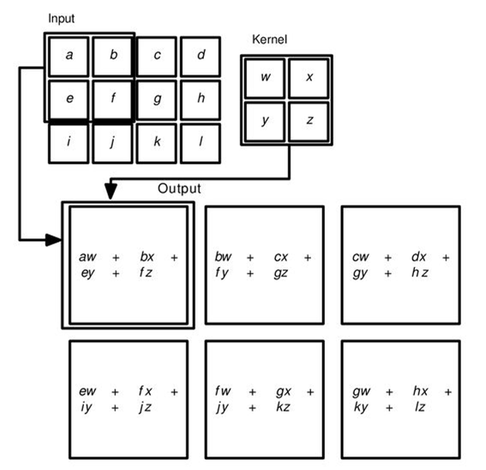
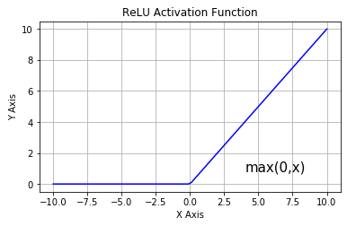
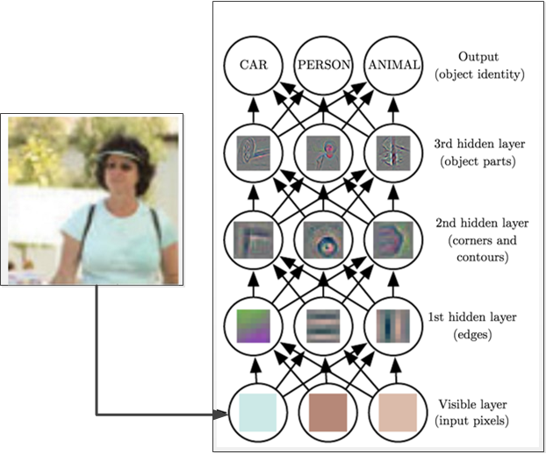
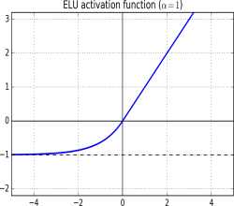
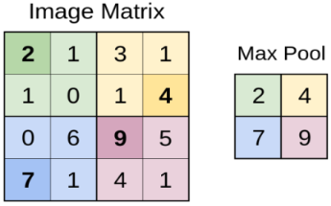
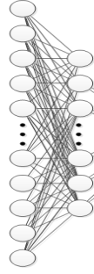
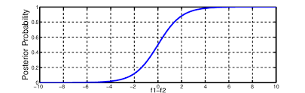
Classification with CNN
Convolution layer
Activation
Image
Probability
Max pool layer
Fully connected layers
Softmax
Class 1
Class 2
Class 3

Slide 24
Classification with CNN
Figure : Image classification with CNN (Goodfellow, 2017)

Slide 25
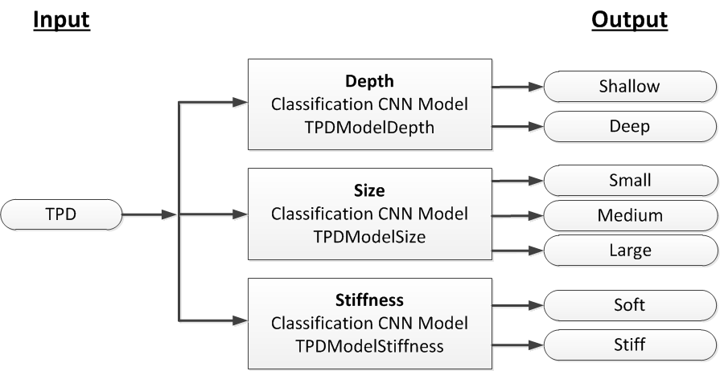
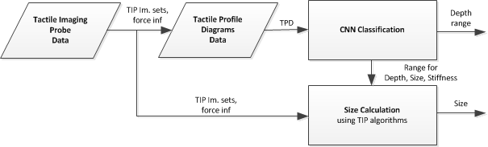
Classification with CNN – TPD
Figure : TPD classification diagram
Figure : Accurate tumor size estimation

Slide 26
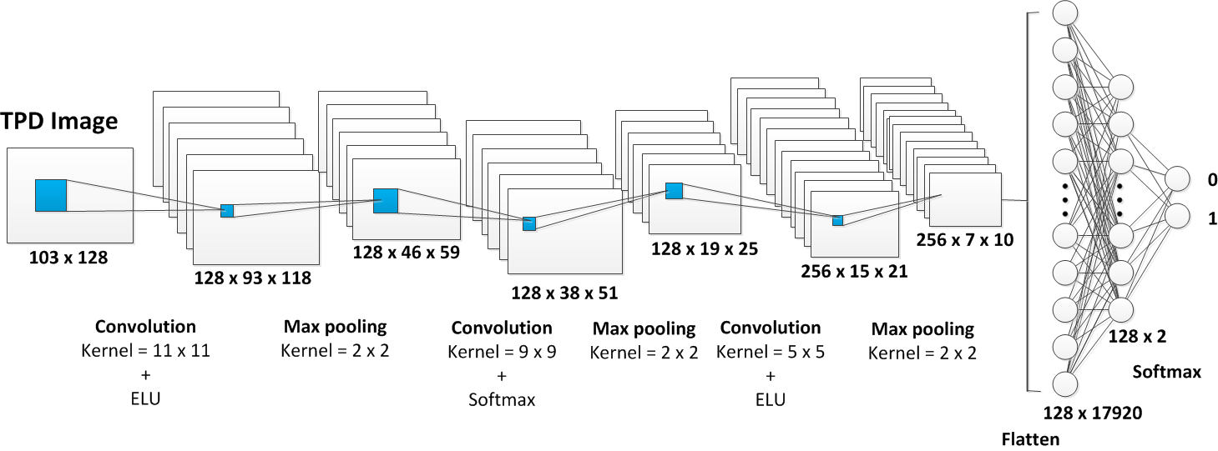
Classification with CNN – Depth
Figure : Depth CNN model (TPDModelDepth)
Dataset
Sizes: 10 mm, 12 mm, 14 mm, 16 mm, 18 mm, 23 mm
Stiffness: 130 kPa – 250 MPa
Shallow subset: depths 0 mm, 2 mm, and 4 mm
Deep subset: depths of 6 mm, 8 mm, 10 mm
Data division: training 80% and validation 20%
Model trained on 6768 TPDs, validated on 1692 TPDs
Training: 50 epochs, 200 TPDs in a batch

Slide 27
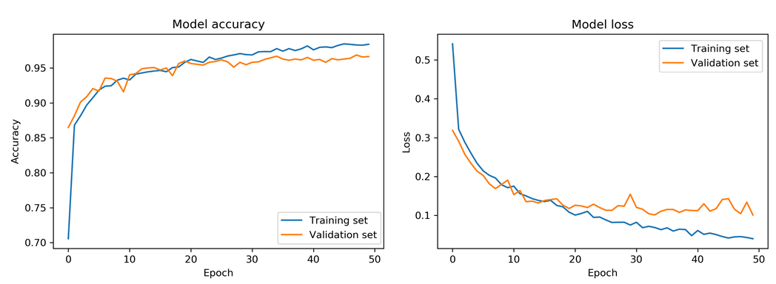
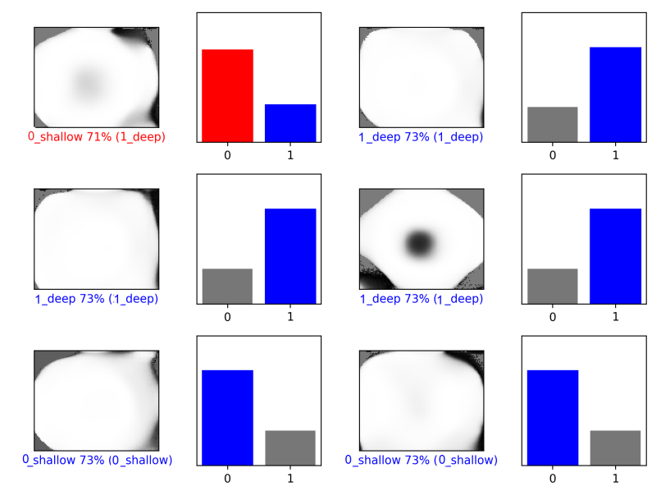
Classification with CNN – Depth
Figure : Graphs for TPDModelDepth model accuracy and loss
Results
Validation accuracy = 0.97.
Figure : Examples of TPD classification with TPDModelDepth

Slide 28
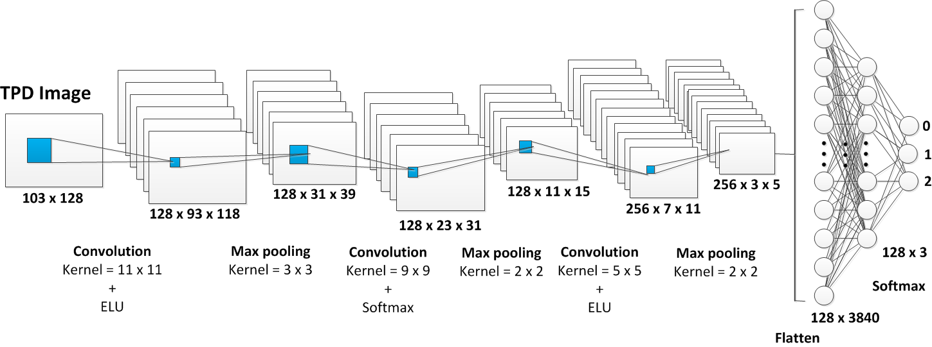
Classification with CNN – Size
Figure : Size CNN model (TPDModelSize)
Dataset
Small subset (10 mm and 12 mm),
Medium subset (14 mm and 16 mm).
Large subset (18 mm and 23 mm)
Stiffness: 130 kPa – 250 MPa
Depths: 0 mm, 2 mm, 4 mm, 6 mm, 8 mm, 10 mm
Data division: training 80% and validation 20%
Model trained on 6789 TPDs, validated on 1696 TPDs
Training: 50 epochs, 200 TPDs in a batch

Slide 29
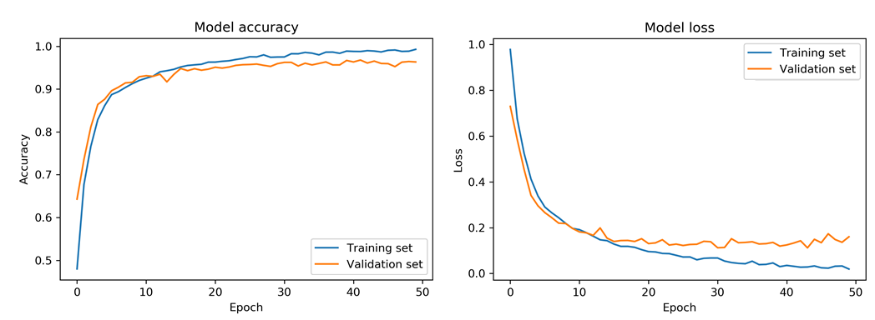
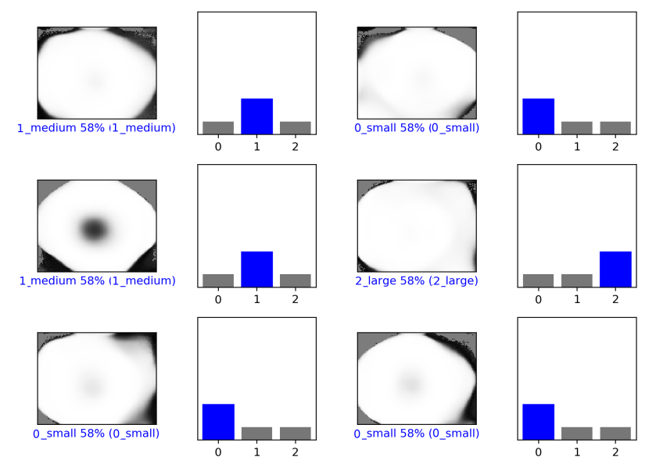
Classification with CNN – Size
Figure : Graphs for TPDModelSize model accuracy and loss
Results
Validation accuracy = 0.96.
Figure : Examples of TPD classification with TPDModelSize

Slide 30
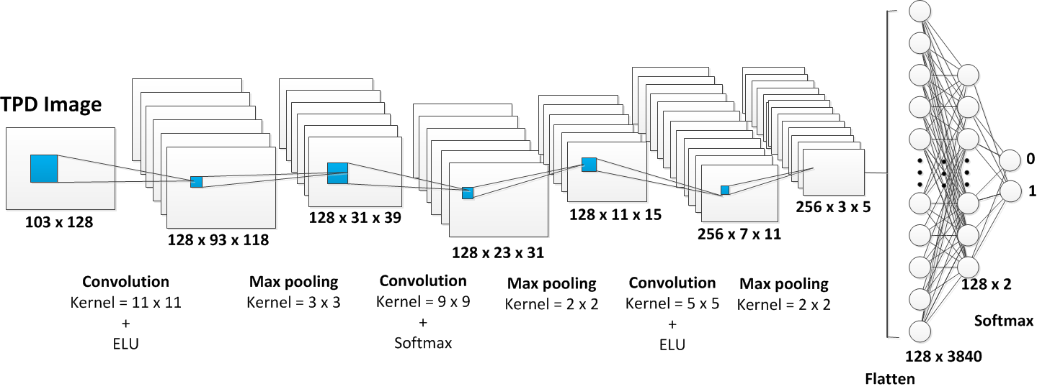
Classification with CNN – Stiffness
Figure : Stiffness CNN model (TPDModelStiffness)
Dataset
Sizes: 10 mm, 12 mm, 14 mm, 16 mm, 18 mm, 23 mm
Soft Subset: 130 kPa – 316 kPa
Stiff Subset: 376 kPa – 250 MPa
Depths: 0 mm, 2 mm, 4 mm, 6 mm, 8 mm, 10 mm
Data division: training 80% and validation 20%
Model trained on 6788 TPDs, validated on 1697 TPDs
Training: 50 epochs, 200 TPDs in a batch

Slide 31
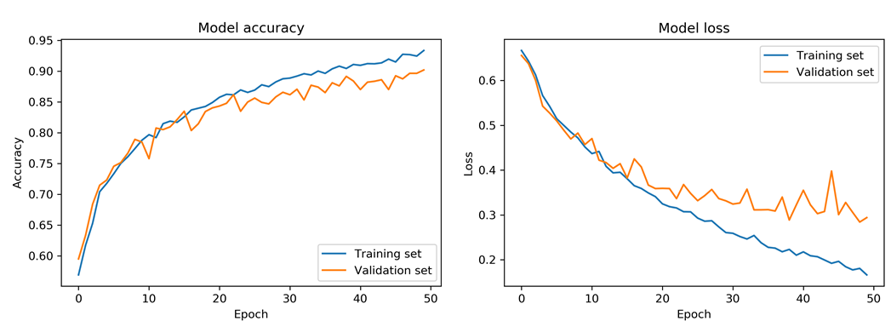
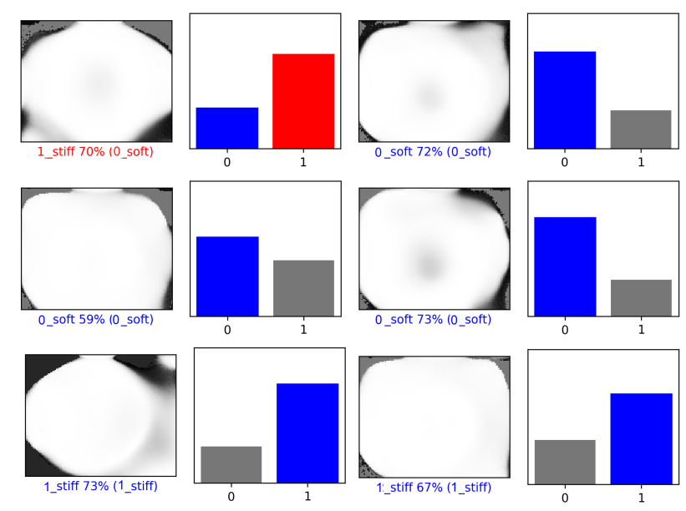
Classification with CNN – Stiffness
Figure : Graphs for TPDModelStiffness model accuracy and loss
Results
Validation accuracy = 0.90
Figure : Examples of TPD classification with TPDModelStiffness

Slide 32
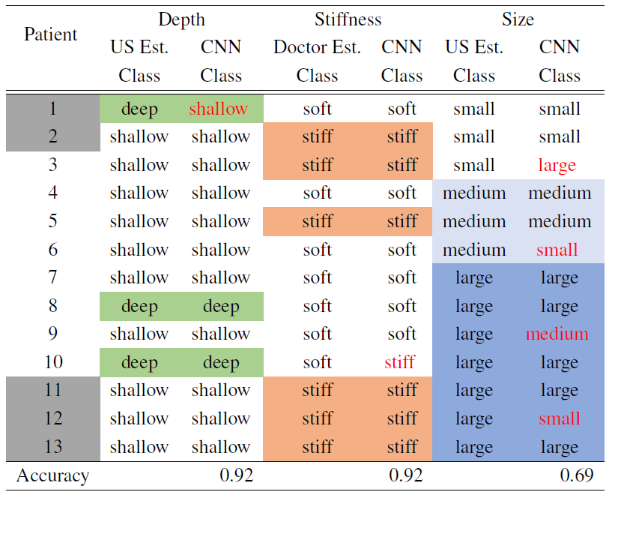
Classification with CNN – in-Vivo Results
Table : CNN classification results for the in-vivo data

Slide 33
Multispectral Imaging Probe
Even without a palpable tumor, there is a possibility of aggressive breast cancer such as IBC, which manifests by a rapidly developing inflammation.
With multispectral imaging modality, we characterize IBC manifestations, such as asymmetry, texture, and inflammation.

Slide 34



Multispectral Imaging Probe
Biological tissues have non-homogeneous optical properties
Light scatters and gets absorbed within tissue
Hyperspectral/Multispectral Imaging can help characterize tissues
Figure : Light propagation in tissue
Figure : Absorption of tissue chromophores
Figure : Hypercube image vs. RGB image

Slide 35



Multispectral Imaging Probe - Hardware
Figure : Retiga EXi with LCTF block
Figure : IDS, lens, and filter adapter
Figure : Experiments with Retiga and IDS cameras
Figure : Quantum efficiency vs. wavelength curves for both cameras

Slide 36

Multispectral Imaging Probe - Hardware
Figure : Multispectral Imaging Probe components and experimental setup

Slide 37

Multispectral Imaging Probe – Image Processing
Multispectral Image Pre-processing
Normalization
Decreases the effect of inhomogeneous illumination and hardware-related noise
Registration
Searches for geometric transformation of multiple images of the same scene to align
Construction of Multispectral Profile Diagram
Carries unique information about the optical properties of breast tissue from four imaging bands consolidated in one pattern image.
Construction of Differential Multispectral Profile Diagram
Carries unique information about the breast tissue changes.

Slide 38


Multispectral Imaging Probe - MPD
Figure : Construction of Multispectral Profile Diagram

Slide 39




Multispectral Imaging Probe - Phantom
Figure : MIP Phantom design
Figure : MIP Phantom implementation

Slide 40




MIP – Wavelengths Selection
Figure : Wavelengths selection experiment samples
Figure : Selected wavelengths for MIP
J. Ruiz, F. Nouizi, J. Cho, J. Zheng, Y. Li, J.-H. Chen, M.-Y. Su, and G. Gulsen, “Breast density quantification using structured-light-based diffuse optical tomography simulations,” Applied Optics, vol. 56, no. 25, p. 7146, 2017.
Figure : Absorbance/scattering spectra

Slide 41


MIP – Multispectral Profile Diagram
Figure : Construction of Multispectral Profile Diagram

Slide 42




MIP – Enhanced Differential MPD
Figure : Differential Multispectral Profile Diagram construction
Figure : Texture enhancement using Differential Multispectral Profile Diagram

Slide 43

Classification with CNN - MPD
Figure : Multispectral Profile Diagram classification with CNN

Slide 44

Classification with CNN - Datasets
Figure : Examples of Differential Multispectral Profile Diagrams Datasets

Slide 45

Classification with CNN – Asymmetry
Figure : Asymmetry CNN Model (MPDModelAsymmetry)
Dataset
The samples were obtained from pairwise combinations of 240 affected and 6 normal MPDs of MIP samples with different combinations of phantom features.
Data division: Training 75%, validation 20%, and test 5%.
Model trained on 30720 MPDs
validated on 7656 MPDs
tested on 1344 MPDs
Training: 5 epochs, 100 MPDs in a batch

Slide 46


Classification with CNN - Asymmetry
Figure : Graphs for MPDModelAsymmetry model accuracy and loss
Results
The training accuracy, validation accuracy, and test accuracy are 99%, 100%, and 98%, respectfully.
Figure : Examples of TPD classification with MPDModelAsymmetry

Slide 47

Classification with CNN – Texture
Figure : Texture CNN Model (MPDModelTexture)
Dataset
The samples were obtained from pairwise combinations of 240 affected and 6 normal MPDs of MIP samples with different combinations of phantom features.
Data division: training 70%, validation 20%, and test 10%.
Model trained on 26880 MPDs, validated on 7656 MPDs, tested on 3840 MPDs
Training: 25 epochs, 100 MPDs in a batch

Slide 48


Classification with CNN - Texture
Figure : Graphs for MPDModelTexture model accuracy and loss
Results
The training accuracy, validation accuracy, and test accuracy are 95%, 81%, and 83%, respectfully.
Figure : Examples of MPD classification with MPDModelTexture

Slide 49

Classification with CNN - Inflammation
Figure . Inflammation CNN Model
Figure : Texture CNN Model (MPDModelInflammation)
Dataset
The samples were obtained from pairwise combinations of 240 affected and 6 normal MPDs of MIP samples with different combinations of phantom features.
Data division: training 77.5%, validation 20%, and test 2.5%.
Model trained on 12251 MPDs, validated on 3056 MPDs, and tested on 372 MPDs
Training: 20 epochs, 50 MPDs in a batch

Slide 50


Classification with CNN - Inflammation
Figure : Graphs for MPDModelInflammation model accuracy and loss
Results
Training accuracy, validation accuracy, and test accuracy are 85%, 61% and 77%, respectfully
Figure : Examples of TPD classification with MPDModelInflammation

Slide 51


Classification with CNN – Test Set
Figure : Independent test samples
Figure : Independent classification test samples

Slide 52

Classification with CNN - Results
Table : MPD classification results on an independent dataset

Slide 53
Multimodal Index for Breast Cancer Risk Assessment
We combine the findings from tactile and multispectral modalities and the individual patients risk to complete breast cancer risk assessment

Slide 54

Multimodal Index
Figure : Block diagram for Multimodal Index computation

Slide 55


Multimodal Index – BCRAT Index
The BCRAT Index is the individual risk of developing breast cancer established by NCI based on Gail statistical model
The online BCRAT calculation tool is publicly available.
Figure : The BCRAT calculator questions
Figure : Example of the NCI BCRAT calculator results

Slide 56



Multimodal Index
Tactile Index
Spectral Index
BCRAT Index
Multimodal Index

Slide 57


Multimodal Index – Phantom
Figure : Bimodal imaging phantom design
Figure : Bimodal imaging phantom implementation

Slide 58


Multimodal Index – Results
Table : Multimodal Index Results

Slide 59
Conclusions
We developed the bimodal imaging prototype and its calculation algorithms to capture tactile and multispectral properties of breast tumors and tissues.
We explained the novel Profile Diagrams method
We capture, encode, and analyze tactile and multispectral imaging signals as pattern images in the application meaningful way.
In TIP experiments, we classified tumors based on depth, size, and stiffness using TPDs and CNN. We also quantified the size and stiffness of tumors.
TIP can be used to differentiate malignant from benign tumors.
In MIP experiments, we classified superficial breast tissues based on asymmetry, texture, and inflammation factors using MPDs and CNN.
MIP can help screening for rare breast cancer, where there are no tumors.
We developed the method to calculate the individualized Multimodal Index for patients based on the imaging data from TIP and MIP modalities, and the individual breast cancer risk.
The method provides an individualized BC risk index for a patient.

Slide 60
Publications
1. V. Oleksyuk, D. Caroline, S. Pascarella, R. Kendzierski, and C.-H. Won, “Tissue Inclusion Characterization using Tactile Profile Diagrams,” Annual International Conference of the IEEE Engineering in Medicine and Biology Society (EMBC 2021) (Submitted for review).
2. S. Choi, V. Oleksyuk, and C.-H. Won, “Breast Tumor Malignancy Classification using Smartphone Compression-induced Sensing System and Deformation Index Ratio,” Annual International Conferences of the IEEE Engineering in Medicine and Biology Society (EMBC), Montreal, Canada: Jul. 2020.
3. V. Oleksyuk, R. Rajan, F. Saleheen, D. Caroline, S. Pascarella and C.-H.Won, “Risk score based pre-screening of breast tumor using compression induced sensing system,” Sensors Journal, IEEE, Vol.18 (10), pp. 4038-4045, 2018.
4. F. Saleheen, V. Oleksyuk, and C.-H.Won, “Itchy skin region detection using hyperspectral imaging,” Proc. SPIE Defense-Commercial Sensing, Paper 10656-7, Baltimore, MD: USA, 2018.
5. V. Oleksyuk, F. Saleheen, D. Caroline, S. Pascarella and C.-H. Won, “Classification of breast masses using tactile imaging system and machine learning algorithms,” IEEE Signal Processing in Medicine and Biology Symposium, Philadelphia, PA: USA, Jan 2017.
6. V. Oleksyuk, F. Saleheen, D. Caroline, S. Pascarella, C.-H. Won. “KNN classification of tactile imaging data,” 2017 International Symposium on Innovation in Information Technology and Application (ISIITA17), Danang: Vietnam, Jan. 2017.
7. C.-H. Won, J. Goldstein, V. Oleksyuk, D. Caroline, S. Pascarella. “Tumor size and elasticity estimation using smartphone-based compression-induced scope,” 39th Annual International Conference of the IEEE Engineering in Medicine and Biology Society (EMBC 17), JeJu Island: S. Korea, July 2017, pp. 4106-4109.
8. F. Saleheen, Z. Wang, W. Moser, V. Oleksyuk, J. Picone, C.-H. Won, “Effectiveness of virtual open laboratory teaching assistant for circuits laboratory,” 123rd ASEE Annual Conference, New Orleans, LA: USA, June 2016.
9. V. Oleksyuk, F. Saleheen, W. Moser, and C.-H. Won, “Tactile imaging sensor for mechanical properties quantification of breast tumor,” IEEE Biomedical Circuits and Systems Conference (BioCAS), Atlanta, GA: USA, Oct. 2015.
10. A. Sahu, F. Saleheen, V. Oleksyuk, C. McGoverin, N. Pleshko, A. Harati, J. Picone and C.-H. Won, “Characterization of Mammary Tumors Using Noninvasive Tactile and Hyperspectral Imaging Sensors,” Sensors Journal, IEEE, Vol.14 (10), pp. 3337- 3344, 2014.
11. A. Sahu, F. Saleheen, V. Oleksyuk, Y. Chen, and C.-H. Won, “Tactile and hyperspectral imaging sensors for mammary tumor characterization,” Sensors, 2013 IEEE, Baltimore, MD: USA, Nov 2013.
12. F. Saleheen, V. Oleksyuk, A. Sahu, and C.-H.Won, “Non-invasive mechanical properties estimation of embedded objects using tactile imaging sensor,” Proc. SPIE 8719, Smart Biomedical and Physiological Sensor Technology X, Baltimore, MD: USA, May 2013.
13. F. Saleheen, A. Sahu, V. Oleksyuk, and C.-H. Won, “Normal force estimation using tactile imaging sensor,” Bioengineering Conference (NEBEC), 2012 38th Annual Northeast, Philadelphia, PA: USA, Mar. 2012, pp. 119-120.

Slide 61
Acknowledgements
Dr. Chang-hee Won for the valuable guidance and continuous support
My committee Dr. Joseph Picone, Dr. Iyad Obeid, Dr. Nancy Pleshko, and Dr. Xiaojiang Du for their time and thoughtful contributions
My friends and CSNAP lab team members Firdous Saleheen, Sung In Choi, Reshma Rajan, and Steve Lash for support and encouragement
Dr. Jie Yin(ME) and Dr. Qiuting Zhang for the aid with simulation modeling
Vinit Shah (ECE) for helpful discussions on deep learning topics
Dr. Chetan Patil and Mohammed Arefin (BioE) for shared expertize on the NIR imaging and phantoms
Helen Freitas (BioE), Max Lin (ECE), Dr. Rouzbeh Tehrani (CE), Dr. Gangadhar Andaluri (CE) for lab resources and support
I am also sincerely thankful to Nadeepuram Ranganathan and Barry Brucker from Avix Medical Inc. for the provided opportunities, financial support, and shared expertise
Dr. Dina Caroline, Dr. Suzanne Pascarella, and Dr. Renee Kendzierski (TUH) for help with the clinical data collection
National Science Foundation, the College of Engineering, the Department of Defense, the PA Department of Health, and Edmund Optics for the financial support and opportunities

Slide 62

Thank you!

Slide 63
Appendices

Slide 64


Appendix : TIP Phantom Results
Table : Size and stiffness calculation in phantom
Notes:
( ⁺⁺ indicates a highly insignificant value for small size tumor. n/a indicates the inability to obtain size information. * indicates the error in deformation index pattern)
At superficial depth (0 mm), the tumor phantom sizes 10 mm, 15 mm and 18 mm are detected better with a less size error percentage of 1.87%, 9.61% and 18.12%, respectively.
As depth increased, from 0 mm to 15 mm the size estimation error only increased slightly which shows the sensitivity of tip and accuracy of measuring the tumor size in varying depth. The 3 mm size estimation shows a large error
The result shows that TIP can determine the size of 1:20 samples more accurately than that of 1:3, and the error is smaller. This shows that TIP is able to detect malignant tumors or stiffer growths over benign or non-stiff growths. The phantom testing showed that the tip is able to determine the size of tumors above 3 mm in size up to 18 mm and to a depth up to 15 mm.
The stiffer samples show higher deformation index than the softer samples. At the depth of 15 mm, a small sized tumor showed a large error due to the difficulties in detecting deeply embedded tumors. Overall, TIP results show that the probe tip deformation index is directly related to the stiffness of the tumor.

Slide 65

Appendix : TIP in-Vivo Results
Table : In-vivo size and stiffness estimation
The TIP was tested in twenty-one human patients (IRB# 22050 Temple University).
Patients were randomly selected by the radiologists.
The patients were scheduled for biopsy, where the histopathology reports from biopsy was used as the truth for classification.
Notes:
The serial numbers from 1 to 15 have a size estimation error less than 20%. In these cases the estimated size values are close to the real values.
In serial numbers 16 to 21, the error percentage increased from 20% to 70%. This is mainly due to the non-palpable nature of the tumor or the human error of performing experiment.
We observe that the malignant tumors (denoted with “+” symbol) show higher deformation index

Slide 66



Appendix : TIP in-Vivo Risk Score
Table. In-vivo malignancy classification
Figure . ROC curve
Sensitivity, Specificity and Accuracy
100%, 82% and 90.5%, respectively.
Notes:
where W1 and W2 are the two weights used for size and deformation index respectively,
S represents the estimated size value,
Smax is the maximum estimated size value, DI is the calculated deformation index, DImax is the maximum calculated deformation index.
R is the highest value of Risk Score used.
The leave-one-out-cross-validation technique was applied for the dataset classification evaluation. To classify tumors, we choose the pair of weights (W₁ and W₂), which gives the best classification sensitivity and specificity for a training subset (20 patients). We computed Receiver Operating Characteristic (ROC) curve with different weights for each training subset, where W₁ and W₂ varied from 0 to 1 in steps of 0.1. The sum of the weights has to be one by using any of the eleven combinations (e.g 0.1 and 0.9, 0.2 and 0.8, etc.). The optimal weights and corresponding threshold values were determined.
sample ROC curve is shown with the optimal point at (0.1818, 1), which corresponds to 100% sensitivity and 82% specificity. The corresponding threshold value for the risk score came out to be 1.99 and the optimal weight came out to be W₁ =0.3 and W₂ =0.7.
ROC curve is shown with the optimal point at (0.1818, 1),
which corresponds to 100% sensitivity and 82% specificity. The corresponding threshold
value for the risk score came out to be 1.99, and the optimal weight came out to be W1 =
0.3 and W2 = 0.7.

Slide 67

Appendix : Classification with CNN – Phantom Results
Table : CNN classification results for the phantom data

Slide 68


Appendix – 3D Interpolation Model Selection with CNN
Table : Size calculation results using CNN aided model selection

Slide 69



Appendix – Kubelka-Munk
Kubelka-Munk transformation is used to translate reflectance ($R_{∞}$) information in terms of absorbance/ scattering (A/S)
$$\frac{A}{S}=\frac{{(1−R_{∞})}^{2}}{2R_{∞}}$$

Slide 70

Appendix : MIP GUI
Figure : MIP acquisition GUI

Slide 71
Appendix : Multimodal Index – Calculation
Tactile Index
0.1 P(Deep) + 0.2(P(Medium) + P(Large)) + 0.7 P(Stiff)
Spectral Index
0.2 P(Asymmetric)+0.2 P(Pitted)+0.6 P(Large Inflammation)
BCRAT Index
Multimodal Index
0.3 Tactile Index + 0.7 Spectral Index

Slide 72

Appendix : Multimodal Index – Results
Table : Tactile Index Results
Table : Spectral Index Results

Slide 73

Appendix : Future Research Directions

