Slide 1


Tactile and Multispectral Imaging Probe with Convolutional Neural Network for Cancer Risk Assessment
Doctoral Dissertation Proposal Presentation
Department of Electrical and Computer Engineering
Vira Oleksyuk
Advisor :
Committee Members :
Dr. Chang-hee Won
Dr. Joseph Picone
Dr. Iyad Obeid
Dr. Nancy Pleshko
May 4, 2020

Slide 2

Motivation
This year, 30% of all new female cancer diagnoses in the US will be due to breast cancer (ACS).
Women from rural or underdeveloped communities often have limited access to cancer screening and healthcare
There is a need for an inexpensive and easy-to-use breast cancer identification device to support primary care physicians.

Slide 3
Outline
Background
Research Goal
Tactile Imaging Probe
  Tactile Profile Diagrams
Multispectral Imaging Probe
  Multispectral Profile Diagrams
Classification with Convolutional Neural Network
Probability of Malignancy Score
Preliminary Results
Conclusions
Future Plans

Slide 4
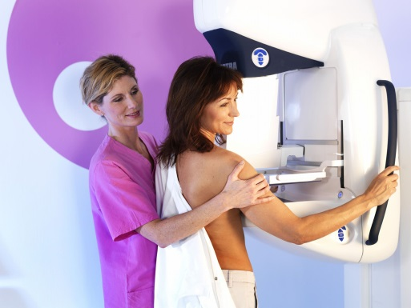
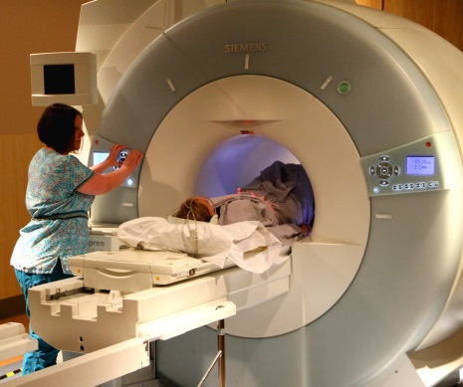
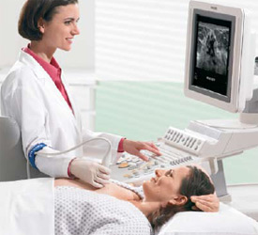
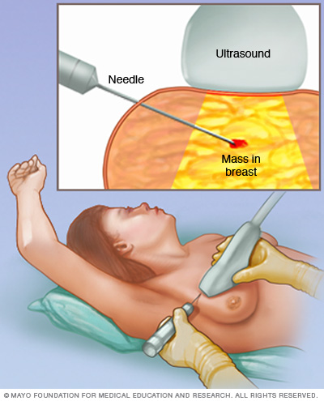
Background
Mammography
x-ray radiation
high number of false positives
Magnetic resonance imaging
costly
limited specificity
Ultrasound
low spatial resolution
low sensitivity
  Biopsy - gold standard
  cancerous tumors often missed
  highly invasive

Slide 5
Background
Alternative breast cancer detection and characterization methods aim to quantify tumor stiffness or tissue chromophores concentration
Cancerous lesions are stiffer than benign lesions
  Tactile sensors characterize tumor stiffness, location, and size
  Most are electromechanical pressure sensors
Breast tissue optical properties change when the tissue becomes malignant (angiogenesis and hypermetabolic activity)
  Hyperspectral/multispectral imaging can characterize superficial optical properties of suspicious breast tissues
  Hyperspectral imaging is available, yet costly and time consuming.

Slide 6
Research Goal
The primary goal of this research is to develop a bimodal imaging system for quantitative breast tumor and tissue characterization using tactile and multispectral imaging.
Tactile Imaging Probe's hardware and software are developed to measure tactile properties, such as the tumor size, stiffness, and depth within the breast tissue.
Multispectral Imaging Probe are developed to characterize superficial breast tissue properties, such as color, texture, size of the affected area, and asymmetry changes.
Finally, we will propose a method for breast tumor classification on malignant or benign using characterization indexes obtained from the two imaging modalities and the patient's health information.

Slide 7
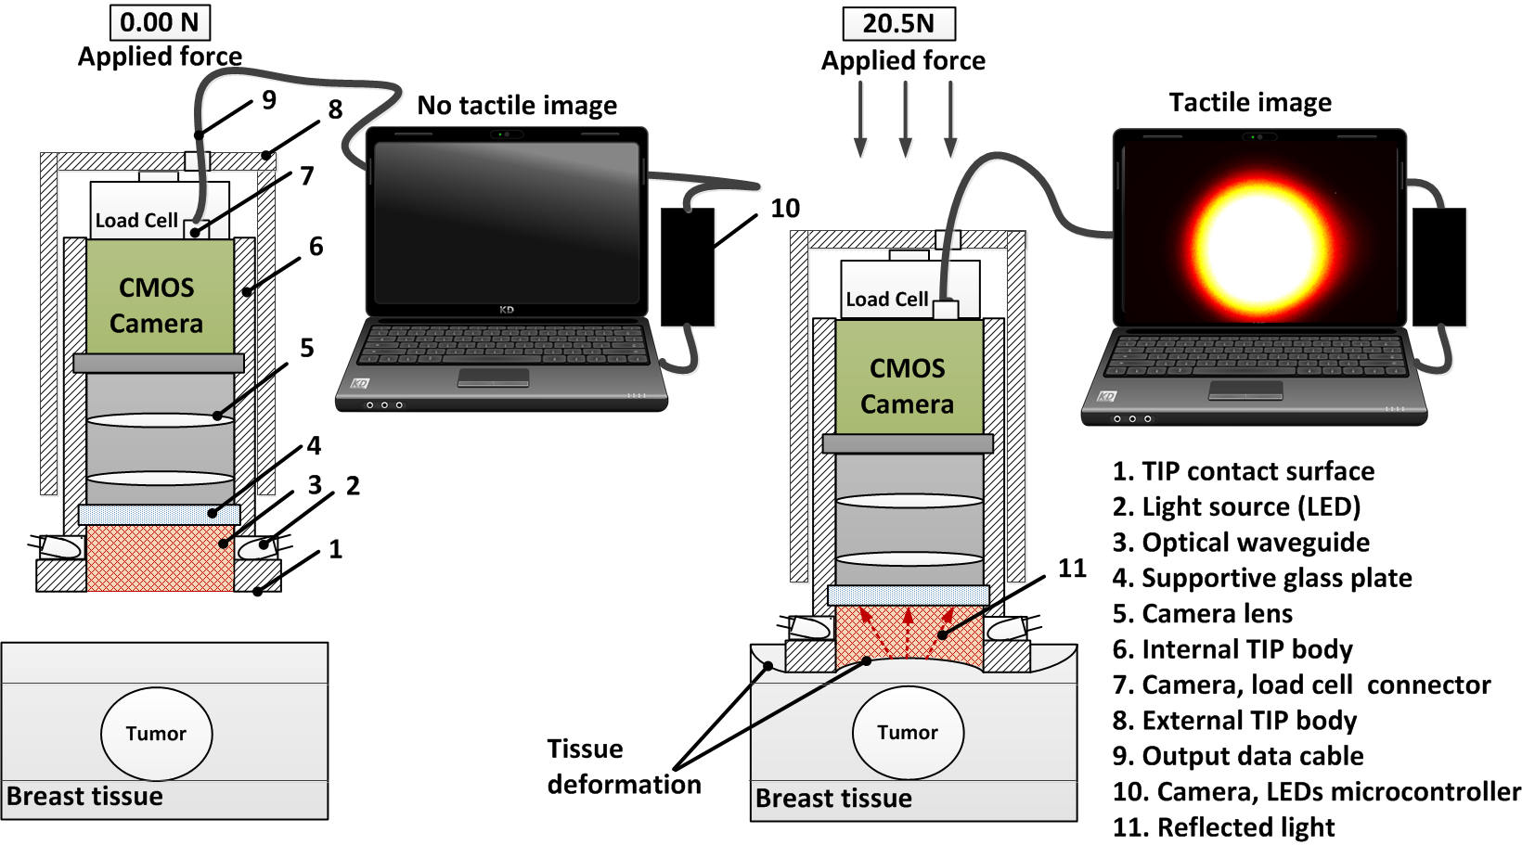
Tactile Imaging Probe - Design
Figure . Tactile Imaging Probe design and sensing principle

Slide 8
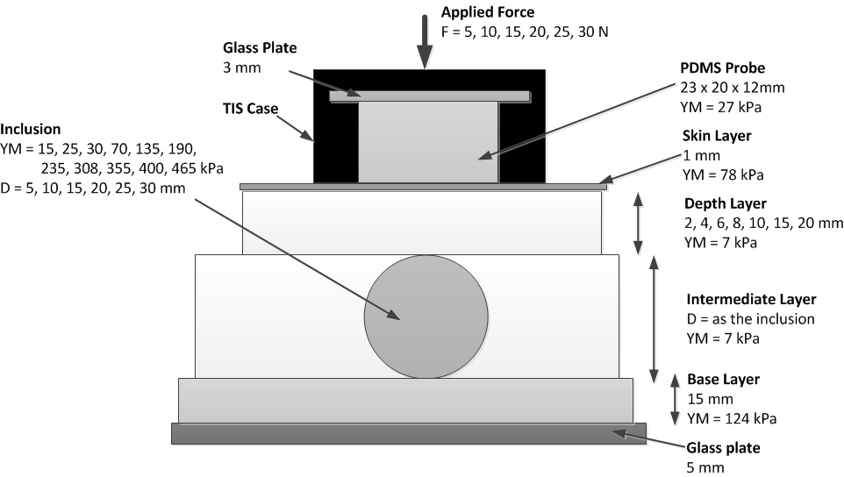
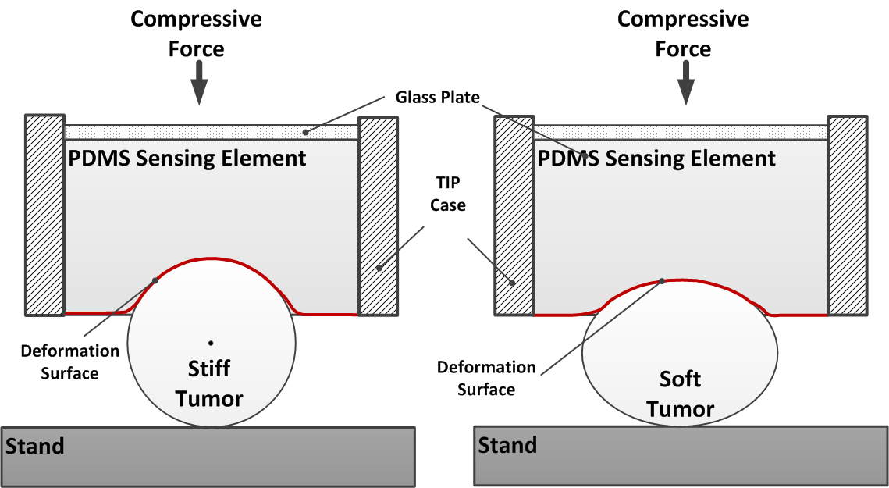
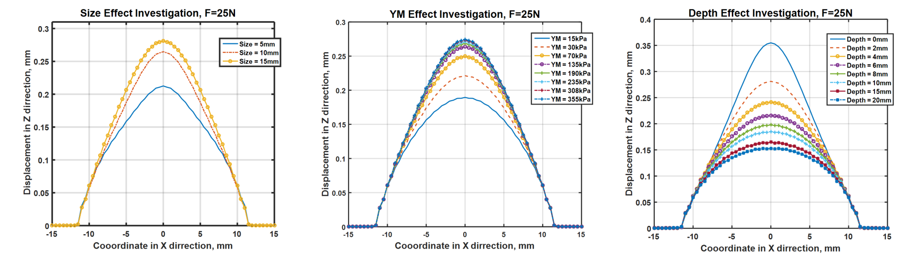
Tactile Imaging Probe - Simulation
Figure . Stiff and soft tumors under TIP compression
Figure . Abaqus simulation model setup
Figure . Abaqus TIP sensing element simulation results

Slide 9
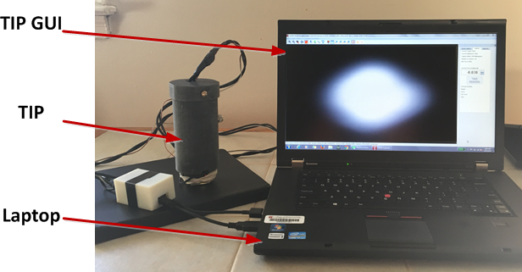
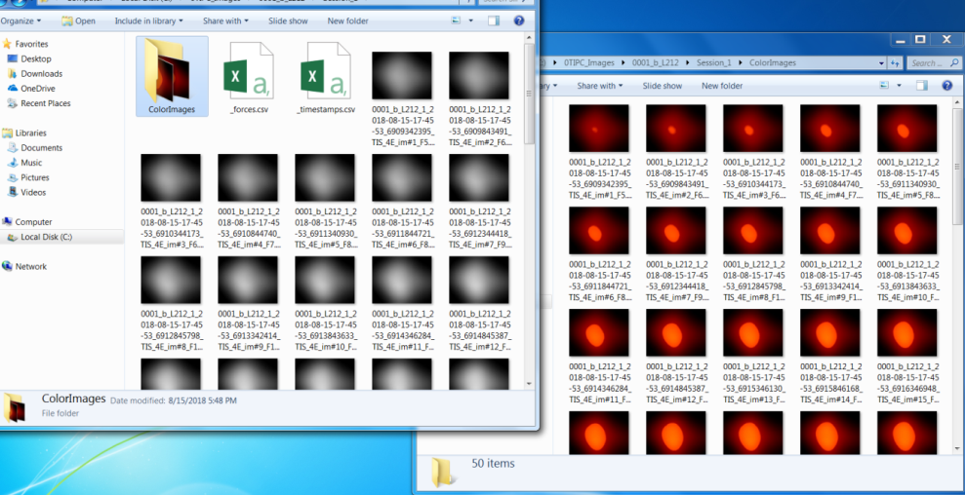
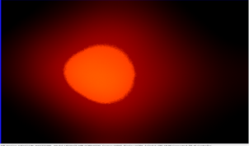

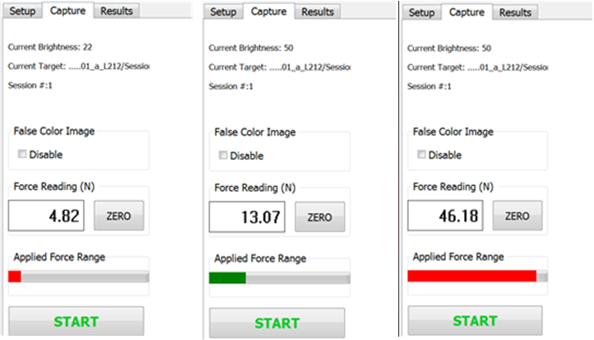
Tactile Imaging Probe - Acquisition
Figure . TIP connected to a laptop with TIP GUI
Figure . Acquired grayscale and colored tactile images
Figure . GUI parameters setup view
Figure . GUI capture view

Slide 10
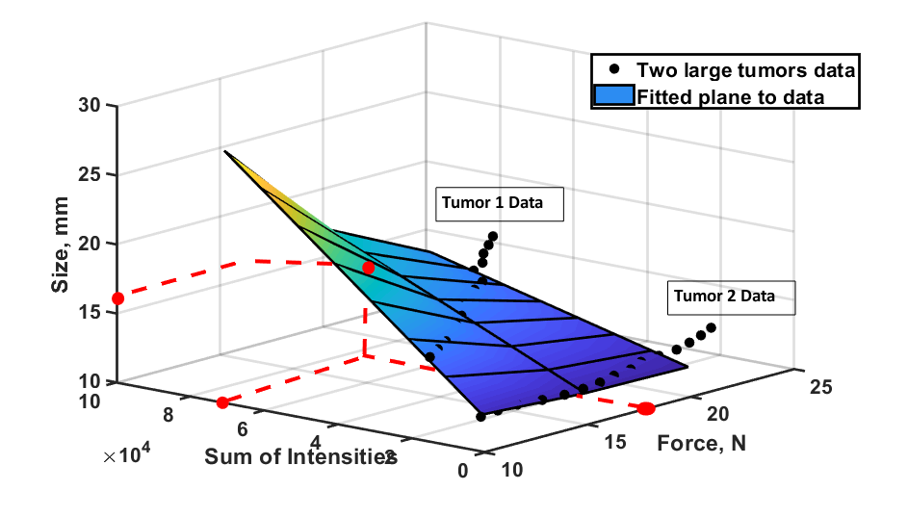
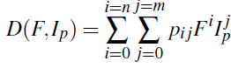
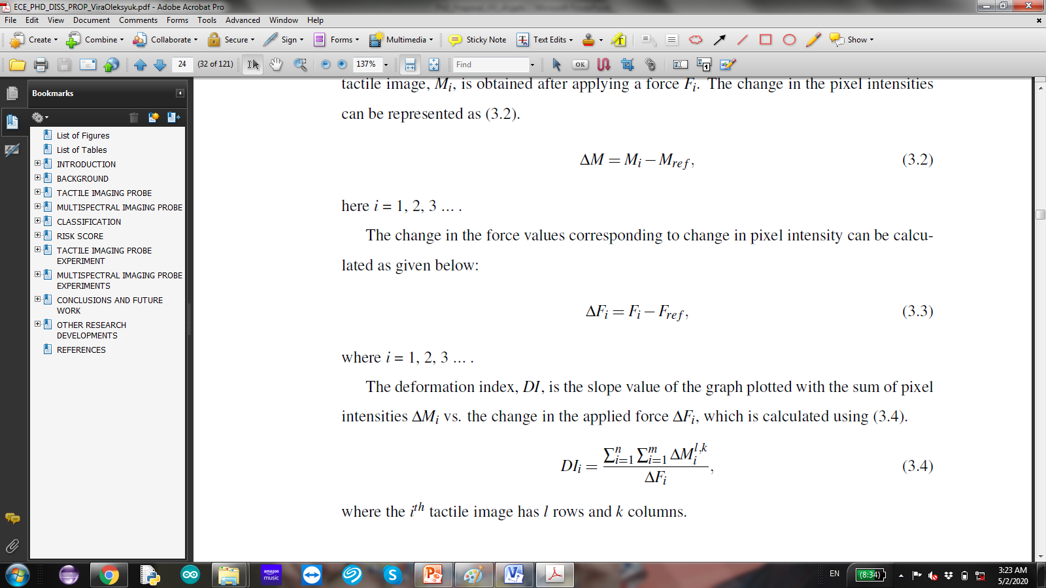
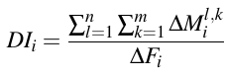
Tactile Imaging Probe - Calculations
Size Estimation
Figure . 3D interpolation model
Stiffness Estimation
TIP sensing element deformation image
Deformation force
Deformation Index of the imaged tumor

Slide 11
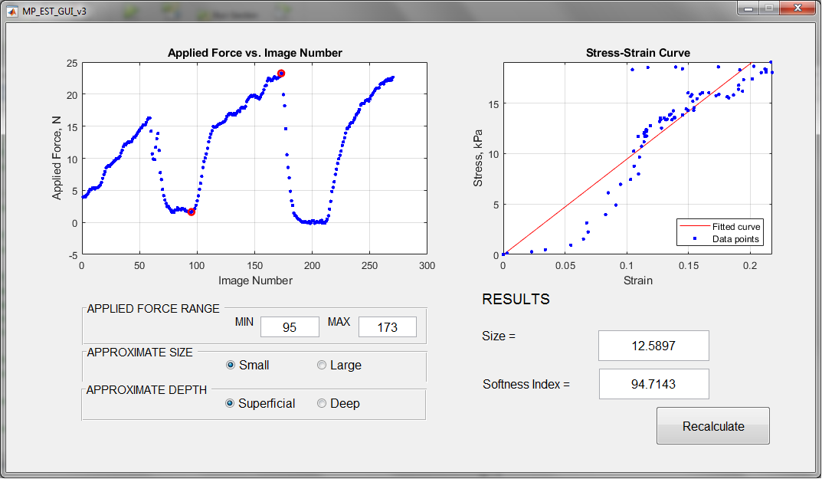
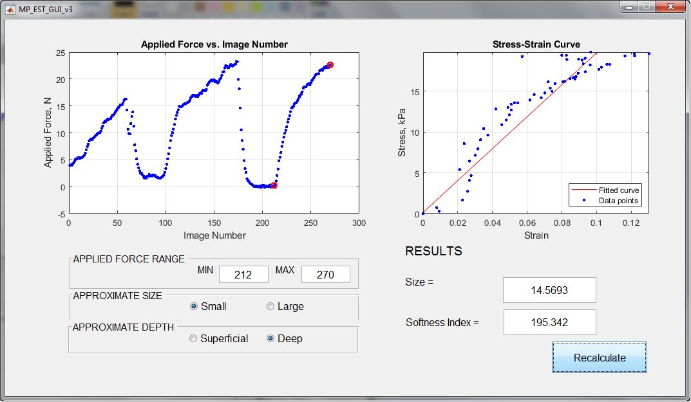
Tactile Imaging Probe - GUI
TIP Calculation GUI

Slide 12

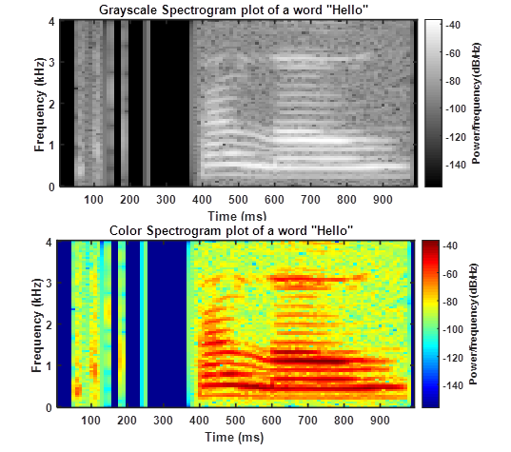
Tactile Imaging Probe - TPD
TIP imaging acquisition video recording for a soft and a stiff tumors
Figure . Example of a voice signal characterization with a spectrogram
Notes:
Time series represented as a pattern image

Slide 13
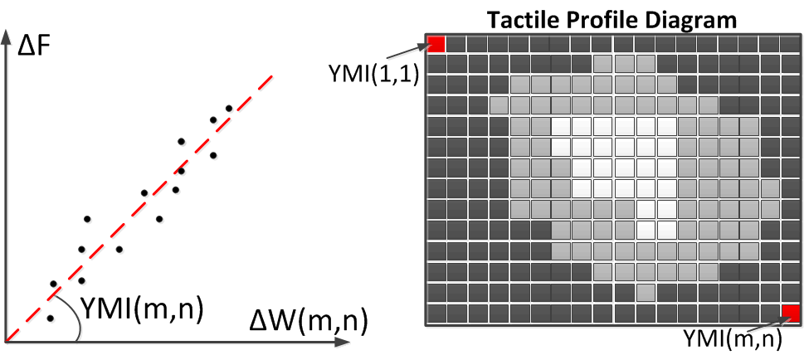
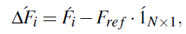
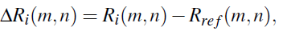
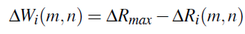
Tactile Imaging Probe - TPD
Tactile Profile Diagram is a complex tactile image, which encodes differential tactile information from a set of TIP images.
Figure . Construction of a Tactile Profile Diagram
Change in compression force
TIP sensing element deformation
Tissue with tumor deformation image

Slide 14
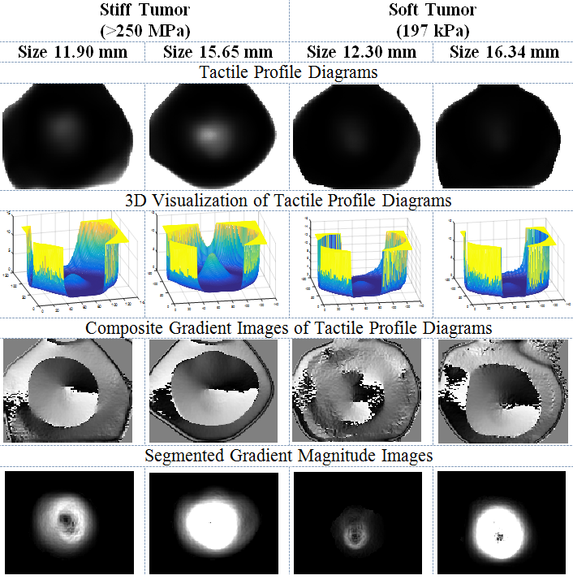
Tactile Imaging Probe - TPDs
Figure . Examples of TPDs for the tumors with different size and stiffness

Slide 15
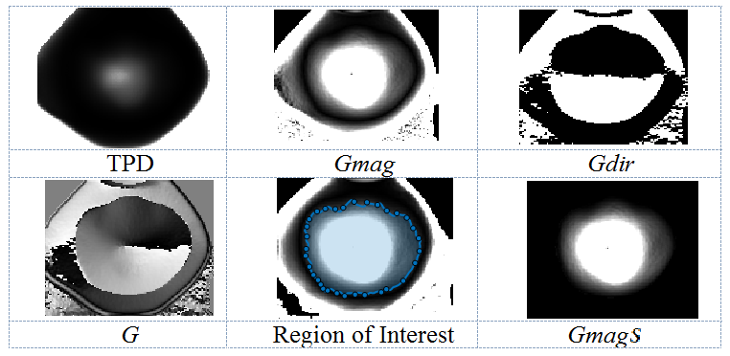
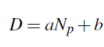
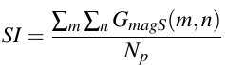
Tactile Imaging Probe – TPD Calculation
Figure . TPD segmentation for the tumor size and stiffness estimation
Size Estimation
Stiffness Estimation

Slide 16
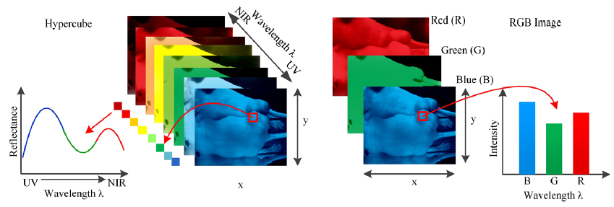
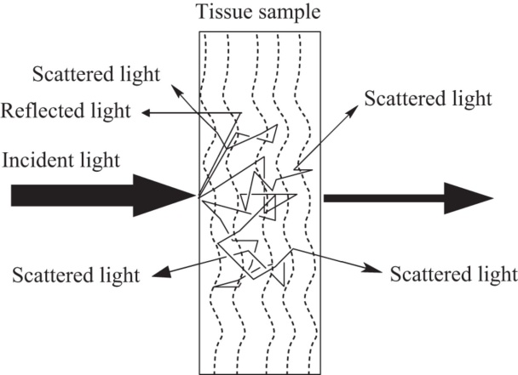
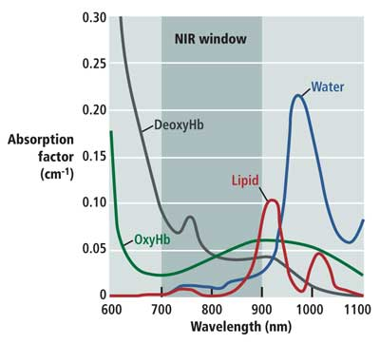
Multispectral Imaging Probe
Figure . Hypercube image vs. RGB image
Biological tissues have non-homogeneous optical properties
Light scatters and gets absorbed
Figure . Light propagation in tissue
Figure . Absorption of tissue chromophores

Slide 17
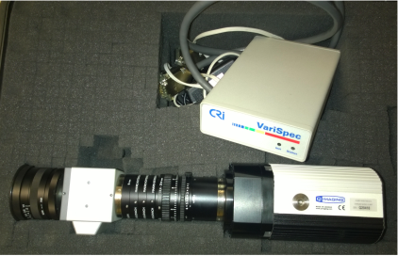
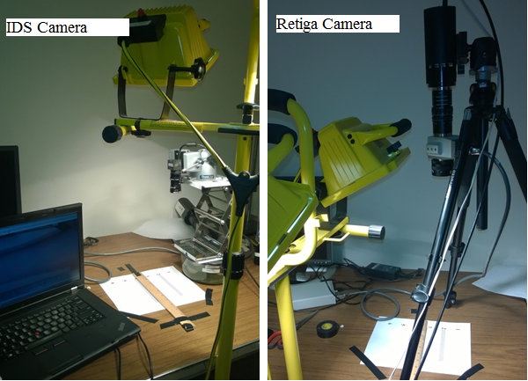
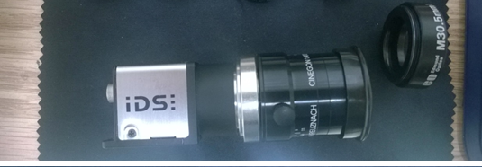
Multispectral Imaging Probe - Hardware
Figure . Retiga EXi with LCTF block
Figure . IDS, lens, and filter adapter
Figure . Experiments with Retiga and IDS cameras
Figure . Quantum efficiency vs. wavelength curves for both cameras

Slide 18
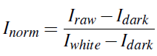
Multispectral Imaging Probe - MPD
Multispectral Image Pre-processing
Smoothing
Eliminates the "salt and pepper" type noise coming from the sensor
Normalization
Decreases the effect of inhomogeneous illumination and hardware-related noise
Registration
Searches for geometric transformation of multiple images of the same scene to align
Construction of Multispectral Profile Diagram
Carries unique information about the optical properties of breast tissue from four imaging bands consolidated in one pattern image.
Notes:
The wavelength bands are selected to target the chromophores of interest in the breast cancer application.

Slide 19
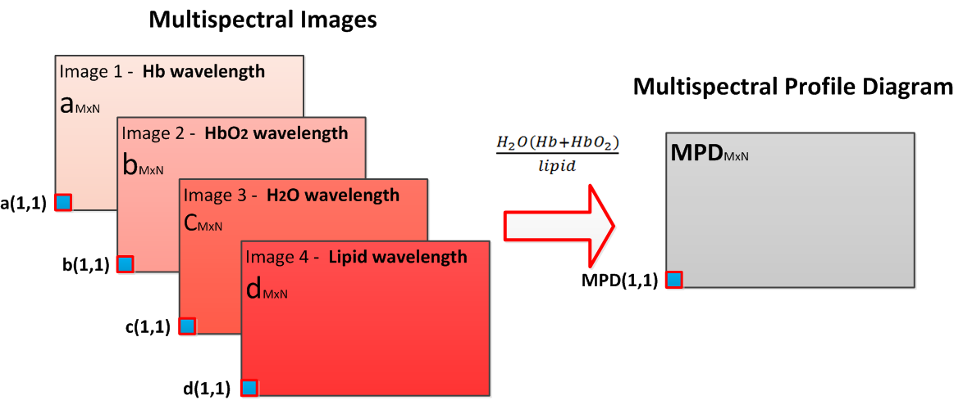
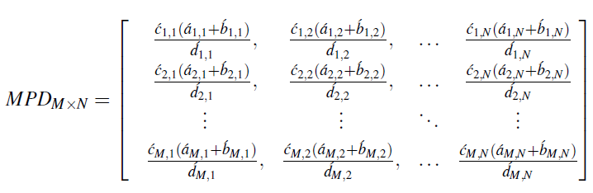
Multispectral Imaging Probe - MPD
Figure . Construction of Multispectral Profile Diagram

Slide 20
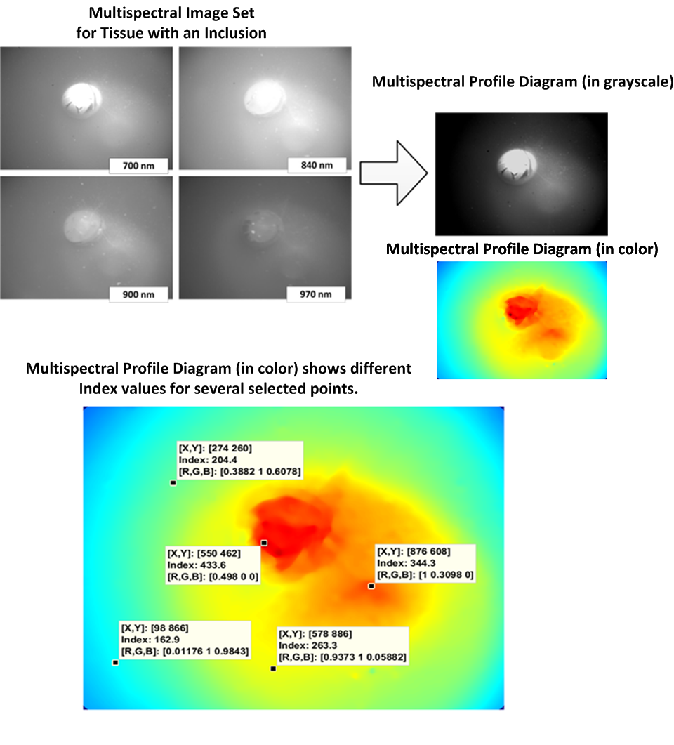
Multispectral Imaging Probe - MPD
Figure . Multispectral Profile Diagram image example

Slide 21
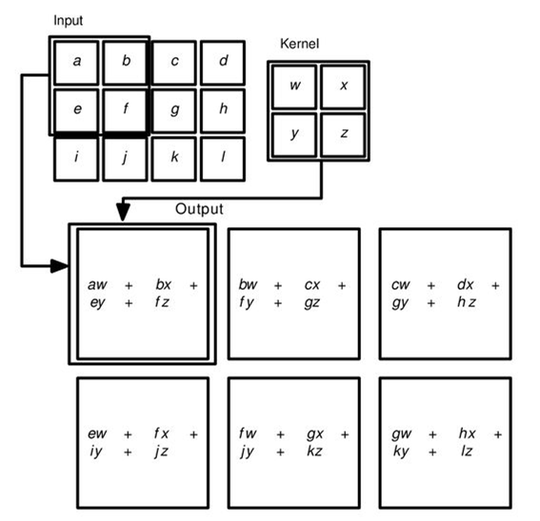
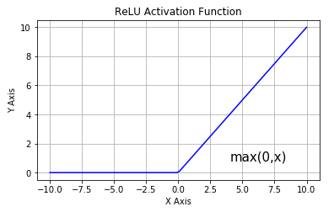
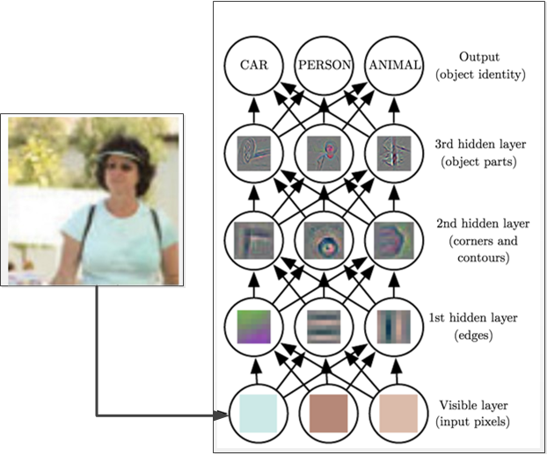
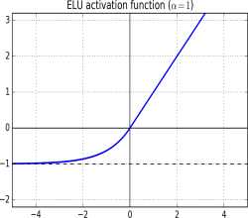
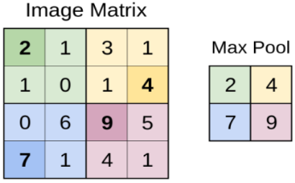
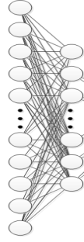
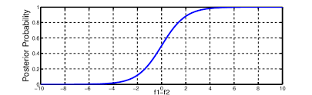
Classification with CNN
Convolution layer
Activation
Image
Probability
Max pool layer
Fully connected layers
Softmax
Class 1
Class 2
Class 3
Notes:
Cnn is a class of deep neural networks which is a great tool for image classification and pattern recognition shared-weights architecture and translation invariance characteristics.
Aplications in image and video recognition, recommender systems,^{[3]} image classification, medical image analysis, natural language processing,^{[4]} and financial time series.^{[5]}
So how CNN classifies images

Slide 22
Classification with CNN
Figure . Image classification with CNN (Goodfellow, 2017)

Slide 23
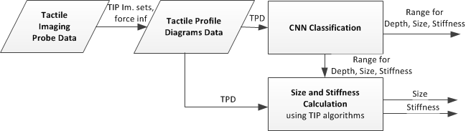
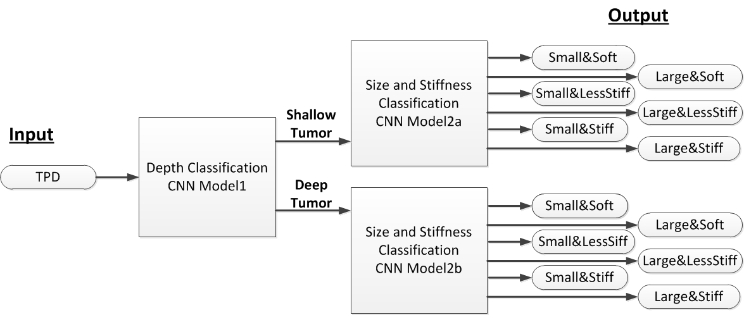
Classification with CNN - TPD
Figure . Dataflow
Figure . TPD classification diagram

Slide 24
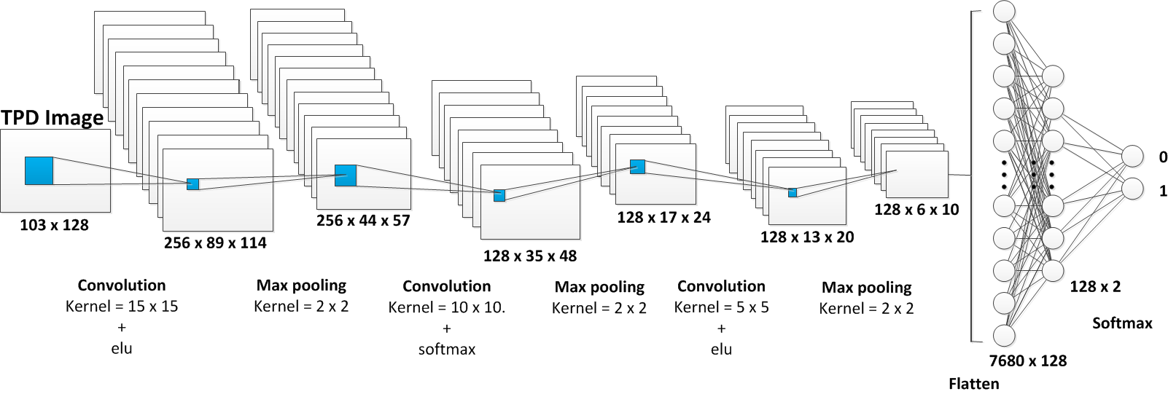
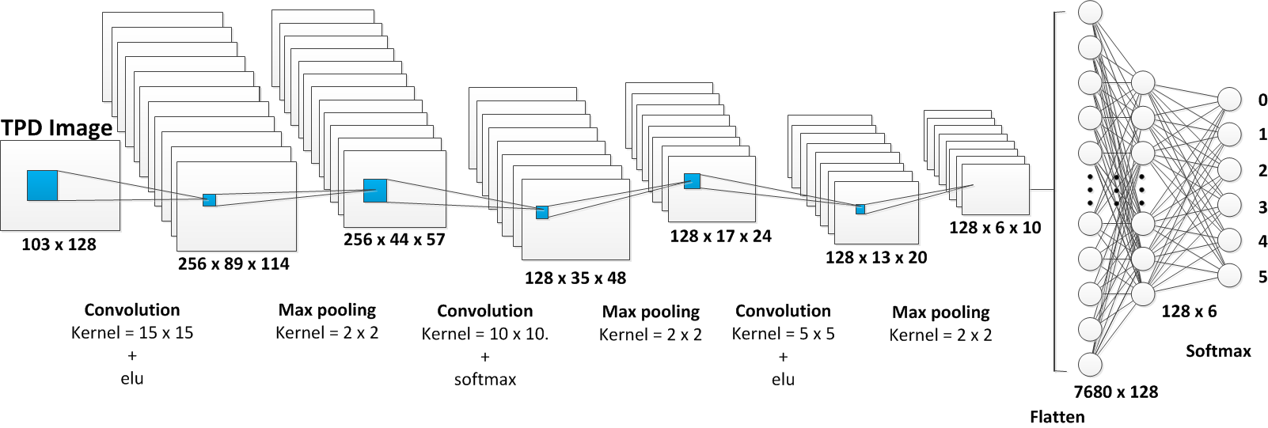
Classification with CNN – TPD
Figure . CNN Model1 – depth estimation
Figure . CNN Model2 – size and stiffness estimation

Slide 25
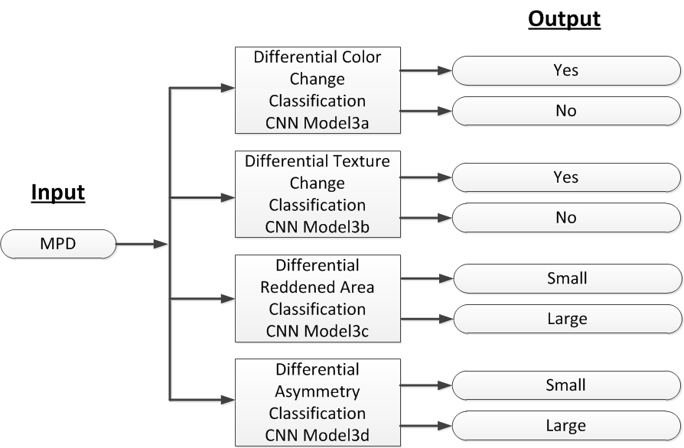

Classification with CNN - MPD
Figure . Multispectral Profile Diagram classification with CNN
Figure . Model3 details

Slide 26
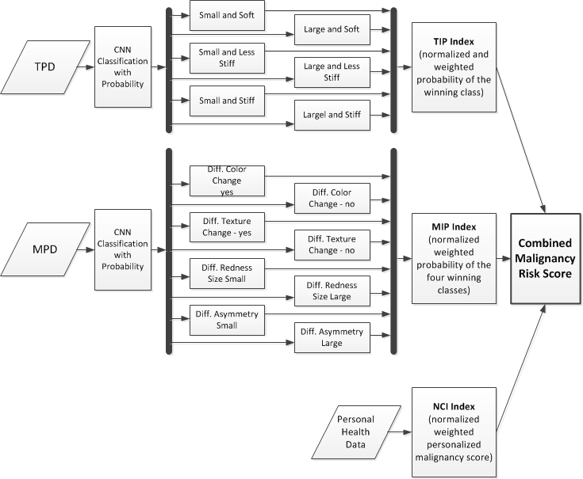
Malignancy Probability Score
Figure . Block diagram for Combined Malignancy Risk Score computation

Slide 27


Malignancy Probability Score
TIP Index calculation
MIP Index calculation
Patient-specific breast cancer risk (5-year probability from BCRAT)
Combined Malignancy Risk Score Computation

Slide 28



Preliminary Results - TIP
Figure . TIP imaging phantom components
Figure . Example of the imaging phantom implementation

Slide 29


Preliminary Results - TIP
Table. Size and stiffness calculation in phantom
Notes:
( ⁺⁺ indicates a highly insignificant value for small size tumor. n/a indicates the inability to obtain size information. * indicates the error in deformation index pattern)
At superficial depth (0 mm), the tumor phantom sizes 10 mm, 15 mm and 18 mm are detected better with a less size error percentage of 1.87%, 9.61% and 18.12%, respectively.
As depth increased, from 0 mm to 15 mm the size estimation error only increased slightly which shows the sensitivity of tip and accuracy of measuring the tumor size in varying depth. The 3 mm size estimation shows a large error
The result shows that TIP can determine the size of 1:20 samples more accurately than that of 1:3, and the error is smaller. This shows that TIP is able to detect malignant tumors or stiffer growths over benign or non-stiff growths. The phantom testing showed that the tip is able to determine the size of tumors above 3 mm in size up to 18 mm and to a depth up to 15 mm.
The stiffer samples show higher deformation index than the softer samples. At the depth of 15 mm, a small sized tumor showed a large error due to the difficulties in detecting deeply embedded tumors. Overall, TIP results show that the probe tip deformation index is directly related to the stiffness of the tumor.

Slide 30

Preliminary Results - TIP
Table. In-vivo size and stiffness estimation
The TIP was tested in twenty-one human patients (IRB# 22050 Temple University).
Patients were randomly selected by the radiologists.
The patients were scheduled for biopsy, where the histopathology reports from biopsy was used as the truth for classification.
Notes:
The serial numbers from 1 to 15 have a size estimation error less than 20%. In these cases the estimated size values are close to the real values.
In serial numbers 16 to 21, the error percentage increased from 20% to 70%. This is mainly due to the non-palpable nature of the tumor or the human error of performing experiment.
We observe that the malignant tumors (denoted with “+” symbol) show higher deformation index

Slide 31



Preliminary Results - TIP
Table. In-vivo malignancy classification
Figure . ROC curve
Sensitivity, Specificity and Accuracy
100%, 82% and 90.5%, respectively.
Notes:
where W1 and W2 are the two weights used for size and deformation index respectively,
S represents the estimated size value,
Smax is the maximum estimated size value, DI is the calculated deformation index, DImax is the maximum calculated deformation index.
R is the highest value of Risk Score used.
The leave-one-out-cross-validation technique was applied for the dataset classification evaluation. To classify tumors, we choose the pair of weights (W₁ and W₂), which gives the best classification sensitivity and specificity for a training subset (20 patients). We computed Receiver Operating Characteristic (ROC) curve with different weights for each training subset, where W₁ and W₂ varied from 0 to 1 in steps of 0.1. The sum of the weights has to be one by using any of the eleven combinations (e.g 0.1 and 0.9, 0.2 and 0.8, etc.). The optimal weights and corresponding threshold values were determined.
sample ROC curve is shown with the optimal point at (0.1818, 1), which corresponds to 100% sensitivity and 82% specificity. The corresponding threshold value for the risk score came out to be 1.99 and the optimal weight came out to be W₁ =0.3 and W₂ =0.7.
ROC curve is shown with the optimal point at (0.1818, 1),
which corresponds to 100% sensitivity and 82% specificity. The corresponding threshold
value for the risk score came out to be 1.99, and the optimal weight came out to be W1 =
0.3 and W2 = 0.7.

Slide 32

Preliminary Results - TIP
Figure . TPD examples
Figure . TPD for tumors with different size and stiffness

Slide 33

Preliminary Results - TIP
Table. Results for tumor size and stiffness estimation from TPDs
Figure . Stiffness estimation from TPDs

Slide 34


Preliminary Results - TIP
Figure . Graphs for Model1 model accuracy and loss for 50 epochs
Dataset
Sizes: 10 mm, 12 mm, 14 mm, 16 mm, 18 mm
Stiffness: 130 kPa – 250 MPa
Shallow subset: depths 0 mm, 2 mm, and 4 mm
Deep subset: depths of 6 mm, 8 mm, 10 mm
Data division: Training 80% and test 20%
Model trained on 6605 TPDs, tested on 1651 TPD
Training: 50 epochs, 250 TPDs in a batch
No augmentation
Results
Validation accuracy = 0.9788
Figure . Examples of TPD classification with Model1

Slide 35


Preliminary Results - TIP
Figure . Graphs for Model2a model accuracy and loss for 50 epochs
Dataset (Shallow: depths 0 mm, 2 mm, and 4 mm)
Size: Small - 10 mm, 12 mm, and Large - 14 mm, 16 mm
Stiffness: 130 kPa – 250 MPa
Soft tumors 130 kPa to 271 kPa
Less stiff tumors 316 kPa to 444 kPa
Stiff tumors 506 kPa to 250 MPa
Data division: Training 80% and test 20%
Model trained on 2713 TPDs and tested on 683
Training: 50 epochs, 250 TPDs in a batch
No augmentation
Results
Validation accuracy = 0.8594
Figure . Examples of TPD classification with Model2a

Slide 36


Preliminary Results - TIP
Figure . Graphs for Model2b model accuracy and loss for 50 epochs
Dataset (Deep: depths 6 mm, 8 mm, and 10 mm)
Size: Small - 10 mm, 12 mm, and Large - 14 mm, 16 mm
Stiffness: 130 kPa – 250 MPa
Soft tumors 130 kPa to 271 kPa
Less stiff tumors 316 kPa to 444 kPa
Stiff tumors 506 kPa to 250 MPa
Data division: Training 80% and test 20%
Model trained on 2727 TPDs and tested on 669
Training: 50 epochs, 250 TPDs in a batch
No augmentation
Results
Validation accuracy = 0.8386
Figure . Examples of TPD classification with Model2b

Slide 37


Preliminary Results - MIP
Figure . Bimodal phantom components
Figure . MIP Phantom design

Slide 38



Preliminary Results - MIP
Figure . MIP experimental setup
Figure . Experimental images of all 9 samples at 650nm
Figure . Sample 8 images at various wavelengths

Slide 39

Preliminary Results - MIP
Figure . Samples 4-9
Figure . Normalized reflectance graph for blood injection and non-injection cites of porcine tissue samples

Slide 40


Preliminary Results - MIP
Figure . MPD segmentation for Sample 8
Figure . MPD segmentation results for 9 samples

Slide 41
Conclusions
We developed the bimodal imaging prototype and its calculation algorithms to capture tactile and multispectral properties of breast tumors and tissues.
We proposed the Profile Diagrams method to efficiently capture, encode, and analyze tactile and multispectral imaging signals.
In our preliminary experiments, we showed good classification accuracy in classifying tissues and tumors based on their depth, size, and stiffness using TPDs and CNN.
We propose the method to calculate the individualized Malignancy Risk Score for patients based on the imaging data from TIP and MIP modalities, and the individual breast cancer risk.

Slide 42
Research Plan
Develop the Tactile Imaging Probe and its algorithms;
Develop the Multispectral Imaging Probe and its algorithms;
Develop the method for Combined Malignancy Risk Score as a patient-specific cancer probability assessment parameter.

Slide 43
Research Plan
Develop the Tactile Imaging Probe (TIP) and its algorithms
  (a) Complete simulations for the Tactile Imaging Probe’s sensing element;
  (b) Build a Tactile Imaging Probe prototype;
  (c) Develop algorithms for tumor size and stiffness estimation;
  (d) Suggest a method to represent tactile information from TIP data as Tactile Profile Diagrams;
  (e) Propose a method to measure tumor depth, and to improve the size and stiffness estimation from Tactile Profile Diagrams using Convolutional Neural Network;
  (f) Develop a breast tissue and tumors mimicking phantom;
  (g) Complete phantom validation experiments, employ the algorithms, analyze the results;
  (h) Complete a pilot in-vivo study and analyze the results.

Slide 44
Research Plan
2. Develop Multispectral Imaging Probe (MIP) and its algorithms
  (a) Review the available literature to learn what superficial breast tissue features attribute to cancer diagnosis, and how they can be captured with a video camera;
  (b) Develop the sensing principle and build the Multispectral Imaging Probe;
  (c) Suggest a method to represent superficial breast tissue information as Multispectral Profile Diagrams;
  (d) Propose a technique for characterization of breast tissue color, texture, size of the affected region, and the extend of bilateral asymmetry from Multispectral Profile Diagrams using Convolutional Neural Network;
  (e) Develop bimodal tissue phantom to mimic breast tissue mechanical and optical properties;
  (f) Complete phantom validation experiments, employ the algorithms, and analyze the results.

Slide 45
Research Plan
3. Develop a method for Combined Malignancy Score estimation as a patient-specific cancer probability assessment parameter
  (a) Complete a literature review on the risk score calculation for cancer patients;
  (b) Propose the method to calculate a malignancy index from TIP modality;
  (c) Propose the method to calculate a malignancy index from MIP modality;
  (d) Propose the method to include the individual malignancy risk assessment into the calculation;
  (e) Develop the method of Combined Malignancy Risk Score calculation with the appropriate weights for the indexes;
  (f) Initially validate the method by using the available patients data from the completed pilot study.

Slide 46
Publications
1. V. Oleksyuk, R. Rajan, F. Saleheen, D. Caroline, S. Pascarella and C.-H. Won, “Risk score based pre-screening of breast tumor using compression induced sensing system,“ Sensors Journal, IEEE, Vol.18 (10), pp. 4038-4045, 2018.
2. F. Saleheen, V. Oleksyuk, and C.-H. Won, "Itchy skin region detection using hyperspectral imaging," Proc. SPIE Defense-Commercial Sensing, Paper 10656-7, Baltimore, MD: USA, 2018.
3. V. Oleksyuk, F. Saleheen, D. Caroline, S. Pascarella and C.-H. Won, “Classification of breast masses using tactile imaging system and machine learning algorithms, “IEEE Signal Processing in Medicine and Biology Symposium, Philadelphia, PA: USA, Jan 2017.
4. V. Oleksyuk, F. Saleheen, D. Caroline, S. Pascarella, C.-H. Won. "KNN classification of tactile imaging data,” 2017 International Symposium on Innovation in Information Technology and Application (ISIITA17), Danang: Vietnam, Jan. 2017.
5. C.-H. Won, J. Goldstein, V. Oleksyuk, D. Caroline, S. Pascarella. "Tumor size and elasticity estimation using smartphone-based compression-induced scope," 39th Annual International Conference of the IEEE Engineering in Medicine and Biology Society (EMBC 17), JeJu Island: S. Korea, July 2017, pp.4106-4109.
6. F. Saleheen, Z. Wang, W. Moser, V. Oleksyuk, J. Picone, C.-H. Won, "Effectiveness of virtual open laboratory teaching assistant for circuits laboratory," 123rd ASEE Annual Conference, New Orleans, LA: USA, June 2016.
7. V. Oleksyuk, F. Saleheen, W. Moser, and C.-H. Won, "Tactile imaging sensor for mechanical properties quantification of breast tumor," IEEE Biomedical Circuits and Systems Conference (BioCAS), Atlanta, GA: USA, Oct. 2015.
8. A. Sahu, F. Saleheen, V. Oleksyuk, C. McGoverin, N. Pleshko, A. Harati, J. Picone and C.-H. Won, “Characterization of Mammary Tumors Using Noninvasive Tactile and Hyperspectral Imaging Sensors," Sensors Journal, IEEE, Vol.14 (10), pp. 3337- 3344, 2014.
9. A. Sahu, F. Saleheen, V. Oleksyuk, Y. Chen, and C.-H. Won, “Tactile and hyperspectral imaging sensors for mammary tumor characterization," Sensors, 2013 IEEE, Baltimore, MD: USA, Nov 2013.
10. F. Saleheen, V. Oleksyuk, A. Sahu, and C.-H. Won, “Non-invasive mechanical properties estimation of embedded objects using tactile imaging sensor," Proc. SPIE 8719, Smart Biomedical and Physiological Sensor Technology X, Baltimore, MD: USA, May 2013.
11. F. Saleheen, A. Sahu, V. Oleksyuk, and C.-H. Won, "Normal force estimation using tactile imaging sensor," Bioengineering Conference (NEBEC), 2012 38th Annual Northeast, Philadelphia, PA: USA, Mar. 2012, pp. 119-120.

Slide 47
Acknowledgements
Dr. Chang-hee Won for the valuable guidance and continuous support
My committee, Dr. Joseph Picone, Dr. Iyad Obeid, and Dr. Nancy Pleshko, for thoughtful contributions
My friends and CSNAP lab team members Firdous Saleheen, Sung In Choi, Reshma Rajan, and Steve Lash for support and encouragement
Dr. Dina Caroline and Dr. Suzanne Pascarella (TUH) for help with the clinical data collection
Dr. Jie Yin and Qiuting Zhang (ME) for the aid with Abaqus TIP simulation modeling
Vinit Shah for helpful discussions on deep learning topics
Dr. Rouzbeh Tehrani (CE), Dr. Gangadhar Andaluri (CE), and Helen Freitas (BioE) for lab resources during breast mimicking model development
The National Science Foundation for the given opportunities
Edmund Optics for multispectral imaging filters and standards

Slide 48


Thank you!

