Slide 1

Gesture Recognition of Tennis Biomechanics
A Thesis Proposal by
Victor Espinoza
Temple University
College of Engineering

Slide 2
Intro
Gesture Recognition
Recognizing human action and using it to as a computer input
Training an algorithm in recognizing biomechanical patterns vs training a human

Slide 3
Objectives
The purpose of this study is to create a gesture recognition system that interprets motion capture data of a tennis player to determine which biomechanical aspects of a tennis swing best correlate to a swing efficacy.
Extract biomechanical features that are correlated to a tennis ball’s trajectory and design a machine learning will be able to predict the tennis ball's trajectory from body tracking data.
Notes:
Gesture recognition has been used for kinect games, sign language and

Slide 4
Motivation
Tennis Teaching Software
  If an algorithm is capable of recognizing such patterns in movement, then it is possible to design a new algorithm to make correctional decisions based on pattern recognition.
Hawk-Eye
Statistical study of tennis technique in present time as the sport evolves

Slide 5
Background

Slide 6
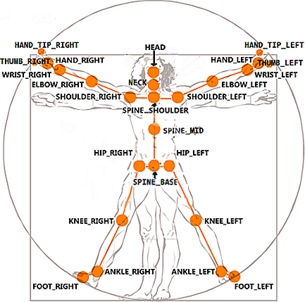
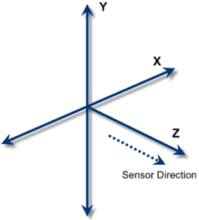
Microsoft Kinect v2
3 streams of data to track up to 6 bodies
Kinect ‘s Cartesian coordinates
25 joint centers
30 Hz

Slide 7
Kinect v2 cont’d
Low accuracy in feet and ankles
Marker-less approach will allow subjects to swing freely within sensor range (4m)
3 streams of data to track up to 6 human bodies
Humans do not require high accuracy to learn or teach biomechanical gestures
[1]

Slide 8
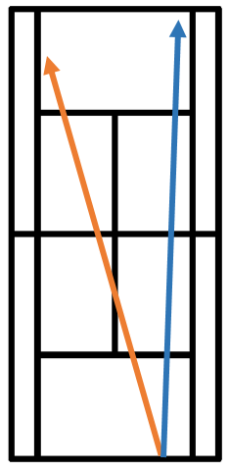
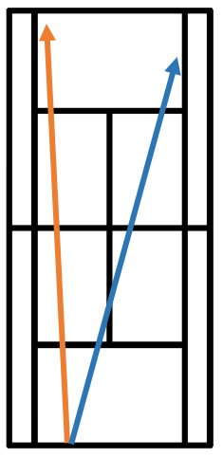
Tennis Baseline
This work will cover the three standard tennis and their respective general trajectories
Forehand- cross court (orange) down the line (blue)
Backhand- cross court (blue) down the line (orange)

Slide 9
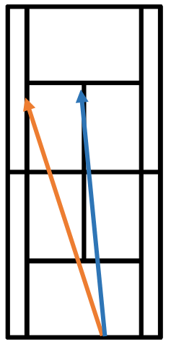
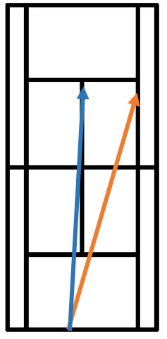
Tennis Baseline cont’d
Deuce Court Serve- out-wide-court (orange) down the T (blue)
Ad Court Serve- out-wide (orange) down the T (blue)

Slide 10
Methods

Slide 11
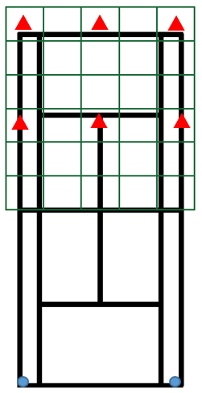
Protocol Design
Recruit local Collegiate Tennis Athletes
All genders
Grid to manually annotate record all resulting trajectories
Ground Strokes Section
  Backhand & forehand
  6 targets (red), 10 attempts each
  Kinect(blue) will be recording while the subject faces the sensor
  Normalized topspin grip

Slide 12
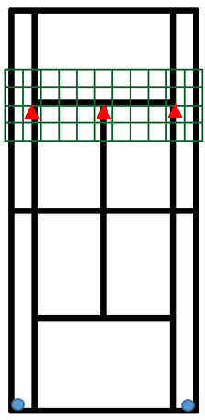
Protocol Design cont’d
Serve Section
  2 targets, 10 attempts from each side
  Normalized flat grip

Slide 13
Accuracy Monitoring
In order to keep a gauge on the sensor’s limited accuracy, the research team will measure each subject’s ulna, humerus, femur and tibia prior to running the protocol, and compare to Kinect based segment length estimation.
This limited accuracy will affect our extracted features, and ultimately our algorithm design.
As long as this accuracy remains within a constant predictable range, it will not be determining factor.

Slide 14
Signal Processing
The Kinect’s frame rate can fluctuate below the advertised 30 fps. This variable frame rate is not controllable by the user and mainly relies on the hardware components of the sensor and the user’s computer resources
In order to compensate for frame rate fluctuation, raw skeletal tracking data will be interpolated and filtered
Algorithms designed in this work will classify recorded skeletal tracking data.

Slide 15
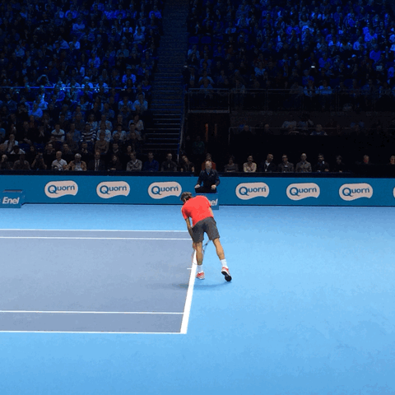
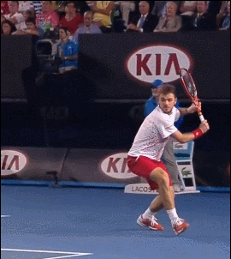
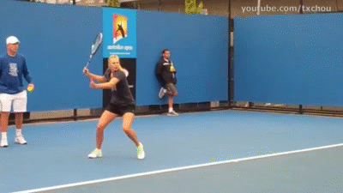
Swing Variance
Notes:
Zero crossings!
IO
Swings vary in length / speed and technique

Slide 16
Swing Window
Dominant- side hand Y component
Adaptive landmark through all 3 swings
Different swing speeds across subject
25x 3x Swing window = input

Slide 17
Implementation

Slide 18
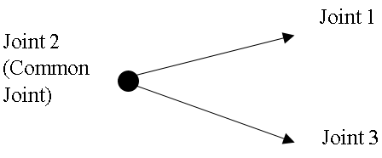
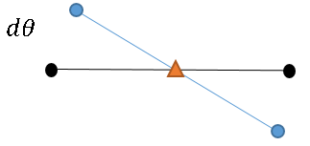
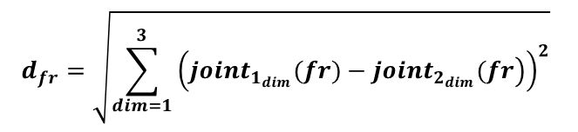
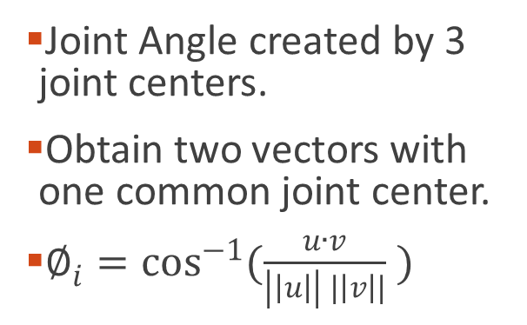
Biomechanical Features
Joint Angle created by 3 joint centers.
Obtain two vectors with one common joint center.
$∅_{i}=\cos^{−1}{(\frac{u∙v}{\left|\left|u\right|\right| |\left|v\right||} )}$
Euclidian Distance between distal landmarks.
$$d_{fr}=\sqrt{\sum_{dim=1}^{3}{{\left(\left.joint_{1_{dim}}(fr)−joint_{2_{dim}}(fr\right)\right)}^{2}}}$$
  Joint center angular velocity.
Notes:
Since position of subjects WRT the sensor will vary we must measure according to other joint centers

Slide 19

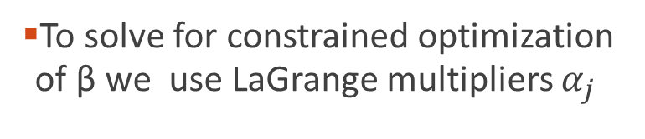
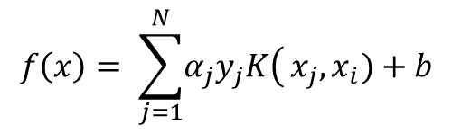
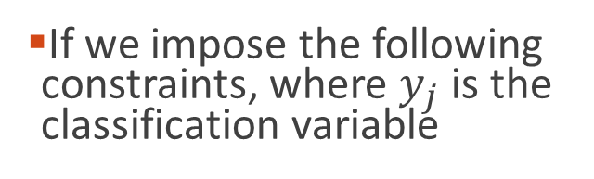
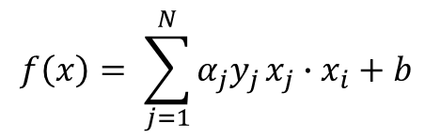

SVM Implementation
Design of a classifier based on a subset of training samples and the remaining data becomes ignorable.
Considering the following basic classifier in slope intercept form.
To solve for constrained optimization of β we use LaGrange multipliers $α_{j}$
$$f\left(x\right)= \sum_{j=1}^{N}{α_{j}y_{j}}x_{j}∙x_{i}+b$$
$$f\left(x\right)=βx+b$$
If we impose the following constraints, where $y_{j}$ is the classification variable
If the classes are not linearly separable, kernel functions are used in practice to separate the data in a higher dimensional space
$$y_{j}\left({βx}_{j}+b\right)≥1$$
$$f\left(x\right)= \sum_{j=1}^{N}{\left.α_{j}y_{j}K\right(}x_{j},x_{i})+b$$

Slide 20

SVM Implementation cont’d
$RBF kernel k\left(x,y\right)= e^{−γ{\left|\left|x_{i}−x_{j}\right|\right|}^{2}}$
Linear Kernel $k\left(x,y\right)= x_{i}x_{j}+c$
Polynomial Kernel $k\left(x,y\right)= {(x}_{i}x_{j}+c)^{d}$
Notes:
Kernels that have worked in gesture recognition

Slide 21
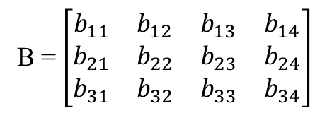
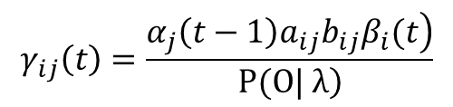
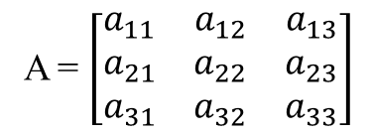
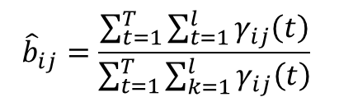
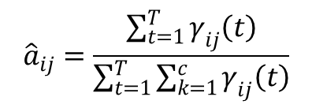
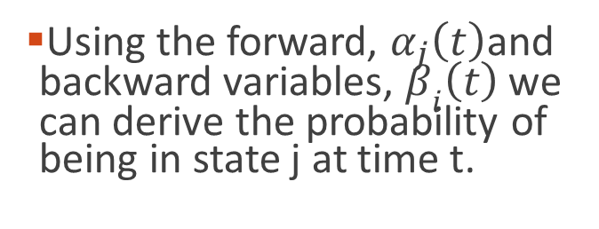
HMM Implementation
Double stochastic process, where only one of them is observable, discrete symbols O
A Hidden Markov model can be defined by as a set of a transitional probabilities, emission probabilities and initial state probabilities
Using the forward, $α_{j}\left(t\right)$and backward variables, $β_{i}\left(t\right)$ we can derive the probability of being in state j at time t.
$$γ_{ij}\left(t\right)=\frac{\left.α_{j}\left(t−1\right)a_{ij}b_{ij}β_{i}(t\right)}{\left.P(O| λ\right)}$$
λ = (A, B, П)
$${\hat{a}}_{ij}=\frac{\sum_{t=1}^{T}{γ_{ij}\left(t\right)}}{\sum_{t=1}^{T}{\sum_{k=1}^{c}{γ_{ij}\left(t\right)}}}$$
A = $\left[\begin{matrix}a_{11} & a_{12} & a_{13} \\ a_{21} & a_{22} & a_{23} \\ a_{31} & a_{32} & a_{33}\end{matrix}\right]$
B =$\left[\begin{matrix}b_{11} & b_{12} & b_{13} & b_{14} \\ b_{21} & b_{22} & b_{23} & b_{24} \\ b_{31} & b_{32} & b_{33} & b_{34}\end{matrix}\right]$
$${\hat{b}}_{ij}=\frac{\sum_{t=1}^{T}{\sum_{t=1}^{l}{γ_{ij}\left(t\right)}}}{\sum_{t=1}^{T}{\sum_{k=1}^{l}{γ_{ij}\left(t\right)}}}$$

Slide 22
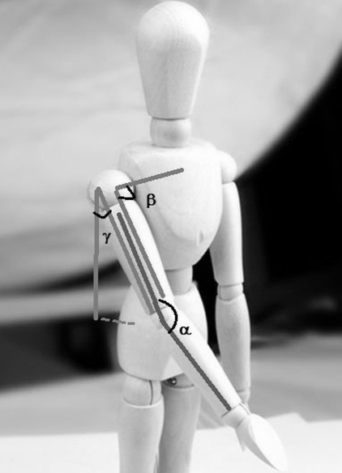
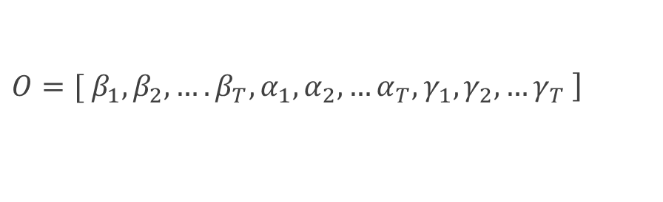
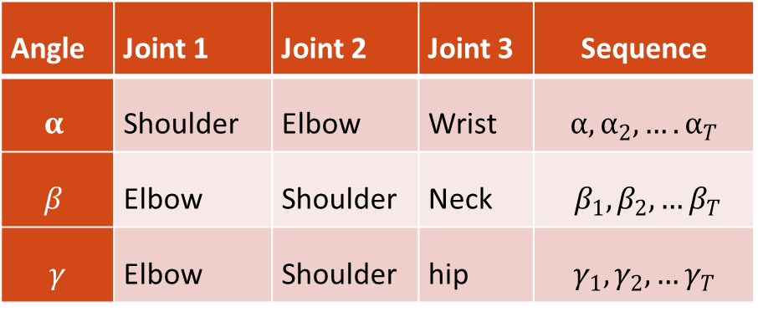
HMM Implementation Cont’d
Angle | Joint 1 | Joint 2 | Joint 3 | Sequence
$$α$$ | Shoulder | Elbow | Wrist | $$α, α_{2},….α_{T}$$
$$β$$ | Elbow | Shoulder | Neck
$$γ$$ | Elbow | Shoulder | hip | $$γ_{1},γ_{2},…γ_{T}$$
$\left.O=[ β_{1}, β_{2},….β_{T}, α_{1},α_{2},…α_{T},γ_{1},γ_{2},…γ_{T} \right]$
[2]

Slide 23
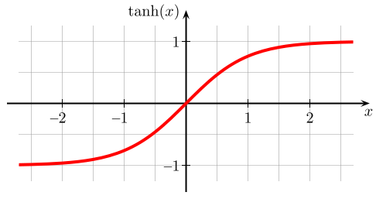
MLP Implementation
Feedforward neural network
Input layer consisting of 75 nodes, 25 neurons with 3 XYZ inputs.
2 outputs with hyperbolic tangent activation function
$$\sum_{i=1}^{m}{\left(w_{i}x_{i}\right)+bias}$$
∑_(𝑖=1)^𝑚▒〖(𝑤_𝑖 𝑥_𝑖 )+𝑏𝑖𝑎𝑠〗
$${joint}_{x}$$
〖𝑗𝑜𝑖𝑛𝑡〗_𝑥
activation function
$${joint}_{z}$$
〖𝑗𝑜𝑖𝑛𝑡〗_𝑧
$${joint}_{y}$$
〖𝑗𝑜𝑖𝑛𝑡〗_𝑦
Notes:
Input, weights, bias, activate
Explain the neural network

Slide 24
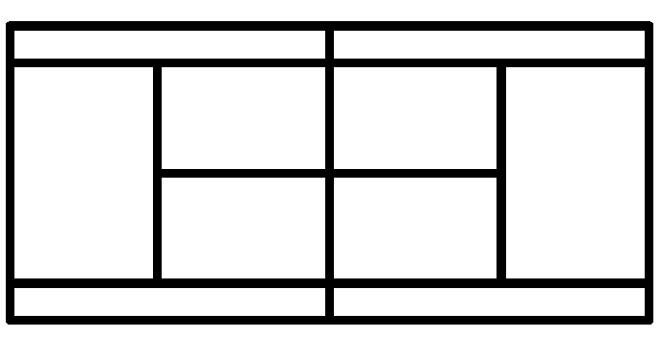
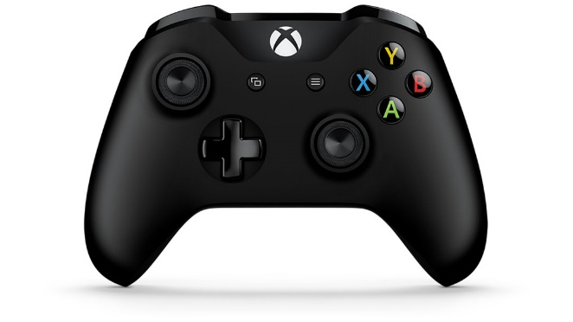
MLP Implementation cont’d
(-1,-1)
(0,1)
(1,1)
2D output with x and y component
Big data
2 outputs with hyperbolic tangent activation function
(0,-1)
(0,0)
(0,1)

Slide 25
Overview

Slide 26
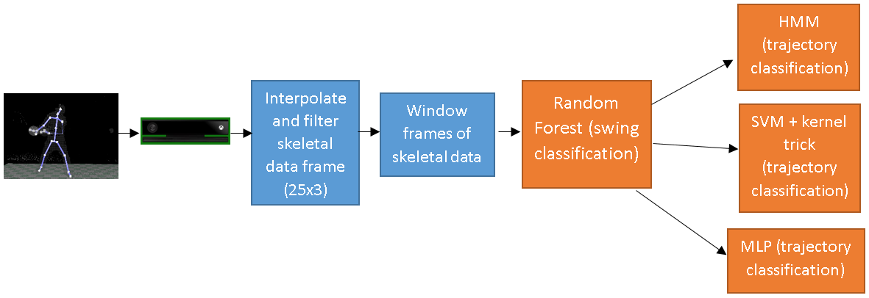
Proposed Work

Slide 27
Timeline of Proposed Work
4 weeks of data collection.
  Maximum of 50 participants, with each individual session of 30 minutes.
  Maximum 25 hours of data collection.
7 weeks to design machine learning algorithms.
  Random forest – 1 week
  HMM – 2 weeks
  SVM – 2 weeks
  MLP – 2 weeks
5 weeks of thesis defense preparation.

Slide 28
References
[1] K. Otte et al., “Accuracy and Reliability of the Kinect Version 2 for Clinical Measurement of Motor Function,” PLOS ONE, vol. 11, no. 11, p. e0166532, Nov. 2016.
[2] H. Hiyadi, F. Ababsa, C. Montagne, E. H. Bouyakhf, and F. Regragui, “A depth-based approach for 3D dynamic gesture recognition,” in 2015 12th International Conference on Informatics in Control, Automation and Robotics (ICINCO), 2015, vol. 02, pp. 103–110.

