Slide 1
Estimating Parameters of a Multi-Class Izhikevich Neuron Model to Investigate the Mechanisms of Deep Brain Stimulation
A Thesis Proposal
By Christopher Tufts

Slide 2
Abstract
The aim of the proposed research is to provide a computationally efficient neural network model for the study of deep brain stimulation efficacy in the treatment of Parkinson’s disease. An Izhikevich neuron model will be used to accomplish this task and four classes of neurons will be modeled. The parameters of each class will be estimated using a genetic algorithm based on a phase plane trajectory density fitness function. After computing the optimal parameters the neurons will be interconnected to form the network model. The network will be simulated under normal conditions, Parkinsonian conditions, and Parkinsonian conditions under DBS treatment.

Slide 3
Motivation
Deep Brain Stimulation (DBS)
Mechanisms unclear
Recording data impractical
Stimulation parameters determined ad hoc
Models are the alternative
Biophysically realistic models are computationally inefficient
Integrate and Fire models incapable of replicating realistic firing patterns

Slide 4
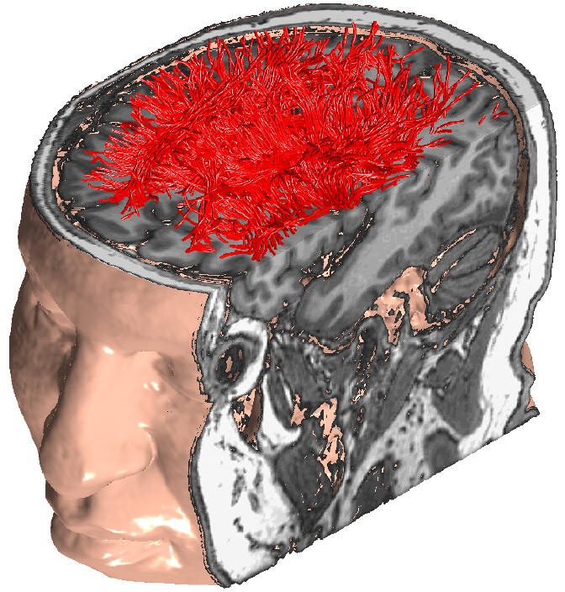
Motivation
Computationally efficient DBS model
Allows large scale network simulation
Comprised of multiple types of neurons from different areas of the brain
Long term study of DBS effect on network dynamics
Short term study of DBS effects on network dynamics

Slide 5
Research Objectives
Develop a computationally efficient model for the study of DBS
Via Izhikevich Neuron Model
4 types of neurons
Parameters of model will be estimated via genetic algorithm and PPTD
Final outcome of model should replicate the results published by Rubin and Terman 2004

Slide 6
Background : Parkinson’s Disease
Neurodegenerative disorder caused by death of dopaminergic neurons in the substantia nigra
Effects 10’s of millions of people worldwide
Symptoms include:
Tremors
Muscular rigidity
Impaired movement
Problems with balance and walking

Slide 7
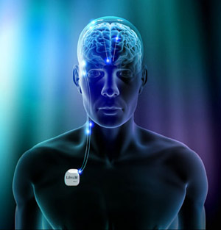
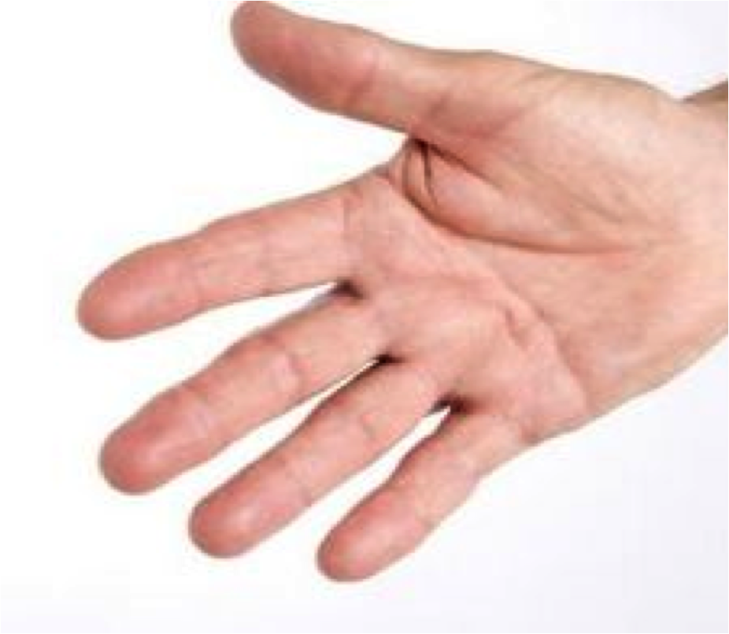
Background : Deep Brain Stimulation
Used for the treatment of disorders/diseases such as Parkinson’s disease and Dystonia
Decreases severity of tremors

Slide 8
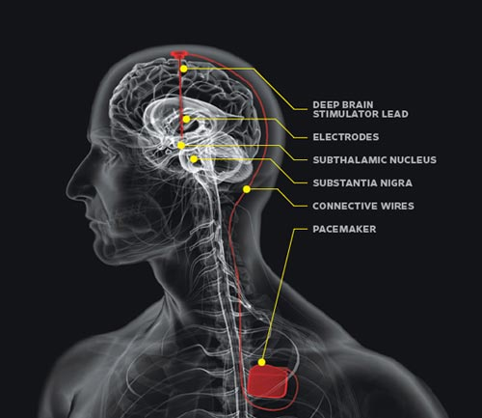
Background : Deep Brain Stimulation
Single or Bilateral Placement of Electrodes
Pulse generator implanted subcutaneously in the subclavical region
Open loop control/manually tuned

Slide 9
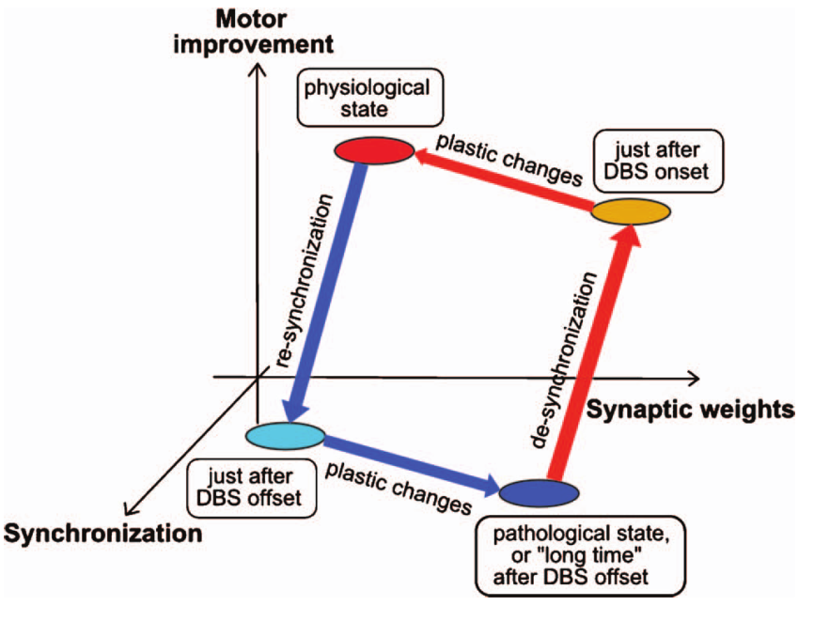
Background : Deep Brain Stimulation
Possible mechanisms
Suppress neuronal activity
Outcome of DBS is similar to ablative surgeries
Increase neuronal activity
Network interaction causes downstream effects

Slide 10
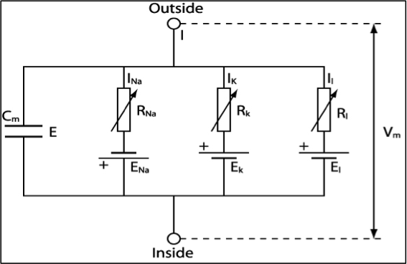
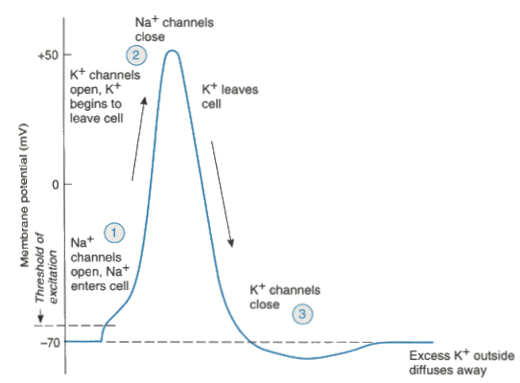
Background : Hodgkin Huxley Neuron Model
Model based on squid axon
Ion channels modeled as resistors and capacitors
Membrane modeled as capacitor

Slide 11
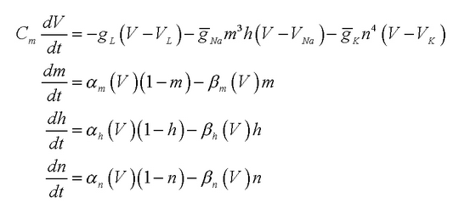
Background : Hodgkin Huxley Neuron Model
Defined by 4 differential equations
Computationally complex

Slide 12
Background : Izhikevich Model
V_{r} – resting membrane potential
V_{t} – instantaneous threshold
a – recovery time constant
b – determines resonance/amplification
c - reset potential
d – (I_{out} – I_{in})during spike
u – recovery variable
v – membrane potential
I – applied current
k – upstroke shape
C – membrane capacitance

Slide 13
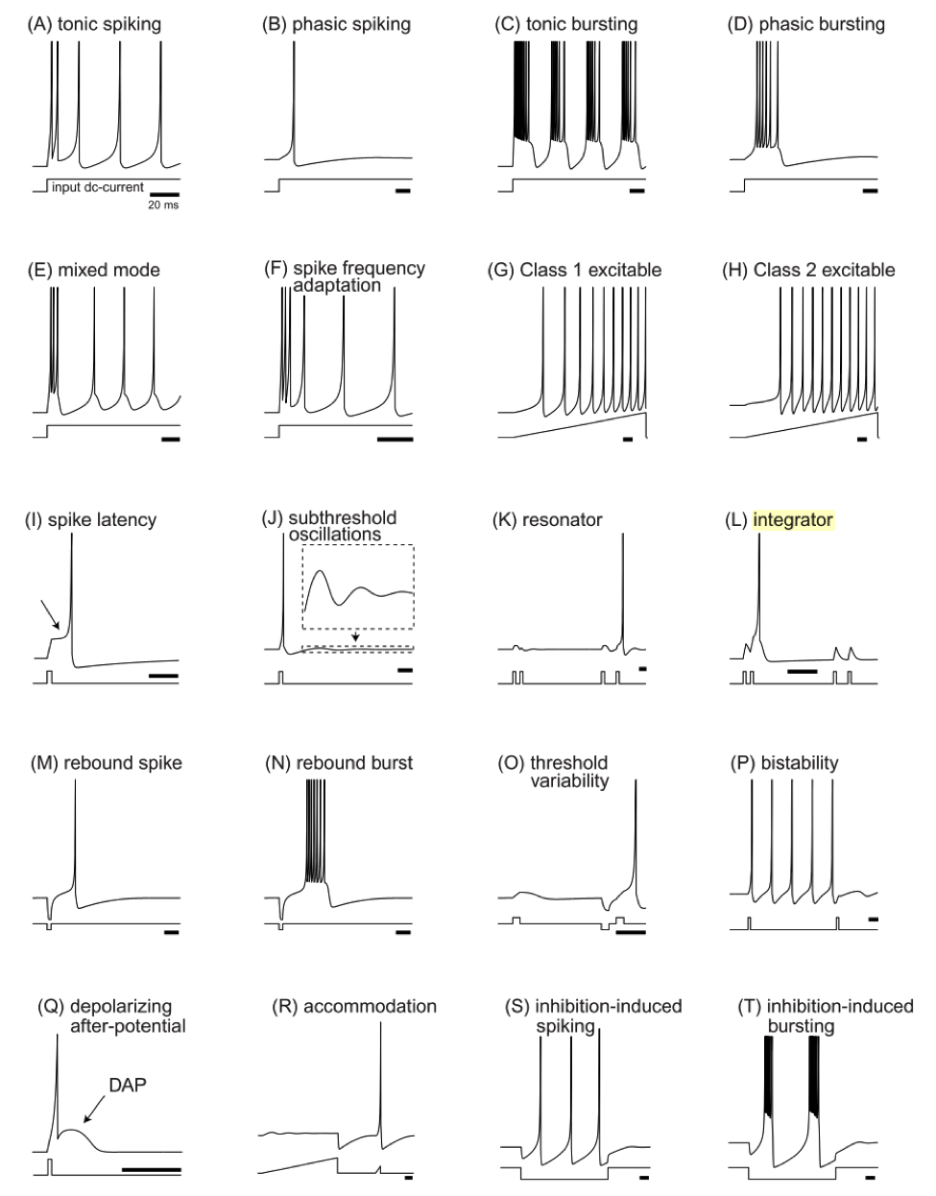
Background : Izhikevich Model
Capable of most biologically realistic spiking characteristics

Slide 14
Methods : Parameter Estimation Overview
Search Technique:
Genetic Algorithm
Fitness Function:
Phase Plane Trajectory Density (PPTD)
Solve for 8 variables:
a, b, c, d, I_{app}, v_{r}, v_{t}, k
Training Data – membrane potentials from HH model

Slide 15
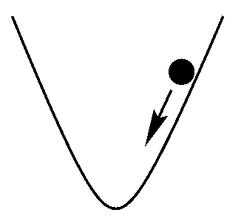
Methods: Considerations for Search Algorithm
Deterministic vs. Stochastic
Exploration vs. Exploitation
Global vs. Local

Slide 16
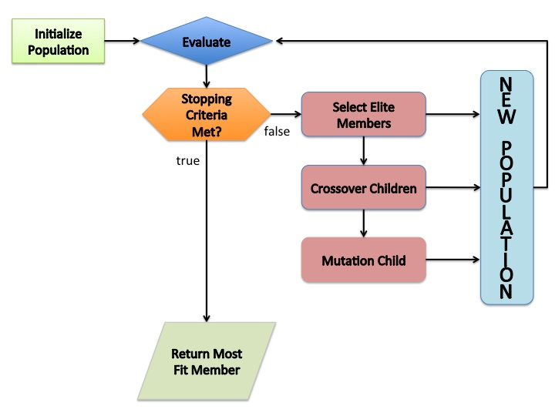
Methods: Genetic Algorithm
A single guess is one member of the population
Next generation dependent on fitness function (PPTD)

Slide 17
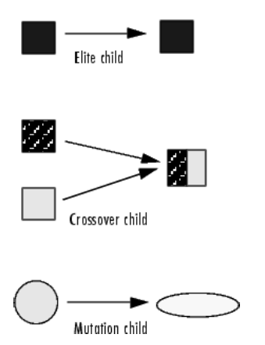
Methods: Genetic Algorithm
Elite Members: guesses with best fitness value
Crossover children: some parameters from each parent passed on to child
Mutation children: parent parameters are changed via random process

Slide 18
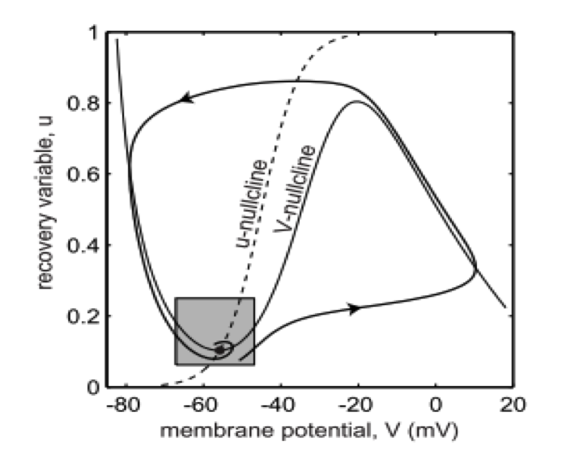
Methods: Phase Plane Analysis
1D analysis
Equilibria
Black – stable
White - unstable
Trajectory
Phase line
2D analysis
Nullclines
u : du/dt = 0
v : dv/dt = 0
Equilibrium – intersection of nullclines

Slide 19
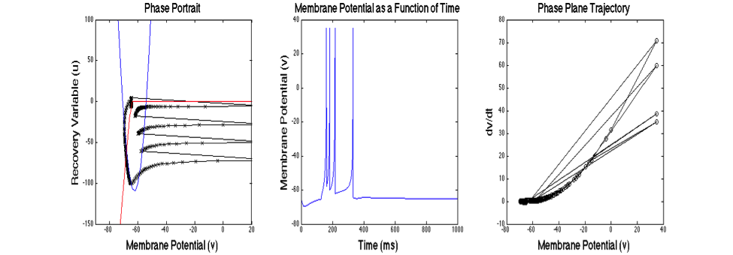
Methods: Phase Plane Analysis
Neuron fires burst in response to inhibition
Recovery variable u driven negative by inhibition
u returns to zero value, firing ceases

Slide 20
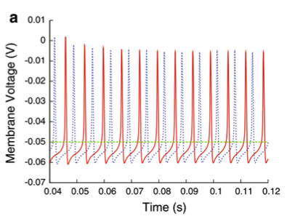
Methods: Phase Plane Trajectory Density
PPTD
Point by point analysis
Less susceptible to time shift

Slide 21
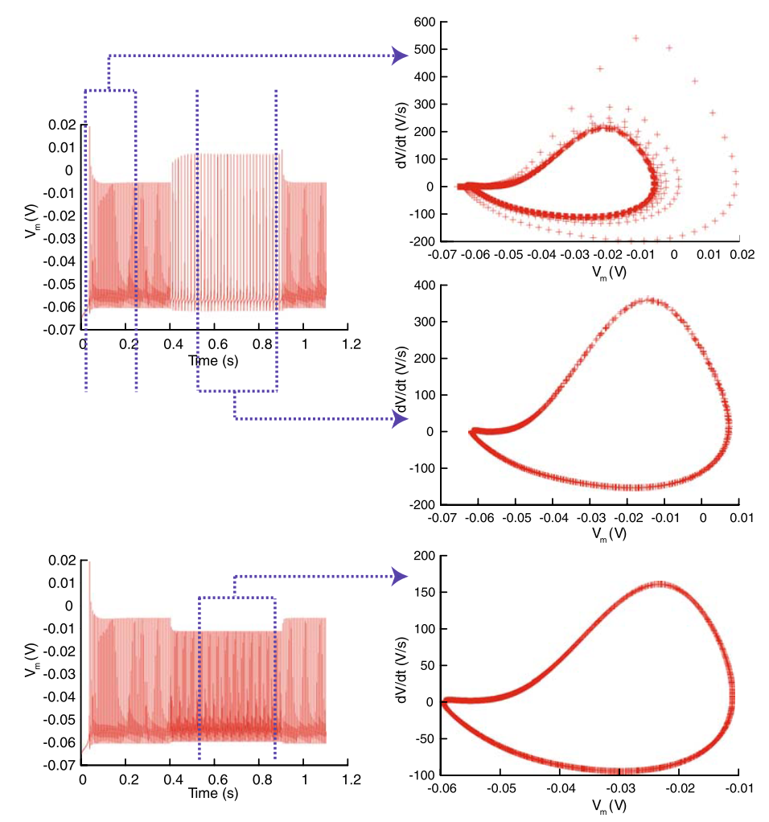
Methods: Phase Plane Trajectory Density
1 dimensional phase plane: dv/dt vs. v
PPTD uses 2d histogram to determine accuracy of estimated parameters

Slide 22
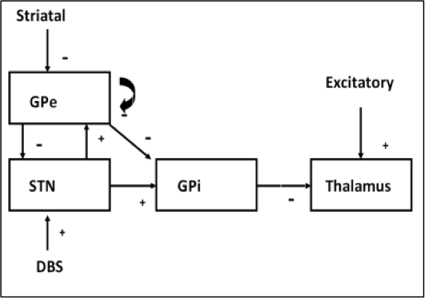
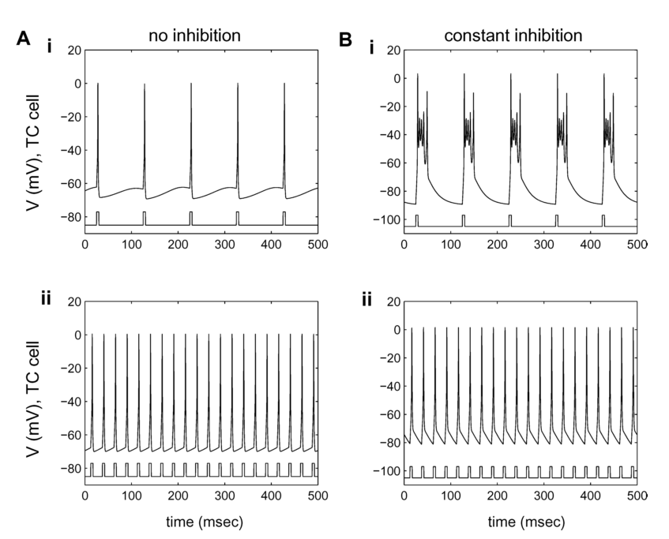
Preliminary Work: Rubin and Terman Model
Subthalamic Nucleus (STN)
Globus Pallidus Interna (GPi)
Globus Pallidus Externa (Gpe)
Thalamic Relay (TC)
TC relays sensorimotor (SM) signals to motor cortex
Inter-network dynamics effect transmission of SM signals

Slide 23
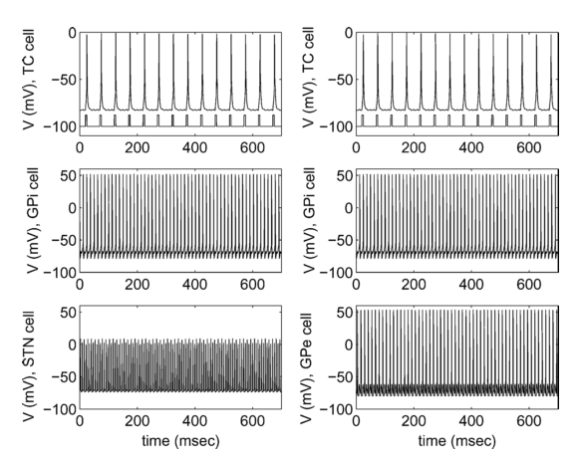
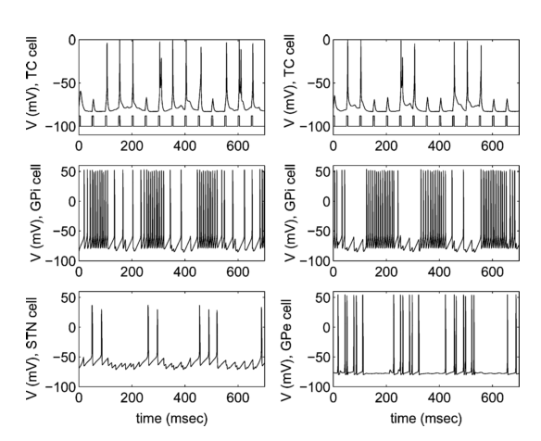
Preliminary Work: Rubin Terman Model
Parkinson’s disease model with DBS on
Parkinson’s disease model with DBS off

Slide 24
Preliminary Work: Rubin and Terman Model
Model implemented in C++ using Hodgkin Huxley model
Neuron Parent Class
4 child classes
GNU Scientific Library
Adaptive 4th Order Runge Kutta Algorithm
Minimum Error value for RK algorithm:
STN: 1e-12
GPe:1e-10
GPi: 1e-6
TC: 1e-12

Slide 25
Preliminary Work: Rubin and Terman Model
The HH based network was tested in:
Normal State
Parkinsonian State
Parkinsonian State w/o DBS
All results validated against Rubin/Terman XPP (X-window phase plane) simulations
Used as template for Izhikevich trials

Slide 26
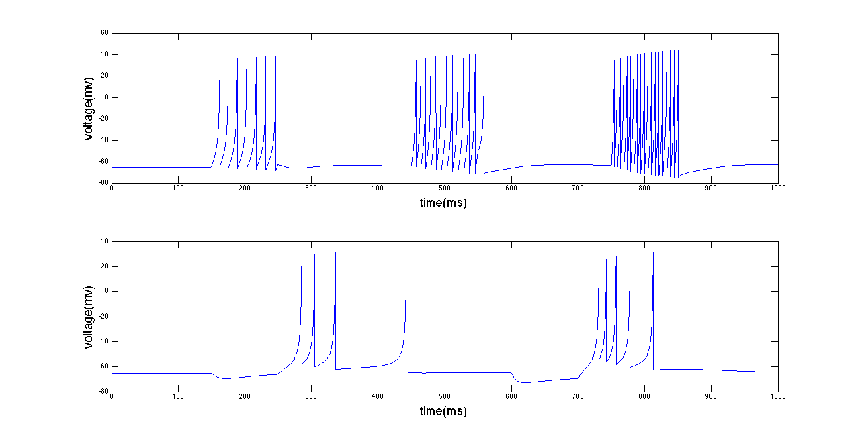
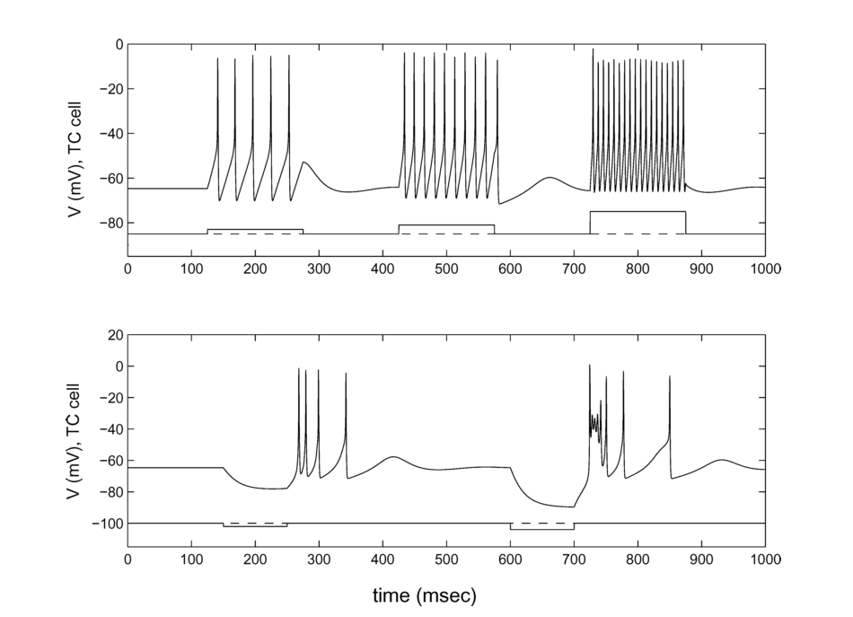
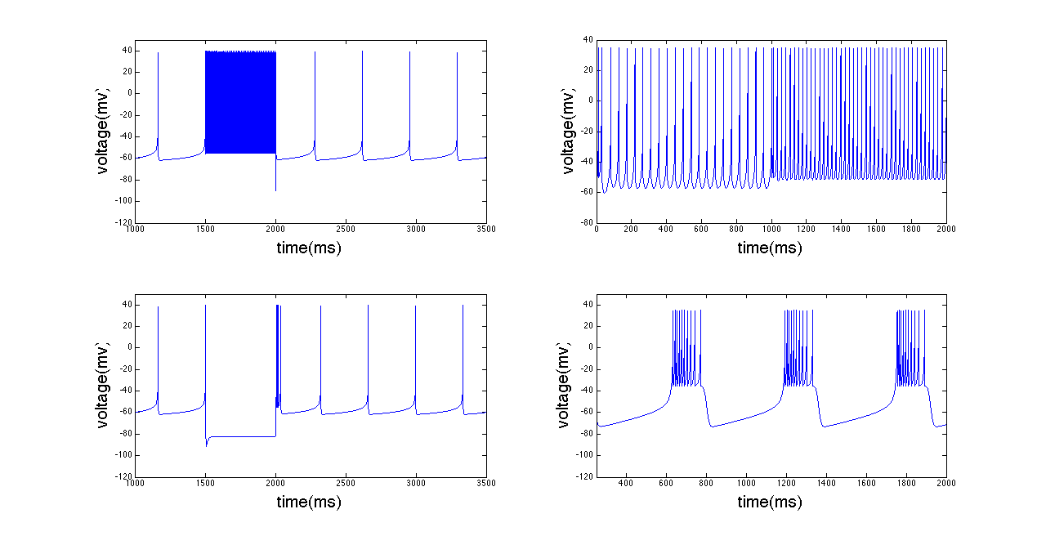
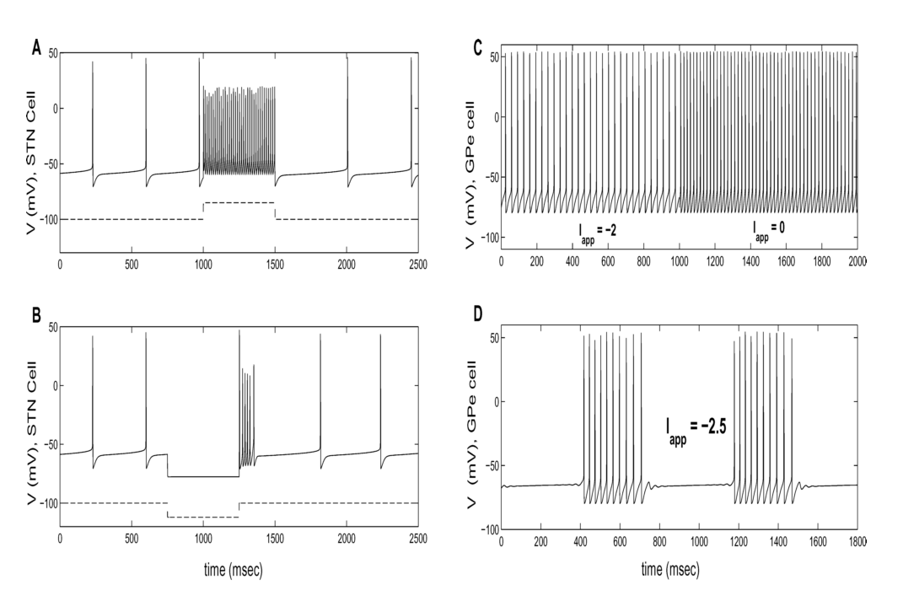
Preliminary Work: Izhikevich Model
The parameters for each neuron were manually tuned

Slide 27
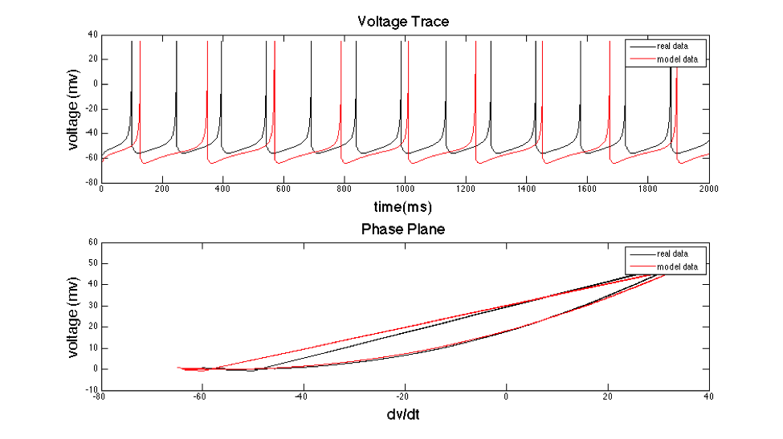
Preliminary Work: Parameter Estimation
Preliminary Results Using GA
Value – real parameter value
Initial guess
GA – estimated value

Slide 28
Proposed Work
Optimal settings for GA must be determined
Population size
Initial guess range
Stopping criteria including:
Function tolerance
Fitness Limit
Maximum number of generations
Number of bins in PPTD

Slide 29
Proposed Work
Implementation
MATLAB global optimization toolbox to implement Genetic Algorithm
PPTD fitness function (MATLAB)
Estimated parameters plugged into C++ model
Run simulations for Normal conditions, PD, and PD with DBS

Slide 30
Proposed Work
Final Implementation
Interconnect model in C++ and validate against HH model created during the preliminary work
Validation via:
Spike frequency
Waveform shape
PPTD comparison
Quantify speed improvements

Slide 31
Questions?

Slide 32
Hodgkin Huxley variable descriptions
n controls the activation of K⁺
h controls inactivation of Na⁺
m controls activation of Na⁺
β - # of times per second a gate in the open state shuts
α - # of times per second a gate in the closed state shuts

Slide 33
Izhikevich parameters
b - determines if u is a resonant (b>0) or amplifying (b<0) variable
Resonant
Sags in response to hyperpolarized pulses
Peaks in response to depolarized subthreshold pulses
Produces rebound spikes (post-inhibitory)
Amplifying
Acts as quadratic integrate and fire model

Slide 34
Basic Neuron Function
High K concentration inside neuron
High Na concentration outside neuron
High Cl⁻ and Ca concentration outside neuron
Action Potential
Na channel opens, Na flows into neuron (Depolarization)
Na channel deactivated, K channel activated, K flow outward (Refractory Period)
After refractory period, Na inactivation ends, all channels close

