Slide 1
Hyperspectral Imaging to Discern Benign and Malignant Canine Mammary tumors
Amrita Sahu
6th December, 2012
Control Sensor Network and Perception Laboratory
Electrical and Computer Engineering Department
Temple University
Philadelphia, PA 19122, U.S.A.
Notes:
Thanks everyone
Excited to be part of NEBEC 2012
Firdous Saleheen, PhD, TU, Philadelphia
Today I am going to present
Tactile sensation is the sensation of touch, perception of external pressure via physical contact.
Tactile Imaing Sensor gives a visual representation of that touch sensation
What is tactile imaging sensor?
Why is normal force estimation important?

Slide 2
Outline
Motivation
Research Objectives
Background
Data Acquisition
Experimental Setup
Data Preprocessing and Normalization
Data Analysis Methods
Preliminary Results
Discussion
Future Research Plan

Slide 3
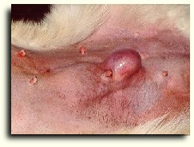
Motivation
Mammary tumors
  Originates in the mammary glands
  Approximately 4.5 million dogs currently have mammary tumors.
  Once a tumor reaches metastatic stage, chances of successful treatment becomes very low.
Canine mammary tumors are physiologically similar to breast tumors. If this experiment works for canine tumors , we can extend the project in future to breast cancer.
http://www.thepetcenter.com/gen/can.html

Slide 4
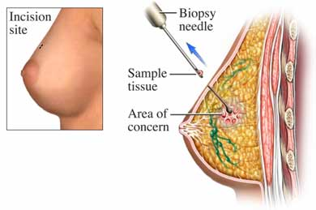
Motivation
No good device to identify canine cancerous tumors.
Doctors usually perform biopsy or just ‘wait and watch’.
Biopsy is the gold standard for cancer detection.
It is invasive and requires several days for the results to be determined.
To avoid the above disadvantages, we propose to use a non-invasive hyperspectral imaging system for characterizing canine mammary tumors.
http://www.beliefnet.com/healthandhealing/getcontent.aspx?cid=14777

Slide 5
Research Objectives
  Design an experiment to acquire the hyperspectral images of mammary tumors from the canine patients.
  Find the best normalization and preprocessing techniques to normalize the spectra.
  Develop an algorithm to discern the malignant tumors from the benign tumors.

Slide 6
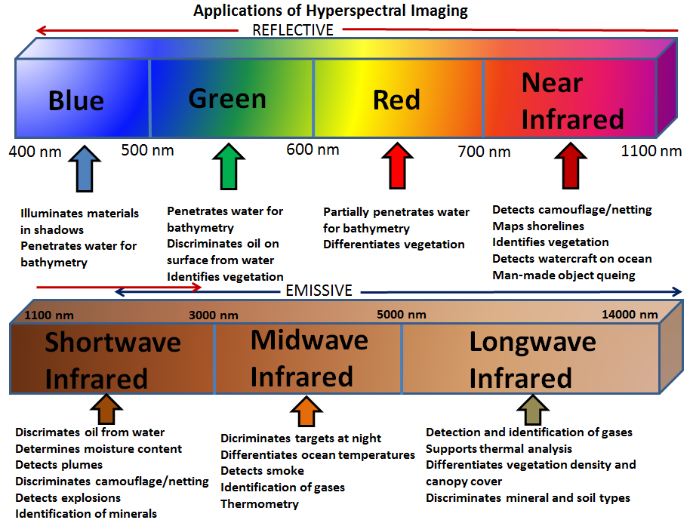
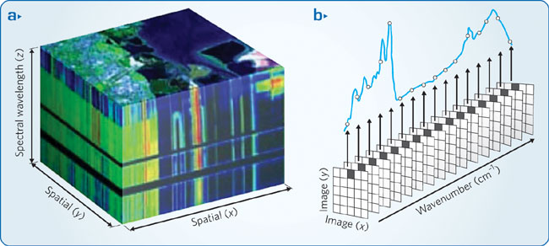
Background
  Hyperspectral imaging measures and collects reflectance intensity information of more than hundred spectral bands across the electromagnetic spectrum.
http://www.nature.com/nphoton/journal/v3/n11/fig_tab/nphoton.2009.205_F3.html

Slide 7
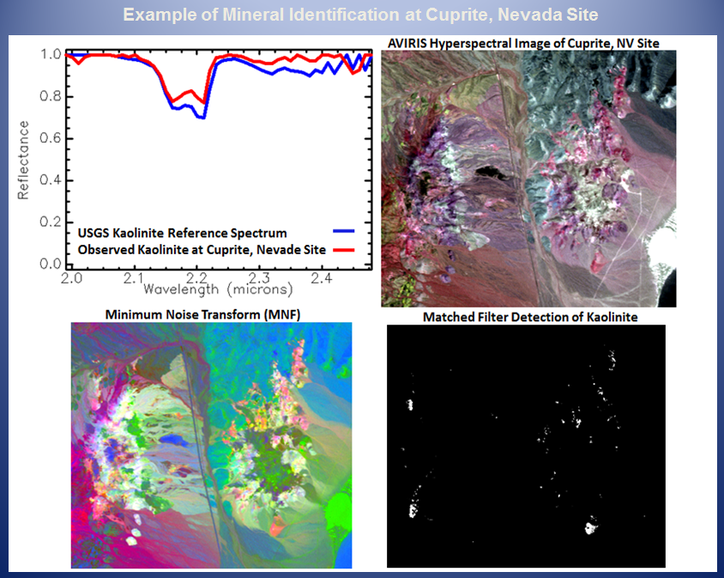
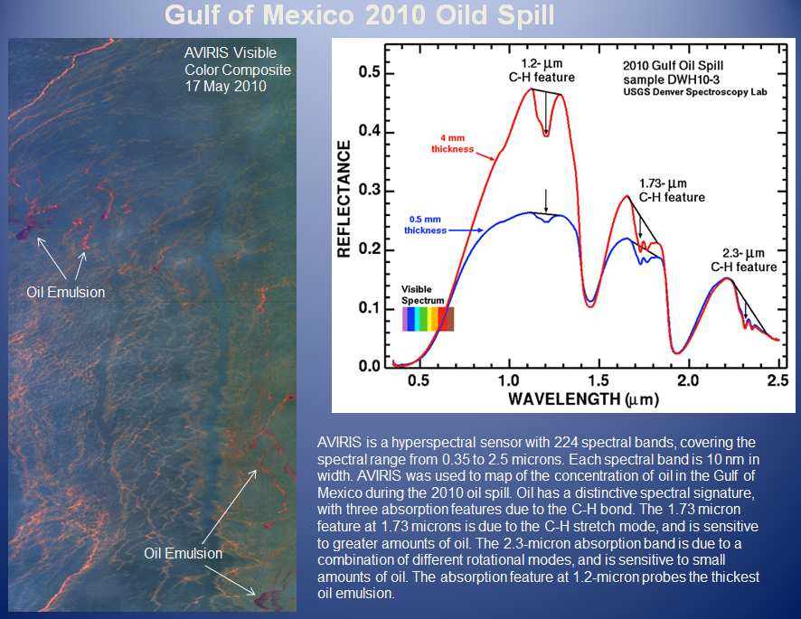
Applications of Hyperspectral Imaging
  Applications of Hyperspectral Imaging are:
  Agriculture
  Mineralogy
  Surveillance
  Monitoring of Oil Drilling
  Non-Invasive Tissue Analysis
http://www.markelowitz.com/Hyperspectral.html

Slide 8
Why is Near Infrared Spectral Range Used?
Near Infrared Hyperspectral Imaging has been used in literature for the detection of various kinds of cancer.
NIR light penetrates further into the tissue than light in any other spectrum, because tissue has low absorptivity in this region.
NIR light is absorbed by certain chromophores in the tissue that are biochemically significant.
In this project, we use the NIR spectral range (650nm to 1100nm) as the light transmission range.

Slide 9
Cancer Detection using Infrared Hyperspectral Imaging
Breast Cancer
Prostate Cancer
Tongue Cancer
Gastric Cancer
Skin Cancer
Canine Mammary Cancer
Other diseases: intestinal ischemia, lung emphysema

Slide 10
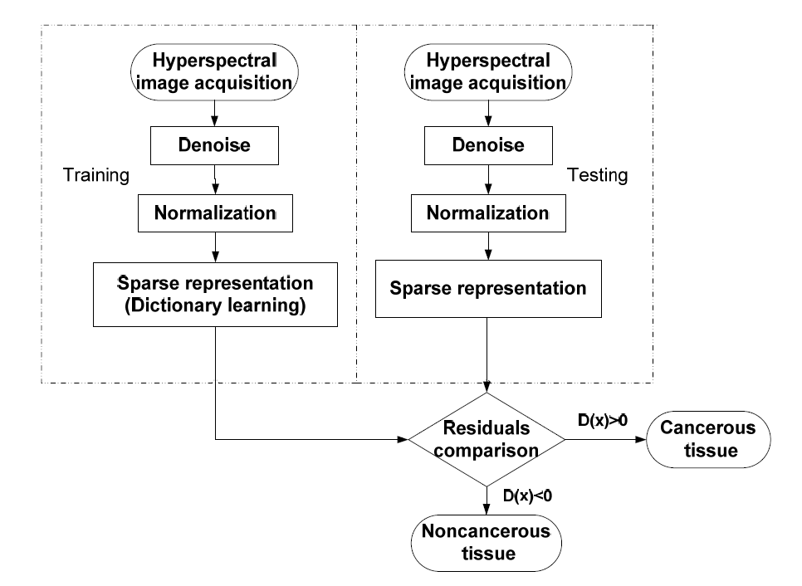
Tongue Cancer
Spectral Dataset of 34 tongue tumors collected.
Median Filtering used for denoising. Standard Reflectance Boards used for Normalization.
500W halogen lamps used for lighting.
The NIR range of 600-1000nm was used as the spectral window.
Sparse Representation was used as the classification algorithm.
Sensitivity: 93.7% Specificity: 91.3%
Liu, Z.; Wang, H.; Li, Q. Tongue Tumor Detection in Medical Hyperspectral Images. Sensors 2012, 12, 162-174.

Slide 11
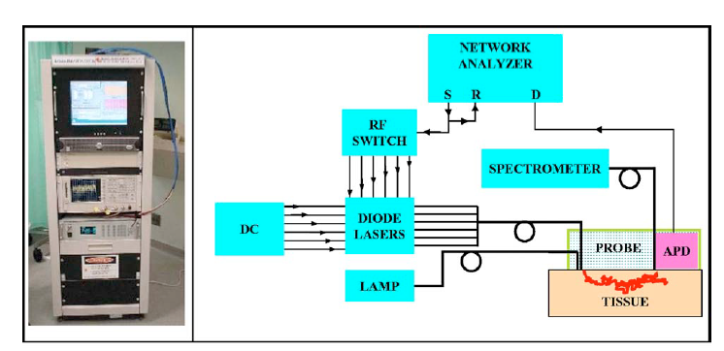
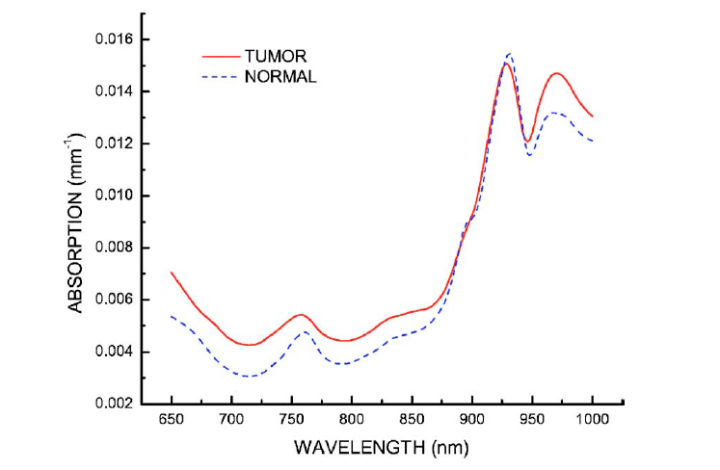
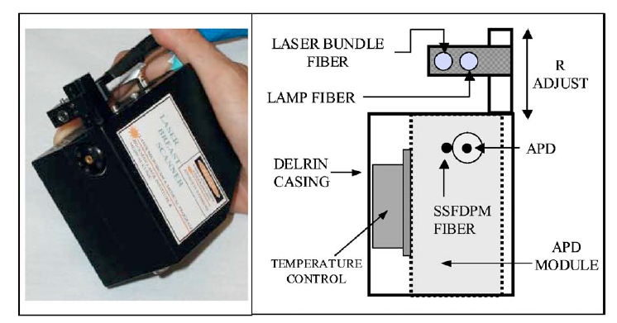
Breast Cancer
Results from 58 malignant breast tumors are reported.
A steady state spectrometer used (650-1100nm).
Six laser diodes used for illumination.
Fiber Optic cable delivers laser light to tissue.
Shah, N., A. E. Cerussi, D. Jakubowski, D. Hsiang, J. Butler, and B. J. Tromberg, The role of diffuse optical spectroscopy in the clinical management of breast cancer. Dis. Markers 19:95–105, 2003.

Slide 12
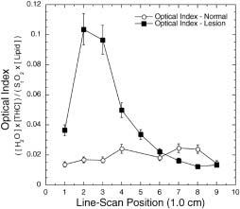
Breast Cancer (Cont.)
Hemoglobin, water and lipid content is different in malignant and benign tumors.
Tissue Optical Index (TOI) was developed.
Higher TOI indicates tumor malignancy.
Shah, N., A. E. Cerussi, D. Jakubowski, D. Hsiang, J. Butler, and B. J. Tromberg, The role of diffuse optical spectroscopy in the clinical management of breast cancer. Dis. Markers 19:95–105, 2003.

Slide 13
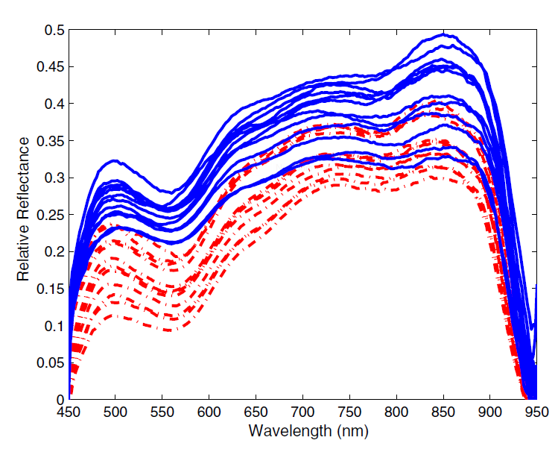
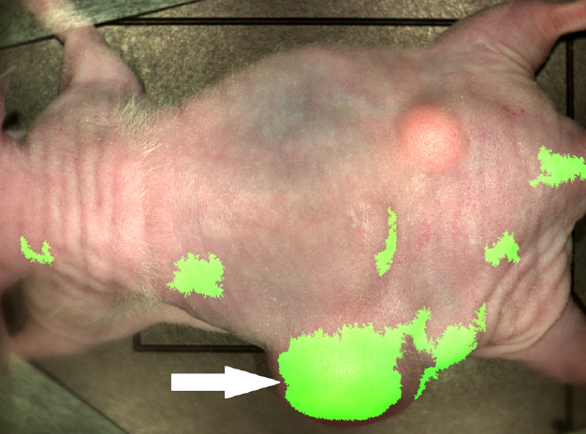
Prostate Cancer
Experiment carried out on 11 mice with human prostate tumors on their flanks.
Data normalized using standard reflectances.
Difference in reflectance properties observed between cancer and normal tissue.
Algorithm was developed using Support Vector Machine (SVM).
Results shows sensitivity and specificity of 92.8% and 96.9% respectively.
Akbari,Hamed, Halig,Luma V, Schuster, David M, Osunkoya, Adeboye, Master,Viraj, Nieh,Peter T, Chen,Georgia Z, Fei,Baowei, Hyperspectral imaging and quantitative analysis for prostate cancer detection, Journal of Biomedical Optics, 2012

Slide 14
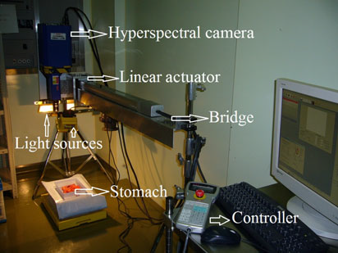
Gastric Cancer
Gastric tumors imaged from 10 human patients.
Each tumor imaged 10 times, to ensure repeatability of system.
Noise removed by median filtering. Normalization by reflectance boards.
Normalized Difference Cancer Index Method gave the best results.
Sensitivity and Specificity is 93% and 91%.
Hamed Akbari, Kuniaki Uto, Yukio Kosugi, Kazuyuki Kojima, Naofumi Tanaka, Cancer detection Using Infrared Hyperspectral Imaging, Cancer Science, pp: 852-857, 2011.
.

Slide 15
Skin Cancer
Data from 274 skin lesions were analyzed.
Principle of Raman Spectroscopy was used.
Wavelength range was 400 to 800nm.
Instrument consists of laser diode (785nm), a CCD camera and a Raman optical probe.
Specificity and Sensitivity was 90% and 75%.
C. Balas, G. Themelis, A. Papadakis, E. Vasgiouraki, A. Argyros, E. Koumantakis, A Tosca, E. Helidonis, A Novel Hyper-Spectral Imaging System : Application on in-vivo Detection and Grading of Cervical Precancers and of Pigmented Skin Lesions, In Proc. of "Computer Vision Beyond the Visible Spectrum" CVBVS'01 Workshop, Hawaii, USA, Dec. 2001.

Slide 16
Canine Mammary Cancer
Fluorescent dyes used.
The dyes were administered in the vein of the canine patient
For illumination, a 660nm laser diode beam used.
The uptake and release rates of the dye varied in the diseased and normal tissue.
M. Gurfinkel, A.B. Thompson, W. Ralston, T. L. Troy, A. L. Moore, T. A. Moore, J. Devens Gust, D. Tatman, J. S. Reynolds, B. Muggenburg, K. Nikula, R. Pandey, R. H. Mayer, D. J. Hawrysz and E. M. Sevick-Muraca, Pharmacokinetics of ICG and HPPH-car for the Detection of Normal and Tumor Tissue Using Fluorescence, Near-Infrared Reflectance Imaging: A Case Study, Photochemistry and Photobiology, 2000, 72(1), 94-102

Slide 17
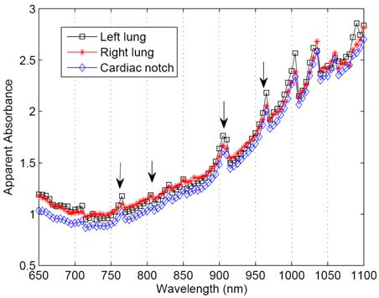
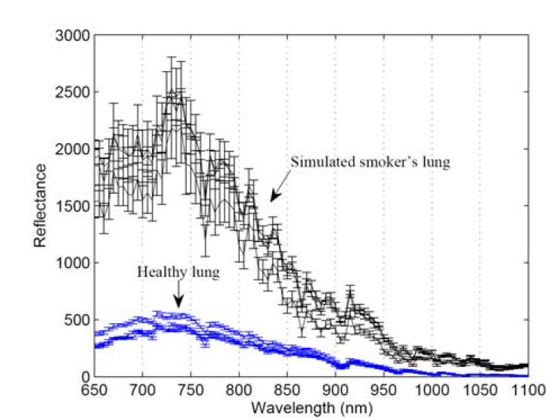
Other diseases diagnosed by hyperspectral imaging
Lung Emphysema
Jong-Ha Lee, Chang-Hee Won, “Characterization of Lung Tissues using Liquid-Crystal Tunable Filter an Hyperspectral Imaging System,” Proceedings of IEEE EMBC 09, 31th Annual International Conference of the IEEE Engineering in Medicine and Biology Society, Minneapolis, MN, September 6-9, 2009

Slide 18
Other diseases diagnosed by hyperspectral imaging…cont
Intestinal Ischemia
Is caused by insufficient flow of oxygenated blood to the intestine.
Spectral signature of intestinal ischemic region of a pig’s intestine were extracted.
Two filters were designed and results compared with that of SVM.
Sensitivity and Specificity of 99% obtained.
H. Akbari, Y. Kosugi, K. Kojima, N. Tanaka, Detection and Analysis of the Intestinal Ischemia Using Visible and Invisible Hyperspectral Imaging, IEEE Transactions on Biomedical Engineering, Vol 57, No. 8, August 2010

Slide 19
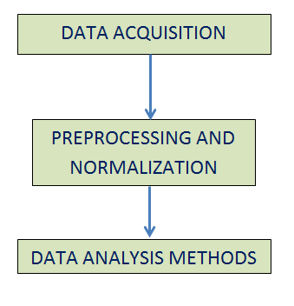
Experimental Flow

Slide 20
Data Acquisition From Canine Patients
Data acquired in collaboration with the University of Pennsylvania Veterinary Hospital.
Canine Patients had multiple mammary tumors in their abdomen.
Animal Experiments approved by the Univ. Of Pennsylvania IACUC Protocol #803829.
Tumors marked with a black marker so it can be recognized during image analysis.
During image acquisition, dogs held by veterinary doctor.

Slide 21
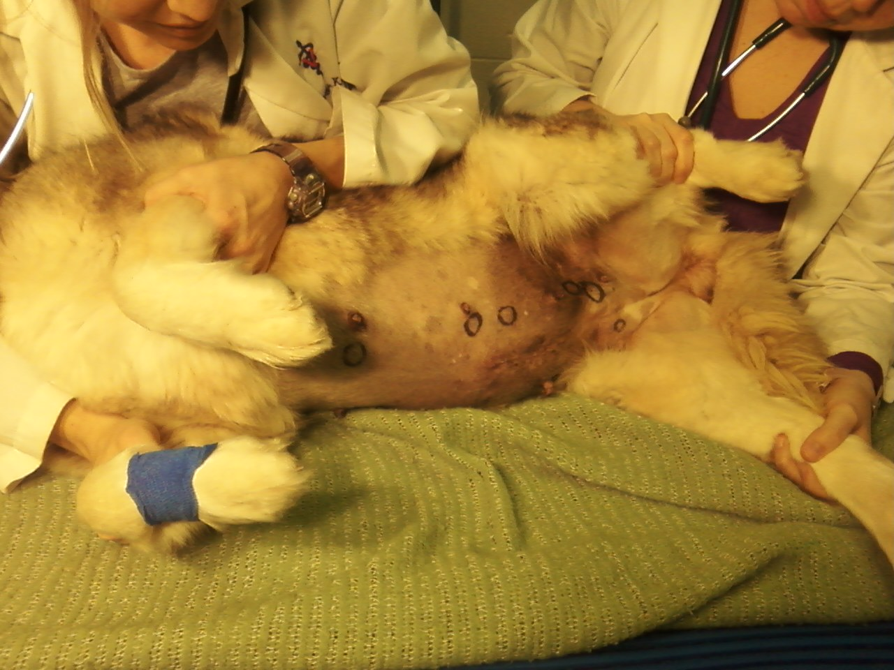
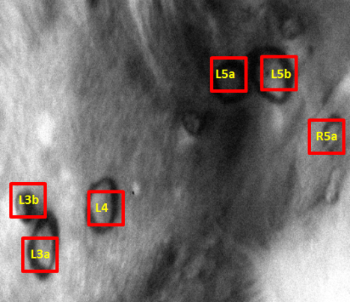
Data Acquisition From Canine Patients (cont.)

Slide 22
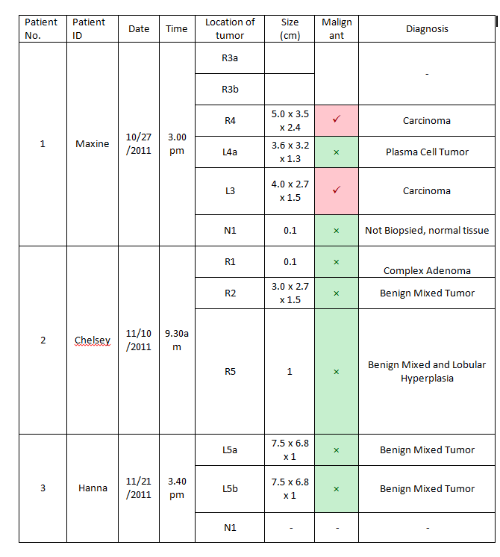
Canine Tumor Data

Slide 23
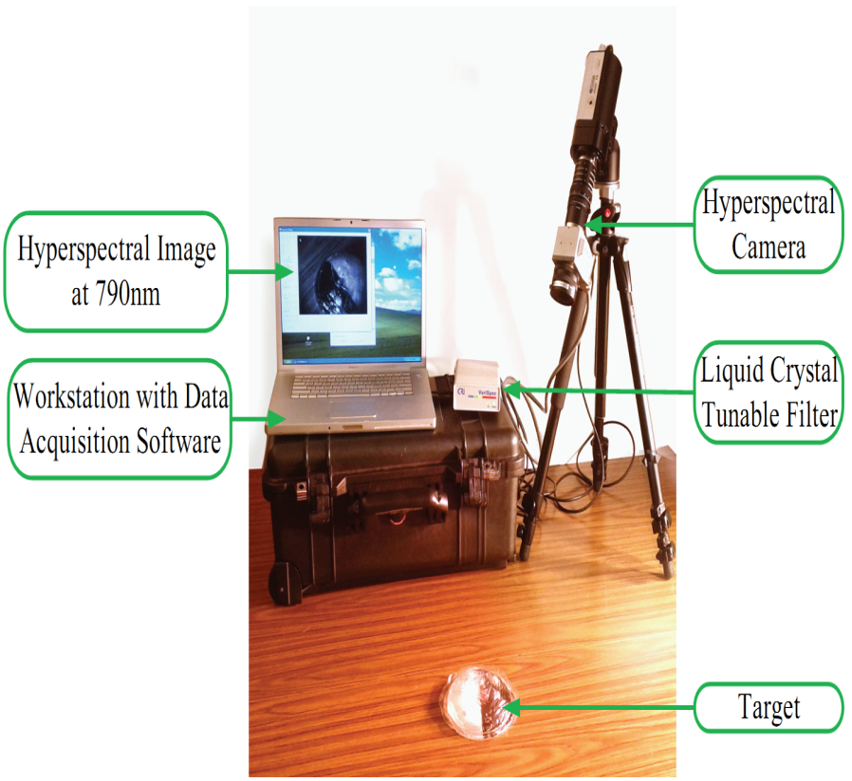
Hyperspectral Imaging System Description
The imaging system consists of:
A digital imager (CCD camera, 1.4 megapixel, 12 bit output)
A Liquid Crystal Tunable Filter.
LCTF Controller.

Slide 24
Hyperspectral Imaging System Description (cont.)
A 500W dual quartz tungsten halogen lamps (360-2500nm) are used for illumination.
The light should fall as uniformly on the subject as possible.
An Apple Macbook Pro Laptop Computer used for spectral acquisition.

Slide 25
Preprocessing and Normalization of data
Data should be preprocessed to eliminate noise.
Data should be normalized to treat spectral non-uniformity of device.
Raw data may change due to illumination, temperature and non-uniform contour of the subject.

Slide 26
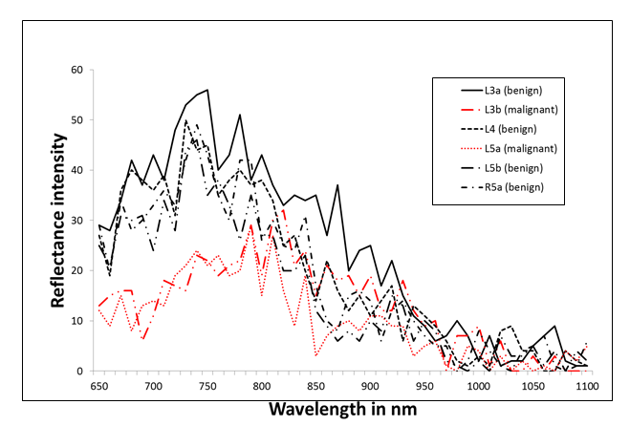
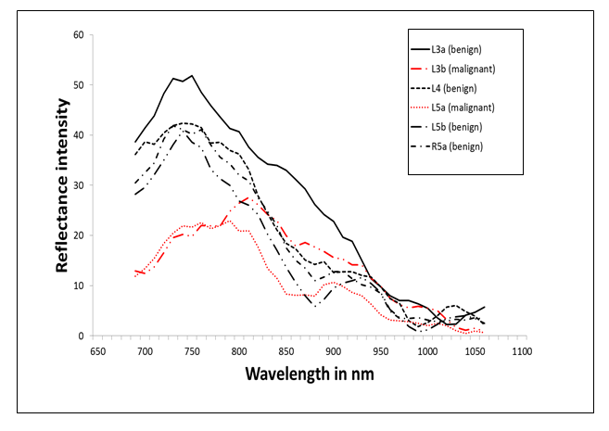
Preprocessing
Methods
Filtering (to minimize noise)
a) Median Filtering
b) Savitzky-Golay Smoothing Process
Smoothing applied on raw data to minimize noise

Slide 27
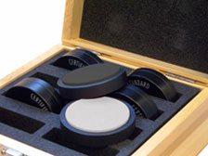
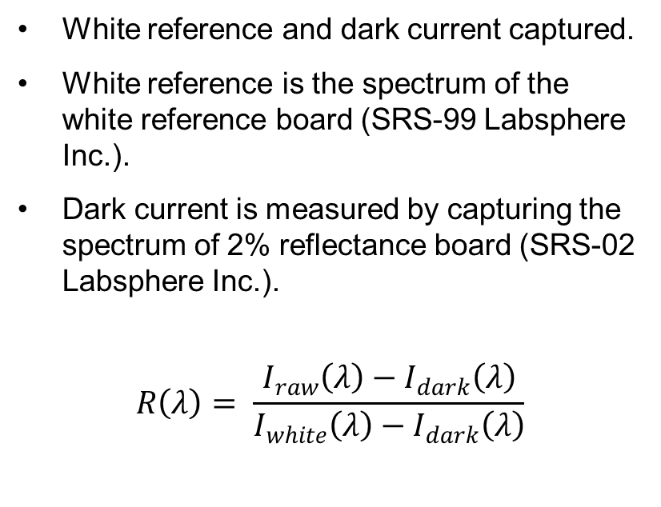
Normalization Technique using Standard Reflectance
White reference and dark current captured.
White reference is the spectrum of the white reference board (SRS-99 Labsphere Inc.).
Dark current is measured by capturing the spectrum of 2% reflectance board (SRS-02 Labsphere Inc.).
$$R\left(λ\right)= \frac{I_{raw}\left(λ\right)−I_{dark}\left(λ\right)}{I_{white}\left(λ\right)−I_{dark}\left(λ\right)}$$
This method will be used in future experiments!

Slide 28
Other Normalization Methods
Area Normalization
Unit Vector Normalization
Mean Normalization
Maximum Normalization
Range Normalization

Slide 29
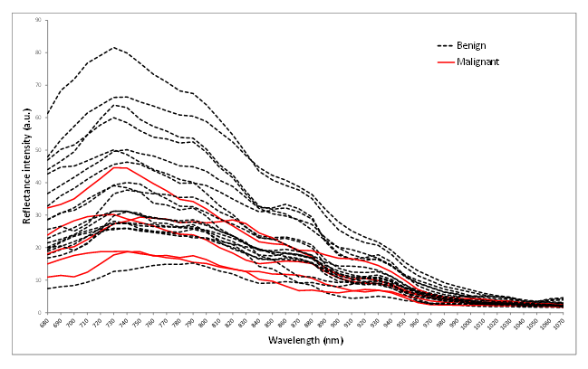
Other Normalization Methods (cont.)
After applying range normalization

Slide 30
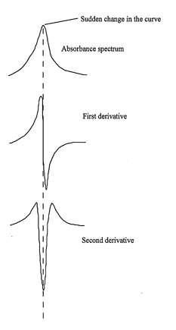
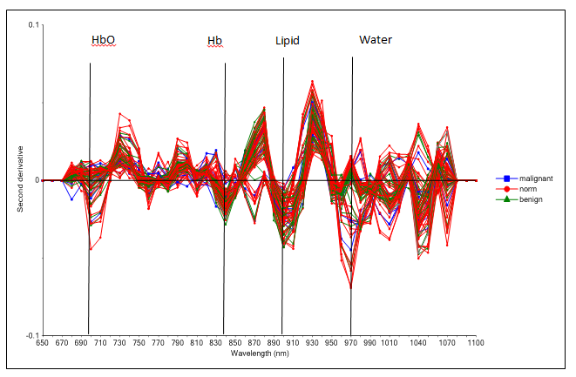
Identifying the Wavelengths of Chromophores
Applying second derivative method on the absorbance spectra

Slide 31
Data Analysis Methods
Principal Component Analysis
Linear Discriminant Analysis
Support Vector Machine
Tissue Optical Indices Methods

Slide 32
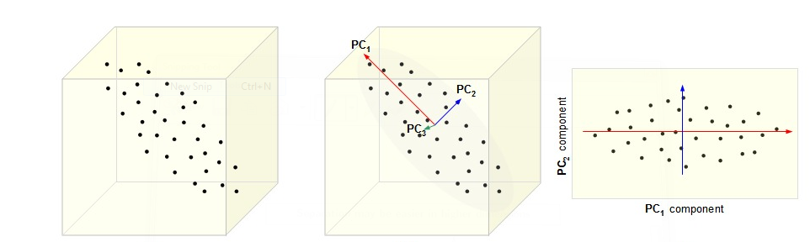
Principal Component Analysis
Converts a larger number of correlated variables into a smaller number of linearly uncorrelated variables called principal components (PC).
The first principal component has the highest variance, the second principal component has the second highest variance and so on.
Each PC is orthogonal to each other.
http://cnx.org/content/m11461/latest/

Slide 33
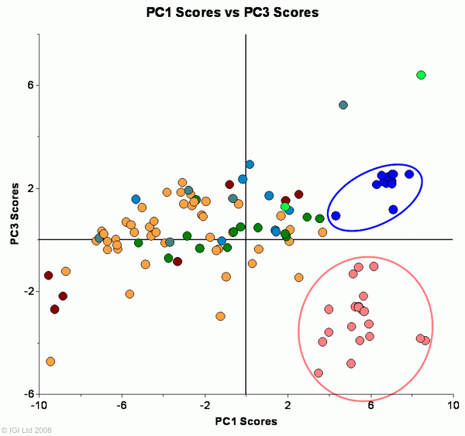
How do we use PCA for the canine data?
Our spectral dataset has 46 variables because we have 46 spectral bands. So our data has 46 dimensions.
So it is difficult to visualize and classify the spectral data.
Applying PCA would give a principal scores plot, which would be two dimensional.
Clusters in the Principal Scores plot would indicate spectral similarity and would enable us to classify the tumors as malignant or benign.

Slide 34
Linear Discriminant Analysis
Linear Discriminant Analysis is widely used in statistics, machine learning and pattern recognition.
It finds a linear combination of features which characterized two or more classes of objects.
It used Bayes’ Formula, and we assume that the prior probabilities for groups are given.

Slide 35
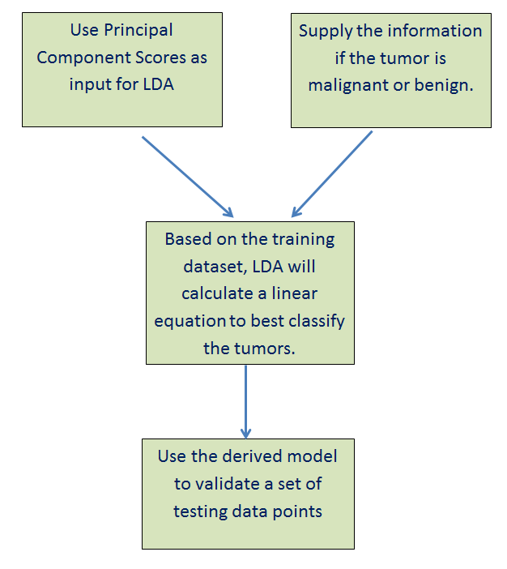
How do we use LDA for our spectral dataset?
Contrary to PCA, LDA is a supervised classifier.
LDA requires that the input vectors are independent. So we input the principal scores.
To build the model, we need to supply the information whether the tumor is cancerous or not.
For the above purpose, we will use some training data points.
The derived model will be used to validate testing data points.

Slide 36
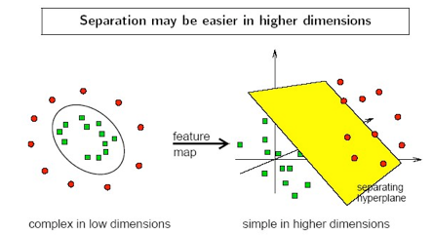
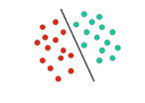
Support Vector Machine
SVM finds optimal dividing hyperplane with maximum margin.
If a linear boundary is not feasible, it maps each object to a higher dimensional space.
Kernel function is used for the mapping.
http://ccforum.com/content/11/4/R83/figure/F1

Slide 37
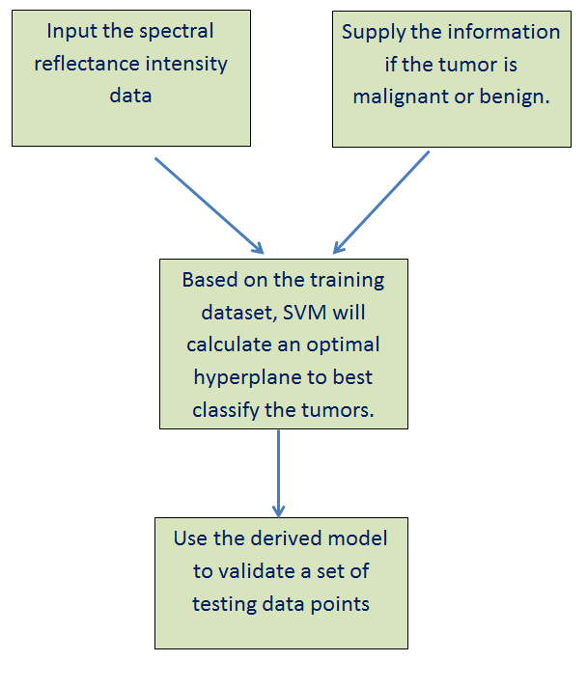
How do we use SVM for our spectral dataset?
The advantage of SVM over LDA is that it is a non-linear classifier.

Slide 38
Tissue Optical Indices Method
Higher content of hemoglobin (HbT) suggests elevated blood volume and angiogenesis.
Higher water content (H₂O) suggest edema and increased cellularity
Decreased StO₂ (tissue oxygen saturation) indicated tissue hypoxia driven by metabolically active tumor cells
Decreased lipid content reflects displacement of parenchymal adipose
A higher TOI suggest that the tumor is malignant, because it indicates higher metabolic activity of the cells.
Notes:
StO₂ is the quantification of the ratio of oxygenated hemoglobin to total hemoglobin in the microcirculation of a volume of illuminated tissue and is an absolute number.

Slide 39
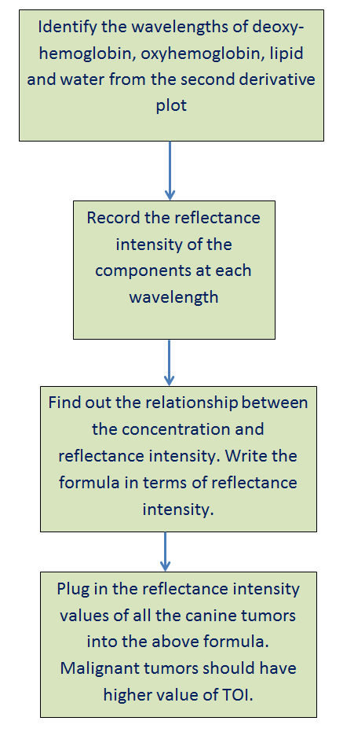
How do we use TOI method for our spectral dataset?
Malignant tumors should have higher value of TOI than benign tumors

Slide 40
Preliminary Results
Smoothed spectral data from 2 canine patients shown.
Cancer Tissue has relatively lower reflectance intensity compared to the benign and the normal tissue.
Decreased reflectance intensity is due to higher metabolic activity (higher blood level) of cancer cells.

Slide 41
Preliminary Results

Slide 42
Discussion
Preliminary Results are promising.
We can differentiate malignant and benign spectra for a single canine patient.
Some issues faced during experiment like lighting and normalization.

Slide 43
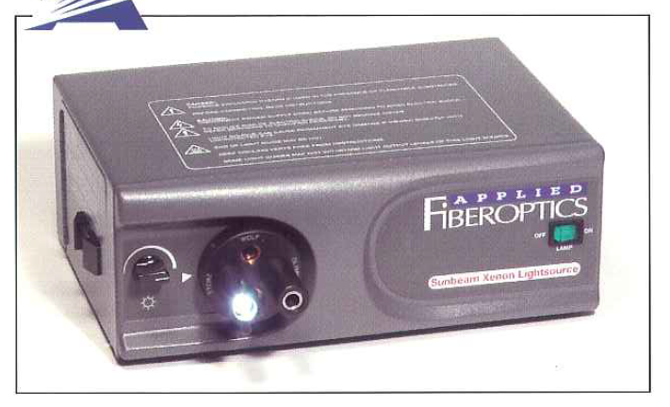
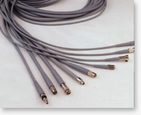
Discussion (cont.)
The lighting should be as uniform as possible.
Non-uniform light will introduce variability in the data.
The temperature of the tungsten halogen lights are very high.
Uncomfortable for patients.
Use of fiber optic cable can mitigate can the problem.

Slide 44
Discussion (cont.)
Normalization of the data is important.
In future experiments, we should use the reflectance standards to normalize data.
This modality can be used by surgeons to determine tumor margin.
A safe resection margin reduces operational mortality and morbidity.

Slide 45
Future Work
Normalize the data.
a) Will apply normalization techniques like range, area, unit-vector,
maximum and mean normalization on the spectral data.
Develop a malignancy detection algorithm.
a) Will apply the four algorithms on the spectral dataset: PCA, LDA,
SVM and TOI methods.
b) Calculate the sensitivity and specificity for each method.

Slide 46
Future Work (cont.)
Check repeatability of system.
Conduct an experiment to image to the same sample over 7
consecutive days.
Keep lighting conditions as similar as possible.
Compare reflectance intensity plots to check if they are similar
or changing with time.

Slide 47
Future Work (cont.)
Find out the depth of interrogation of the system.
In case of canine patients, most of the tumors were surface
tumors. So depth was not an issue here.
However, if we extend this project to human cancer, then
depth of interrogation of the system will be an issue.
I will conduct a literature search on how to find out the depth of
interrogation of the system.

Slide 48
Acknowledgement
I would like to thank the following people:
Dr. Chang-Hee Won for providing me the opportunity to work on this project and for guiding me through the project.
My Committee Members: Dr. Joseph Picone and Dr. Nancy Pleshko.
Dr. Karin Sorenmo, for providing the canine patient data.
Dr. Cushla McGoverin, for her constant help, support and encouragement.
Dr. Won and Firdous Saleheen, for their help in canine data acquisition.
The members of the CSNAP lab.

Slide 49
Acknowledgement
I would like to thank the following people:
Dr. Chang-Hee Won for providing me the opportunity to work on this project and for guiding me through the project.
My Committee Members: Dr. Joseph Picone and Dr. Nancy Pleshko.
Dr. Karin Sorenmo, for providing the canine patient data.
Dr. Cushla McGoverin, for her constant help, support and encouragement.
Dr. Won and Firdous Saleheen, for their help in canine data acquisition.
The members of the CSNAP lab.

Slide 50


