Slide 1
A Comparative Analysis of Bayesian Nonparametric Variational Inference Algorithms for Speech Recognition
A Thesis Proposal By:
John Steinberg
Institute for Signal and Information Processing
Temple University
Philadelphia, Pennsylvania, USA

Slide 2
Abstract
Nonparametric Bayesian models have become increasingly popular in speech recognition tasks such as language and acoustic modeling due to their ability to discover underlying structure in an iterative manner. Nonparametric methods do not require a priori assumptions about the structure of the data, such as the number of mixture components, and can learn this structure directly from the data. Dirichlet process mixtures (DPMs) are a widely used nonparametric method. These processes are an extension of the Dirichlet distribution which spans non-negative numbers that sum to one. Thus, DPMs are particularly useful for modeling distributions of distributions. Because DPMs potentially require infinite parameters, inference algorithms are needed to approximate these models for sampling purposes. The focus of this work is an evaluation of three of these Bayesian inference algorithms, which have only recently become computationally viable: Accelerated Variational Dirichlet Process Mixtures (AVDPM), Collapsed Variational Stick Breaking (CVSB), and Collapsed Dirichlet Priors (CDP).
Rather than conducting a complete speech recognition experiment where classification is affected by several factors (i.e. language and acoustic modeling), a simple phone classification task is chosen to more clearly assess the efficacy of these algorithms. Furthermore, this evaluation is conducted using the CALLHOME Mandarin and English corpora, two languages that, from a human perspective, are phonologically very different. This serves two purposes: (1) Artifacts from either language that influence classification will be identified. (2) If no such artifacts exist, then these algorithms will have strongly supported their use for future multi-language recognition tasks. Finally, Mandarin misclassification error rates have consistently been much higher than those from comparable English experiments. Thus the last goal of this work is to show whether these three inference algorithms can help reduce this gap while maintaining reasonable computational complexity.

Slide 3
Introduction

Slide 4
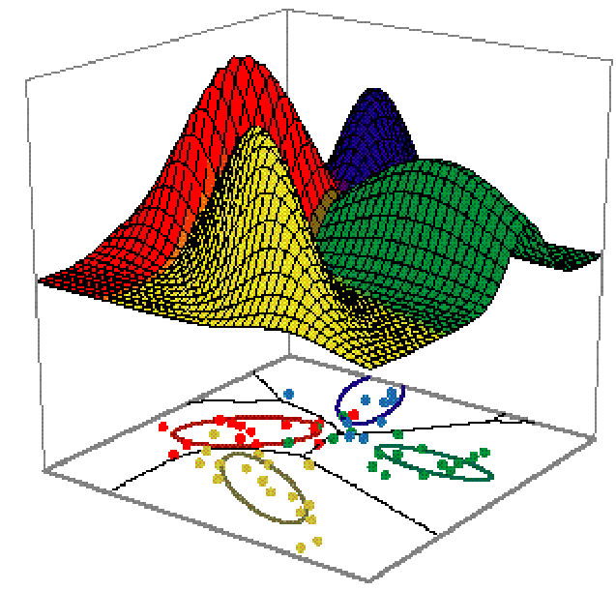
The Motivating Problem
A set of data is generated from multiple distributions but it is unclear how many.
Parametric methods assume the number of distributions is known a priori
Nonparametric methods learn the number of distributions from the data, e.g. a model of a distribution of distributions
Notes:
Don’t discuss parametric and non-parametric methods here

Slide 5
Goals
Investigate three variational inference algorithms on a:
Accelerated Variational Dirichlet Process Mixtures (AVDPM)
Collapsed Variational Stick Breaking (CVSB)
Collapsed Dirichlet Priors (CDP)
Assess Performance:
Understand computational complexity
Identify any language-specific artifacts
Assess viability for multilingual speech recognition
Notes:
-phone classification is used to better assess efficacy (full scale speech recognition has many variables that affect output, i.e. language and acoustic models)
-Mandarin and English are on opposite ends of language spectrum – we use these as a sanity check to verify that the algorithms over/underperform on a particular language.

Slide 6
Remaining Outline
Background
Speech Recognition Overview
Parametric and Nonparametric Models
Dirichlet Distributions and Processes
Inference Algorithms
Experimental Setup
Data
Baseline Algorithms
Feature Extraction
Preliminary Results
Future Timeline

Slide 7
Background

Slide 8
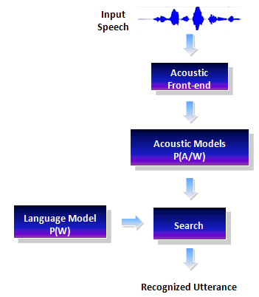
Speech Recognition Overview
Notes:
-We don’t run a complete recognition experiment but we do train monophone models in order to generate a phone alignment
-Parametric models are most common

Slide 9
Parametric vs. Nonparametric Models
Parametric | Nonparametric
Requires a priori assumptions about data structure | Do not require a priori assumptions about data structure
Underlying structure is approximated with a limited number of mixtures | Underlying structure is learned from data
Number of mixtures is rigidly set | Number of mixtures can evolve Distributions of distributions Needs a prior!
Complex models frequently require inference algorithms for approximation!
Notes:
-Averaging across distributions is ok for capturing general acoustic features for phone identification but can’t capture unique acoustic traits.

Slide 10
Taxonomy of Nonparametric Models
Nonparametric Bayesian Models
Regression
Model Selection
Survival Analysis
Neural Networks
Wavelet-Based Modeling
Proportional Hazards
Competing Risks
Dirichlet Processes
Multivariate Regression
Spline Models
Neutral to the Right Processes
Dependent Increments
Inference algorithms are needed to approximate these infinitely complex models
Notes:
-survival analysis focuses on modeling time before an event

Slide 11
Dirichlet Distributions
Dirichlet Distribution pdf:
q ϵ ℝ^{k} : a probability mass function (pmf)
α: a concentration parameter
Notes:
-example, 3 hidden dice to model probability of (1,2, …, 6)
-Dirichlet Dist. are distributions over pmfs
-α is similar to inverse variance

Slide 12
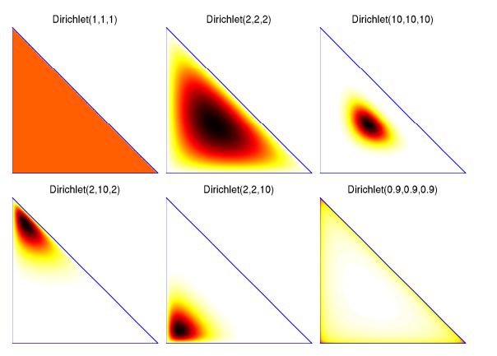
Dirichlet Distributions
Dirichlet Distribution
Properties of Dirichlet Distributions
Agglomerative Property (Joining)
Decimative Property (Splitting)
Notes:
Each corner represents a die, alpha represents how often each dice is rolled

Slide 13
Dirichlet Processes (DPs)
A Dirichlet Process is a Dirichlet distribution split infinitely many times
q₂₂
q₂
q₂₁
q₁₁
q₁
q₁₂
These discrete probabilities are used as a prior for our infinite mixture model

Slide 14
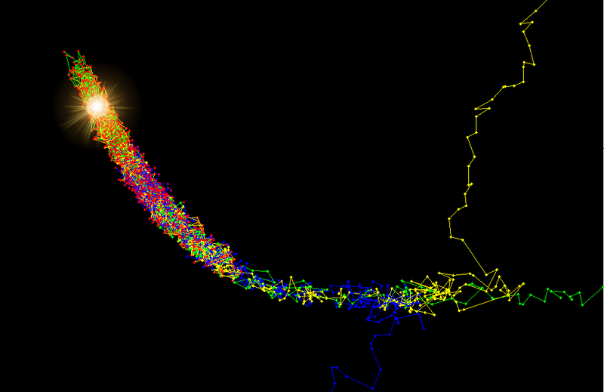
Inference: An Approximation
Parameter estimation is computationally difficult
Distributions of distributions ∞ parameters
Posteriors, p(y|x), can’t be analytically solved
Sampling methods are most common
Markov Chain Monte Carlo (MCMC)
Samples estimate true distribution
Drawbacks
Needs large number of samples for accuracy
Step size must be chosen carefully
“Burn in” phase must be monitored/controlled

Slide 15
Variational Inference
Converts sampling problem to an optimization problem
Avoids need for careful monitoring of sampling
Simpler distributions can approximate the true posterior, p(y|x).
Use independence assumptions to create variational distributions, q(y), to approximate p(y|x).
Optimize q from Q = {q1, q2, …, q_{m}} using an objective function, e.g. Kullbach-Liebler divergence
Constraints can be added to Q to improve computational efficiency

Slide 16
Variational Inference Algorithms
Accelerated Variational Dirichlet Process Mixtures (AVDPMs)
Limits computation of Q: For i > T, q_{i} is set to its prior
Incorporates kd-trees to improve efficiency
number of splits is controlled to balance computation and accuracy
A, B, C, D, E, F, G
A, B, D, F
A, D
B
C, E, G
C, G
E
F
Notes:
-splits in kd-trees can be controlled (can control balance of computation/accuracy)
-each node shares a common distribution, q, which is used to optimize calculations of child nodes’ q’s

Slide 17
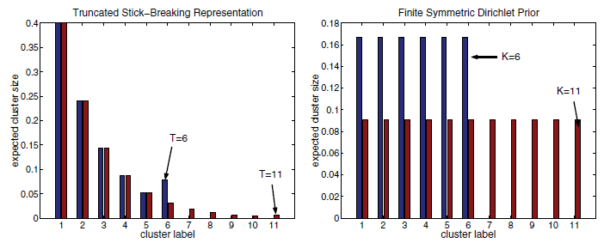
Variational Inference Algorithms
Collapsed Variational Stick Breaking (CVSB)
Truncates the DPM to a maximum of K clusters and marginalizes out mixture weights
Creates a finite DP
Collapsed Dirichlet Priors (CDP)
Truncates the DPM to a maximum of K clusters and marginalizes out mixture weights
Assigns cluster size with a
symmetric prior
Creates many small clusters that can later be collapsed
[ 4 ]
Notes:
Both truncate clusters (everything beyond T =0)
CDP assigns cluster size, uses large number of small clusters, and can be later collapsed into bigger clusters

Slide 18
The Story So Far…
DPs can be used as a prior to select statistically meaningful distributions for our model.
Distributions of distributions (DPs) require an infinite number of parameters.
Complex Models ➔ Inference Algorithms
Speech data is complex and we don’t know the underlying structure.
Nonparametric models automatically find structure.
Approach: Apply variational inference algorithms for DPs to a speech recognition task.
A complete speech recognition experiment has too many performance altering variables.
Phone classification is more controlled.

Slide 19
Experimental Setup

Slide 20
Experimental Phone Classification Design
TIMIT (phone alignments provided)
Read speech, controlled recording environment
630 speakers, ~212,000 phones (42 labels)
Call Home English (generated phone alignments)
Conversational telephone speech, spontaneous, noisy
120 conversations, ~293,000 phone instances (42 labels)
Call Home Mandarin
Conversational telephone speech, spontaneous, noisy
120 conversations
Notes:
TIMIT is a well calibrated corpus (i.e. many publications on phone classification)
Data was formatted to only include single speakers
CTS is much more difficult to model than read speech

Slide 21
Experimental Setup: Feature Extraction
Raw Audio
Data
Sampling
Window
F_{1AVG}
_{Round}
_{Down}
F_{2AVG}
_{Round}
_{Up}
F_{3AVG}
_{Remainder}
3-4-3 Averaging
3x40 Feature Matrix
Window | 39 MFCC Features + Duration
F_{1AVG} | 40 Features
F_{2AVG} | 40 Features
F_{3AVG} | 40 Features

Slide 22
Experimental Setup: Baseline Algorithms
Comparisons for Inference Algorithms
Neural Networks
Training method: Resilient back-propagation
Number of Hidden Layers: 1
Transfer function: tangent sigmoid
Failure Conditions: 1000 epochs or max failures = 20
Error rates averaged across multiple iterations
Random Forests
K Nearest Neighbors
Distance Metric: Euclidean
Notes:
RFs are ensemble methods. Each tree makes a decision and the mode is chosen for final classification

Slide 23
Baseline Results: Neural Networks
TIMIT
CH-E
# of Neurons | Misclassification Error (%)
60 | 21.07
75 | 20.66
90 | 20.63
120 | 20.56
200 | 21.09
300 | 22.57
400 | 24.85
500 | 25.72
# of Neurons | Misclassification Error (%)
60 | 42.20
75 | 41.34
90 | 41.57
120 | 41.32
200 | 42.50
300 | 44.41
400 | 47.68
500 | 50.95

Slide 24
Baseline Results: Random Forests
TIMIT
CH-E
# of Trees | Misclassification Error (%)
5 | 33.34
10 | 27.65
20 | 24.40
100 | 21.50
200 | 21.20
300 | 21.06
500 | 21.00
1000 | 20.82
# of Trees | Misclassification Error (%)
5 | 55.63
10 | 49.84
20 | 45.62
100 | 40.94
200 | 40.32
300 | 40.14
500 | 39.91
1000 | 39.70

Slide 25
Baseline Results: K Nearest Neighbor
TIMIT
CH-E
K | Misclassification Error (%)
1 | 29.47
3 | 47.34
5 | 55.41
K | Misclassification Error (%)
1 | 50.77
3 | 71.07
5 | 78.19

Slide 26
Timeline of
Future Work

Slide 27
Objectives Revisited
Assess Performance:
Understand computational complexity
Identify any language-specific artifacts
Assess viability for multilingual speech recognition
Data required to meet objectives:
Inference Algorithm | Error Rate | Complexity | Theoretical CPU Time | Actual CPU Time | Theoretical Memory Usage | Actual Memory Usage
NN
RF
KNN
AVDPM
CVSB
CDP
Notes:
Theoretical cpu time: # of flops used
Actual cpu time: run time (CPU time, not clock time)
Memory: estimated amount of memory needed to run (based on data size)

Slide 28
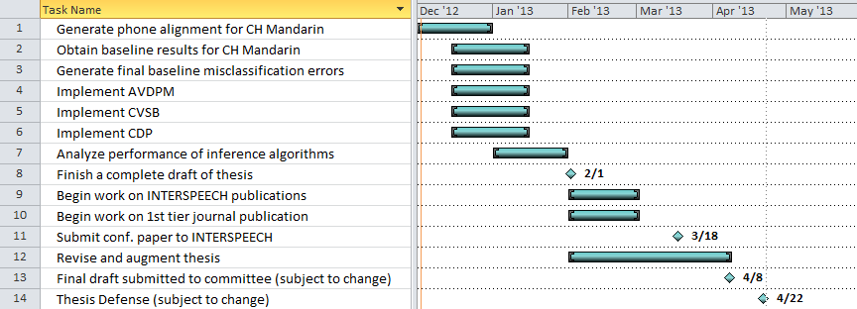
Timeline of Future Work:

Slide 29
Acknowledgements
Thanks to my committee for all of the help and support:
Dr. Iyad Obeid
Dr. Joseph Picone
Dr. Marc Sobel
Dr. Chang-Hee Won
Dr. Alexander Yates
Thanks to my research group for all of their patience and support:
Amir Harati
Shuang Lu
The Linguistic Data Consortium (LDC) for awarding a data scholarship to this project and providing the lexicon and transcripts for Call Home Mandarin.
Owlsnest¹
1. This research was supported in part by the National Science Foundation through Major Research Instrumentation Grant No. CNS-09-58854.

Slide 30
Brief Bibliography of Related Research
[1] Bussgang, J. (2012). Seeing Both Sides. Retrieved November 27, 2012 from http://bostonvcblog.typepad.com/vc/2012/05/forget-plastics-its-all-about-machine-learning.html
[2] Ng, A. (2012). Machine Learning. Retrieved November 27, 2012 from https://www.coursera.org/course/ml
[3] K. Kurihara, M. Welling, and N. Vlassis, “Accelerated variational Dirichlet process mixtures,” Advances in Neural Information Processing Systems, MIT Press, Cambridge, Massachusetts, USA, 2007 (editors: B. Schölkopf and J.C. Hofmann).
[4] K. Kurihara, M. Welling, and Y. W. Teh, “Collapsed variational Dirichlet process mixture models,” Proceedings of the 20th International Joint Conference on Artificial Intelligence, Hyderabad, India, Jan. 2007.
[5] Picone, J. (2012). HTK Tutorials. Retrieved from http://www.isip.piconepress.com/projects/htk_tutorials/
[6] Harati Nejad Torbati, A. H., Picone, J., & Sobel, M. (2012). Applications of Dirichlet Process Mixtures to speaker adaptation. 2012 IEEE International Conference on Acoustics, Speech and Signal Processing (ICASSP) (pp. 4321–4324). Philadelphia, Pennsylvania, USA: IEEE. doi:10.1109/ICASSP.2012.6288875
[7] Frigyik, B., Kapila, A., & Gupta, M. (2010). Introduction to the Dirichlet Distribution and Related Processes. Seattle, Washington, USA. Retrieved from https://www.ee.washington.edu/techsite/papers/refer/UWEETR-2010-0006.html
[8] D. M. Blei and M. I. Jordan, “Variational inference for Dirichlet process mixtures,” Bayesian Analysis, vol. 1, pp. 121–144, 2005.
[9] Zografos, V. Wikipedia. Retrieved November 27, 2012 from http://en.wikipedia.org/wiki/File:3dRosenbrock.png
[10] Rabiner, L. (1989). A Tutorial on Hidden Markov Models and Selected Applications in Speech Recognition. Proceedings of the IEEE, 77(2), 879–893. doi:10.1109/5.18626
[11] Schalkwyk, J. Overview of the Recognition Process Retrieved December 2, 2012 from http://www.cslu.ogi.edu/toolkit/old/old/version2.0a/documentation/csluc/node3.html
[12] Quintana, F. A., & Muller, P. (2004). Nonparametric Bayesian Data Analysis. Statistical Science, 19(1), 95–110. doi:10.1214/088342304000000017
[13] Picone, J., Harati, A. (2012). Applications of Dirichlet Process Models to Speech Processing and Machine Learning. Presentation given at IEEE Nova. Virginia
[14] Teh, Y. W. (2007) Dirichlet Processes: Tutorial and Practical Course. Retrieved November 30, 2012 from http://videolectures.net/mlss07_teh_dp/

