Slide 1


A MULTI-AGENT BASED APPROACH
FOR SOLVING
THE REDUNDANCY ALLOCATION PROBLEM
Zhuo Li
Dr. Li Bai (Advisor)
Dr. Joseph Picone (Committee Member)
Dr. Saroj Biswas (Committee Member)
May-2011

Slide 2
Presentation outlines:
Introduction and background
    RAP applications
    Problem definition and formulation
    Literature review
Preliminary investigation
Proposed approach
Comparison of results
Summary and conclusion

Slide 3
Introduction
Problem classification:
RAP(redundancy allocation problem) is a type of combinatorial optimization problems. _{[1]}
[1]. David W. Coit and Alice E. Smith. Reliability optimization of serial-parallel systems using a genetic algorithm. IEEE Transactions on reliability, 45(2):254-266, JUNE 1996

Slide 4
Introduction
Combinatorial Optimization Problems
Assignment problem
  Quadratic assignment problem (QAP)
  Generalized assignment problem (GAP)
  Frequency assignment problem (FAP)
  Traveling salesman problem (TSP)
  Redundancy allocation problem (RAP)
Set problem
  Set covering problem(SCP)
  Set partition problem (SPP)
  Weight constrained graph tree partition problem (WCGTPP)
  Arc-weighted l-cardinality tree problem (AWlCTP)
  Multiple knapsack problem (MKP)
  Maximum independent set problem (MIS)

Slide 5


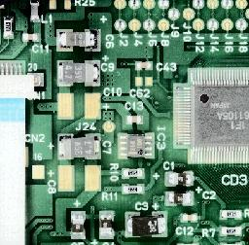
Introduction
Applications of redundancy allocation
♦ Circuit design
♦ Power plant components replacement
♦ Consumer electronics industry
♦ etc.
Notes:
First, lets see what the RAP is and some of its applications. It is a mathematical model abstracted from series-parallel system design

Slide 6
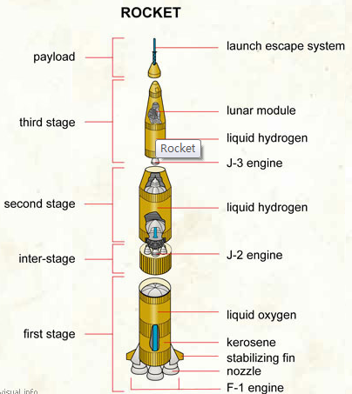
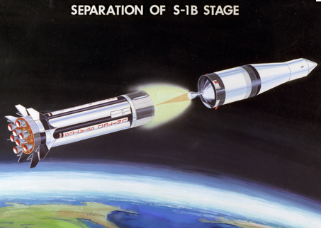


Introduction
Redundancy Example 1: Rocket
Reliability
Notes:
As we know, most rockets have 3 or 4 stages. These stages are connected in serial, and inside each of these stages, there are redundant components with same functionality to provide higher reliability of the launching.

Slide 7

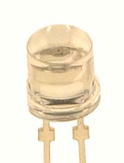

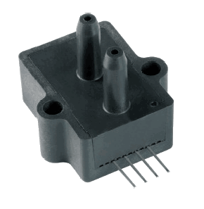

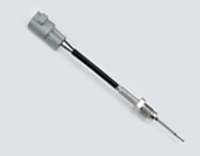
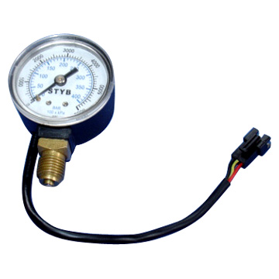
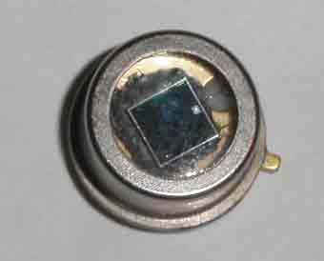
Introduction
Redundancy Example2: sensor network
Monitor the environment
Temperature sensor
Pressure sensor
Light
sensor
Photocell
Photodiode
Notes:
Designers may deploy thousands of functionally identical sensors to a building or a dam because after construction, the buildings are sealed with cement where it is extremely hard to replace the broken sensors by reconstructing. That’s why people need to put these sensors all in once with to high probability.

Slide 8
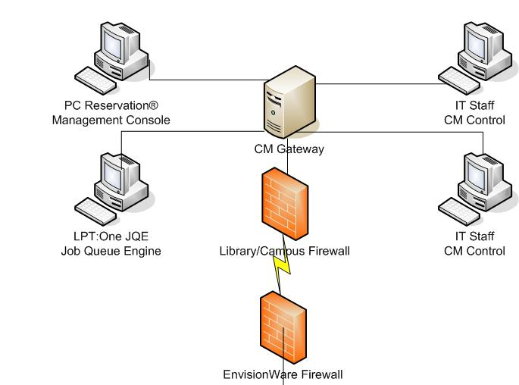








Introduction
RAP Example3: server system
User info
Database
Service
Software
storage
Gateway
facilities
Notes:
For example, a portal website like Yahoo which provides highly integrated services, may separate the business of downloading, email service, query service, etc, onto different servers.
Google even use 3 strategies for power – grid, generator, battery. As reported in their technical paper.

Slide 9
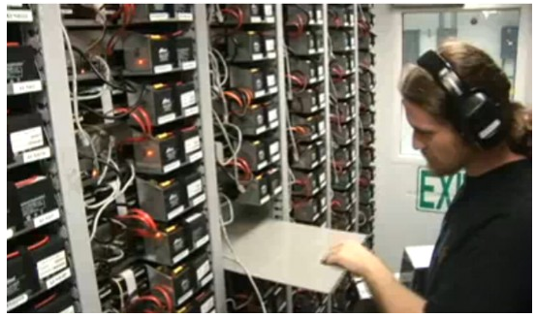
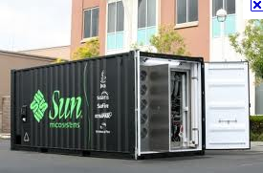


Introduction
Google Data Container Center
Notes:
They can’t afford the system crashing and losing users’ data or suspend service.
This is the inside view of the container.

Slide 10
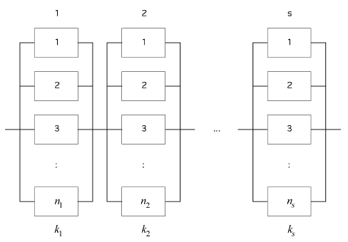
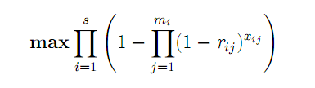
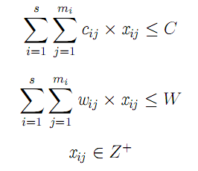
Formulation
Fig.1 A series-parallel system configuration [1]

Slide 11
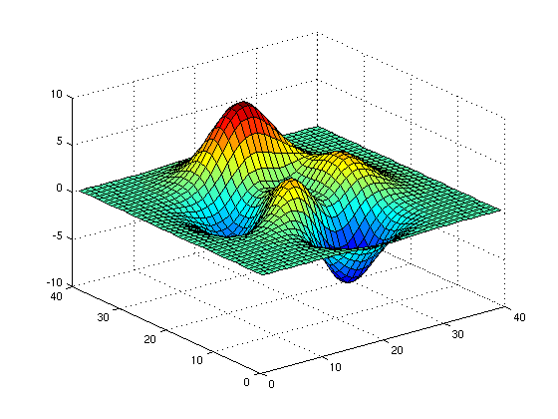
Formulation
Features:
Objective function is non-linear;
Multiple maximal / extreme points;
N-P hard [9]
Difficulty :
Traversal is infeasible and impractical;
Local optimization vs. global optimization
[9] Chern MS. On the computational complexity of reliability redundancy allocation in a series system. Operation Research Letter, 11(5):309-315, JUNE, 1992.
Notes:
The difficulty of solving this problem mainly lies in the following aspects.

Slide 12
Formulation
Terminology:
Redundancy:
  -What?
  Functionally identical units in parallel are referred to as redundant units.
  -Why?
  Adding redundancy is one of several methods of improving system reliability [5]
Redundancy level: the amount of functional identical components
active
cold: component does not fail before it operates
warm: component is more prone to failure before operation
hot: the failure pattern of component does not depend on whether it is idle or in operation
Redundancy strategy
standby

Slide 13
Formulation
Terminology:
Redundancy:
  -What?
  Functionally identical units in parallel are referred to as redundant units.
  -Why?
  Adding redundancy is one of several methods of improving system reliability [5]
Redundancy level: the amount of functional identical components
active
cold: component does not fail before it operates
warm: component is more prone to failure before operation
hot: the failure pattern of component does not depend on whether it is idle or in operation
Redundancy strategy
standby

Slide 14
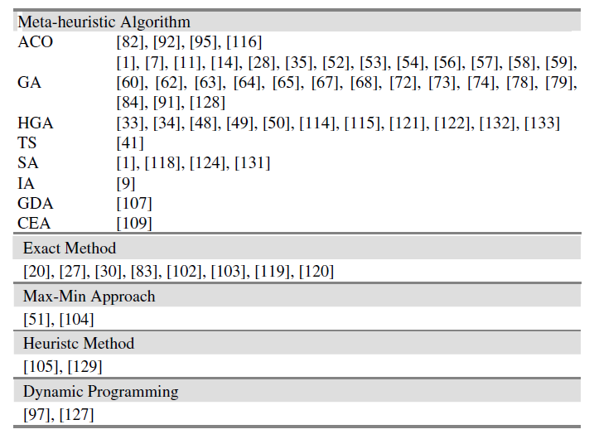
Literature review
Summary of methods in the literature [1]
[1]. Recent Advances in Optimal Reliability Allocation

Slide 15
Literature review
Some approaches and algorithms in the literature
Exact algorithms：
  Nonlinear Integer Programming, Luus, [1]
  Dynamic programming, Fyffe et al. [2] [3]
[1]. Luus. R. Optimization of system reliability by a new nonlinear integer programming procedure. IEEE Trans. Reliab., R(24):14C16, 1975.
[2]. William W. Hines David E. Fyffe and Nam Kee Lee. System reliability allocation and a computational algorithm. IEEE transactions on Reliability, 17(2):64-70, JUNE 1968.
[3]. Misra, K. B.(1971) 'Dynamic Programming Formulation of the Redundancy Allocation Problem',
International Journal of Mathematical Education in Science and Technology, 2: 3, 207 — 215
Notes:
Here, we select some approaches in the literature to show how others solve the RAP in a little bit detail

Slide 16
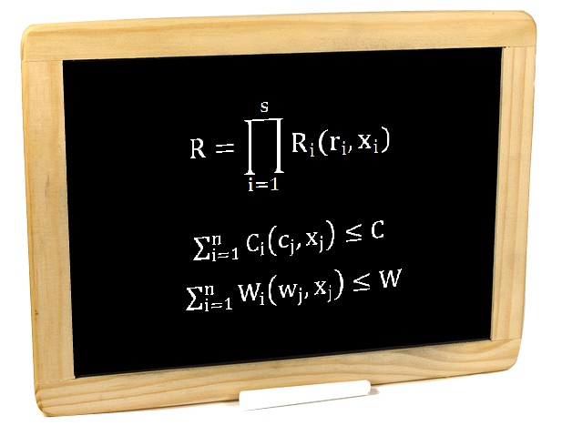



Literature review
Dynamic programming _{[1]}
Reduction in Dimensionality
Lagrange multiplier
Subject to
[2]. William W. Hines David E. Fyffe and Nam Kee Lee. System reliability allocation and a computational algorithm. IEEE transactions on Reliability, 17(2):64-70, JUNE 1968.

Slide 17
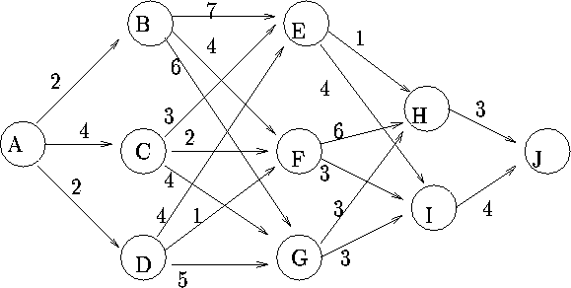
Literature review
Dynamic programming

Slide 18
Literature review
Dynamic programming _{[1]}
Advantages:
When associated results (sub optimums) are useful
Drawbacks:
● Very trivial to pick a right Lagrange multiplier
● Traverse the range for cost constraint
[2]. William W. Hines David E. Fyffe and Nam Kee Lee. System reliability allocation and a computational algorithm. IEEE transactions on Reliability, 17(2):64-70, JUNE 1968.
Notes:
The advantages of this approach is that it generates results which associate with each Lagrange multiplier. So, in industry, when sub optimums or a big pool of alternative solutions are needed, this approach will reveal its superiority.
The drawbacks of this approach are that it is very trivial to pick an appropriate Lagrange multiplier and the right range for cost constraint in each optimization step. There is no easy way to do this but to manually try lots of times. Since the real optimum only appears when the appropriate Lagrange multiplier is hit, the step of varying the Lagrange multiplier needs to be small enough to avoid missing the right one, which make this approach be more computationally complex.

Slide 19
Literature review
Some approaches and algorithms in the literature
Meta-heuristic：
  GA (Genetic algorithm) [3] [4]
  TS(Tabu search) [5] [6] [7]
  ACO (Ant colony optimization) [8]
  VNS (Variable neighborhood search algorithm) [9]
[3]. David W. Coit and Alice E. Smith. Soving the redundancy allocation problem using a combined neural network/genetcic algorithm approach. Computers Ops Res, 23(6): 515-526, 1996.
[4]. David W. Coit and Alice E. Smith. Reliability optimization of serial-parallel systems using a genetic algorithm. IEEE Transactions on reliability, 45(2):254-266, JUNE 1996
[5]. TABU SEARCH IN THE RAP Optimization For multi-State Series-Parallel Systems
[6]. Availability Optimization of Series-Parallel Multi-State Systems Using a Tabu Search Meta-heuristic
[7]. Alice E. Smith, Sadan Kulturel-Konak, and David W. Coit. Effciently solving the redundancy allocation problem using Tabu search. IIE Transactions, 35:515-526, 2003.
[8]. Yun-Chia Liang and A.E. Smith. An ant colony optimization algorithm for the redundancy allocation problem (rap). Reliability, IEEE Transactions on, 53(3):417-423, sep. 2004
[9]. Yun-Chia Liang and Yi-Ching Chen. Redundancy allocation of series-parallel systems using a variable neighborhood search algorithm. Reliability Engineering and System Safety, 92:323-331, 2007.
Notes:
They can become motivations to reduce computation complexity. They becomes heuristic algorithms.

Slide 20
Literature review
GA
Randomly generate initial solutions;
Mutate new solution with existing solutions;
Score the new solution ;
Iterate.
VNS [11]
Build up a neighborhood structure;
Randomly pick a structure as the initial solutions;
Neighborhood search;
Apply penalty function;
Iterate.
[11]. Yun-Chia Liang and Yi-Ching Chen. Redundancy allocation of series-parallel systems using a variable neighborhood search algorithm. Reliability Engineering and System Safety, 92:323-331, 2007.
Notes:
Heuristic search could be solutions.

Slide 21
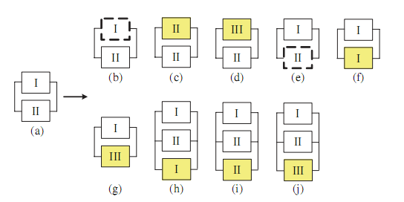
Literature review
A variable neighborhood search(VNS) algorithm
Fig.2 An example of neighborhood structure

Slide 22
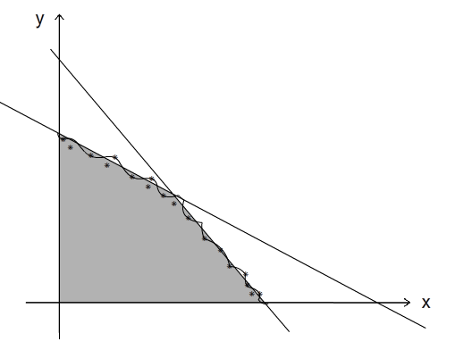




Literature review
Reliability
Increase the magnitude of penalty heavily on infeasible solutions in order to move toward the border of the feasible region;
Otherwise, encourage movement further into the infeasible region.
Penalty function in VNS:
Fig2. A 2-D schematic showing the idea of VNS search direction
*Note: this is just a schematic diagram of the search direction, the RAP has much more dimensions of variables

Slide 23
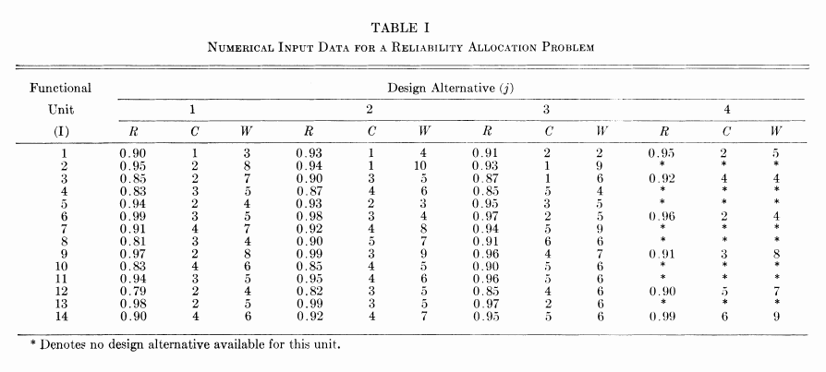
Literature review
Tabel1. Data for test problem 1 [10]
[10]. William W. Hines David E. Fyffe and Nam Kee Lee. System reliability allocation and a computational algorithm. IEEE transactions on Reliability, 17(2):64-70, JUNE 1968.
Notes:
Since I’m

Slide 24
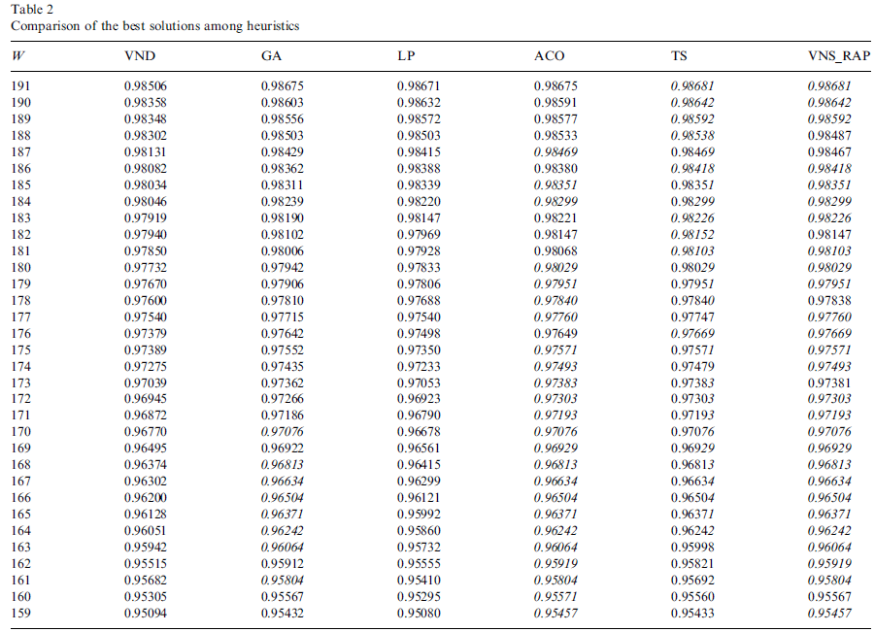
Literature review
Tabel2. Results derived by different heuristics in literature [11]

Slide 25
Preliminary research
Tabel1. data for test problem 1 [10]
Search space: 10³³ [Liang 2004 *]
Supercomputer 360 teraflops/sec
More than 10¹⁰ years
*Yun-Chia Liang and A.E. Smith. An Ant Colony Optimization Algorithm for the Redundancy Allocation Problem (RAP), Reliability, IEEE Transactions on, 53(3):417{423, sep. 2004
Notes:
For a test problem 1, if we are using exact algorithms, the computation time is infeasible.

Slide 26

Preliminary research
48 types of components. Pick no more than 40 components.
The number of non-negative integer solutions of
x₁ + x₂ + …… + x₄₈ ≦ 40
Component type | 1 | 2 | 3 | 4 | 5 | 6 | 7 | 8 | …… | 46 | 47 | 48
amount | 1 | 0 | 2 | 0 | 1 | 0 | 1 | 0 | …… | 0 | 2 | 0
40 ones(1) and 47 starts (*)

Slide 27
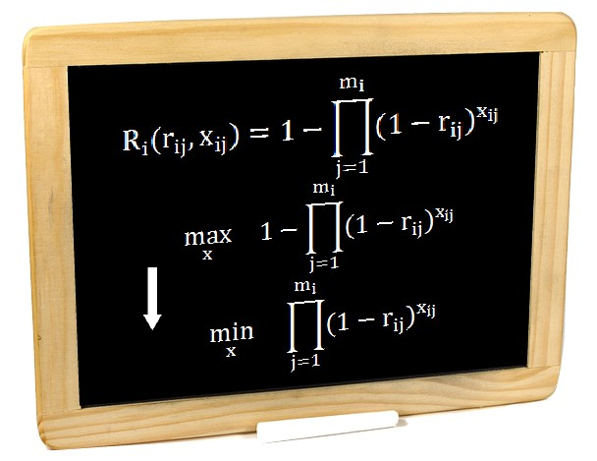


Preliminary research
Step I: Decomposition
(convert to small scale linear programming problem)
…..
Independent *
* This is a commonly accepted assumption in the literature

Slide 28

Preliminary research
Step I: Decomposition
(convert to small scale linear programming problem)
…..
ln

Slide 29
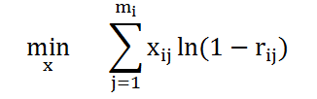

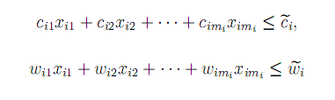
Preliminary research
For each subsystem, the objective function becomes:
Subject to
Tiny scale linear
programming problem
Tools available: Cplex, Matlab LP function, etc.

Slide 30
Preliminary research
For subsystem 1, the problem becomes:
min x₁ ln0.1 + x₂ ln0.07 + x₃ ln0.09 +x₄ ln0.05
Subject to x₁ + x₂ + 2x₃ + 2 x4 <=15
3x₁ + 4x₂ + 2x₃ + 5x4 <= 20

Slide 31


Preliminary research
Step II:
      Generating a good initial solution
      (Evaluation of the cost-efficiency of a component)
        R/C
        R/W
        R/(C+W)
        C/W -> C_{total}/ W_{total} (cost tight & weight tight)
Notes:
To eliminate some unnecessary search

Slide 32
Preliminary research
Cost-efficiency of a component
Reliability | Cost | weight
0.90 | 1 | 3
0.99 = 1-(1-0.90)² | 2 | 6
0.95 | 2 | 5
Notes:
As we can see that choose items appropriately, we need not iterate all possible combinations.

Slide 33

Preliminary research
Bottleneck situation
1 × 1 × 1 × 1 × 0.95 = 0.95
Notes:
Also, we need to make sure all subsystems will have high reliability. If any one subsystem with low reliability, it will become a bottleneck of the whole system.

Slide 34
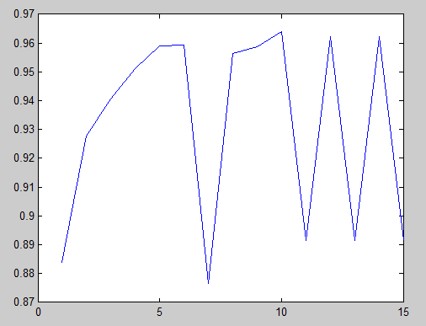
Preliminary research
reliability
Iteration rounds
Fig. A schematic showing that the search stagnates at some local optimal

Slide 35
Proposed approach
Goal:
Develop a decentralized agent based algorithm to solve the RAP.
Motivation:
Parallel computing,
Improve current solution,
Simplify the decision process.
Notes:
In this research, we will develop a decentralized approach.

Slide 36
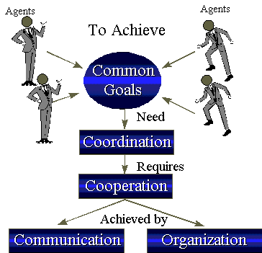
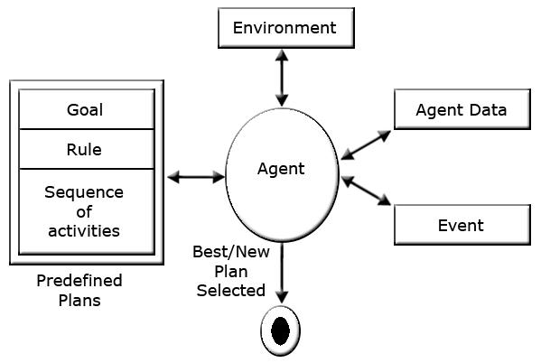
Proposed approach
Multi-agent concept
Notes:
From top level, here is what a multi-agent system will try to achieve through coordination and cooperation. Multi-agent systems, referred to as "self-organized systems“, is a system consist of multiple autonomous entities having different information and/or diverging interests.
This behavior is called “BDI” (belief, desire, intention).
For each agent, it will has certain goal and rule simply for it to follow based on agent data (belief). The goal is to reduce computation complexity by implement simple logic computation in each agent level.

Slide 37





Proposed approach
The big picture
Agent schematic
…..
Multi- agent platforms
Jade, 3APL, etc.
CBA(Broker Agent)
Notes:
If we think each subsystem as an agent, we will have a multi-agent system. For a common good, they will try to achieve a higher reliability system.

Slide 38
Proposed approach
Agent1
Agent2
Agent-s
Broker Agent
Each agent sends message to every other agent;
Each agent receives messages from every other agent;
Each agent calculates feasible trades and sends the best one to CBA;
CBA receives trade messages from all agents;
Evaluates contribution of trades to the whole system reliability;
Picks the highest one, perform the trading and informs involved
two agents to update performance sets.
Pick max
Making decision

Slide 39
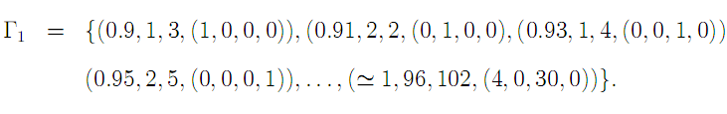
Proposed approach
Data sets (agent’s belief)
…
…
…
…
…
Notes:
For each agent we will have its belief for the database for its own reliability.

Slide 40
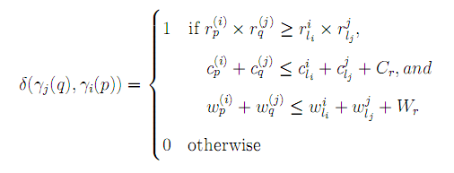
Proposed approach
The trading function

Slide 41
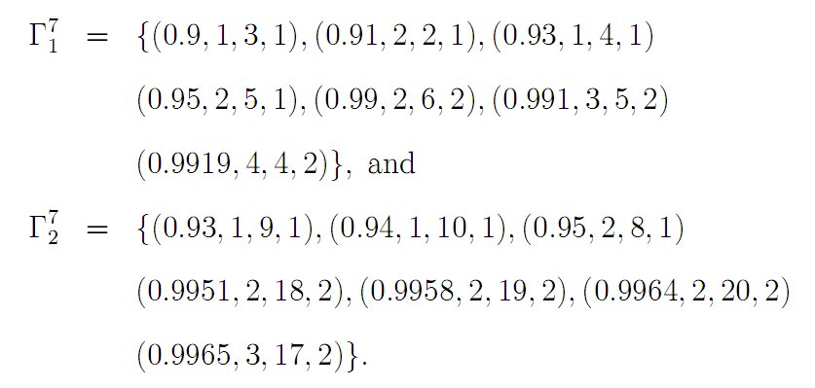
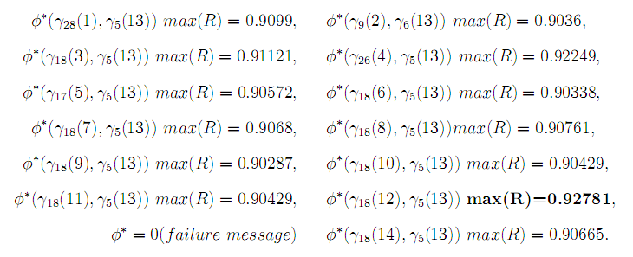
Proposed approach
Message format
Subsystem agent
CBA

Slide 42
Proposed approach
Agent trading procedure:
Agent1
Agent2
Agent-s
subR | subC | subW | opt Set
0.9996 | 6 | 6 | 3
0.9993 | 3 | 10 | 3
… | … | … | …
subR | subC | subW | opt Set
0.9970 | 3 | 18 | 2
0.9975 | 4 | 16 | 2
… | … | … | …
subR | subC | subW | opt Set
0.9996 | 4 | 10 | 3
0.9994 | 5 | 8 | 3
… | … | … | …
Trading attempt | subC | subW | opt Set
 | 6 | 6 | 3
0.9993 | 3 | 10 | 3
… | … | … | …
Proposed trading
1
2
….
13
Proposed trading
1
2
….
13

Slide 43

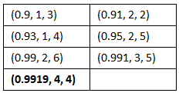
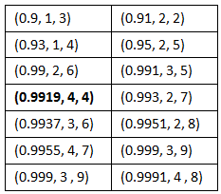
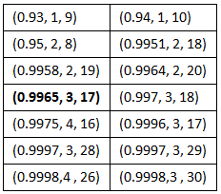
Proposed approach
Agent trading procedure:
Agent1
Agent2
(0.9996, 3, 17)
(0.9996, 3, 17)
(0.99978, 3, 17)
(0.99985 3, 17)
Agent-s

Slide 44
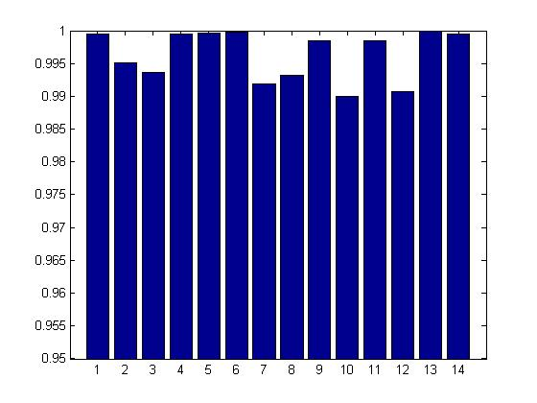
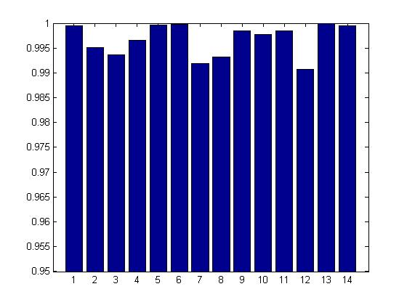
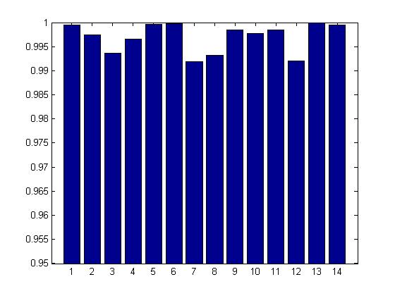
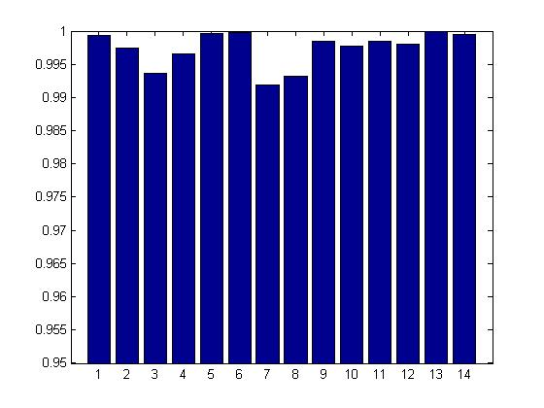
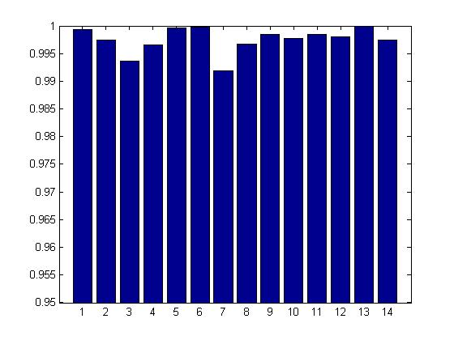
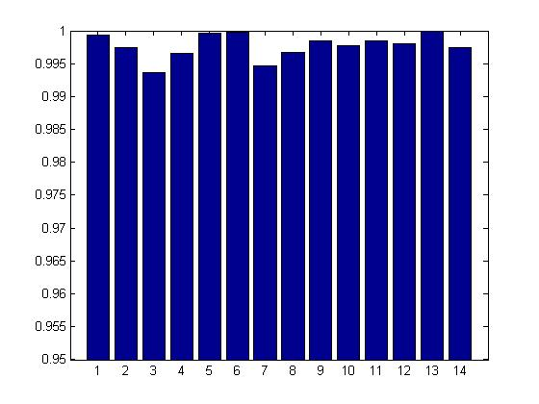
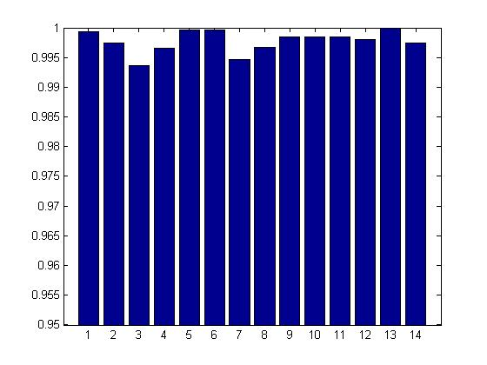
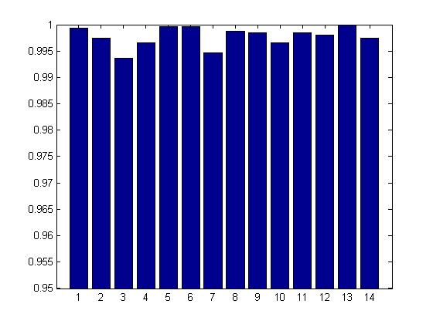
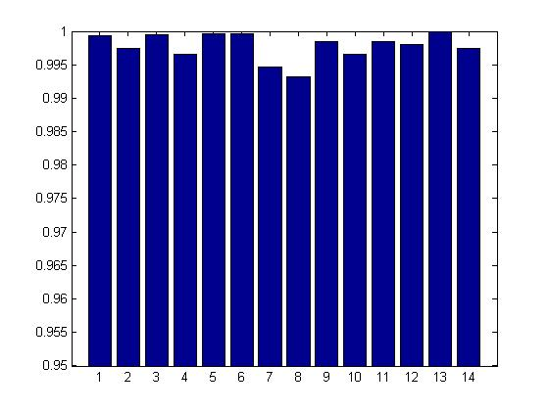
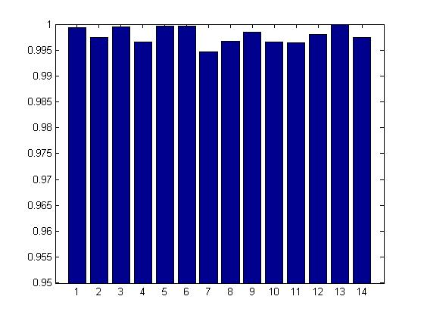
Results
Test problem 1 - Simulation
Subsystem Reliability
R = 0.97076
R = 0.9692
R = 0.9689
R = 0.9688
R = 0.9683
R = 0.9657
R = 0.9641
R = 0.9585
R = 0.9549
Agent index
R = 0.9502

Slide 45
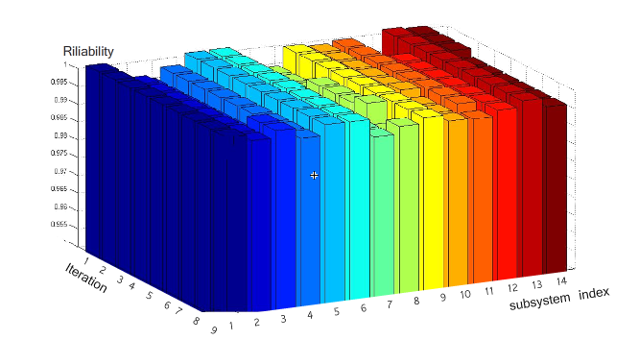
Results
Test problem 1 - Simulation

Slide 46

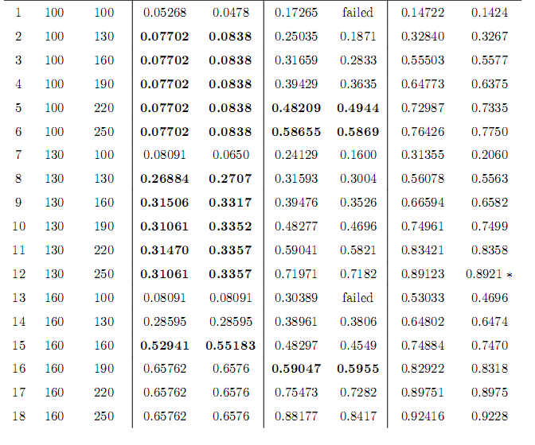
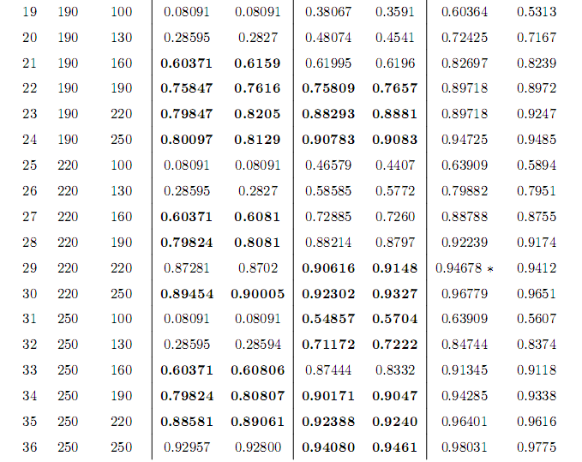
Results

Slide 47
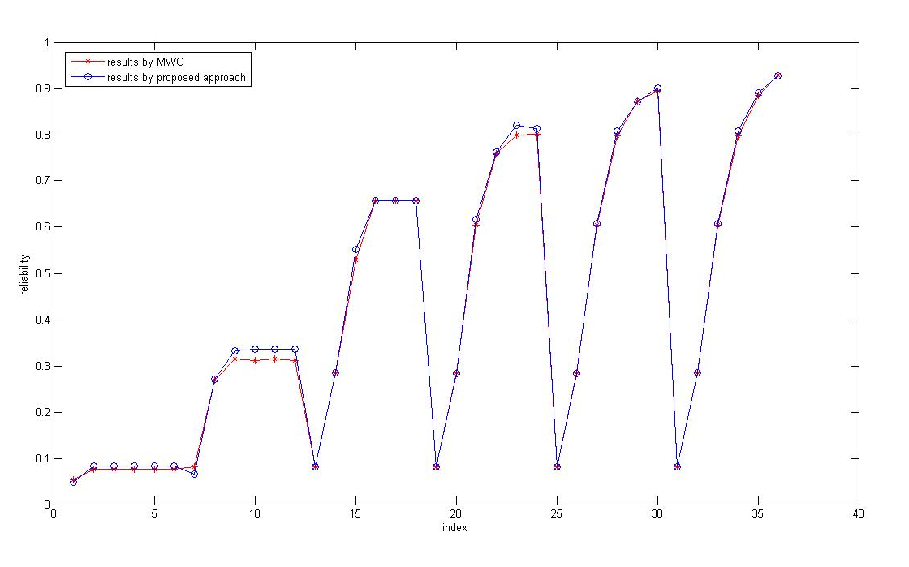
Results
Comparison
Succeeded in 21 out of 36 cases for test problem 2,
with 8 other cases equivalent,
David W. Coit and Abdullah Konak, Multiple Weighted Objectives Heuristic for the Redundancy Allocation Problem, IEEE TRANSACTIONS ON RELIABILITY, VOL. 55, NO. 3, SEPTEMBER 2006

Slide 48
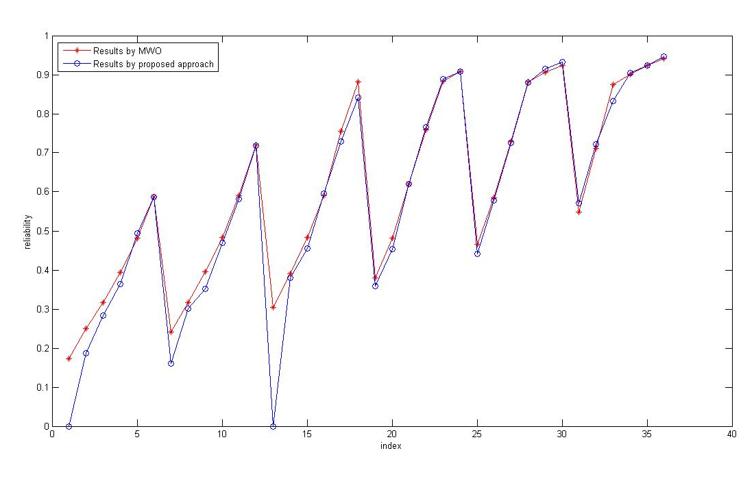
Results
Comparison
Succeeded in 13 out of 36 cases for test problem 3.
David W. Coit and Abdullah Konak, Multiple Weighted Objectives Heuristic for the Redundancy Allocation Problem, IEEE TRANSACTIONS ON RELIABILITY, VOL. 55, NO. 3, SEPTEMBER 2006

Slide 49
Trouble shooting
Subsystems 1~10
0.9 5 7 1
0.91 6 4 1
0.92 10 1 1
0.92 3 9 1
0.92 2 4 1
0.9936 4 8 2
0.9995 6 12 3
1 8 16 4
0.91 1 9 1
0.92 9 1 1
0.93 5 6 1
0.93 7 4 1
0.9 9 3 1
0.92 7 5 1
0.93 5 7 1
0.93 1 9 1
0.9 6 4 1
0.91 9 2 1
0.91 5 7 1
0.93 1 10 1
0.9 4 7 1
0.9 7 5 1
0.91 2 8 1
0.92 9 1 1
0.9 9 3 1
0.9 6 4 1
0.9 5 7 1
0.93 1 10 1
0.91 7 5 1
0.92 9 3 1
0.92 5 7 1
0.92 2 8 1
0.9 8 2 1
0.9 1 8 1
0.91 4 7 1
0.93 6 5 1
0.91 9 1 1
0.91 5 7 1
0.92 7 5 1
0.93 1 10 1
Notes:
In this case, the used cost exceeds the cost constraints directly, there is no room to share cost or weight quota without losing reliability.

Slide 50
Trouble shooting
Subsystems 11~20
0.9 6 4 1
0.91 9 2 1
0.93 4 6 1
0.93 1 10 1
0.9 8 1 1
0.9 7 4 1
0.9 1 9 1
0.93 5 6 1
0.9 4 6 1
0.91 6 4 1
0.92 10 1 1
0.93 1 9 1
0.91 9 1 1
0.91 6 5 1
0.92 5 6 1
0.93 2 10 1
0.9 9 3 1
0.91 6 5 1
0.93 4 7 1
0.93 2 8 1
0.9 4 6 1
0.91 10 3 1
0.91 2 9 1
0.93 6 4 1
0.9 5 6 1
0.9 2 10 1
0.92 9 3 1
0.92 7 4 1
0.9 6 5 1
0.91 9 2 1
0.91 1 8 1
0.92 5 7 1
0.9 5 6 1
0.9 7 4 1
0.92 3 8 1
0.93 8 3 1
0.9 6 5 1
0.91 5 7 1
0.91 1 9 1
0.93 8 2 1
Cost: 122
Weight: 88

Slide 51
Conclusion
Time complexity
Agent: O((l_{i})²(s-1)iteration)
CBA：s multiplications
Independent and autonomous.
Notes:
The change of an agent does not affect the overall system

Slide 52
Summary
● Investigated algorithms in the literature;
● Proposed an agent prototype for solving the RAP;
● Tested it on the test problem and analyzed its performance
● Compared the results with the results in the literature.

Slide 53
Future work
● Parallel computing on multiple devices;
● Asynchronization and message loss;
● Variant RAPs.

Slide 54
References
[1]. An Ant Colony Optimization Algorithm for the Redundancy Allocation Problem (RAP)
[2]. TABU SEARCH IN THE RAP Optimization For multi-State Series-Parallel Systems
[3]. David W. Coit and Alice E. Smith. Soving the redundancy allocation problem using a combined neural network/genetcic algorithm approach. Computers Ops Res, 23(6):515{526, 1996.
[4]. Availability Optimization of Series-Parallel Multi-State Systems Using a Tabu Search Meta-heuristic
[5]. Alice E. Smith, Sadan Kulturel-Konak, and DavidW. Coit. Effciently solving the redundancy allocation problem using Tabu search. IIE Transactions, 35:515-526, 2003.
[6]. An ACO Algorithm for the RAP
[7]. David W. Coit and Alice E. Smith. Reliability optimization of serial-parallel systems using a genetic algorithm. IEEE Transactions on reliability, 45(2):254-266, JUNE 1996
[8]. Redundancy Allocation for Series-Parallel Systems Using Integer Linear Programming
[9]. Chern MS. On the computational complexity of reliability redundancy allocation in a series system. Operation Research Letter, 11(5):309-315, JUNE, 1992.
[10]. William W. Hines David E. Fyffe and Nam Kee Lee. System reliability allocation and a computational algorithm. IEEE transactions on Reliability, 17(2):64-70, JUNE 1968.
[11]. Redundancy allocation of series-parallel systems using a variable neighborhood search algorithm
[12]. Luus. R. Optimization of system reliability by a new nonlinear integer programming procedure. IEEE Trans. Reliab., R(24):14C16, 1975.

Slide 55
[13]. Yun-Chia Liang and Alice E. Smith. An ant colony optimization algorithm for the redundancy allocation problem. IEEE Transactions on reliability, 53(3):417-423, SEPTEMBER 2004.
[14]. Liang Y-C and Smith AE. An ant system approach to redundancy allocation. Proceedings of the 1999 congress on evolutionary computation Washington DC, USA, page 1478-1484, 1999.
[15]. Yun-Chia Liang and Yi-Ching Chen. Redundancy allocation of series-parallel systems using a variable neighborhood search algorithm. Reliability Engineering and System Safety, 92:323-331, 2007.
[16]. Yi-Chih Hsieh. A linear approximation for redundant reliability problems with multiple component choices. Computer and Industrial Engineering, 44-91C103, 2002.
[17]. David W. Coit and Abdullah Konak, Multiple Weighted Objectives Heuristic for the Redundancy Allocation Problem, IEEE TRANSACTIONS ON RELIABILITY, VOL. 55, NO. 3, SEPTEMBER 2006

Slide 56
Acknowledgement
I would like to express my gratefulness to my academic advisor Dr. Li Bai, my program advisor Dr. Olga Vilceanu, and thesis committee members Dr. Saroj Biswas, and Dr. Joseph Picone.
I would also like to thank Department of Electrical and Computer Engineering, Temple University.
Thanks to all my lab colleagues James Ren, Michael Korostelev, etc.

Slide 57
Thank you!
Questions?

Slide 58
Because of the exponential increase in search space with problem size, heuristics have become a popular alternative to exact methods. Meta-heuristics
Some algorithms are able to find local optimization, however,
global optimization is not guaranteed.
Convergence: An algorithm is convergent if it is able to find the global optimum in a finite time.
In the 2006 TOP500 list, which ranks supercomputers by speed, the top three supercomputers are as follows:
IBM's BlueGene/L - 360 teraflops
IBM's BGW - 115 teraflops
IBM's ASC Purple - 93 teraflops

Slide 59

Proposed approach
Step II:
Create agents and incorporate trading behavior
Multi-agent system
Multi-agent systems, referred to as "self-organized systems“, is a system consist of multiple autonomous entities having different information and/or diverging interests.
This behavior is called “BDI” (belief, desire, intention).
* Figure cited from “Google-pacman”

Slide 60

Literature review
Use a shaking operator to provide an opportunity to escape from local optimums while a deterministic algorithm has no such luck.
Penalty function in VNS:
Otherwise

