Slide 1
Investigating the Robust Ability of Classic, Modern, and Contemporary Brain Machine Interface Decoders
A Thesis Proposal Submitted to: Temple University Graduate Board
In Partial Fulfillment of the Requirements of the Degree: MASTER OF SCIENCE IN ELECTRICAL ENGINEERING
Michael Samarco

Slide 2
Background

Slide 3
What is a Brain Machine Interface (BMI)?
A brain-machine interface (BMI) is a system in which the brain’s electrical signals, or neuronal activity, are acquired and processed directly by a computer or other external device(s).
Tap into the brain via:
Electrocorticogram (ECoG)
Single-Unit/Neuron
Electroencephalograms (EEG)
Peripheral Nerve Activity
Notes:
Allows us to get better insight into how the brain works (practical tool)
Prosthesis (extends hope and independence to paraplegic individuals' victim of disease or traumatic accidents)
Electrocorticography (ECoG), a type of intracranial electroencephalography (iEEG), is a type of electrophysiological monitoring that uses electrodes placed directly on the exposed surface of the brain to record electrical activity
Peripheral nerves branch throughout body from spinal cord

Slide 4
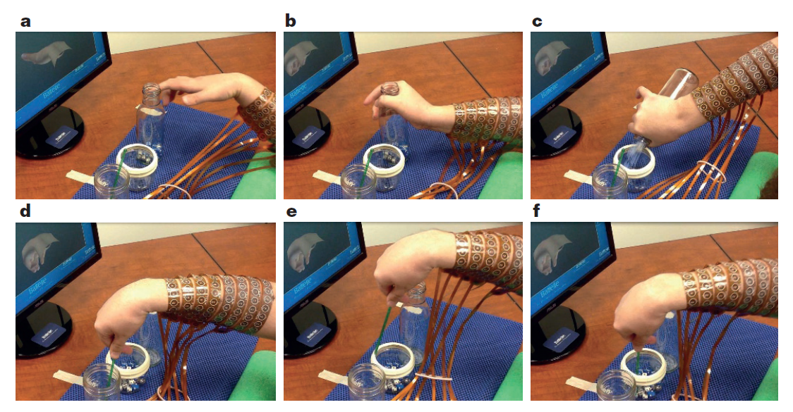
Possibilities (Example Use Case)
Muscle Activation using intracortical signals from a BMI system (Bouton et al., 2016)
Demonstrated successful hand/arm gestures with overall accuracy of their system showing ~70% (at $P<0.01$ by permutation test)
Image from Bouton et al., 2016
Notes:
Bouton tasks (grasp and pour and stir [dice]) and gestures
(human with quadriplegia)

Slide 5
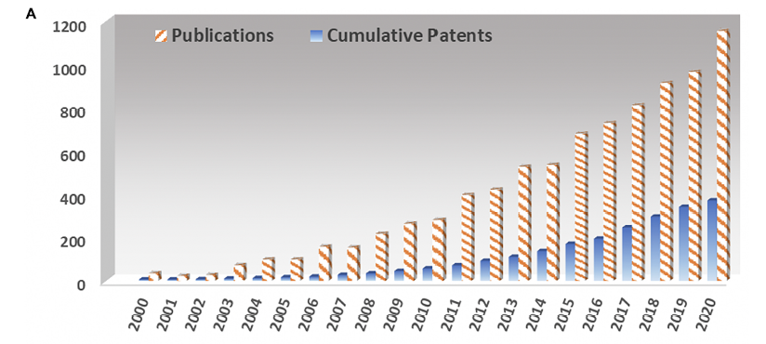
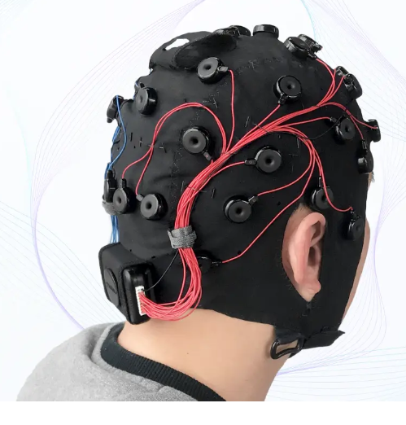
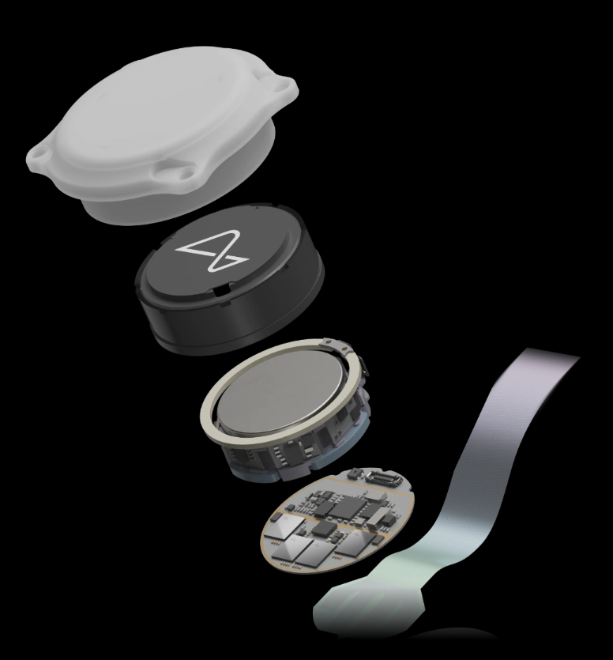
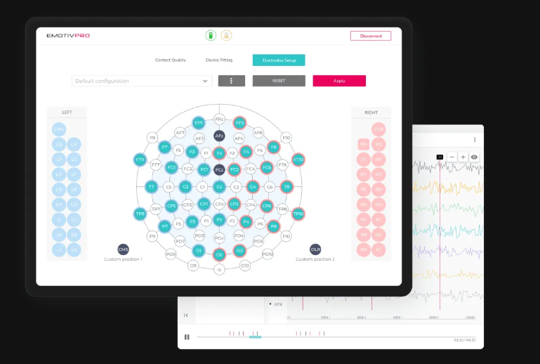
BMI Relevancy
Image from Salahuddin and Gao, 2021
EPOC X. EMOTIV. Wireless EEG Headset. (https://www.emotiv.com/epoc-x/#)
EmotivPRO. Licensed EEG Software. (https://www.emotiv.com/emotivpro/)
Flex 2.0 Saline. High-Density Saline EEG Head Cap. (https://www.emotiv.com/flex-saline/)
N1 Implant. Neuralink. BMI Implant. (Neuralink)
Neuralink (Fremont, CA)
Emotiv Devices (San Francisco, CA)
BMI Publications over the years
Neuralink (Fremont, CA)
Emotiv (San Francisco, CA)
Notes:
Neuralink is beginning there first in-human trials (Neuralink’s First-in-Human Clinical Trial is Open for Recruitment | Blog | Neuralink) as of September 2023 (awarded by FDA)
“N1 Implant is cosmetically invisible and is intended to record and transmit brain signals wirelessly to an app that decodes movement intention. The initial goal of our BCI is to grant people the ability to control a computer cursor or keyboard using their thoughts alone.”
Emotiv has licensed software (e.g. EmotivPro) for EEG research that features cloud computing and real time EEG processing

Slide 6
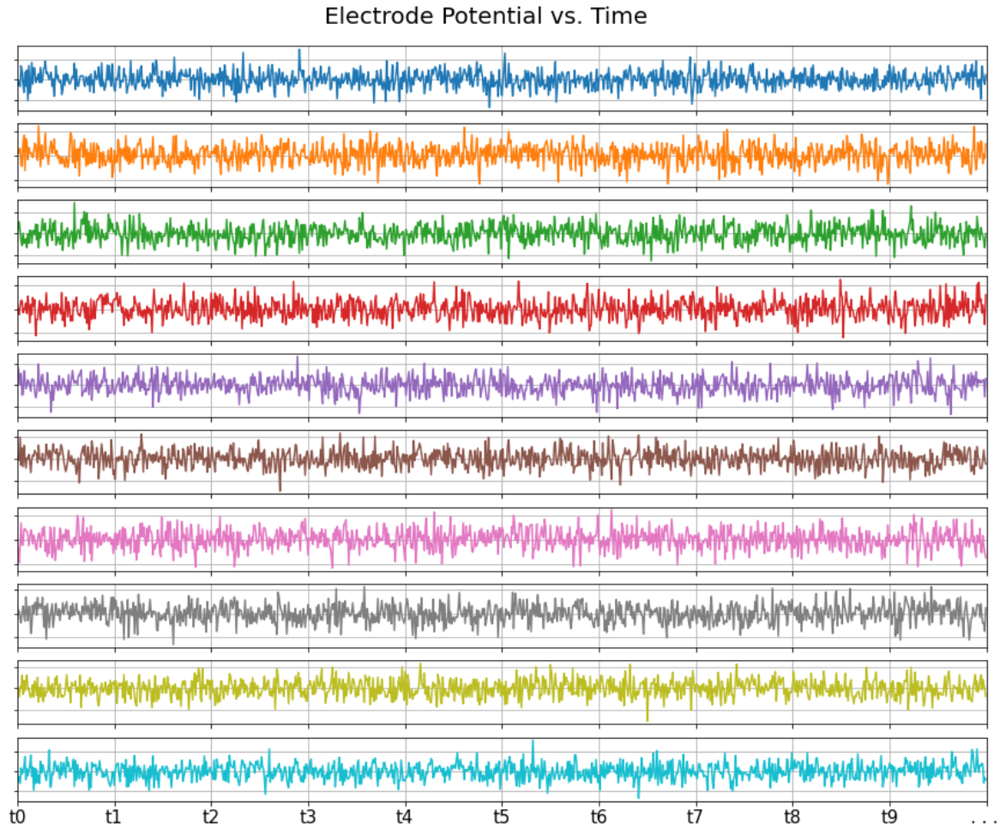
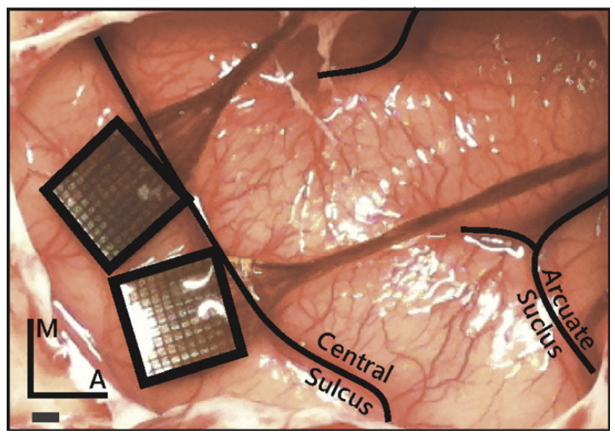
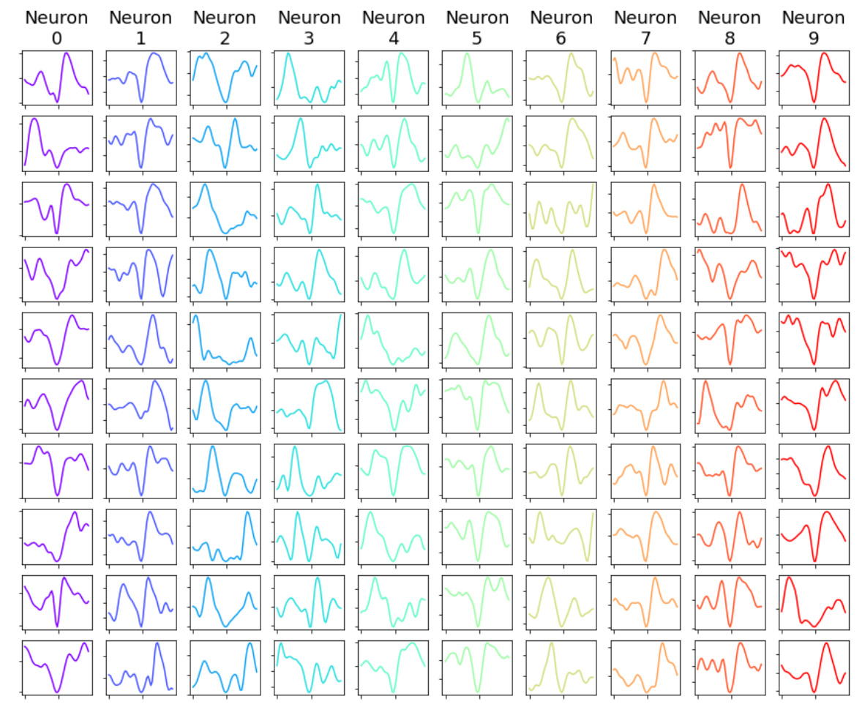
Overview of a Typical BMI System
gain
(d) Pre-Amplifier
(photo from Rajan et al., 2015)
ADC
…
filter
0100011101…
0001100011…
0010001111…
1110000110…
0000111010…
0011001101…
(c) Raw Electrode Signals (Potential vs. Time)
(e) Processing System
…
(b) Measurement Source (Brain)
Control Signal
Digitized Waveforms
(f) Algorithms
[${\hat{p}}_{x}$,${\hat{p}}_{y}$,${\hat{v}}_{x}$,${\hat{y}}_{y},{\hat{a}}_{x}$,${\hat{a}}_{y}$]
Spike Detection
Decoder
…
(g) Device Under Control
(a) Subject
Spike Sorting
…
Notes:
Figure 1. This is an overview of a typical brain machine interface system. (a) The subject has chronically implanted electrodes in its brain to record neural activity. The subject can be a person or non-human primate. (b) An example photo of micro-electrode arrays implants in brain tissue (photo from Rajan et al., 2015). Specifically, this image shows Utah arrays (Blackrock Neurotech (New York City, New York)). (c) Each electrode measures raw electrical potential from the neurons that neighbor it. (d) A pre-amplifier, filters and amplifies as well as samples, or digitizes, the raw electrode signals. This conditions the signal for the processing system. (e) The processing system processes the digitized electrode signals and runs application algorithms on the data to achieve a task. (f) The algorithms typically consist of a spike detection phase, followed by (or optionally skipped) a spike sorting/classification algorithm. The “spiked” data is asynchronous and usually needs to be time aligned, or binned. The binned spike data then feeds the main application algorithm/model which essentially decodes that data and transforms it to an equivalent action, task, and/or state of a system. (g) Finally, the prediction from the decoder algorithm can be used to update the state of a device (for example, control position of a prosthesis).
Key Points:
Spike Sorting
Multi-Unit Data
Neural Decoders
Data Collection Issues

Slide 7
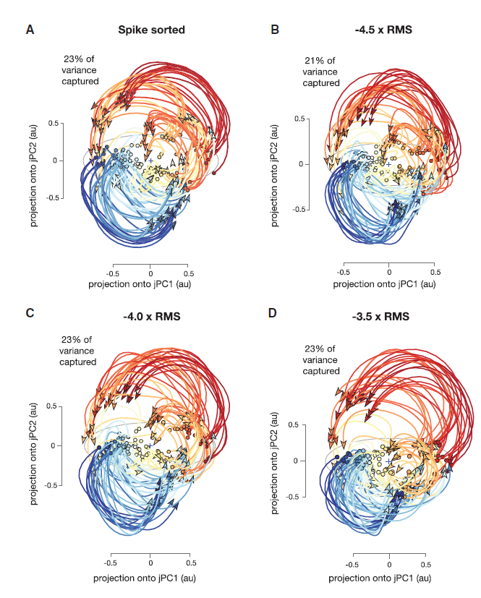
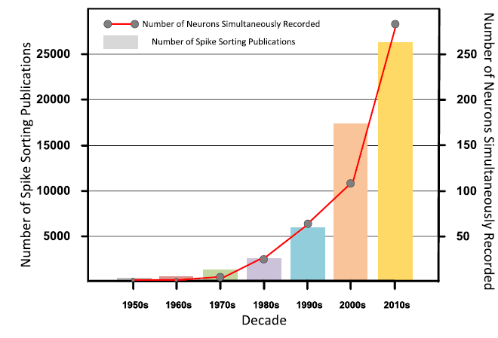
Neural Data Formats
Image from Zhang et al., 2023
Image from Trautmann et al., 2019
Spike Sorting is a common process employed in BMI systems
Widely Used
Three step process: Adds Complexity, Adds a layer of training, Issue for embedded system design (hardware), Sometimes requires manual calibration
An alternative approach to spike sorting is to use Multi-Unit Data
Notes:
Three step process is: thresholding, feature learning, classification/clustering
Some Studies suggest multi-unit still retains the features associated with tasking (very similarly)

Slide 8
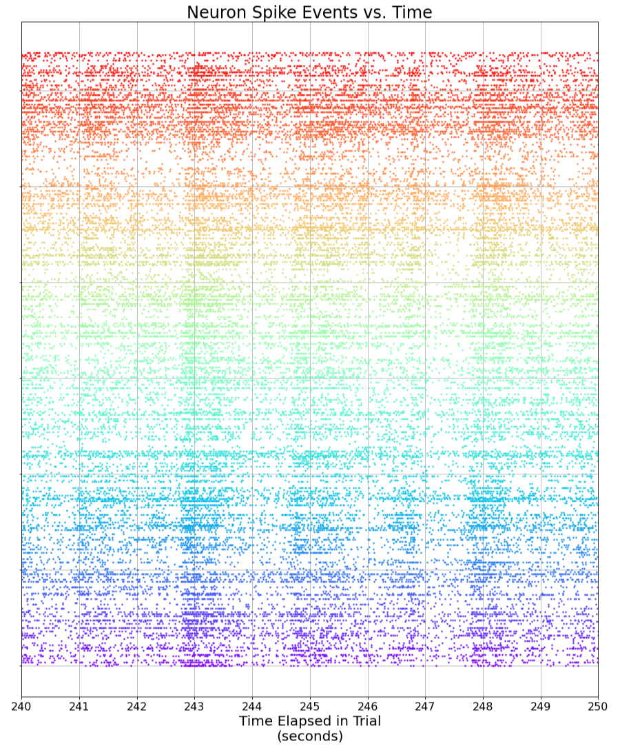
Neural Decoders
t1
t2
t3
…
t4
t5
t6
…
…
…
…
…
…
…
Training
Supervised vs. Unsupervised learning
Binning
Overall Goal
Thought
$$x_{t+1}=x_{t}A^{T}+w$$
$$r_{t}=x_{t}H^{T}+q$$
Action/Task
Model
This plot is over a snippet of time for a trial in the O’Doherty et al., 2020 dataset. In this plot, each spike sorted neuron is offset vertically. The markers across the horizontal indicate when a spike detected event occurred for a neuron corresponding to the vertical position of those horizontal mark sets. These spike recordings are asynchronous.
Notes:
Note on binning: online control has shown good results with 16 ms bins [15] in Makin

Slide 9
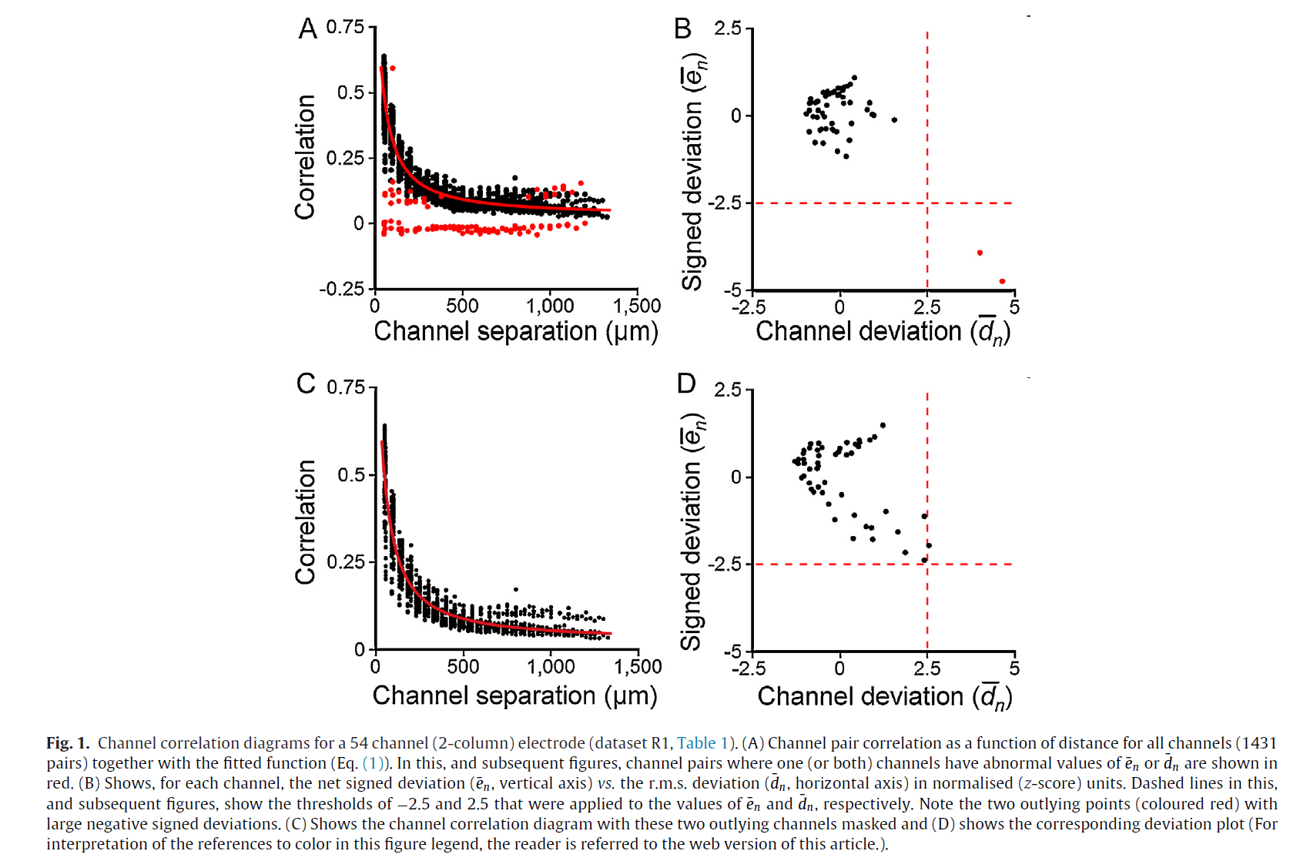
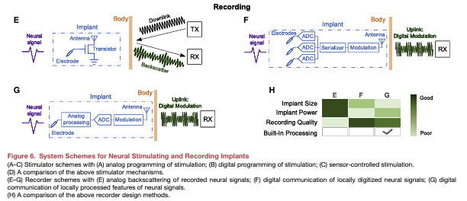
Issues in Data Acquisition
Image from Swindale and Spacek, 2016
Image from Luan et al., 2020
Electrodes can shift, become detached, experience short circuiting, or be open circuited
System can be wireless at any point (image top right)
Wireless systems are subject to interference, poor reception, etc.
Research being done in integrity fault detection (top left image)
Masking faulty channels is a possibility for performance upgrade
Notes:
“since electrodes detached from their amplifier may broadcast their data intermittently or simply get distorted by noise. For this case, real-time rejection of corrupted channels would be favorable (Swindale and Spacek, 2016; Li et al., 2020a).”
Swindale and Spacek, 2016 conducted a study where they were able to survey multichannel electrode arrays and detect issues in integrity automatically. They demonstrated an improved spike sorting process by masking non-functional channels (or those that appear to be shorted, open circuit, or corrupted in large noisy amplitudes).
Swindale and Spacek: spikes > 500 Hz have correlations that fall off exponentially with physical spacing;
channels with corr -> 0 = non-functional;
corr -> 1 = short
Other deviations can indicate mislabel or alignment issue
Integrity affects spike sorting negatively
Luan reviewed wireless BMIs
Inherent Biological requirement on power (limitation on transmission)

Slide 10
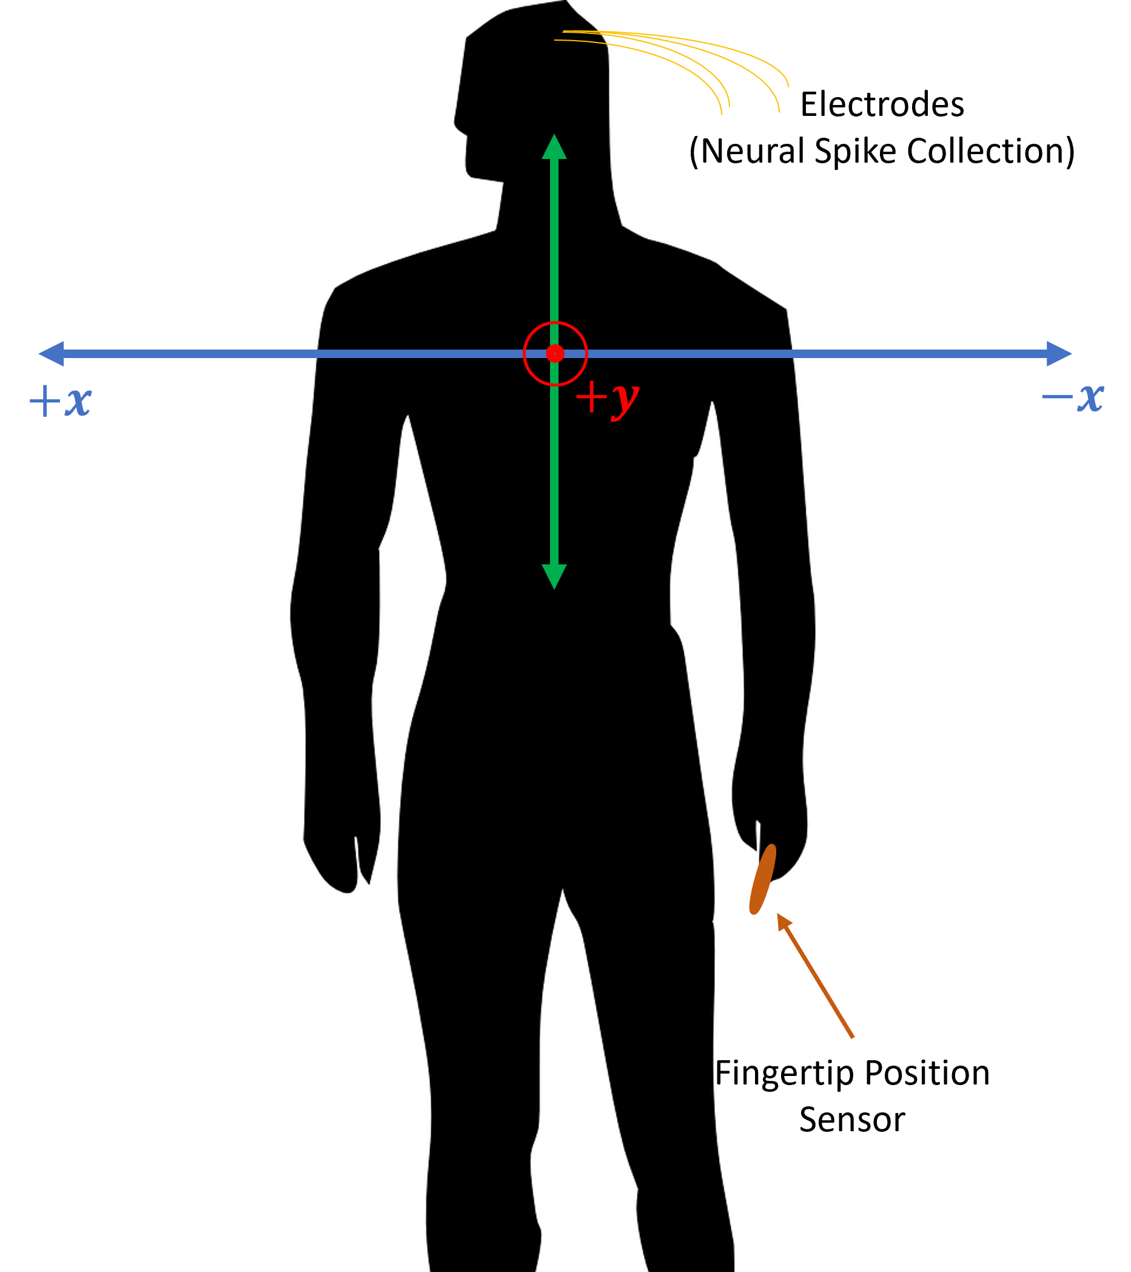
Relevant Work/Experiment
$$r_{t}=\left[r_{t,1},r_{t,2},…,r_{t,M}\right]$$
Makin et al., 2018 published code and datasets from data collected in non-human primate reach trials
Data collection spanned ~11 months (46 diff days) and 2 different subjects
Demonstrated rEFH to significantly outperform the conventional decoders in their tests
Neural data collected was spike sorted
Training was performed in each trial, but training time tested
Tested different bin sizes for binned neural spikes
Tested number of available neurons
$$x_{t}=[p_{x},p_{y},v_{x},v_{y},a_{x},a_{y}]$$
Notes:
Bin sizes are [16 ms. 32 ms, 64 ms, and 128 ms].
Lateral is x and sagittal is y
+x -> reaches to right
+y -> reaches rostral to the subject (in front of face)
Kinematic states sampled at 250 Hz

Slide 11
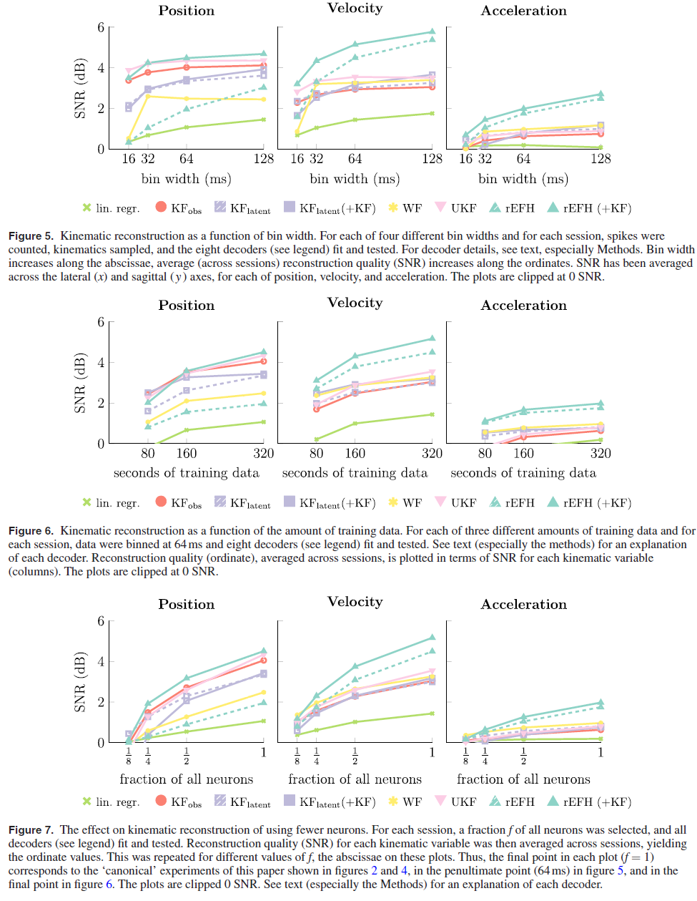
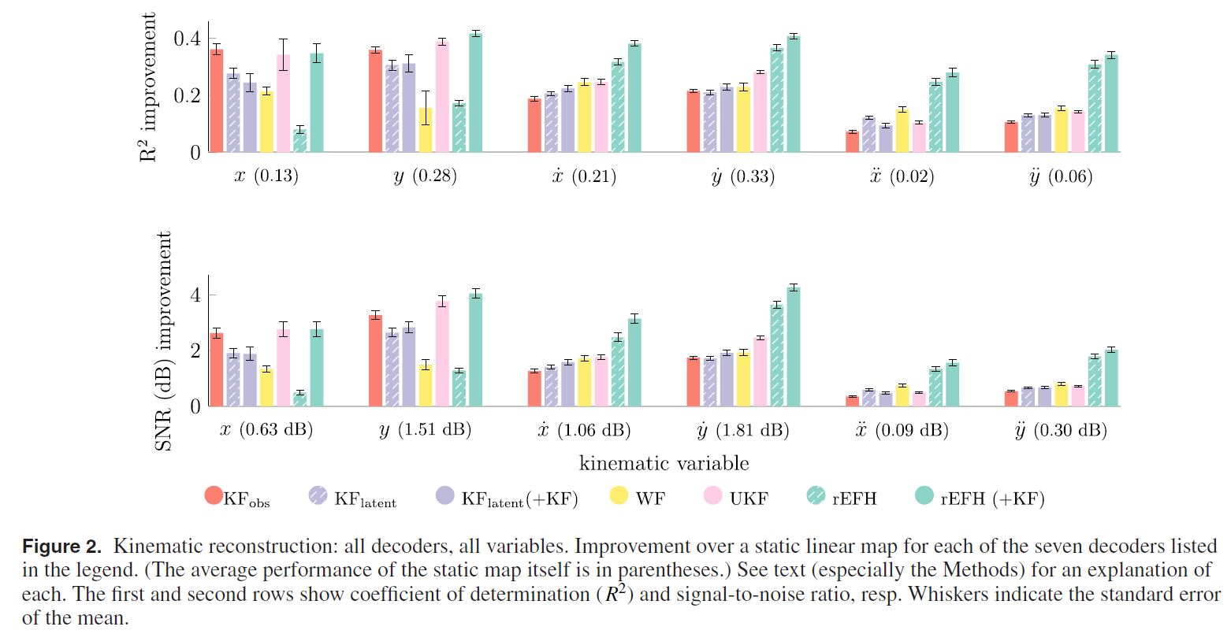
Relevant Work/Experiment
Figures from Makin et al., 2018
Summary of their main experiment (above)
Notes:
KF_lat(+KF) is two-stage KF (first stage produces latent states, second state produces kinematic states
UKF is a non-linear flavor of KF (allows the model to be such)
rEFH(+KF) is a two-stage decoder that treats the generated outputs from the rEFH as noisy, linear observations of the latent, linearly evolving, kinematic state, and therefore as inputs to a KF
rEFH superior to UKF and KF_obs with P < 0.01 for both kinematic variables ($x_{x}$, $x_{y}$) decoding (< 0.01 % prob of null being correct-reject with 99% confidence)
rEFH superior in position reconstruction to Kfobs (p < 0.01). Not distinguishable from UKF (not even at p=0.05
UKF was superior at 16 ms for position (p < 0.01)
Bin Sizes:
rEFH clearly superior velo and accel (and best for all bins [p << 0.01])
Training Data:
rEFH superior at 320 s, but inferior at 80 s (p=0.01) to KF_obs – rEFH has about 4x more params
Number of Neurons:
* rEFH superior to all rivals for velo and accel (p < 0.01), except WF in accel @ f=1/4 (p < 0.05)

Slide 12
Goals

Slide 13
Goals
Reproduce the decoding algorithms and results from Makin et al., 2018 and develop a custom Python library to do so. Publish the custom code online.
Quantify algorithm performances when the data is multi-unit and there are no labels associating neuron “spikes” to any individual neuron.
Explore the concept of transfer learning, in which a quantified is made on how well different algorithms can be trained from just one experimental trial and then used to decode different trials. Transfer learning will be evaluated for single-unit configurations.
Finally, performance will be quantified among the different decoders as they are introduced to more and more neural spike dropouts, or missing spikes.

Slide 14
Implementation

Slide 15
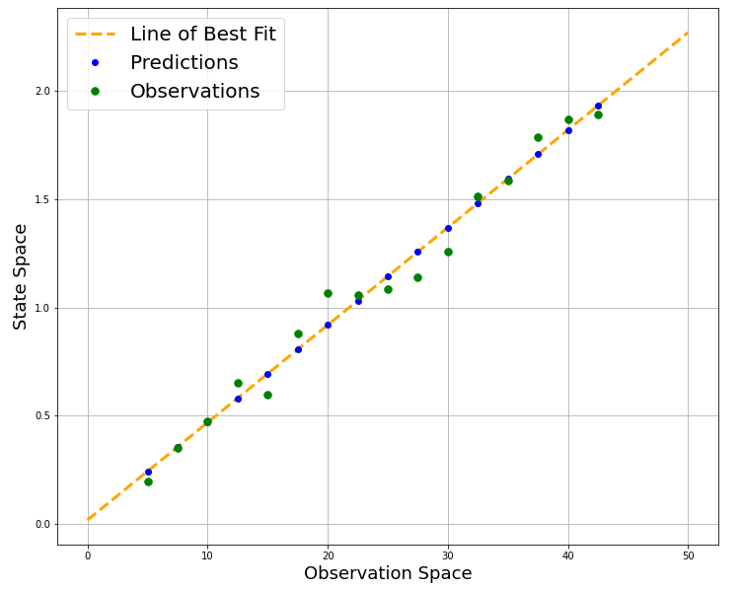
Linear Regression Decoder
2-D Example
This is essentially a line of best fit amongst observations and measurement states
Model: ${\hat{x}}_{t}=β_{0}+β_{1}r_{t,1}+ β_{2}r_{t,2}+…+β_{M}r_{t,M}=r_{t}^{′T}β$
Collection (train): $X=R^{′}β$
Solve: $β={\left(R^{′T}R′\right)}^{−1}R^{′T}X$

Slide 16
Kalman Filter – Supervised Training
Start with LGDS Model: $x_{t+1}=x_{t}A^{T}+w$ $r_{t}=x_{t}H^{T}+q$
Train Model:
$A$ and $H$ through regression. $W=\frac{\left(X_{t+1}−X_{t}A^{T}\right){\left(X_{t+1}−X_{t}A^{T}\right)}^{T}}{T−1}$ $Q=\frac{\left(R_{t}−X_{t}H^{T}\right){\left(R_{t}−X_{t}H^{T}\right)}^{T}}{T}$
$$w\sim N\left(0 , W\right)$$
$$q\sim N\left(0 , Q\right)$$
A: State Matrix
H: Output Matrix
W: Process Noise
Q: Measurement Noise

Slide 17
Kalman Filter – Unsupervised Training
Generate initial latent variables with factor analysis
Perform Expectation Maximization to learn parameters of model
Map posterior mean of latent states to the kinematic states
Factor Analysis says: $R=CZ+μ+ε$, where,
R are observations (must be 0 mean)
C are factor loadings
Z are latent variables
$μ$ is a constant, whose maximum likelihood estimator is the mean of the observations
$ε$ is the error or noise in the observations, where $ε\sim N(0,Ψ)$, with $Ψ$ being diagonal

Slide 18
Kalman Filter – Unsupervised Training
Factor Analysis:
Initialize Parameters. Remove mean from observations. Initialize loading matrix $C$ (can use svd and set to loading matrix). Initialize $ε$ (set to covariance of 0 mean observation data).
Run Expectation Maximization (EM).
Expectation Step. Compute $E[Z|R;C,ε]$ and $E[ZZ^{T}|R;C,ε]$.
Maximization Step. Update parameters ($C$ and $Ψ$) that maximize log likelihood $p\left(R | C,Ψ\right)=L\left(C,Ψ | R\right)$. Compute negative log-likelihood: Re-estimate mean of observed data, $μ$: ($R−CZ$) Re-estimate covariance of observations: $CC^{T}+Ψ$ Sum up the negative logpdf of all observations given distribution params.
Repeat until convergence.
Note: Must assume the number of latent states (Makin et al., 2018 assumed 1/3 as the number of observations)
Notes:
https://scentellegher.github.io/machine-learning/2020/01/27/pca-loadings-sklearn.html

Slide 19
Kalman Filter – Unsupervised Training
Expectation Maximization for LGDS Parameters:
Initialize Parameters. Latent variable estimates and latent variable variance (both posteriors from factor analysis). Set $E[Z_{t}Z_{t−1}|R_{t}]$ to $I$.
Run Expectation Maximization (EM).
Maximization Step. Take derivative $E[log⁡(P\left(Z,R\right))|R]$ wrt parameters from LGDS ($A,H,W,Q$) as well as the latent state initial mean and variances.
Expectation Step. Run a series of forward and backward recursions, with the forward being a KF to give posterior latent mean and variance. The other being a smoother to give $E[Z_{t}Z_{t−1}|R_{t}]$ . From the posterior mean and covariance of the latent states, sum up the negative logpdf of all generated latent states given distribution params
Repeat until convergence.
Notes:
https://scentellegher.github.io/machine-learning/2020/01/27/pca-loadings-sklearn.html

Slide 20
Kalman Filter - Decoding
Initialize. Make assumptions on prior knowledge. Predict $x _{0}^{−}$ (initial state) and uncertainty in initial state, $P_{0}^{−}$.
Measure. Take a measurement at the current time step, $t$, and acquire the latest neural binned counts, $r_{t}$.
Posteriori/Update Step. Make an informed estimate of the kinematic state and uncertainties: Kalman Gain: $K_{t}=P_{t}^{−}H^{T}{\left(HP_{t}^{−}H^{T}+Q\right)}^{−1}$ State Update: ${\hat{x}}_{t}={\hat{x}}_{t}^{−}+\left(r_{t}−{\hat{x}}_{t}H^{T}\right)K_{t}^{T}$ Covariance Update: $P_{t}=\left(I_{N}−K_{t}H\right)P_{t}^{−}$
Prediction (a Priori). Predict the next kinematic state and estimate uncertainty in that prediction: Covariance Extrapolation: $P_{t+1}^{−}=AP_{t}A^{T}+W$ State Extrapolation: ${{\hat{x}}^{−}}_{t+1}={\hat{x}}_{t}A^{T}$
Repeat steps 2-4 throughout.
Note(s):
Replace $x$ with $z$ for unsupervised case.
For unsupervised case, use ${\hat{x}}_{t} =z_{t}D^{T}$ (pre-determined regressive mapping—latent to kinematic state)
Notes:
1. As done in Makin et al., 2018, these will be set to the average and variance of the kinematic state at every time step in the training data respectively.
In note, it is not really pre-determined in case of Makin

Slide 21
Recurrent Exponential-Family Harmonium
Harmonium = Restricted Boltzmann Machine (RBM)
Exponential-Family: Models an exponential distribution
Recurrent: Keeps history has connections from past samples
RBM
$$+b_{1}$$
$$z_{t,1}$$
$$r_{t,1}$$
$$+b_{2}$$
Goal: $$argmax(E\left[log⁡(P(r_{t})\right])$$
$$z_{t,2}$$
$$r_{t,2}$$
$$+b_{3}$$
$$z_{t,3}$$
…
Backward Pass: $p(r_{t}|z_{t};w)$
Forward Pass: $p(z_{t}|r_{t};w)$
Generative Model: $p(r_{t},z_{t})$
…
$$r_{t,M}$$
$$+b_{K}$$
$$z_{t,1}$$
W

Slide 22
Evaluation Metrics
Coefficient of Determination: $R^{2}=1−\frac{\sum_{t=1}^{T}{{\left(x_{t}−\hat{x_{t}}\right)}^{2}} }{\sum_{t=1}^{T}{{\left(x_{t}−\overline{x}\right)}^{2}}}$
Signal-to-noise ratio: $SNR=−10\log_{10}{(1−R^{2})}$
Notes:
R^2 “Standard measure for kinematic reconstruction, has been argued to understate performance at the high end due to saturation”
SNR “less sensitive to extreme failures, since negative coefficients of determination are compressed closer together. This is an attractive property, since it seems unintuitive to penalize very differently two decoders neither one of which is extracting any useful information out of the neural data.”

Slide 23
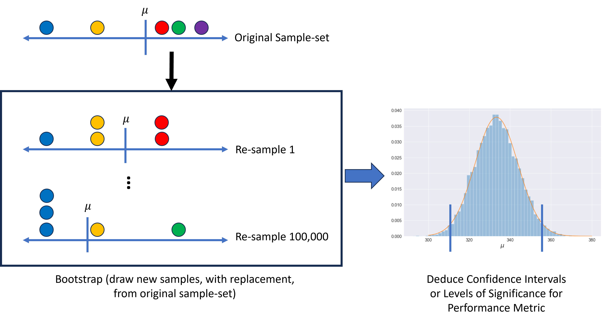
Statistical Significance
File 1
File 2
(e.g. SNR Results per Decoder from each *File in the Dataset)
File 4
File 3
File 5
$$P\left(\left|\overline{X_{n}}−μ\right|<ε\right)=1−P\left(\left|\overline{X_{n}}−μ\right|≥ε\right)≥1−\frac{σ^{2}}{nε^{2}}$$
As $n→∞$, $$\overline{X}→μ$$
*Note: There are 46 Files in the Published Dataset.
Chebyshev Inequality
$$P\left(\left|\overline{X_{n}}−μ\right|≥ε\right)≤\frac{σ^{2}}{ε^{2}}$$
Bootstrapping, Confidence Intervals, Levels of Significance, Central Limit Theorem

Slide 24
Preliminary Results

Slide 25
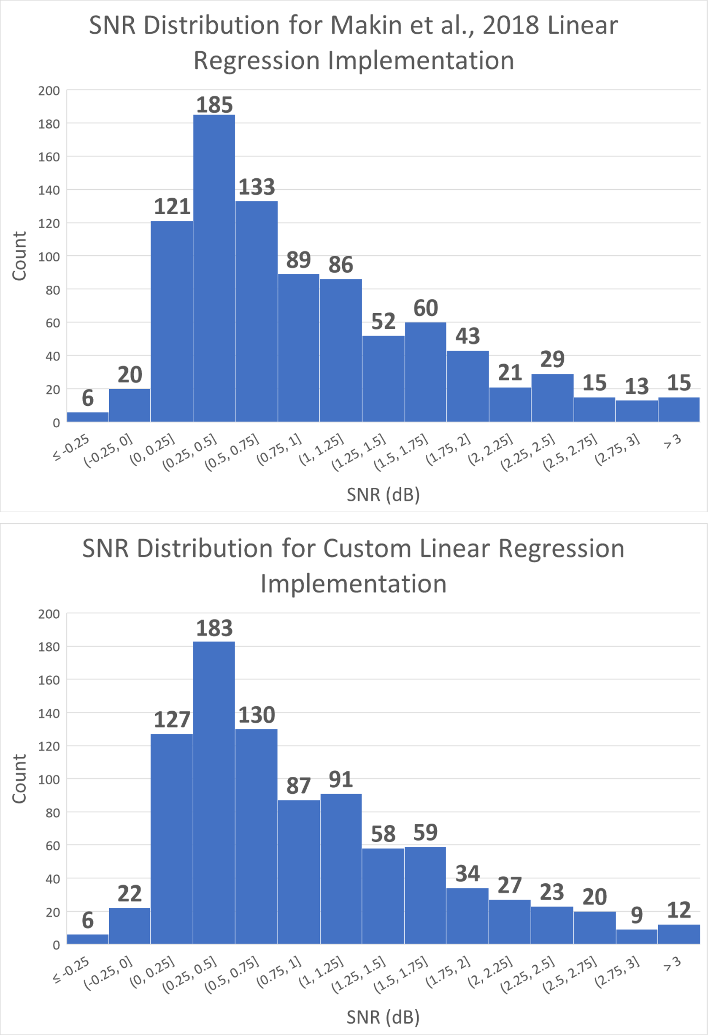
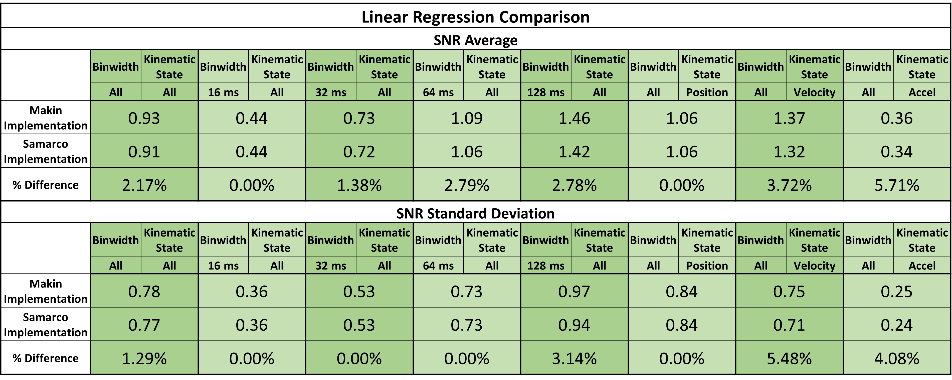
Regression Decoder Implementation
SNR Average % Difference amongst all kinematic state predictions and all binwidths for the training files is ~2.2 %

Slide 26
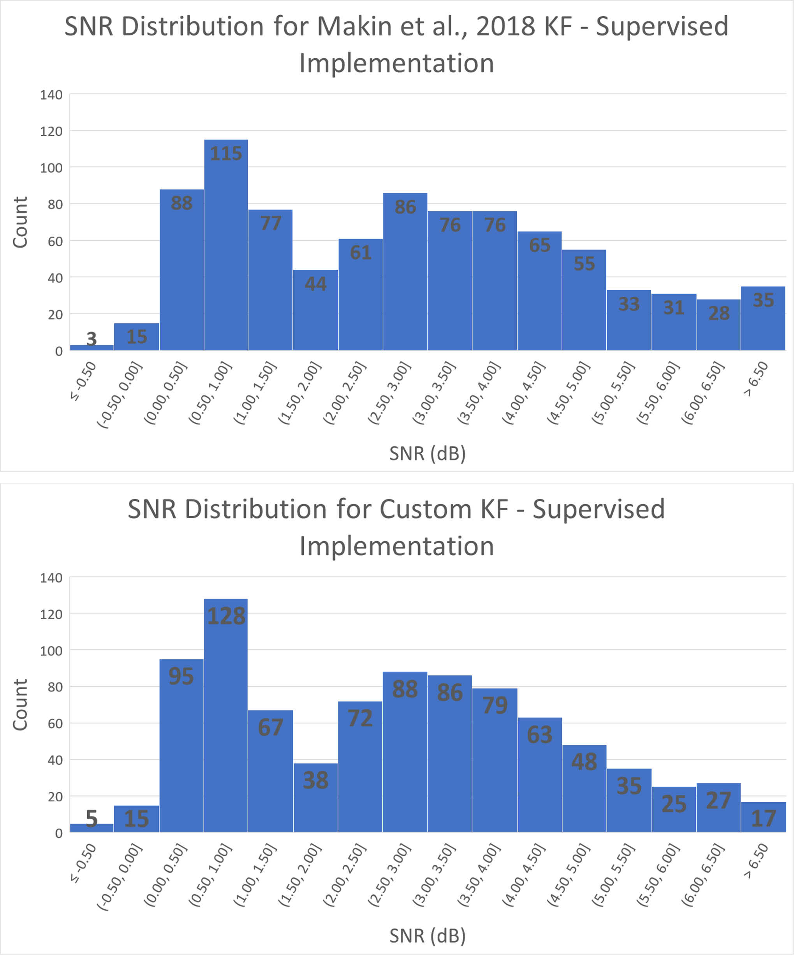
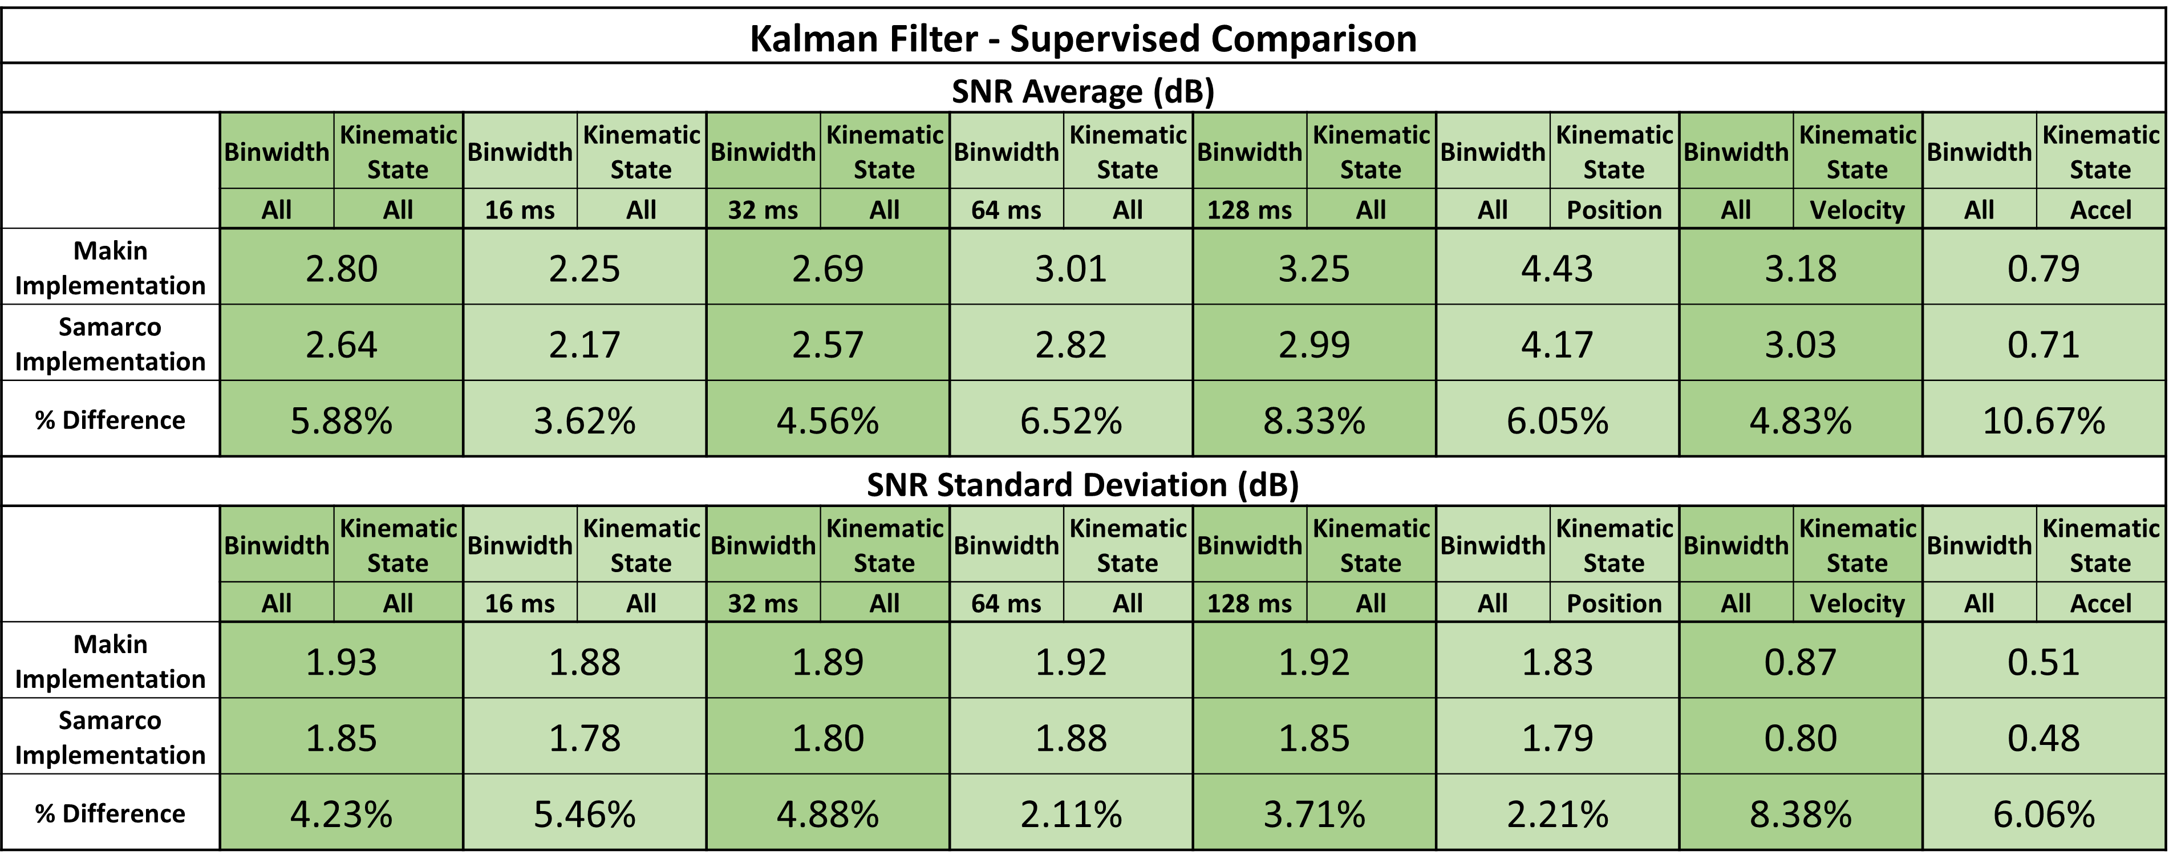
Reproducing Kalman Filter – Supervised Decoder
SNR Average % Difference amongst all kinematic state predictions and all binwidths for the training files is ~5.9 %

Slide 27
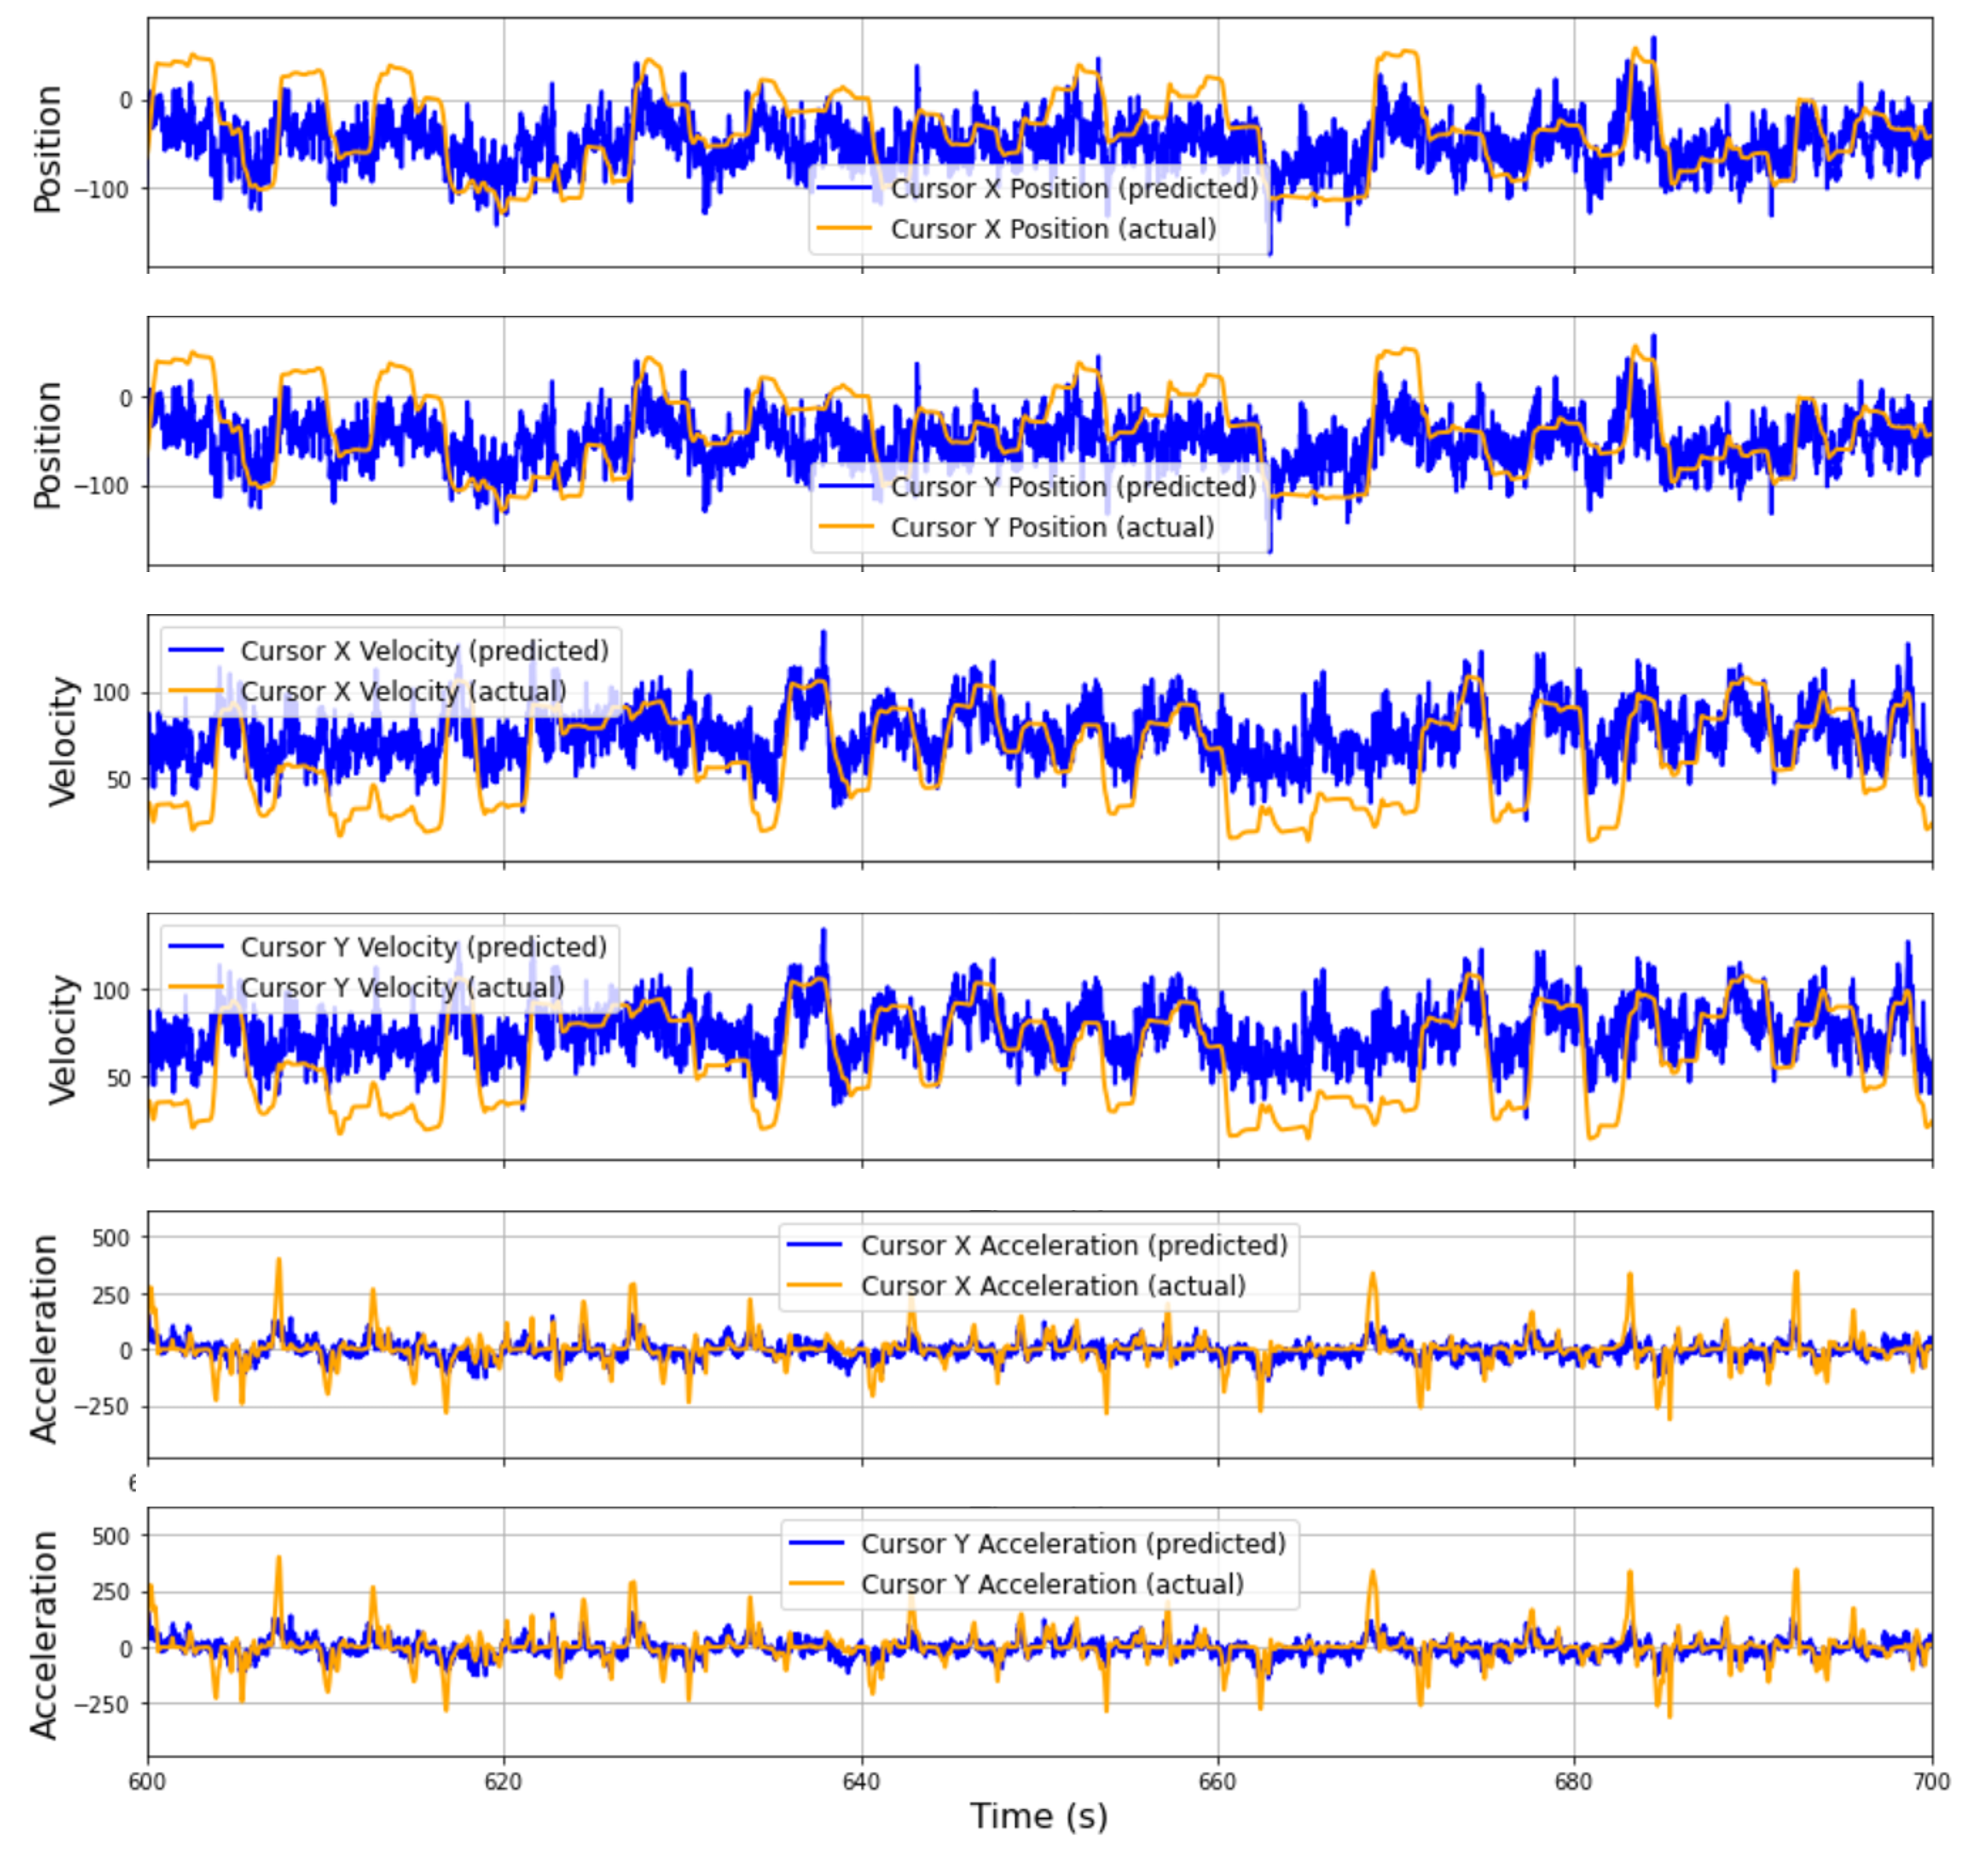
Reproducing Kalman Filter - Unsupervised
Haven’t yet verified that this decoding algorithm coincides with the Makin et al., 2018 implementation
Qualitative assessment—looks promising

Slide 28
Proposed Work

Slide 29
Task 1: Validate the Kalman Filter – Unsupervised Implementation
Takes several hours
Need to parallelize code (e.g. GPU or multi-threading)
Compare Distributions (Custom vs. Makin et al., 2018)

Slide 30
Task 2: Implement the rEFH Decoder
Welling, Rosen-Zvi, and Hinton, 2004 show how Harmoniums are extended to exponential-families
Makin, Dichter, and Sabes, 2015 give theory for rEFH
Implement and compare implementation (distribution of results)

Slide 31
Task 3: Quantify the Performance of the Neural Decoders in Handling Multi-Unit Data
Undue Spike Sorting by pooling Single-Unit Times into the electrodes they associate with
Feed Decoders multi-unit binned spike times and compute metrics ($SNR$ and $R^{2}$)
Use bootstrapping to:
Quantify 95% CI for $SNR$ and $R^{2}$ Improvement from baseline decoder (*main experiment)
Determine significance level of improvement for each decoder from baseline (*main experiment)
Quantify 95% CI for $SNR$ for the different binwidths and kinematic types
Determine Significance level in which any decoder outperforms others
*Note: “Main Experiment” is 64 ms binwidth

Slide 32
Task 4: Quantify the Performance of the Neural Decoders in Transfer Learning
Compute average $SNR$ for the case where each file takes a turn as providing the training data
Produces 45 averages
Averages weighted by # samples in files
Perform bootstrapping to:
Quantify 95% CI for decoder $SNR$ for different binwidths & Kinematic types
Determine significance level at which any decoder outperforms others

Slide 33
Task 5: Quantify the Performance of the Neural Decoders in Handling Dropped Data
Compute metrics for dropping spikes at random for 5%, 15%, 25%, and 50% of spikes dropped
Perform bootstrapping to:
Quantify 95% CI for decoder $SNR$ for different binwidths & Kinematic types & dropped spikes
Determine significance level at which any decoder outperforms others

Slide 34
Task 6: Complete Documentation of Custom Python Library and Publish Code Online
Have a working Github repository for the library and implementations
Neural-Instrumentation-Lab/makin_2018_reproduction at msamarco (github.com)

Slide 35
Questions?

Slide 36
Bibliography
Rajan, A. T., Boback, J. L., Dammann, J. F., Tenore, F. V., Wester, B. A.,
Otto, K. J., Gaunt, R. A., &amp; Bensmaia, S. J. (2015). The effects
of chronic intracortical microstimulation on neural tissue and
fine motor behavior. Journal of Neural Engineering, 12(6),
066018. https://doi.org/10.1088/1741-2560/12/6/066018
Makin, J. G., O’Doherty, J. E., Cardoso, M. M., &amp; Sabes, P. N. (2018).
Superior arm-movement decoding from cortex with a new,
unsupervised-learning algorithm. Journal of Neural Engineering,
15(2), 026010. https://doi.org/10.1088/1741-2552/aa9e95

Slide 37
Bibliography
Max Welling, Michal Rosen-Zvi, and Geoffrey E. Hinton. Exponential Family
Harmoniums with an Application to Information Retrieval. In
Advances in Neural Information Processing Systems 17: Proceedings
of the 2004 Conference, pages 1481–1488., 2005.
Makin J. G., Dichter B. K. and Sabes P. N. (2015). Recurrent Exponential-
Family Harmoniums without Backprop-through-Time
(arXiv:1605.05799)
Swindale, N. V., &amp; Spacek, M. A. (2016). Verification of multichannel
electrode array integrity by use of cross-channel correlations. Journal
of Neuroscience Methods, 263, 95–102.
https://doi.org/10.1016/j.jneumeth.2016.02.009

Slide 38
Bibliography
Luan, L., Robinson, J. T., Aazhang, B., Chi, T., Yang, K., Li, X., Rathore, H.,
Singer, A., Yellapantula, S., Fan, Y., Yu, Z., &amp; Xie, C. (2020).
Recent advances in electrical neural interface engineering: Minimal
invasiveness, longevity, and scalability. Neuron, 108(2), 302–321.
https://doi.org/10.1016/j.neuron.2020.10.011
N1 Implant. Neuralink. BMI Implant.
Studio, P. (n.d.). Neuralink’s first-in-human clinical trial is open for
recruitment: Blog. Neuralink. https://neuralink.com/blog/first-clinical-
trial-open-for-recruitment/

Slide 39
Bibliography
EPOC X. EMOTIV. Wireless EEG Headset. (https://www.emotiv.com/epoc-x/#)
EmotivPRO. Licensed EEG Software. (https://www.emotiv.com/emotivpro/)
Flex 2.0 Saline. High-Density Saline EEG Head Cap.
(https://www.emotiv.com/flex-saline/)
Salahuddin, U., &amp; Gao, P.-X. (2021). Signal Generation, acquisition, and
processing in Brain Machine Interfaces: A unified review. Frontiers
in Neuroscience, 15. https://doi.org/10.3389/fnins.2021.728178

Slide 40
Bibliography
Trautmann, E. M., Stavisky, S. D., Lahiri, S., Ames, K. C., Kaufman, M. T.,
O’Shea, D. J., Vyas, S., Sun, X., Ryu, S. I., Ganguli, S., &amp;
Shenoy, K. V. (2019). Accurate estimation of neural population
dynamics without spike sorting. Neuron, 103(2).
https://doi.org/10.1016/j.neuron.2019.05.003
Zhang, T., Rahimi Azghadi, M., Lammie, C., Amirsoleimani, A., &amp; Genov,
R. (2023). Spike sorting algorithms and their efficient hardware
implementation: A comprehensive survey. Journal of Neural
Engineering, 20(2), 021001. https://doi.org/10.1088/1741-2552/acc7cc
Bouton, C., Shaikhouni, A., Annetta, N. et al. Restoring cortical control of functional movement
in a human with quadriplegia. Nature 533, 247–250 (2016).
https://doi.org/10.1038/nature17435

