Slide 1
is high in a
TEMPLE
U N I V E R S I T Y
Department of Electrical and Computer Engineering
Development of a Neural Signal Decoder Python Library and an Investigation of Neural Signal Decoder Handling of Sub-Optimal Neural Data
A Masters Project Presentation in Partial Fulfillment of the Requirements of the Degree: MASTER OF SCIENCE IN ELECTRICAL ENGINEERING
Presenter: Michael J. Samarco Jr.
TEMPLE
U N I V E R S I T Y

Slide 2
Project Presentation Overview
Introduction
Research Objective 1
Methodology
Results for Research Objective 1
Research Objective 2 and 3
Results for Research Objective 2 and 3
Conclusion and Future Work

Slide 3
Introduction

Slide 4
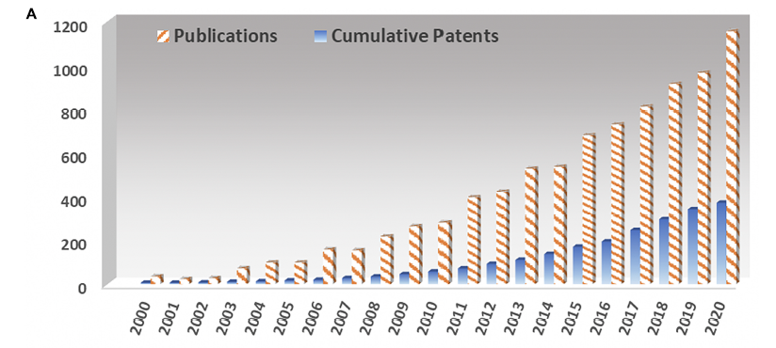
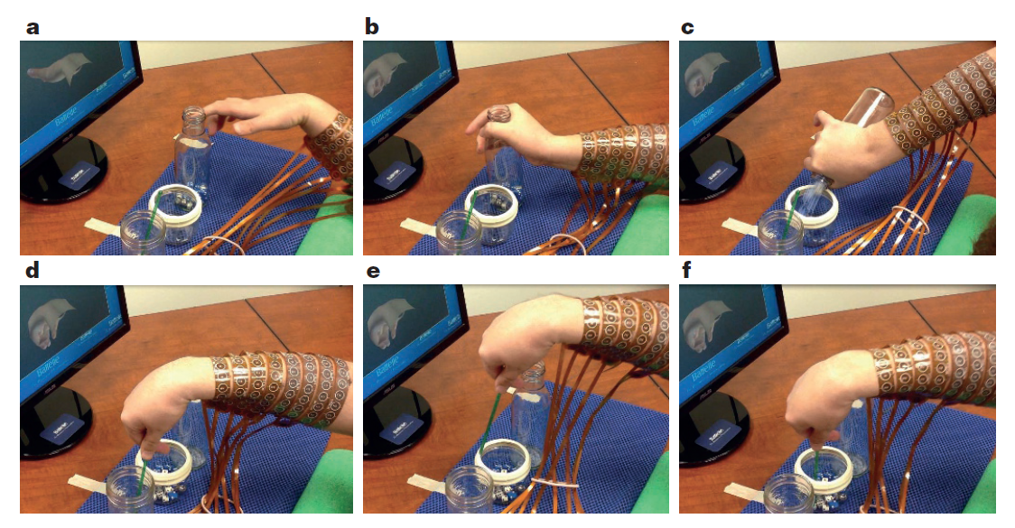
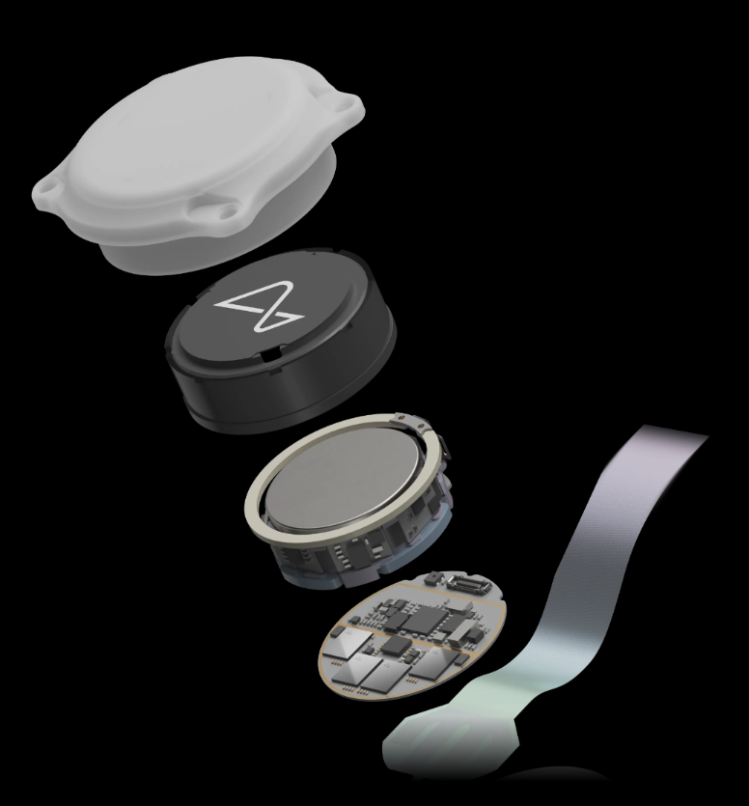
Introduction: Motivation
Image from Bouton et al., 2016
Image from Salahuddin and Gao, 2021
What is a Brain Machine Interface (BMI)?
System with intended purpose to decode information from the brain with an external machine
Why research neural signal decoders?
Exponential Trend for BMI Publications.
It’s capabilities (e.g. restore movement/give control back to paraplegic individuals)
Commercialized hardware in the works (Neuralink)
N1 Implant. Neuralink. BMI Implant. (Neuralink)
Neuralink (Fremont, CA)
Notes:
Read point 1 and sub 1:
The machine is typically a computer or electronic processor system
This information being decoded is generated by groups of cells in the brain called neurons and encoded by them in the form of electrical signals
The information presented in these electrical signals are typically modeled mathematically and decoded via a computer algorithm
So why should anyone care about neural signal decoding?
In fact, if you look at this plot from a study conducted in 2021, you will see that both the number of patents and publications involving BMI systems has both increased exponentially since 2000.
Now, popularity aside, BMIs also come with great power. E.g. since they give us the power to decode what someone is thinking about, you could in theory develop a system targeted at e.g., decoding thoughts regarding the body’s motor function.
The figure being shown at the top right is from a paper which demonstrated just that. They essentially demonstrated restoration of arm and hand movement for a paralyzed individual. They did this by modeling a neural signal decoder to drive a neuromuscular electrical stimulation system (which you can see on the person’s arm in the photo). In the experiments, and with the help of a BMI, the paralyzed individual demonstrated a renewed ability of tasks like grasping, pouring, and stirring (~70 % accuracy for hand gestures).
Lastly, BMI have become so important these days that they are starting commercialization. In just last fall of 2023, the company Neuralink received approval by the FDA to begin their first in human trials for their N1 implant which is a completely wireless BMI (Neuralink’s First-in-Human Clinical Trial is Open for Recruitment | Blog | Neuralink).

Slide 5
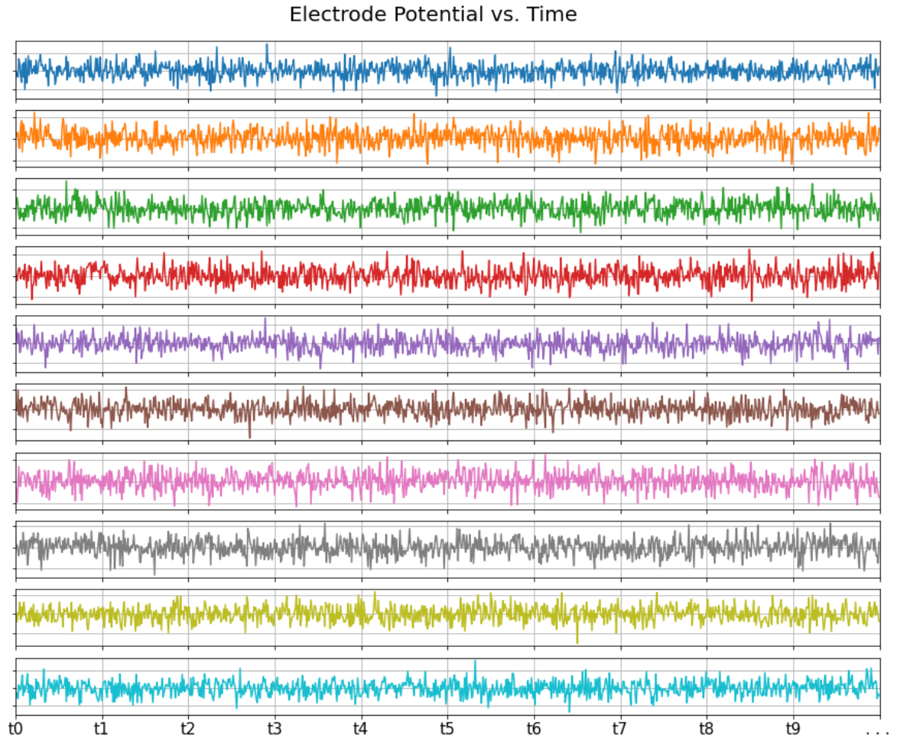
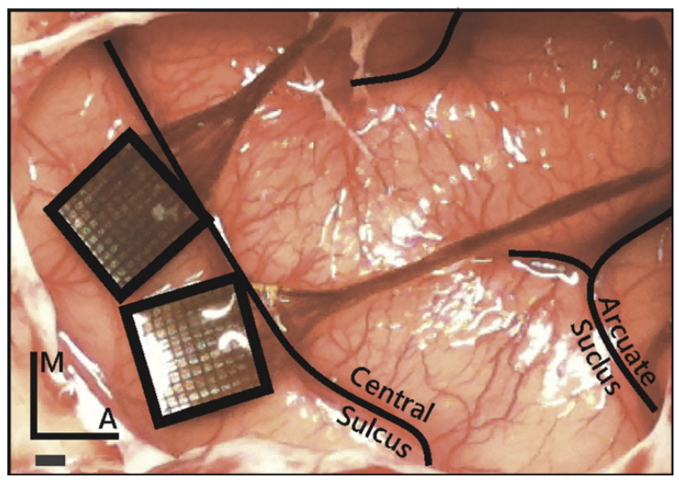
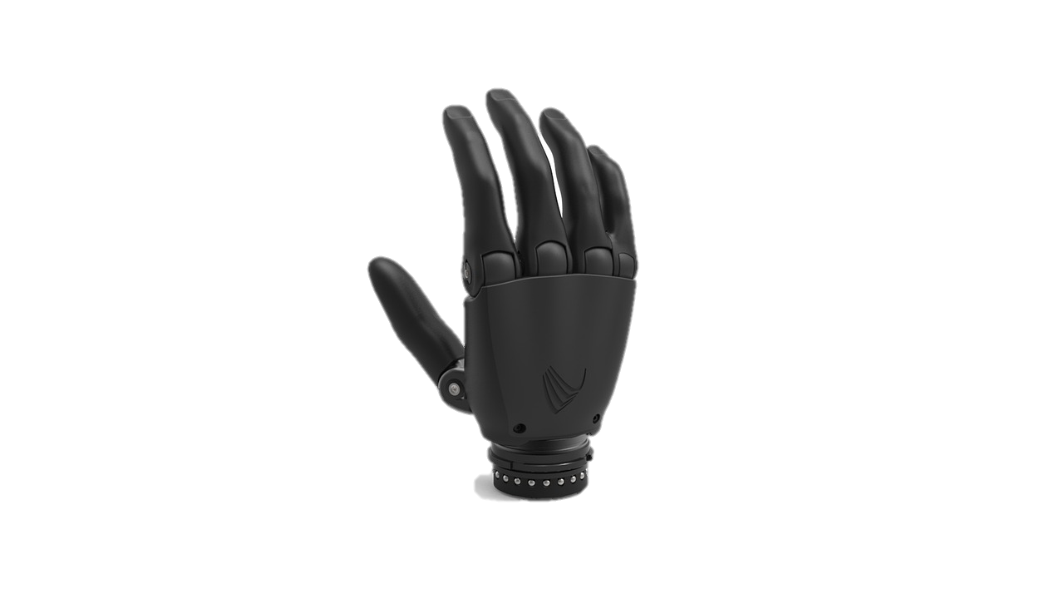
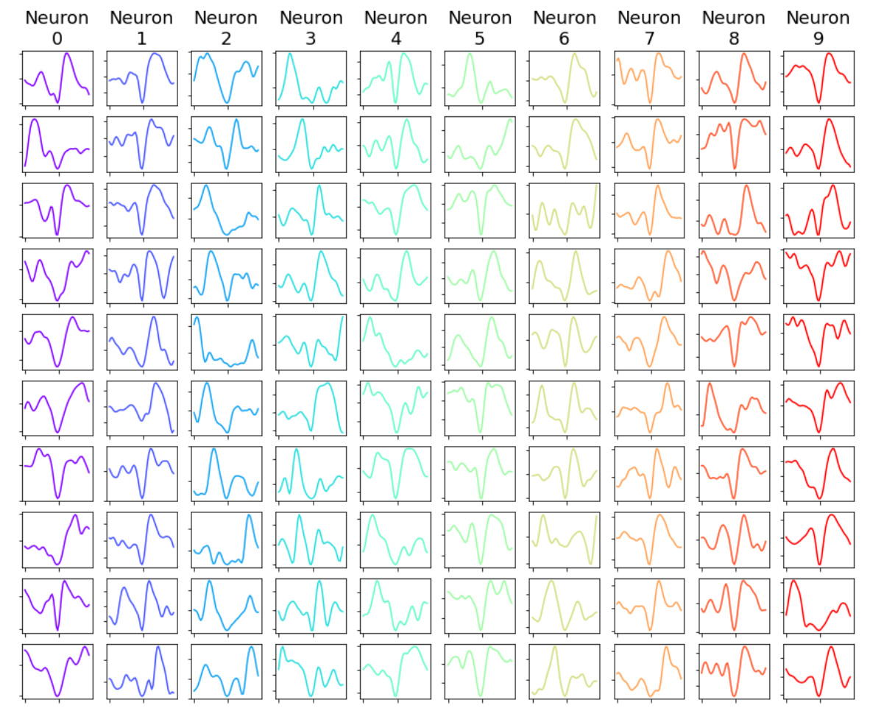
Introduction: What is a Neural Signal Decoder?/Typical BMI System
Subject (typically primate)
Electrodes chronically implanted in brain to sense neuron potential
A pre-amplifier, filters, amplifies, and digitizes raw analog electrode signals.
Digital signals passed to a processor system, which typically perform:
Spike detection
Spike sorting (optionally skipped)
Synchronizing data/Binning
Binned spike data feeds the neural signal decoder
Transforms neural data to equivalent action, task, and/or state of a system
Neural signal decoder prediction can be used to update the state of a device (e.g., control position of a prosthesis)
(photo from Rajan et al., 2015)
gain
ADC
…
filter
0100011101…
0001100011…
0010001111…
1110000110…
0000111010…
0011001101…
(c) Raw Electrode Signals (Potential vs. Time)
(d) Pre-Amplifier
(b) Measurement Source (Brain)
…
Control Signal
(e) Processing System
Digitized Waveforms
(f) Algorithms
[$\hat{x}$,$\hat{y}$,${\hat{v}}_{x}$,${\hat{y}}_{y},{\hat{a}}_{x}$,${\hat{a}}_{y}$]
(a) Subject
Decoder
…
(g) Device Under Control
Spike Detection
Spike Sorting
Bin
$m$,$m+1$,..
…
Notes:
(Before getting into bullets) I am going to show you a specific type of BMI, which is relevant to this project and that is one where electrical signals are extracted from the surface of the brain and down to the single neuron level.
Take a look at figure a and b: Microelectrode arrays are surgically implanted in a subject’s brain, typically a primate (e.g. a monkey). In the photo provided here you can see a matrix of many small electrodes. Each of those electrodes form a recording channel and pick up electrical signals from all neurons closest to them. These signals are typically very small and in the 100s of microvolt range. At this point, these are analog signals and not in a form that can be processed on a digital platform.
The next step in a typical BMI system involves a pre-amplifier, which filters unwanted noise from the signal, amplifies it, and quantizes the signal—forming a digital signal that can now be processed on a digital platform.
Now, the digital signals are typically sent to a processor system like a computer or embedded processor chip. The processor system processes the digital electrode signals and does the following:
First, it will detect spikes, or events where a neuron’s signal has passed a threshold and indicated an “action potential.” These are when key events are expected to happen.
Next, a spike sorting algorithm is run on all of the detected spikes from each electrode. This algorithm essentially places labels for each spike and determines which individual neuron each of these spikes belong to. At this point, the spikes can be reduced into just times of when the spikes occur.
Since these spikes are stochastic events and can occur at any time, these spike times do not have a sample rate associated with them. This is needed for a decoder that aims to update at periodic intervals. In order to synchronize these spike times to some sample rate, a binning algorithm is performed, which converts the spike times to number of spike events or counts per update period.
The spike counts for each neuron can then be passed into a decoder, which ultimately models some underlying process to predict a task or thought.
If desired, this prediction can then be turned into e.g. some actuation signal to control and external device like the example given on the previous slide.
At this point, I want to mention that the main focus for this project will be targeted at the neural signal decoding aspect.

Slide 6
Research Objective 1:
This project’s first (main) goal is to develop a Python library for neural signal decoding that is well documented and can be directly implemented on a published dataset.
Notes:
prove convenient and allow for other investigators to easily modify or extend decoder functionality.

Slide 7
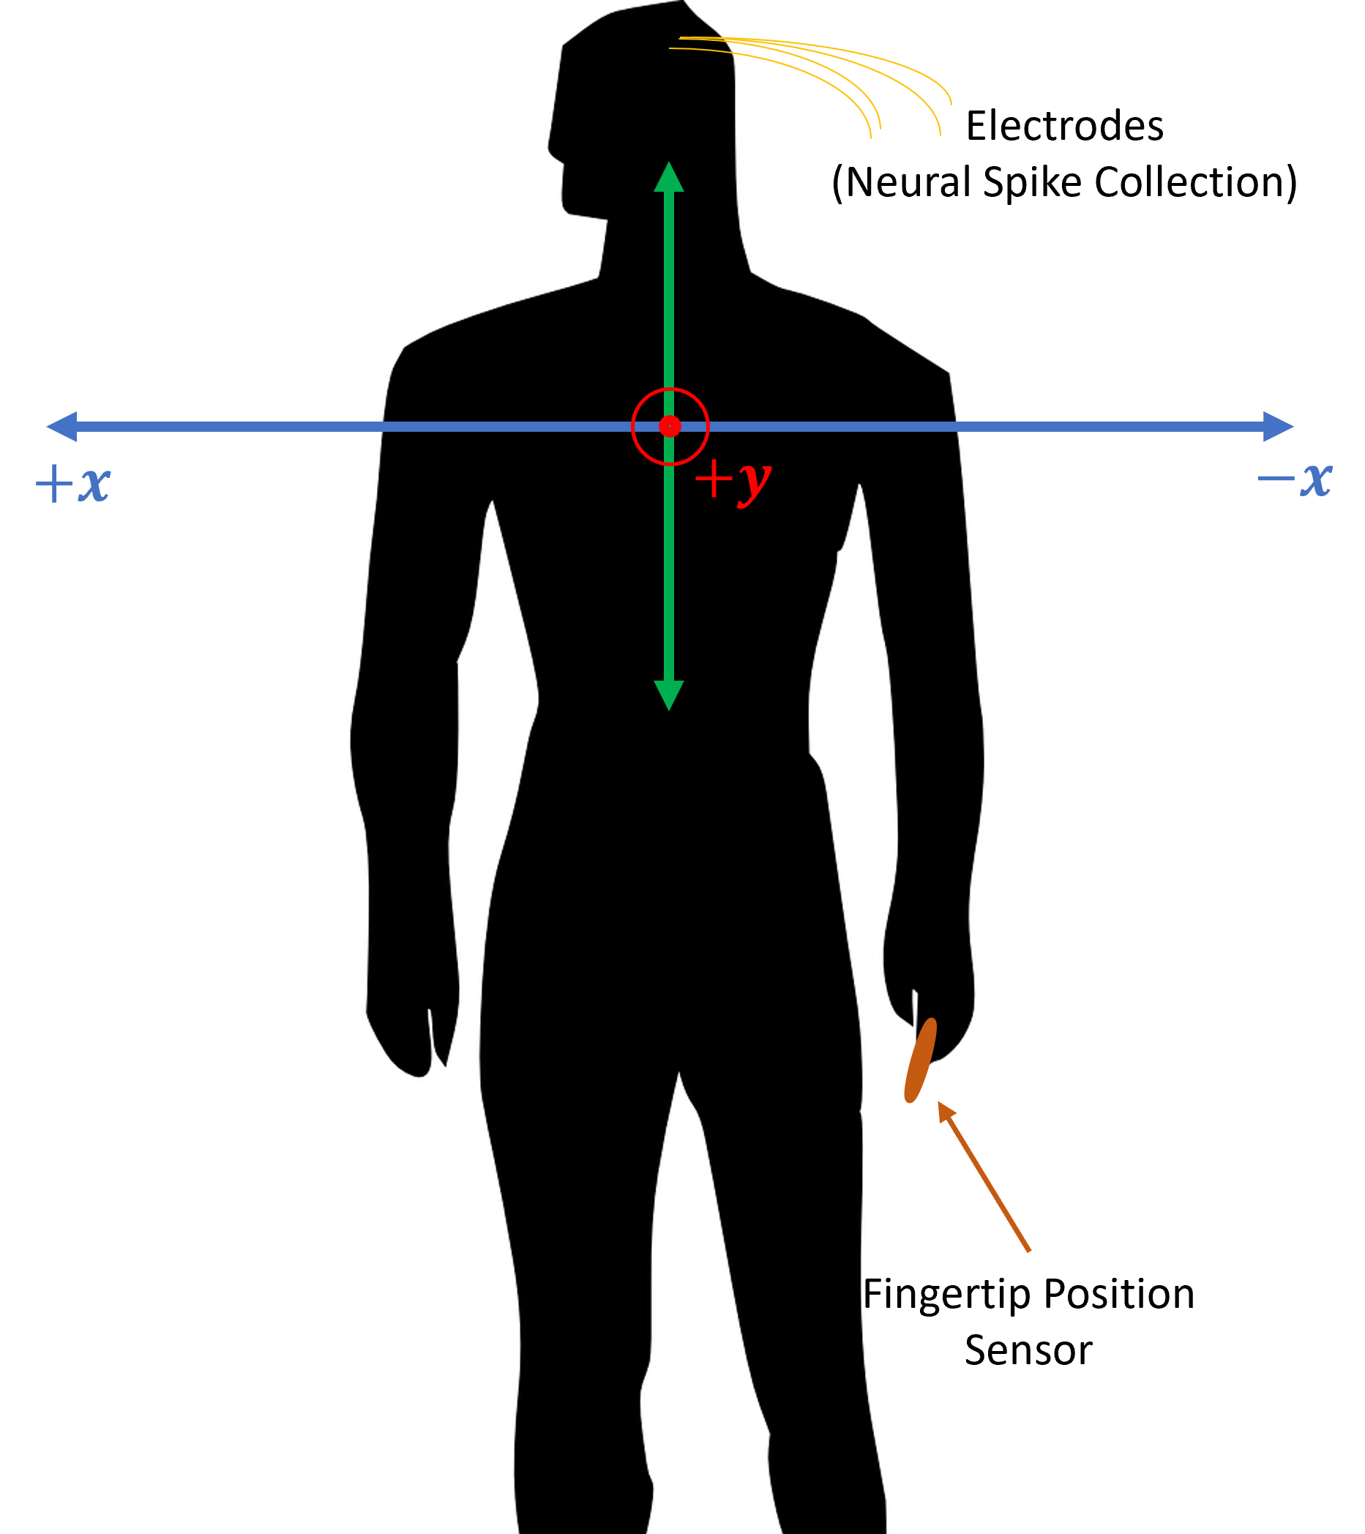
Dataset
$$r_{t}=\left[r_{t,1},r_{t,2},…,r_{t,M}\right]$$
O’Doherty et al., 2020 (Nonhuman Primate Reaching with Multichannel Sensorimotor Cortex Electrophysiology (zenodo.org))
Consists of 2 Monkeys (“Indy” and “Loco”)
Consists of 47 experimental sessions/data collection trials
Collected reaches into space (just below shoulder)
Data includes time aligned kinematic fingertip position and asynchronous single-unit neuron firing times
Comes with a supplementary results file, quantifying different modern day decoder performances for all sessions in the dataset
The decoders were implemented by *Makin et al., 2018 and documented in that paper (published in Journal of Neural Engineering).
$$x_{t}=[p_{x},p_{y},v_{x},v_{y},a_{x},a_{y}]$$
Snippet of Results file (.csv)
…
*Superior arm-movement decoding from cortex with a new, unsupervised-learning algorithm (see bibliography)
Notes:
Sessions in the experiment were collected over 44 days with the range of days spanning almost a year, or 329 days.
In these experiments, monkeys, who had microelectrode arrays implanted into their brains, were instructed to perform reaching tasks to hit targets that appeared visually in front of them.
These targets were just below shoulder level and out-front of the monkey, which established an x-y coordinate system as you can see in the figure shown.
In the experiment, fingertip positional data in x and y coordinates was recorded from a fingertip sensor.
And SU spike sorted data was extracted from the monkey’s as well.
What is good about this published dataset is that there are currently 30 other publications making use of this dataset.
One of the publications titled (read title in footnote), implemented 7 different neural decoders and published performance results, in the form of a csv file (seen below), for those decoders for every data collection session.
The fact that this dataset comes with a results file, provides good validation for custom decoder implementation

Slide 8
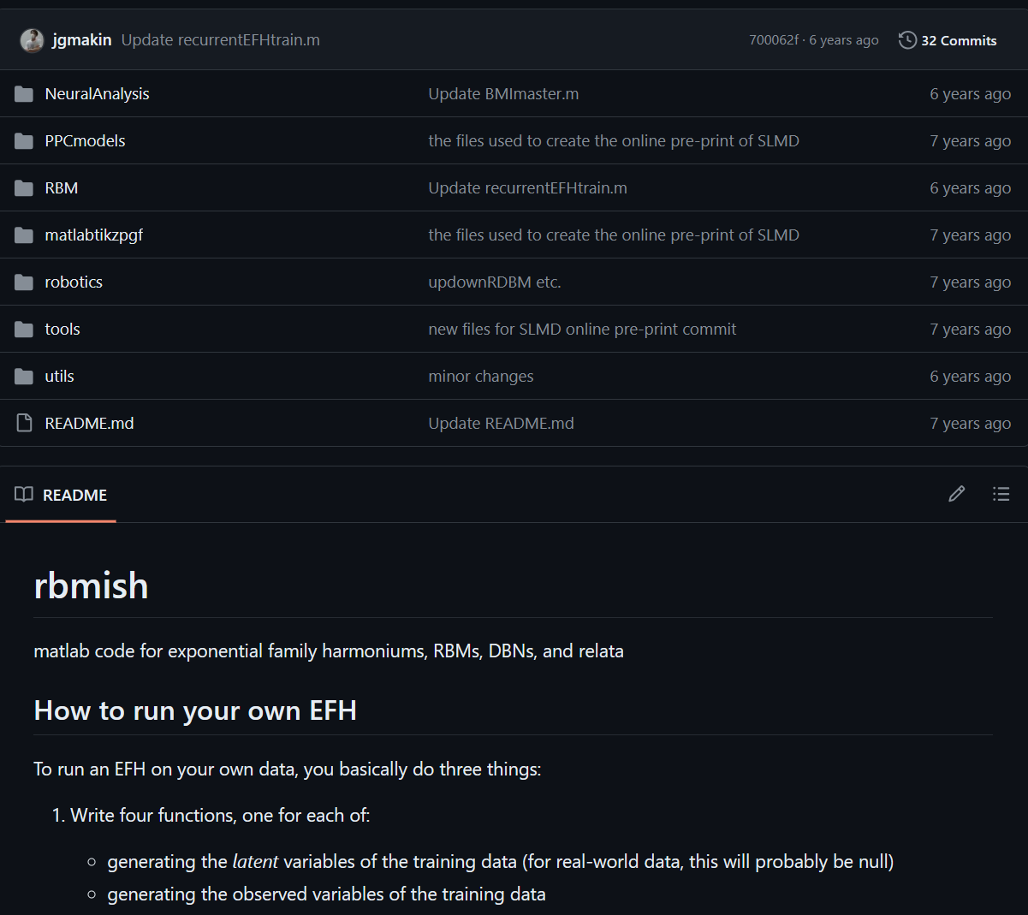
Decoders: What are modern day Neural-kinematic signal decoders?
Makin et al., 2018 published results for 7 different conventional and contemporary decoders:
Linear Regression (1)
Kalman Filter (KF) Supervised (2)
KF Unsupervised
With a static transformation from a latent state to kinematic state (3)
With a dynamic (KF) mapping from a latent state to kinematic state (4)
Unscented KF (5)
Recurrent Exponential-Family Harmonium (rEFH)
With a static transformation from a latent state to kinematic state (6)
With a dynamic (KF) mapping from a latent state to kinematic state (7)
Makin et al., 2018 also published code for their MATLAB based implementation of the decoders (https://github.com/jgmakin/rbmish)
Notes:
MATLAB code by Makin and O’Doherty was not written in a way to reproduce their results from their paper (more focused on running a general EFH).
Makin and O’Doherty MATLAB code was also not very well documented (e.g. no tutorial and few comments)
Following the documentation of Makin et al., 2018 paper and using the O’Doherty et al., 2020 published results, we can use that to implement decoders.
As I said, Makin and others implemented 7 different conventional and contemporary neural signal decoders:
The Linear Regression is a decoder which essentially finds a best linear fit between neural observations and kinematic outputs
A Kalman Filter makes use of linear gaussian dynamic model and measurement data to essentially make a best prediction for kinematic state at each time step given the neural observations
Supervised means that the model parameters are trained with ground truth data (in this case kinematic data)
Unsupervised means the model parameters do not have access to ground truth data and are trained using some probabilistic methods and their observational data alone (this leads to an intermediate step of predicting latent states from observations)
Unscented KF allows for a non-linear model for the neual-kinematics
rEFH is a new NN technique, developed by Makin and group, which leverages temporal relationships in past observations and allows for the model to be modeled as an exponential distribution

Slide 9
Methodology

Slide 10
Methodology: Overview
Binning Asynchronous Neural Data
Additional Data Conditioning
Decoding:
Linear Regression
KF Supervised
KF Unsupervised with a Static Mapping

Slide 11
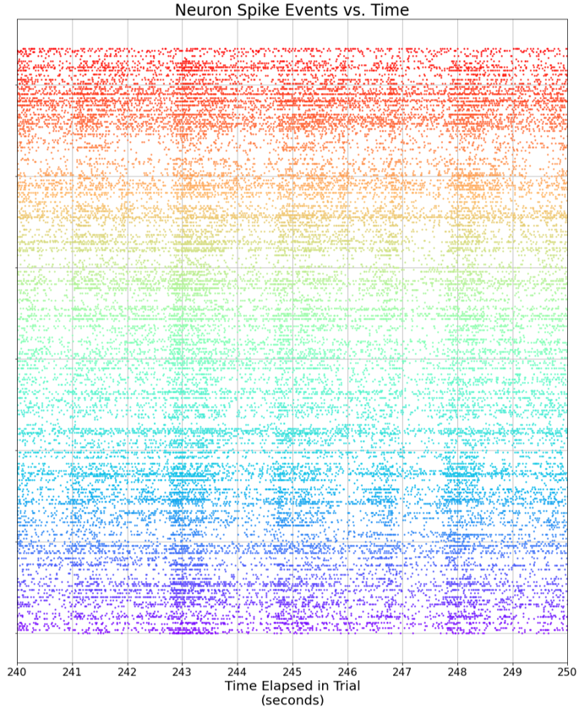
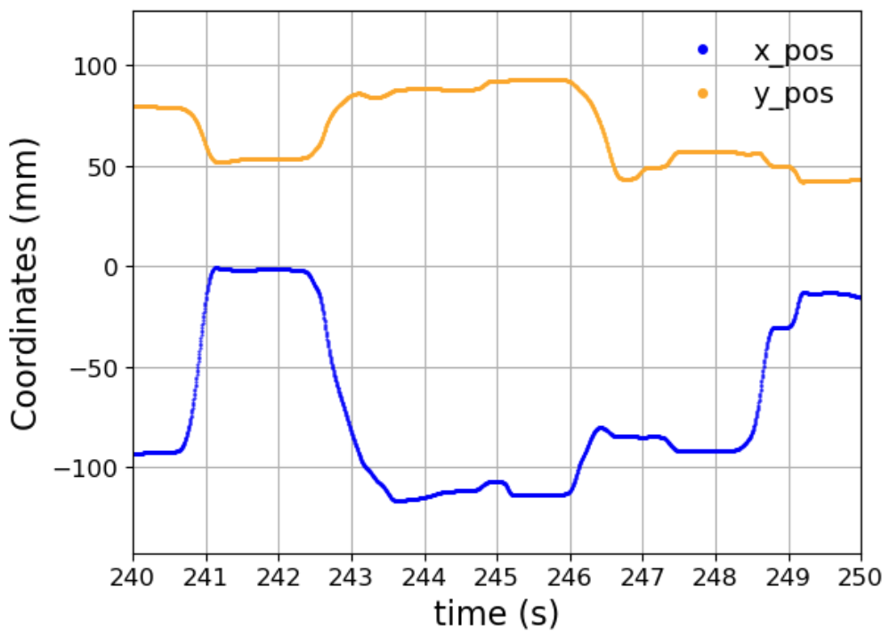
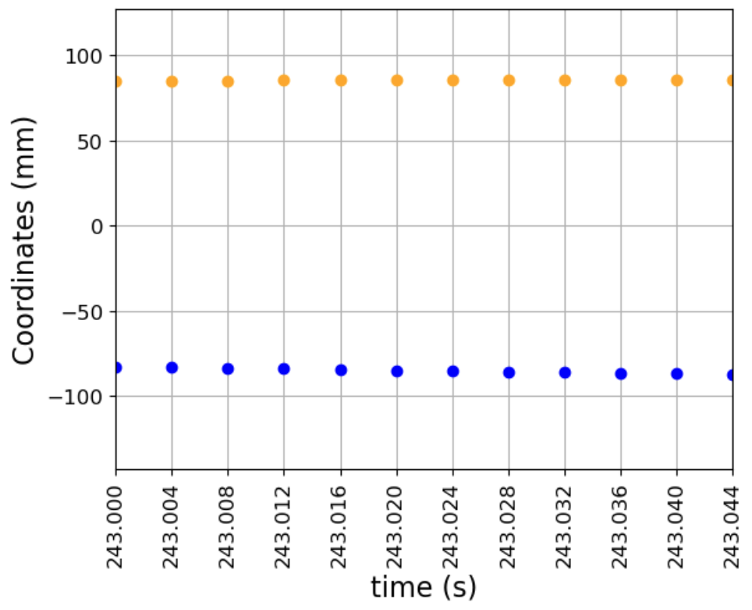
Methodology: Binning Neural Data
Ground truth data and Observations are asynchronous
Solution: Bin (results file has results for bin sizes of 16, 32, 64, and 128ms)
t1
t2
t3
t4
t5
t6
…
…
Electrode 1
…
…
…
…
…
…
…
Asynchronous
Sampled Periodically
…
Electrode C
Notes:
Models for decoders update estimates sample by sample, with fixed sampling
Note: after fixing the neural data to an update rate, by binning, the positional data is then decimated and resampled at the rate corresponding to the bin width of a decoder

Slide 12
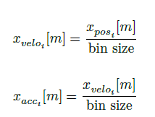
Methodology: Additional Data Conditioning
In the ground truth measurement data, only positional data was obtained from experiments
Compute Velocity and Acceleration from that:
For every decoder there will be a model, which parameters will need to be learned in (or trained) e.g.,:
$$Δ$$
$$Δ$$
$$x_{t+1}=x_{t}A^{T}+w$$
$$r_{t}=x_{t}H^{T}+q$$
Trial 1
Trial 2
Model
Trial 3
…
Each session will be broken up into “training” and “evaluation” partitions
Training data is the first 320 secs of data, everything after is evaluation
Trial 47
$$t_{train}$$
$$t_{evaluate}$$
$$t$$
0
320 s

Slide 13
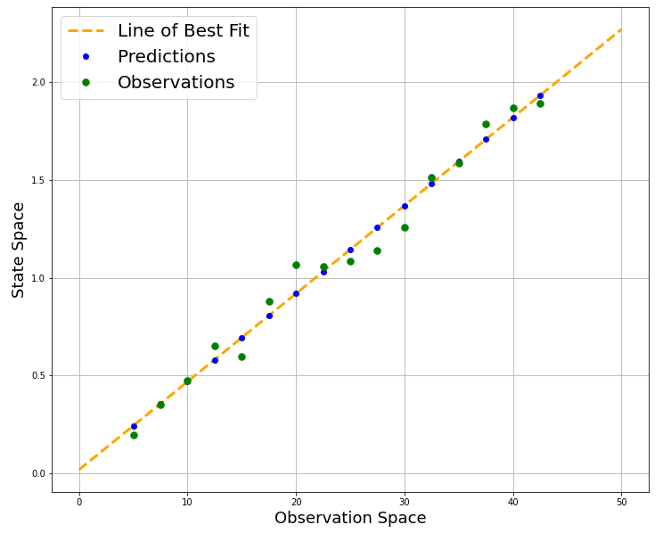
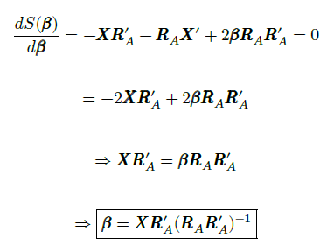
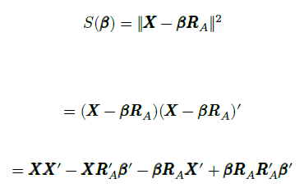
Methodology: Regression Decoder
Example: Linear Regression for 1 dimensional data
This decoder performs a linear transformation to predict kinematic state, $x_{m}$, from neural observation, $r_{m}$:
Find the parameters for a Linear Fit through a least squares approximation ($X$ below is on a training partition):
(Kinematic States)
(1; Neural Spike Counts)
(Neural Spike Counts)
(Transformation Mat.)
Notes:
Right pseudo-inverse

Slide 14
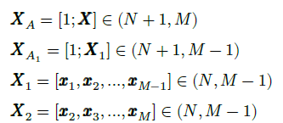
Methodology: KF Supervised - Training
KF is centered around a Linear-Gaussian Dynamical System (LGDS) Model:
Training is done on the model parameters using a linear regressive approach (least squares approximation) on the ground truth kinematic data here:
[Observation Offset vector, Observation Matrix]
[State Offset vector, State Transition Matrix]
Where:
Observation Covariance Matrix
State Covariance Matrix
Notes:
H: Observation Matrix
A: State Transition Matrix
h: Observation offset vector
a: State offset vector
Q: is observation covariance matrix
W: state covariance matrix

Slide 15
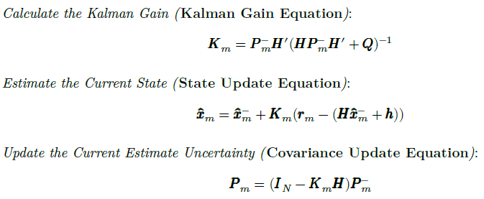
Methodology: KF Supervised - Estimation
Iterate through steps to make predictions on kinematic states:
Step 0. Initialize:
Step 1. Measure, get the $m$-th time’s observation vector (neural spike counts for $m$-th bin): $z_{m}$
Step 2. Update (Posteriori):
Step 3. Prediction (a Priori):
Repeat steps 1-3 for each time step in the experimental session.

Slide 16
Methodology : KF Unsupervised with Static Mapping – Overview
Unlike KF Supervised, for the KF Unsupervised it is assumed that we do not have access to the ground truth kinematic state data in training the model.
Same LGDS Model is used here, with a slight tweak (relate neural data to a “latent” state):
The training here is done by applying an expectation maximization (EM) algorithm to learn the parameters for the model and initial states
Before training—a pre-training step is performed to learn sufficient initial points for the parameters and latent states
This is done by Factor Analysis (FA)
Following training, estimation is done with KF (predicts latent states, $z_{m}$)
Transform latent states to kinematic state from a static mapping (learned from regression on training set)

Slide 17
Methodology: KF Unsupervised with Static Mapping – Training Step 1 (Initialization)
FA models the relationship between observational/latent data as:
Prior for latent states assumed:
Likelihood (or generative model) thus:
Posterior model can be deduced as:
Steps for FA:
Init (use loading mat found in PCA):
E (update posterior):
M (Maximize likelihood for Parameters):
Repeat E and M steps until convergence (or 100 iterations):
* $N=\frac{1}{3}C$
“best performance” (Makin et al., 2018)
$$\frac{d}{θ}$$
= 0 ($θ$=parameters)
Where:
= $\overline{R}$
(sample avg)
*Notes: N=Number of Latent States C=Number of Observed
Notes:
Repeat until the Gaussian Cross Entropy is < 1/100 of the total decrease in cross entropy since starting EM

Slide 18
Methodology: KF Unsupervised with Static Mapping – Training Step 2 (EM)
Now, the main training for the LGDS model for KF unsupervised can begin:
Step 1: Initialize, use FA results:
Step 2: E Step:
Step 2.1. Apply KF on LGDS with latest/most updated parameters, get:
Step 2.2. Apply Rauch-Tung-Striebel Smoother (backward recursion) to refine/smooth estimates (see * for $M$ step):
LGDS Params:
KF Initial states:
(or $Cov(R|Z)$)
(or $Cov(Z|R)$)
, , , $K_{M}$
*Note:
= =
Notes:
J is smoother gain matrix

Slide 19
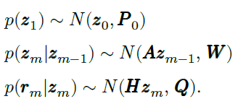
Methodology: KF Unsupervised with Static Mapping – Training Step 2 (EM)
Step 3: M Step (Find model parameters that maximize likelihood):
Step 4: Repeat E and M until convergence (or 100 iterations):
Stop when decrease in cross entropy < 1/100 % of total cross entropy decrease since starting the EM (done in Makin et al., 2018)
Or another criteria: the max of the average parameter element changes from one step to the next is < 0.005 (done in this project)

Slide 20
Methodology: KF Unsupervised with Static Mapping – Estimation
Run a KF on the observations and LGDS model given the parameters from EM and get final latent state estimates, $\hat{Z}$
For static mapping, perform a least squares approximation to find a linear transformation from latent to kinematic state:
Assumes a good understanding of how latent and kinematic relationship (gives a sense of best-case performance)
Notes:
performing an approximation this way assumes a best case of static mapping or allows the researcher to gauge what performance can be expected if there is a good understanding for how the latent states map to the kinematic states beforehand.
This is how it was also described in Makin

Slide 21
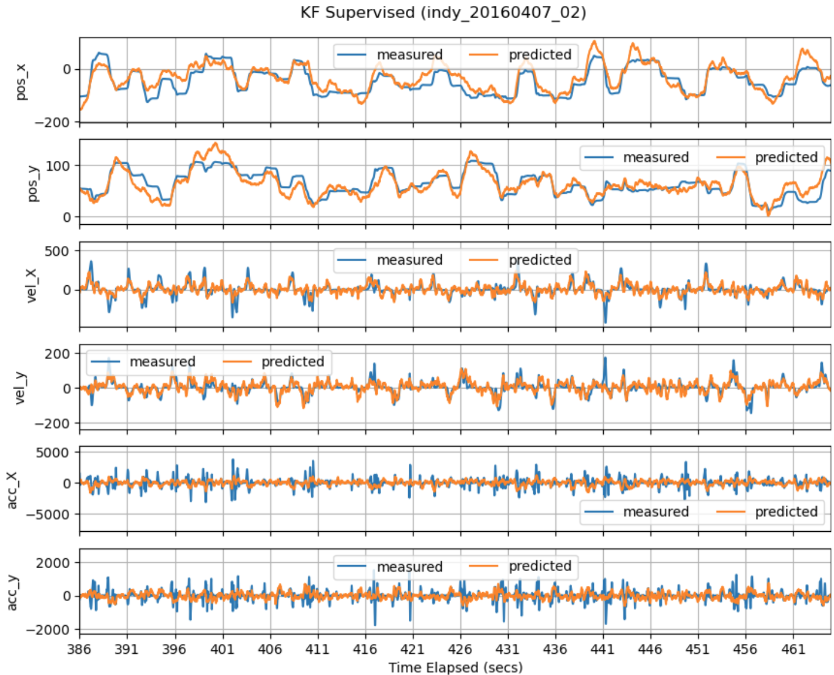
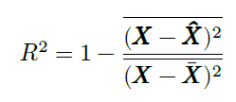
Methodology: Evaluation Metric
How to quantify how well decoders work in prediction?
Coefficient of Determination, $R^{2}$:
Signal-to-Noise Ratio, $SNR$:

Slide 22
Results 1
These are the results for the first objective: Implement a Python neural signal decoder library and validate the results by quantifying how well the results match the accompanying results file from the O’Doherty et al., 2020 dataset.

Slide 23
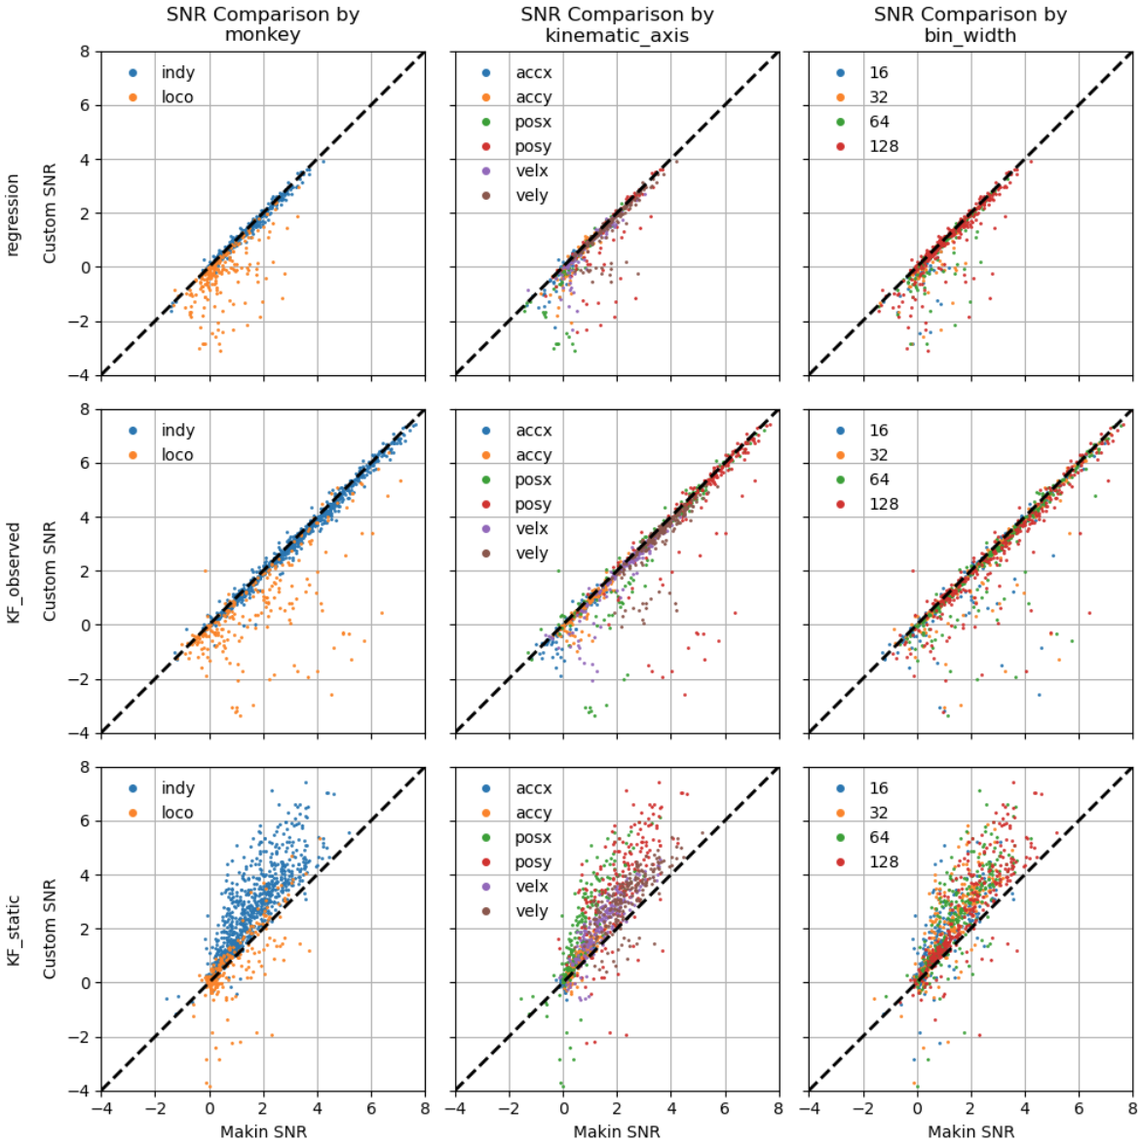
Results 1: Qualitative
Was not able to reproduce results for “Loco” monkey (~21 % of results from results file for O’Doherty 2020 dataset)
All results reported will be for “Indy”
Regression and KF Observed match well
Custom KF Unsupervised with static mapping (KF_static) appears to outperform Makin et al., 2018

Slide 24
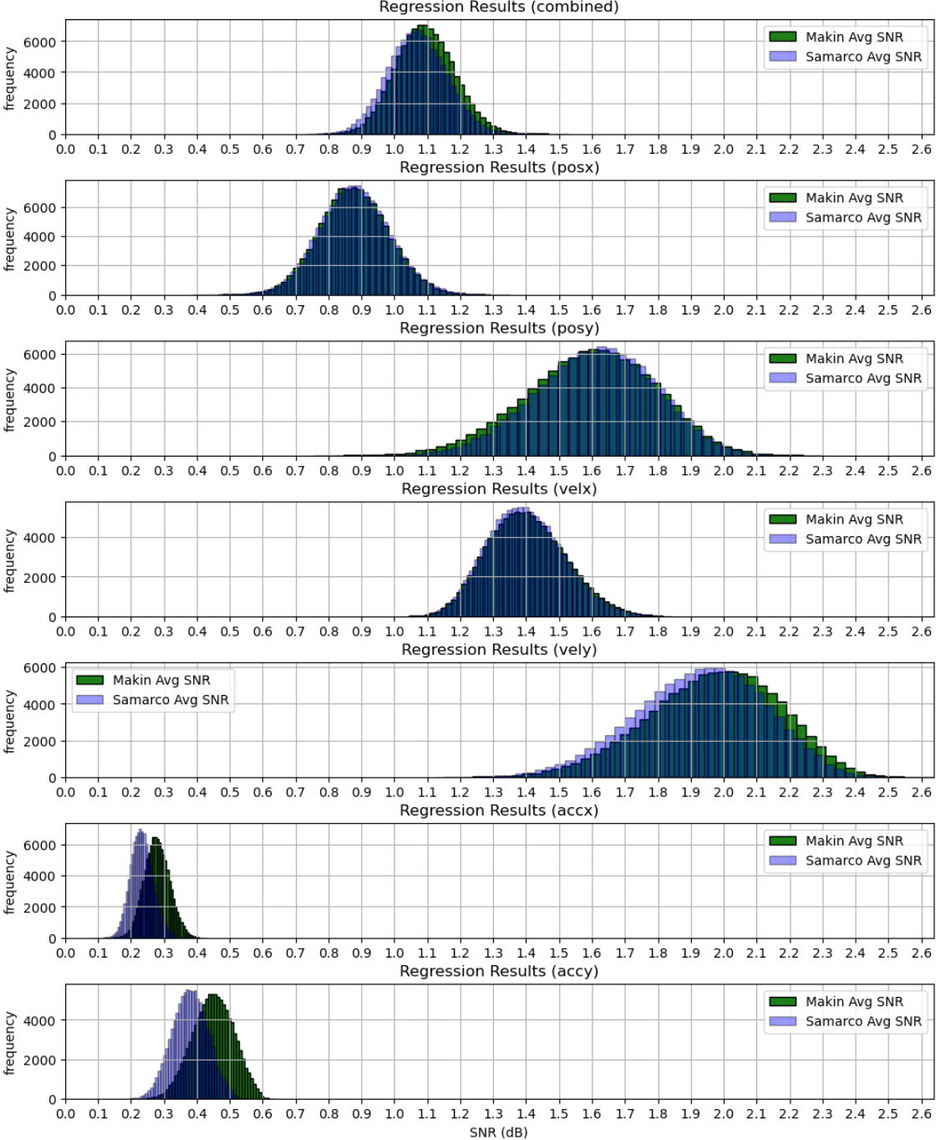
Results 1: Quantitative for Regression
Results for 64ms bin width case:
Collected Bootstrap results (100,000 samples) for all permutations of kinematic axis and bin width
Considering all kinematics/bin widths, SNR average is ~1.3 % different with ~0.3 % difference in standard error

Slide 25
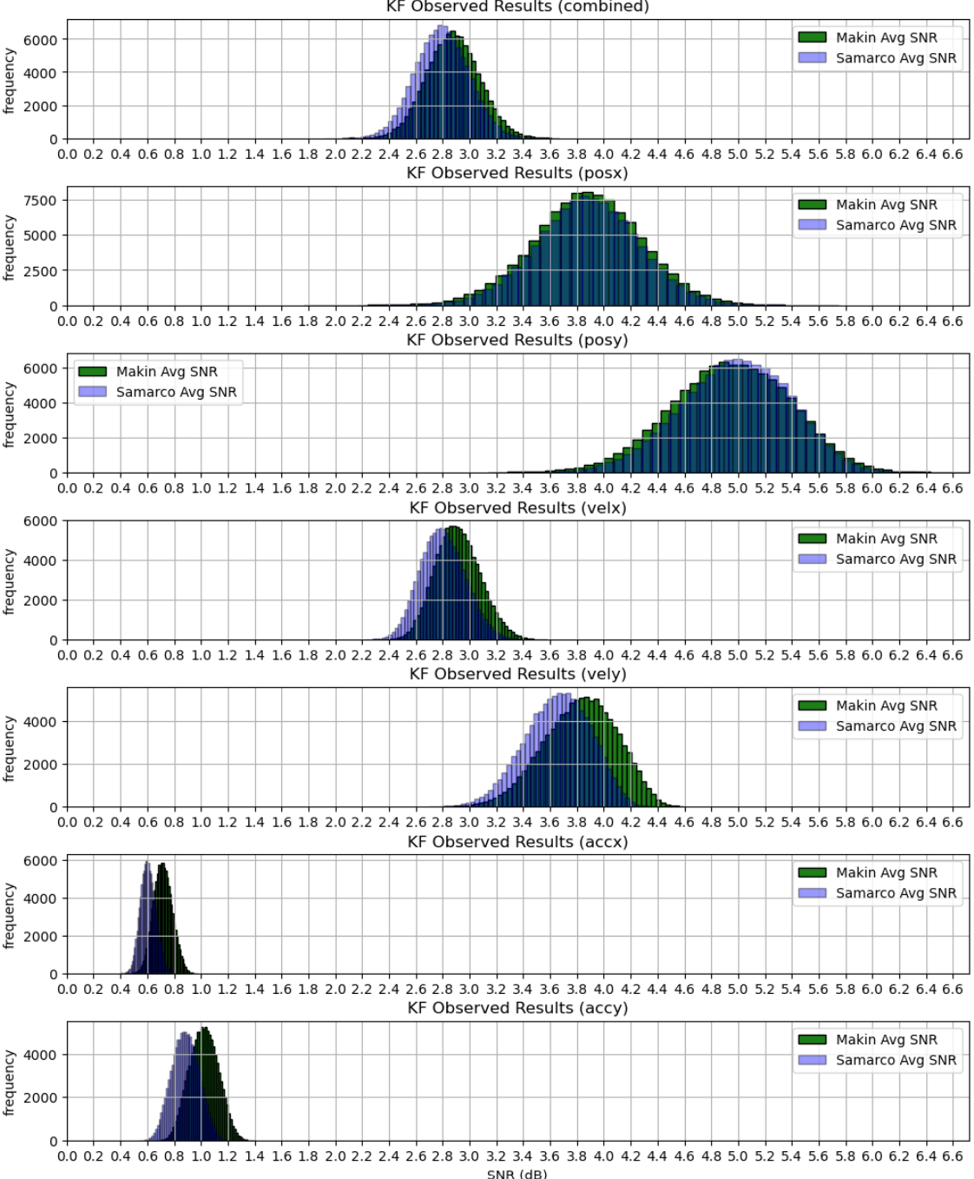
Results 1: Quantitative for KF Supervised
Results for 64ms bin width case:
Collected Bootstrap results (100,000 samples) for all permutations of kinematic axis and bin width
Considering all kinematics/bin widths, SNR average is ~2 % different with ~0.8 % difference in standard error

Slide 26
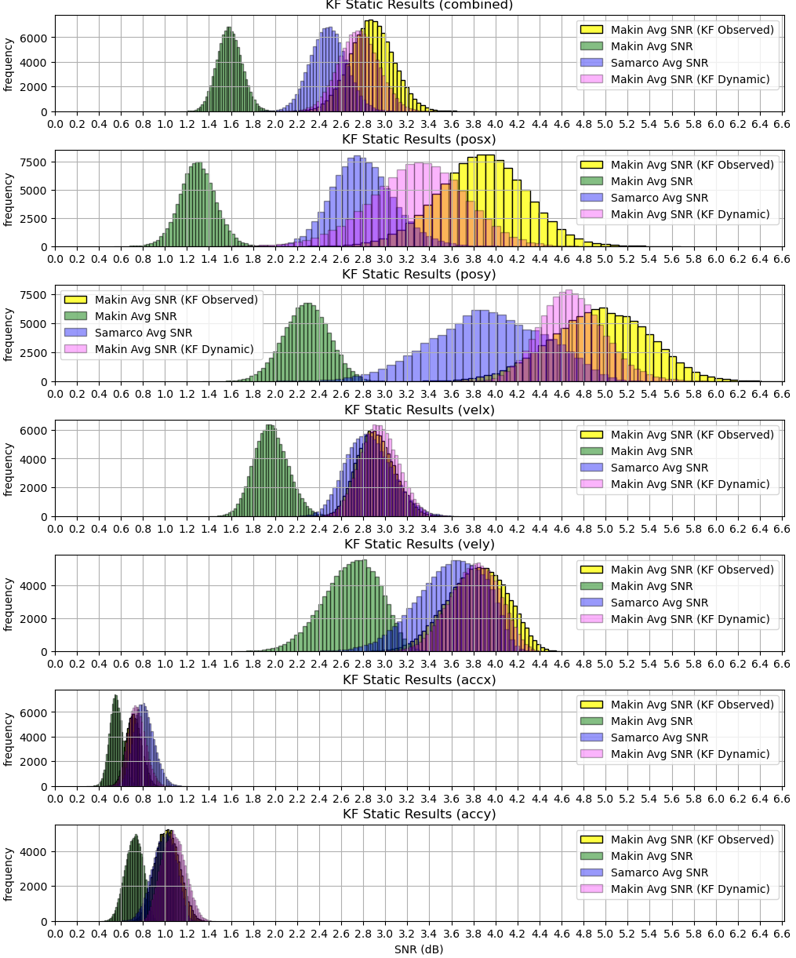
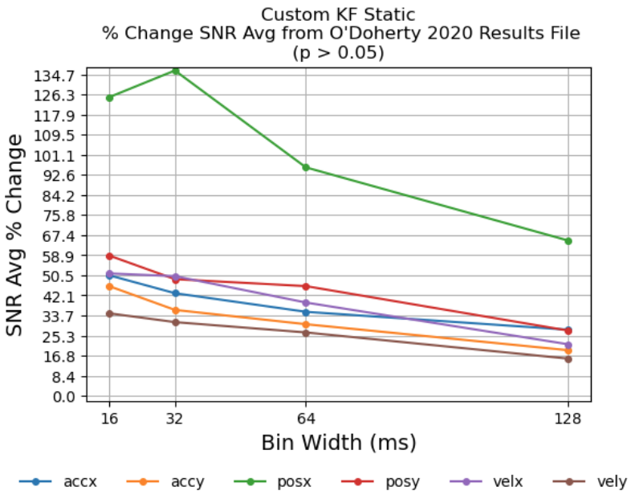
Results 1: Quantitative for KF Unsupervised w/ Static Mapping
Results for 64ms bin width case:
Collected Bootstrap results (100,000 samples) for all permutations of kinematic axis and bin width
Considering all kinematics/bin widths, Increase in SNR avg. from Makin et al., 2018 results is >59% (p > 0.05)
From plot on right, KF Static comparable to other KF variants (especially velocity)

Slide 27
Research Objectives 2 and 3:
Now that the decoders have been implemented into a custom library and proven by comparison to published results—investigate the decoder’s handling of sub-optimal data. I.e., quantify how well the decoders perform under two separate conditions: one, when neural observations are presented as multi-unit (instead of single-unit); two, when spike times are dropped from the neural observations at random (i.e. uniformly random).

Slide 28
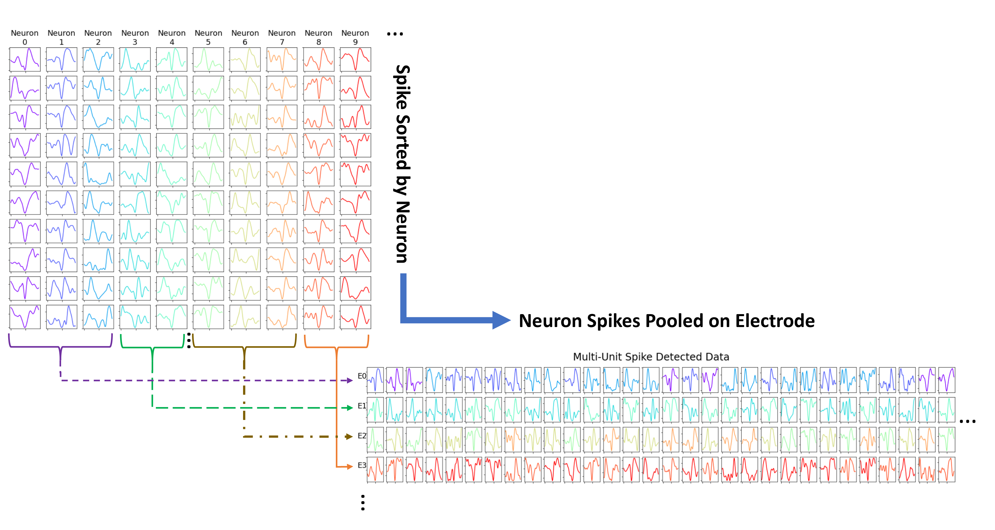
Single-Unit vs. Multi-Unit
The results collected previously reflect that for single-unit spike sorted data
Spike sorting adds an additional layer of complexity (scale with the number of electrode channels)
Not always feasible
New goal: quantify performance for multi-unit data, or when pooling all spikes detected on one neuron
Electrode acts as a single neuron
Notes:
Added complexity comes with the demand for more powerful computational resources, which comes with added size, power, and thermal requirements. For embedded/real-time applications, this may prove non-feasible based on the inherent biological requirements at hand
First, a spike detection algorithm reduces the electrode data from all time samples to just segments, or periods, where the electrodes are thought to have recorded a neuron firing/producing an action potential.
Then, a feature extraction algorithm is deployed to discover features that best explain the differences among the different neurons.
Finally, a classification algorithm is applied to the features and labels are placed for most likely fit of which neuron produced which “spike”.

Slide 29
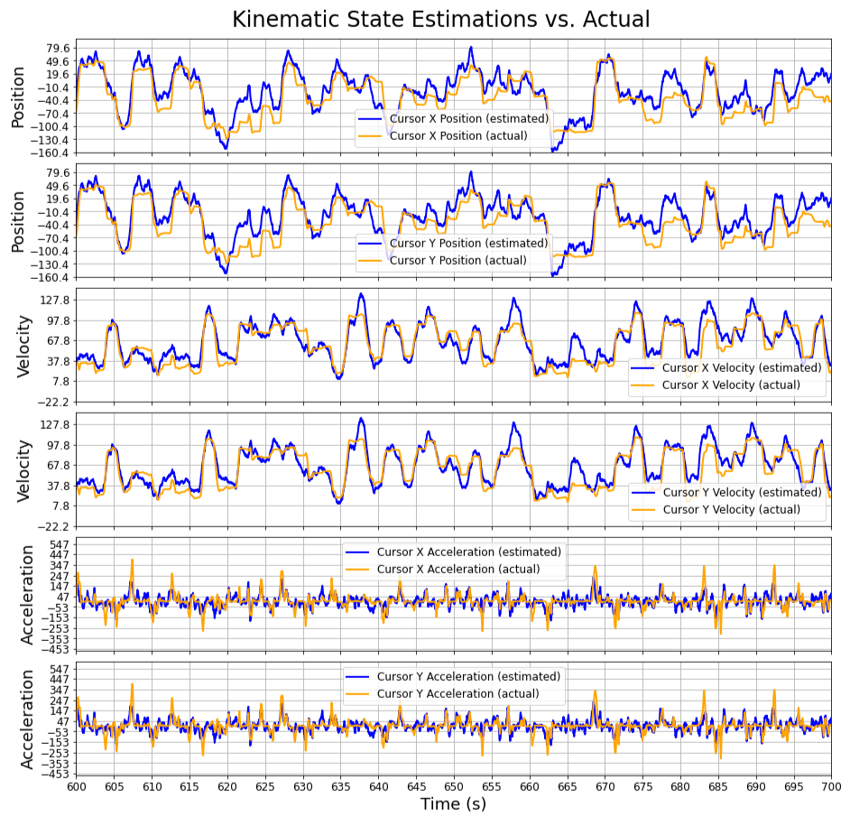
Randomly Dropping Neural Spike Data
Compute Performance Metric
Data is never perfect in any realistic data collection system
The link for the implanted electrodes (e.g. Neuralink) are at times wireless
Subject to dropouts
Spike data can often get very large in size too
Good case for compression testing
Test the case of randomly dropping 5 %, 15 %, 25 %, and 50 % of all session spikes
Randomly Remove % of Spike Events
Decode
$$r_{t}→{\hat{x}}_{t}$$
Notes:
Reference Elon Musk’s paper on thousand channel neurons

Slide 30
Results 2
These are the results for the second objective: Quantifying how well the decoders implemented in this work perform to multi-unit and spike dropped data (randomly dropped).

Slide 31
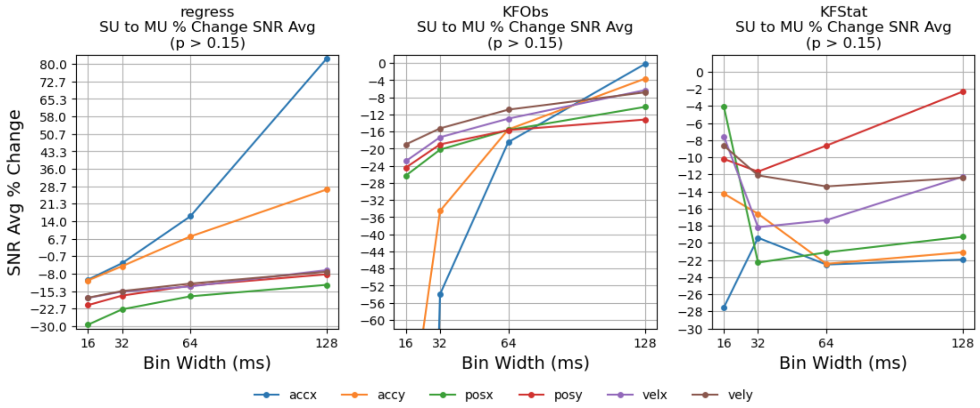
Multi-Unit Results
Results obtained with bootstrapping (100,000 statistic samples)
For Regression and KF Supervised, the MU performance increases as the temporal window increases for the neural spike bins
Regression accelerations perform better for higher temporal windows
-339 % (accx @ 16ms)
-90 % (accy @ 16ms)

Slide 32
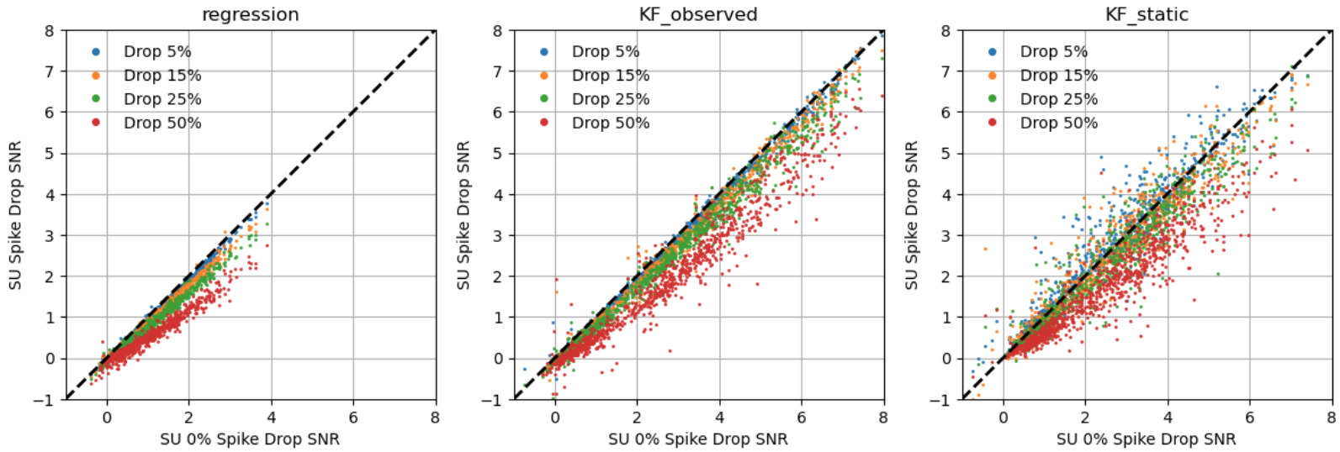
Spike Drop Results
Regression results dropped linear (same rate) at rate that spikes dropped at
KF Supervised dropped slightly from 5-15% rate
KF static showed improvement, or no difference, for some smaller drop rates

Slide 33
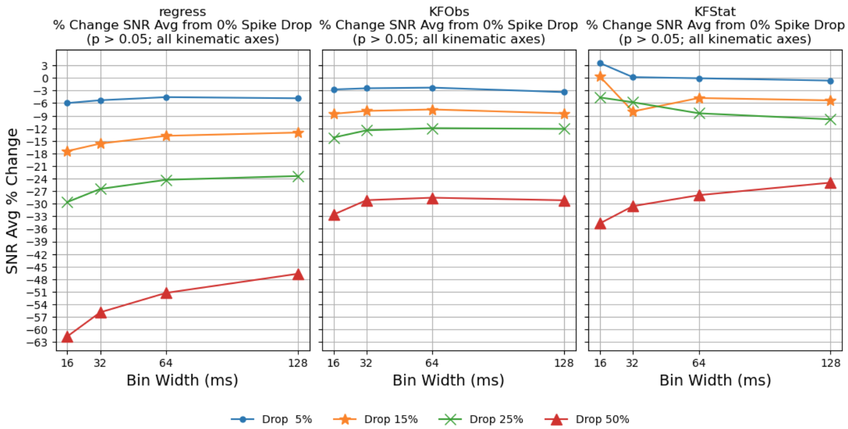
Spike Drop Results
Quantitative results for Bootstrapping (100,000 samples)
Results shown for all kinematic axes combined for different bin sizes
Regression drops at about the same rate as rate of spikes dropped
KF Supervised performance drop is about half of the dropped spike rate for drop rates from 5-25% and all bins considered
KF static shows increase or no drop in performance for the different bins considered at 5 % drop
KF static also shows increase in performance for dropping 15 % of spikes at 16ms bin size

Slide 34
Conclusion and Future Work

Slide 35
Conclusion
Implemented a Library in Python for Neural Signal Decoding (https://github.com/Neural-Instrumentation-Lab/makin_2018_reproduction)
Works with a published dataset for actual collected Single-Unit Neural-Kinematic Data (https://zenodo.org/records/3854034)
Demonstrated two decoders (Regression and KF Supervised) to have similar performance on the dataset as published work (Makin et al., 2018)
2% or less difference in SNR avg performance with < 1% standard error difference when bootstrapping
Demonstrated superior performance for the other decoder (KF Unsupervised (Static)) when compared to an implementation from published work on the dataset (Makin et al., 2018)
Multi-Unit test suggest that multi-unit data improves decoder performance for higher temporal neural bins compared to a single-unit spike sorting approach (at least for acceleration and for regression and KF Supervised)
Dropping Neural Spikes test showed:
Linear Regression drops in performance at approximately the same rate as the spikes being dropped
KF Supervised drops in performance at about half of the rate of dropped spikes (at least for drops up to 25%)
KF Unsupervised has increase in performance or no change when dropping 5% of spikes
Also shows increase in performance when dropping spikes at 15% for 16ms bin case

Slide 36
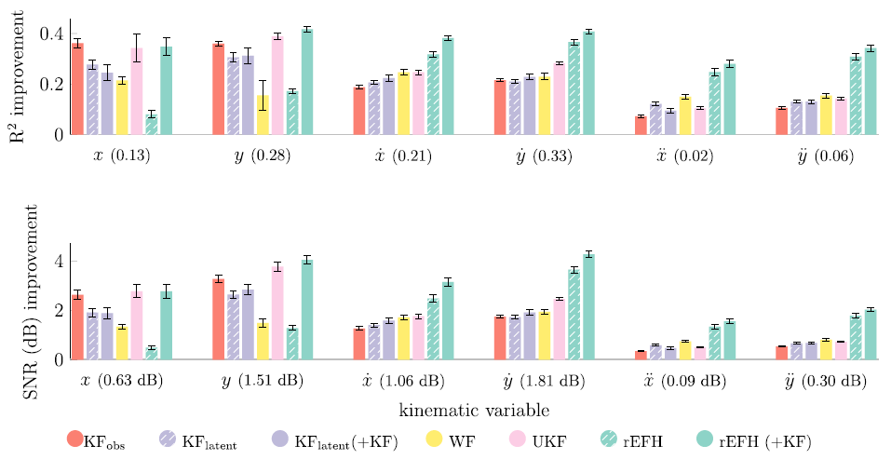
Future Work Suggestions
Implement other decoders, especially the rEFH
Evaluate transfer learning among decoders (O’Doherty dataset is a good candidate for this)
Sessions in the experiment were collected over 44 days with the range of days spanning almost a year, or 329 days
Figure out what was the issue with the “Loco” data and why we were unable to match Makin results when applying the same methods to the “Indy” data
Speed up decoders (KF Decoders take a while)
The KF decoders are sequential algorithms (challenge to parallelize)
Test MU Results Decoding for Larger Bin Sizes
Do results for all kinematic axes improve from SU?
64 ms results from Makin et al., 2018

Slide 37
TEMPLE
U N I V E R S I T Y
Department of Electrical and Computer Engineering
Special thank you to the committee members!
Iyad Obeid, PhD., Department of Electrical and Computer Engineering (Project Advisor)
Joseph Picone, PhD., Electrical and Computer Engineering
Thank You!
TEMPLE
U N I V E R S I T Y

Slide 38
Bibliography
Rajan, A. T., Boback, J. L., Dammann, J. F., Tenore, F. V., Wester, B. A.,
Otto, K. J., Gaunt, R. A., &amp; Bensmaia, S. J. (2015). The effects
of chronic intracortical microstimulation on neural tissue and
fine motor behavior. Journal of Neural Engineering, 12(6),
066018. https://doi.org/10.1088/1741-2560/12/6/066018
Salahuddin, U., &amp; Gao, P.-X. (2021). Signal Generation, acquisition, and
processing in Brain Machine Interfaces: A unified review. Frontiers
in Neuroscience, 15. https://doi.org/10.3389/fnins.2021.728178
Bouton, C., Shaikhouni, A., Annetta, N. et al. Restoring cortical control of functional movement
in a human with quadriplegia. Nature 533, 247–250 (2016).
https://doi.org/10.1038/nature17435
N1 Implant. Neuralink. BMI Implant.

Slide 39
Bibiliography
Makin, J. G., O’Doherty, J. E., Cardoso, M. M., &amp; Sabes, P. N. (2018).
Superior arm-movement decoding from cortex with a new,
unsupervised-learning algorithm. Journal of Neural Engineering,
15(2), 026010. https://doi.org/10.1088/1741-2552/aa9e95
O’Doherty, J. E., Cardoso, M. M. B., Makin, J. G., &amp; Sabes, P. N. (2020, May 26).
Nonhuman primate reaching with Multichannel Sensorimotor Cortex Electrophysiology.
Zenodo. https://zenodo.org/doi/10.5281/zenodo.788569

Slide 40
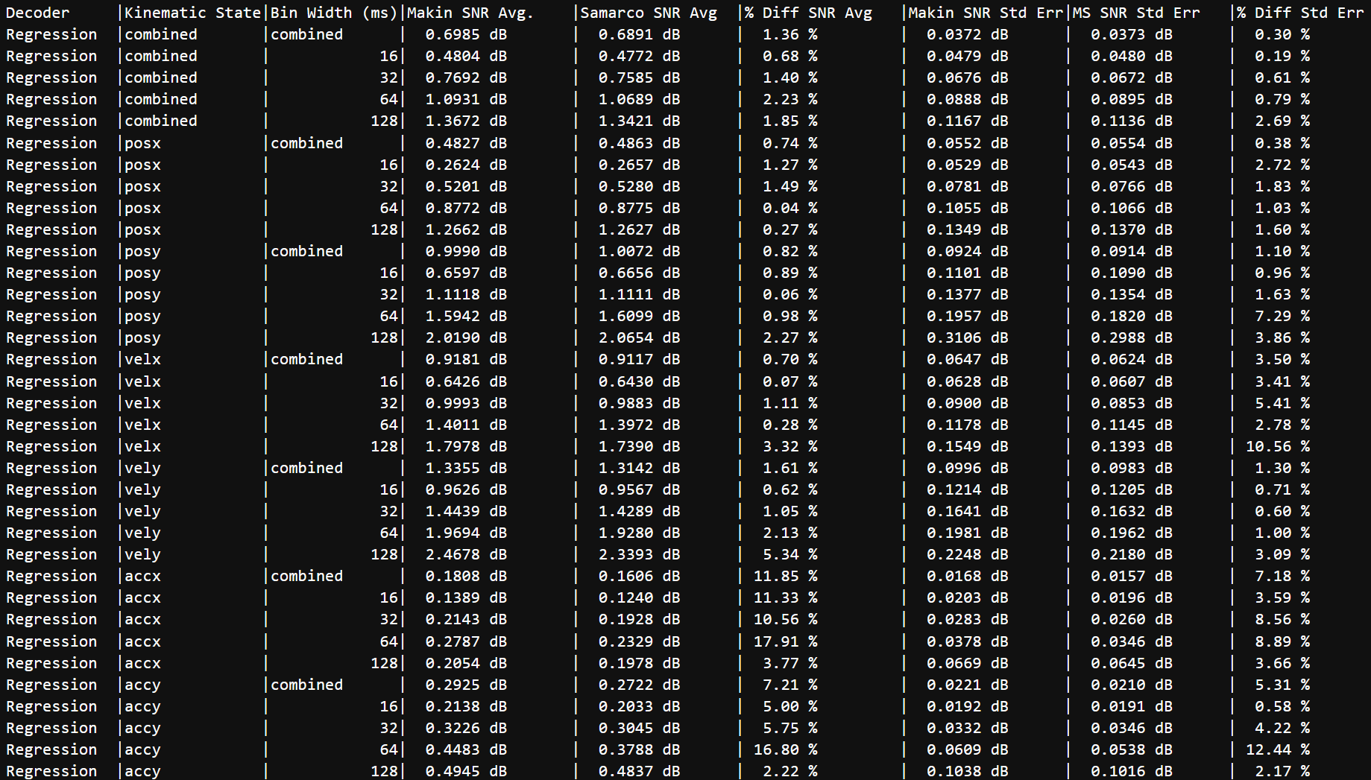
Linear Regression Results Table

Slide 41
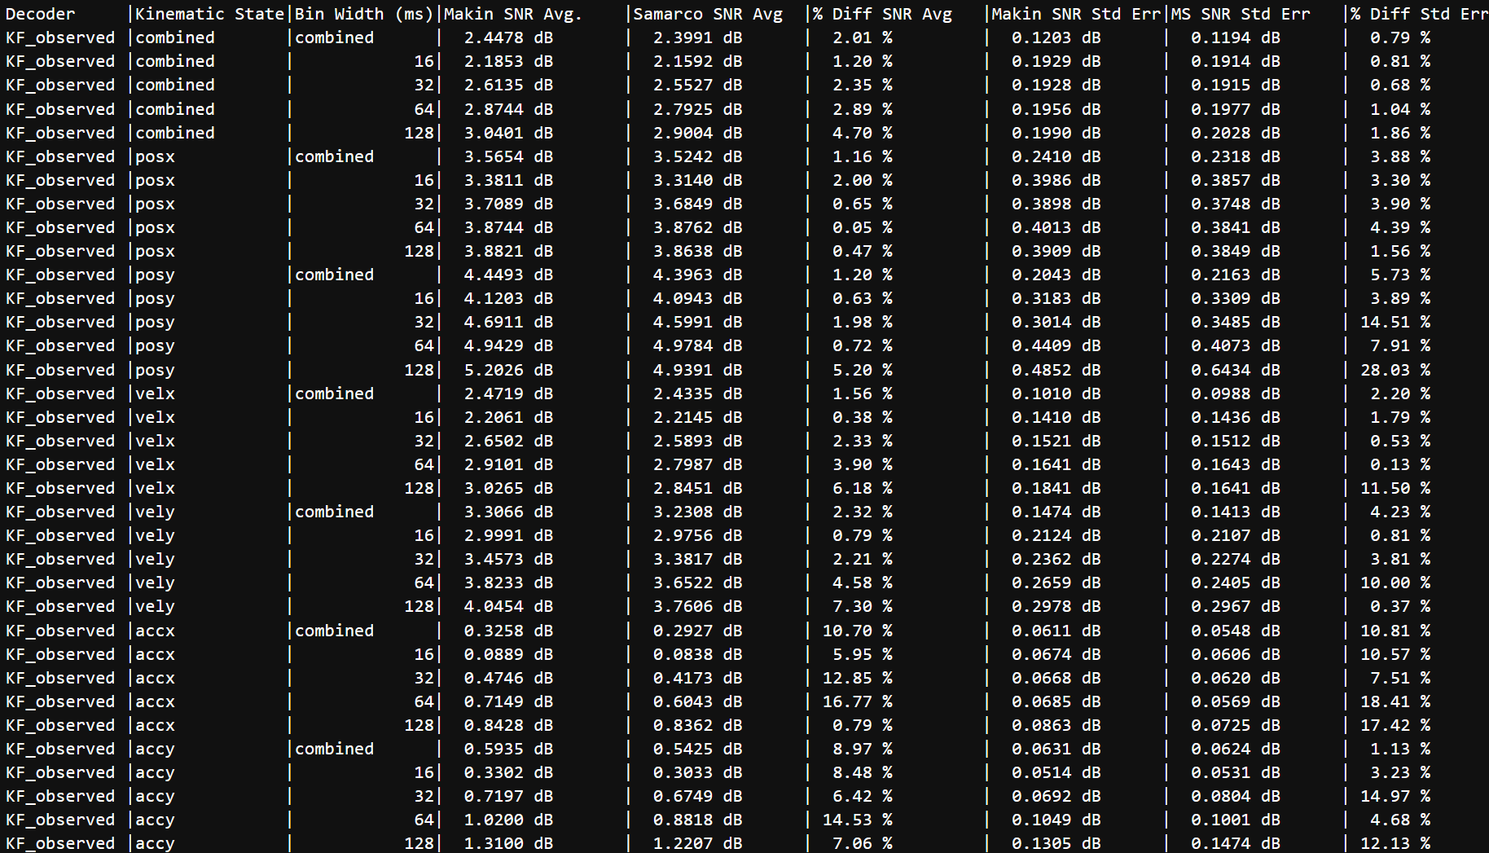
KF Supervised Results Table

Slide 42
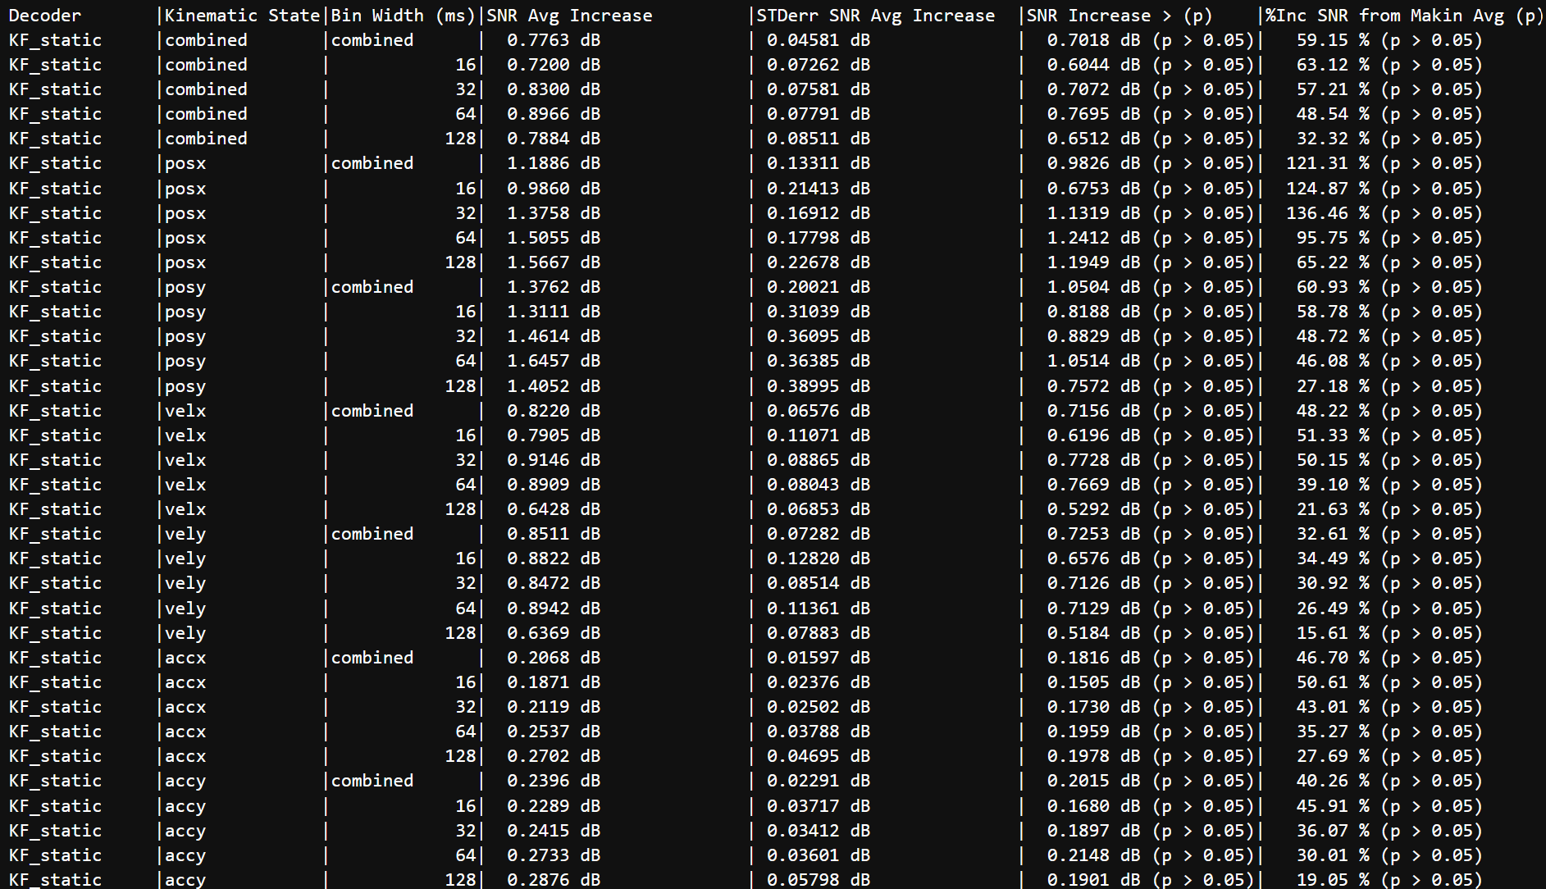
KF Static Results vs. Makin et al., 2018’s

Slide 43
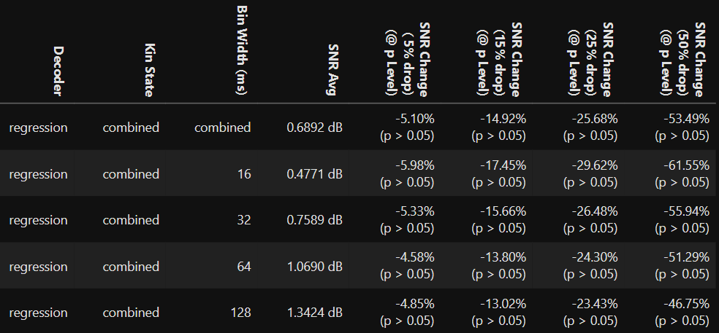
KF Static Results Table

