Slide 1
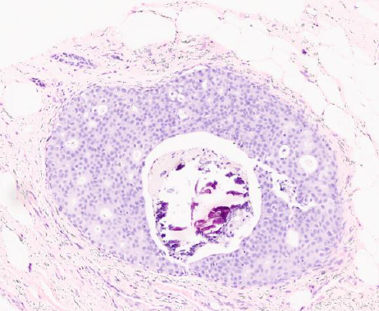
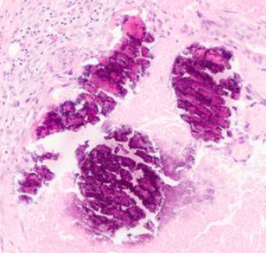
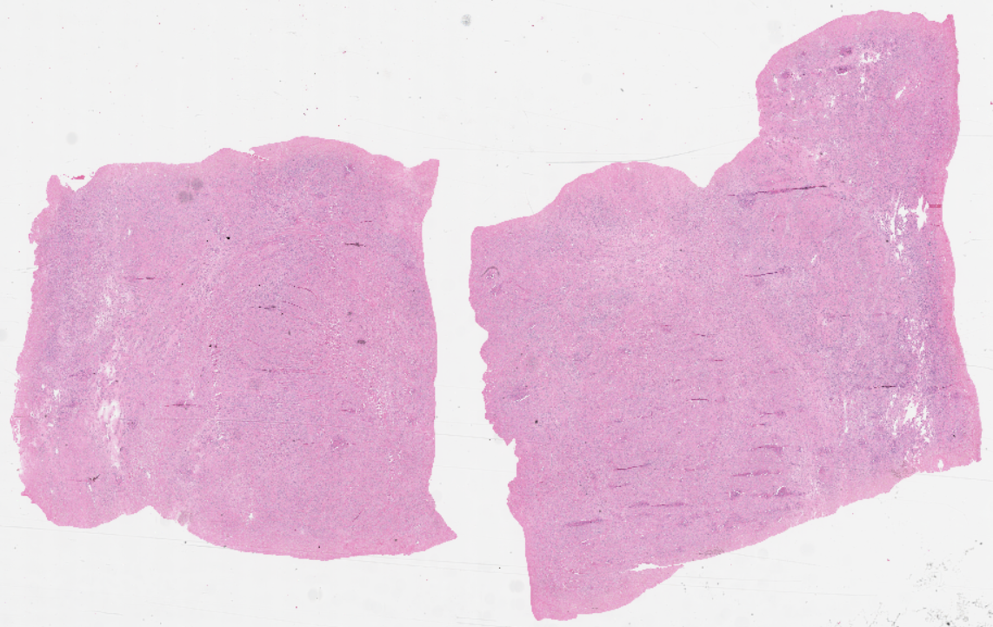
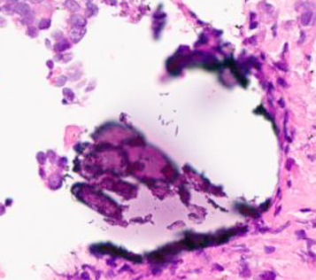
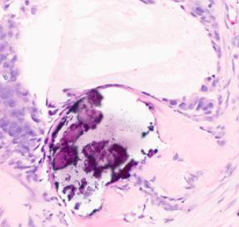

Crystallization Signatures as
Predictive Biomarkers in Histopathology
C. Dumitrescu, D. Hackel, I. Obeid and J. Picone
The Neural Engineering Data Consortium
Temple University

Slide 2
Abstract
Early AI-based detection is hindered by overdiagnosis and a lack of transparency
Tissue crystallization (micro-calcifications) correlates with pathological cell activity and has diagnostic promise in cancer (X‑ray diffraction)
Approach: We introduced a crystallization-focused multi-class classification method using the Fox Chase Cancer Center Breast Tissue Corpus (FCBR)
Data: We enriched the FCBR dataset with 439 new annotated patches, labeled as Crystalline Non-Neoplastic (CNNO, n=51), Crystalline Ductal Carcinoma in Situ (CDCS, n=168), and Crystalline Invasive Ductal Carcinoma (CIDC, n=220) => FCBR Crystallization Subset
Experiment: Trained a balanced random forest classifier on (1) a standard dataset (1,850 patches) vs (2) an enriched dataset including the 440 crystallization annotations (2,243 patches total)
Evaluation:
Tested on held-out FCBR samples (18,224 patches) and TUBR (46,666 patches)
Incorporation of crystallization annotations improved the overall accuracy over all the classes: from 18.4% to 34.6% on FCBR and from 20.7% to 23.5% on TUBR
Proof of Concept: Our findings demonstrate that explicit modeling of microcalcification patterns provides biologically meaningful features that strengthen deep learning based breast cancer detection.

Slide 3
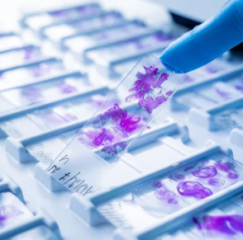

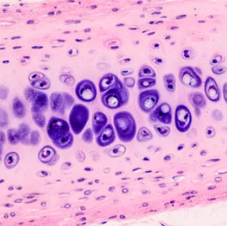
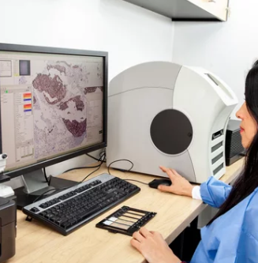
What is Digital Pathology?
Digital pathology (DP) is the process of digitizing glass pathology slides into whole-slide images (WSIs) for viewing and analysis.
Images are scanned at ultra-high resolution, then manually interpreted by clinically-trained pathologists using software to manage, share and visualize the images.
Our goal is to use AI (Machine Learning) to accelerate disease diagnosis.
Challenges: Localization of information supporting a diagnosis is very challenging. Manual interpretation of these images is quite challenging compared to other medical disciplines.

Slide 4
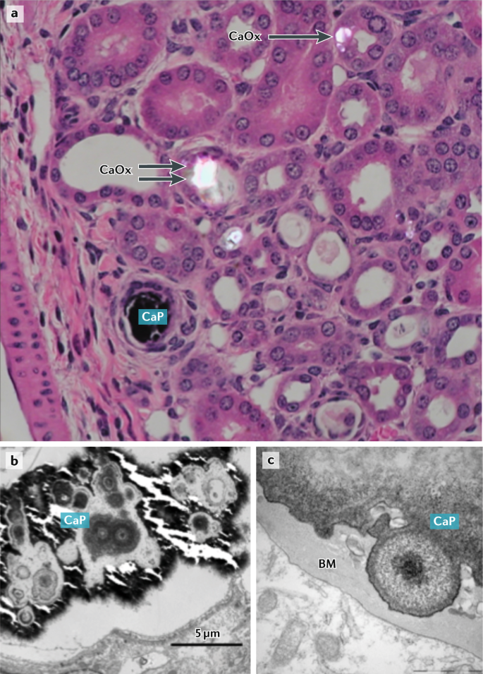
What is Crystallization?
Crystallization refers to the formation and deposition of microscopic crystals (usually calcium-based) in tissues.
Healthy tissues, such as bone and teeth, naturally regulate these processes.
Intracellular Ca²⁺ signaling is central to both physiological mineralization and pathological calcification.
Calcification is a potentially treatable process.
Normal vs. Pathological: Normally regulated in hard tissues (bone, teeth), but ectopic calcification can occur under abnormal conditions.
Mechanisms: cell-driven mineralization, necrosis/apoptosis niches, osteogenic reprogramming in tumor microenvironment.
Types of Mineralization in Soft Tissues:
Type I (calcium oxalate)
Type II (calcium phosphate/hydroxyapatite)
Clinical relevance: composition and pattern correlate with lesion grade and aggressiveness in some studies.
(Source: https://www.nature.com/articles/s41581-020-00392-1)
Notes:
a | Light microscopy image of a kidney from a hyperoxaluric Npt2^{−/−} mouse (×40 magnification)⁵⁰. Intratubular calcium phosphate (CaP) and calcium oxalate (CaOx) crystals deposit in different sections of the nephron. CaOx is present both within the tubular lumen (double arrow) and intracellularly (single arrow). b | Transmission electron microscopic appearance of a CaP deposit in the kidney tubule of an Npt2^{−/−} mouse. The large deposit formed by aggregation and growth of spherulitic crystalline deposits has obliterated the kidney tubule. c | CaP deposit in the tubular epithelium basement membrane (BM) of a Umod^{−/−} mouse. https://www.nature.com/articles/s41581-020-00392-1

Slide 5
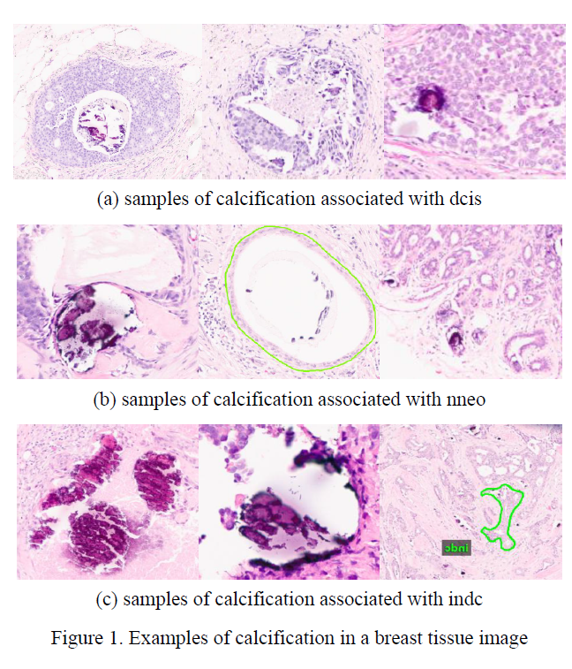
Pathological Crystallization
Diagnostic Role: Calcifications are a key diagnostic clue in breast pathology, but until now have been underutilized in AI-based models.
Pathological crystallization refers to abnormal deposition of calcium salts and ionic crystals in soft tissues due to disease (e.g. necrosis, inflammation, apoptosis).
Cause: Cancer cells and stroma can undergo osteogenic-like changes, expressing bone-related proteins that promote hydroxyapatite and calcium oxalate deposition. Tumor necrosis and apoptosis release calcium-binding vesicles, creating niches for crystal growth.
X‑ray diffraction demonstrates potential clinical application, with measurements of carbonate substitution achieving a sensitivity of 85% and a specificity of 88% in distinguishing benign and neoplastic cases using the average carbonate content alone.

Slide 6
Data Overview
We used two open-source digital pathology breast datasets from NEDC:
Fox Chase Breast Tissue Subset (FCBR) – annotated patches focusing on breast cancer.
Temple University Breast Subset (TUBR) – large histology corpus for validation.
Why FCBR?
Specialized in breast cancer.
Rich in varied breast pathologies.
Rich metadata is available.
Why TUBR for Validation?
Serves as an external dataset to test generalization.
Includes a wide range of breast tissue types, collected from a different hospital using different slide preparation techniques.
Label | Description / Features
Background (BCKG) | stroma, no ducts or lobules
Normal (NORM) | normal ducts and lobules
Artifact (ARTF) | grease pen marks, foreign bodies, etc.
Indistinguishable (NULL) | indistinguishable tissue, normally due to issues with the cut/stain
Suspected (SUSP) | regions that are at risk of developing into cancerous regions
Inflammation (INFL) | areas of inflammation
Ductal Carcinoma in Situ (DCIS) | ductal carcinoma in situ, and lobular carcinoma in situ
Non-Neoplastic (NNEO) | fibrosis, hyperplasia, intraductal papilloma, adenosis, ectasia, etc.
Invasive Ductal Carcinoma (INDC) | invasive ductal carcinoma, invasive lobular carcinoma, and invasive mammary carcinoma
Crystalline DCIS (CDCS) | small, loose calcific clusters in stroma
Crystalline NNEO (CNNO) | large, dense deposits of calcium in or close to invasive structures
Crystalline INDC (CIDC) | large, dense deposits of calcification in ducts

Slide 7
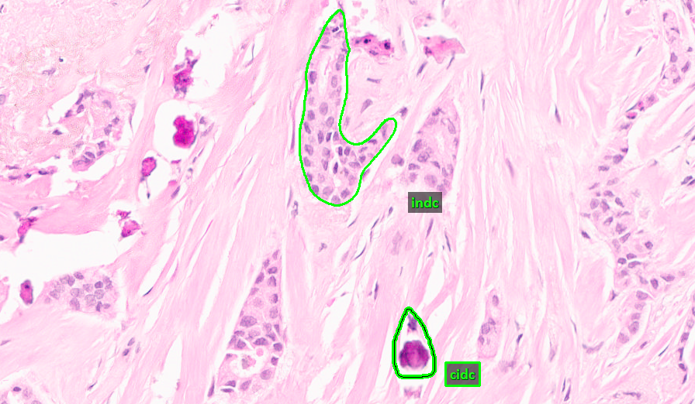
Data Annotation
FCBR Crystallization Subset (FCBR): Augmented FCBR with 439 detailed annotations of crystal deposits in tissue.
Annotation Criteria:
Classes are based on visual patterns of calcifications in different contexts.
The whole slide, as well as the proximity, is taken into consideration.
.
. Background Tissue
Original Database
DB | Non-Cancer | Carcinogenic | Cancerous | Anns/ Slide
FCBR | 12,164 | 1,967 | 5,954 | 13.7
TUBR | 8,035 | 6,222 | 2,714 | 6.3
Augmented Database
DB | NNEO | DCIS | INDC
FCBR | 728 | 1,209 | 10,955
DB | CNNO | CDCS | CIDC
FCBR | 51 | 168 | 220
Legend:
NNEO: Non-Neoplastic
DCIS: Ductal Carcinoma in Situ
INDC: Invasive Ductal Carcinoma
CNNO: Crystalline Non-Neoplastic
CDCS: Crystalline Ductal Carcinoma in Situ
CIDC: Crystalline Invasive Ductal Carcinoma

Slide 8
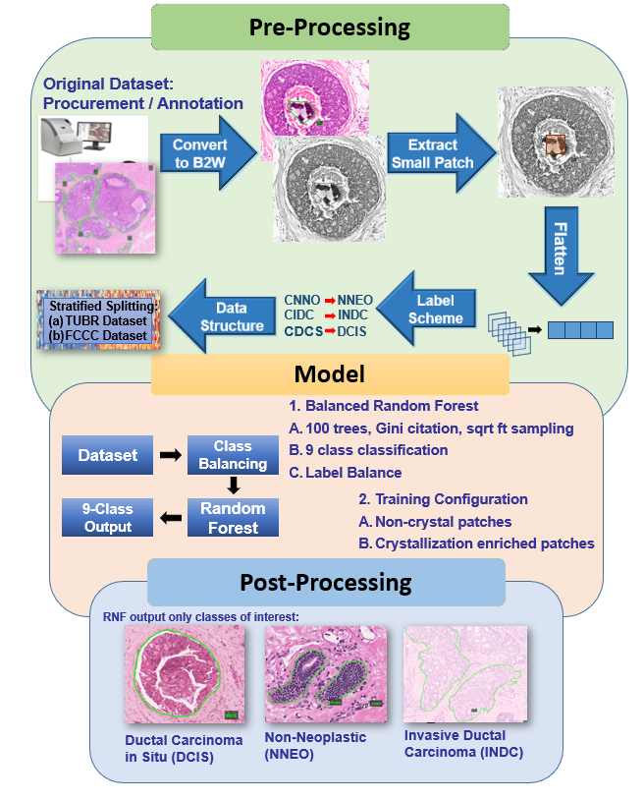
Data Preprocessing
Mapping: Each new annotated patch (calcification) was converted to its characteristic label that already belonged in the class of interest (dcis, nneo, indc).
Greyscale: The RGB dimensionality was dropped to a greyscale matrix, consisting the whole annotation image.
Resizing: Greyscale images were resized to 256×256 pixels to standardize input size.
Flattening: The 256×256 mask was flattened into a feature vector for model input.
Data Balancing: Datasets were balanced (bootstrap) during training to prevent class imbalance, given the small NNEO class, characteristic of the FCBR set.
This simple preprocessing ensured consistent, compact representations of calcification patterns for the classifier.
The vector representation is limited, as hierarchical features are lost (edges, textures, shapes).

Slide 9
Machine Learning Model – Balanced Random Forest
We used a balanced Random Forest (RF) as a simple baseline.
Why RF?: Chosen for simplicity, speed, and stability. Past evaluations showed RF yields comparable trends to deep networks on this data.
Balanced RF uses the same tree-growing logic as RF, no changes:
feature subsampling (every split, a random subset of features is drawn from the full feature set, and the best split is selected),
Impurity (Gini impurity - an artificially balanced class distribution drives split selection at each node),
split APIs (unchanged greedy CART split search, optimized Cython tree engine: same threshold evaluation, impurity-decrease scoring, and node expansion logic as standard RF).
Original Dataset (Imbalanced)
For each tree: draw a bootstrap from the minority class + sample (with replacement) same number from the majority class
Voting /
Aggregation
Final
Prediction
Minority class
Tree 1
Tree 3
Majority class
Tree 2
What makes it different?
Balanced Bootstrap Sampling: each tree is trained on a balanced sample via undersampling the majority class and bootstrapping the minority class Reduction of Class Bias: because each tree sees equal representation, the minority class is not ignored
Balanced Bootstrap sample
Balanced Bootstrap sample
Grows to full size (no pruning)

Slide 10
Experimental Design
Data Split: The individual patients are split up into three sets: train, dev, and eval.
Overall Split Ratio: 50% (train) - 25% (dev) - 25% (eval)
TUBR: 74 cancerous patients (20 were allotted for both the dev and eval), 222 non-cancerous patients were split up so that each patient would be distributed to a different set.
FCBR: Same split, but we induced some patient bias in this case, due to training with all the possible calcification samples (that did not always belong to the train set).
We designed the experiment for all the labels, but we focused on the following classes of interest: NNEO, DCIS, and INDC. We balanced RF used a fixed random seed (42), default parameters (imbalanced-learn).
Two training configurations: baseline (non-crystallization) versus crystallization-enriched training set.
Training Configurations:
Baseline model (FCBR): Trained on 1,850 patches without additional crystal annotations.
Crystallization model (FCBR): Trained on 2,243 patches (1,850 + 439 new), including the calcified patches.
Evaluation configuration: The eval and dev sets from FCBR and TUBR.

Slide 11
Results I: A Comparison of Overall Accuracy
Overall Accuracy: We see an across-the-board improvement in our ability to detect all the classes. Each class (9 classes) experienced an increase in the absolute detection performance.
Large gains for FCBR - from 18.4% to 34.6% (Δ+16.2%, 95% CI [15.37,17.15]).
While the domain-shift results (TUBR) show a modest overall accuracy gain (from 20.7% to 23.5%, Δ = 2.8%, 95% CI = [2.23%, 3.29%]), this improvement, though statistically significant, may not yet be clinically transformative. Likely motivated by:
Domain shift
Different cancerous vs non-cancerous distribution
Larger number of samples
Wider range of morphologies
Fox Chase Cancer Center Breast Tissue Subset (FCBR)
Metric | Crystal | Non-Crystal
Correct | 6,308 | 3,345
Incorrect | 11,916 | 14,879
Accuracy | 34.6% | 18.4%
Temple University Digital Pathology Breast Tissue Subset (TUBR)
Metric | Crystal | Non-Crystal
Correct | 10,968 | 9,681
Incorrect | 35,698 | 36,985
Accuracy | 23.5% | 20.7%
Notes:
Significance by McNema

Slide 12
Results II: Per Class Analysis of Performance
The crystallization-enriched model roughly doubled accuracy, compared to the non-crystallization baseline.
Substantial per-class gains for DCIS (+14.58%) and INDC (+12.97%) suggest that calcification annotations enhance the detection of lesions with high diagnostic relevance. The modest gain in the NNEO class is likely associated with the low representation of this class in the FCBR dataset.
These results likely reflect greater morphological variability and staining differences in TUDP, emphasizing the need for domain adaptation and fine-tuning before deployment.
The non-crystallization model shows heavy confusion between malignant and background classes, likely due to missing structural cues associated with mineralization.
The observed improvements point toward the potential of crystallization modeling to strengthen diagnostics in malignant categories.
Fox Chase Cancer Center Breast Tissue Subset (FCBR)
Class | Acc (Crystal) | Acc (Non-Crystal)
indc | 19.11% | 4.96%
dcis | 17.21% | 8.53%
nneo | 7.52% | 2.66%
Temple University Digital Pathology Breast Tissue Subset (TUBR)
Class | Acc (Crystal) | Acc (Non-Crystal)
indc | 17.95% | 4.97%
dcis | 20.68% | 6.10%
nneo | 4.40% | 2.72%

Slide 13
Results III: Per Class Precision, Recall, F1 score
Crystal modeling consistently improves recall, especially for DCIS and INDC across both datasets.
F1 scores increase sharply for the most challenging classes (e.g., FCBR - INDC 0.35 vs 0.09).
Precision changes are class-dependent: some classes show strong gains (e.g., TUBR-DCIS).
Crystal achieves better balance between precision and recall, yielding more reliable per-class performance.
FCBR:
TUBR:
Class | Metric | Crystal | Baseline
NNEO | Precision | 0.12 | 0.05
 | Recall | 0.076 | 0.03
 | F1 | 0.09 | 0.03
DCIS | Precision | 0.08 | 0.08
 | Recall | 0.18 | 0.09
 | F1 | 0.11 | 0.08
INDC | Precision | 0.78 | 0.78
 | Recall | 0.23 | 0.05
 | F1 | 0.35 | 0.09
Class | Metric | Crystal | Baseline
NNEO | Precision | 0.45 | 0.38
 | Recall | 0.04 | 0.03
 | F1 | 0.08 | 0.05
DCIS | Precision | 0.06 | 0.03
 | Recall | 0.21 | 0.06
 | F1 | 0.10 | 0.04
INDC | Precision | 0.06 | 0.07
 | Recall | 0.18 | 0.05
 | F1 | 0.09 | 0.06

Slide 14
Discussion
Key Finding: Explicitly modeling calcification as a feature enhances diagnostic accuracy for breast tissue classification.
Baseline: Model that does not consider textures or data dimensionality.
Morphological Insight: Calcification patterns act as discriminative biomarkers complementing cell/tissue features.
In INDC, diffused calcifications (heterogeneous and often infiltrative distribution of calcifications) provide spatial cues;
In DCIS/NNEO, small local crystals serve as early warning markers.
AI Implications: The crystallization-aware model showed better calibration and fewer false positives between malignant and benign classes. This supports our hypothesis that mineral deposits carry clinically meaningful information.
Localization and structure of the calcification demonstrated that it can be further used for classification or simply as reinforced feedback.
Broader Impact: These results suggest that enriching histopathology datasets with microcalcification labels can make AI tools more sensitive and interpretable in cancer detection.

Slide 15
Summary
Contribution: We created a new Fox Chase Crystallization Corpus (FCCR) by annotating 439 calcification deposits in FCBR data.
Models: Used a simple balanced Random Forest classifier to compare standard vs crystallization-augmented training sets.
Results: Incorporating crystal annotations doubled FCBR overall accuracy (from 18.4% to 34.6%) and improved TUBR accuracy (20.7% to 23.5%) over all the classes in the database (9).
Interpretation: Microcalcification signatures are biologically meaningful features that markedly improve AI classification of breast tissue.
Localization and the structure of microcalcification hold diagnosis information that is underused in Computer Vision.
Takeaway: Modeling calcification patterns yields a more nuanced and sensitive breast cancer diagnosis using AI approaches.
Clinically informed models allow for improved understanding of model predictions.
Distinguishing between biologically meaningful calcifications can aid in the reduction of overdiagnosis (especially in benign cases).

Slide 16
Future Work
Expand Annotations: Adding more crystallization labels, especially for underrepresented non-neoplastic (CNNO) cases to balance the dataset.
New Data Release: Annotations on the TUBR dataset are currently planned for a future release.
Deep Learning Models: Integrate these annotations into convolutional neural networks and segmentation pipelines to fully leverage spatial patterns.
Dataset Release: The resulting subset is publicly available, encouraging further studies on mineralization as a biomarker.
Transparency: Correlate histology calcifications with mammography findings or biochemical assays (e.g. X-ray diffraction features) to strengthen predictive power, and ultimately explainability. Need for clinical confirmation.
Goal: Enhance diagnostic granularity and sensitivity in AI-driven pathology by systematically incorporating crystallization insights.

Slide 17
Acknowledgements
This material is based on work supported by several organizations over the years including the National Science Foundation (grants nos. 1925494 and 1726188), the Temple University Catalytic Collaborative Funding Initiative and most recently by the Pennsylvania Breast Cancer Coalition Breast and Cervical Cancer Research Initiative.
Any opinions, findings, and conclusions or recommendations expressed in this material are those of the author(s) and do not necessarily reflect the views of these organizations.

Slide 18
References
D. Hackel et al., “Enabling Microsegmentation: Digital Pathology Corpora for Advanced Model Development,” in Signal Processing in Medicine and Biology: Applications of Artificial Intelligence in Medicine and Biology, vol. 1, New York City, New York, USA: Springer, 2026, p. 50. [Online]. Available: https://isip.piconepress.com/publications/book_sections/2026/springer/dpath/ (in publication).
S. S. Shalamzari et al., “Big Data Resources for Digital Pathology,” in Proceedings of the IEEE Signal Processing in Medicine and Biology Symposium, Philadelphia, Pennsylvania, USA: IEEE, 2023, pp. 1–19. doi: 10.1109/SPMB59478.2023. 10372721.
B. Doshna, Z. Wevodau, N. Jhala, I. Akhtar, I. Obeid, and J. Picone, “The Temple University Digital Pathology Corpus: The Breast Tissue Subset,” in Proceedings of the IEEE Signal Processing in Medicine and Biology Symposium (SPMB), I. Obeid, I. Selesnick, and J. Picone, Eds., Philadelphia, Pennsylvania, USA: IEEE, 2021, pp. 1–3. doi: 10.1109/SPMB52430.2021.9672275.
C. McGenity et al., “Artificial intelligence in digital pathology: a systematic review and meta-analysis of diagnostic test accuracy,” npj Digit. Med., vol. 7, no. 1, Art. no. 1, May 2024, doi: 10.1038/s41746-024-01106-8.
D. Proudfoot, “Calcium Signaling and Tissue Calcification,” Cold Spring Harbor Perspectives in Biology, vol. 11, no. 10, Oct. 2019, doi: 10.1101/cshperspect.a035303.
K. S. Shin, M. Laohajaratsang, S. Men, B. Figueroa, S. M. Dintzis, and D. Fu, “Quantitative chemical imaging of breast calcifications in association with neoplastic processes,” Theranostics, vol. 10, pp. 5865–5878, 2020. doi: 10.7150/‌thno.43325.
A. B. Miller, C. Wall, C. J. Baines, P. Sun, T. To, and S. A. Narod, “Twenty five year follow-up for breast cancer incidence and mortality of the Canadian National Breast Screening Study: randomised screening trial,” BMJ, vol. 348, p. 10, 2014, doi: 10.1136/‌‌bmj.g366.
J. E. Gonzalez, R. G. Caldwell, and J. Valaitis, “Calcium oxalate crystals in the breast. Pathology and significance,” Am J Surg Pathol, vol. 15, no. 6, pp. 586–591, June 1991, doi: 10.1097/00000478-199106000-00007.

